Slide 1
Recursive Descent Parser
Dhanya N.M.

Slide 2
Recursive descent parser
Some grammars are easy to parse using a simple algorithm known as recursive descent.
In essence, each grammar production turns into one clause of a recursive function.
We illustrate this by writing a recursive-descent parser for the following Grammar.
A recursive-descent parser for this language has one function for each non terminal and one clause for each production.

Slide 3
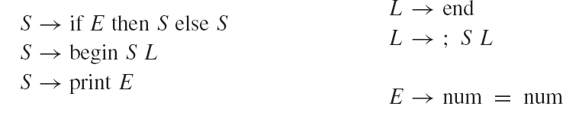
Sample grammar

Slide 4
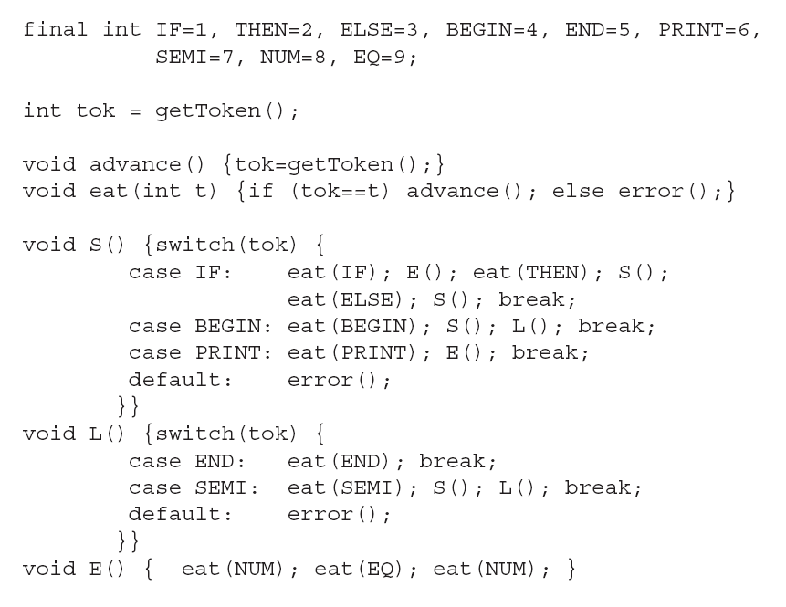

Slide 5
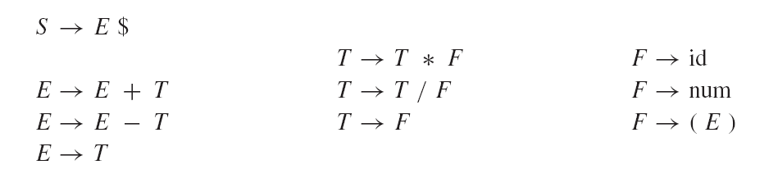
Example
Emboldened by success with this simple method, let us try it with the following Grammar

Slide 6
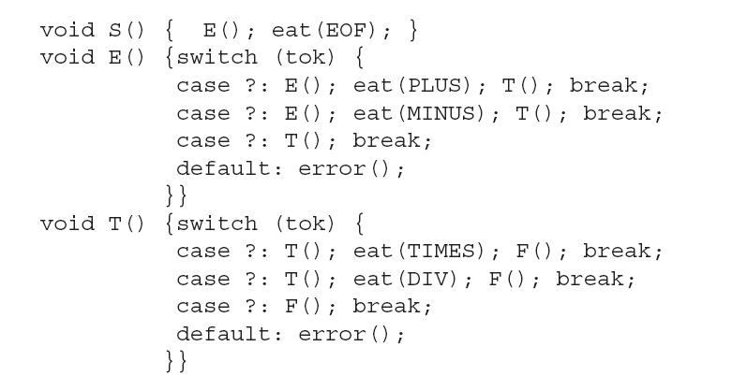

Slide 7
Conflict
There is a conflict here: The E function has no way to know which clause to use.
Consider the strings (1*2-3)+4 and (1*2-3). In the former case, the initial call to E should use the E → E + T production, but the latter case should use E → T .
Recursive-descent, or predictive, parsing works only on grammars where the first terminal symbol of each sub expression provides enough information to choose which production to use

Slide 8
RD Parser Examples

Slide 9
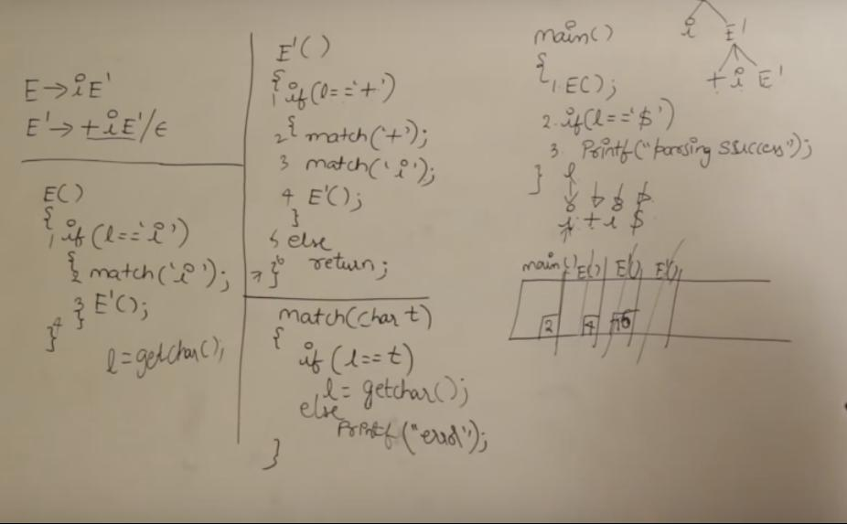

Slide 10
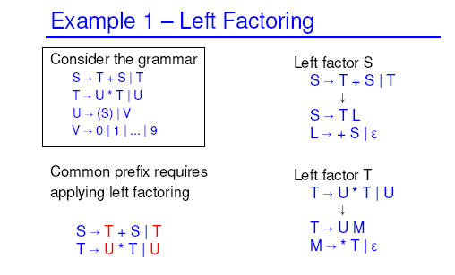

Slide 11
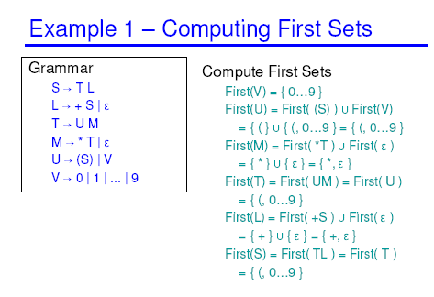

Slide 12
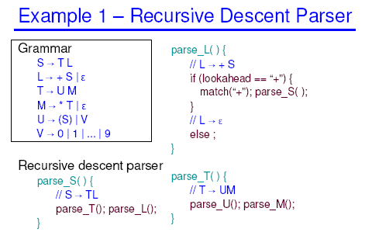

Slide 13
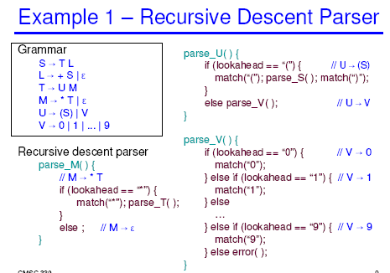

Slide 14
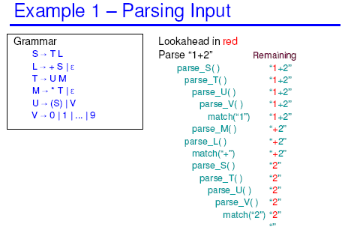

Slide 15
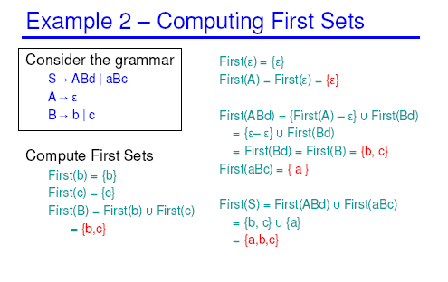

Slide 16
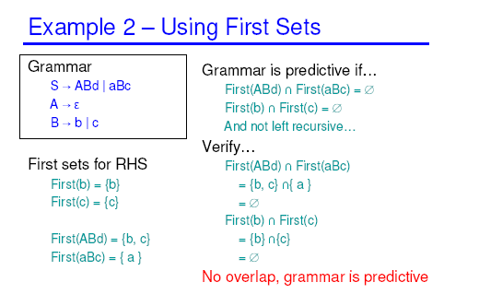

Slide 17
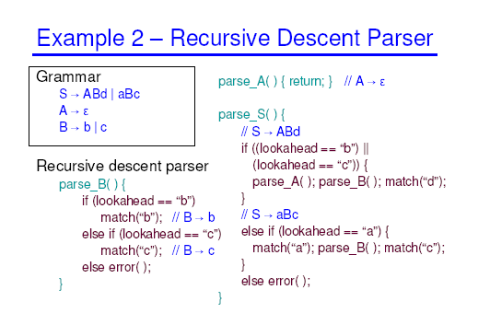

Slide 18
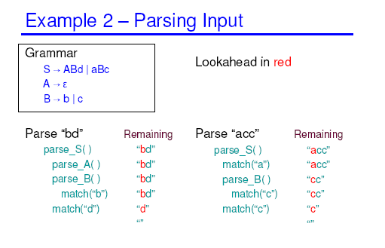

Slide 19
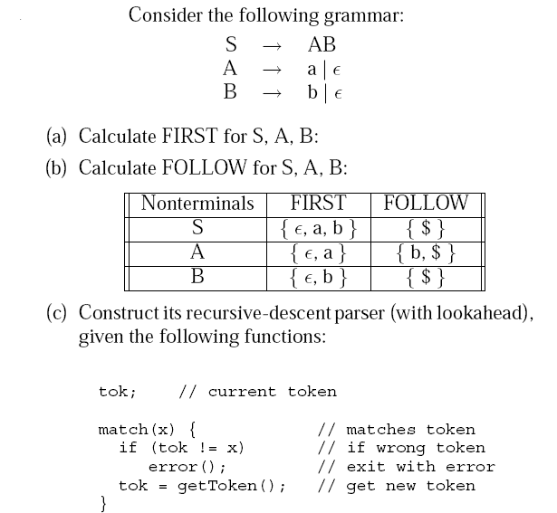

Slide 20
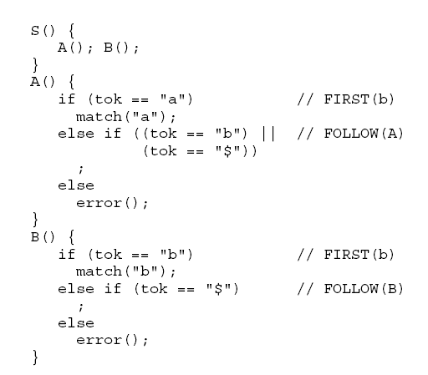

Slide 21
RD Parser without Semantic Action

Slide 22
ParseE
static void parseE() {
// E -> T E1
parseT();
parseE1();
}

Slide 23
ParseE’
static void parseE1() {
// E1 -> T E1 | epsilon
if (curr=="+") {
next();
parseT();
parseE1();
} else if(curr==")" || curr=="$" ) {
} else {
error("Unexpected :"+curr);
}
}

Slide 24
ParseT
static void parseT() {
// T -> F T1
parseF();
parseT1();
}

Slide 25
ParseT’
static void parseT1() {
// T1 -> * F T1 | epsilon
if (curr=="*") {
next();
parseF();
parseT1();
} else if(curr=="+" || curr==")" || curr=="$") {
} else {
error("Unexpected :"+curr);
}

Slide 26
ParseF
static void parseF() {
// F -> ( E ) | a
if( curr=="(") {
next();
parseE();
if(curr==")") {
next();
} else {
error (") expected.");
}
} else if(curr=="a") {
next();
} else {
error("Unexpected :"+curr);
}
}

Slide 27
RD Parser with Semantic Action

Slide 28
ParseE
static int parseE() {
// E -> T E1
int x=parseT();
return parseE1(x);
}

Slide 29
ParseE’
static int parseE1(int x) {
// E1 -> + T E1 | epsilon
switch (curr) {
case "+":
next();
int y = parseT();
return parseE1(x+y);
case ")":
case "$":
return x;
default:
error("Unexpected :"+curr);
return x; // to make compiler happy
}
}

Slide 30
ParseT
static int parseT() {
// T -> F T1
int x=parseF();
return parseT1(x);
}

Slide 31
ParseT’
static int parseT1(int x) {
if (null != curr) // T1 -> * F T1 | epsilon
// T1 -> * F T1 | epsilon
switch (curr) {
case "*":
next();
int y=parseF();
return parseT1(x*y);
case "+":
case ")":
case "$":
return x;
default:
error("Unexpected :"+curr);
return x; // to make compiler happy
}
return 0;
}

Slide 32
ParseF
static int parseF() {
// F -> ( E ) | a
if( "(".equals(curr)) {
next();
int x=parseE();
if(")".equals(curr)) {
next();
return x;
} else {
error (") expected.");
return -1; // to make compiler happy
}
} else try {
int x=Integer.parseInt(curr);
System.err.println("The Vaule of X is "+x);
next();
return x;
} catch(NumberFormatException e) {
error("Number expected.");
return -1; // to make compiler happy
}
}

Slide 33
Main
public static void main(String args []) throws IOException {
String line=in.readLine();
st = new StringTokenizer(line+" $");
next();
int x=parseE();
if("$".equals(curr)) {
System.out.println("OK "+x);
} else {
error("End expected");
}
}

