Slide 1
Semantic Analysis

Slide 2

Roadmap
Context-sensitive analysis
Strategies for semantic analysis
Type Systems
Attribute grammars
Symbol tables and type-checking

Slide 3
Roadmap
Context-sensitive analysis – Semantic elaboration
Strategies for semantic analysis
Type Systems
Attribute grammars
Symbol tables and type-checking

Slide 4
Semantic Analysis
The compilation process is driven by the syntactic structure of the program as discovered by the parser
Semantic routines:
interpret meaning of the program based on its syntactic structure
two purposes:
finish analysis by deriving context-sensitive information
begin synthesis by generating the IR or target code
associated with individual productions of a context free grammar or sub-trees of a syntax tree

Slide 5
Beyond Syntax
There is a level of correctness that is deeper than grammar

Slide 6
Beyond Syntax
To generate code, we need to understand its meaning.

Slide 7
Few more Examples…Why Context Sensitive Analysis is needed? – Beyond syntax
Consider two production rules in CFG,
x ← y and x←z ( integer vs strings) - Parse tree
Algol Language ( declare before use) - CFG
ProcedureBody → Declarations Executables

Slide 8
Context-sensitive analysis
Why is context-sensitive analysis hard?
answers depend on values, not syntax
questions and answers involve non-local information
answers may involve computation
Several alternatives:
symbol tables: central store for facts; express checking code
abstract syntax tree (attribute grammars): specify non-local computations; automatic evaluators
language design: simplify language; avoid problems
Notes:
automatic evaluators?

Slide 9
Roadmap
Context-sensitive analysis
Strategies for semantic analysis
Type System
Attribute grammars
Symbol tables and type-checking

Slide 10
Semantic processing
The Semantic Processing phase consists of: ­
Checking the Semantics of the language ­
Generating an Intermediate Representation of the program
build and decorate the Abstract Syntax Tree (AST)
Non-terminals used for ease of parsing may be omitted in the abstract syntax tree.

Slide 11
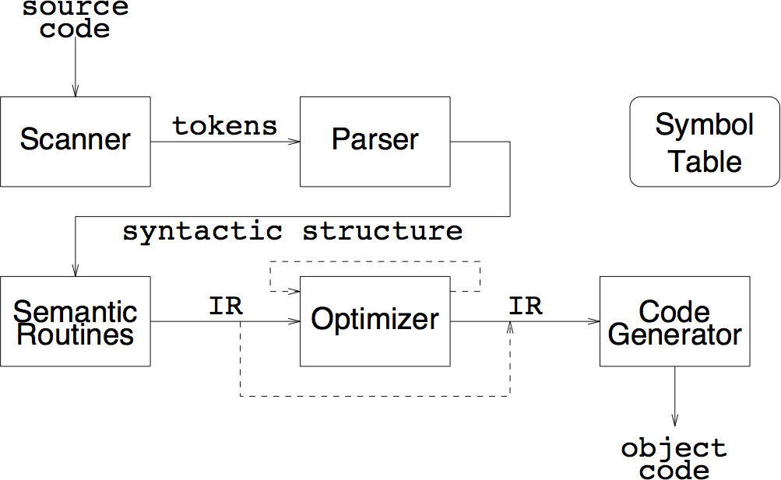
Alternatives for semantic processing
one-pass: compiler and synthesis
two-pass: compiler + peephole
two-pass: compiler & IR synthesis + code generation pass
multi-pass analysis
multi-pass synthesis
language-independent and re-targetable compilers

Slide 12
One-pass compilers
interleave scanning, parsing and translation
no explicit IR
generate target code directly
emit short sequences of instructions on each parser action
little or no optimization possible (minimal context)
can add peephole optimization pass
extra pass over generated code through small window (“peephole”) of instructions
smoothes out “rough edges” between code emitted by subsequent calls to code generator

Slide 13
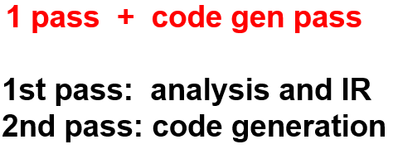
Two-pass: analysis & IR synthesis + code generation
Generate explicit IR as interface to code generator
linear (e.g., tuples)
can emit multiple tuples at a time for better code context
Advantages
easier retargeting (IR must be expressive enough for different machines!)
can add optimization pass later (multi-pass synthesis)

Slide 14
Multi-pass analysis
Several passes, read/write intermediate files
scan source file, generate tokens
place identifiers and constants in symbol table
parse token file
generate semantic actions or linearized parse tree
process declarations to symbol table
semantic checking with IR synthesis
Motivations:
Historical: constrained address spaces
Language: e.g., declaration after use
Multiple analyses over IR tree

Slide 15
Multi-pass synthesis
Passes operate on linear or tree-structured IR
Options:
code generation and peephole optimization
multi-pass IR transformation
machine-independent then dependent optimizations
high-level to low-level IR transformation before code generation
e.g., in gcc high-level trees drive generation of low-level Register Transfer Language for machine-independent optimization
language-independent front ends
retargetable back ends

Slide 16
Multi-language and multi-target compilers

Slide 17
Roadmap
Context-sensitive analysis
Strategies for semantic analysis
Type Systems
Attribute grammars
Symbol tables and type-checking

Slide 18
What is Type?
An abstract category that specifies properties held in common by all its member.
It defines a set of values (range of variables) and a set of operations on those values.
Common types include integer , list and character
Types can be
specified by membership – integer- range
specified by rules; structure in C defines type
Type =
a set of values
operations that are allowed on these values.

Slide 19
Type System
A type system is a collection of rules that assign types to program constructs (more constraints added to checking the validity of the programs, violation of such constraints indicate errors).
A languages type system specifies which operations are valid for which types.
Type systems provide a concise formalization of the semantic checking rules.
Type rules are defined on the structure of expressions
Type rules are language specific

Slide 20
The purpose of Type Systems
More precise level of program behaviour compared to CFG.
Second vocabulary by describing form and behaviour of valid programs.
More information cannot be obtained from scanning and parsing.
The purpose of the Type system information are,
Safety
Expressiveness
Run time efficiency

Slide 21
Ensuring Runtime Safety
Programs are well behaved— that is, the compiler and runtime system can identify all ill-formed programs before they execute an operation that causes a runtime errors.
Type system cannot catch all ill-formed programs;
The set of ill-formed programs is not computable - dereferencing an out-of-bounds pointer.
Compiler should eliminate as many runtime errors as it can using type-checking techniques.

Slide 22
Ensuring Runtime Safety - Type inference
The process of determining a type for each name and each expression in the code –Type inference.

Slide 23
Ensuring Runtime Safety -Evolution of Type System
Safety is a strong reason for using typed languages.
Strongly typed (“Type errors always caught.”)
Statically typed (e.g., ML, Ada, Eiffel, etc)
Compile-time type checking : Efficient.
Dynamically typed (e.g., Scheme, Smalltalk, etc)
Run-time type checking : Flexible.
Weakly typed (e.g., C)
Unreliable Casts (int to/from pointer).
Arrays (bounds not checked), Union type
Typeless
Assembly language
Any instruction can be run on any data “bit pattern”

Slide 24
Improving Expressiveness
Operator Overloading
An operator that has different meanings based on the types of its arguments is "overloaded."
Example ‘+’ Operator : interpretation of ‘+’ depends on the types of its operands.
ANSI C uses function prototypes- declarations of the number and type of a function’s parameters and the type of its returned value—to convert arguments to the appropriate types
Auto-incrementing a pointer in c : amount of the increment is determined by the pointer’s type.
Java : default constructor Vs. constructors with an argument list

Slide 25
Generating Better Code
A well-designed type system provides the compiler with detailed information about every expression in the program—information that can often be used to produce more efﬁcient translations.
The types that cannot be wholly determined at compile time, some of this checking might be deferred until runtime.
Overhead due to tag and value field in runtime type checking -- Compile time type checking eliminates these kind of overheads. Compile time type checking is preferable. But language design makes a final call type checking.

Slide 26
Type Checking
To avoid the overhead of runtime type checking, the compiler must analyze the program and assign a type to each name and each expression
+
Check these types to ensure that they are used in contexts where they are legal
Statically typed : All or almost all checking of types is done as part of compilation (C, ML, Java)
Dynamically typed : Almost all checking of types is done as part of program execution (Scheme, Prolog)
Untyped : No type checking (machine code)

Slide 27
Components of a Type System
Four Major Components,
Base types (or) built-in types
Rules for constructing new types from the existing types
Method for determining if two types are equivalent or compatible
Rules for inferring the type of each source language expression

Slide 28
Components of a Type System
Basic types: Numbers , Characters, Boolean
Compound and Constructed Types
Strings
Enumerated Types – type that contains a specific set of set of constant values.
Arrays.
If T is a type expression and n is an int then
array(n, T)
is a type expression denoting the type of an array with elements in T and indicies in the range 0 ... n - 1.
Monday < Tuesday and June < July
Tuesday > September

Slide 29
Components of a Type System
Structures and Variants – Grouping multiple objects of arbitrary type.
The type of a structure is the ordered product of the types of the individual elements that it contains
Node1 as (Node1 *)×unsigned×int, while a Node2 would be (Node2 *)×(Node2 *)×unsigned×int.

Slide 30
Components of a Type System
Pointers.
Pointers let a program save an address and later examine the object that it addresses
if T is a type expression then pointer(T) is a type expression denoting type pointer to an object of type T
Products.
If T1 and T2 are type expressions then
T1 × T2
is a type expression denoting the type of an element of the Cartesian product of T1 and T2.
Records.
If name1 and name2 are two type names, if T1 and T2 are type expressions then
record(name1: T1, name2: T2)

Slide 31
Components of a Type System- Type Equivalence
Mechanism that uses to decide whether or not two different type declarations are equivalent.
Structural Equivalence ** https://www.youtube.com/watch?v=5Iqe5crQqKU
Two types are equivalent iff they have the same structure
Name Equivalence ** https://www.youtube.com/watch?v=nPT5lJir4BM
Two types are equivalent iff they have the same name
Issues in Name Equivalence
Identical names
Issues in Structural Equivalence
Special meanings of some values – System I/O control bock Vs bit mapped image on the screen

Slide 32
Example
type Vector = array [1..10] of real;
type Weights = array [1..10] of real;
var x, y: Vector;
z: Weight;
Name Equivalence: When they have the same name.
x and y have same type, but z has different type.
Structural Equivalence: When they have the same structure. x, y and z have same type

Slide 33
Components of a Type System-Inference Rules
Mapping between the operand types and the result types.
Operand type Vs. result types
Declarations and inference
Declaring a variable – Constant ( 2 or 2.0 ) or By usage sin(2) or x ← 2

Slide 34
Components of a Type System- Inferring Types for expressions
Assigning of type inference is to assign a type to each expression that occurs in a program.
Simplest is – assign type inference to the bas element.
If e1 has type int and e2 has type int,
then e1 + e2 has type int

Slide 35
Components of a Type System- Interprocedural Aspects of Type Inference
To analyze and understand procedure calls, the compiler needs a type signature.
For example, the strlen function in c’s
unsigned int strlen(const char *s);
This prototype asserts that strlen takes an argument of type char *, which it does not modify, as indicated by the const attribute. The function returns a nonnegative integer
strlen : const char * → unsigned int
Type signature : A specification of the types of the formal parameters and return value(s) of a function
Compiler needs a type signature to perform accurate type inference.

Slide 36
Roadmap
Context-sensitive analysis
Strategies for semantic analysis
Type Systems
Attribute grammars
Symbol tables and type-checking

