Slide 1
Semantic Analysis -III

Slide 2

Roadmap
Attribute Grammar
Attribute Grammar Examples
Inherited attributes
Symbol tables and type-checking

Slide 3
Roadmap
Attribute Grammar
Attribute Grammar Examples
Inherited attributes
Attribute grammars
Symbol tables and type-checking

Slide 4
Attribute Grammar - Example 4
A simple AG for the evaluation of a real number from its bit-string representation
Example: 110.1010 = 6 + 10/2⁴ = 6 + 10/16 = 6 + 0.625 = 6.625
N → X.X
X → BX | B
B → 0 | 1

Slide 5
Attribute Grammar - Example 4
AS(N) = AS(B) = {value ↑: real},
AS(X) = {length ↑: integer, value ↑: real}
N → X₁.X₂ {N.value ↑:= X₁.value ↑ +X₂.value ↑ /2 ^{X}₂^{.length}}
X → B {X.value ↑:= B.value ↑; X.length ↑:= 1}
X₁ → BX₂ {X₁.length ↑:= X₂.length ↑+1;
X₁.value ↑:= B.value ↑ ∗2 ^{X}₂^{.length}↑ + X₂.value ↑}
B → 0 {B.value ↑:= 0}
B → 1 {B.value ↑:= 1}

Slide 6
Roadmap
Attribute Grammar
Attribute Grammar Examples
Inherited attributes
Attribute grammars
Symbol tables and type-checking

Slide 7
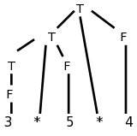
Why Have Inherited Attributes?
Consider the following left-recursive grammar for multiplication of numbers and the parse tree on the right for 3*5*4.
T → T * F
T → F
F → num
When doing top-down parsing, we need to avoid left recursion. Consider the grammar below, which is the result of removing the left recursion….
T → F T'
T' → * F T'
T' → ε T'
F → num

Slide 8
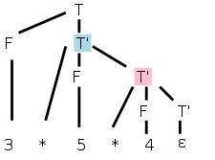
Why Have Inherited Attributes?
Where on the tree should we do the multiplication 3*5?

Slide 9
Why Have Inherited Attributes?
Where on the tree should we do the multiplication 3*5?
There is no node that has 3 and * and 5 as children

Slide 10
Why Have Inherited Attributes?
Where on the tree should we do the multiplication 3*5?
There is no node that has 3 and * and 5 as children
The second production is the one with the * so that is the natural candidate for the multiplication site.

Slide 11
Why Have Inherited Attributes?
Where on the tree should we do the multiplication 3*5?
There is no node that has 3 and * and 5 as children
The second production is the one with the * so that is the natural candidate for the multiplication site.
The right operand (5) can be obtained from the F that is the middle child of this T'

Slide 12
Why Have Inherited Attributes?
Where on the tree should we do the multiplication 3*5?
There is no node that has 3 and * and 5 as children
The second production is the one with the * so that is the natural candidate for the multiplication site.
The right operand (5) can be obtained from the F that is the middle child of this T'
F gets the value from its child, the number itself --simple synthesized
F.val=num.lexval

Slide 13
Why Have Inherited Attributes?
But where is the left operand?

Slide 14
Why Have Inherited Attributes?
But where is the left operand?
It is located at the sibling of T' in the parse tree, i.e., at the F immediately to T's left

Slide 15
Why Have Inherited Attributes?
But where is the left operand?
It is located at the sibling of T' in the parse tree, i.e., at the F immediately to T's left
This F is not mentioned in the production associated with the T' node

Slide 16
Why Have Inherited Attributes?
But where is the left operand?
It is located at the sibling of T' in the parse tree, i.e., at the F immediately to T's left
This F is not mentioned in the production associated with the T' node
How does T' get F.val from its sibling?

Slide 17
Why Have Inherited Attributes?
But where is the left operand?
It is located at the sibling of T' in the parse tree, i.e., at the F immediately to T's left
This F is not mentioned in the production associated with the T' node
How does T' get F.val from its sibling?
The common parent, in this case T, can get the value from F and then our node can inherit the value from its parent -- inherited attribute

Slide 18
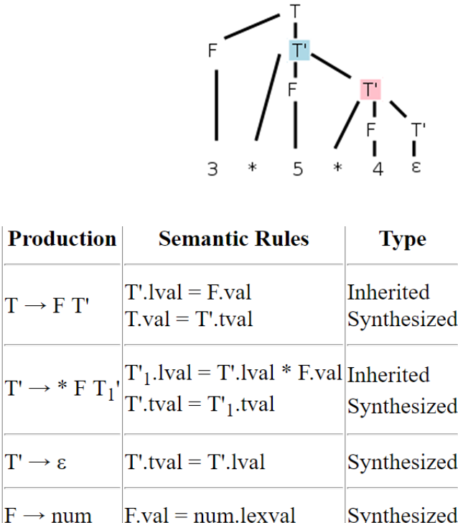
Why Have Inherited Attributes?
T.tmp = F.val (synthesized)
T'.lval = T.tmp (inherited)
Lets look at the second multiplication (3*5)*4, where the parent of T' is another T'

Slide 19
Why Have Inherited Attributes?
T.tmp = F.val (synthesized)
T'.lval = T.tmp (inherited)
Lets look at the second multiplication (3*5)*4, where the parent of T' is another T'

Slide 20
Why Have Inherited Attributes?
T’ needs as left operand, the product 3*5 that its parent can calculate.

Slide 21
Why Have Inherited Attributes?
T’ needs as left operand, the product 3*5 that its parent can calculate.
We have the parent (another T' node, the blue one in this case) calculate the product and store it as an attribute of its right child namely the pink T'.

Slide 22
Why Have Inherited Attributes?
T’ needs as left operand, the product 3*5 that its parent can calculate.
We have the parent (another T' node, the blue one in this case) calculate the product and store it as an attribute of its right child namely the pink T'.

Slide 23
Why Have Inherited Attributes?
T’ needs as left operand, the product 3*5 that its parent can calculate.
We have the parent (another T' node, the blue one in this case) calculate the product and store it as an attribute of its right child namely the pink T‘ – added as a first rule in T’

Slide 24
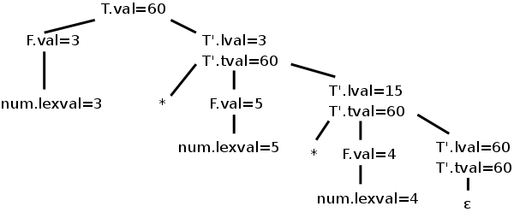
Why Have Inherited Attributes?
We trace it through, 60 does get evaluated and stored in the bottom right T', the one associated with the ε-production

Slide 25
Why Have Inherited Attributes?
We trace it through, 60 does get evaluated and stored in the bottom right T', the one associated with the ε-production
To get the value up to the root where it represents the evaluation of this term T and can be combined with other terms to get the value of a larger expression.

Slide 26
Why Have Inherited Attributes?
We trace it through, 60 does get evaluated and stored in the bottom right T', the one associated with the ε-production
To get the value up to the root where it represents the evaluation of this term T and can be combined with other terms to get the value of a larger expression.
Just synthesize to go up from ε-production– named as term value ( T’-tval)

Slide 27
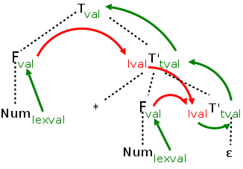
Why Have Inherited Attributes?
Another way to write an Semantic Rule for the given grammar

Slide 28
Thanks

