Slide 1
Semantic Analysis -IV

Slide 2

Roadmap
L Attribute Grammar
Attribute Grammar Examples
Inherited attributes
Review Questions

Slide 3
L Attribute Grammar - Example 2
D → T {L.inh := T.type} L
T → int {T.type := integer}
T → real {T.type := real}
L → {L₁.inh := L.inh} L₁, id {addtype(id.entry, L.inh)}
L → id {addtype(id.entry, L.inh)}

Slide 4
L Attribute Grammar - Example 2
D → T {L.inh := T.type} L
T → int {T.type := integer}
T → real {T.type := real}
L → {L₁.inh := L.inh} L₁, id {addtype(id.entry, L.inh)}
L → id {addtype(id.entry, L.inh)}

Slide 5
L Attribute Grammar - Example 3
AI(L) = AI(ID) = {type ↓: {integer, real}}
AS(T) = {type ↑: {integer, real}}
AS(ID) = AS(identifier) = {name ↑: string}
DList → D | DList ; D
D → T L {L.type ↓:= T.type ↑}
T → int {T.type ↑:= integer}
T → float {T.type ↑:= real}
L → ID {ID.type ↓:= L.type ↓}
L₁ → L₂ , ID {L₂.type ↓:= L₁.type ↓; ID.type ↓:= L₁.type ↓}
ID → identifier {ID.name ↑:= identifier.name ↑}

Slide 6
L Attribute Grammar - Example 3
AI(L) = AI(ID) = {type ↓: {integer, real}}
AS(T) = {type ↑: {integer, real}}
AS(ID) = AS(identifier) = {name ↑: string}
DList → D | DList ; D
D → T L {L.type ↓:= T.type ↑}
T → int {T.type ↑:= integer}
T → float {T.type ↑:= real}
L → ID {ID.type ↓:= L.type ↓}
L₁ → L₂ , ID {L₂.type ↓:= L₁.type ↓; ID.type ↓:= L₁.type ↓}
ID → identifier {ID.name ↑:= identifier.name ↑}

Slide 7
L Attribute Grammar - Example 3

Slide 8
L Attribute Grammar - Example 4

Slide 9
L Attribute Grammar - Example 4
Annotated parse tree for w = -101

Slide 10
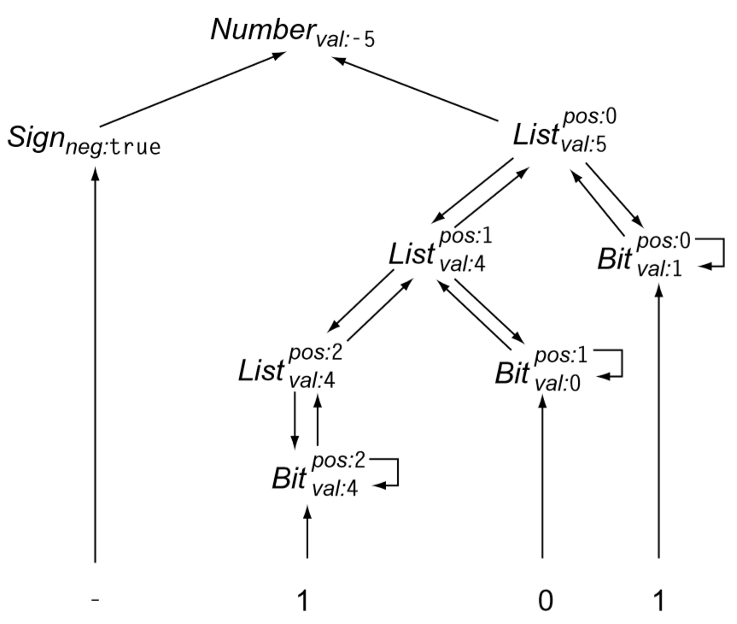
L Attribute Grammar - Example 4
Dependency Graph for w = -101

Slide 11
HOW TO EVALUATE ATTRIBUTES
A parse tree containing or showing the values of its attributes is called Attributed Parse Tree
For synthesized attributes we can evaluate the attributes in Bottom up manner.
For SDD’s with both inherited and synthesized attributes, it can’t be ensured that there exists even own order to evaluate the attributes. Let us consider the following example:
PRODUCTION SEMANTIC RULE
X->Y X.syn=f(Y.inh)
Y.inh=g(X.syn)
Dependency Graphs are used to find the evaluation order for evaluating the attributes

Slide 12
DEPENDENCY GRAPHS
It depicts the path of flow of information.
For each node in the Parse Tree the Dependency graph has a node for each attribute in the node.
For each production of the form X.a=f(Y.a,Z.b,….) create an edge from Y.a node to X.a node,Z.b to X.a and so on. This means Y.a and Z.b are to be evaluated before evaluating X.a

Slide 13
S Attributed SDD
An S Attributed SDD is a SDD if all the attributed is synthesized.
When the SDD is S attributed, it can evaluated in any bottom-up order of the nodes of the parse tree. Generally post order traversal is used to evaluate where attributes of child are evaluated first and then the attribute of it.
POSTORDER (N) { for (each child C of N, from the left) POSTORDER(C); Evaluate the attributes of node N }
It is easy to implement the S attributed SDD with Bottom up Parser as Bottom up Parser corresponds to Post Order traversal

Slide 14
L Attributed SDD
Each attribute in each semantic rule for the production A → X₁, . . . ,X_{n} is either
a synthesized attribute or
an inherited attribute X_{i} with the following constraints.
the inherited attributes of its parent node A;
either inherited or synthesized attributes from its elder siblings X₁, X₂,..., X_{i−1};
inherited or synthesized attributed associated from itself X_{i}, but only in such a way that there are no cycles in a dependency graph formed by the attributes of this X_{i}.
Every S-attributed definition is an L-attributed definition

Slide 15
TOPOLOGICAL SORT
A topological sort of a Directed Acyclic Graph (DAG) is a linear ordering of its vertices such that for every directed edge uv from vertex u to vertex v, u comes before v in the ordering.
The vertices may represent the task to be done and the edges constraints that one order should be completed before another.
Top Sort is possible only is the Graph is Acyclic or else there doesn’t any order. Any DAG has at least one topological ordering.
It can more than 1 order.

Slide 16
Circularity
Circular attribute grammars can give rise to cyclic attribute-dependence graphs.
A failure of this kind in a compiler causes serious problems
Example, the compiler might not be able to generate code for its input
If a compiler uses attribute grammars, it must handle circularity in an appropriate way.
Avoidance
Restrict the attribute grammar - Grammar uses only synthesized attributes or constant attributes
Evaluation
use an proper evaluation method

Slide 17
Circularity
We can only evaluate acyclic instances
We can prove that some grammars can only generate instances with acyclic dependence graphs
Largest such class is “strongly non-circular” grammars (SNC )
SNC grammars can be tested in polynomial time
Failing the SNC test is not conclusive
Many evaluation methods discover circularity dynamically
⇒ Bad property for a compiler to have
SNC grammars were first defined by Kennedy & Warren

Slide 18
A Circular Attribute Grammar

Slide 19
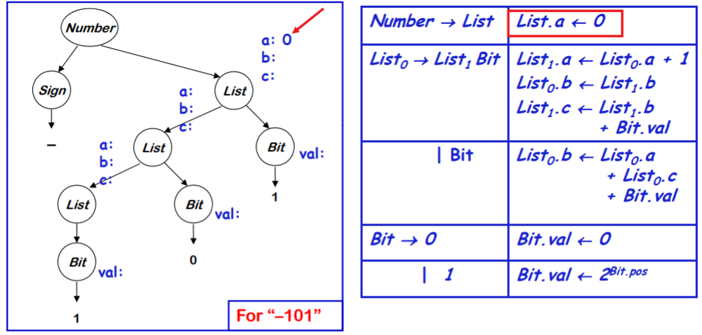
A Circular Attribute Grammar

Slide 20
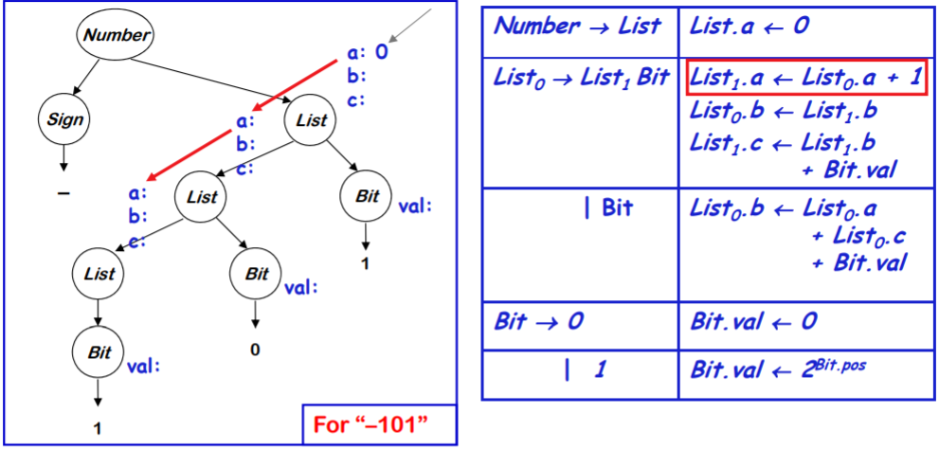
A Circular Attribute Grammar

Slide 21
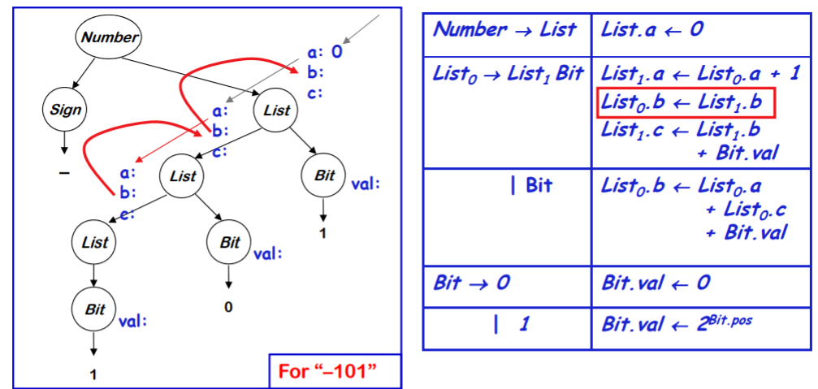
A Circular Attribute Grammar

Slide 22
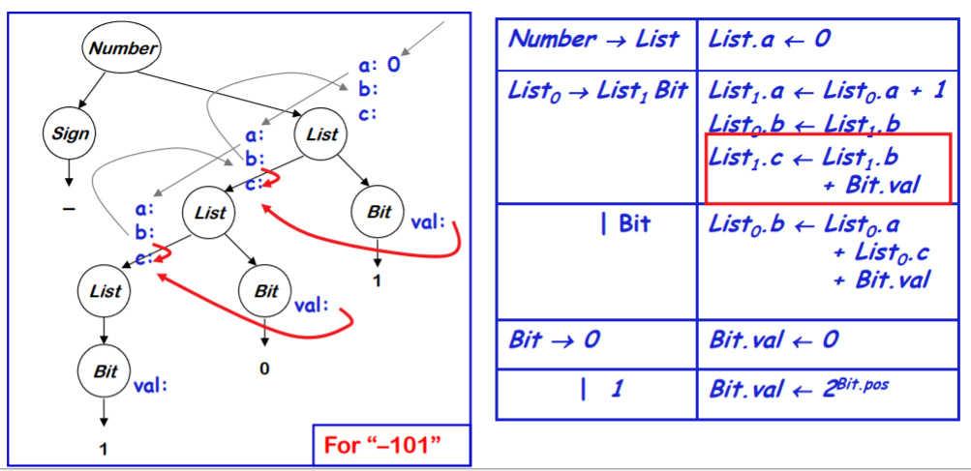
A Circular Attribute Grammar

Slide 23
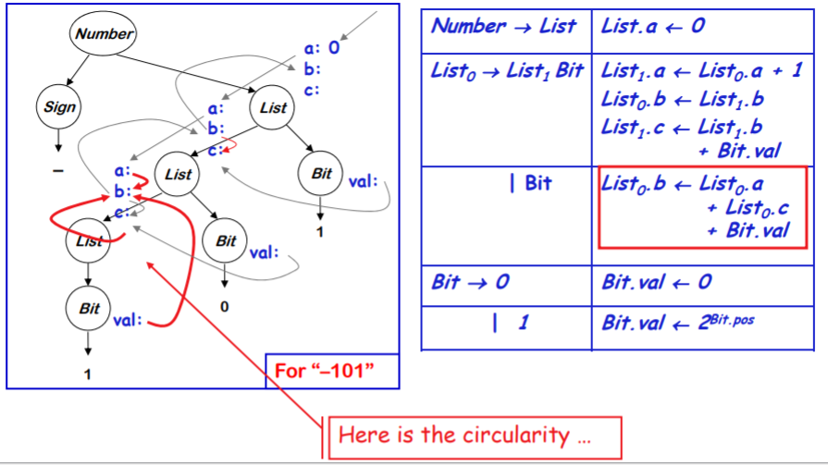
A Circular Attribute Grammar

Slide 24
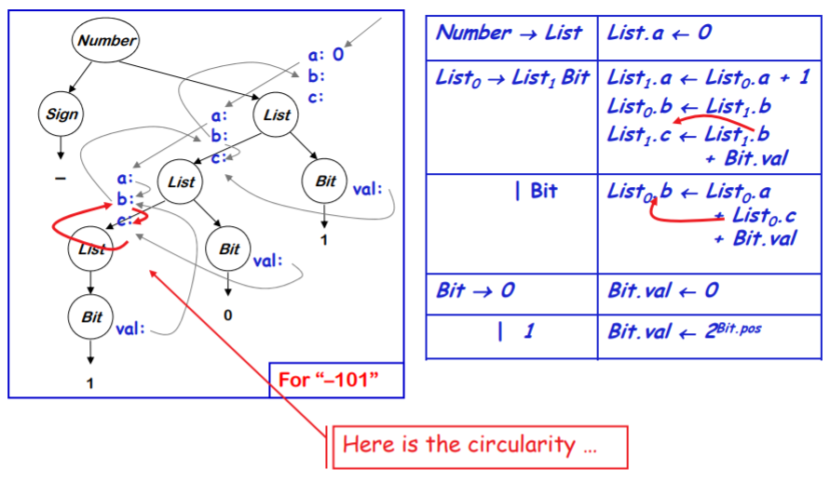

A Circular Attribute Grammar

Slide 25
Review Questions
1)
A → LM L.i = f1 (A.i) M.i = f2 (L.s) A.s = f3 (M.s)
A → QR R.i = f4(A.i) Q.i = f5(R.s) A.s = f6(Q.s)
A) S – Attributed B ) L – Attributed C ) both D) None
2) A → BC {B.s = A.s}
A) S – Attributed B ) L – Attributed C ) both D) None

Slide 26
Review Questions
1)
A → LM L.i = f1 (A.i) M.i = f2 (L.s) A.s = f3 (M.s)
A → QR R.i = f4(A.i) Q.i = f5(R.s) A.s = f6(Q.s)
A) S – Attributed B ) L – Attributed C ) both D) None
2) A → BC {B.s = A.s}
A) S – Attributed B ) L – Attributed C ) both D) None

Slide 27
Review Questions
Consider the grammar with the following translation rules and E as the start symbol. E -> E1 #T {E.value = E1.value * T.value} | T {E.value = T.value} T -> T1 & F {T.value = T1.value + F.value} |F {T.value= F.value} F -> num {F.value = num.value}
Compute E.value for the root of the parse tree for the expression:
2 # 3 & 5 # 6 &4
a) 200 b) 180 c) 160 d) 40

Slide 28
Review Questions
Consider the grammar with the following translation rules and E as the start symbol. E -> E1 #T {E.value = E1.value * T.value} | T {E.value = T.value} T -> T1 & F {T.value = T1.value + F.value} |F {T.value= F.value} F -> num {F.value = num.value}
Compute E.value for the root of the parse tree for the expression:
2 # 3 & 5 # 6 &4
a) 200 b) 180 c) 160 d) 40

Slide 29
Review Questions
Consider the syntax directed definition shown below.
S → id : = E {gen (id.place = E.place;);}
E → E1 + E2 {t = newtemp ( ); gen (t = El.place + E2.place;); E.place = t}
E → id {E.place = id.place;}
Here, gen is a function that generates the output code, and newtemp is a function that returns the name of a new temporary variable on every call. Assume that ti's are the temporary variable names generated by newtemp. For the statement 'X: = Y + Z', the 3-address code sequence generated by this definition is
A) X = Y + Z
B) t1 = Y + Z; X = t1
C) t1 =Y; t2 = t1 + Z; X = t2
D) t1 = Y; t2 = Z; t3 = t1 + t2; X = t3

Slide 30
Review Questions
Consider the syntax directed definition shown below.
S → id : = E {gen (id.place = E.place;);}
E → E1 + E2 {t = newtemp ( ); gen (t = El.place + E2.place;); E.place = t}
E → id {E.place = id.place;}
Here, gen is a function that generates the output code, and newtemp is a function that returns the name of a new temporary variable on every call. Assume that ti's are the temporary variable names generated by newtemp. For the statement 'X: = Y + Z', the 3-address code sequence generated by this definition is
A) X = Y + Z
B) t1 = Y + Z; X = t1
C) t1 =Y; t2 = t1 + Z; X = t2
D) t1 = Y; t2 = Z; t3 = t1 + t2; X = t3

Slide 31
Thanks

