Slide 1
Context Sensitive Analysis
AHSDT, Type Checking, Building AST
Chapter-4 (Keith Cooper)
Nalinadevi Kadiresan, CSE DEPT.
AMRITA SCHOOL OF ENGG.

Slide 2
Problem with Attribute grammar a recap
Attributes with complex pattern information flow is difficult to express
  If the computation requires nonlocal value we need copy rules to move the values to required location in parse tree
This introduces the following problems:
  Copy rules increase cognitive overhead
  Copy rules increase the space requirements
    Storage reclamation of attributes to reuse space introduces more task.
  Further phases inspect the parse tree (Say an abstract parse tree)
    Locating answers of attributes need additional traversal
      To handle this propagate important results to root that introduces more copy rules
Even Semester 2017-18
Nalinadevi Kadiresan

Slide 3
Addressing the Problem
If you gave this problem to a programmer at IBM
Introduce a central repository for facts
  Table of names
    Field in table for loaded/not loaded state
  This avoids all the copy rules, allocation & storage headaches
  All inter-assignment attribute flow is through table
    Clean, efficient implementation
    Good techniques for implementing the table (hashing, § B.3)
    When its done, information is in the table !
    Cures most of the problems
Unfortunately, this design violates the functional paradigm
  Do we care? → Yes, the dependency in dependence graph is lost so determining evaluation order is difficult
  Demonstrated in next example
Even Semester 2017-18
Nalinadevi Kadiresan

Slide 4
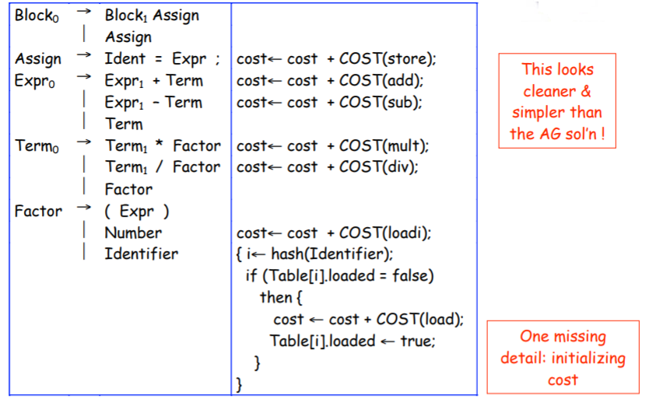
Reworking the Example (with load tracking)
Even Semester 2017-18
Nalinadevi Kadiresan

Slide 5
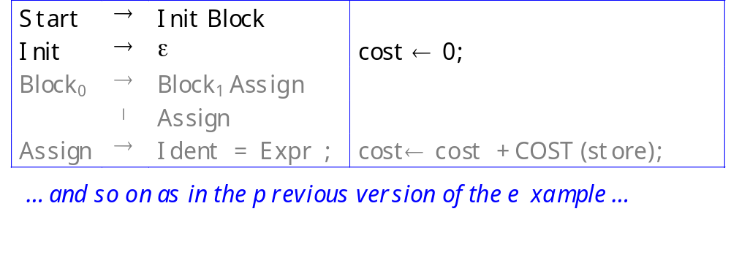
Reworking the Example (with load tracking)
Before parser can reach Block, it must reduce Init
Reduction by Init sets cost to zero
This is an example of splitting a production to create a reduction in the middle — for the sole purpose of hanging an action routine there!
Even Semester 2017-18
Nalinadevi Kadiresan

Slide 6
The Realist’s Alternative
Adhoc syntax-directed translation(AHSDT)
It is a rule based evaluation method (treewalk)
  Analyze rules at compiler-generation time
  Determine a fixed (static) ordering
  Evaluate nodes in that order
Associate a snippet of code with each production
At each reduction/derivation, the corresponding snippet/action is executed
AHSDT nicely fits into parsers
  Top-down, Recursive-Descent Parser
  Bottom-up, shift/reduce Parsers
Even Semester 2017-18
Nalinadevi Kadiresan

Slide 7
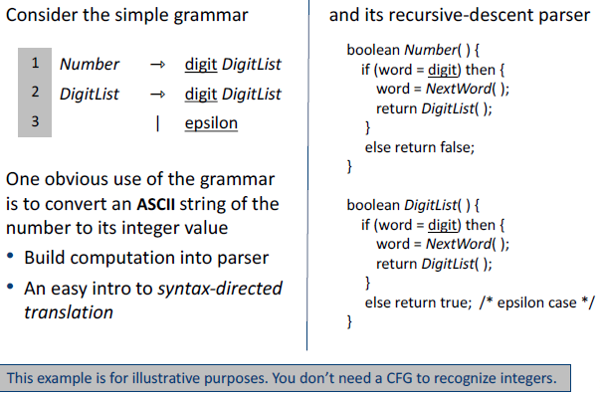
AHSDT using Recursive Descent Parser
Nalinadevi Kadiresan
Even Semester 2017-18

Slide 8
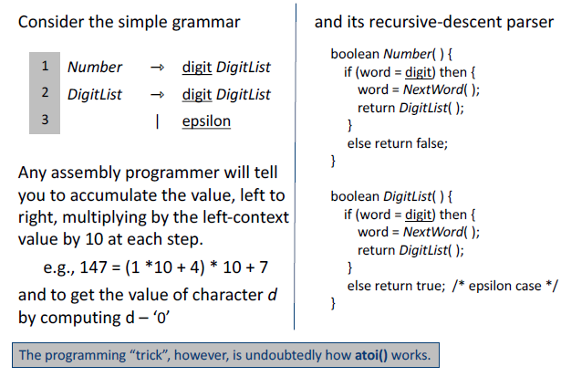

AHSDT using Recursive Descent Parser
Even Semester 2017-18
Nalinadevi Kadiresan

Slide 9
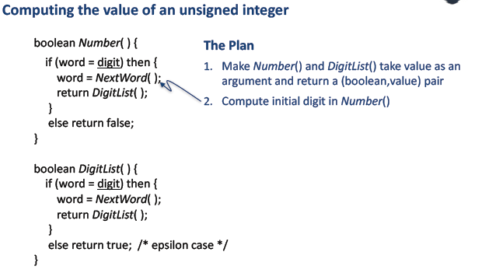
AHSDT using Recursive Descent Parser
Even Semester 2017-18
Nalinadevi Kadiresan

Slide 10
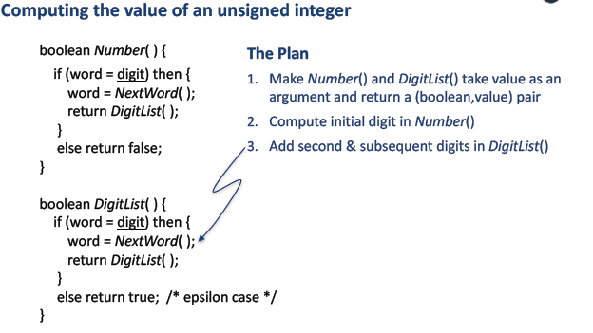
AHSDT using Recursive Descent Parser
Even Semester 2017-18
Nalinadevi Kadiresan

Slide 11
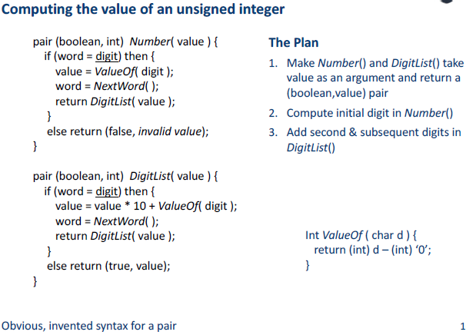
AHSDT using Recursive Descent Parser
Even Semester 2017-18
Nalinadevi Kadiresan

Slide 12
AHSDT using Recursive Descent Parser
Computing the value of an unsigned integer
  Consider the simple grammar
  Ok, so it works with recursive descent.
What about an LR(1) parser?
Even Semester 2017-18
Nalinadevi Kadiresan

Slide 13
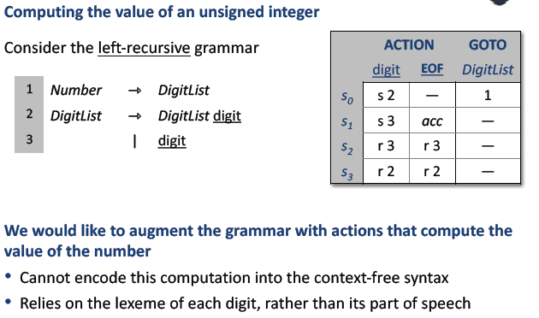
AHSDT using LR(1) parser
Even Semester 2017-18
Nalinadevi Kadiresan

Slide 14
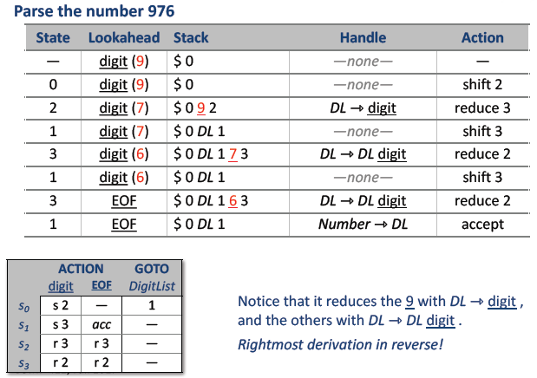
AHSDT using LR(1) parser
Even Semester 2017-18
Nalinadevi Kadiresan

Slide 15
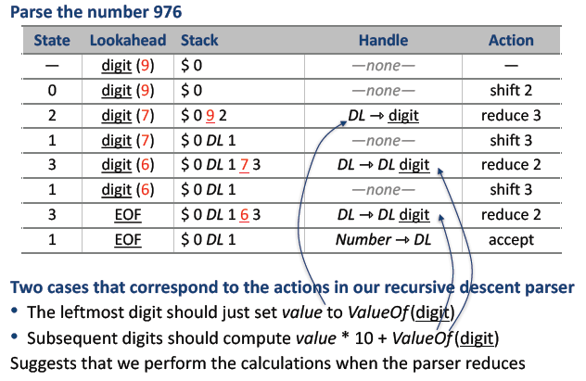
AHSDT using LR(1) parser
Even Semester 2017-18
Nalinadevi Kadiresan

Slide 16
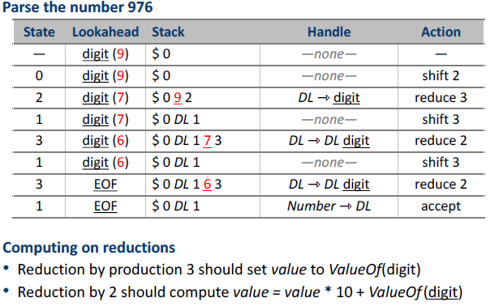
AHSDT using LR(1) parser
Even Semester 2017-18
Nalinadevi Kadiresan

Slide 17
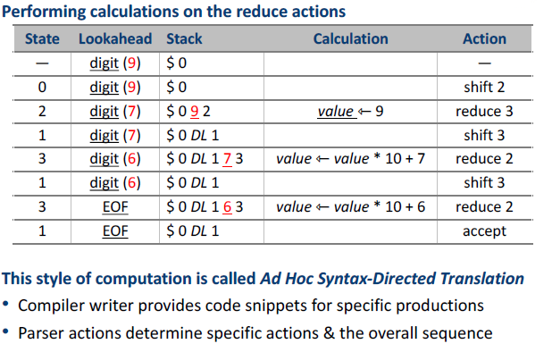
AHSDT using LR(1) parser
Even Semester 2017-18
Nalinadevi Kadiresan

Slide 18
AHSDT using LR(1) parser
Summary
Associate a snippet of code with each production
At each reduction, the corresponding snippet runs
Allowing arbitrary code provides complete flexibility
  Includes ability to do tasteless & bad things
To make this work
Need names for attributes of each symbol on lhs & rhs
  Typically, one attribute passed through parser + arbitrary code (structures, globals, statics, …)
Need an evaluation scheme that fits to the parsing algorithm
Even Semester 2017-18
Nalinadevi Kadiresan

Slide 19
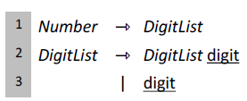
AHSDT in CUP
terminal Integer digit;
non terminal Integer DigitList, Number;
start with Number;
Number ::= DigitList:d {: RESULT= d; :};
DigitList ::= DigitList:d1 digit:d2 {: RESULT = d1 * 10 + d2; :};
DigitList ::= digit:d {: RESULT = d; :};
Even Semester 2017-18
Nalinadevi Kadiresan

Slide 20
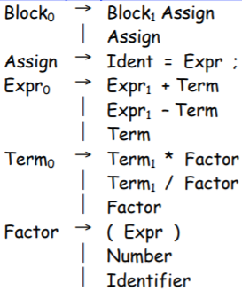
AHSDT in CUP
Example-2(contd)
action code {: java.util.dictionary dict = new java.util.Hastable();
      Integer get (String id) { return (Integer)dict.get(id.intern()); }
      void put(String id, Integer v) { dict.put(id.intern(), v); }
    :}
terminal EQ, PLUS, MINUS, STAR, DIV, LPAREN, RPAREN;
terminal Integer NUM;
terminal String ID;
non terminal S, Block, Assign;
non terminal Integer Expr, Term, Factor;
start with S;
Even Semester 2017-18
Nalinadevi Kadiresan

Slide 21
AHSDT in CUP
Example-2(contd)
S::= Block ;
Block::= Block Assign ;
Block::= Assign ;
Assign::= ID:i EQ Expr:e {: put(i,e); :};
Expr::= Expr:e PLUS Term:t {: RESULT= e+t ; :};
Expr::= Expr:e MINUS Term:t {: RESULT= e-t ; :};
Expr::=Term:t {: RESULT=t; :};
Even Semester 2017-18
Nalinadevi Kadiresan

Slide 22
AHSDT in CUP
Example-2(contd)
Term::= Term:t STAR Factor:f {: RESULT= t*f ; :};
Term::= Term:t DIV Factor:f {: RESULT= t/f ; :};
Term::= Factor:f {: RESULT= f ; :};
Factor::=LPAREN Expr:e RPAREN {: RESULT=e; :};
Factor::=NUM:n {: RESULT=n; :};
Factor::=ID:i {: RESULT=get(i); :};
NOW TRY, cost estimation evaluation in CUP !!!
Even Semester 2017-18
Nalinadevi Kadiresan

Slide 23
Is This Really “Ad-hoc” ?
Relationship between practice and attribute grammars
Similarities
Both rules & actions associated with productions
Application order determined by tools, not author
(Somewhat) abstract names for symbols
Differences
Actions applied as a unit; not true for AG rules
Anything goes in ad-hoc actions; AG rules are functional
AG rules are higher level than ad-hoc actions
Even Semester 2017-18
Nalinadevi Kadiresan

Slide 24
How do we handle inherited attribute in LR(1) Parser?
In bottom-up evaluation scheme, the semantic actions are evaluated during the reductions.
During the bottom-up evaluation of S-attributed definitions, we have a parallel stack to hold synthesized attributes.
Problem: where are we going to hold inherited attributes?
A Solution: We will convert our grammar to an equivalent grammar to guarantee the following:
  All embedding semantic actions in our translation scheme will be moved into the end of the production rules.
  All inherited attributes will be copied into the synthesized attributes (most of the time synthesized attributes of new non-terminals).
  Thus we will be evaluating all the semantic actions during reductions, and we find a place to store an inherited attribute.
Even Semester 2017-18
Nalinadevi Kadiresan

Slide 25
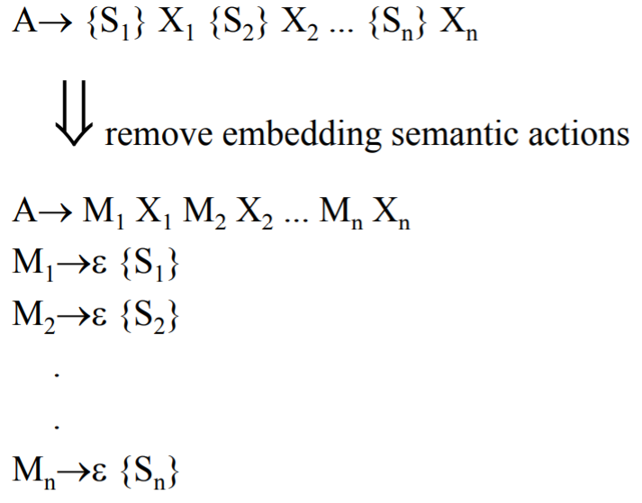
Removing Embedding Semantic Actions
Even Semester 2017-18
Nalinadevi Kadiresan

Slide 26
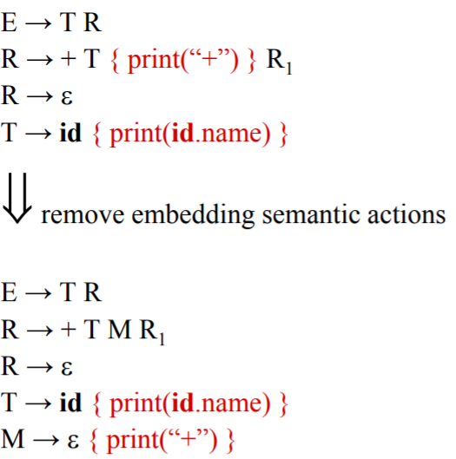
Removing Embedding Semantic Actions
Even Semester 2017-18
Nalinadevi Kadiresan

Slide 27
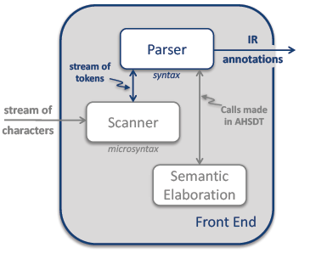
Role of Parser in Front End -- Recap
A parser’s other(than syntax) activities can be termed “semantic elaboration.”
It may perform many tasks, including
  Type checking
  Code generation
  Storage layout
  Error checking
It might create an IR & interpret that IR to produce answers
It might pretty-print the code back to a file in some modified form.
Semantic elaboration makes parsers quite versatile tools.
Even Semester 2017-18
Nalinadevi Kadiresan

Slide 28
Other uses of AHSDT
Type checking
Build IR tree
Build symbol Table
Code generation
Next is type checking !!!
Even Semester 2017-18
Nalinadevi Kadiresan

Slide 29
Type Systems
Types
  Values that share a set of common properties
  Defined by language (built-ins) and/or programmer (user defined)
• Type System
  Set of types in a programming language
  Rules that use types to specify program behaviour
Example type rules
  If operands of addition are of type integer, then result is of type integer
  The result of the unary “&” operator is a pointer to the object referred to by the operand
Advantages
  Ensures run-time safety
  Provides information for code generation
Even Semester 2017-18
Nalinadevi Kadiresan

Slide 30
Type Checker
Enforces rules of the type system
May be strong/weak, static/dynamic
Static type checking
  Performed at compile time
  Early detection, no run-time overhead
  Not always possible (e.g., A[I], where I comes from input)
Dynamic type checking
  Performed at run time
  More flexible, rapid prototyping
  Overhead to check run-time type tags
Even Semester 2017-18
Nalinadevi Kadiresan

Slide 31
Type expressions
Used to represent the type of a language construct
Describes both language and programmer types
Examples
  Basic types (built-ins) : integer, float, character
  Constructed types : arrays, structs, functions
Even Semester 2017-18
Nalinadevi Kadiresan

Slide 32
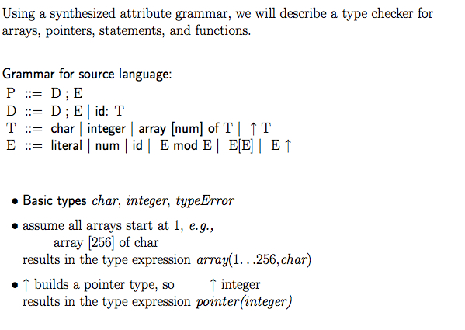
A simple Type checker
Even Semester 2017-18
Nalinadevi Kadiresan

Slide 33
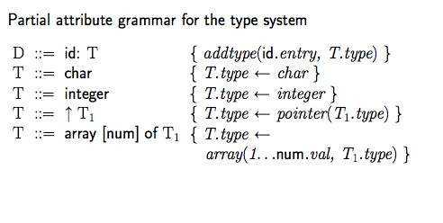
Type checking example
Even Semester 2017-18
Nalinadevi Kadiresan

Slide 34
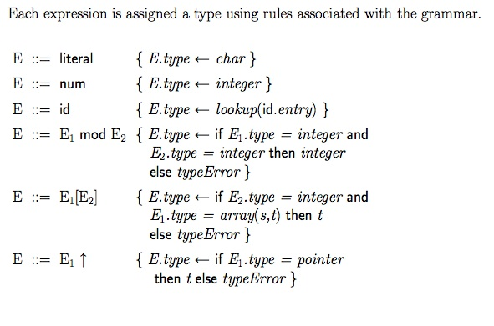
Type checking expressions
Even Semester 2017-18
Nalinadevi Kadiresan

Slide 35
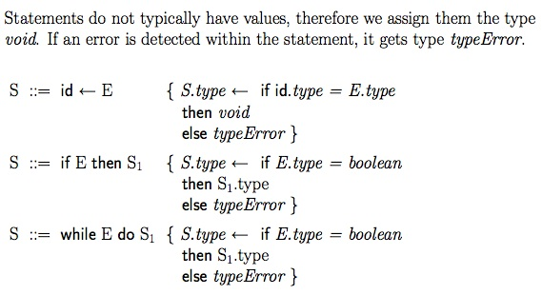
Type checking statements
Even Semester 2017-18
Nalinadevi Kadiresan

Slide 36
Build IR tree – AST
Consider the grammar:
Stm → Stm; Stm (CompoundStm)
Stm → id := Exp (AssignStm)
Stm → print (ExpList) (PrintStm)
Exp → id (IdExp)
Exp → num (NumExp)
Exp → Exp Binop Exp (OpExp)
Exp → (Stm, Exp) (EseqExp)
ExpList → Exp, ExpList (PairExpList)
ExpList → Exp (LastExpList)
Binop →+ (Plus)
Binop →− (Minus)
Binop →× (Times)
Binop → / (Div)
Even Semester 2017-18
Nalinadevi Kadiresan

Slide 37
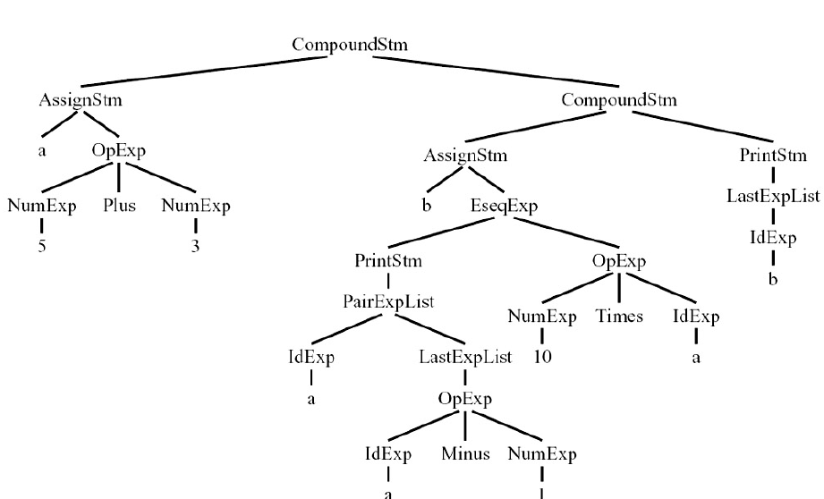
Build IR tree – AST
Tree representation of the following sample program for Grammar
a := 5+3; b := (print(a, a-1), 10*a); print(b)
Even Semester 2017-18
Nalinadevi Kadiresan

Slide 38
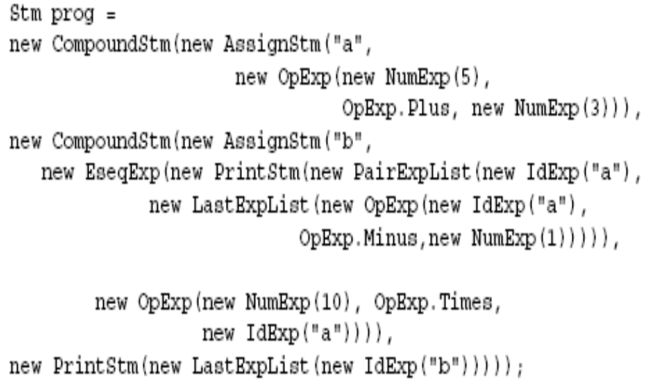
Build IR tree – AST
Even Semester 2017-18
Nalinadevi Kadiresan

Slide 39
Build IR tree – AST
Step 1
Write OO library for the supplied CFG
Step-2
Create the instance for every production using CUP
Even Semester 2017-18
Nalinadevi Kadiresan

Slide 40
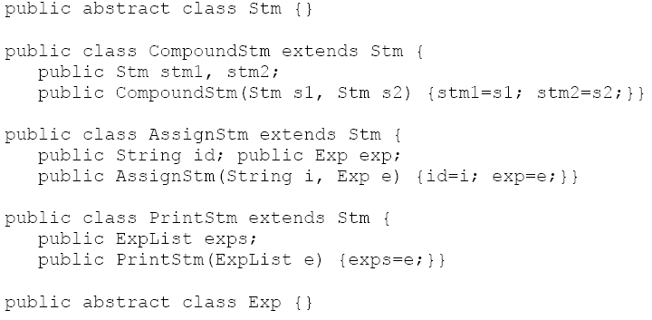
Step-1: Write OO library for the supplied CFG
Even Semester 2017-18
Nalinadevi Kadiresan

Slide 41
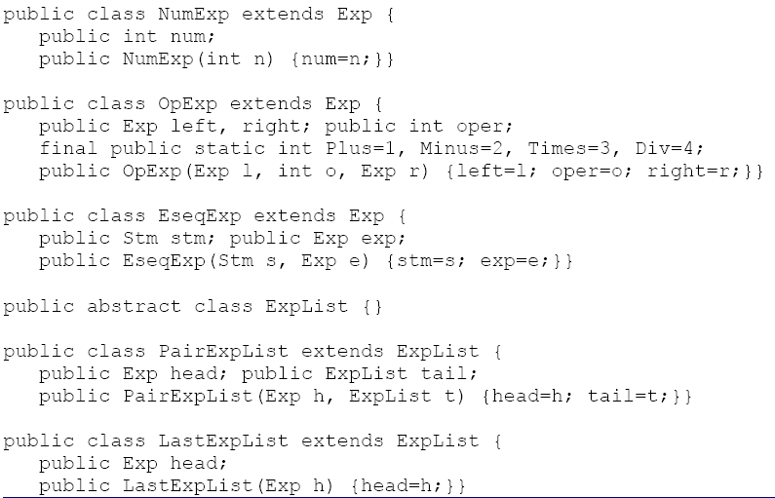
Step-1: Write OO library for the supplied CFG
Even Semester 2017-18
Nalinadevi Kadiresan

Slide 42
Step-2: Create the instance for every production using CUP
Sample CUP specification as Interpreter
terminal PLUS, MINUS, TIMES, DIV,ASSIGN, PRINT, LPAREN, RPAREN, COMMA, SEMICOLON;
terminal Integer INT;
terminal String ID;
non terminal Exp exp;
non terminal Stm stm;
non terminal ExpList exps;
non terminal Table prog;
start with prog;
Even Semester 2017-18
Nalinadevi Kadiresan

Slide 43
Step-2: Create the instance for every production using CUP
precedence right SEMICOLON
precedence left PLUS, MINUS;
precedence left TIMES, DIV;
prog ::= stm:s {: RESULT = s.eval(new EmptyTable()); :}
stm := stm:a SEMICOLON stm:b {: RESULT = new CompoundStm(a,b)); :}
stm := ID:i ASSIGN exp:e {: RESULT = new AssignStm(i,e)); :}
stm := PRINT LPAREN exps:e RPAREN {: RESULT = new PrintStm(e)); :}
exps := exp:e {: RESULT = new ExpList(e,null)); :}
exps := exp:e COMMA exps:es {: RESULT = new ExpList(e, es)); :}
Even Semester 2017-18
Nalinadevi Kadiresan

Slide 44
Step-2: Create the instance for every production using CUP
exp:= INT:i {: RESULT = new NumExp(i.intValue()); :}
exp:= ID:id {: RESULT = new IdExp(id); :}
exp:= expr:a PLUS expr:b {: RESULT = new PlusExp(a,b); :}
exp:= expr:a MINUS expr:b {: RESULT = new MinusExp(a,b); :}
exp:= expr:a TIMESexpr:b {: RESULT = new TimesExp(a,b); :}
exp:= expr:a DIV expr:b {: RESULT = new DivExp(a,b); :}
exp:= stm:s COMMA expr:e {: RESULT = new EseqExp(s,e); :}
exp:= LPAREN expr:e RPAREN {: RESULT = e; :}
Even Semester 2017-18
Nalinadevi Kadiresan

