Slide 1

Chapter 3
Underlying Technology
Objectives
Upon completion you will be able to:
Understand the different versions of wired Ethernet
Understand wireless Ethernet
Understand the types of point-to-point WANs
Understand the types of switched WANs, especially ATM
Differentiate between repeaters, bridges, routers, and hubs

Slide 2
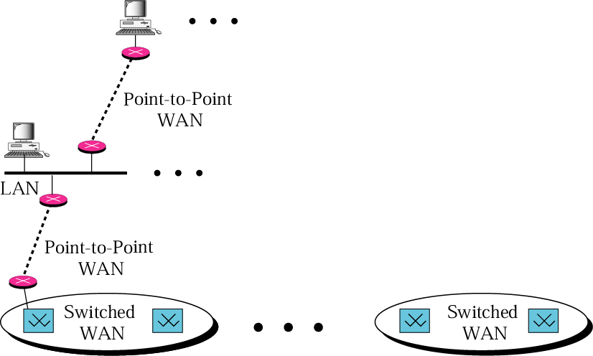
Figure 3.1 Internet model

Slide 3
3.1 Local Area Networks
A local area network (LAN) is a data communication system that allows a number of independent devices to communicate directly with each other in a limited geographic area such as a single department, a single building, or a campus. A large organization may need several connected LANs.The most popular LANs are Ethernet and wireless LANs. We briefly review these technologies in this section.
The topics discussed in this section include:
Wired LANs: Ethernet
Wireless LANs: IEEE 802.11

Slide 4
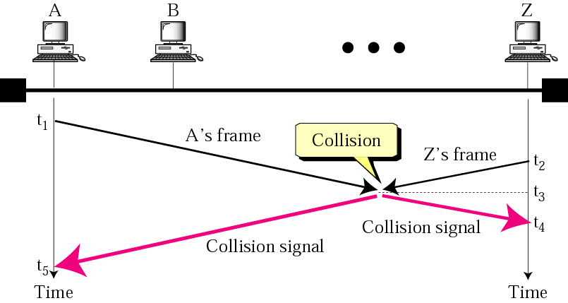
Figure 3.2 CSMA/CD

Slide 5
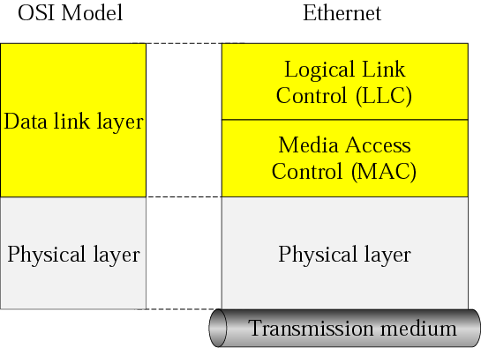
Figure 3.3 Ethernet layers

Slide 6
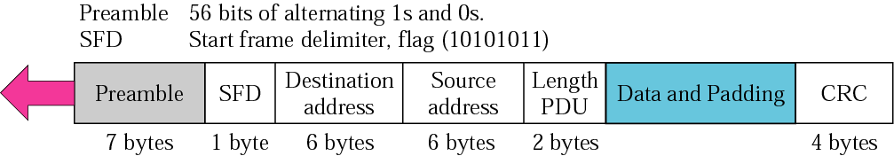
Figure 3.4 Ethernet frame

Slide 7
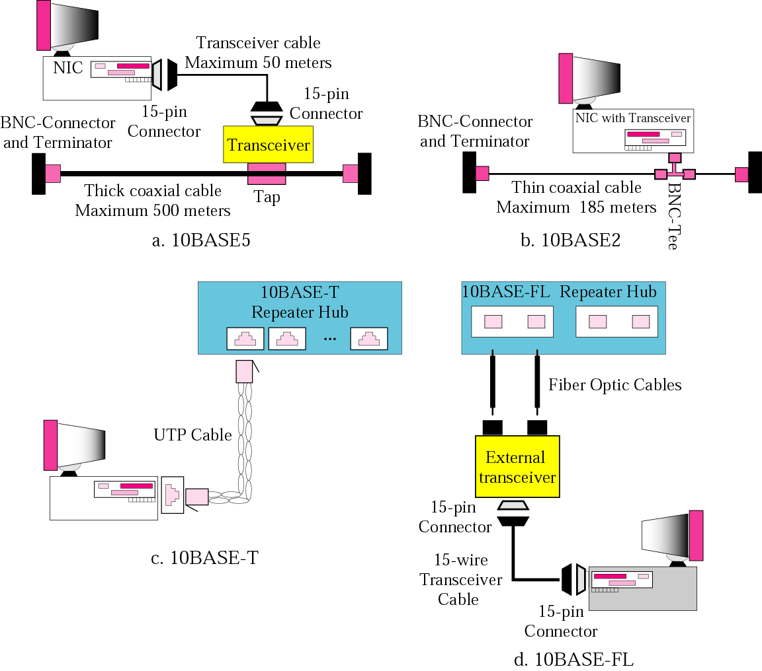
Figure 3.5 Ethernet implementations

Slide 8
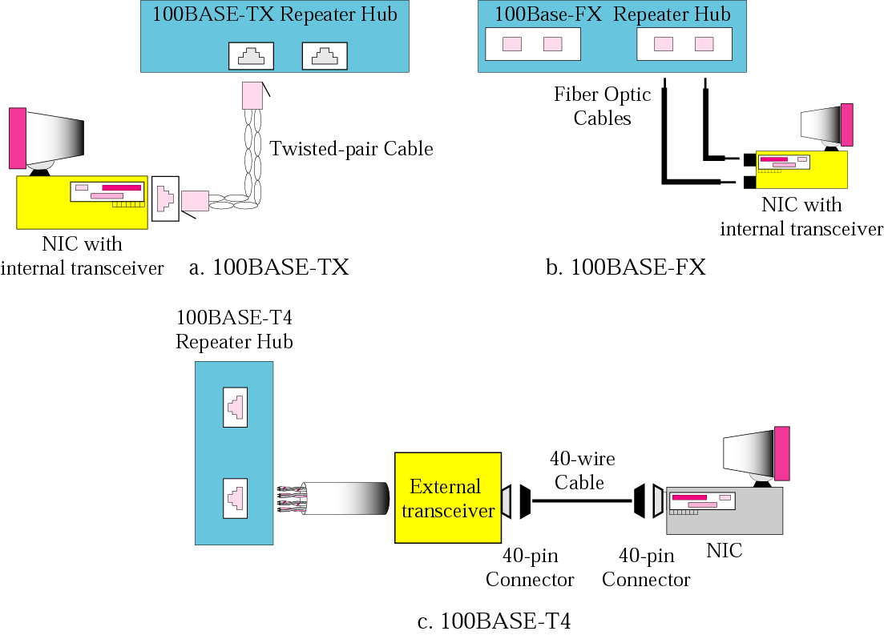
Figure 3.6 Fast Ethernet implementations

Slide 9
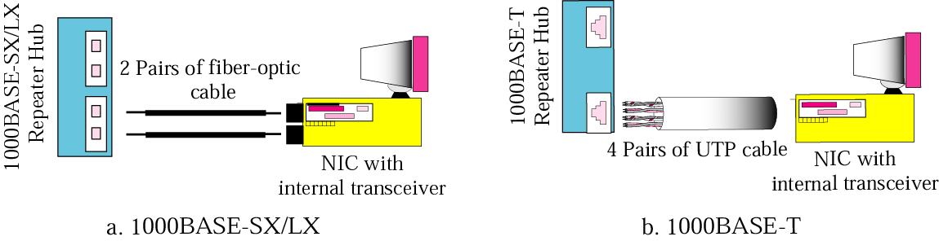
Figure 3.7 Gigabit Ethernet implementations

Slide 10
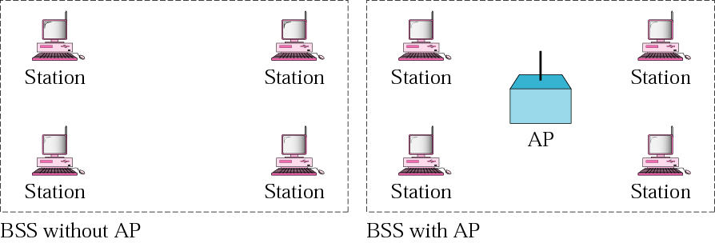
Figure 3.8 BSSs

Slide 11
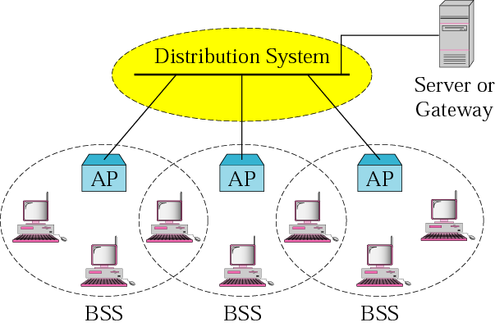
Figure 3.9 ESS

Slide 12
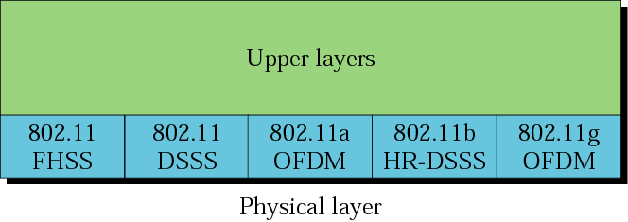
Figure 3.10 Physical layer

Slide 13
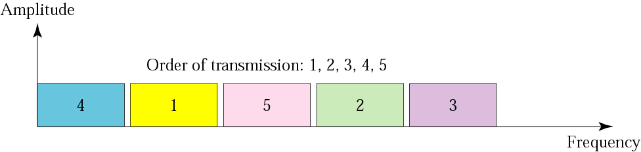
Figure 3.11 FHSS

Slide 14
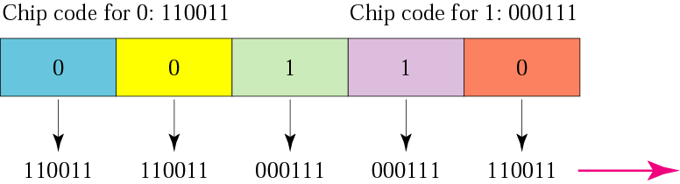
Figure 3.12 DSSS

Slide 15
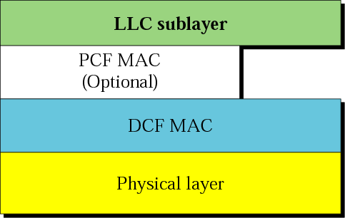
Figure 3.13 MAC layers in IEEE 802.11 standard

Slide 16
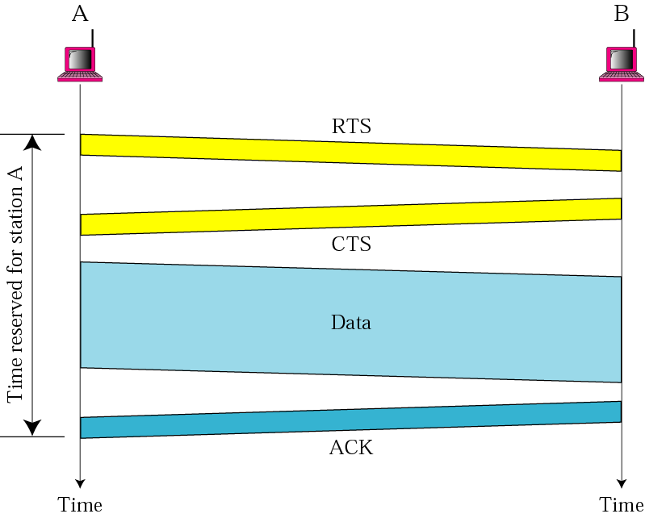
Figure 3.14 CSMA/CA

Slide 17
Figure 3.15 Frame

Slide 18
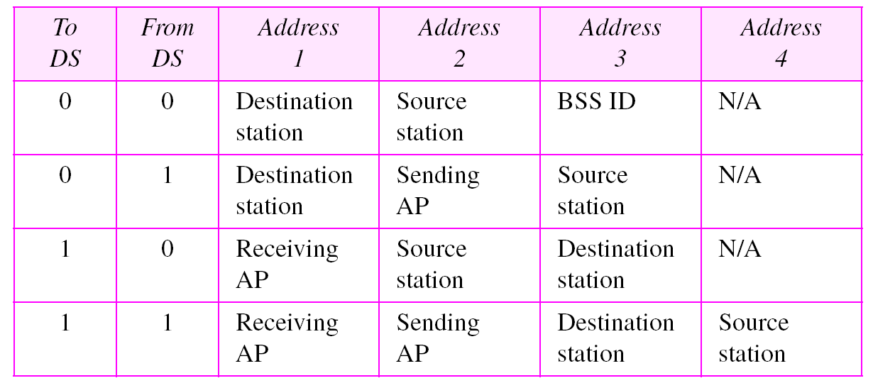
Table 3.1 Addresses in IEEE 802.11

Slide 19
3.2 Point-to-Point WANs
A second type of network we encounter in the Internet is the point-to-point wide area network. A point-to-point WAN connects two remote devices using a line available from a public network such as a telephone network. We discuss the physical and data link layers of these technologies here..
The topics discussed in this section include:
Physical Layer
Data Link Layer

Slide 20
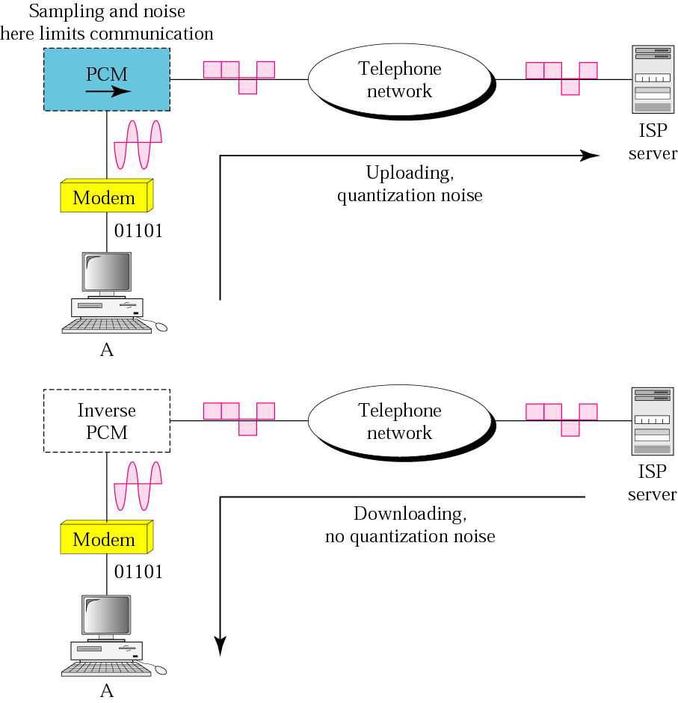
Figure 3.16 56K modem

Slide 21

Note:
ADSL is an asymmetric communication technology designed for residential users;
it is not suitable for businesses.

Slide 22
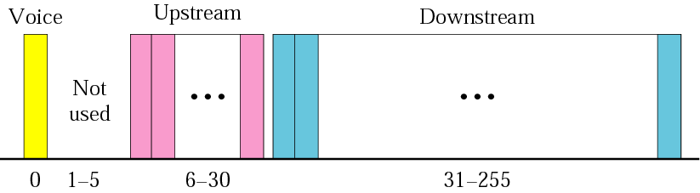
Figure 3.17 Bandwidth division

Slide 23
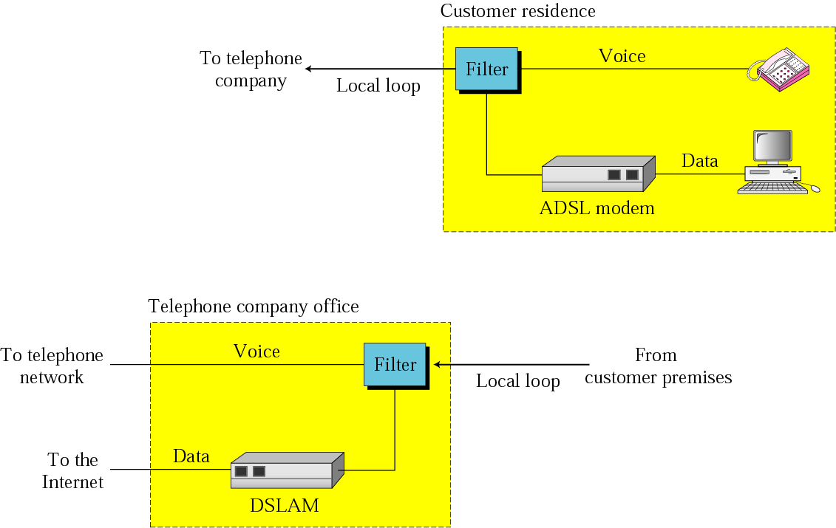
Figure 3.18 ADSL and DSLAM

Slide 24
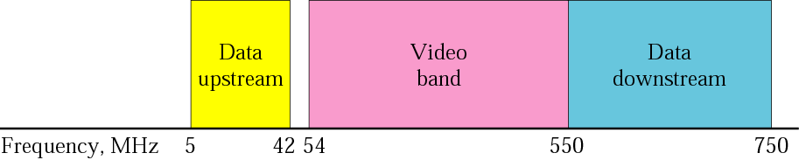
Figure 3.19 Cable bandwidth

Slide 25
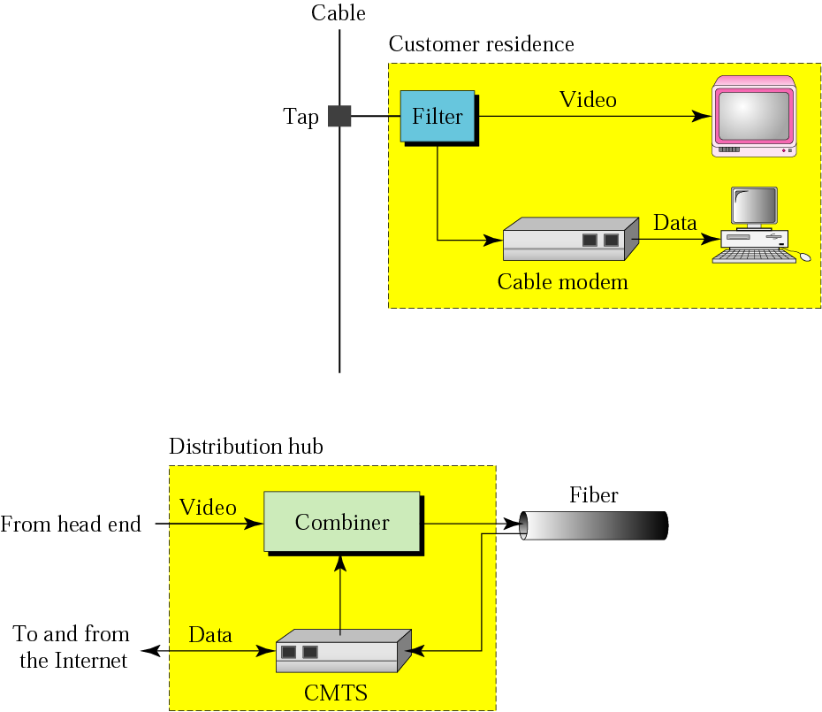
Figure 3.20 Cable modem configurations

Slide 26
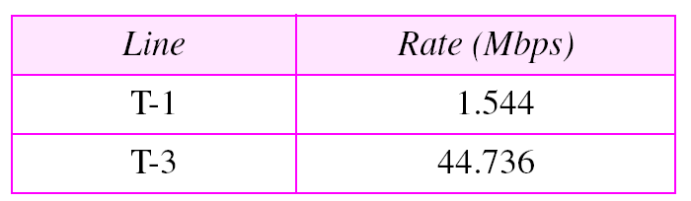
Table 3.2 T line rates

Slide 27
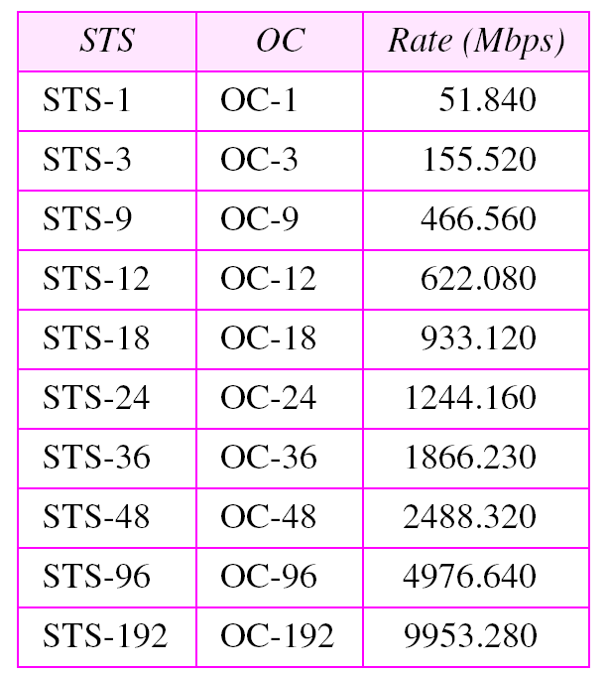
Table 3.3 SONET rates

Slide 28
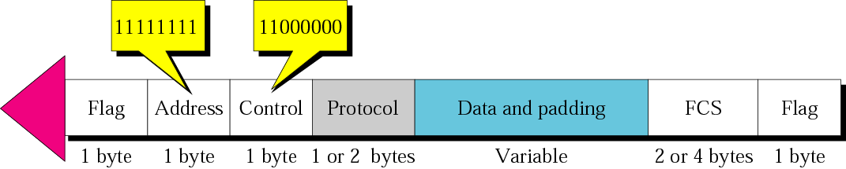
Figure 3.21 PPP frame

Slide 29
3.3 Switched WANs
The backbone networks in the Internet are usually switched WANs. A switched WAN is a wide area network that covers a large area (a state or a country) and provides access at several points to the users. Inside the network, there is a mesh of point-to-point networks that connects switches. The switches, multiple port connectors, allow the connection of several inputs and outputs.
The topics discussed in this section include:
X.25
Frame Relay
ATM

Slide 30
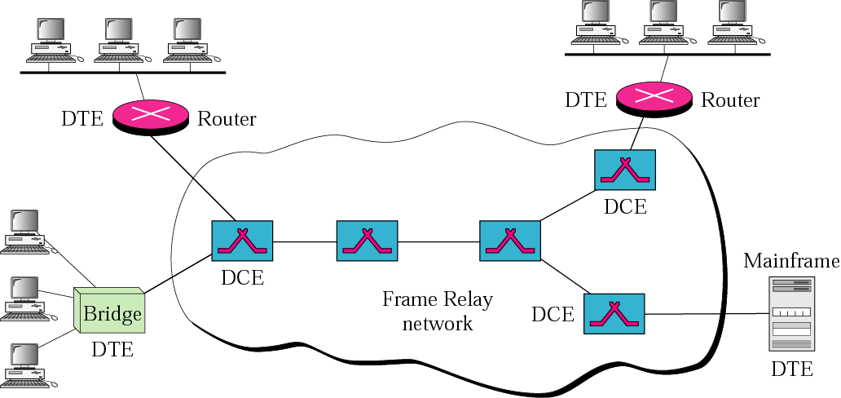
Figure 3.22 Frame Relay network

Slide 31
Note:
A cell network uses the cell as the basic unit of data exchange. A cell is defined as a small, fixed-size block of information.

Slide 32
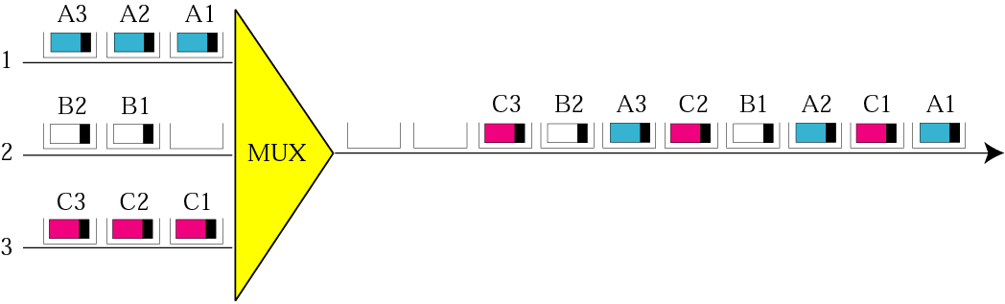
Figure 3.23 ATM multiplexing

Slide 33
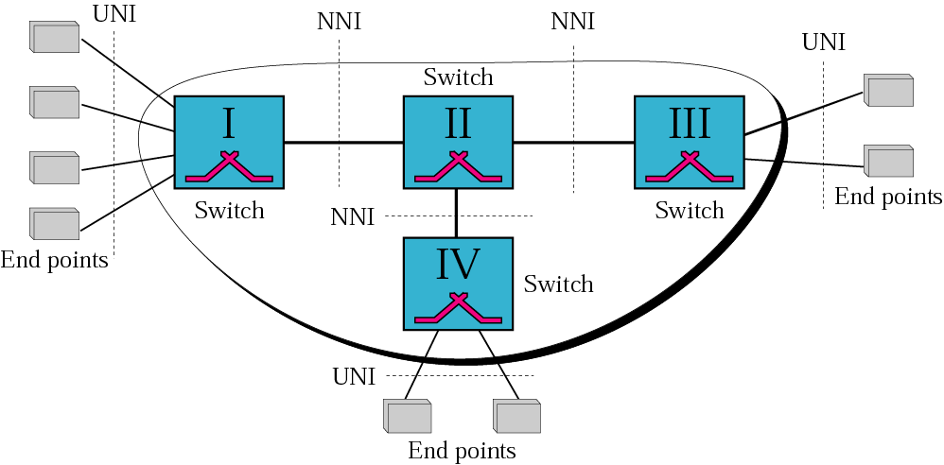
Figure 3.24 Architecture of an ATM network

Slide 34
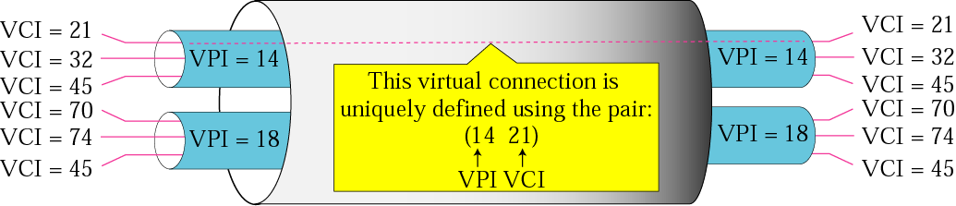
Figure 3.25 Virtual circuits

Slide 35
Note:
Note that a virtual connection is defined by a pair of numbers:
the VPI and the VCI.

Slide 36
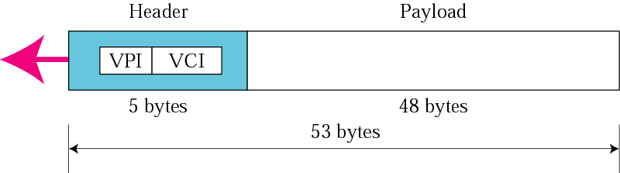
Figure 3.26 An ATM cell

Slide 37
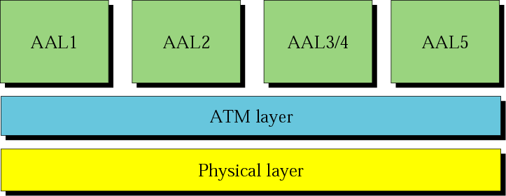
Figure 3.27 ATM layers

Slide 38
Note:
The IP protocol uses the AAL5 sublayer.

Slide 39
Note:
We will discuss IP over ATM in Chapter 23.

Slide 40
3.4 Connecting Devices
LANs or WANs do not normally operate in isolation. They are connected to one another or to the Internet. To connect LANs or WANs, we use connecting devices. Connecting devices can operate in different layers of the Internet model. We discuss three kinds of connecting devices: repeaters (or hubs), bridges (or two-layer switches), and routers (or three-layer switches). Repeaters and hubs operate in the first layer of the Internet model. Bridges and two-layer switches operate in the first two layers. Routers and three-layer switches operate in the first three layers
The topics discussed in this section include:
Repeaters
Hubs
Bridges
Router

Slide 41
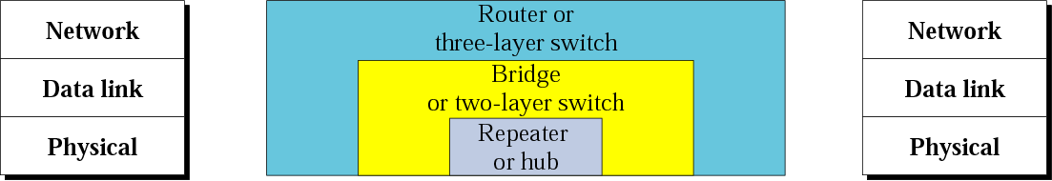
Figure 3.28 Connecting devices

Slide 42
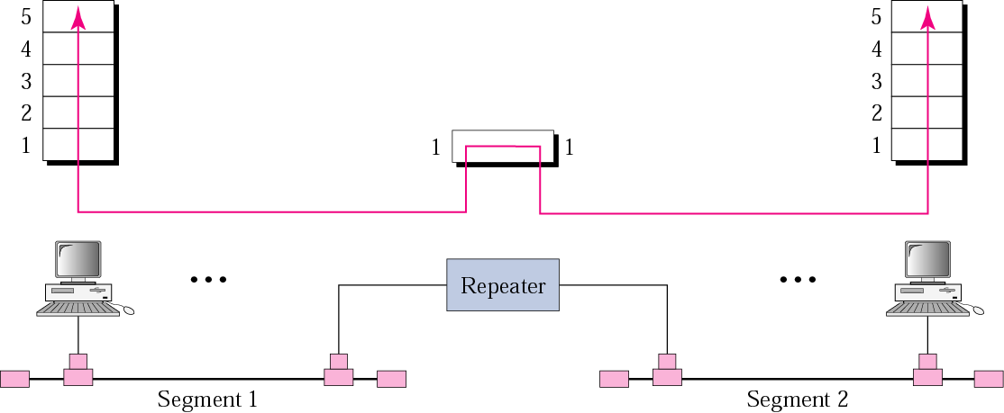
Figure 3.29 Repeater

Slide 43
Note:
A repeater connects segments of a LAN.

Slide 44
Note:
A repeater forwards every bit;
it has no filtering capability.

Slide 45
Note:
A repeater is a regenerator, not an amplifier.

Slide 46
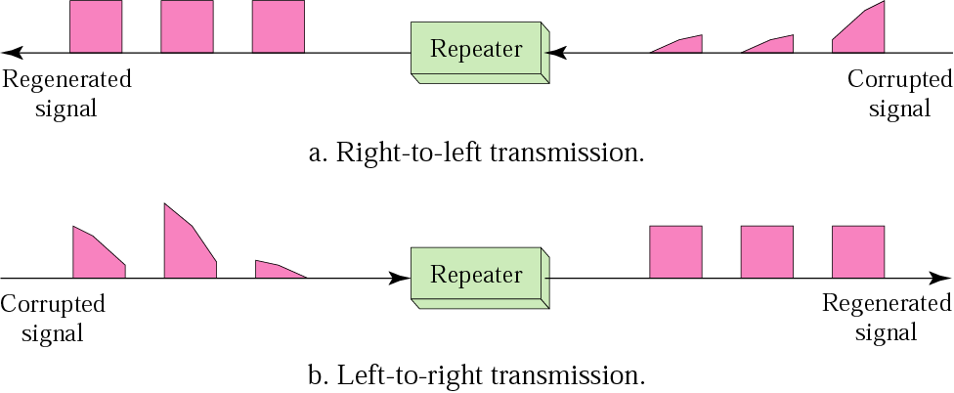
Figure 3.30 Function of a repeater

Slide 47
Note:
A bridge has a table used in filtering decisions.

Slide 48
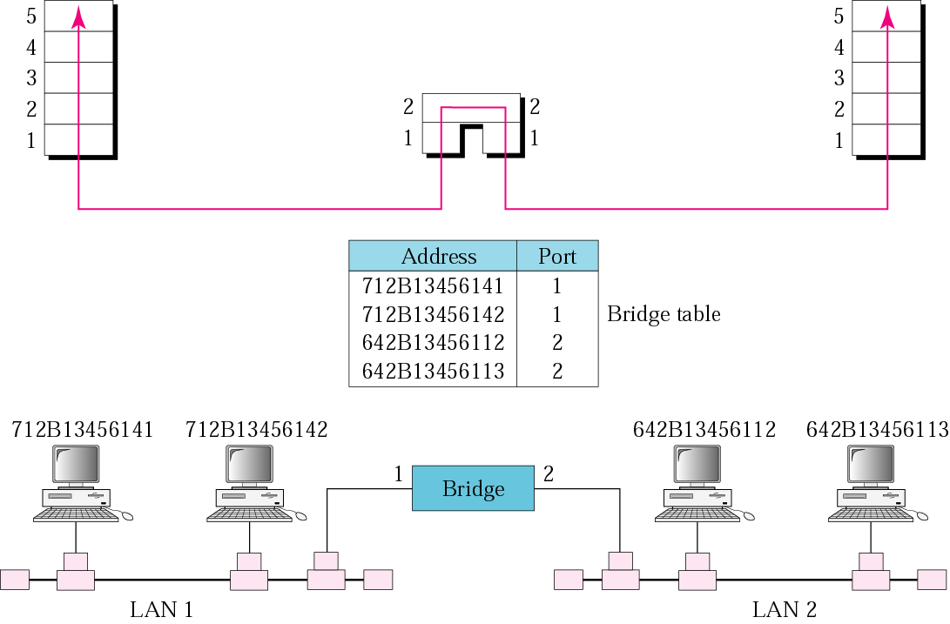
Figure 3.31 Bridge

Slide 49
Note:
A bridge does not change the physical (MAC) addresses in a frame.

Slide 50
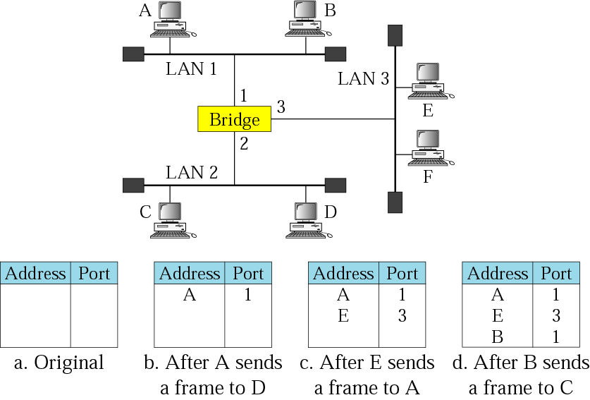
Figure 3.32 Learning bridge

Slide 51
Note:
A router is a three-layer
(physical, data link, and network)
device.

Slide 52
Note:
A repeater or a bridge connects segments of a LAN.
A router connects independent LANs or WANs to create an internetwork (internet).

Slide 53
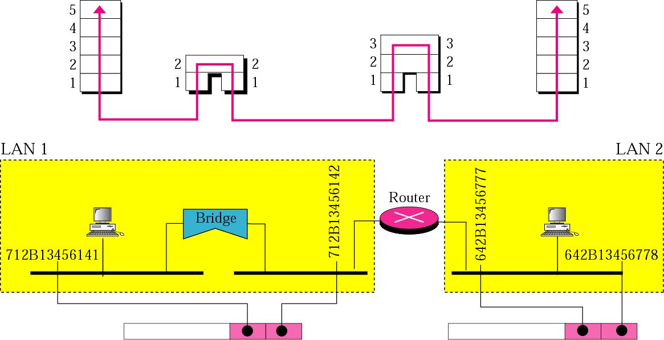
Figure 3.33 Routing example

Slide 54
Note:
A router changes the physical addresses
in a packet.

