Slide 1

Chapter 4
IP Addresses:
Classful Addressing
Objectives
Upon completion you will be able to:
Understand IPv4 addresses and classes
Identify the class of an IP address
Find the network address given an IP address
Understand masks and how to use them
Understand subnets and supernets

Slide 2
4.1 INTRODUCTION
4.1 INTRODUCTION
The identifier used in the IP layer of the TCP/IP protocol suite to identify each device connected to the Internet is called the Internet address or IP address. An IP address is a 32-bit address that uniquely and universally defines the connection of a host or a router to the Internet. IP addresses are unique. They are unique in the sense that each address defines one, and only one, connection to the Internet. Two devices on the Internet can never have the same address.
The topics discussed in this section include:
Address Space
Notation

Slide 3

Note:
An IP address is a 32-bit address.

Slide 4
Note:
The IP addresses are unique.

Slide 5
Note:
The address space of IPv4 is
2³² or 4,294,967,296.

Slide 6
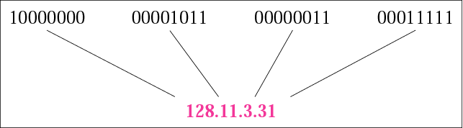
Figure 4.1 Dotted-decimal notation

Slide 7
Note:
The binary, decimal, and hexadecimal number systems are reviewed in Appendix B.

Slide 8
Example 1
Change the following IP addresses from binary notation to dotted-decimal notation.
a. 10000001 00001011 00001011 11101111
b. 11000001 10000011 00011011 11111111
c. 11100111 11011011 10001011 01101111
d. 11111001 10011011 11111011 00001111
Solution
We replace each group of 8 bits with its equivalent decimal number (see Appendix B) and add dots for separation:
a. 129.11.11.239 b. 193.131.27.255
c. 231.219.139.111 d. 249.155.251.15

Slide 9
Example 2
Change the following IP addresses from dotted-decimal notation to binary notation.
a. 111.56.45.78 b. 221.34.7.82
c. 241.8.56.12 d. 75.45.34.78
Solution
We replace each decimal number with its binary equivalent:
a. 01101111 00111000 00101101 01001110
b. 11011101 00100010 00000111 01010010
c. 11110001 00001000 00111000 00001100
d. 01001011 00101101 00100010 01001110

Slide 10
Example 3
Find the error, if any, in the following IP addresses:
a. 111.56.045.78 b. 221.34.7.8.20
c. 75.45.301.14 d. 11100010.23.14.67
Solution
a. There are no leading zeroes in dotted-decimal notation (045).
b. We may not have more than four numbers in an IP address.
c. In dotted-decimal notation, each number is less than or equal
to 255; 301 is outside this range.
d. A mixture of binary notation and dotted-decimal notation is not
allowed.

Slide 11
Example 4
Change the following IP addresses from binary notation to hexadecimal notation.
a. 10000001 00001011 00001011 11101111
b. 11000001 10000011 00011011 11111111
Solution
We replace each group of 4 bits with its hexadecimal equivalent (see Appendix B). Note that hexadecimal notation normally has no added spaces or dots; however, 0X (or 0x) is added at the beginning or the subscript 16 at the end to show that the number is in hexadecimal.
a. 0X810B0BEF or 810B0BEF₁₆
b. 0XC1831BFF or C1831BFF₁₆

Slide 12
4.2 CLASSFUL ADDRESSING
IP addresses, when started a few decades ago, used the concept of classes. This architecture is called classful addressing. In the mid-1990s, a new architecture, called classless addressing, was introduced and will eventually supersede the original architecture. However, part of the Internet is still using classful addressing, but the migration is very fast.
The topics discussed in this section include:
Recognizing Classes
Netid and Hostid
Classes and Blocks
Network Addresses
Sufficient Information
Mask
CIDR Notation
Address Depletion

Slide 13
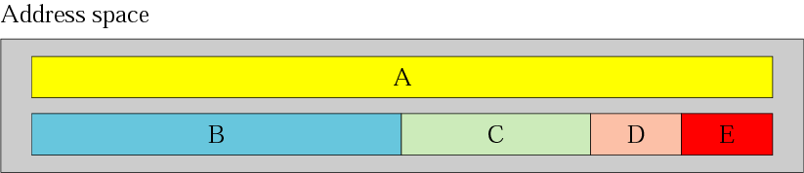
Figure 4.2 Occupation of the address space

Slide 14
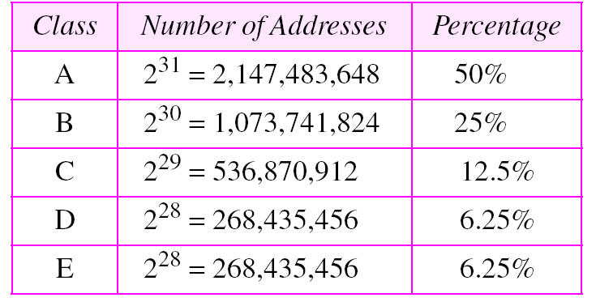
Table 4.1 Addresses per class

Slide 15
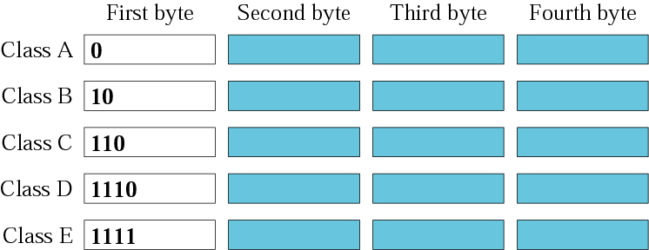
Figure 4.3 Finding the class in binary notation

Slide 16
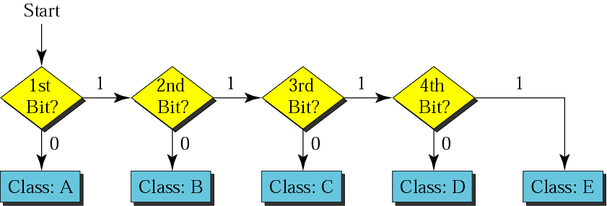
Figure 4.4 Finding the address class

Slide 17
Example 5
How can we prove that we have 2,147,483,648 addresses in class A?
Solution
In class A, only 1 bit defines the class. The remaining 31 bits are available for the address. With 31 bits, we can have 2³¹
or 2,147,483,648 addresses.

Slide 18
Example 6
Find the class of each address:
a. 00000001 00001011 00001011 11101111
b. 11000001 10000011 00011011 11111111
c. 10100111 11011011 10001011 01101111
d. 11110011 10011011 11111011 00001111
Solution
See the procedure in Figure 4.4.
a. The first bit is 0. This is a class A address.
b. The first 2 bits are 1; the third bit is 0. This is a class C address.
c. The first bit is 0; the second bit is 1. This is a class B address.
d. The first 4 bits are 1s. This is a class E address..

Slide 19

Figure 4.5 Finding the class in decimal notation

Slide 20
Example 7
Find the class of each address:
a. 227.12.14.87 b.193.14.56.22 c.14.23.120.8
d. 252.5.15.111 e.134.11.78.56
Solution
a. The first byte is 227 (between 224 and 239); the class is D.
b. The first byte is 193 (between 192 and 223); the class is C.
c. The first byte is 14 (between 0 and 127); the class is A.
d. The first byte is 252 (between 240 and 255); the class is E.
e. The first byte is 134 (between 128 and 191); the class is B.

Slide 21
Example 8
In Example 5 we showed that class A has 2³¹ (2,147,483,648) addresses. How can we prove this same fact using dotted-decimal notation?
Solution
The addresses in class A range from 0.0.0.0 to 127.255.255.255. We need to show that the difference between these two numbers is 2,147,483,648. This is a good exercise because it shows us how to define the range of addresses between two addresses. We notice that we are dealing with base 256 numbers here. Each byte in the notation has a weight. The weights are as follows (see Appendix B):
See Next Slide

Slide 22
Example 8 (continued)
256³, 256², 256¹, 256⁰
Now to find the integer value of each number, we multiply each byte by its weight:
Last address: 127 × 256³ + 255 × 256² +
255 × 256¹ + 255 × 256⁰ = 2,147,483,647
First address: = 0
If we subtract the first from the last and add 1 to the result (remember we always add 1 to get the range), we get 2,147,483,648 or 2³¹.

Slide 23
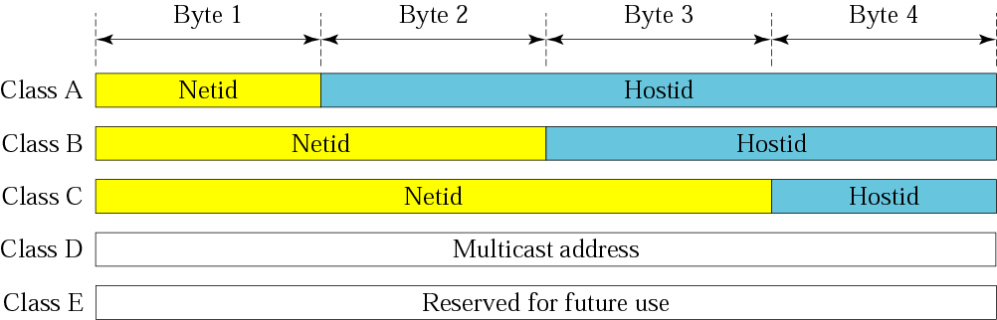
Figure 4.6 Netid and hostid

Slide 24
Note:
Millions of class A addresses are wasted.

Slide 25
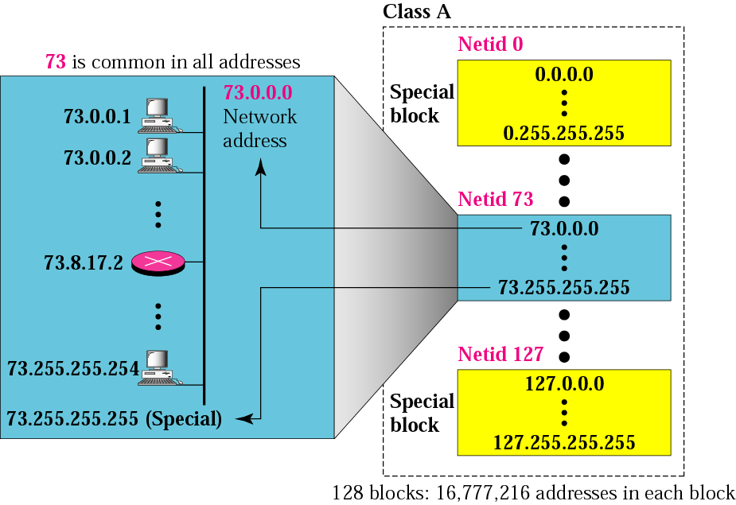
Figure 4.7 Blocks in class A

Slide 26
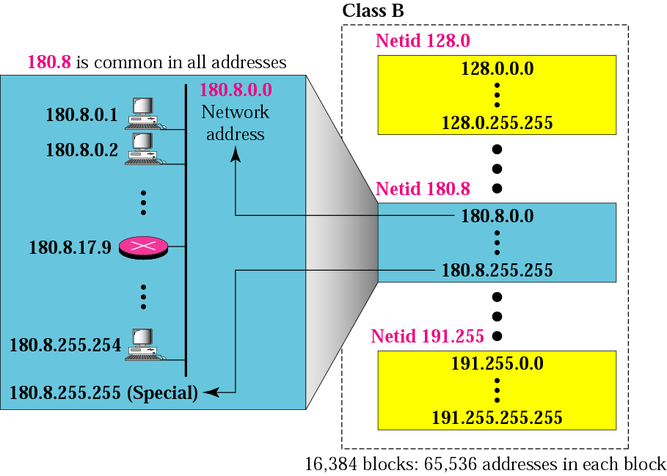
Figure 4.8 Blocks in class B

Slide 27
Note:
Many class B addresses are wasted.

Slide 28

Figure 4.9 Blocks in class C

Slide 29
Note:
The number of addresses in class C is smaller than the needs of most organizations.

Slide 30
Note:
Class D addresses are used for multicasting; there is only one block in this class.

Slide 31
Note:
Class E addresses are reserved for future purposes; most of the block is wasted.

Slide 32
Note:
In classful addressing, the network address (the first address in the block) is the one that is assigned to the organization. The range of addresses can automatically be inferred from the network address.

Slide 33
Example 9
Given the network address 17.0.0.0, find the class, the block, and the range of the addresses.
Solution
The class is A because the first byte is between 0 and 127. The block has a netid of 17. The addresses range from 17.0.0.0 to 17.255.255.255.

Slide 34
Example 10
Given the network address 132.21.0.0, find the class, the block, and the range of the addresses.
Solution
The class is B because the first byte is between 128 and 191. The block has a netid of 132.21. The addresses range from 132.21.0.0 to 132.21.255.255.

Slide 35
Example 11
Given the network address 220.34.76.0, find the class, the block, and the range of the addresses.
Solution
The class is C because the first byte is between 192 and 223. The block has a netid of 220.34.76. The addresses range from 220.34.76.0 to 220.34.76.255.

Slide 36
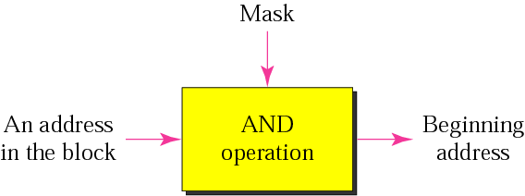
Figure 4.10 Masking concept

Slide 37
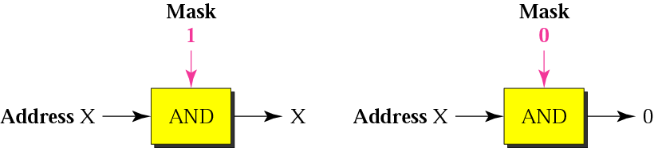
Figure 4.11 AND operation

Slide 38
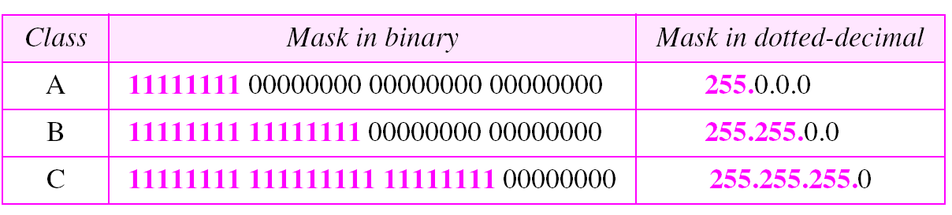
Table 4.2 Default masks

Slide 39
Note:
The network address is the beginning address of each block. It can be found by applying the default mask to any of the addresses in the block (including itself). It retains the netid of the block and sets the hostid to zero.

Slide 40
Example 12
Given the address 23.56.7.91, find the beginning address (network address).
Solution
The default mask is 255.0.0.0, which means that only the first byte is preserved and the other 3 bytes are set to 0s. The network address is 23.0.0.0.

Slide 41
Example 13
Given the address 132.6.17.85, find the beginning address (network address).
Solution
The default mask is 255.255.0.0, which means that the first 2 bytes are preserved and the other 2 bytes are set to 0s. The network address is 132.6.0.0.

Slide 42
Example 14
Given the address 201.180.56.5, find the beginning address (network address).
Solution
The default mask is 255.255.255.0, which means that the first 3 bytes are preserved and the last byte is set to 0. The network address is 201.180.56.0.

Slide 43
Note:
Note that we must not apply the default mask of one class to an address belonging to another class.

Slide 44
4.3 OTHER ISSUES
In this section, we discuss some other issues that are related to addressing in general and classful addressing in particular.
The topics discussed in this section include:
Multihomed Devices
Location, Not Names
Special Addresses
Private Addresses
Unicast, Multicast, and Broadcast Addresses

Slide 45
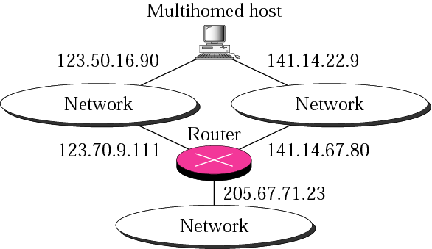
Figure 4.12 Multihomed devices

Slide 46
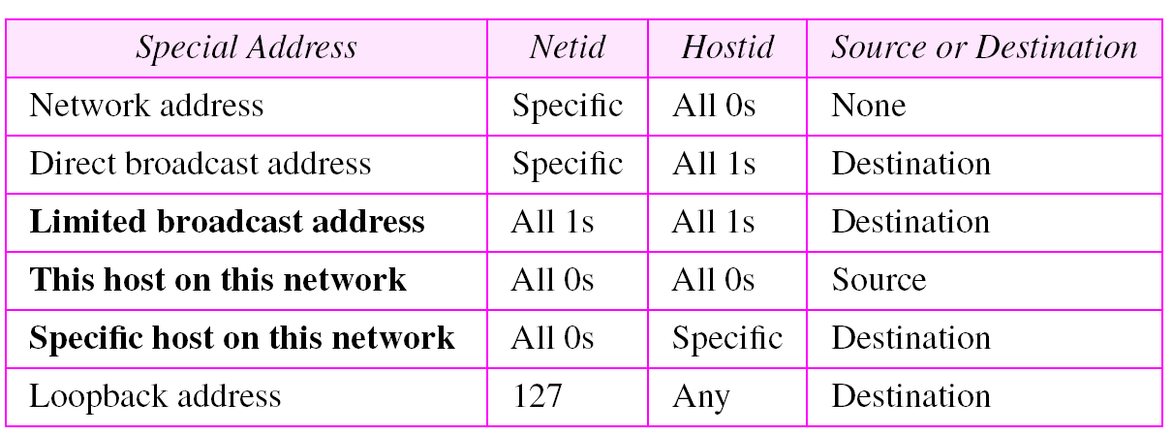
Table 4.3 Special addresses

Slide 47
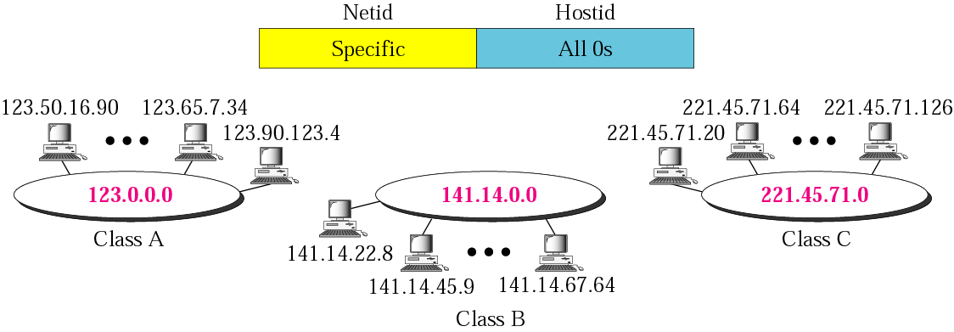
Figure 4.13 Network address

Slide 48
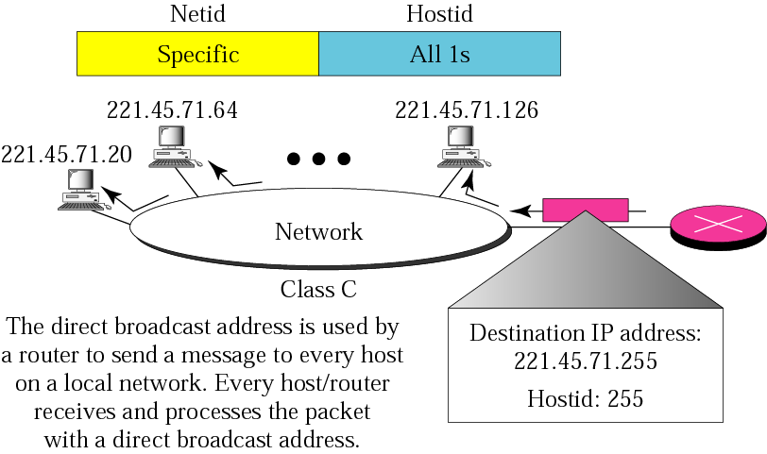
Figure 4.14 Example of direct broadcast address

Slide 49
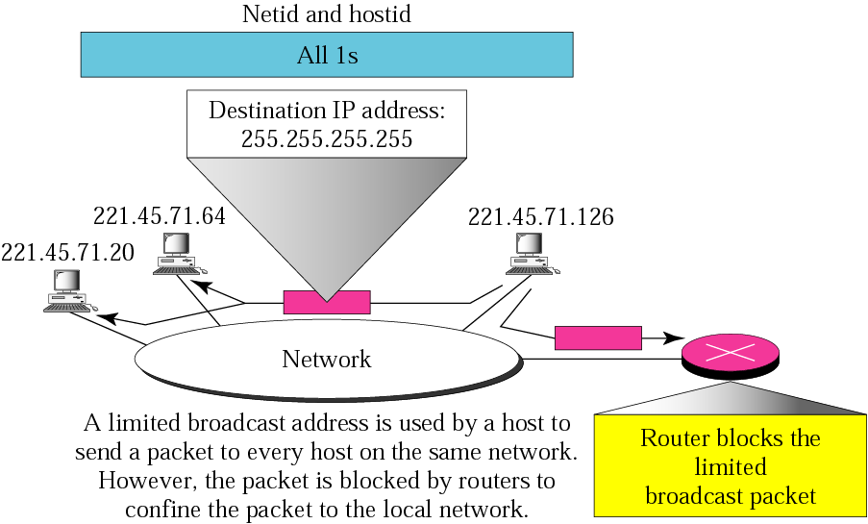
Figure 4.15 Example of limited broadcast address

Slide 50
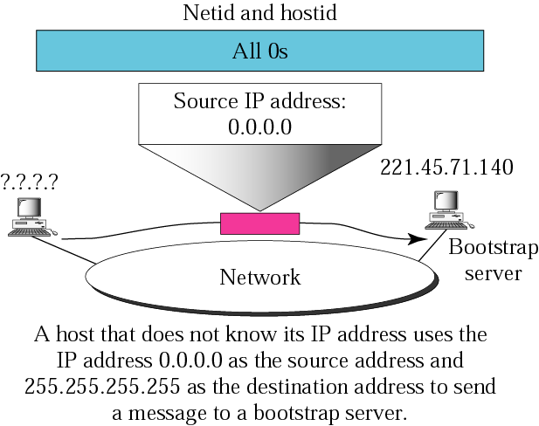
Figure 4.16 Examples of “this host on this network”

Slide 51
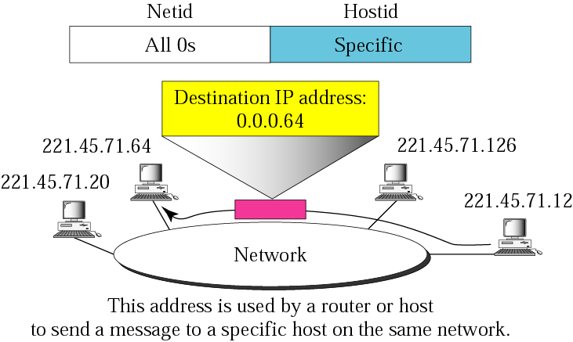
Figure 4.17 Example of “specific host on this network”

Slide 52
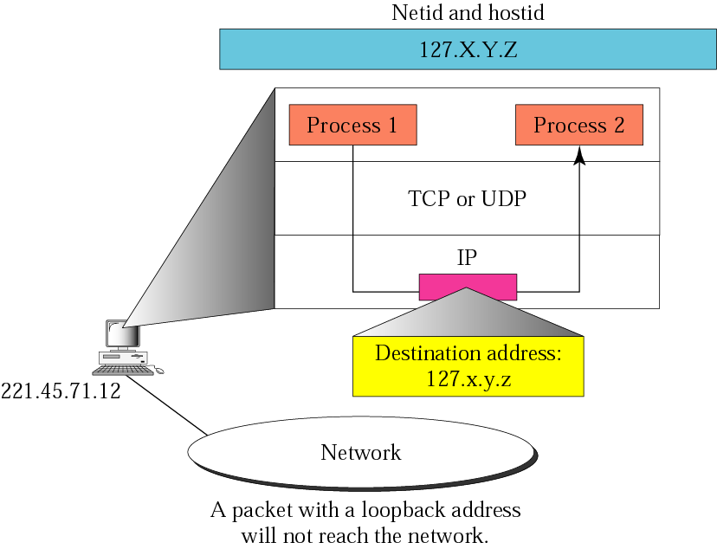
Figure 4.18 Example of loopback address

Slide 53
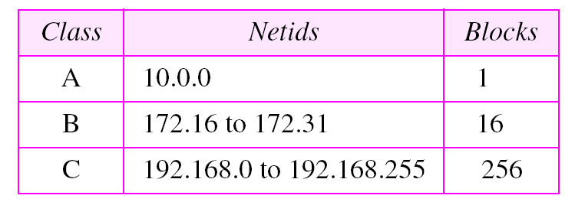
Table 4.5 Addresses for private networks

Slide 54
Note:
Multicast delivery will be discussed in depth in Chapter 15.

Slide 55
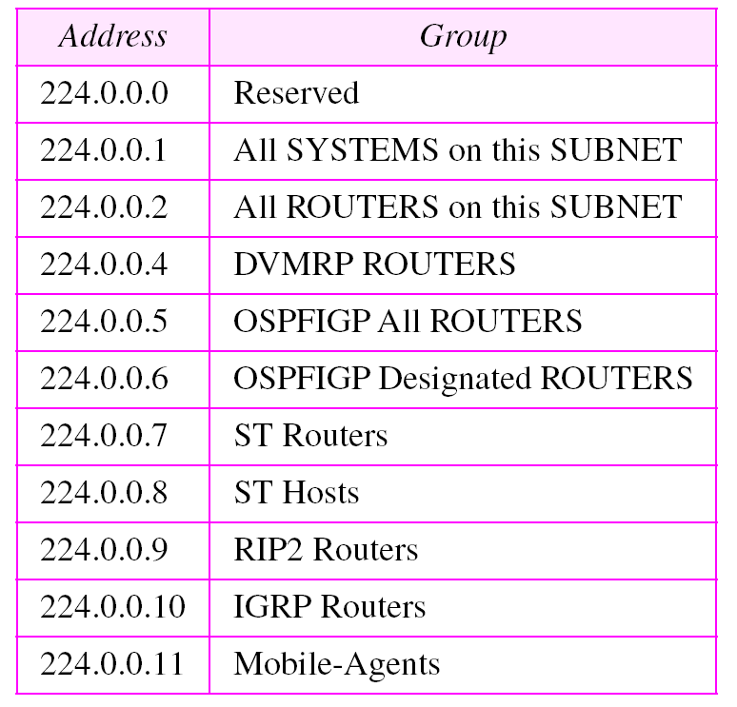
Table 4.5 Category addresses

Slide 56
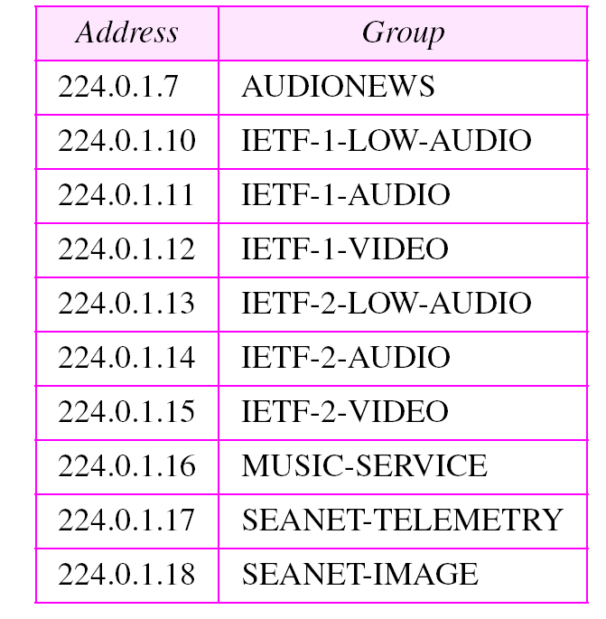
Table 4.6 Addresses for conferencing

Slide 57
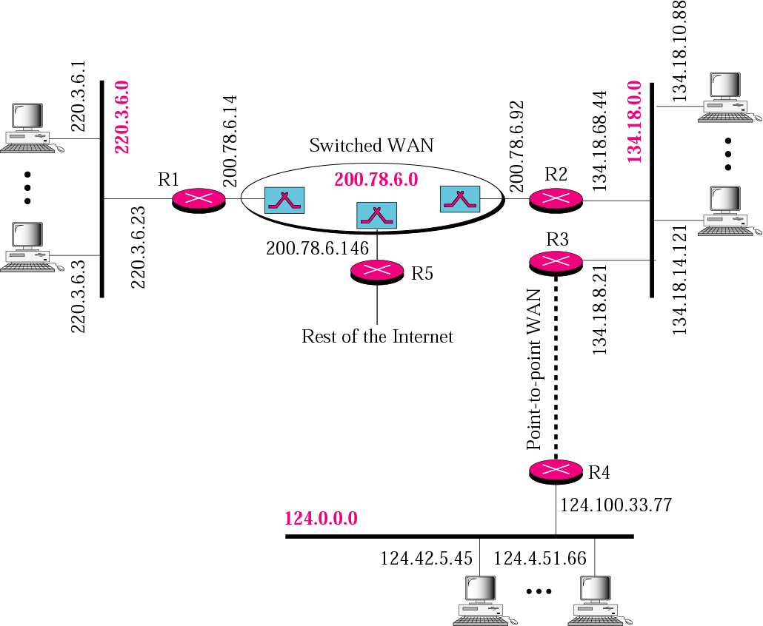
Figure 4.19 Sample internet

Slide 58
4.4 SUBNETTING AND
SUPERNETTING
In the previous sections we discussed the problems associated with classful addressing. Specifically, the network addresses available for assignment to organizations are close to depletion. This is coupled with the ever-increasing demand for addresses from organizations that want connection to the Internet. In this section we briefly discuss two solutions: subnetting and supernetting.
The topics discussed in this section include:
Subnetting
Supernetting
Supernet Mask
Obsolescence

Slide 59
Note:
IP addresses are designed with two levels of hierarchy.

Slide 60
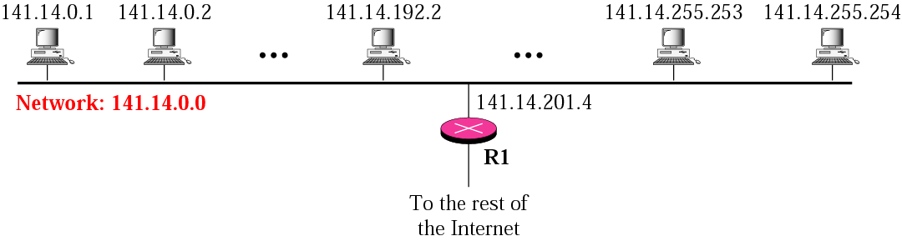
Figure 4.20 A network with two levels of hierarchy (not subnetted)

Slide 61
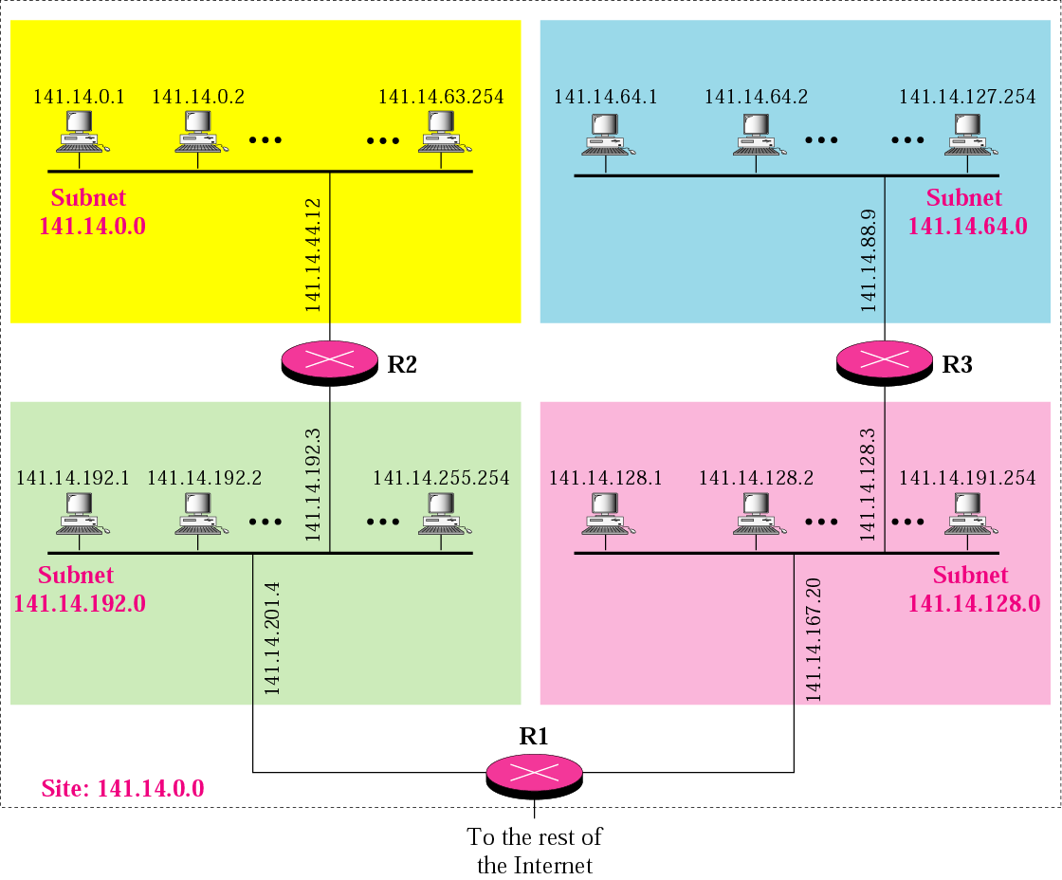
Figure 4.21 A network with three levels of hierarchy (subnetted)

Slide 62
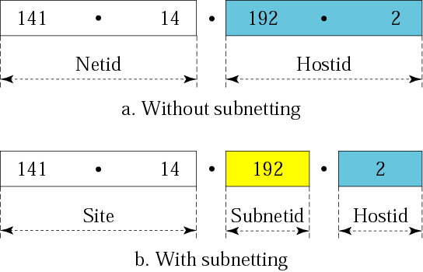
Figure 4.22 Addresses in a network with and without subnetting

Slide 63

Figure 4.23 Hierarchy concept in a telephone number

Slide 64
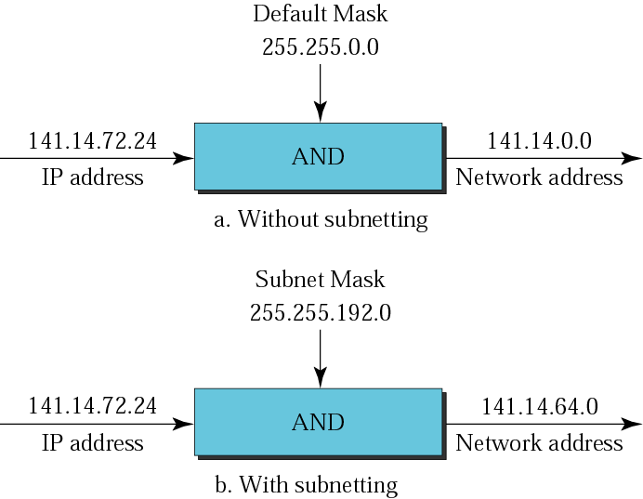
Figure 4.24 Default mask and subnet mask

Slide 65
Example 15
What is the subnetwork address if the destination address is 200.45.34.56 and the subnet mask is 255.255.240.0?
Solution
We apply the AND operation on the address and the subnet mask.
Address ➡ 11001000 00101101 00100010 00111000
Subnet Mask ➡ 11111111 11111111 11110000 00000000
Subnetwork Address ➡ 11001000 00101101 00100000 00000000.

Slide 66
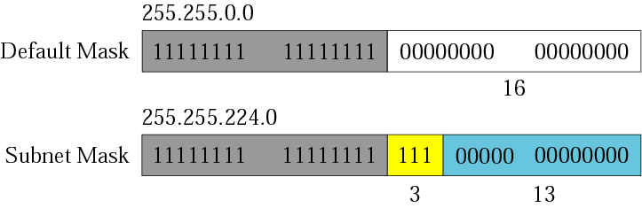
Figure 4.25 Comparison of a default mask and a subnet mask

Slide 67
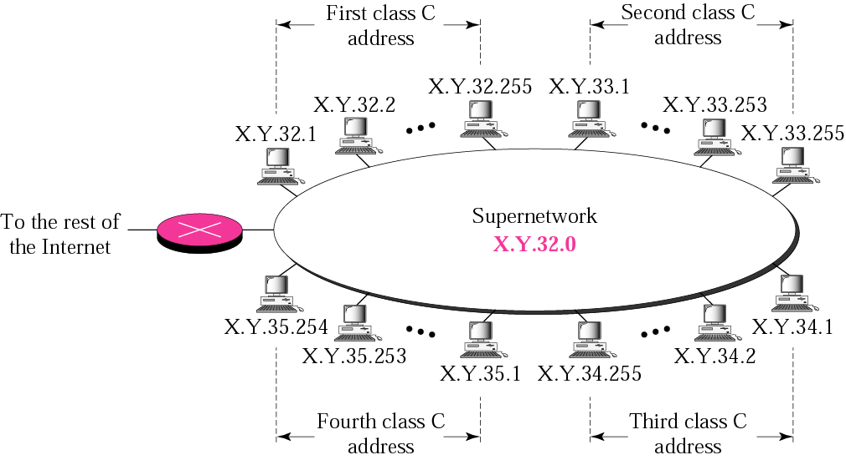
Figure 4.26 A supernetwork

Slide 68
Note:
In subnetting, we need the first address of the subnet and the subnet mask to define the range of addresses.
In supernetting, we need the first address of the supernet and the supernet mask to define the range of addresses.

Slide 69
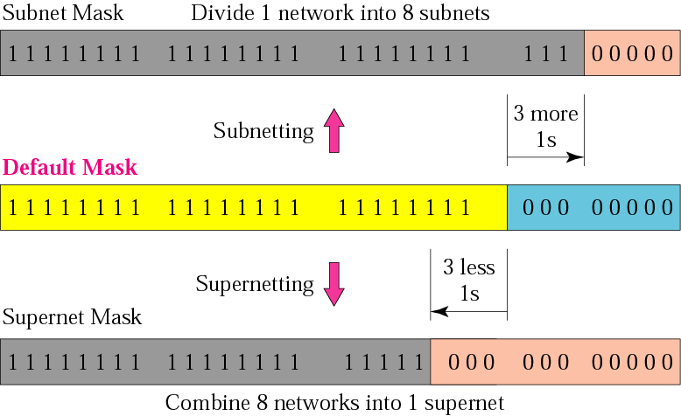
Figure 4.27 Comparison of subnet, default, and supernet masks

Slide 70
Note:
The idea of subnetting and supernetting of classful addresses is almost obsolete.

