Slide 1

Chapter 9
Internet Control Message
Protocol
Objectives
Upon completion you will be able to:
Be familiar with the ICMP message format
Know the types of error reporting messages
Know the types of query messages
Be able to calculate the ICMP checksum
Know how to use the ping and traceroute commands
Understand the modules and interactions of an ICMP package

Slide 2
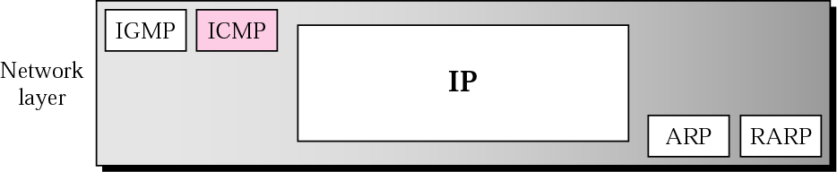
Figure 9.1 Position of ICMP in the network layer

Slide 3
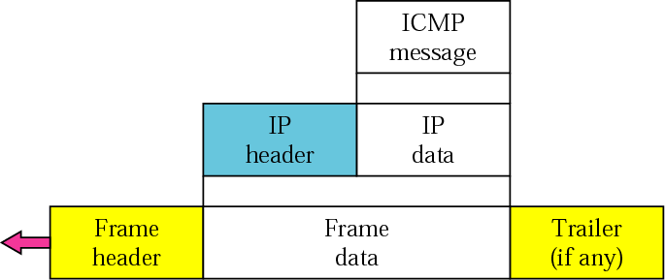
Figure 9.2 ICMP encapsulation

Slide 4
9.1 TYPES OF MESSAGES
ICMP messages are divided into error-reporting messages and query messages. The error-reporting messages report problems that a router or a host (destination) may encounter. The query messages get specific information from a router or another host.

Slide 5
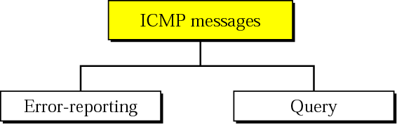
Figure 9.3 ICMP messages

Slide 6
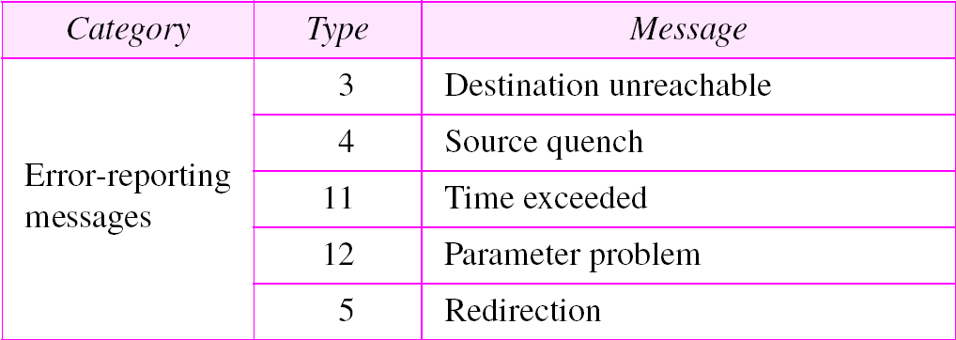
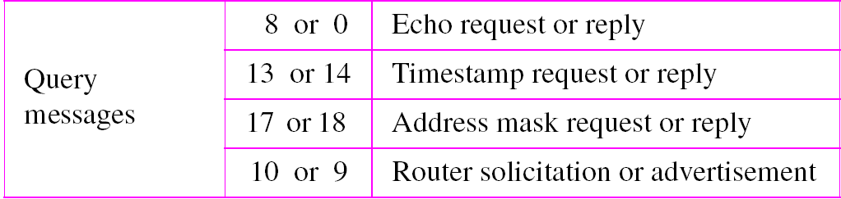
Table 9.1 ICMP messages

Slide 7
9.2 MESSAGE FORMAT
An ICMP message has an 8-byte header and a variable-size data section. Although the general format of the header is different for each message type, the first 4 bytes are common to all.

Slide 8
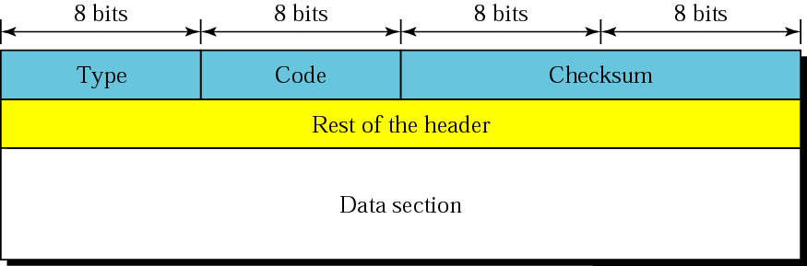
Figure 9.4 General format of ICMP messages

Slide 9
9.3 ERROR REPORTING
IP, as an unreliable protocol, is not concerned with error checking and error control. ICMP was designed, in part, to compensate for this shortcoming. ICMP does not correct errors, it simply reports them.
The topics discussed in this section include:
Destination Unreachable
Source Quench
Time Exceeded
Parameter Problem
Redirection

Slide 10

Note:
ICMP always reports error messages to the original source.

Slide 11
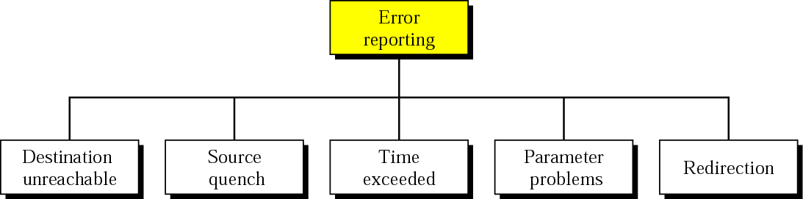
Figure 9.5 Error-reporting messages

Slide 12
Note:
The following are important points about ICMP error messages:
❏ No ICMP error message will be generated in response
to a datagram carrying an ICMP error message.
❏ No ICMP error message will be generated for a
fragmented datagram that is not the first fragment.
❏ No ICMP error message will be generated for a
datagram having a multicast address.
❏ No ICMP error message will be generated for a
datagram having a special address such as 127.0.0.0 or
0.0.0.0.

Slide 13
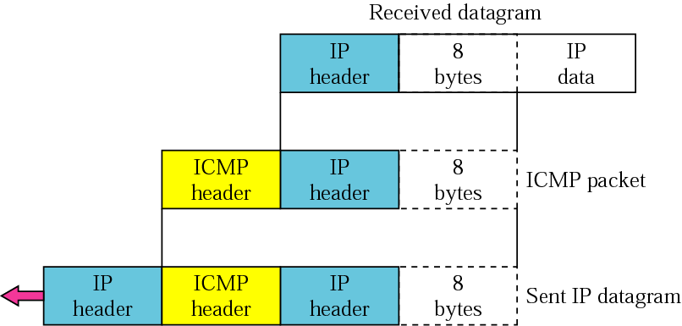
Figure 9.6 Contents of data field for the error messages

Slide 14
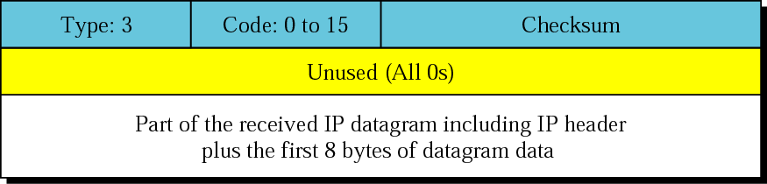
Figure 9.7 Destination-unreachable format

Slide 15
Note:
Destination-unreachable messages with codes 2 or 3 can be created only by the destination host.
Other destination-unreachable messages can be created only by routers.

Slide 16
Note:
A router cannot detect all problems that prevent the delivery of a packet.

Slide 17
Note:
There is no flow-control mechanism in the IP protocol.

Slide 18
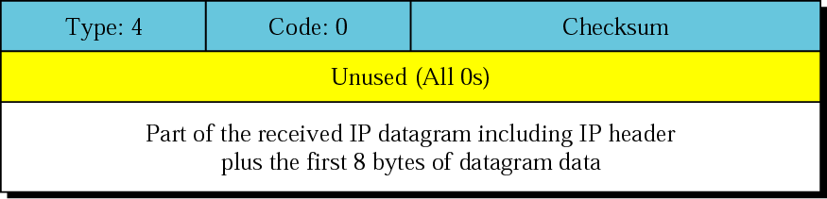
Figure 9.8 Source-quench format

Slide 19
Note:
A source-quench message informs the source that a datagram has been discarded due to congestion in a router or the destination host.
The source must slow down the sending of datagrams until the congestion is relieved.

Slide 20
Note:
One source-quench message is sent for each datagram that is discarded due to congestion.

Slide 21
Note:
Whenever a router decrements a datagram with a time-to-live value to zero, it discards the datagram and sends a time-exceeded message to the original source.

Slide 22
Note:
When the final destination does not receive all of the fragments in a set time, it discards the received fragments and sends a time-exceeded message to the original source.

Slide 23
Note:
In a time-exceeded message, code 0 is used only by routers to show that the value of the time-to-live field is zero. Code 1 is used only by the destination host to show that not all of the fragments have arrived within a set time.

Slide 24

Figure 9.9 Time-exceeded message format

Slide 25
Note:
A parameter-problem message can be created by a router or the destination host.

Slide 26
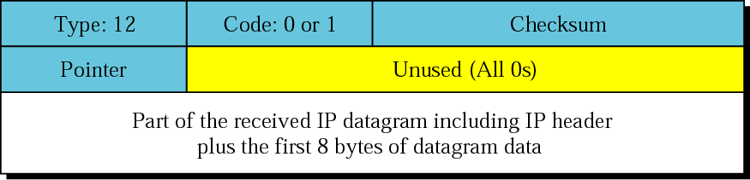
Figure 9.10 Parameter-problem message format

Slide 27
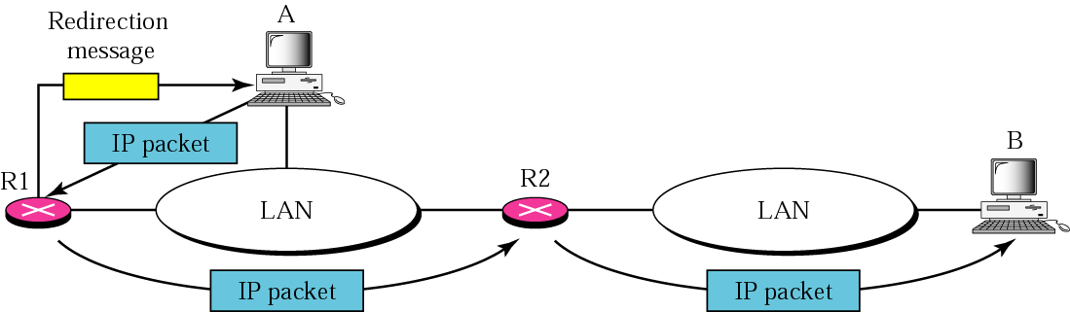
Figure 9.11 Redirection concept

Slide 28
Note:
A host usually starts with a small routing table that is gradually augmented and updated. One of the tools to accomplish this is the redirection message.

Slide 29
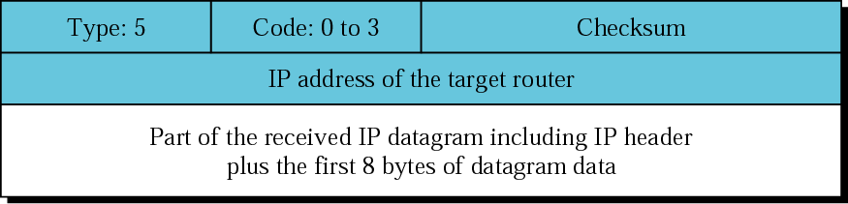
Figure 9.12 Redirection message format

Slide 30
Note:
A redirection message is sent from a router to a host on the same local network.

Slide 31
9.4 QUERY
ICMP can also diagnose some network problems through the query messages, a group of four different pairs of messages. In this type of ICMP message, a node sends a message that is answered in a specific format by the destination node.
The topics discussed in this section include:
Echo Request and Reply
Timestamp Request and Reply
Address-Mask Request and Reply
Router Solicitation and Advertisement

Slide 32
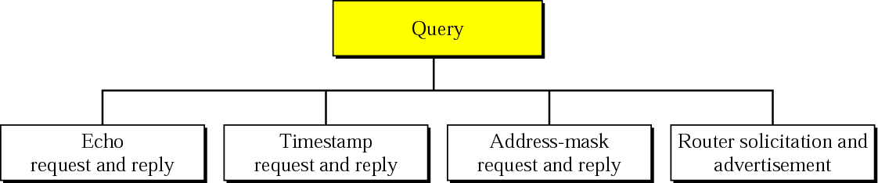
Figure 9.13 Query messages

Slide 33
Note:
An echo-request message can be sent by a host or router. An echo-reply message is sent by the host or router which receives an echo-request message.

Slide 34
Note:
Echo-request and echo-reply messages can be used by network managers to check the operation of the IP protocol.

Slide 35
Note:
Echo-request and echo-reply messages can test the reachability of a host. This is usually done by invoking the ping command.

Slide 36
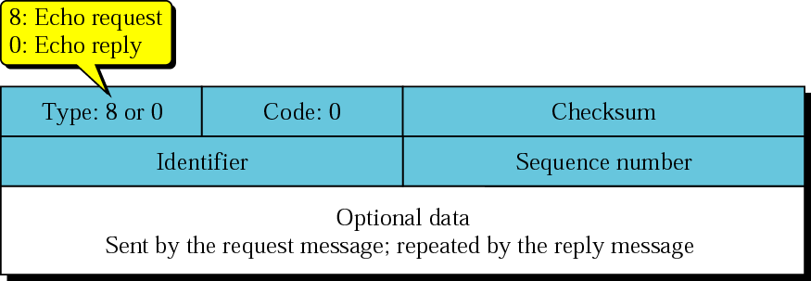
Figure 9.14 Echo-request and echo-reply messages

Slide 37
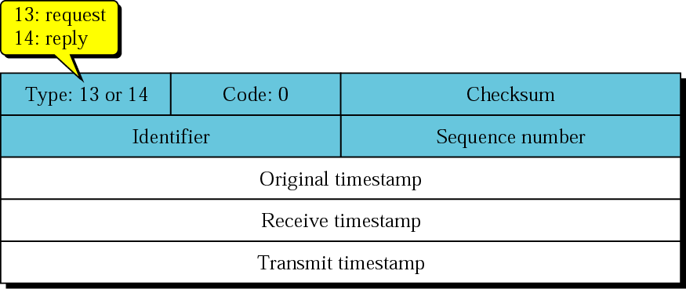
Figure 9.15 Timestamp-request and timestamp-reply message format

Slide 38
Note:
Timestamp-request and timestamp-reply messages can be used to calculate the round-trip time between a source and a destination machine even if their clocks are not synchronized.

Slide 39
Note:
The timestamp-request and timestamp-reply messages can be used to synchronize two clocks in two machines if the exact one-way time duration is known.

Slide 40
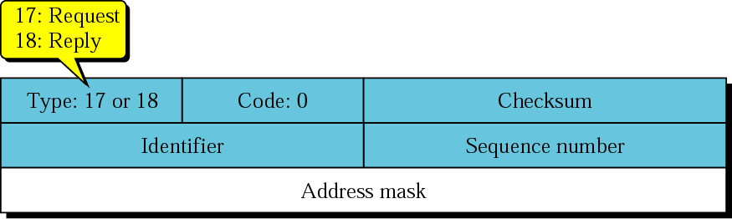
Figure 9.16 Mask-request and mask-reply message format

Slide 41
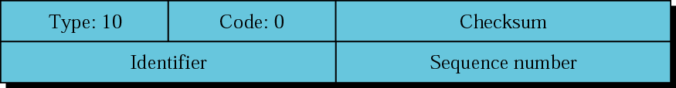
Figure 9.17 Router-solicitation message format

Slide 42
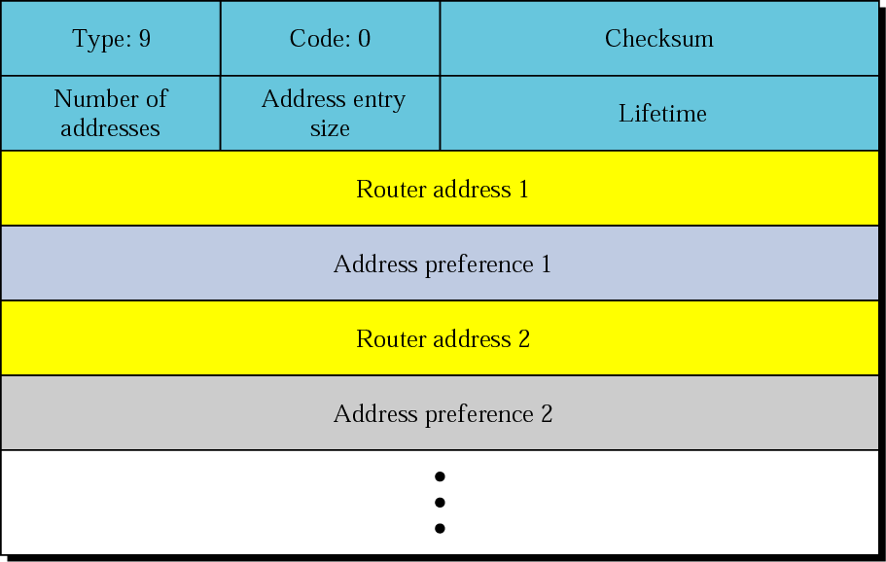
Figure 9.18 Router-advertisement message format

Slide 43
9.5 CHECKSUM
In ICMP the checksum is calculated over the entire message (header and data).
The topics discussed in this section include:
Checksum Calculation
Checksum Testing

Slide 44
Example 1
Figure 9.19 shows an example of checksum calculation for a simple echo-request message (see Figure 9.14). We randomly chose the identifier to be 1 and the sequence number to be 9. The message is divided into 16-bit (2-byte) words. The words are added together and the sum is complemented. Now the sender can put this value in the checksum field.
See Next Slide

Slide 45
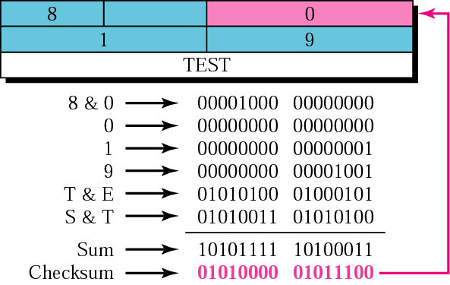
Figure 9.19 Example of checksum calculation

Slide 46
9.6 DEBUGGING TOOLS
We introduce two tools that use ICMP for debugging: ping and traceroute.
The topics discussed in this section include:
Ping
Traceroute

Slide 47
Example 2
We use the ping program to test the server fhda.edu. The result is shown below:
$ ping fhda.edu
PING fhda.edu (153.18.8.1) 56 (84) bytes of data.
64 bytes from tiptoe.fhda.edu (153.18.8.1): icmp_seq=0 ttl=62 time=1.91 ms
64 bytes from tiptoe.fhda.edu (153.18.8.1): icmp_seq=1 ttl=62 time=2.04 ms
64 bytes from tiptoe.fhda.edu (153.18.8.1): icmp_seq=2 ttl=62 time=1.90 ms
64 bytes from tiptoe.fhda.edu (153.18.8.1): icmp_seq=3 ttl=62 time=1.97 ms
64 bytes from tiptoe.fhda.edu (153.18.8.1): icmp_seq=4 ttl=62 time=1.93 ms
See Next Slide

Slide 48
Example 2 (Continued)
64 bytes from tiptoe.fhda.edu (153.18.8.1): icmp_seq=5 ttl=62 time=2.00 ms
64 bytes from tiptoe.fhda.edu (153.18.8.1): icmp_seq=6 ttl=62 time=1.94 ms
64 bytes from tiptoe.fhda.edu (153.18.8.1): icmp_seq=7 ttl=62 time=1.94 ms
64 bytes from tiptoe.fhda.edu (153.18.8.1): icmp_seq=8 ttl=62 time=1.97 ms
64 bytes from tiptoe.fhda.edu (153.18.8.1): icmp_seq=9 ttl=62 time=1.89 ms
64 bytes from tiptoe.fhda.edu (153.18.8.1): icmp_seq=10 ttl=62 time=1.98 ms
--- fhda.edu ping statistics ---
11 packets transmitted, 11 received, 0% packet loss, time 10103ms
rtt min/avg/max = 1.899/1.955/2.041 ms

Slide 49
Example 3
For the this example, we want to know if the adelphia.net mail server is alive and running. The result is shown below:
$ ping mail.adelphia.net
PING mail.adelphia.net (68.168.78.100) 56(84) bytes of data.
64 bytes from mail.adelphia.net (68.168.78.100): icmp_seq=0 ttl=48 time=85.4 ms
64 bytes from mail.adelphia.net (68.168.78.100): icmp_seq=1 ttl=48 time=84.6 ms
64 bytes from mail.adelphia.net (68.168.78.100): icmp_seq=2 ttl=48 time=84.9 ms
64 bytes from mail.adelphia.net (68.168.78.100): icmp_seq=3 ttl=48 time=84.3 ms
64 bytes from mail.adelphia.net (68.168.78.100): icmp_seq=4 ttl=48 time=84.5 ms
See Next Slide

Slide 50
Example 3 (Continued)
64 bytes from mail.adelphia.net (68.168.78.100): icmp_seq=5 ttl=48 time=84.7 ms
64 bytes from mail.adelphia.net (68.168.78.100): icmp_seq=6 ttl=48 time=84.6 ms
64 bytes from mail.adelphia.net (68.168.78.100): icmp_seq=7 ttl=48 time=84.7 ms
64 bytes from mail.adelphia.net (68.168.78.100): icmp_seq=8 ttl=48 time=84.4 ms
64 bytes from mail.adelphia.net (68.168.78.100): icmp_seq=9 ttl=48 time=84.2 ms
64 bytes from mail.adelphia.net (68.168.78.100): icmp_seq=10 ttl=48 time=84.9 ms
64 bytes from mail.adelphia.net (68.168.78.100): icmp_seq=11 ttl=48 time=84.6 ms
64 bytes from mail.adelphia.net (68.168.78.100): icmp_seq=12 ttl=48 time=84.5 ms
--- mail.adelphia.net ping statistics ---
14 packets transmitted, 13 received, 7% packet loss, time 13129ms
rtt min/avg/max/mdev = 84.207/84.694/85.469

Slide 51
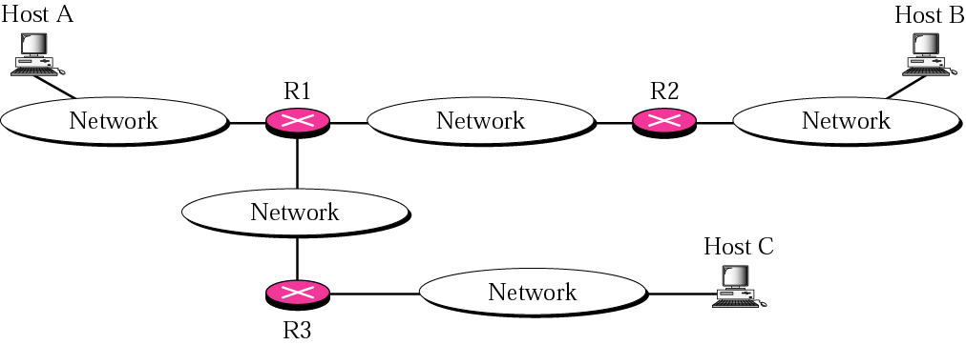
Figure 9.20 The traceroute program operation

Slide 52
Example 4
We use the traceroute program to find the route from the computer voyager.deanza.edu to the server fhda.edu. The following shows the result:
$ traceroute fhda.edu
traceroute to fhda.edu (153.18.8.1), 30 hops max, 38 byte packets
1 Dcore.fhda.edu (153.18.31.254) 0.995 ms 0.899 ms 0.878 ms
2 Dbackup.fhda.edu (153.18.251.4) 1.039 ms 1.064 ms 1.083 ms
3 tiptoe.fhda.edu (153.18.8.1) 1.797 ms 1.642 ms 1.757 ms
See Next Slide

Slide 53
Example 4 (Continued)
The un-numbered line after the command shows that the destination is 153.18.8.1. The TTL value is 30 hops. The packet contains 38 bytes: 20 bytes of IP header, 8 bytes of UDP header, and 10 bytes of application data. The application data is used by traceroute to keep track of the packets.
The first line shows the first router visited. The router is named Dcore.fhda.edu with IP address 153.18.31.254. The first round trip time was 0.995 milliseconds, the second was 0.899 milliseconds, and the third was 0.878 milliseconds.
The second line shows the second router visited. The router is named Dbackup.fhda.edu with IP address 153.18.251.4. The three round trip times are also shown.
The third line shows the destination host. We know that this is the destination host because there are no more lines. The destination host is the server fhda.edu, but it is named tiptoe. fhda.edu with the IP address 153.18.8.1. The three round trip times are also shown.

Slide 54
Example 5
In this example, we trace a longer route, the route to xerox.com
$ traceroute xerox.com
traceroute to xerox.com (13.1.64.93), 30 hops max, 38 byte packets
1 Dcore.fhda.edu (153.18.31.254) 0.622 ms 0.891 ms 0.875 ms
2 Ddmz.fhda.edu (153.18.251.40) 2.132 ms 2.266 ms 2.094 ms
...
18 alpha.Xerox.COM (13.1.64.93) 11.172 ms 11.048 ms 10.922 ms
Here there are 17 hops between source and destination. Note that some round trip times look unusual. It could be that a router is too busy to process the packet immediately.

Slide 55
Example 6
An interesting point is that a host can send a traceroute packet to itself. This can be done by specifying the host as the destination. The packet goes to the loopback address as we expect.
$ traceroute voyager.deanza.edu
traceroute to voyager.deanza.edu (127.0.0.1), 30 hops max, 38 byte packets
1 voyager (127.0.0.1) 0.178 ms 0.086 ms 0.055 ms

Slide 56
Example 7
Finally, we use the traceroute program to find the route between fhda.edu and mhhe.com (McGraw-Hill server). We notice that we cannot find the whole route. When traceroute does not receive a response within 5 seconds, it prints an asterisk to signify a problem, and then tries the next hop..
$ traceroute mhhe.com
traceroute to mhhe.com (198.45.24.104), 30 hops max, 38 byte packets
1 Dcore.fhda.edu (153.18.31.254) 1.025 ms 0.892 ms 0.880 ms
2 Ddmz.fhda.edu (153.18.251.40) 2.141 ms 2.159 ms 2.103 ms
3 Cinic.fhda.edu (153.18.253.126) 2.159 ms 2.050 ms 1.992 ms
...
16 * * *
17 * * *
...............

Slide 57
9.7 ICMP PACKAGE
To give an idea of how ICMP can handle the sending and receiving of ICMP messages, we present our version of an ICMP package made of two modules: an input module and an output module.
The topics discussed in this section include:
Input Module
Output Module

Slide 58
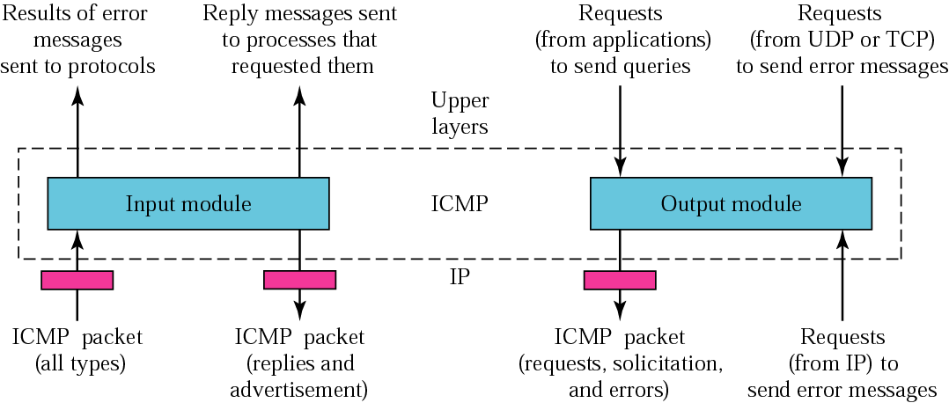
Figure 9.21 ICMP package

