Slide 1

Chapter 21
Network Management:
SNMP
Objectives
Upon completion you will be able to:
Understand the SNMP manager and the SNMP agent
Understand the roles of SMI and MIB in network management
Be familiar with SMI object attributes and encoding methods
Know how an MIB variable is accessed
Be familiar with the SNMP PDU and format

Slide 2
21.1 CONCEPT
SNMP defines a manager, usually a host, that controls and monitors a set of agents, usually routers.
The topics discussed in this section include:
Managers and Agents

Slide 3
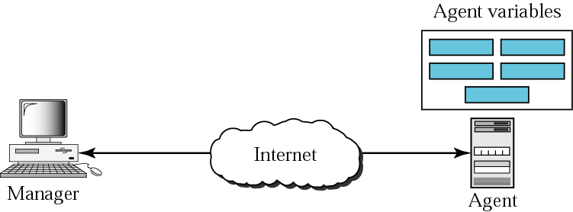
Figure 21.1 SNMP concept

Slide 4
21.2 MANAGEMENT COMPONENTS
SNMP requires the use of two other protocols: Structure of Management Information (SMI) and Management Information Base (MIB). Network management on the Internet is done through the cooperation of SNMP, SMI, and MIB.
The topics discussed in this section include:
Role of SNMP
Role of SMI
Role of MIB
An Analogy
An Overview

Slide 5
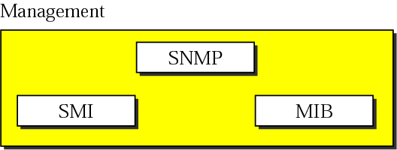
Figure 21.2 Components of network management on the Internet

Slide 6

Note:
SNMP defines the format of packets exchanged between a manager and an agent. It reads and changes the status (values) of objects (variables) in SNMP packets.

Slide 7
Note:
SMI defines the general rules for naming objects, defining object types (including range and length), and showing how to encode objects and values. SMI defines neither the number of objects an entity should manage, nor names the objects to be managed nor defines the association between the objects and their values.

Slide 8
Note:
MIB creates a collection of named objects, their types, and their relationships to each other in an entity to be managed.

Slide 9
Note:
We can compare the task of network management to the task of writing a program.
❏ Both tasks need rules. In network management
this is handled by SMI.
❏ Both tasks need variable declarations. In network
management this is handled by MIB.
❏ Both tasks have actions performed by statements.
In network management this is handled by SNMP.

Slide 10
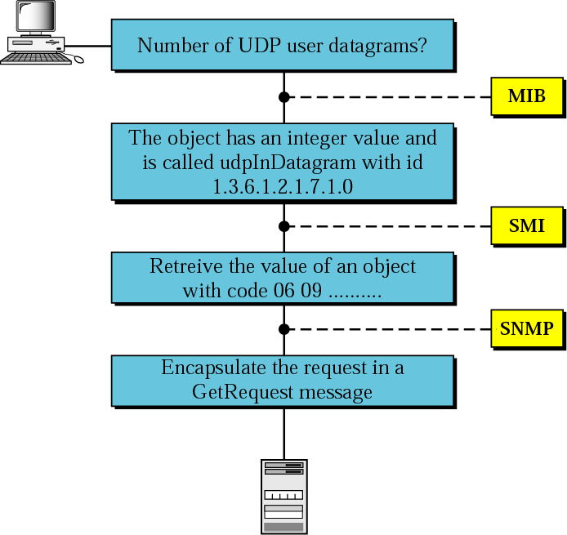
Figure 21.3 Management overview

Slide 11
21.3 SMI
SMI is a component used in network management. It names objects, defines the type of data that can be stored in an object, and shows how data can be encoded for transmission over the network
The topics discussed in this section include:
Name
Type
Encoding Method

Slide 12
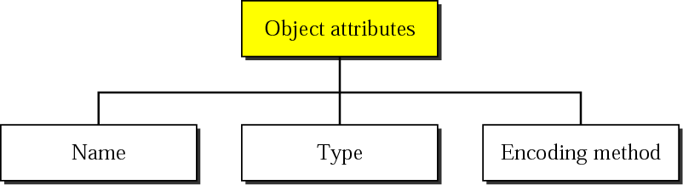
Figure 21.4 Object attributes

Slide 13
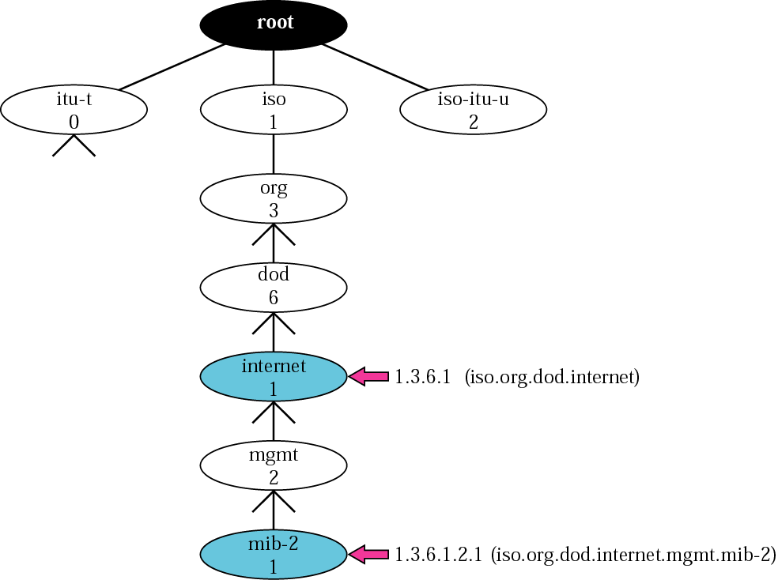
Figure 21.5 Object identifier

Slide 14
Note:
All objects managed by SNMP are given an object identifier.
The object identifier always starts with 1.3.6.1.2.1.

Slide 15
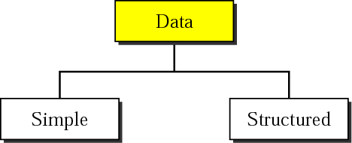
Figure 21.6 Data type

Slide 16
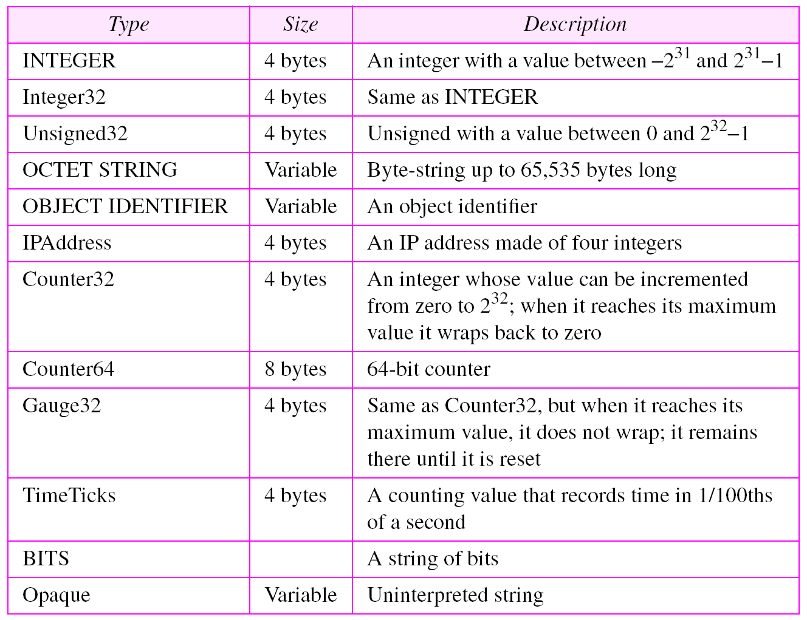
Table 21.1 Data types

Slide 17
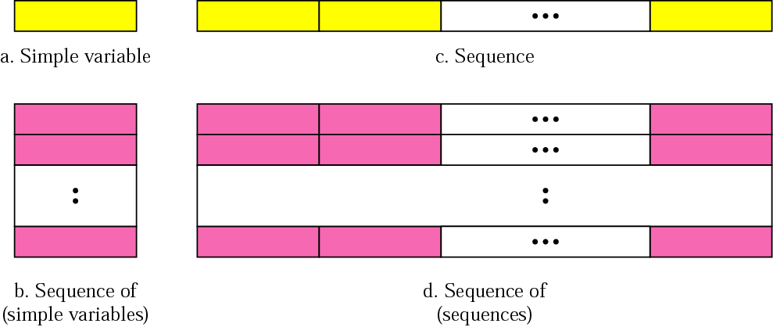
Figure 21.7 Conceptual data types

Slide 18
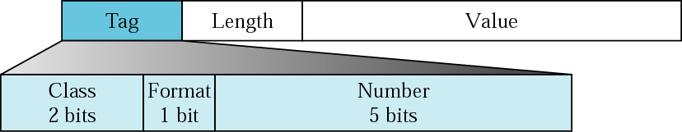
Figure 21.8 Encoding format

Slide 19
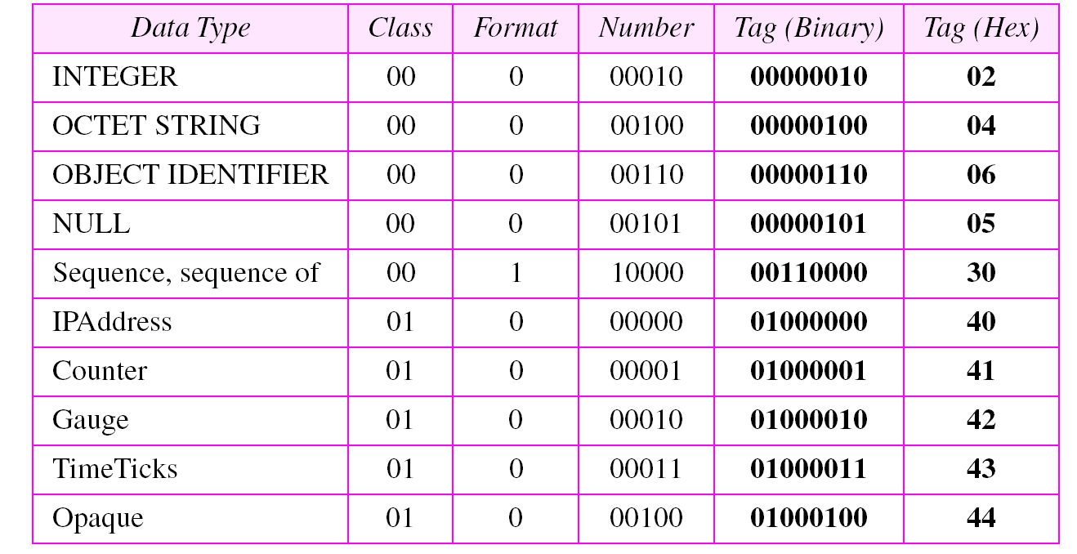
Table 21.2 Codes for data types

Slide 20
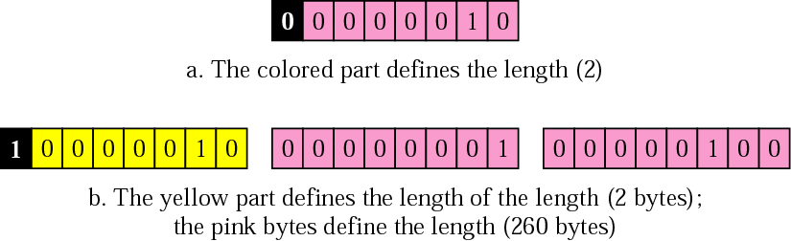
Figure 21.9 Length format

Slide 21
Example 1
Figure 21.10 shows how to define INTEGER 14.
See Next Slide

Slide 22
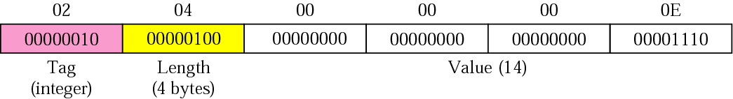
Figure 21.10 Example 1, INTEGER 14

Slide 23
Example 2
Figure 21.11 shows how to define the OCTET STRING “HI.”
See Next Slide

Slide 24
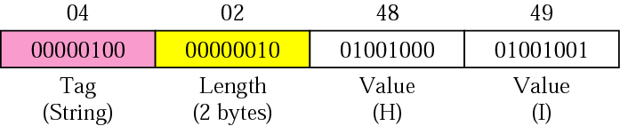
Figure 21.11 Example 2, OCTET STRING “HI”

Slide 25
Example 3
Figure 21.12 shows how to define ObjectIdentifier 1.3.6.1 (iso.org.dod.internet).
See Next Slide

Slide 26
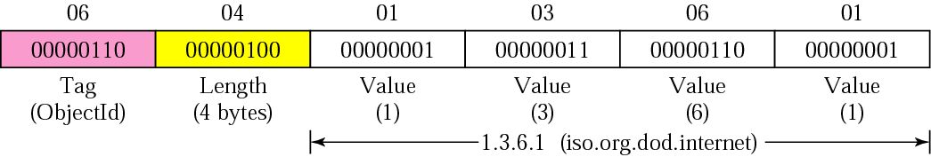
Figure 21.12 Example 3, ObjectIdentifier 1.3.6.1

Slide 27
Example 4
Figure 21.13 shows how to define IPAddress 131.21.14.8.
See Next Slide

Slide 28
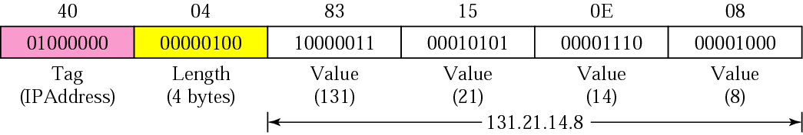
Figure 21.13 Example 4, IPAddress 131.21.14.8

Slide 29
21.4 MIB
MIB is a component used in network management. Each agent has its own MIB, a collection of all the objects that the manager can manage.
The topics discussed in this section include:
Accessing MIB Variables
Lexicographic Ordering

Slide 30
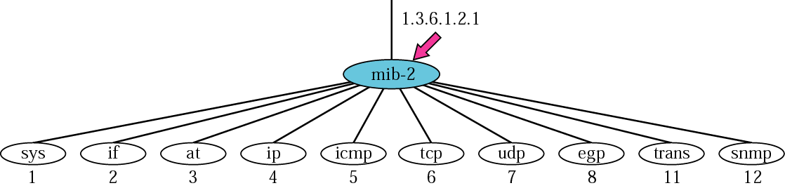
Figure 21.14 mib-2

Slide 31
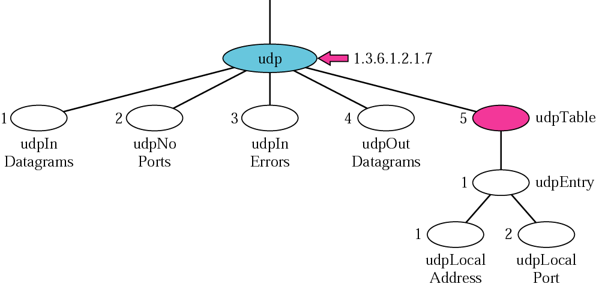
Figure 21.15 udp group

Slide 32
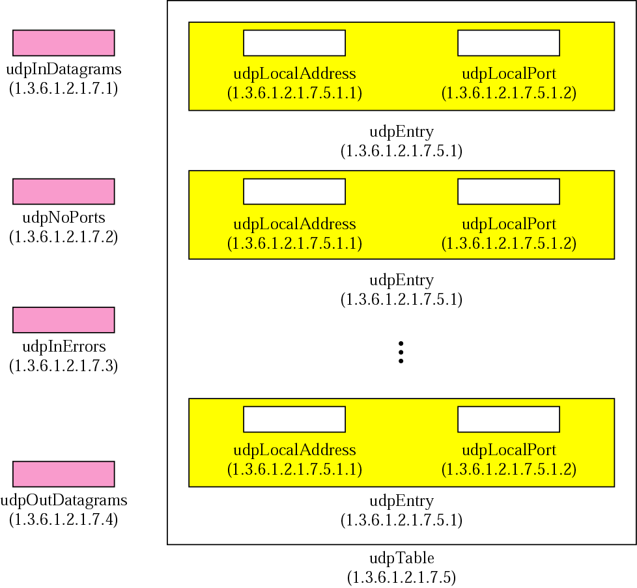
Figure 21.16 udp variables and tables

Slide 33
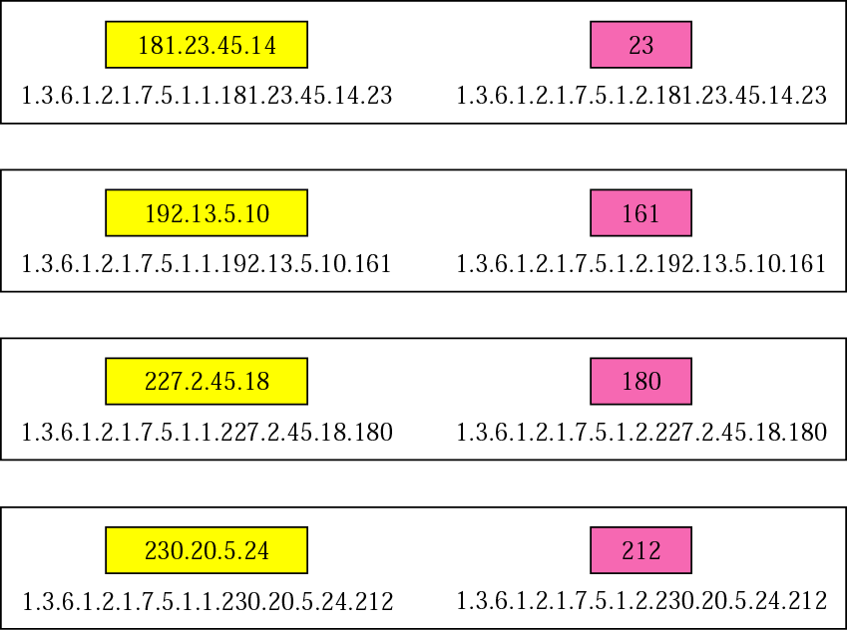
Figure 21.17 Indexes for udpTable

Slide 34
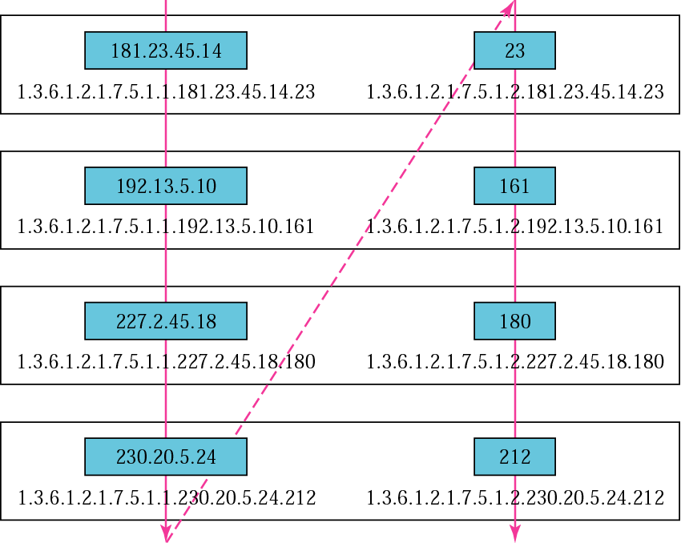
Figure 21.18 Lexicographic ordering

Slide 35
21.5 SNMP
SNMP is an application program that allows 1) a manager to retrieve the value of an object defined in an agent; 2) a manager to store a value in an object defined in an agent; and 3) an agent to send an alarm message about an abnormal situation to the manager
The topics discussed in this section include:
PDUs
Format

Slide 36
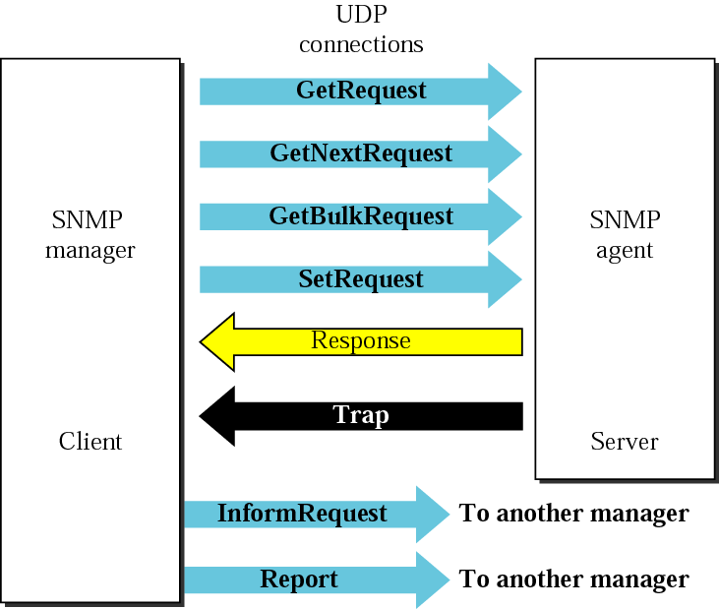
Figure 21.19 SNMP PDUs

Slide 37
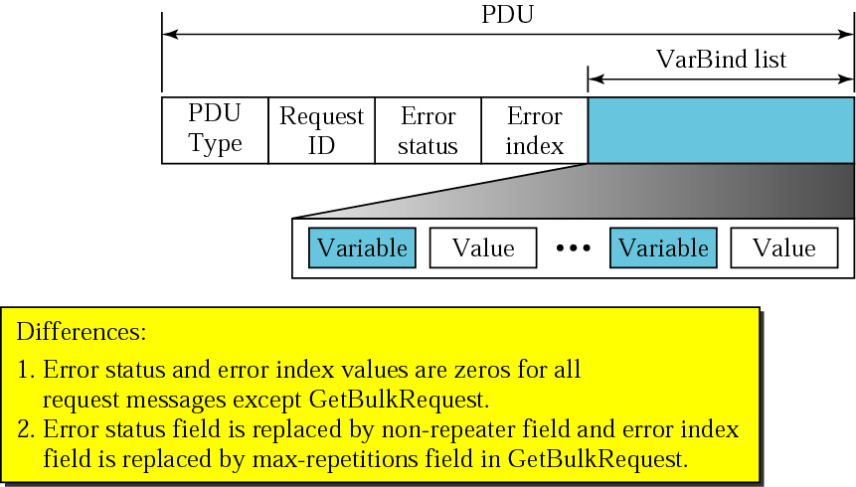
Figure 21.20 SNMP PDU format

Slide 38
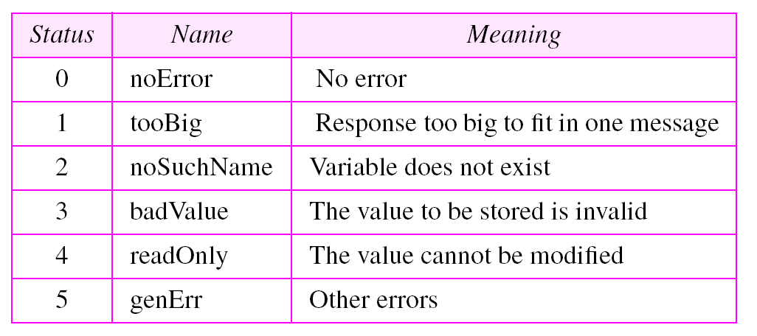
Table 21.3 Types of errors

Slide 39
21.6 MESSAGES
A message in SNMP is made of four elements: version, header, security parameters, and data (which includes the encoded PDU).

Slide 40
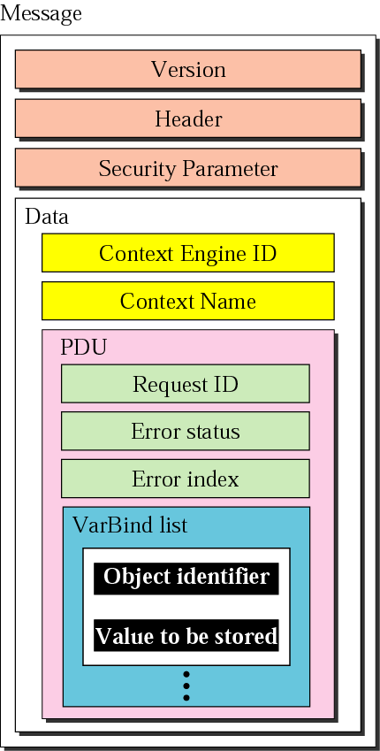
Figure 21.21 SNMP message

Slide 41
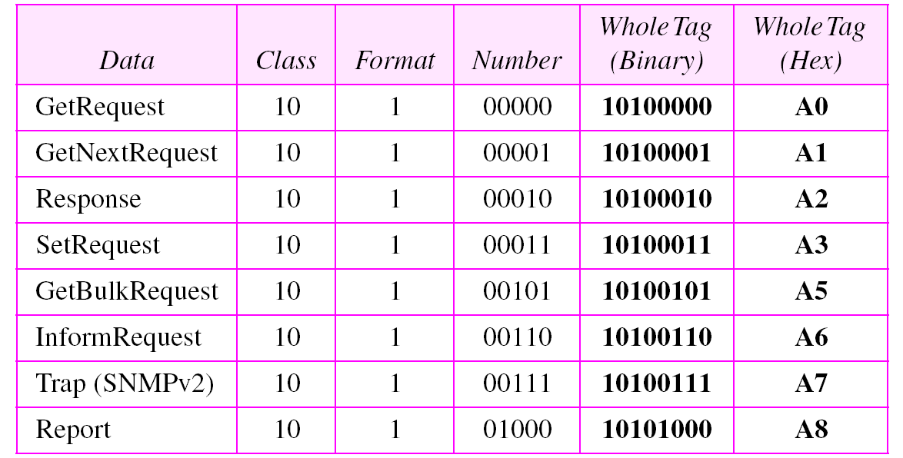
Table 21.4 Codes for SNMP messages

Slide 42
Example 5
In this example, a manager station (SNMP client) uses the GetRequest message to retrieve the number of UDP datagrams that a router has received. There is only one VarBind entity. The corresponding MIB variable related to this information is udpInDatagrams with the object identifier 1.3.6.1.2.1.7.1.0. The manager wants to retrieve a value (not to store a value), so the value defines a null entity. Figure 21.22 shows the conceptual view of the packet showing the hierarchical nature of sequences. We have used white and color boxes for the sequence and a gray one for the PDU.
See Next Slide

Slide 43
Example 5
The VarBind list has only one VarBind. The variable is of type 06 and length 09. The value is of type 05 and length 00. The whole is a sequence of length 0D (13). The VarBind list is also a sequence of length 0F (15). The GetRequest PDU is of length 1D (29). Now we have three OCTET STRINGs related to security parameter, security model, and flags. Then we have two integers defining maximum size (1024) and message ID (64). The header is a sequence of length 12, which we left blank for simplicity. There is one integer, version (version 3). The whole message is a sequence of 52 bytes. Figure 21.23 shows the actual message sent by the manager station (client) to the agent (server).
See Next Slide

Slide 44
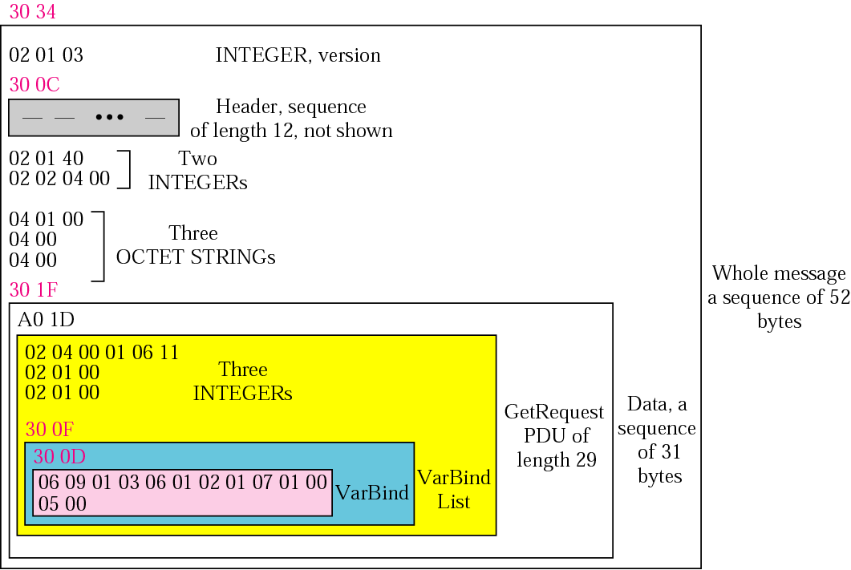
Figure 21.22 Example 5

Slide 45
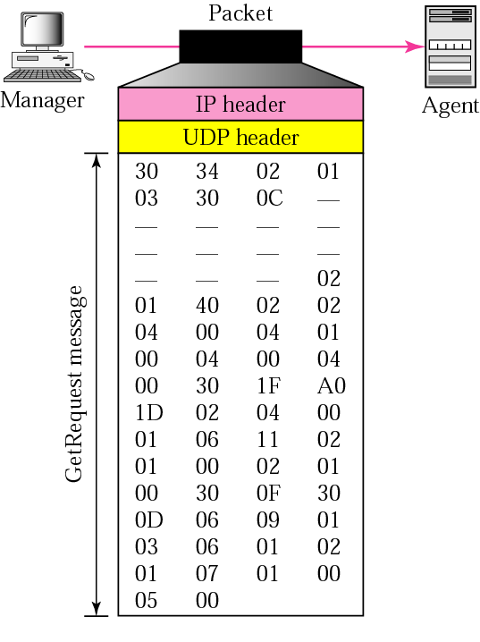
Figure 21.23 GetRequest message

Slide 46
21.7 UDP PORTS
SNMP uses the services of UDP on two well-known ports, 161 and 162. The well-known port 161 is used by the server (agent), and the well-known port 162 is used by the client (manager).

Slide 47
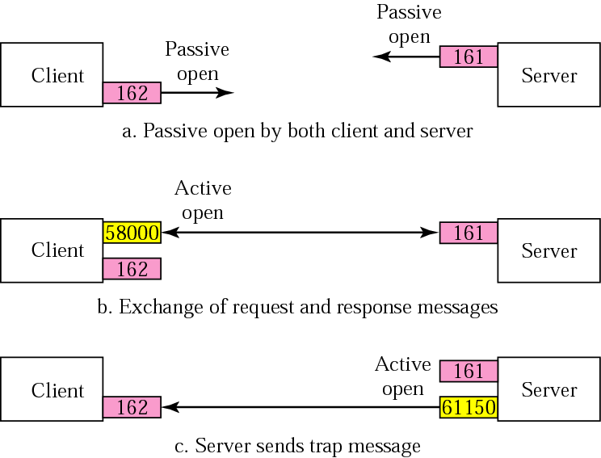
Figure 21.24 Port numbers for SNMP

Slide 48
21.8 SECURITY
The main difference between SNMPv3 and SNMPv2 is the enhanced security. SNMPv3 provides two types of security: general and specific. SNMPv3 provides message authentication, privacy, and manager authorization.

