Slide 1

Chapter 23
IP Over ATM
Objectives
Upon completion you will be able to:
Review the features of an ATM WAN
Understand how an a datagram can pass through an ATM WAN
Understand how an IP packet is encapsulated in cells
Understand how cells are routed in an ATM network
Understand the function of ATMARP

Slide 2
23.1 ATM WANS
We review some features of the ATM WAN needed to understand IP over ATM. The only AAL used by the Internet is AAL5, sometimes called the simple and efficient adaptation layer (SEAL).
The topics discussed in this section include:
Layers

Slide 3
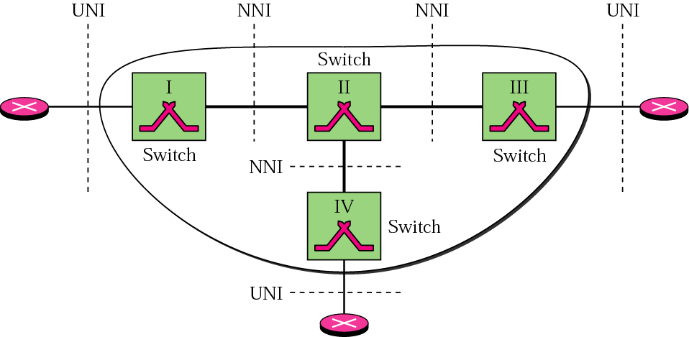
Figure 23.1 An ATM WAN in the Internet

Slide 4
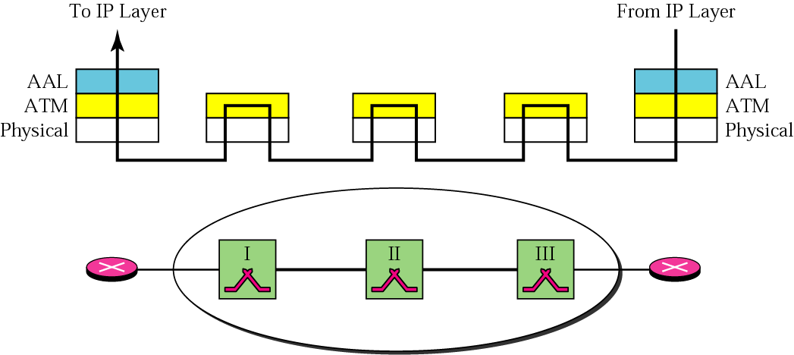
Figure 23.2 ATM layers in routers and switches

Slide 5

Note:
End devices such as routers use all three layers, while switches use only the bottom two layers.

Slide 6
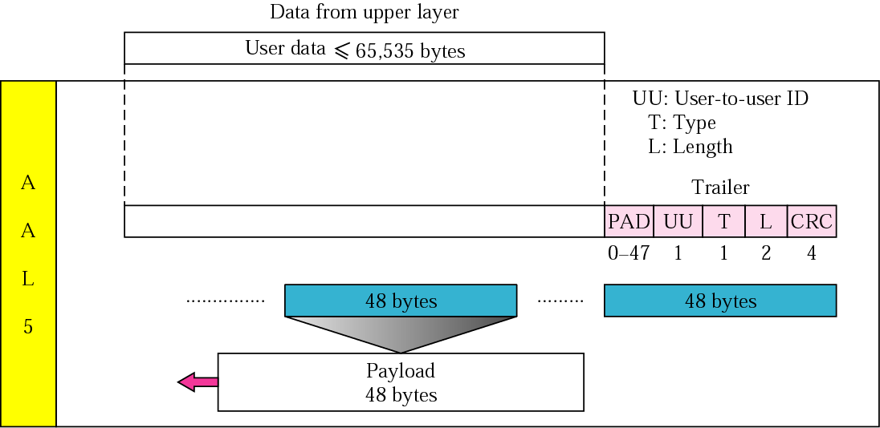
Figure 23.3 AAL5

Slide 7
Note:
The AAL layer used by the IP protocol is AAL5.

Slide 8
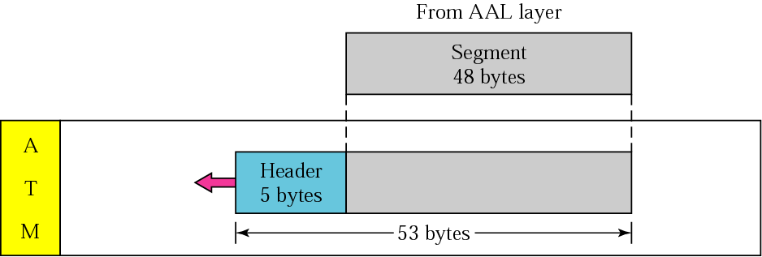
Figure 23.4 ATM layer

Slide 9
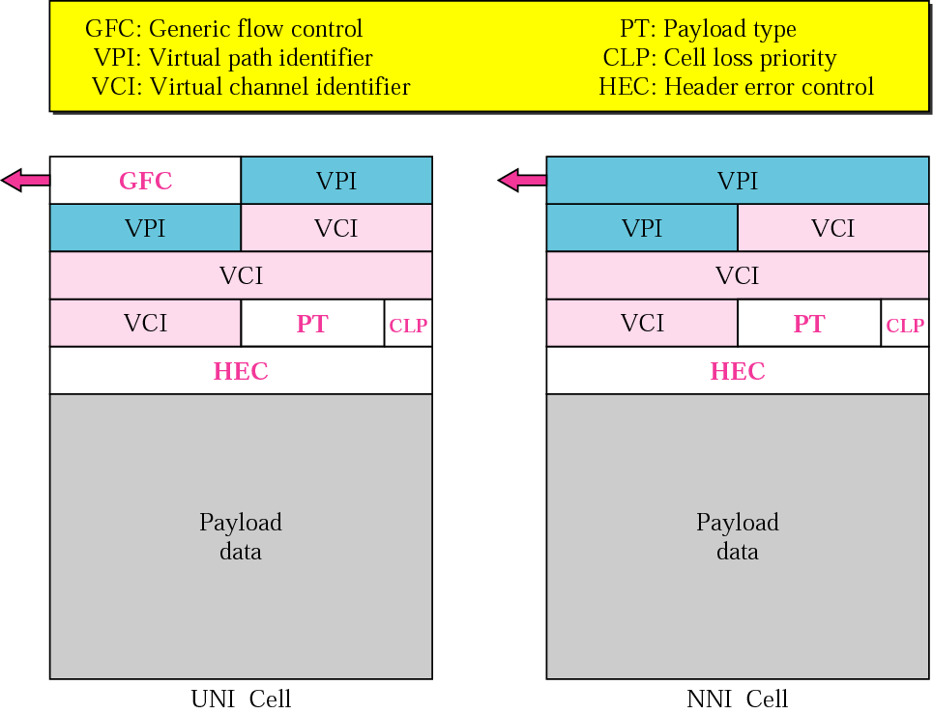
Figure 23.5 ATM headers

Slide 10
23.2 CARRYING A DATAGRAM
IN CELLS
We show how an example of a datagram encapsulated in four cells and transmitted through an ATM network.
The topics discussed in this section include:
Why Use AAL5?

Slide 11
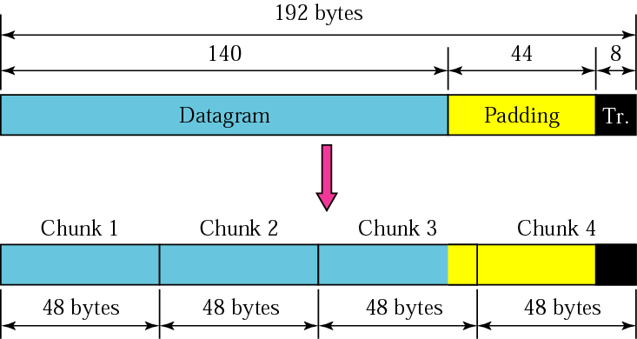
Figure 23.6 Fragmentation

Slide 12
Note:
Only the last cell carries the 8-byte trailer added to the IP datagram. Padding can be added only to the last cell or the last two cells.

Slide 13
Note:
The value of the PT field is 000 in all cells carrying an IP datagram fragment except for the last cell;
the value is 001 in the last cell.

Slide 14
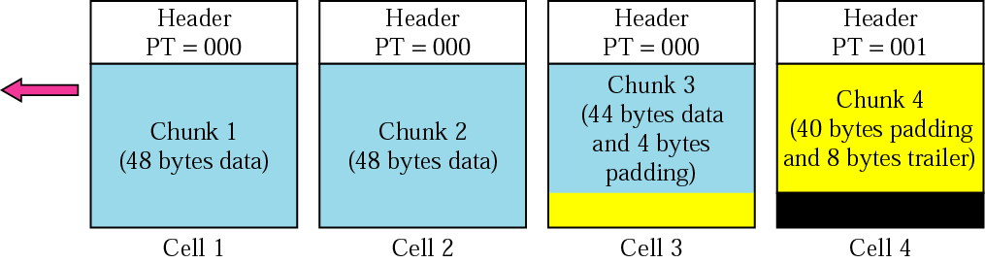
Figure 23.7 ATM cells

Slide 15
23.3 ROUTING THE CELLS
The ATM network creates a route between two routers. We call these routers entering-point and exiting-point routers.
The topics discussed in this section include:
Addresses
Address Binding

Slide 16
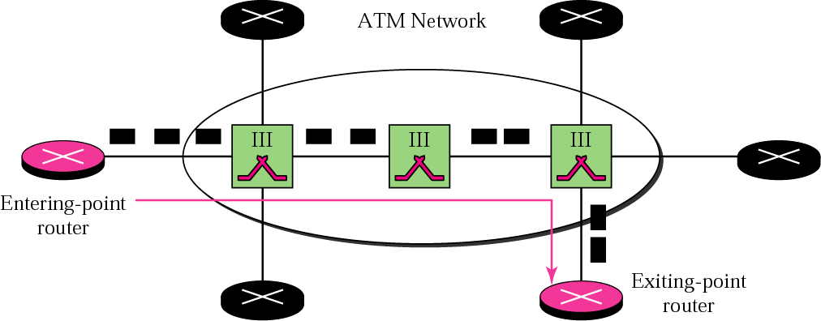
Figure 23.8 Entering-point and exiting-point routers

Slide 17
23.4 ATMARP
ATMARP finds (maps) the physical address of the exiting-point router given the IP address of the exiting-point router. No broadcasting is involved.
The topics discussed in this section include:
Packet Format
ATMARP Operation

Slide 18
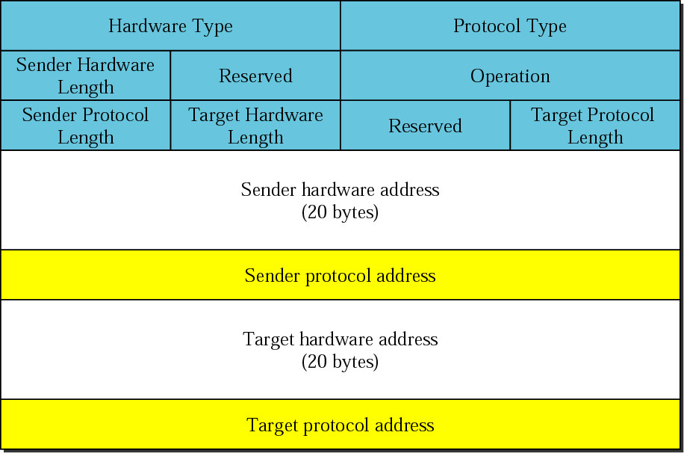
Figure 23.9 ATMARP packet

Slide 19
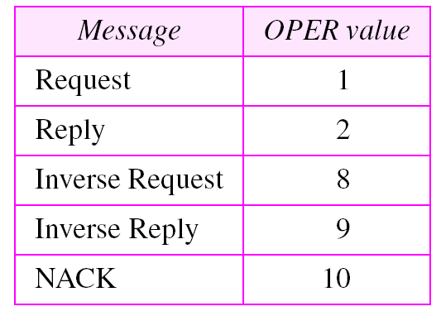
Table 23.1 OPER field

Slide 20
Note:
The inverse request and inverse reply messages can bind the physical address to an IP address in a PVC situation.

Slide 21
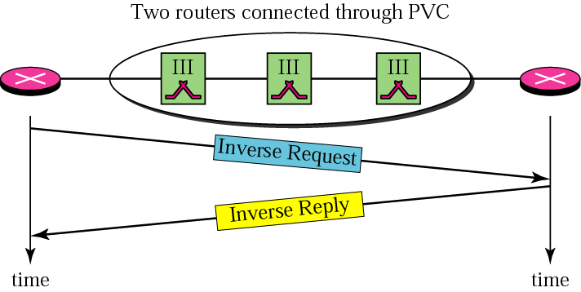
Figure 23.10 Binding with PVC

Slide 22
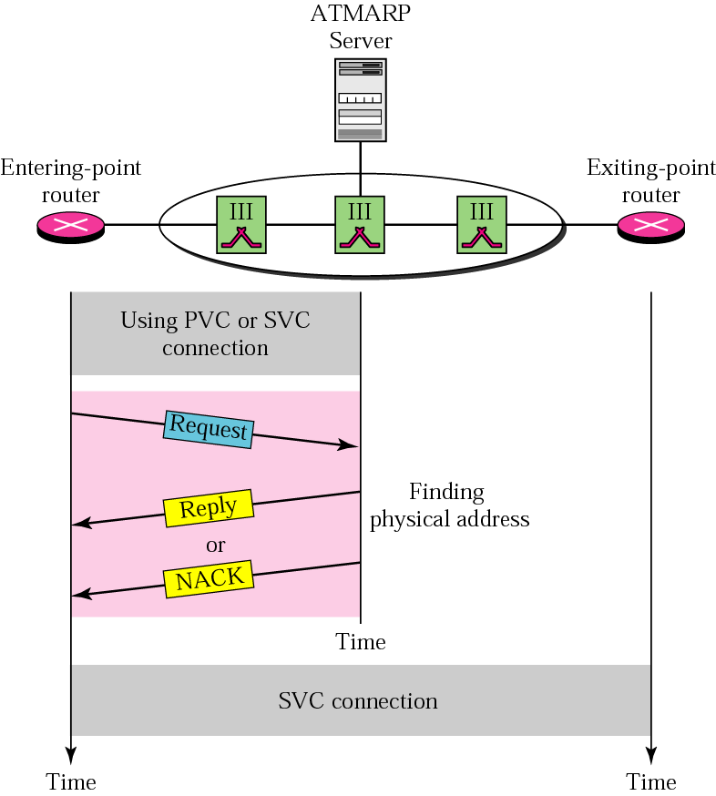
Figure 23.11 Binding with ATMARP

Slide 23
Note:
The request and reply message can be used to bind a physical address to an IP address in an SVC situation.

Slide 24
Note:
The inverse request and inverse reply can also be used to build the server’s
mapping table.

Slide 25
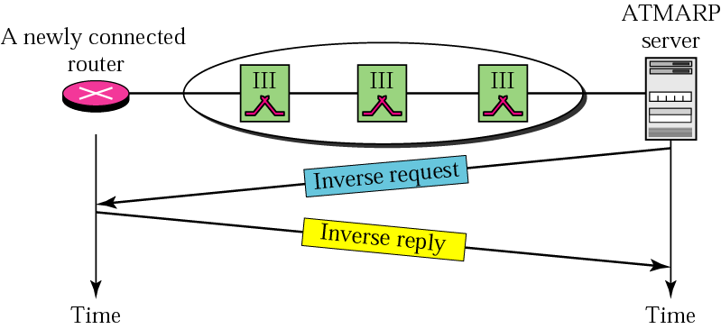
Figure 23.12 Building a table

Slide 26
23.5 LOGICAL IP SUBNET (LIS)
An ATM network can be divided into logical (not physical) subnetworks. This facilitates the operation of ATMARP and other protocols (such as IGMP) that need to simulate broadcasting on an ATM network.

Slide 27
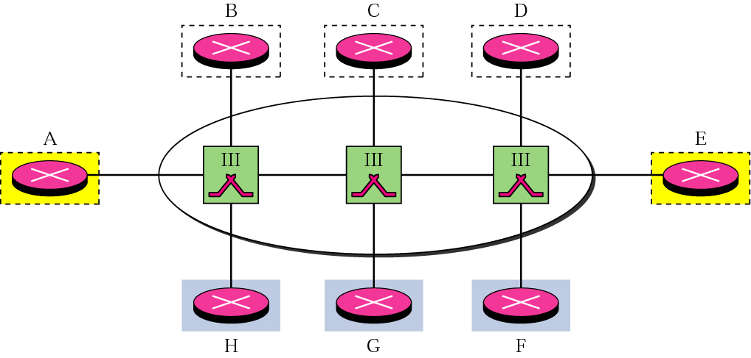
Figure 23.13 LIS

Slide 28
Note:
LIS allows an ATM network to be divided into several logical subnets. To use ATMARP, we need a separate server for each subnet.

