Slide 1

Chapter 24
Mobile IP
Objectives
Upon completion you will be able to:
Understand the addressing scheme for mobile hosts.
To define home, care-of, and co-located care-of addresses
Understand the interactions between a home and a foreign agent
Know the three phases involved in mobile communication
Understand why mobile IP communication can be inefficient

Slide 2
24.1 ADDRESSING
The main problem that must be solved in providing mobile communication using the IP protocol is addressing.
The topics discussed in this section include:
Stationary Hosts
Mobile Hosts

Slide 3

Note:
The IP addresses are designed to work with stationary hosts because part of the address defines the network to which the host is attached.

Slide 4
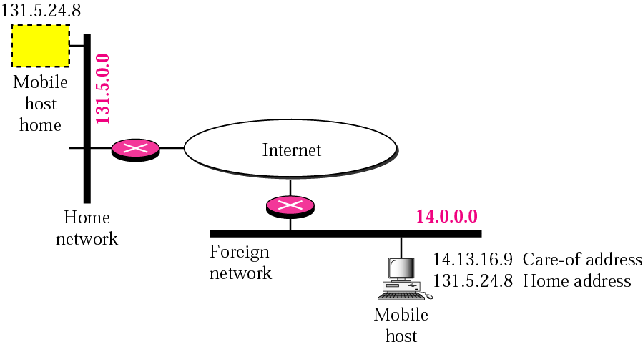
Figure 24.1 Home address and care-of address

Slide 5
Note:
Mobile IP has two addresses for a mobile host: one home address and one care-of address. The home address is permanent; the care-of address changes as the mobile host moves from one network to another.

Slide 6
24.2 AGENTS
To make the change of address transparent to the rest of the Internet requires a home agent and a foreign agent. The specific function of an agent is performed in the application layer.
The topics discussed in this section include:
Home Agent
Foreign Agent

Slide 7
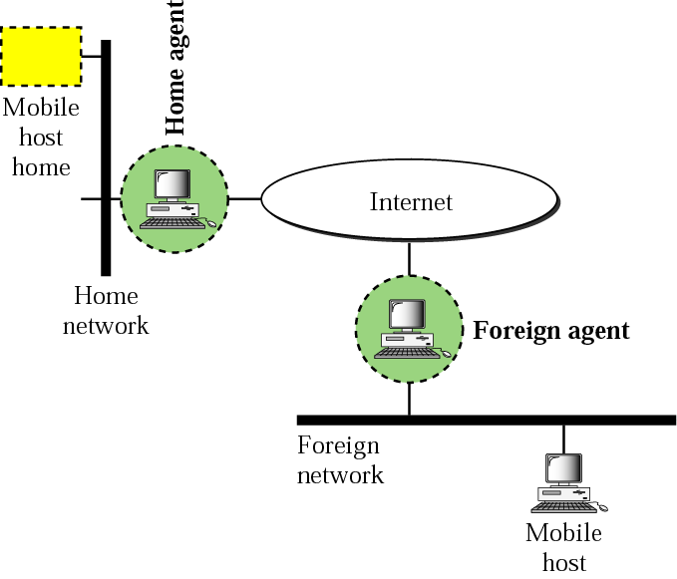
Figure 24.2 Home agent and foreign agent

Slide 8
Note:
When the mobile host and the foreign agent are the same, the care-of address is called a co-located care-of address.

Slide 9
24.3 THREE PHASES
To communicate with a remote host, a mobile host goes through three phases: agent discovery, registration, and data transfer.
The topics discussed in this section include:
Agent Discovery
Registration
Data Transfer

Slide 10
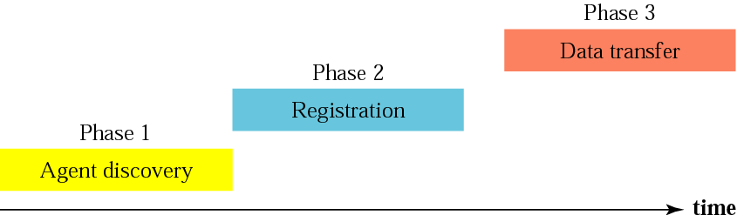
Figure 24.3 Remote host and mobile host communication

Slide 11
Note:
Mobile IP does not use a new packet type for agent advertisement; it uses the router advertisement packet of ICMP, and appends an agent advertisement message.

Slide 12
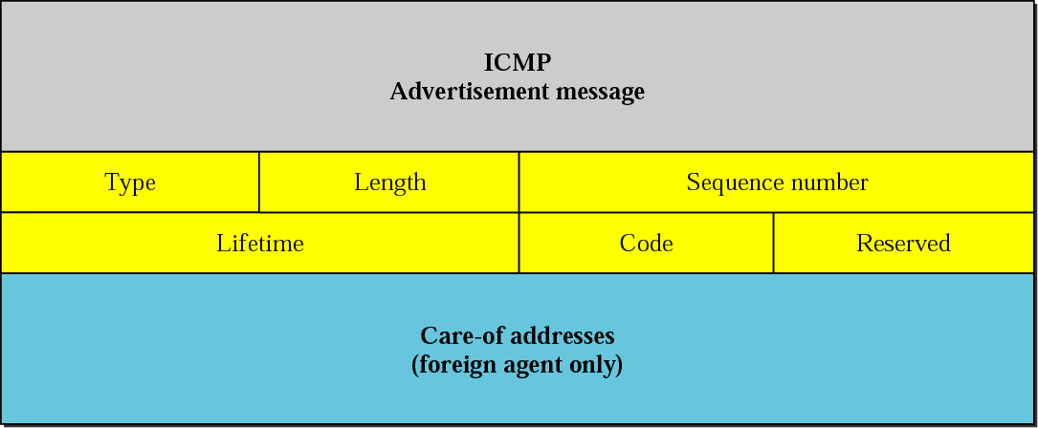
Figure 24.4 Agent advertisement

Slide 13
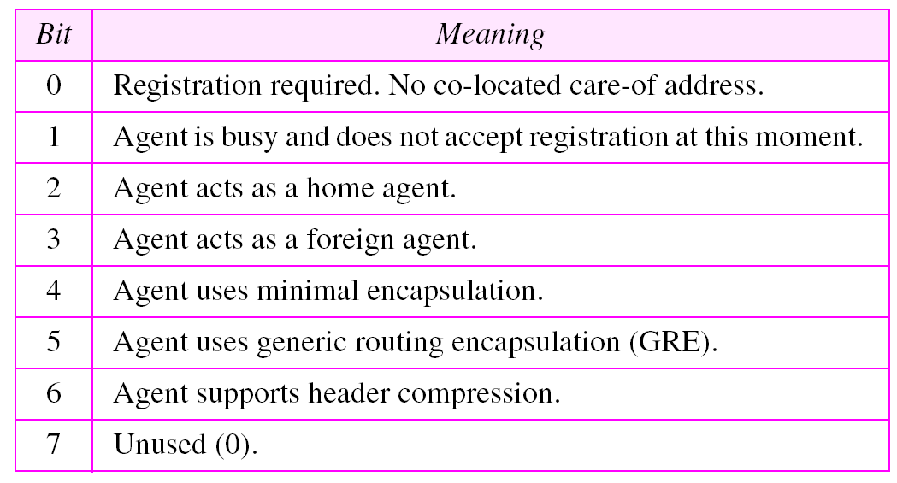
Table 24.1 Code bits

Slide 14
Note:
Mobile IP does not use a new packet type for agent solicitation; it uses the router solicitation packet of ICMP.

Slide 15
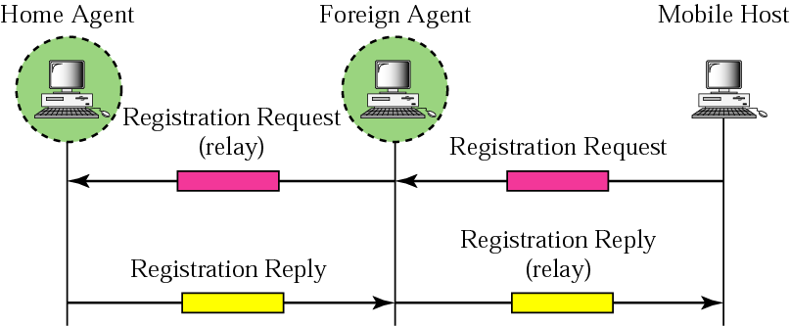
Figure 24.5 Registration request and reply

Slide 16
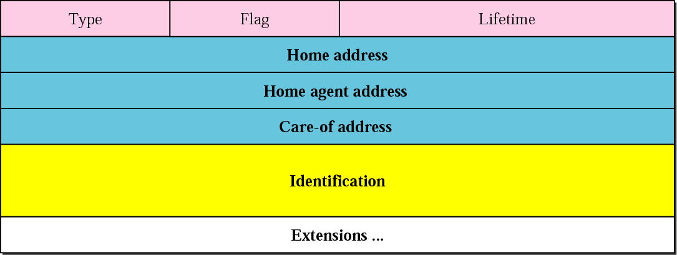
Figure 24.6 Registration request format

Slide 17
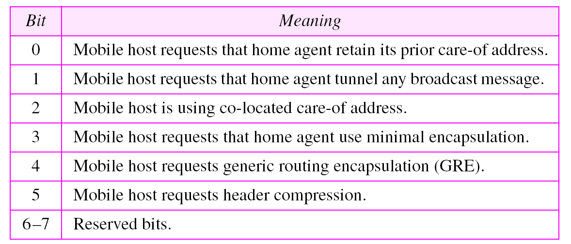
Table 24.2 Registration request flag field bits

Slide 18
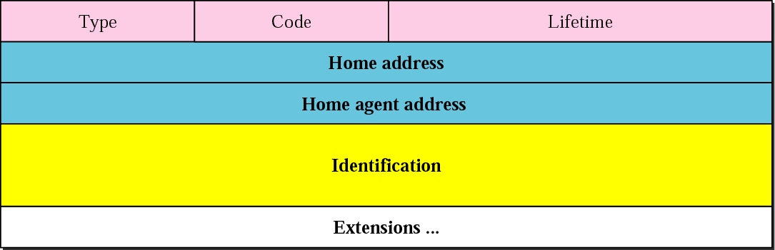
Figure 24.7 Registration reply format

Slide 19
Note:
A registration request or reply is sent by UDP using the well-known port 434.

Slide 20
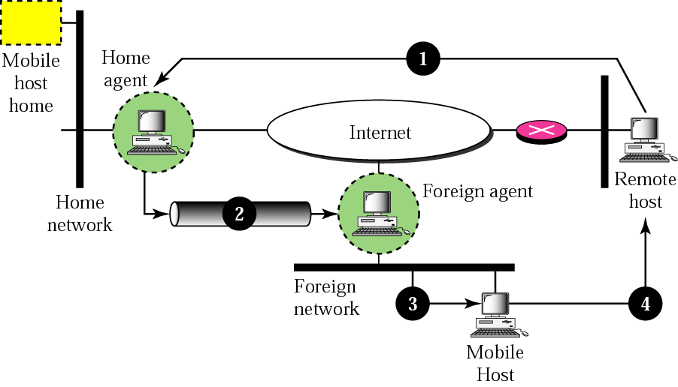
Figure 24.8 Data transfer

Slide 21
Note:
The movement of the mobile host is transparent to the rest of the Internet.

Slide 22
24.4 INEFFICIENCY IN MOBILE IP
Communication involving mobile IP can be inefficient. A severe case is called double crossing or 2X. A moderate case is called triangle routing or dog-leg routing.
The topics discussed in this section include:
Double Crossing
Triangle Routing
Solution

Slide 23
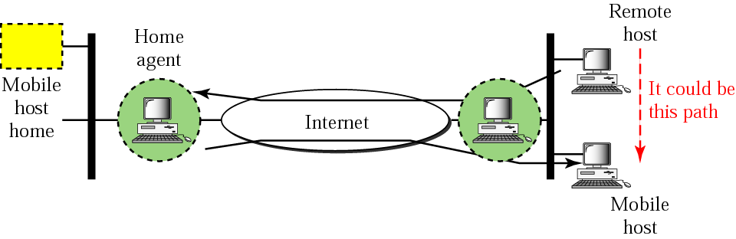
Figure 24.9 Double crossing

Slide 24
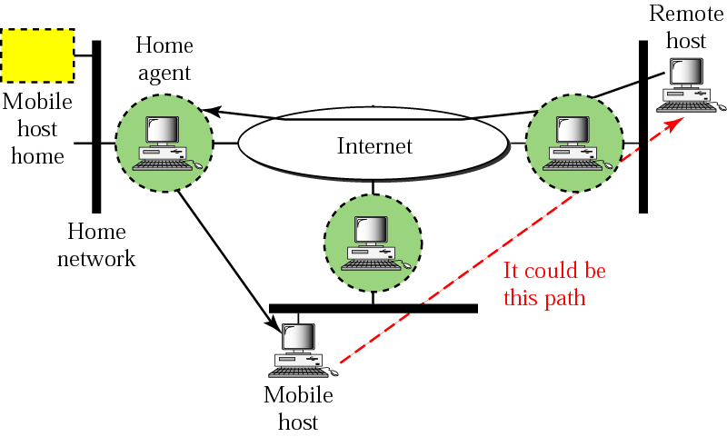
Figure 24.10 Triangle routing

