Slide 1

Chapter 26
Virtual Private Networks and
Network Address Translation
Objectives
Upon completion you will be able to:
Understand the difference between an internet and an extranet
Understand private, hybrid, and virtual private networks
Understand how VPN can guarantee privacy
Understand the mechanism of NAT

Slide 2
26.1 PRIVATE NETWORKS
A private network is designed to be used only inside an organization. It allows access to shared resources and, at the same time, provides privacy.
The topics discussed in this section include:
Intranet
Extranet
Addressing

Slide 3
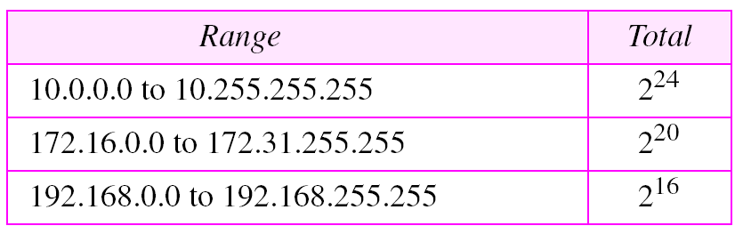
Table 26.1 Addresses for private networks

Slide 4
26.2 VIRTUAL PRIVATE
NETWORKS (VPN)
Virtual private network (VPN) is a technology for large organizations that use the global Internet for both intra- and interorganization communication, but require privacy in their intraorganization communication.
The topics discussed in this section include:
Achieving Privacy
VPN Technology

Slide 5
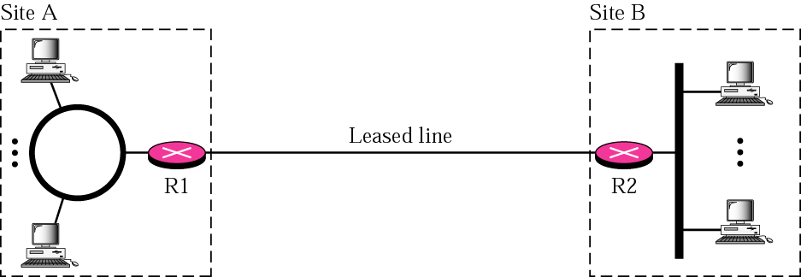
Figure 26.1 Private network

Slide 6
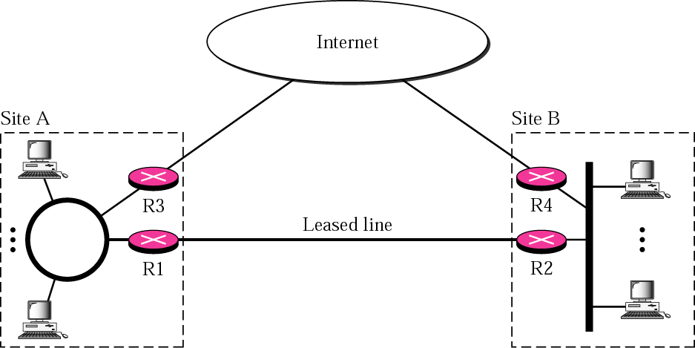
Figure 26.2 Hybrid network

Slide 7
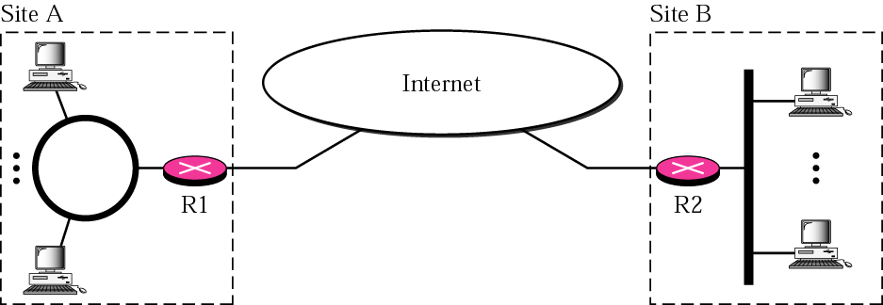
Figure 26.3 Virtual private network

Slide 8
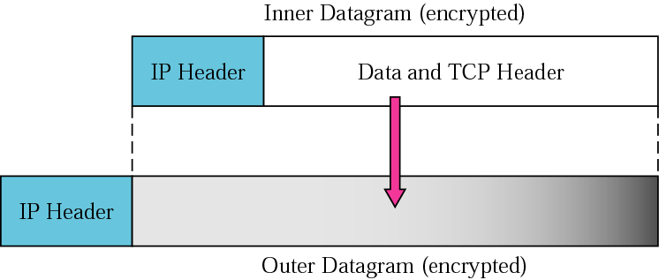
Figure 26.4 Tunneling

Slide 9
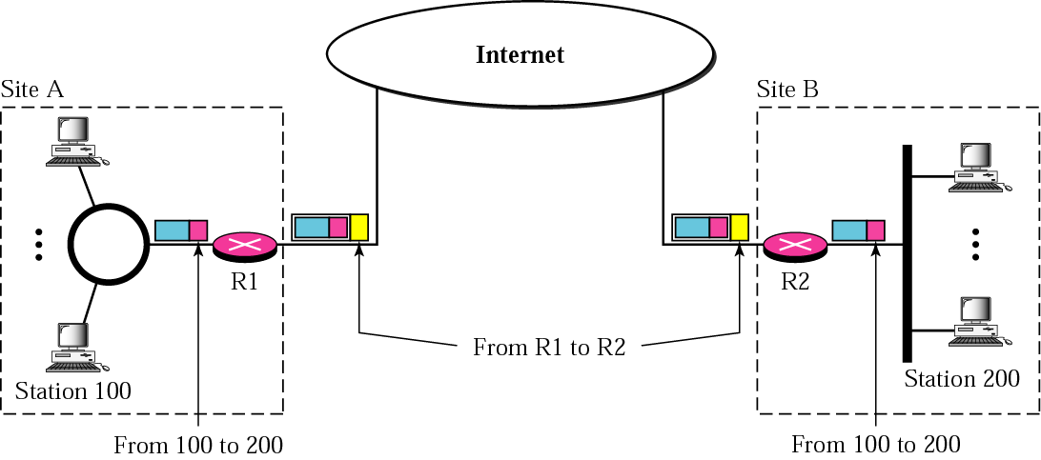
Figure 26.5 Addressing in a VPN

Slide 10
26.3 NETWORK ADDRESS
TRANSLATION (NAT)
Network address translation (NAT) allows a site to use a set of private addresses for internal communication and a set of global Internet addresses for communication with another site. The site must have only one single connection to the global Internet through a router that runs NAT software.
The topics discussed in this section include:
Address Translation
Translation Table
NAT and ISP

Slide 11
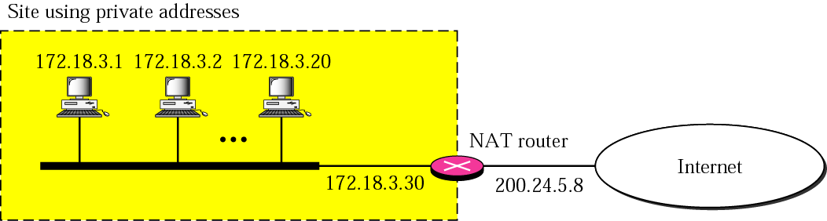
Figure 26.6 NAT

Slide 12
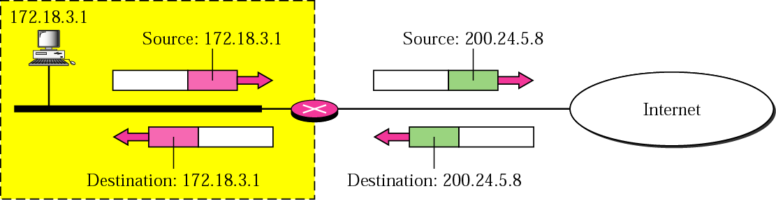
Figure 26.7 Address translation

Slide 13
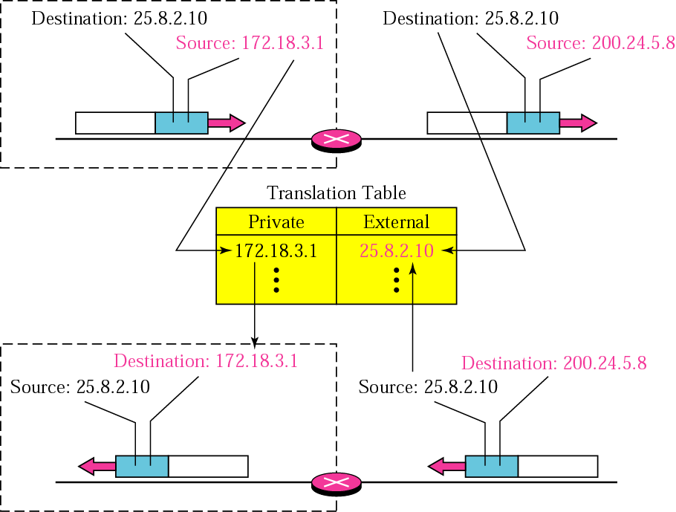
Figure 26.8 Translation

Slide 14
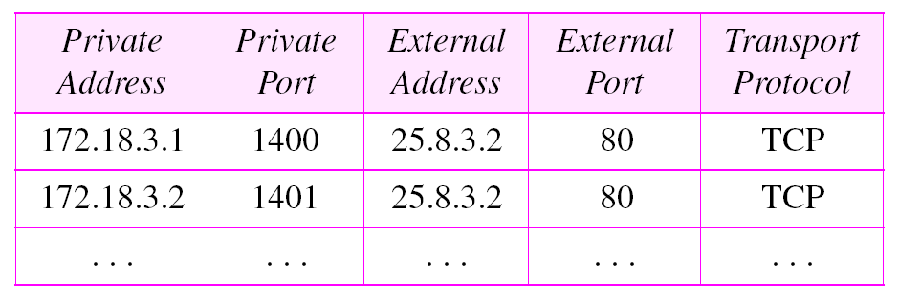
Table 26.2 Five-column translation table

Slide 15
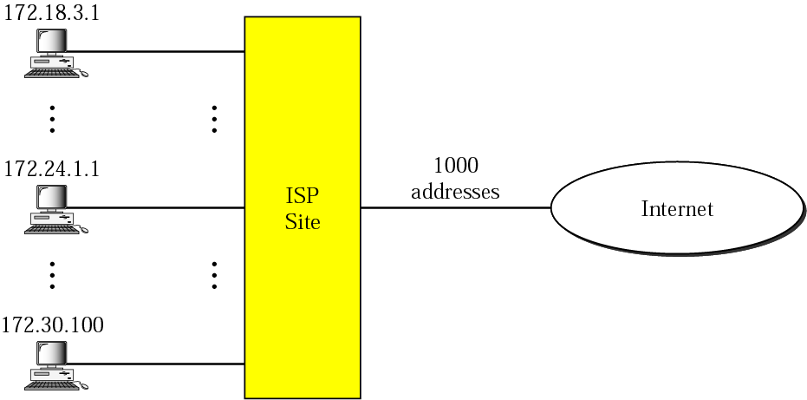
Figure 26.9 An ISP and NAT

