Slide 1

Chapter 10
Internet Group
Management Protocol
Objectives
Upon completion you will be able to:
Know the purpose of IGMP
Know the types of IGMP messages
Understand how a member joins a group and leaves a group
Understand membership monitoring
Understand how an IGMP message is encapsulated
Understand the interactions of the modules of an IGMP package

Slide 2
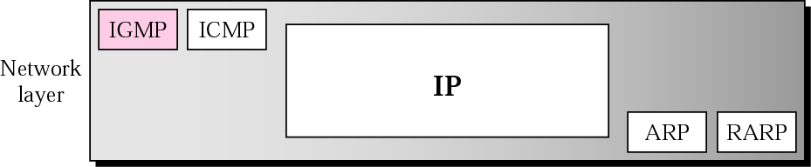
Figure 10.1 Position of IGMP in the network layer

Slide 3
10.1 GROUP MANAGEMENT
IGMP is a protocol that manages group membership. The IGMP protocol gives the multicast routers information about the membership status of hosts (routers) connected to the network. .

Slide 4

Note:
IGMP is a group management protocol. It helps a multicast router create and update a list of loyal members related to each router interface.

Slide 5
10.2 IGMP MESSAGES
IGMP has three types of messages: the query, the membership report, and the leave report. There are two types of query messages, general and special.
The topics discussed in this section include:
Message Format

Slide 6
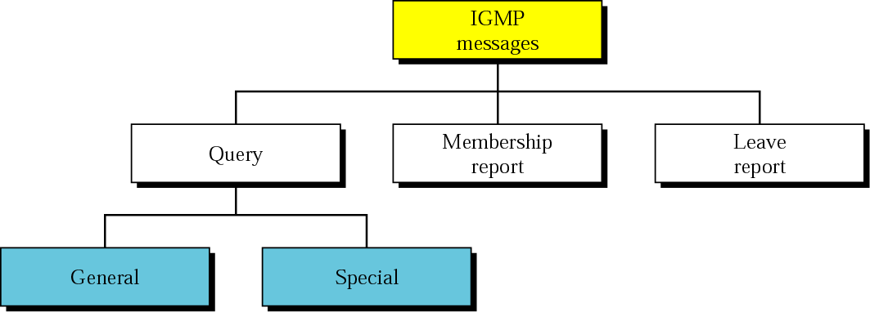
Figure 10.2 IGMP message types

Slide 7
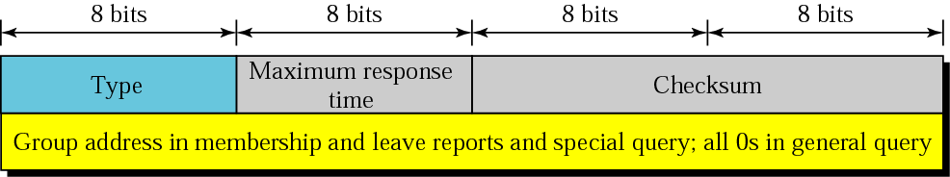
Figure 10.3 IGMP message format

Slide 8
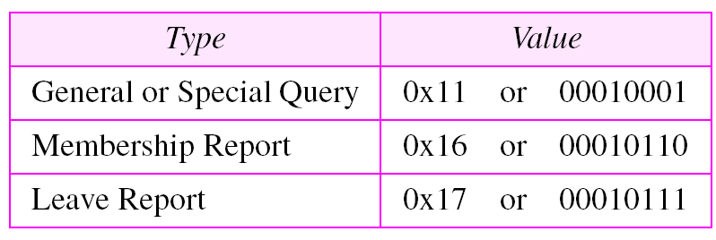
Table 10.1 IGMP type field

Slide 9
10.3 IGMP OPERATION
A multicast router connected to a network has a list of multicast addresses of the groups with at least one loyal member in that network. For each group, there is one router that has the duty of distributing the multicast packets destined for that group.
The topics discussed in this section include:
Joining a Group
Leaving a Group
Monitoring Membership

Slide 10
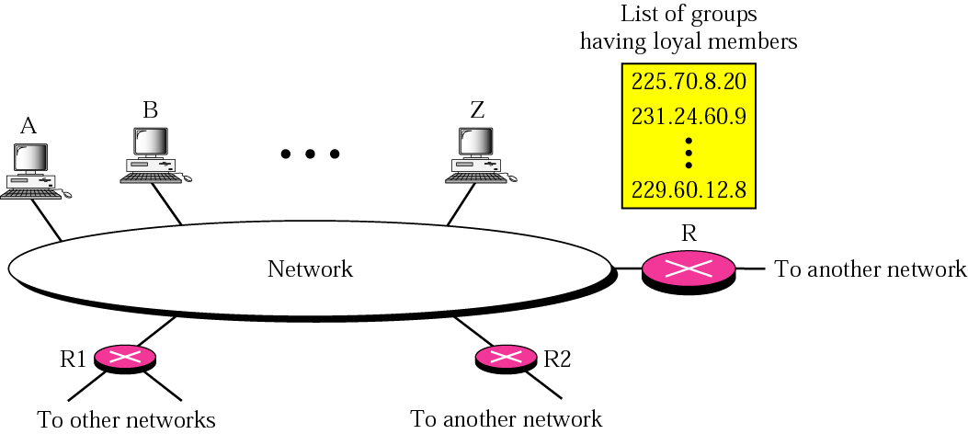
Figure 10.4 IGMP operation

Slide 11
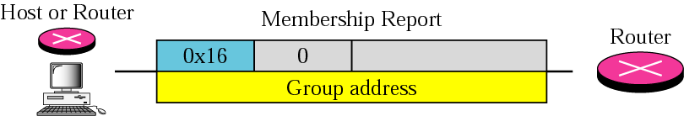
Figure 10.5 Membership report

Slide 12
Note:
In IGMP, a membership report is sent twice, one after the other.

Slide 13
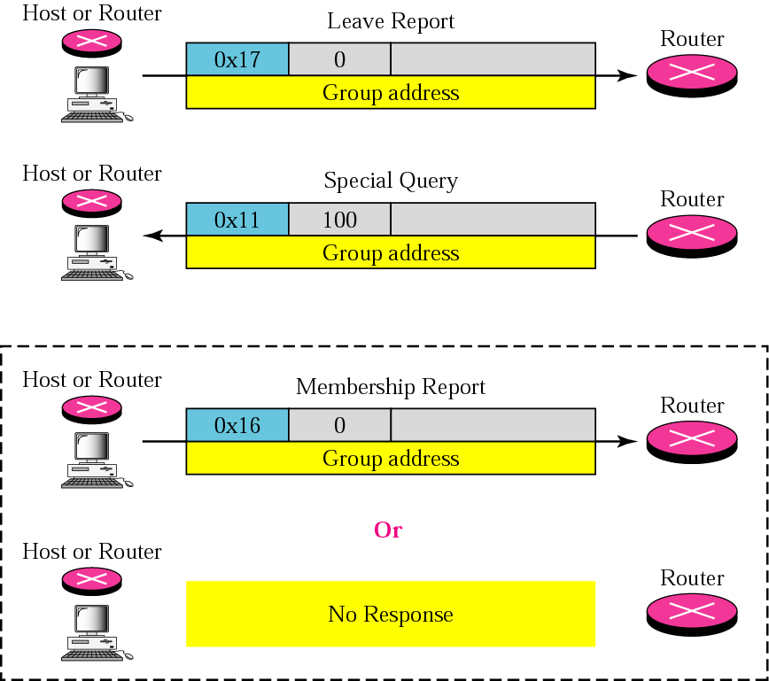
Figure 10.6 Leave report

Slide 14
Note:
The general query message does not define a particular group.

Slide 15
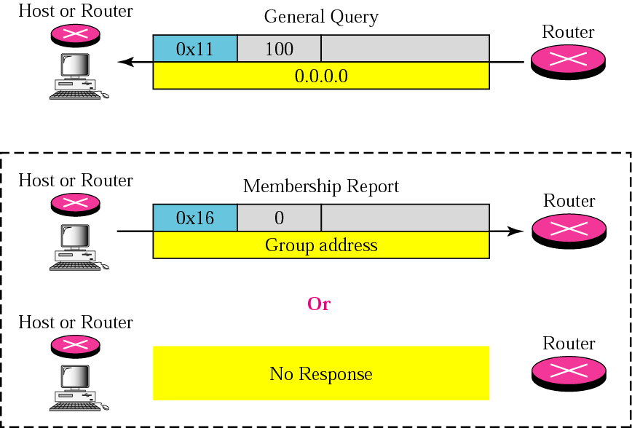
Figure 10.7 General query message

Slide 16
Example 1
Imagine there are three hosts in a network as shown in Figure 10.8.
A query message was received at time 0; the random delay time (in tenths of seconds) for each group is shown next to the group address. Show the sequence of report messages.
See Next Slide

Slide 17
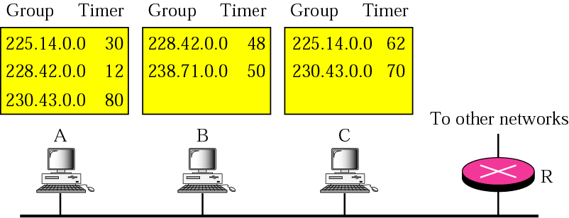
Figure 10.8 Example 1

Slide 18
Example 1 (Continued)
Solution
The events occur in this sequence:
a. Time 12: The timer for 228.42.0.0 in host A expires and a membership report is sent, which is received by the router and every host including host B which cancels its timer for 228.42.0.0.
b. Time 30: The timer for 225.14.0.0 in host A expires and a membership report is sent, which is received by the router and every host including host C which cancels its timer for 225.14.0.0.
c. Time 50: The timer for 238.71.0.0 in host B expires and a membership report is sent, which is received by the router and every host.
See Next Slide

Slide 19
Example 1 (Continued)
d. Time 70: The timer for 230.43.0.0 in host C expires and a membership report is sent, which is received by the router and every host including host A which cancels its timerfor 230.43.0.0.
Note that if each host had sent a report for every group in its list, there would have been seven reports; with this strategy only four reports are sent.

Slide 20
10.4 ENCAPSULATION
The IGMP message is encapsulated in an IP datagram, which is itself encapsulated in a frame.
The topics discussed in this section include:
IP Layer
Data Link Layer
Netstat Utility

Slide 21
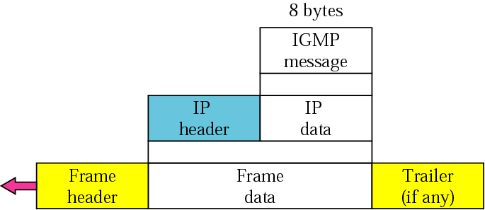
Figure 10.9 Encapsulation of IGMP packet

Slide 22
Note:
The IP packet that carries an IGMP packet has a value of 2 in its
protocol field.

Slide 23
Note:
The IP packet that carries an IGMP packet has a value of 1 in its
TTL field.

Slide 24
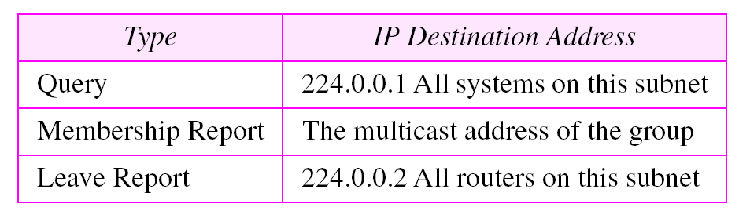
Table 10.2 Destination IP addresses

Slide 25
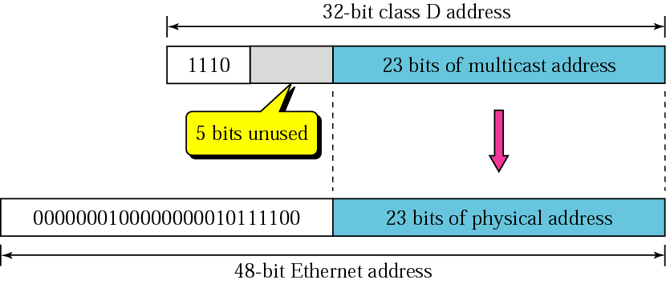
Figure 10.10 Mapping class D to Ethernet physical address

Slide 26
Note:
An Ethernet multicast physical address is in the range
01:00:5E:00:00:00
to
01:00:5E:7F:FF:FF.

Slide 27
Example 2
Change the multicast IP address 230.43.14.7 to an Ethernet multicast physical
Solution
We can do this in two steps:
a. We write the rightmost 23 bits of the IP address in hexadecimal. This can be done by changing the rightmost 3 bytes to hexadecimal and then subtracting 8 from the leftmost digit if it is greater than or equal to 8. In our example, the result is 2B:0E:07.
b. We add the result of part a to the starting Ethernet multicast address, which is (01:00:5E:00:00:00). The result is
01:00:5E:2B:0E:07

Slide 28
Example 3
Change the multicast IP address 238.212.24.9 to an Ethernet multicast address.
Solution
a. The right-most three bytes in hexadecimal are D4:18:09. We need to subtract 8 from the leftmost digit, resulting in 54:18:09..
b. We add the result of part a to the Ethernet multicast starting address. The result is
01:00:5E:54:18:09

Slide 29
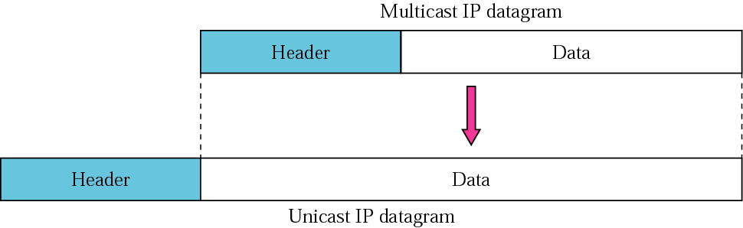
Figure 10.11 Tunneling

Slide 30
Example 4
We use netstat with three options, -n, -r, and -a. The -n option gives the numeric versions of IP addresses, the -r option gives the routing table, and the -a option gives all addresses (unicast and multicast). Note that we show only the fields relative to our discussion.
$ netstat -nra
Kernel IP routing table
Destination Gateway Mask Flags Iface
153.18.16.0 0.0.0.0 255.255.240.0 U eth0
169.254.0.0 0.0.0.0 255.255.0.0 U eth0
127.0.0.0 0.0.0.0 255.0.0.0 U lo
224.0.0.0 0.0.0.0 224.0.0.0 U eth0
0.0.0.0 153.18.31.254 0.0.0.0 UG eth0
Any packet with a multicast address from 224.0.0.0 to 239.255.255.255 is masked and delivered to the Ethernet interface.

Slide 31
10.5 IGMP PACKAGE
We can show how IGMP can handle the sending and receiving of IGMP packets through our simplified version of an IGMP package. In our design an IGMP package involves a group table, a set of timers, and four software modules.
The topics discussed in this section include:
Group Table
Timers
Group-Joining Module
Group-Leaving Module
Input Module
Output Module

Slide 32
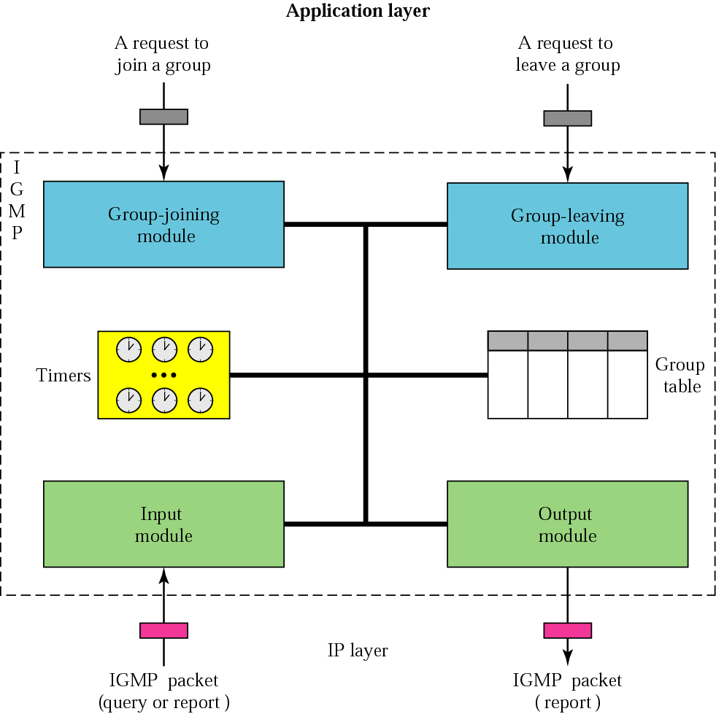
Figure 10.12 IGMP package

Slide 33
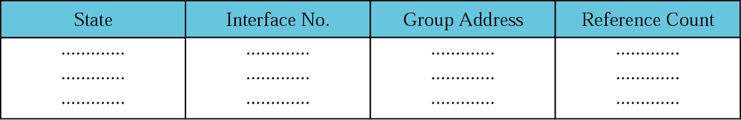
Figure 10.13 Group table

