Slide 1

Chapter 13
Stream Control
Transmission Protocol
Objectives
Upon completion you will be able to:
Be able to name and understand the services offered by SCTP
Understand SCTP’s flow and error control and congestion control
Be familiar with the fields in a SCTP segment
Understand the phases in an SCTP association
Understand the SCTP state transition diagram

Slide 2
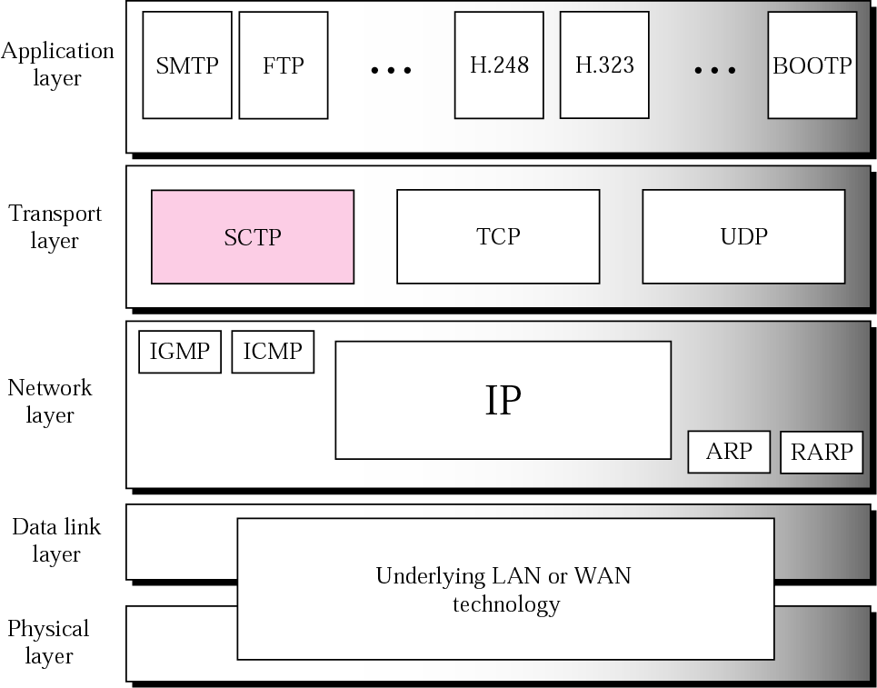
Figure 13.1 TCP/IP protocol suite

Slide 3

Note:
SCTP is a message-oriented, reliable
protocol that combines the
good features of UDP and TCP.

Slide 4
13.1 SCTP SERVICES
We explain the services offered by SCTP to the application layer processes.
The topics discussed in this section include:
Process-to-Process Communication
Multiple Streams
Multihoming
Full-Duplex Communication
Connection-Oriented Service
Reliable Service

Slide 5
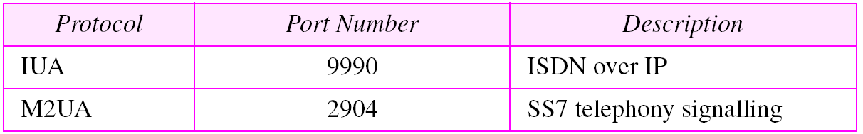
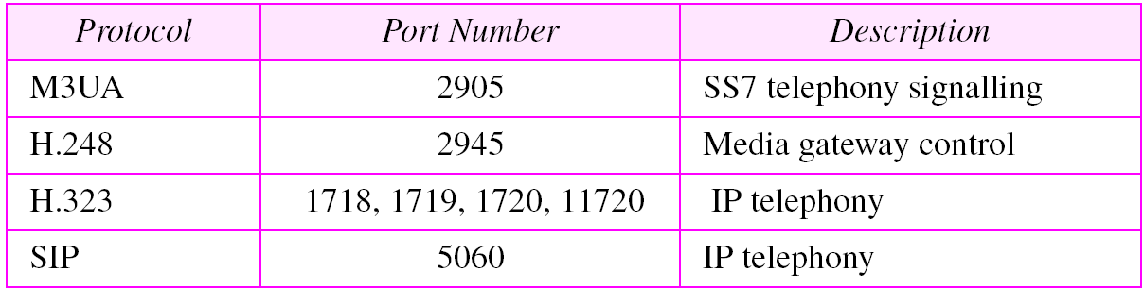
Table 13.1 Some SCTP applications

Slide 6
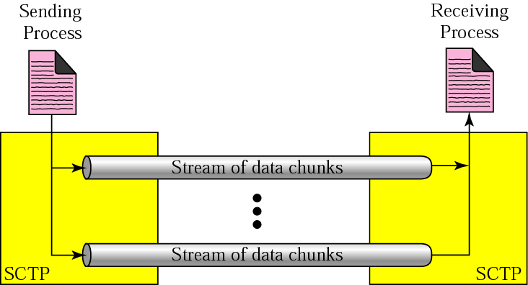
Figure 13.2 Multiple-stream concept

Slide 7
Note:
An association in SCTP can involve multiple streams.

Slide 8
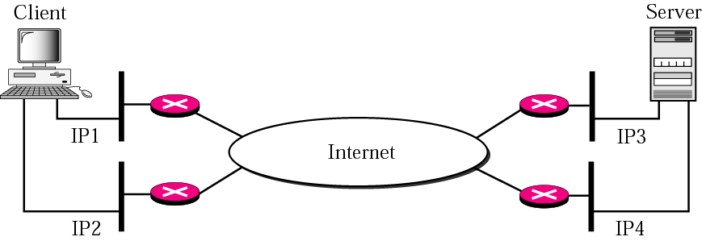
Figure 13.3 Multihoming concept

Slide 9
Note:
SCTP association allows multiple IP addresses for each end.

Slide 10
13.2 SCTP FEATURES
We discuss the general features of SCTP and then compare them with those of TCP.
The topics discussed in this section include:
Transmission Sequence Number (TSN)
Stream Identifier (SI)
Stream Sequence Number (SSN)
Packets
Acknowledgment Number
Flow Control
Error Control
Congestion Control

Slide 11
Note:
In SCTP, a data chunk is numbered using a TSN.

Slide 12
Note:
To distinguish between different streams, SCTP uses a SI.

Slide 13
Note:
To distinguish between different data chunks belonging to the same stream, SCTP uses SSNs.

Slide 14
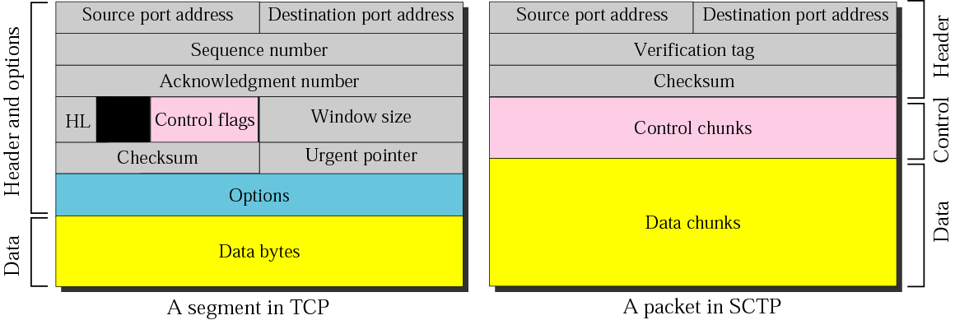
Figure 13.4 Comparison between a TCP segment and an SCTP packet

Slide 15
Note:
TCP has segments;
SCTP has packets.

Slide 16
Note:
In SCTP, control information and data information are carried in separate chunks.

Slide 17
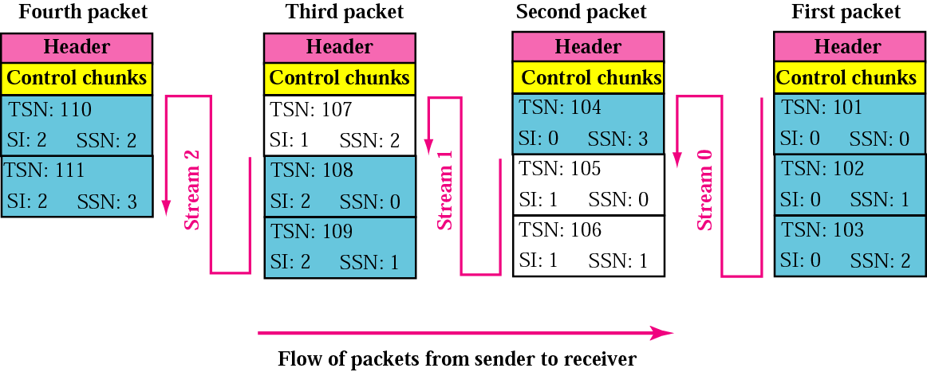
Figure 13.5 Packet, data chunks, and streams

Slide 18
Note:
Data chunks are identified by three identifiers: TSN, SI, and SSN.
TSN is a cumulative number identifying the association; SI defines the stream; SSN defines the chunk in a stream.

Slide 19
Note:
In SCTP, acknowledgment numbers are used to acknowledge only data chunks; control chunks are acknowledged by other control chunks if necessary.

Slide 20
13.3 PACKET FORMAT
We show the format of a packet and different types of chunks. An SCTP packet has a mandatory general header and a set of blocks called chunks. There are two types of chunks: control chunks and data chunks.
The topics discussed in this section include:
General Header
Chunks

Slide 21
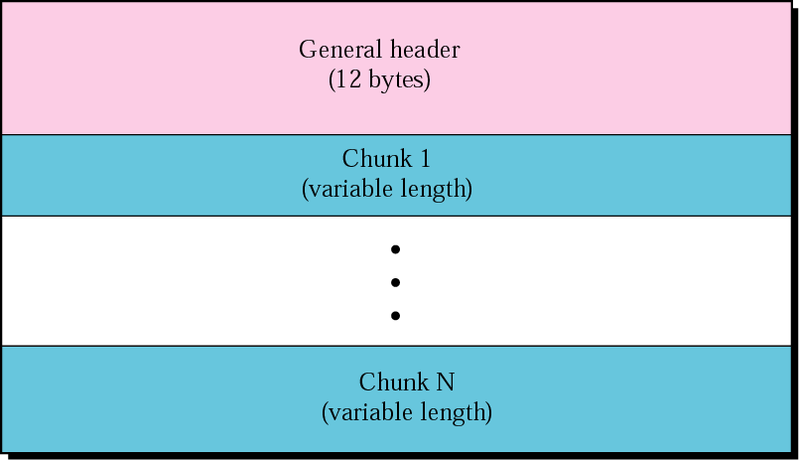
Figure 13.6 SCTP packet format

Slide 22
Note:
In an SCTP packet, control chunks come before data chunks.

Slide 23
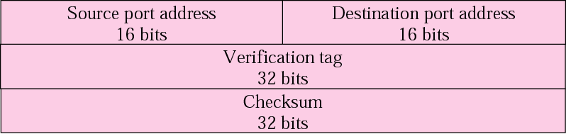
Figure 13.7 General header

Slide 24
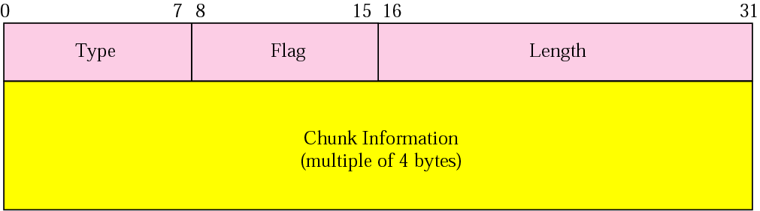
Figure 13.8 Common layout of a chunk

Slide 25
Note:
Chunks need to terminate on a 32-bit (4 byte) boundary.

Slide 26
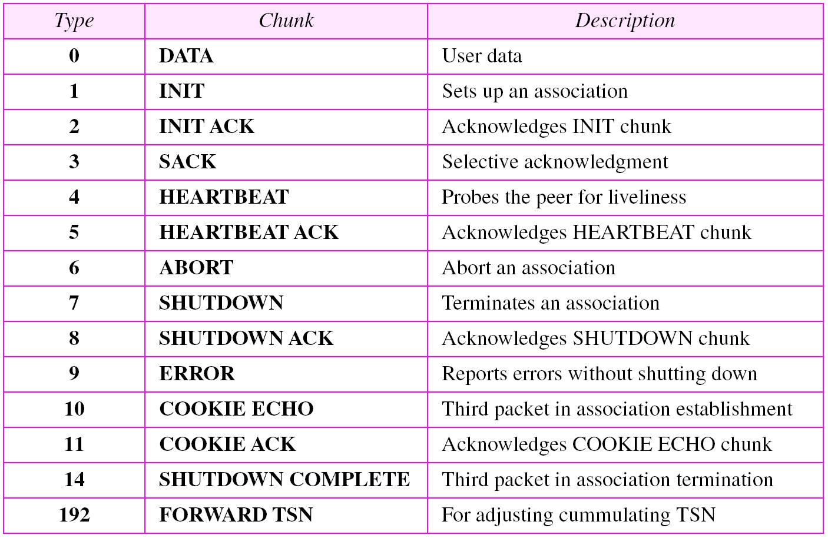
Table 13.2 Chunks

Slide 27
Note:
The number of padding bytes are not included in the value of
the length field.

Slide 28
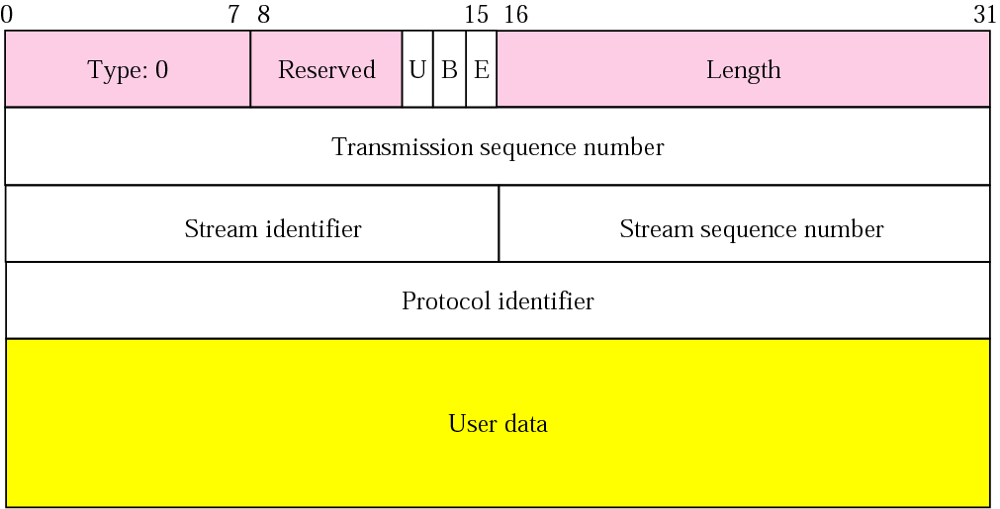
Figure 13.9 DATA chunk

Slide 29
Note:
A DATA chunk cannot carry data belonging to more than one message, but a message can be split into several chunks.
The data field of the DATA chunk must carry at least one byte of data, which means the value of length field cannot be
less than 17.

Slide 30
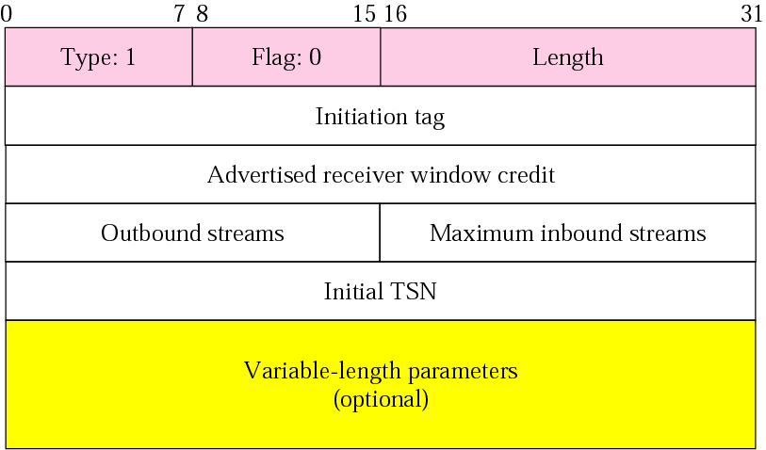
Figure 13.10 INIT chunk

Slide 31
Note:
No other chunk can be carried in a packet that carries an INIT chunk.

Slide 32
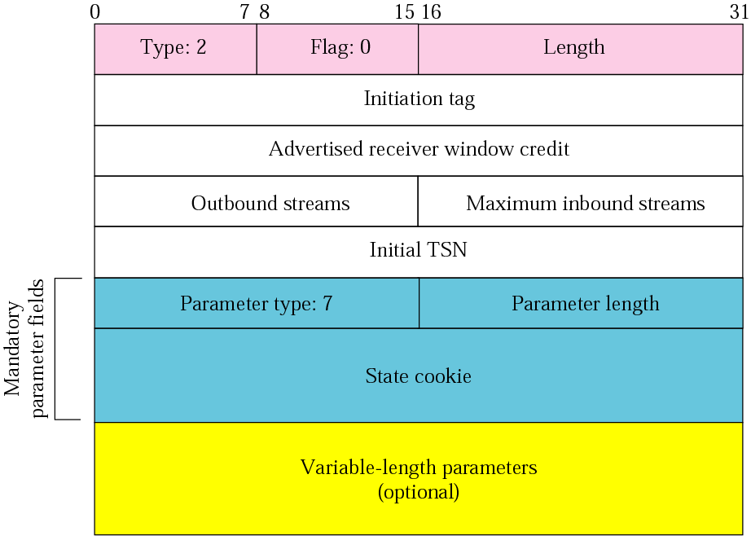
Figure 13.11 INIT ACK chunk

Slide 33
Note:
No other chunk can be carried in a packet that carries an
INIT ACK chunk.

Slide 34
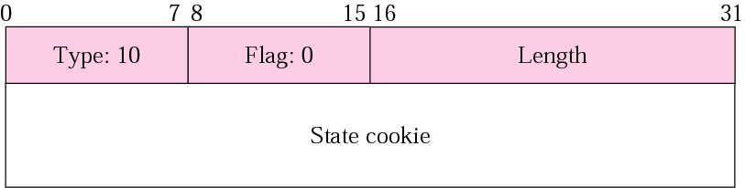
Figure 13.12 COOKIE ECHO chunk

Slide 35

Figure 13.13 COOKIE ACK

Slide 36
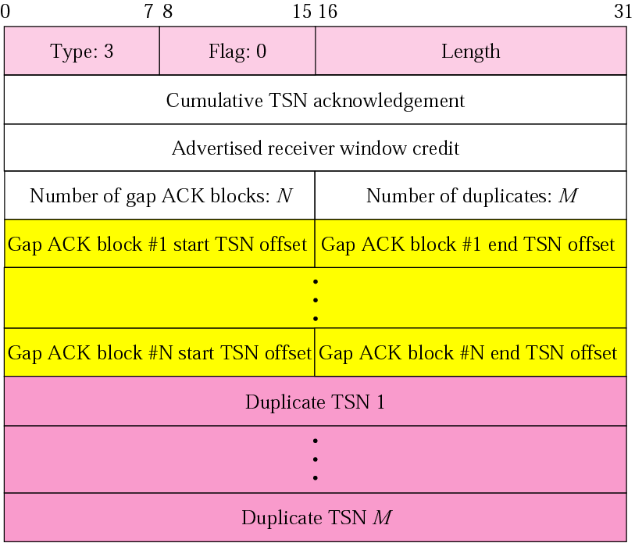
Figure 13.14 SACK chunk

Slide 37
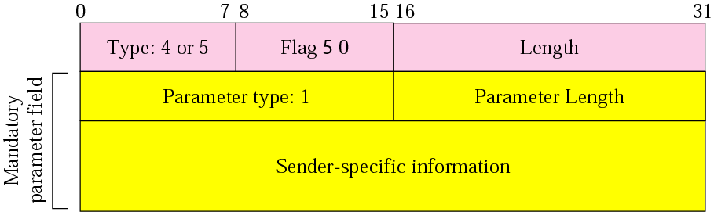
Figure 13.15 HEARTBEAT and HEARTBEAT ACK chunks

Slide 38
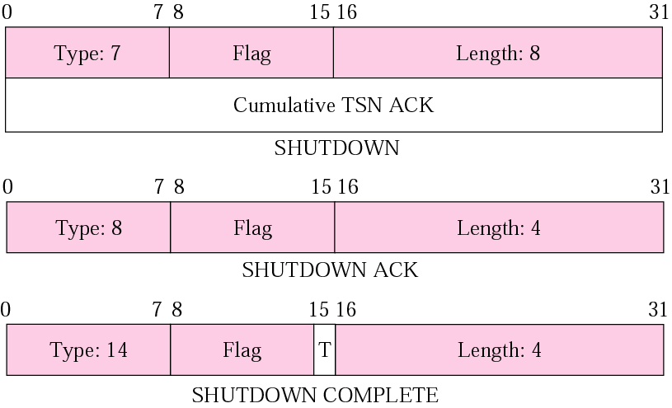
Figure 13.16 SHUTDOWN, SHUTDOWN ACK, and SHUTDOWN
COMPLETE chunks

Slide 39
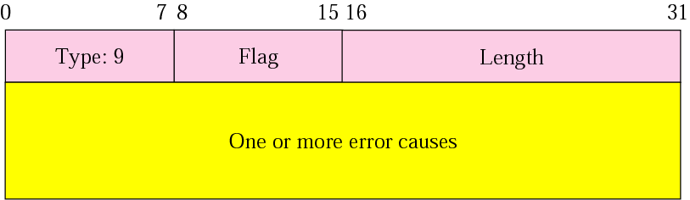
Figure 13.17 ERROR chunk

Slide 40
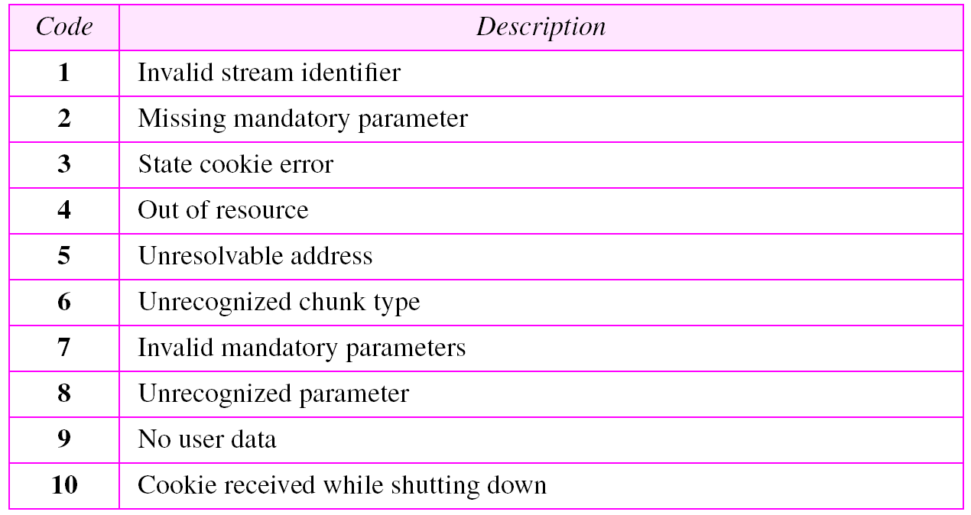
Table 13.3 Errors

Slide 41
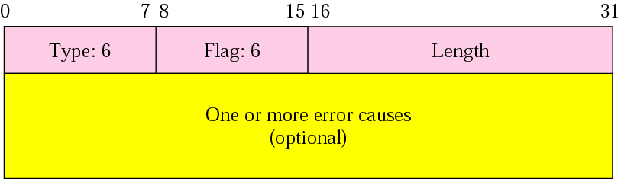
Figure 13.18 ABORT chunk

Slide 42
13.4 AN SCTP ASSOCIATION
SCTP, like TCP, is a connection-oriented protocol. However, a connection in SCTP is called an association to emphasize multihoming
The topics discussed in this section include:
Association Establishment
Data Transfer
Association Termination
Association Abortion

Slide 43
Note:
A connection in SCTP is called an association.

Slide 44
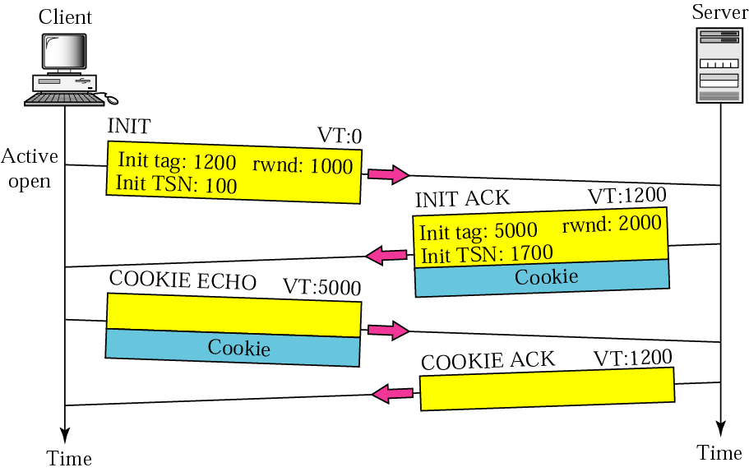
Figure 13.19 Four-way handshaking

Slide 45
Note:
No other chunk is allowed in a packet carrying an INIT or INIT ACK chunk.
A COOKIE ECHO or a COOKIE ACK chunk can carry DATA chunks.

Slide 46
Note:
In SCTP, only DATA chunks consume TSNs;
DATA chunks are the only chunks that are acknowledged.

Slide 47
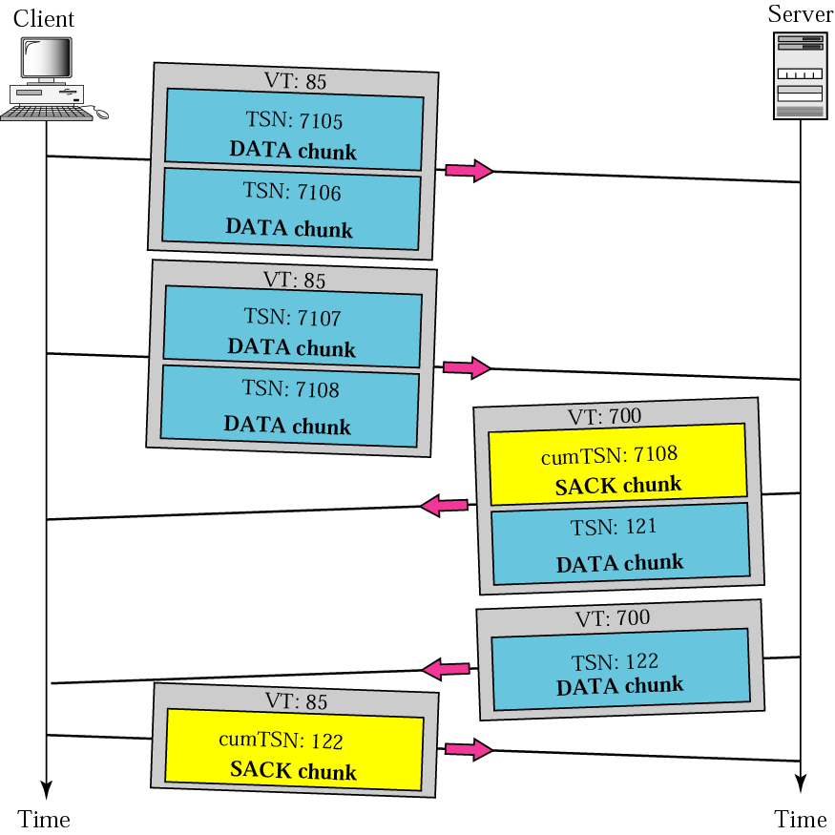
Figure 13.20 Simple data transfer

Slide 48
Note:
The acknowledgment in SCTP defines the cumulative TSN, the TSN of the last DATA chunk received in order.

Slide 49
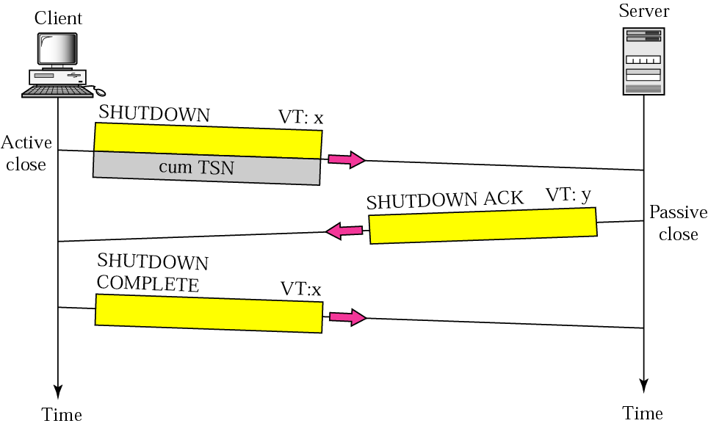
Figure 13.21 Association termination

Slide 50
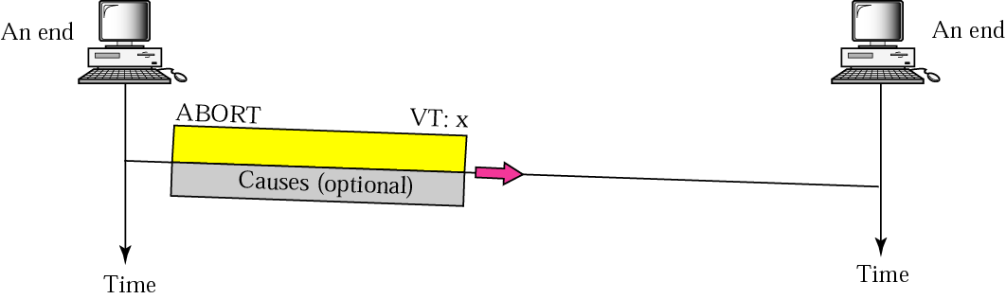
Figure 13.22 Association abortion

Slide 51
13.5 STATE TRANSITION DIAGRAM
To keep track of all the different events happening during association establishment, association termination, and data transfer, the SCTP software, like TCP, is implemented as a finite state machine.
The topics discussed in this section include:
Scenarios
Simultaneous Close

Slide 52
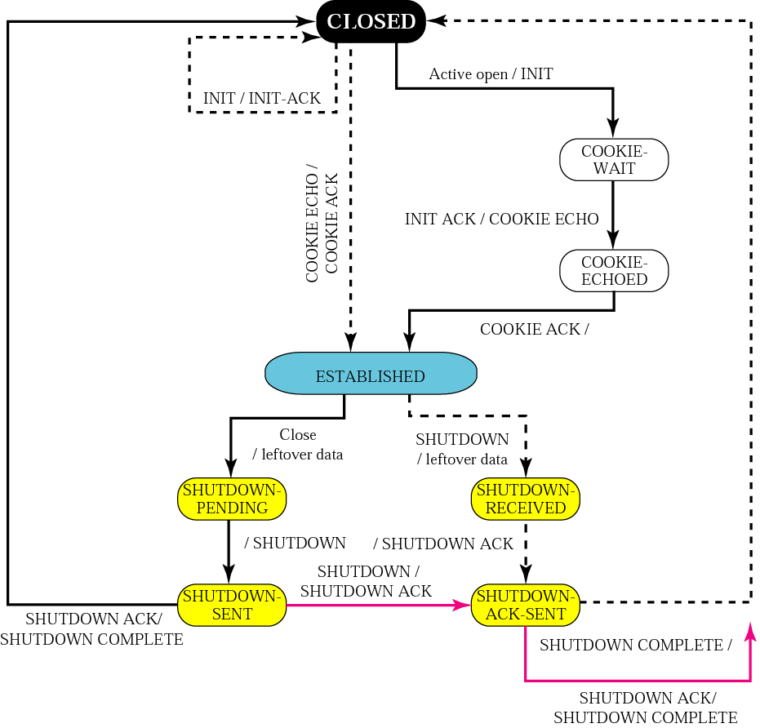
Figure 13.23 State transition diagram

Slide 53
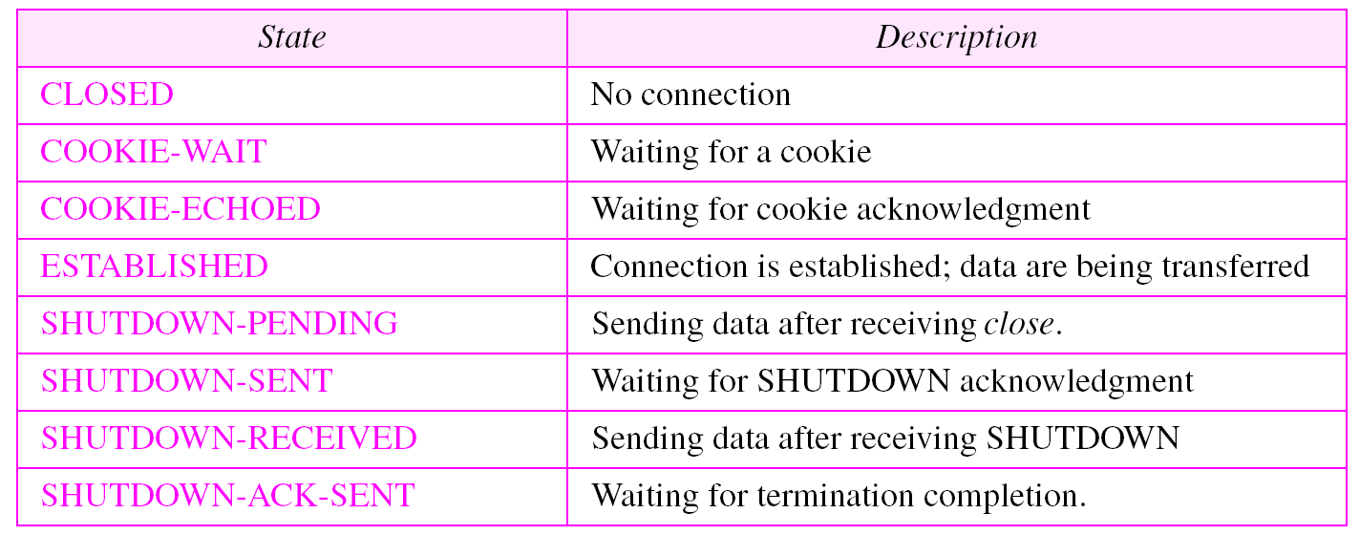
Table 13.4 States for SCTP

Slide 54
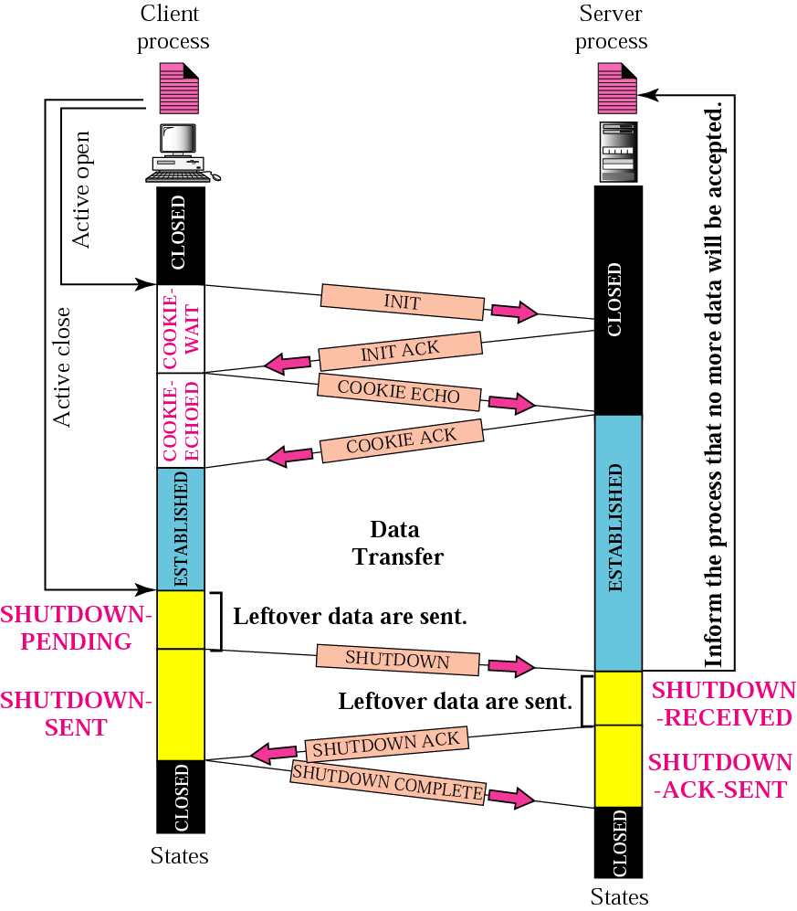
Figure 13.24 A common scenario of states

Slide 55
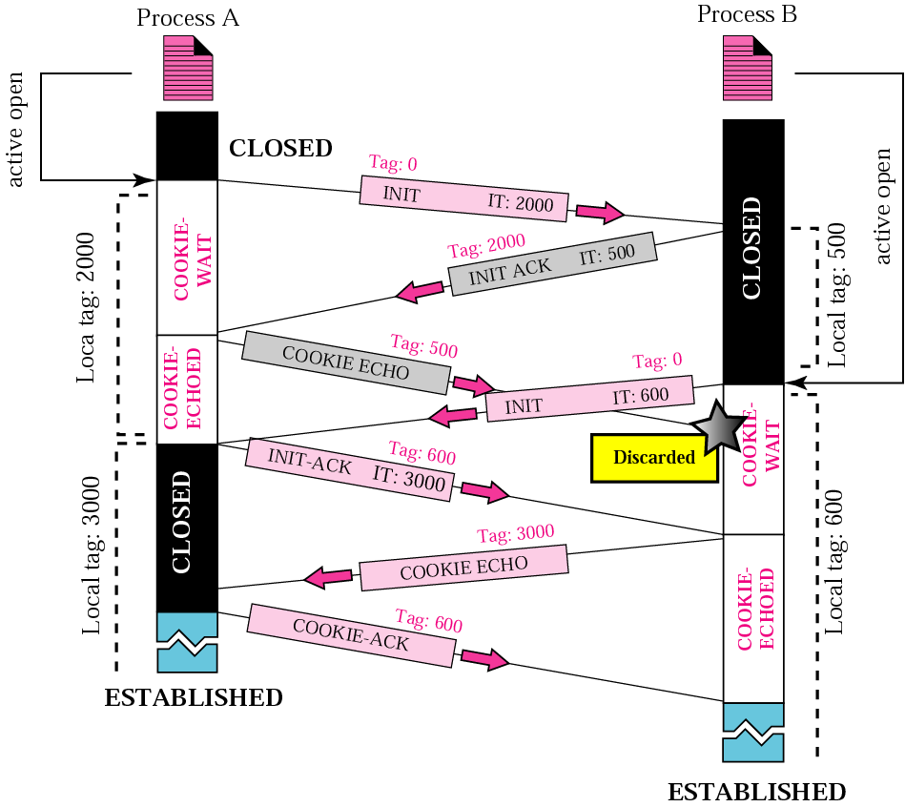
Figure 13.25 Simultaneous open

Slide 56
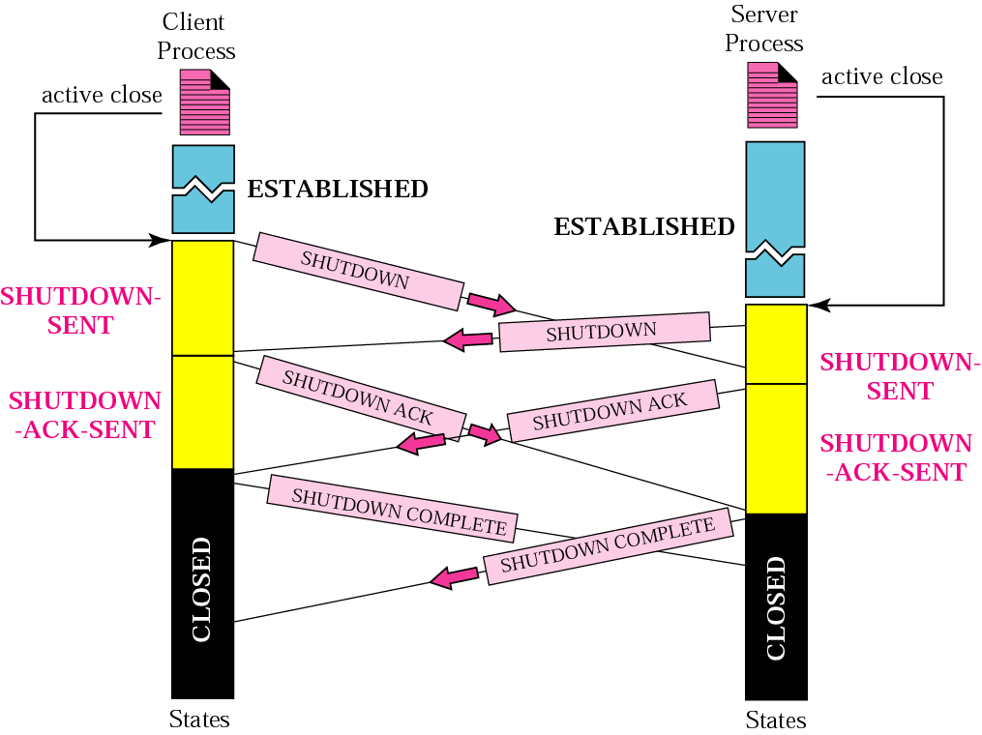
Figure 13.26 Simultaneous close

Slide 57
13.6 FLOW CONTROL
Flow control in SCTP is similar to that in TCP. In SCTP, we need to handle two units of data, the byte and the chunk.
The topics discussed in this section include:
Receiver Site
Sender Site
A Scenario

Slide 58
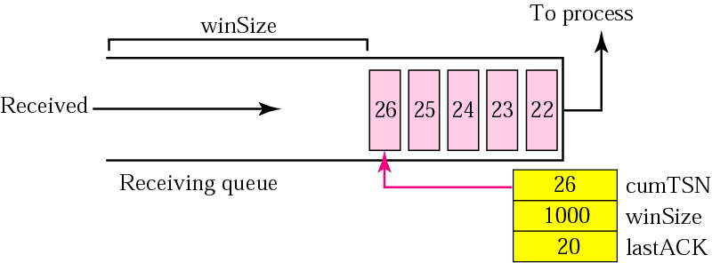
Figure 13.27 Flow control, receiver site

Slide 59
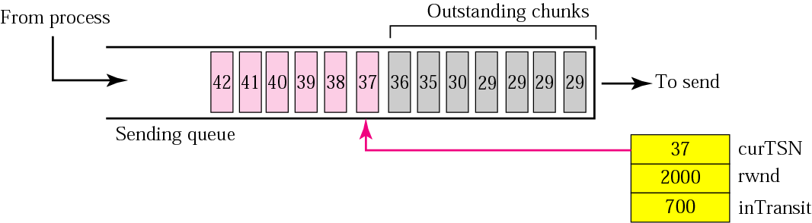
Figure 13.28 Flow control, sender site

Slide 60
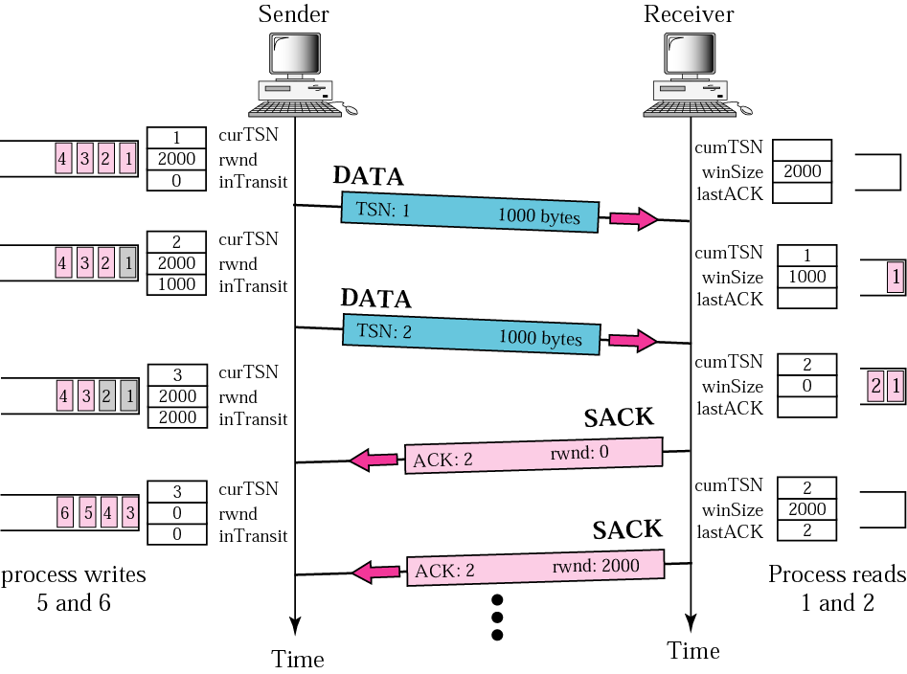
Figure 13.29 Flow control scenario

Slide 61
13.7 ERROR CONTROL
SCTP uses a SACK chunk to report the state of the receiver buffer to the sender. Each implementation uses a different set of entities and timers for the receiver and sender sites.
The topics discussed in this section include:
Receiver Site
Sender Site
Sending Data Chunks
Generating SACK Chunks

Slide 62
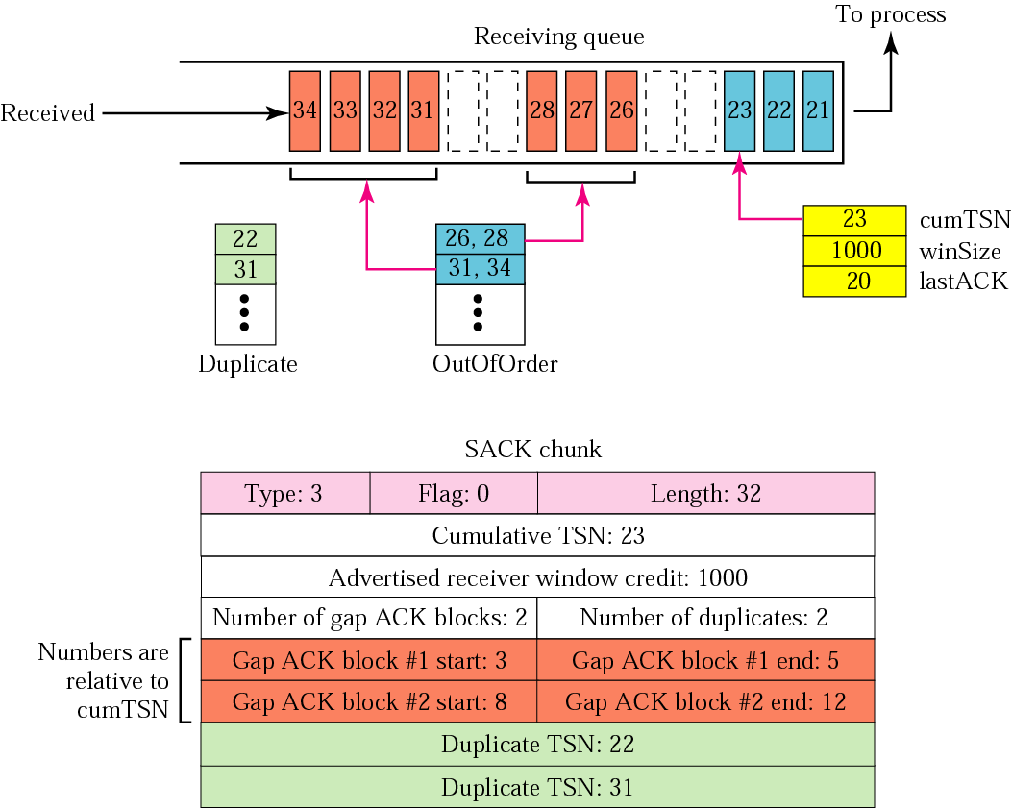
Figure 13.30 Error control, receiver site

Slide 63
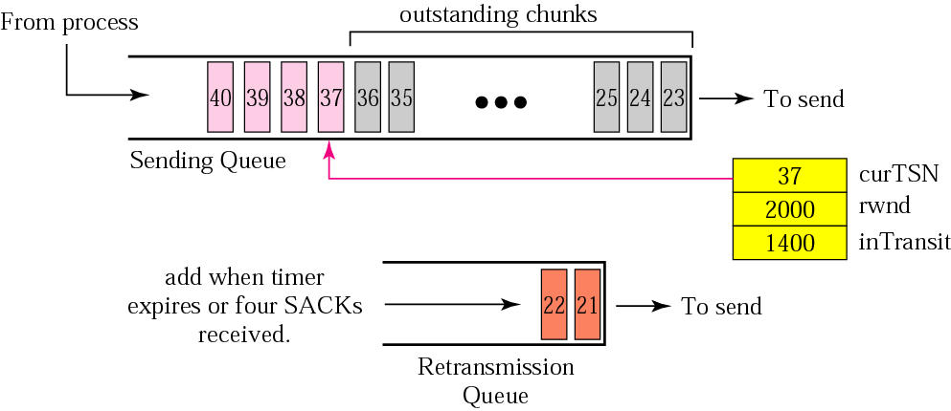
Figure 13.31 Error control, sender site

Slide 64
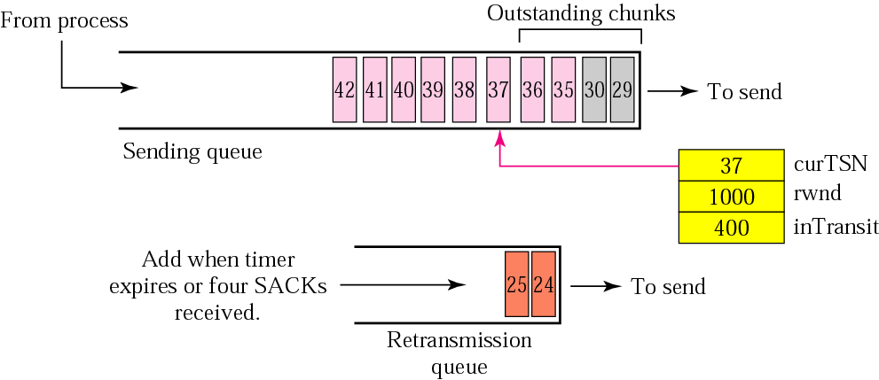
Figure 13.32 New state at the sender site after receiving a SACK chunk

Slide 65
13.8 CONGESTION CONTROL
SCTP uses the same strategies for congestion control as TCP. SCTP uses slow start, congestion avoidance, and congestion detection phases. SCTP also uses fast retransmission and fast recovery.
The topics discussed in this section include:
Congestion Control and Multihoming
Explicit Congestion Notification

