Slide 1

Chapter 16
Host Configuration:
BOOTP and DHCP
Objectives
Upon completion you will be able to:
Know the types of information required by a system on boot-up
Know how BOOTP operates
Know how DHCP operates
Understand the differences between BOOTP and DHCP
Understand the DHCP transition state diagram

Slide 2
16.1 BOOTP
The Bootstrap Protocol (BOOTP) is a client/server protocol that configures a diskless computer or a computer that is booted for the first time. BOOTP provides the IP address, net mask, the address of a default router, and the address of a name server.
The topics discussed in this section include:
Operation
Packet Format

Slide 3
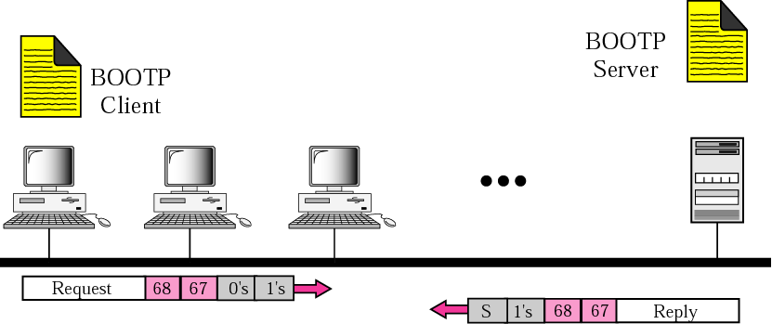
Figure 16.1 Client and server on the same network

Slide 4
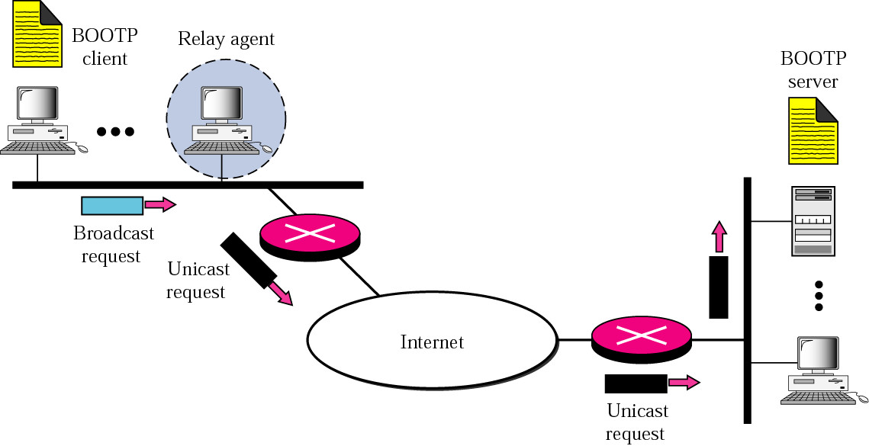
Figure 16.2 Client and server on two different networks

Slide 5
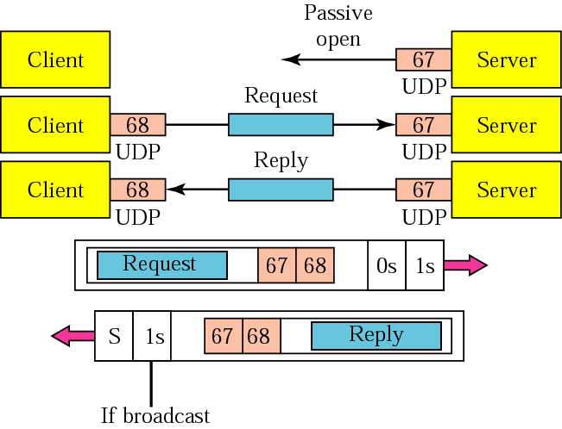
Figure 16.3 Use of UDP ports

Slide 6
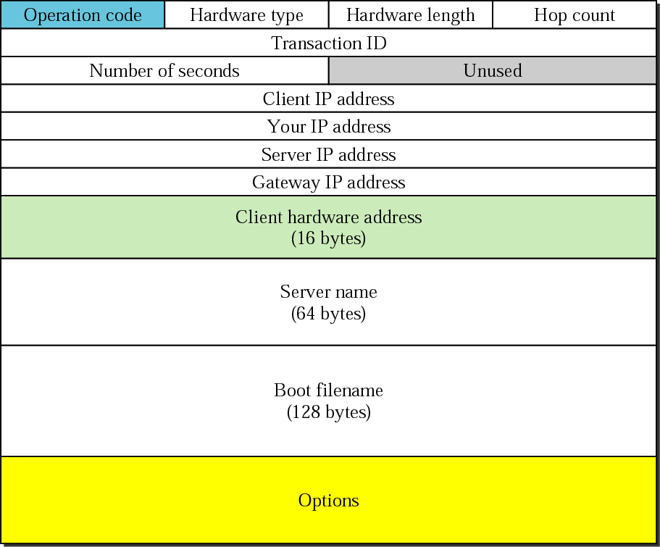
Figure 16.4 BOOTP packet format

Slide 7
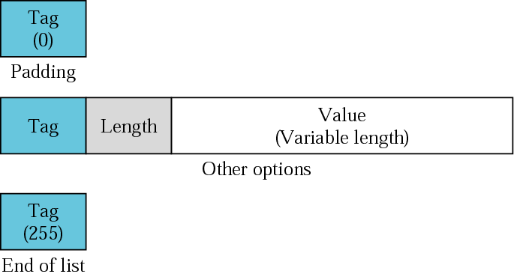
Figure 16.5 Option format

Slide 8
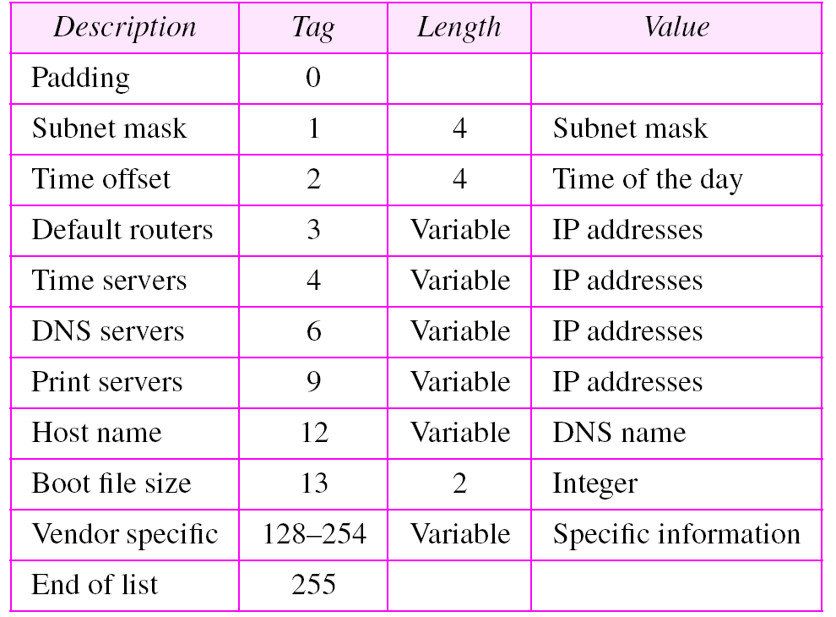
Table 16.1 Options for BOOTP

Slide 9
16.2 DHCP
The Dynamic Host Configuration Protocol (DHCP) provides static and dynamic address allocation that can be manual or automatic.
The topics discussed in this section include:
Static Address Allocation
Dynamic Address Allocation
Manual and Automatic Configuration
Packet Format
Transition States
Exchanging Messages

Slide 10

Note:
DHCP provides static and dynamic address allocation that can be manual or automatic.

Slide 11
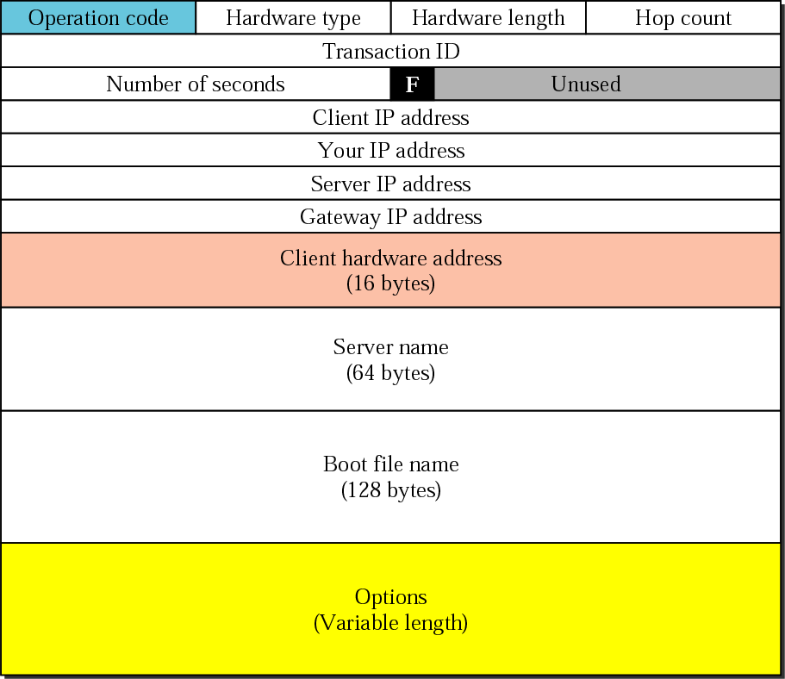
Figure 16.6 DHCP packet

Slide 12
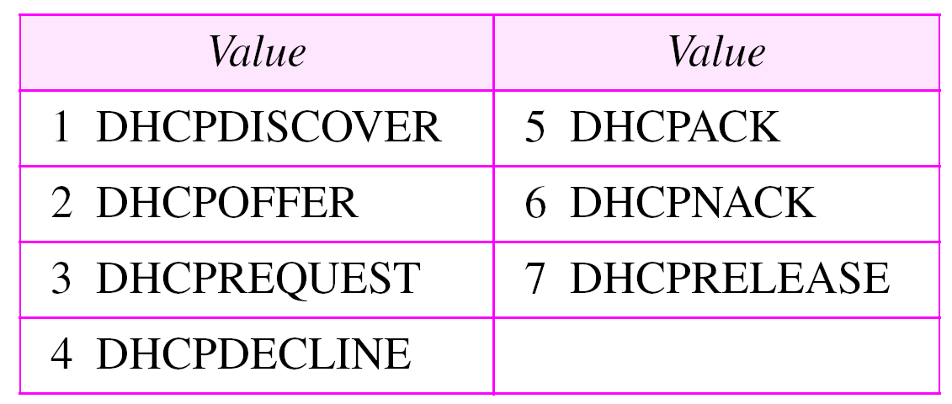
Table 16.2 Options for DHCP

Slide 13
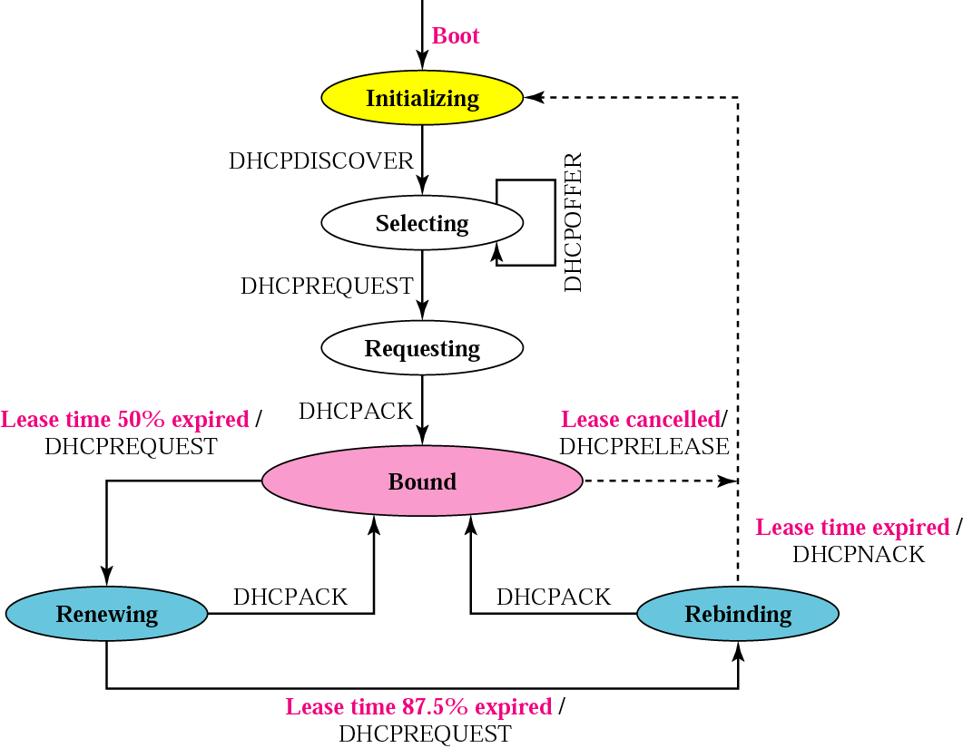
Figure 16.7 DHCP transition diagram

Slide 14
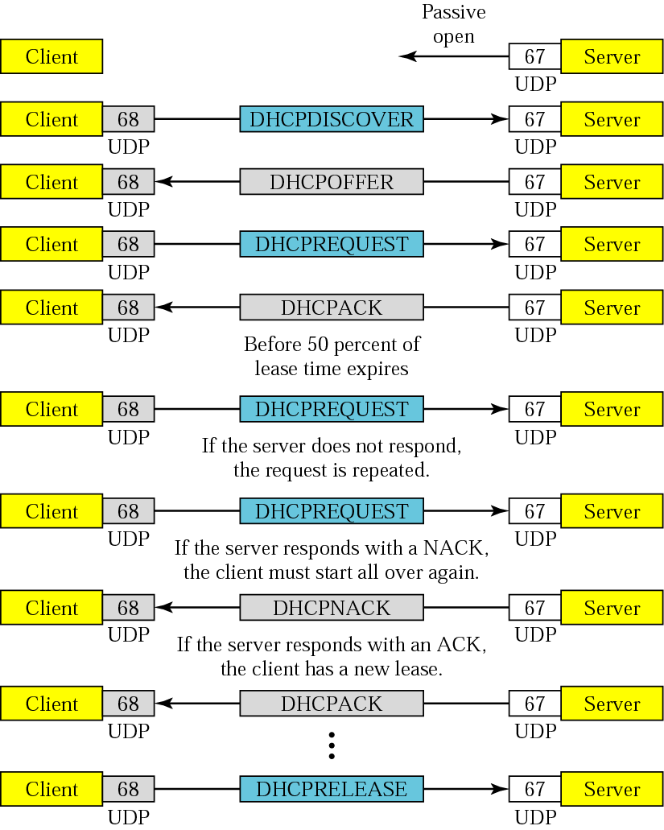
Figure 16.8 Exchanging messages

