Slide 1

Chapter 22
World Wide Web:
HTTP
Objectives
Upon completion you will be able to:
Understand the components of a browser and a server
Understand the function of the URL and cookies
Understand how HTML is related to static documents
Understand how CGI is related to dynamic documents
Understand how Java is related to active documents
Know how HTTP accesses data on the WWW

Slide 2
22.1 ARCHITECTURE
The WWW is a distributed client-server service, in which a client using a browser can access a service using a server. The service provided is distributed over many locations called sites.
The topics discussed in this section include:
Client (Browser)
Server
Uniform Resource Locator (URL)
Cookies

Slide 3
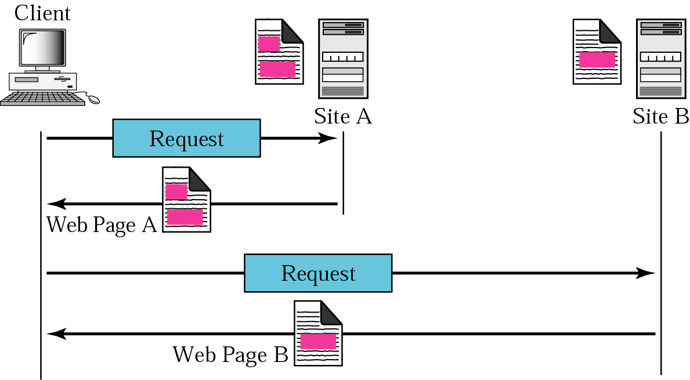
Figure 22.1 Architecture of WWW

Slide 4
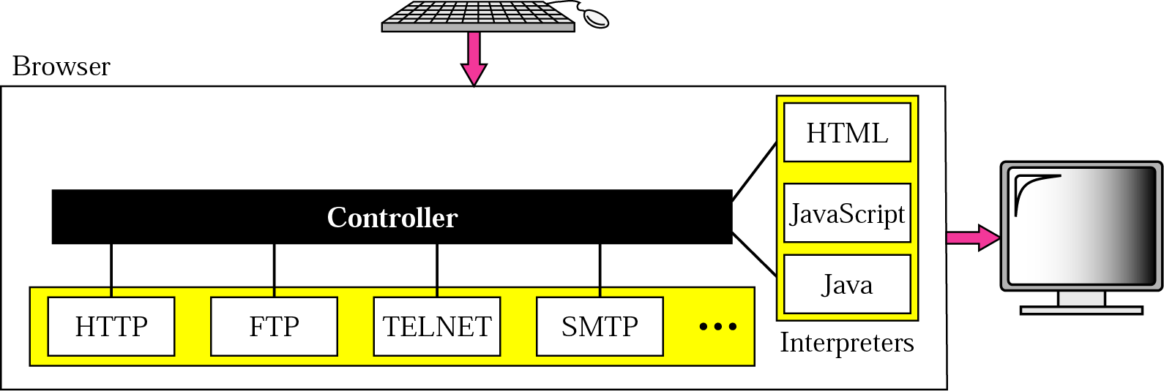
Figure 22.2 Browser

Slide 5
Figure 22.3 URL

Slide 6
22.2 WEB DOCUMENTS
The documents in the WWW can be grouped into three broad categories: static, dynamic, and active. The category is based on the time the contents of the document are determined.
The topics discussed in this section include:
Static Documents
Dynamic Documents
Active Documents

Slide 7
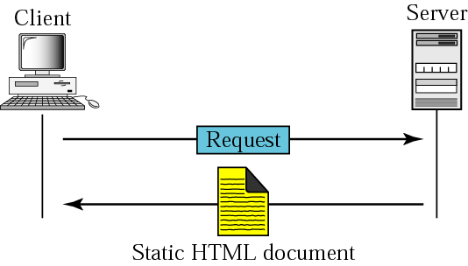
Figure 22.4 Static document

Slide 8

Figure 22.5 Boldface tags

Slide 9
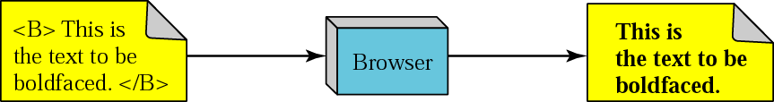
Figure 22.6 Effect of boldface tags

Slide 10
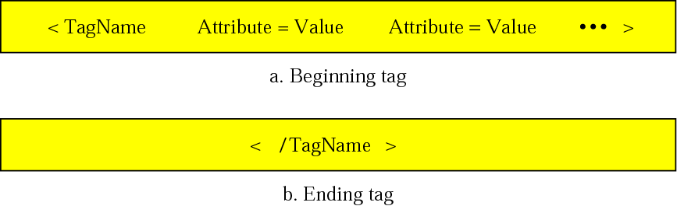
Figure 22.7 Beginning and ending tags

Slide 11
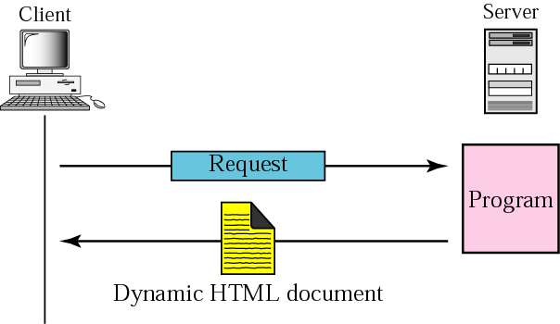
Figure 22.8 Dynamic document using CGI

Slide 12
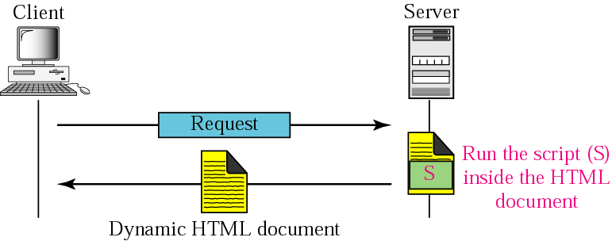
Figure 22.9 Dynamic document using server-site script

Slide 13

Note:
Dynamic documents are sometimes referred to as server-site dynamic documents.

Slide 14
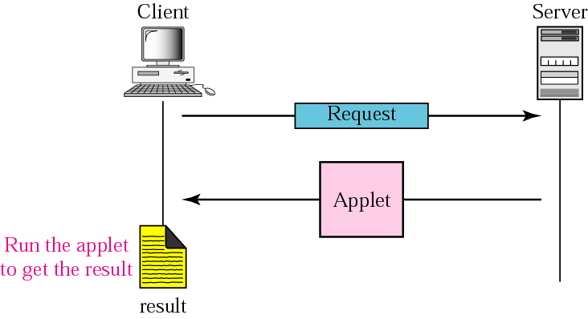
Figure 22.10 Active document using Java applet

Slide 15
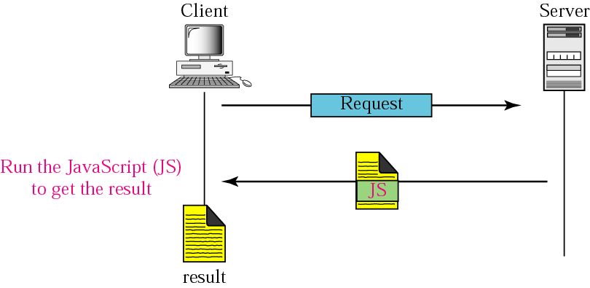
Figure 22.11 Active document using client-site script

Slide 16
Note:
Active documents are sometimes referred to as client-site dynamic documents.

Slide 17
22.3 HTTP
The Hypertext Transfer Protocol (HTTP) is a protocol used mainly to access data on the World Wide Web. HTTP functions like a combination of FTP and SMTP.
The topics discussed in this section include:
HTTP Transaction
Persistent versus Nonpersistent Connection
Proxy Server

Slide 18
Note:
HTTP uses the services of TCP on well-known port 80.

Slide 19
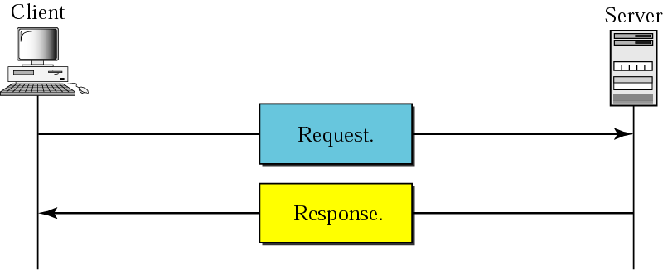
Figure 22.12 HTTP transaction

Slide 20
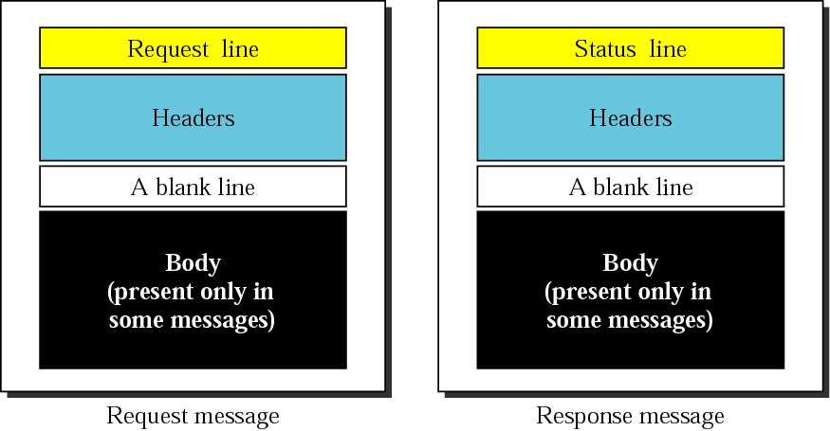
Figure 22.13 Request and response messages

Slide 21
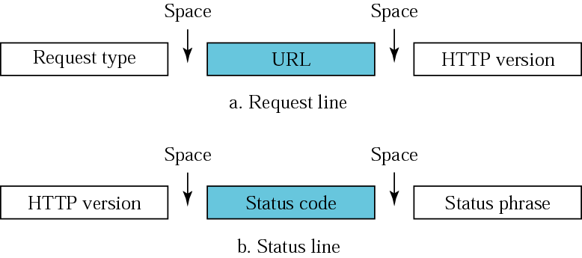
Figure 22.14 Request and status lines

Slide 22
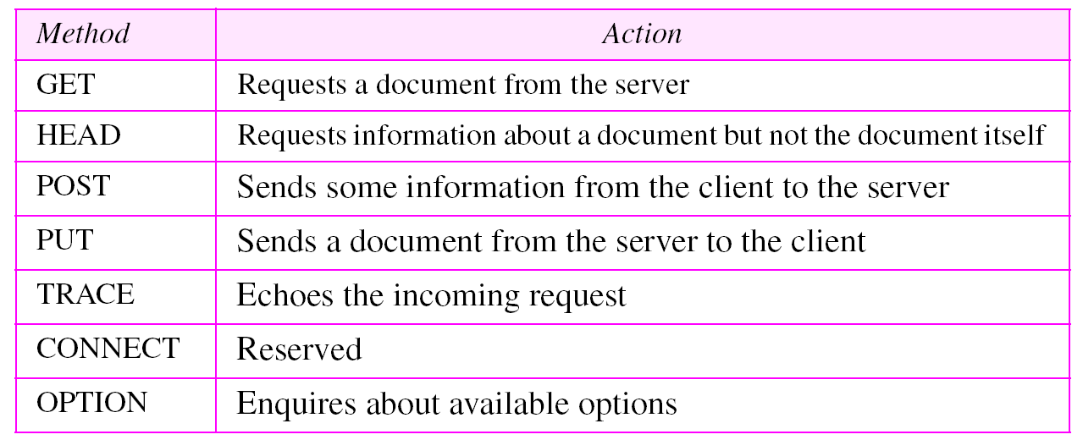
Table 22.1 Methods

Slide 23
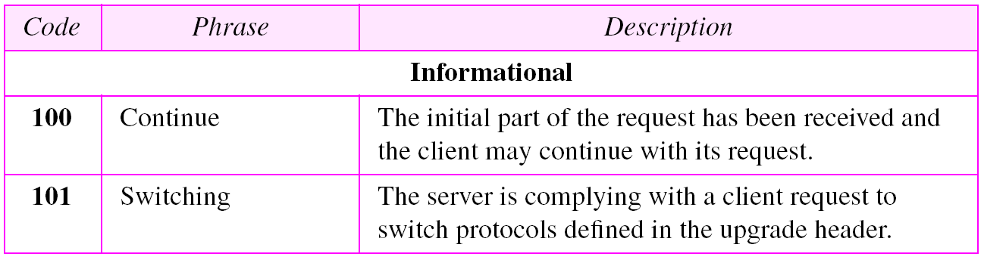
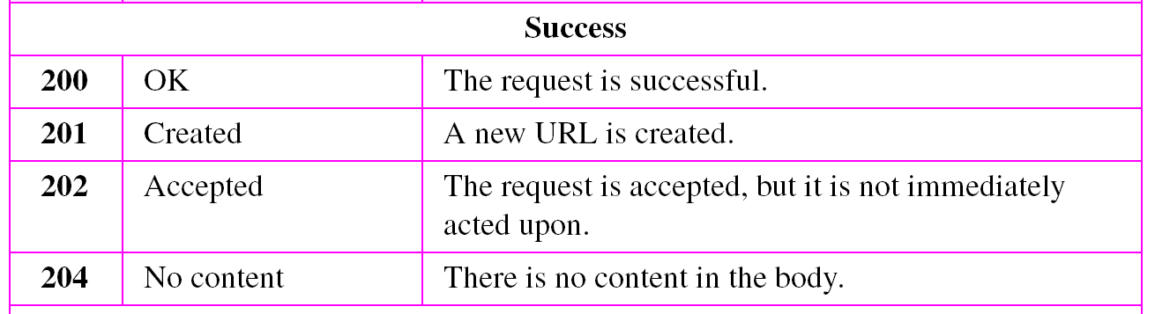
Table 22.2 Status codes

Slide 24
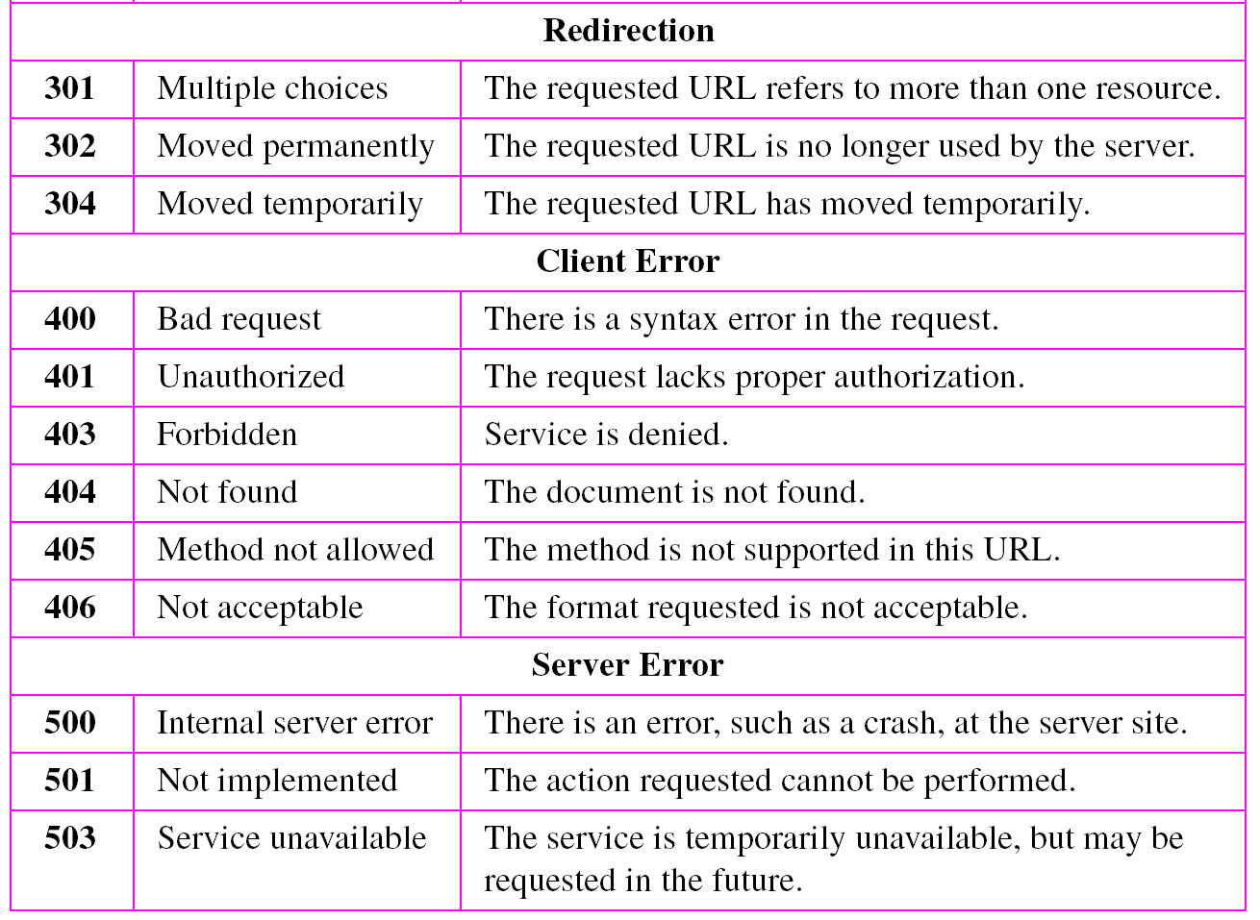
Table 22.2 Status codes (continued)

Slide 25
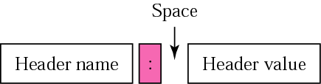
Figure 22.15 Header format

Slide 26
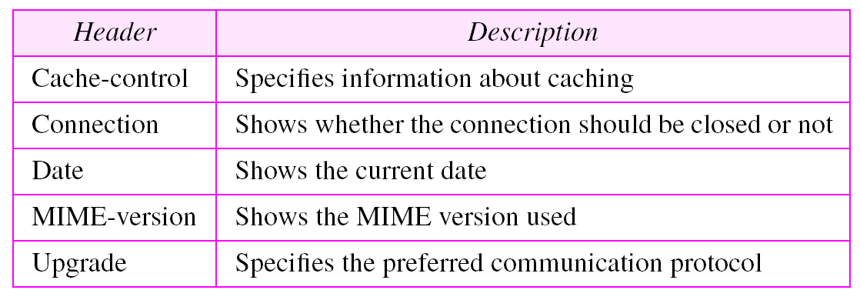
Table 22.3 General headers

Slide 27
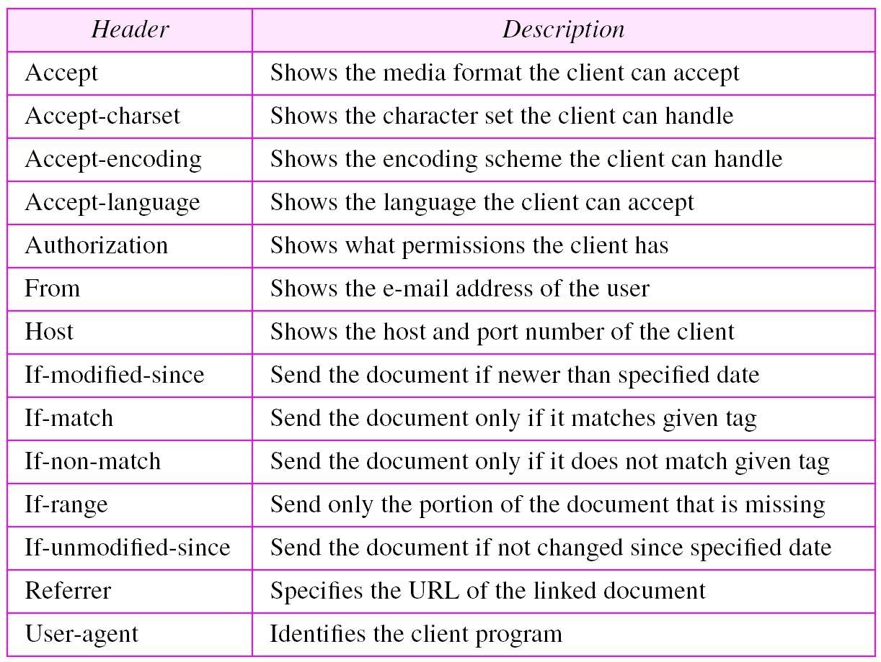
Table 22.4 Request headers

Slide 28
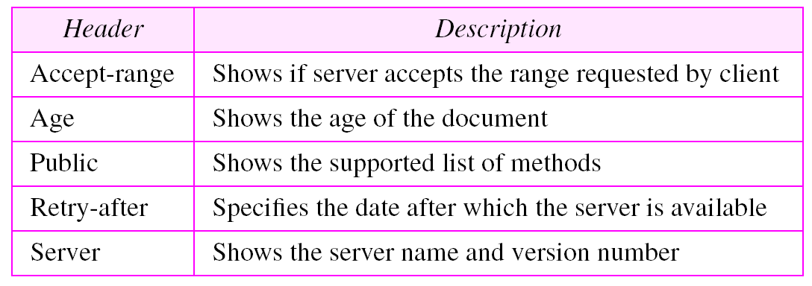
Table 22.5 Response headers

Slide 29
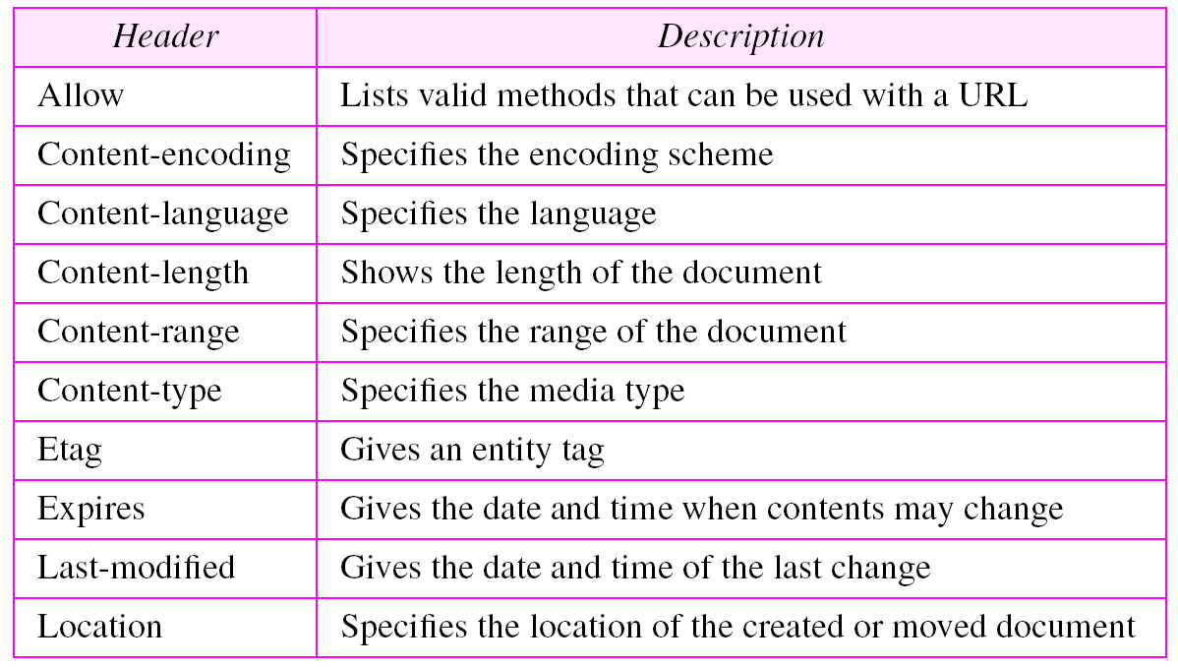
Table 22.6 Entity headers

Slide 30
Example 1
This example retrieves a document. We use the GET method to retrieve an image with the path /usr/bin/image1. The request line shows the method (GET), the URL, and the HTTP version (1.1). The header has two lines that show that the client can accept images in the GIF or JPEG format. The request does not have a body. The response message contains the status line
and four lines of header. The header lines define the date, server, MIME version, and length of the document. The body of the document follows the header (see Figure 22.16).
See Next Slide

Slide 31
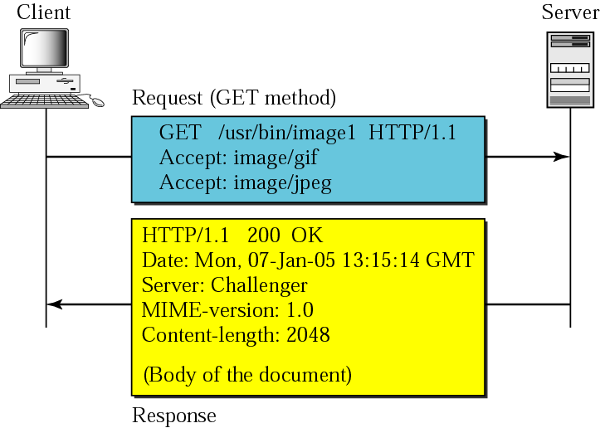
Figure 22.16 Example 1

Slide 32
Example 2
In this example, the client wants to send data to the server. We use the POST method. The request line shows the method (POST), URL, and HTTP version (1.1). There are four lines of headers. The request body contains the input information. The response message contains the status line and four lines of headers. The created document, which is a CGI document, is included as the body (see Figure 22.17).
See Next Slide

Slide 33
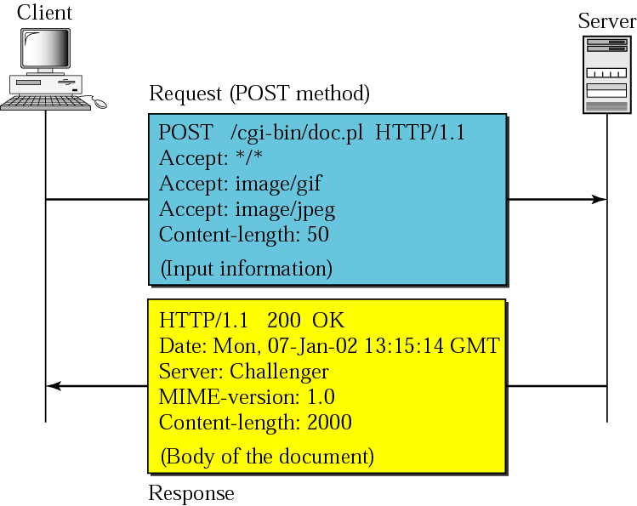
Figure 22.17 Example 2

Slide 34
Example 3
HTTP uses ASCII characters. A client can directly connect to a server using TELNET, which logs into port 80. The next three lines shows that the connection is successful. We then type three lines. The first shows the request line (GET method), the second is the header (defining the host), the third is a blank terminating the request. The server response is seven lines starting with the status line. The blank line at the end terminates the server response. The file of 14230 lines is received after the blank line (not shown here). The last line is the output by the client.
See Next Slide

Slide 35
Example 3
$ telnet www.mhhe.com 80
Trying 198.45.24.104...
Connected to www.mhhe.com (198.45.24.104).
Escape character is '^]'.
GET /engcs/compsci/forouzan HTTP/1.1
From: forouzanbehrouz@fhda.edu
HTTP/1.1 200 OK
Date: Thu, 28 Oct 2004 16:27:46 GMT
Server: Apache/1.3.9 (Unix) ApacheJServ/1.1.2 PHP/4.1.2 PHP/3.0.18
MIME-version:1.0
Content-Type: text/html
Last-modified: Friday, 15-Oct-04 02:11:31 GMT
Content-length: 14230
Connection closed by foreign host.

Slide 36
Note:
HTTP version 1.1 specifies a persistent connection by default.

