Slide 1
HMIPv6
(Hierarchical Mobile IPv6)

Slide 2
Hierarchical Mobile IPV6 (HMIPv6) provides micro-mobility support by installing a mobility anchor point (MAP). МАР is an entity which is responsible for a certain domain and acts as a local HA within this domain for visiting MNs.
The MAP receives all packets on behalf of the MN, encapsulates and forwards them directly to the MN's current address LCOA (Link COA).
As long as an MN stays within the domain of a MAP, the globally visible COA (regional COA, RCOA) does not change.
A MAP domain’s boundaries are defined by the access routers (AR) advertising the MAP information to the attached MNs. A MAP assists with local handovers and maps RCOA to LCOA.

Slide 3
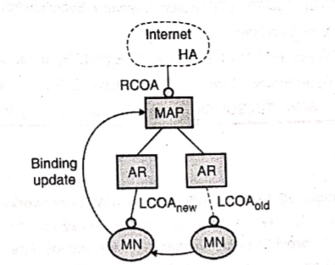
Fig. Basic architecture of Hierarchical mobile IP
MNs register their RCOA with the HA using a binding update. When a MN moves locally it must only register its new LCOA with its MAP. The RCOA stays unchanged.
To support smooth handovers between MAP domains, an MN can send a binding update to its former MAP.

Slide 4
It should be mentioned as a security benefit that mobile nodes can be provided with some kind of limited location privacy because LCOAs on lower levels of the mobility hierarchy can be hidden from the outside world.
However, this applies only to micro mobility, that is, as long as the mobile node rests in the same domain. A MN can also send a binding update to a CN (Core Network) who shares the same link.
This reveals its location but optimizes packet flow (direct routing without going through the MAP). MNs can use their RCOA as source address.
The extended mode of HMIPv6 supports both mobile nodes and mobile networks.

Slide 5
Advantages
1. Security: MNs can have (limited) location privacy because LCOAs can be hidden.
2. Efficiency: Direct routing between CNs(Core Network) sharing the same link is possible
Disadvantages
1. Transparency: Additional infrastructure component (MAP).
2. Security: Routing tables are changed based on messages sent by mobile nodes. This requires strong authentication and protection against denial of service attacks. Additional security functions might be necessary in MAPS

Slide 6
Thank You!

