Slide 1
Web Application Security 101
Steve Carter
(special thanks to SPI Dynamics)

Slide 2
Overview
Background
Web app vulnerabilities
Securing web apps

Slide 3
Background

Slide 4
HTTP
Hypertext Transfer Protocol
  “Hypertext Transfer Protocol (HTTP) is a communications protocol for the transfer of information on intranets and the World Wide Web. Its original purpose was to provide a way to publish and retrieve hypertext pages over the Internet.”
  http://en.wikipedia.org/wiki/HTTP
Server
www.mybank.com
(64.58.76.230)
Port: 80
Client PC
(10.1.0.123)
Request
Response
Notes:
HTTP is called a stateless protocol because each request is processed independently, without any knowledge of the requests that came before it.

Slide 5
HTTP Request - GET
Form data encoded in the URL
Most common HTTP method used on the web
Should be used to retrieve information, not for actions that have side-effects
Notes:
REST is a term coined by Roy Fielding in his Ph.D. dissertation [1] to describe an architecture style of networked systems. REST is an acronym standing for Representational State Transfer. http://www.xfront.com/REST-Web-Services.html

Slide 6

HTTP Request - GET
GET http://www.mysite.com/kgsearch/search.php?catid=1 HTTP/1.1
Host: www.mysite.com
User-Agent: Mozilla/5.0 (Windows; U; Windows NT 5.1; en-US; rv:1.8.1.13) Gecko/20080311 Firefox/2.0.0.13
Accept: text/xml,application/xml,application/xhtml+xml,text/html;q=0.9,text/plain;q=0.8,image/png,*/*;q=0.5
Accept-Language: en-us,en;q=0.5
Accept-Encoding: gzip,deflate
Accept-Charset: ISO-8859-1,utf-8;q=0.7,*;q=0.7
Keep-Alive: 300
Connection: keep-alive
Referer: http://www.mysite.com/

Slide 7
HTTP Request - GET
http://www.google.com/search?hl=en&lr=&c2coff=1&rls=GGLG%2CGGLG%3A2005-26%2CGGLG%3Aen&q=http%3A%2F%2Fwww.google.com%2Fsearch%3Fhl%3Den%26lr%3D%26c2coff%3D1%26rls%3DGGLG%252CGGLG%253A2005-26%252CGGLG%253Aen%26q%3Dhttp%253A%252F%252Fwww.google.com%252Fsearch%253Fhl%253Den%2526lr%253D%2526c2coff%253D1%2526rls%253DGGLG%25252CGGLG%25253A2005-26%25252CGGLG%25253Aen%2526q%253Dhttp%25253A%25252F%25252Fwww.google.com%25252Fsearch%25253Fsourceid%25253Dnavclient%252526ie%25253DUTF-8%252526rls%25253DGGLG%25252CGGLG%25253A2005-26%25252CGGLG%25253Aen%252526q%25253Dhttp%2525253A%2525252F%2525252Fwww%2525252Egoogle%2525252Ecom%2525252Fsearch%2525253Fsourceid%2525253Dnavclient%25252526ie%2525253DUTF%2525252D8%25252526rls%2525253DGGLG%2525252CGGLG%2525253A2005%2525252D26%2525252CGGLG%2525253Aen%25252526q%2525253Dhttp%252525253A%252525252F%252525252Fuk2%252525252Emultimap%252525252Ecom%252525252Fmap%252525252Fbrowse%252525252Ecgi%252525253Fclient%252525253Dpublic%2525252526GridE%252525253D%252525252D0%252525252E12640%2525252526GridN%252525253D51%252525252E50860%2525252526lon%252525253D%252525252D0%252525252E12640%2525252526lat%252525253D51%252525252E50860%2525252526search%252525255Fresult%252525253DLondon%25252525252CGreater%252525252520London%2525252526db%252525253Dfreegaz%2525252526cidr%252525255Fclient%252525253Dnone%2525252526lang%252525253D%2525252526place%252525253DLondon%252525252CGreater%252525252BLondon%2525252526pc%252525253D%2525252526advanced%252525253D%2525252526client%252525253Dpublic%2525252526addr2%252525253D%2525252526quicksearch%252525253DLondon%2525252526addr3%252525253D%2525252526scale%252525253D100000%2525252526addr1%252525253D%2526btnG%253DSearch%26btnG%3DSearch&btnG=Search

Slide 8
HTTP Requests - POST
Data is included in the body of the request.
Should be used for any action that has side-effects
  Storing/updating data, ordering a product, etc…

Slide 9

HTTP Requests - POST
POST http://www.mysite.com/kgsearch/search.php HTTP/1.1
Host: www.mysite.com
User-Agent: Mozilla/5.0 (Windows; U; Windows NT 5.1; en-US; rv:1.8.1.13) Gecko/20080311 Firefox/2.0.0.13
Accept: text/xml,application/xml,application/xhtml+xml,text/html;q=0.9,text/plain;q=0.8,image/png,*/*;q=0.5
Accept-Language: en-us,en;q=0.5
Accept-Encoding: gzip,deflate
Accept-Charset: ISO-8859-1,utf-8;q=0.7,*;q=0.7
Keep-Alive: 300
Connection: keep-alive
Referer: http://www.mysite.com/
catid=1

Slide 10
Famous quote of the day
“Every program has at least two purposes: the one for which it was written, and another for which it wasn't.”
-Alan J. Perlis
Notes:
A big part of web application security testing involves attempts to force an application to function in a way it was not intended to.
Alan Jay Perlis was an computer scientist known for his pioneering work in programming languages and the first recipient of the Turing Award (nobel prize of computing)

Slide 11
GET v. POST Security
There information contained in parameters can tell a user a lot about how your application works
GET parameters are easily visible in the address bar
POST parameters are hidden from the average user
  Users can still view source code
  Users can still view the packets
  Users can still intercept & modify web requests

Slide 12
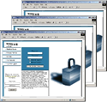

Web Sites
No applications
Static pages
Hard coded links
Browser
Web Server

Slide 13
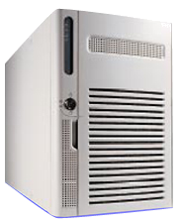

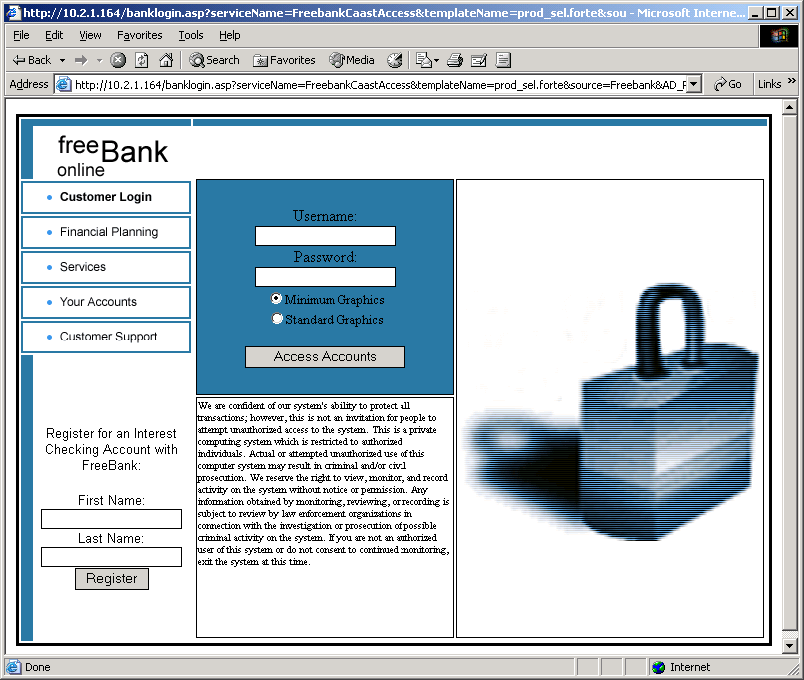
Web Applications
Very complex architectures, multiple platforms, multiple protocols
Web Application
Web Services
HTTP
Network
Application Server
Business Logic
Content Services
Database Server
Customer Identification
Access Controls
Transaction Information
Core Business Data
Wireless
Web Servers
Presentation Layer
Media Store
Browser
Notes:
Main speaking points:
- Now we no longer have websites, we have web applications
- Web applications reside on multiple systems in distributed architectures
- Three tiers (presentation, logic, data)
- Use sophisticated programming languages and architectures
- Corporate and customer data moved to the computing edge
- Edge extended to cellphones, pda’s, mobile sales force solutions, inventory management systems, etc.

Slide 14

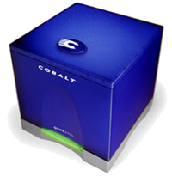

Web Applications Breach the Perimeter
Internet
DMZ
Trusted Inside
IIS
SunOne
Apache
ASP
.NET
WebSphere
Java
SQL
Oracle
DB2
HTTP(S)
Corporate Inside
Browser
Firewall only allows applications
on the web server to talk to
application server.
Firewall only allows application server to talk to database server.
Allows HTTP port 80
Allows HTTPS port 443

Slide 15
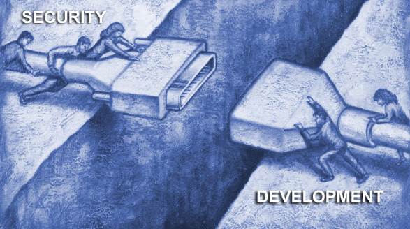
Why Web Application Vulnerabilities Occur
The Web Application
Security Gap
Security Professionals Don’t Know The Applications
Application Developers and QA Professionals Don’t Know Security
  “As a Network Security Professional, I don’t know how my companies web applications are supposed to work so I deploy a protective solution…but don’t know if it’s protecting what it’s supposed to.”
  “As an Application Developer, I can build great features and functions while meeting deadlines, but I don’t know how to develop my web application with security as a feature.”
Notes:
Main Speaking Points:
There is a lack of awareness of application vulnerabilities in security departments.
Security Departments scrutinize the desktop, the network, and even the web servers, but the web application escapes their measures.
Even in departments that want to audit for web application vulnerabilities, the lack of effective tools has made it impractical
As a result, Certification and Accreditation programs rarely examine the web application
In fact, the entire development cycle is usually missing from security procedures and controls
This illustrates the fundamental gap between security and development, which creates these web application vulnerabilities
Many traditional information security practitioners are ill-equipped to
mitigate application security issues
– Little to no experience coding
– No experience coding in “modern” enterprise environments like .NET and J2EE
– Understand that there are risks, but not in a position to address them

Slide 16
Web Application Vulnerabilities
“If builders built buildings the way programmers wrote programs, then the first woodpecker that came along would destroy civilization.”
-Weinberg's Second Law

Slide 17
Web Application Vulnerabilities
Technical Vulnerabilities
  Result of insecure programming techniques
  Mitigation requires code changes
  Detectable by scanners
  http://example/order.asp?item=<script>alert(‘p0wned’)</script>&price=300.00
Logical Vulnerabilities
  Result of insecure program logic
  Most often to due to poor decisions regarding trust
  Mitigation often requires design/architecture changes
  Detection often requires humans to understand the context
  http://example/order.asp?item=toaster&price=30.00

Slide 18
Web Application Vulnerabilities
Web application vulnerabilities occur in multiple areas.
Application
Application Mapping
Cookie Manipulation
Custom Application Scripting
Parameter Manipulation
Reverse Directory Transversal
Brute Force
Application Mapping
Cookie Poisoning/Theft
Buffer Overflow
SQL Injection
Cross-site scripting
Administration
Extension Checking
Common File Checks
Data Extension Checking
Backup Checking
Directory Enumeration
Path Truncation
Hidden Web Paths
Forceful Browsing
Platform
Known Vulnerabilities
Notes:
Main Speaking Points:
-Web Application vulnerabilities occur in different areas of the web application.
[Note: Start at bottom of the screen]
-The web server itself is subject to a variety of known vulnerabilities, all of which must be readily patched for.
The actual administration and management of the server and contents is very important
A misconfigured server or poorly managed content can permit system file and source code disclosure
The application itself is of the utmost importance.
It too can inadvertently reveal source code and system files, and even allow full system access.
It can mistakenly allow replay attacks against your customers.
It could allow a hacker to impersonate your customers.
In addition it is the web application that interacts with the database to manage and tracks customer information and store business and transaction information .
One slip-up in the web application can expose the entire system and database, right through a web browser, right over port 80.

Slide 19
Web Application Vulnerabilities
Platform:
  Known vulnerabilities can be exploited immediately with a minimum amount of skill or experience – “script kiddies”
  Most easily defendable of all web vulnerabilities
  MUST have streamlined patching procedures
Platform
Known Vulnerabilities
Notes:
Main Speaking Points:
Known vulnerabilities in web servers are obviously a source of great risk.
However it is the most easily defended against. You install a patch.
The difficulty becomes installing patches on lots of server
You must have streamlined patching procedures
You must be able to easily inventory your servers for patches
Don’t worry, if you miss a patch, a hacker will let you know

Slide 20
Web Application Vulnerabilities
Administration:
  Less easily corrected than known issues
  Require increased awareness
  More than just configuration, must be aware of security flaws in actual content
  Remnant files can reveal applications and versions in use
  Backup files can reveal source code and database connection strings
Administration
Extension Checking
Common File Checks
Data Extension Checking
Backup Checking
Directory Enumeration
Path Truncation
Hidden Web Paths
Forceful Browsing
Notes:
Main Speaking Points:
-Administrative issues are less easily corrected than known issues.
-Require a security awareness from those who manage the website and it’s content on a daily basis
Obviously you don’t want directory browsing enabled anywhere, and you want the right ACL’s
More than just configuration – must be aware of the implication of content as well
For example: remnant files like readme.txt’s or sample applications can reveal the applications and versions in use.
Commercial applications has known vulnerabilities too, not just webservers and operating systems.
Backup files or improper application mapping can reveal source code, including the information necessary to connect to the database

Slide 21
Web Application Vulnerabilities
Application Programming:
  Common coding techniques do not necessarily include security
  Input is assumed to be valid, but not tested
  Unexamined input from a browser can inject scripts into page for replay against later visitors
  Unhandled error messages reveal application and database structures
  Unchecked database calls can be ‘piggybacked’ with a hacker’s own database call, giving direct access to business data through a web browser
Application
Administration
Administration
Application Mapping
Cookie Manipulation
Custom Application Scripting
Parameter Manipulation
Reverse Directory Transversal
Brute Force
Application Mapping
Cookie Poisoning/Theft
Buffer Overflow
SQL Injection
Cross-site scripting
Notes:
Main Speaking Points:
The application logic itself must be careful constructed and must include security mechanisms
Don’t assume that the input you received is what you expected. It must be tested, validated, and filtered. Test before you ingest
Be extremely careful how you call up files, especially if you pull files directly from the file system. You could expose your pages’ source code, or worse yet, expose system files.
Be particularly careful to remove anything that even resembles javascript or vbscript. Inadvertently storing scripts entered from a hacker will allow them to be replayed against your customers, resulting in your website attacking your customers or divulging session information to the hacker.
Handle all error messages. Unhandled (raw) error messages are a roadmap through the application and database.
Structure your database calls carefully, and scrutinize any user-input that will become used in the query. Carefully constructed input could allow a hacker to piggy-back your queries with their own, letting them access the database through the web application.

Slide 22
How to Secure Web Applications
Incorporate security into the lifecycle
  Apply information security principles to all software development efforts
Educate
  Issue awareness, Training, etc…

Slide 23
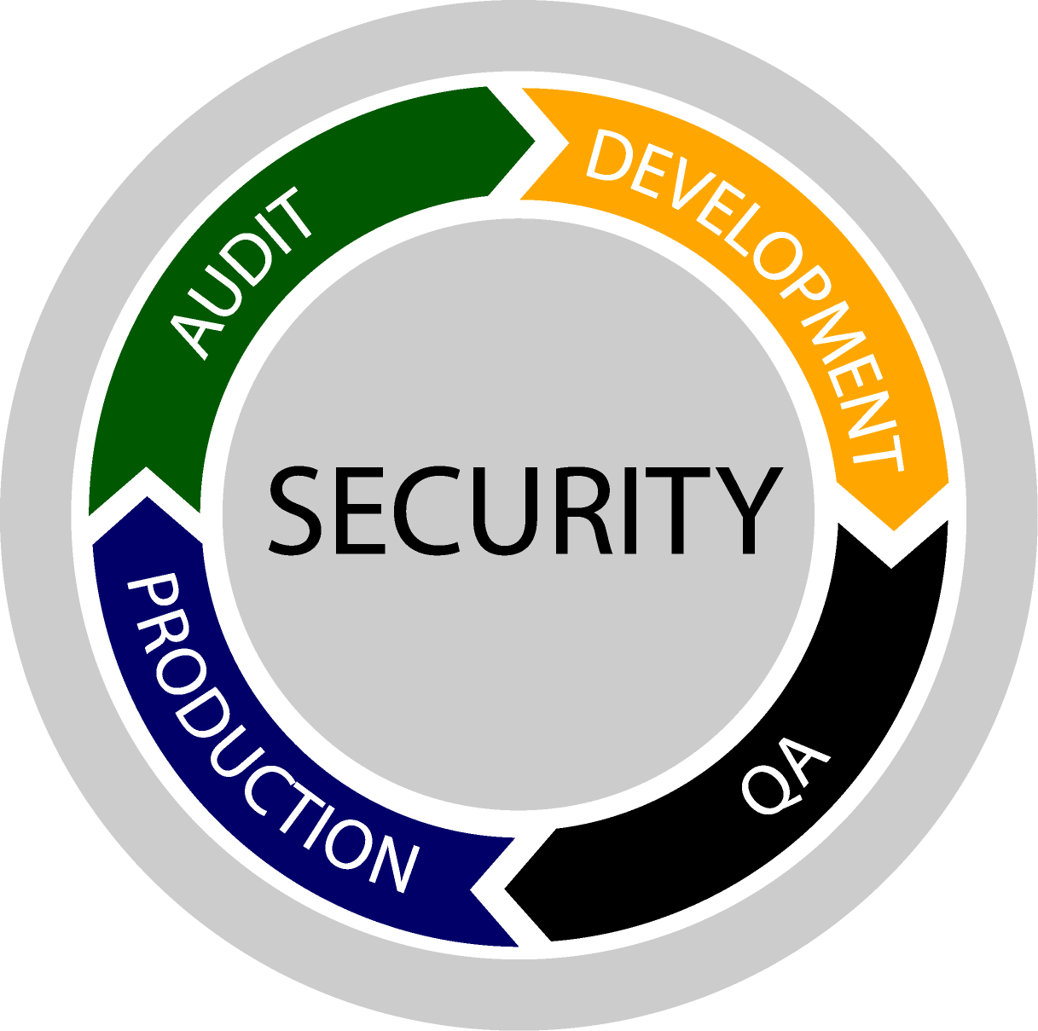
How to Secure Web Applications
Incorporating security into lifecycle
  Integrate security into application requirements
  Including information security professionals in software architecture/design review
  Security APIs & libraries (e.g. ESAPI, Validator, etc.) when possible
  Threat modeling
  Web application vulnerability assessment tools
Notes:
Where to begin?

Slide 24
How to Secure Web Applications
Educate
  Developers – Software security best practices
  Testers – Methods for identifying vulnerabilities
  Security Professionals – Software development, Software coding best practices
  Executives, System Owners, etc. – Understanding the risk and why they should be concerned
Notes:
Where to begin?

Slide 25
Questions?

