Slide 1
Update Manager
Product Release Management System for Accops Products
Streamlining Version Control, Rollout, and Lifecycle Management
Accops Technologies - 2025

Slide 2
Agenda
• Overview & Problem Statement
• Solution Architecture
• Key Features & Capabilities
• Supported Products
• Technical Stack
• Implementation Phases
• Benefits & Value Proposition
• Demo & Screenshots
• Future Roadmap

Slide 3
Overview
What is Update Manager?
A comprehensive automated update system and management portal for Accops products that:
• Streamlines version control and rollout of updates
• Provides proactive admin notifications
• Ensures product versions are current, compatible, and centrally managed
• Reduces manual overhead and upgrade errors
Mission: Enhance operational efficiency and product lifecycle transparency

Slide 4
Problem Statement
Current Challenges
❌ Manual Upgrade Processes
  • Time-consuming and error-prone
  • Lack of centralized visibility
❌ Version Management Complexity
  • Multiple products across different platforms
  • Compatibility tracking difficulties
❌ Limited Visibility
  • No real-time status updates
  • Difficult to track deployment versions

Slide 5
Solution Overview
Update Manager - Complete Solution
✅ Centralized Portal
  • Real-time dashboard with version status
  • Visual indicators for pending updates
  • Batch update capabilities
✅ Automated Workflows
  • Version detection and notifications
  • Compatibility validation
  • Release approval workflow
✅ Customer Management
  • Multi-tenant support
  • Deployment tracking
  • License management

Slide 6
Architecture Overview
Update Manager Portal (React)
• Dashboard, Release Management, Customer UI
RESTful API Layer (Go Backend)
• Product/Version Management
• Customer/Tenant/Deployment APIs
• License Management
MongoDB Database
• Products, Versions, Customers
• Deployments, Licenses, Audit Logs

Slide 7
Key Features - Product Management
📦 Product Management
• Support for all Accops products (Server & Client)
• Product metadata and categorization
• Multi-platform support (Windows, Linux, Mobile)
🔢 Version Management
• Semantic versioning support
• Release types: Security, Feature, Maintenance, Major
• Version states: Draft → Pending Review → Approved → Released
📝 Release Notes
• Structured release notes format
• What's New, Bug Fixes, Breaking Changes
• Compatibility information
• Upgrade instructions

Slide 8
Key Features - Release Workflow
Streamlined Release Process
Pre-Release Phase
  1. Version preparation with metadata
  2. Compatibility validation
  3. Package upload with integrity checks
Release Phase
  4. Release approval workflow
  5. Automatic notification generation
  6. Release notes publication
Post-Release Phase
  7. Update detection
  8. Update rollout management
  9. Progress tracking and audit logging

Slide 9
Key Features - Customer Management
Customer, Tenant & Deployment Management
👥 Customer Management
  • Customer registration and profiles
  • Organization details and contact information
  • Account status tracking
🏢 Tenant Management
  • Multiple tenants per customer
  • Independent deployment organization
  • Tenant-level statistics and views
🚀 Deployment Management
  • Product deployments per tenant
  • UAT/Production environment distinction
  • Version tracking per deployment
  • User count and license information

Slide 10
Key Features - Pending Updates
Intelligent Update Tracking
🔍 Automatic Detection
  • Real-time calculation of pending updates
  • Version gap analysis (patch, minor, major)
  • Security update indicators
📊 Multi-Level Visibility
  • Deployment-level pending updates
  • Tenant-level aggregation
  • Customer-level dashboard
  • System-wide admin view
🎯 Smart Prioritization
  • Critical: Security releases, EOL approaching
  • High: Major updates, Production deployments
  • Normal: Minor/patch updates

Slide 11
Key Features - License Management
Comprehensive License System
📜 Subscription Management
  • Customer subscriptions
  • Time-based and perpetual licenses
  • Status tracking (Active, Expired, Suspended)
🎫 License Assignment
  • Product-specific licenses
  • User/seat allocation
  • License distribution across tenants/deployments
📈 License Dashboard
  • Utilization tracking
  • Expiration warnings (30/60/90 days)
  • Compliance reporting
  • Allocation history

Slide 12
Key Features - Notifications
Automated Notification System
🔔 Automatic Detection
  • New version release detection
  • Affected customer identification
  • Deployment-level impact analysis
📧 Multi-Channel Delivery
  • In-app notifications with real-time polling
  • Notification center with badge counts
  • Email notifications (future)
📋 Smart Notifications
  • Priority-based delivery
  • UAT vs Production distinction
  • Release notes summary
  • Direct action links

Slide 13
Supported Products
Accops Product Portfolio
Server Products
  • HyWorks - Application virtualization platform
  • HySecure - Secure remote access/VPN
  • IRIS - Identity and access management
  • ARS - Resource management and provisioning
Client Products
  • Clients for Linux - Linux client applications
  • Clients for Windows - Windows client applications
  • Mobile Clients - iOS and Android apps
Update Strategies
  • Blue-Green Deployment (Server products - zero downtime)
  • In-Place Updates (Client products)
  • App Store Distribution (Mobile)

Slide 14
Technical Stack
Modern Technology Stack
Backend
  • Go 1.21+ - High-performance backend
  • MongoDB 6.0+ - Flexible document database
  • JWT Authentication - Secure API access
  • RESTful API - Standard HTTP endpoints
Frontend
  • React - Modern UI framework
  • TypeScript - Type-safe development
  • Tailwind CSS - Utility-first styling
  • Playwright - E2E testing
Infrastructure
  • Docker - Containerization
  • Makefile - Build automation
  • Load Testing - Artillery for performance

Slide 15
Implementation Phases
Phased Delivery Approach
Phase 1: Foundation & Core Release Management ✅
  • Product and version management
  • Package upload and storage
  • Release approval workflow
  • Basic portal UI
Phase 2: Enhanced Release Management ✅
  • Compatibility validation
  • Notification system
  • Update detection
  • Update rollout management
Phase 3: Integration & Optimization ✅
  • Pending updates integration
  • Performance caching
  • Enhanced testing
  • Workflow automation

Slide 16
Benefits - Operational Efficiency
Operational Benefits
⏱️ Time Savings
  • Automated update detection
  • Batch update capabilities
  • Reduced manual coordination
👁️ Visibility
  • Real-time status dashboard
  • Centralized version tracking
  • Comprehensive audit trails
🔄 Automation
  • Automated notifications
  • Compatibility validation
  • Release workflow automation

Slide 17
Benefits - Risk Reduction
Risk Mitigation
✅ Compatibility Assurance
  • Pre-update compatibility validation
  • Upgrade path calculations
  • Dependency checking
🛡️ Security
  • Security release prioritization
  • Integrity verification (checksums)
  • Secure package distribution
🔄 Rollback Capability
  • Update failure handling
  • Version rollback support
  • Audit trail for compliance

Slide 18
Benefits - Customer Experience
Enhanced Customer Experience
🎯 Proactive Communication
  • Automatic notifications on new releases
  • Release notes with clear information
  • Upgrade path guidance
📱 Self-Service Portal
  • Customer dashboard
  • Deployment management
  • Version tracking
📊 Transparency
  • Clear version status
  • Pending updates visibility
  • License utilization tracking

Slide 19
Future Roadmap
Upcoming Enhancements
Phase 4: Advanced Features
  • Update Agent implementation
  • Automated update scheduling
  • A/B testing capabilities
  • Update preview/sandbox
Phase 5: Integration
  • CI/CD pipeline integration
  • Third-party monitoring tools
  • Mobile app for management
  • Advanced analytics dashboard

Slide 20
Conclusion
Update Manager - Transforming Product Release Management
Key Takeaways
  • Centralized version control and visibility
  • Automated workflows reduce manual overhead
  • Enhanced customer experience
  • Enterprise-grade security and compliance
  • Scalable and performant architecture
Value Delivered
  • Operational efficiency improvements
  • Risk reduction through automation
  • Better customer engagement
  • Comprehensive audit and compliance

Slide 21
Thank You!
Questions & Discussion
Project Repository: UpdateManager
Documentation: /docs directory
API Specification: /docs/api-specification.md
Accops Technologies - 2025

Slide 22
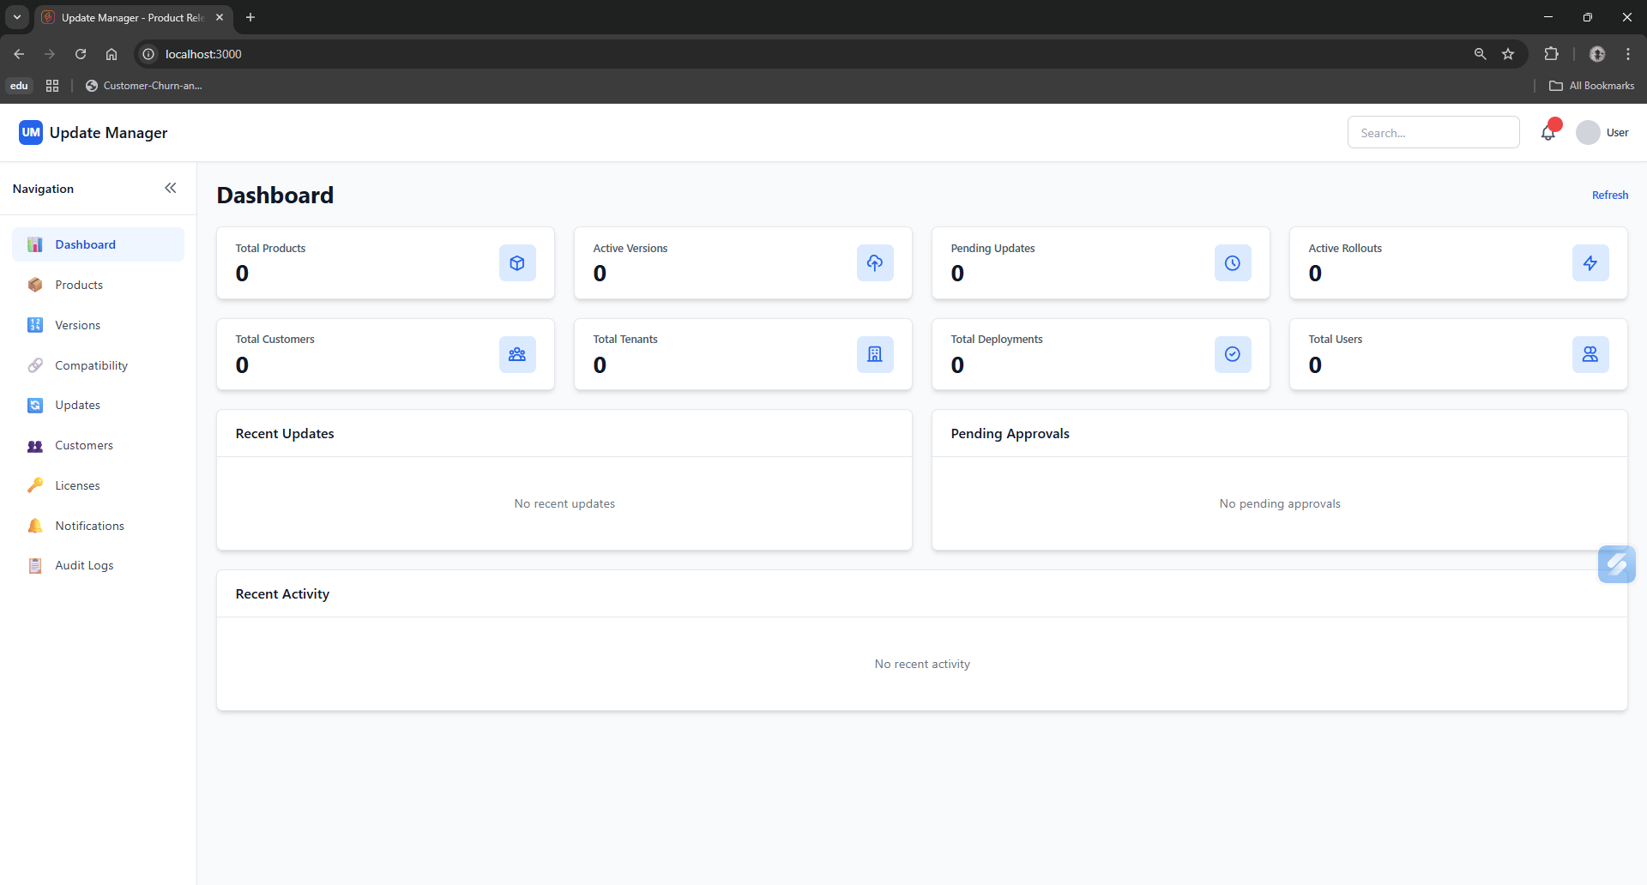
Dashboard

Slide 23
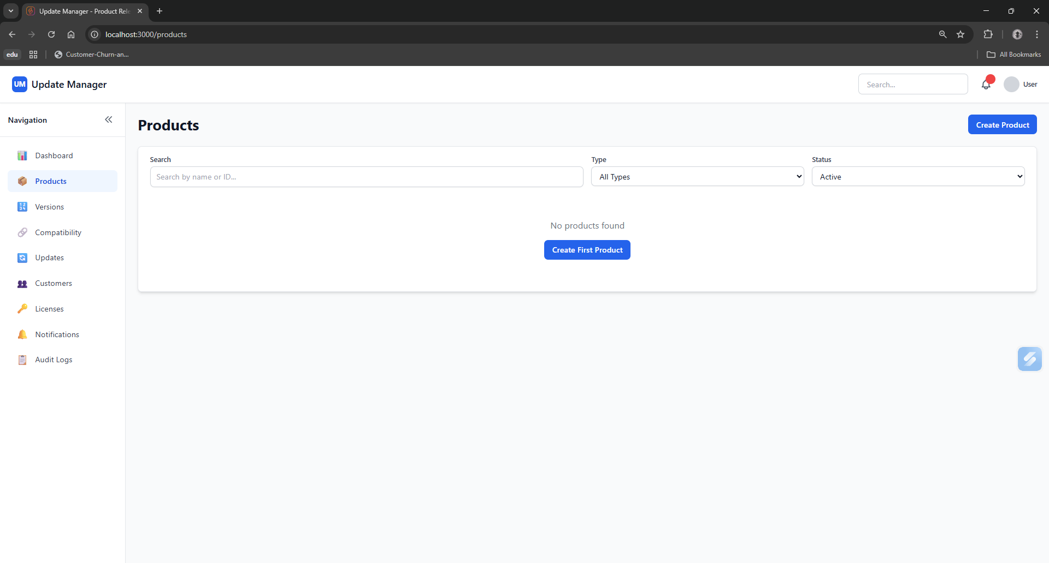
Products

Slide 24
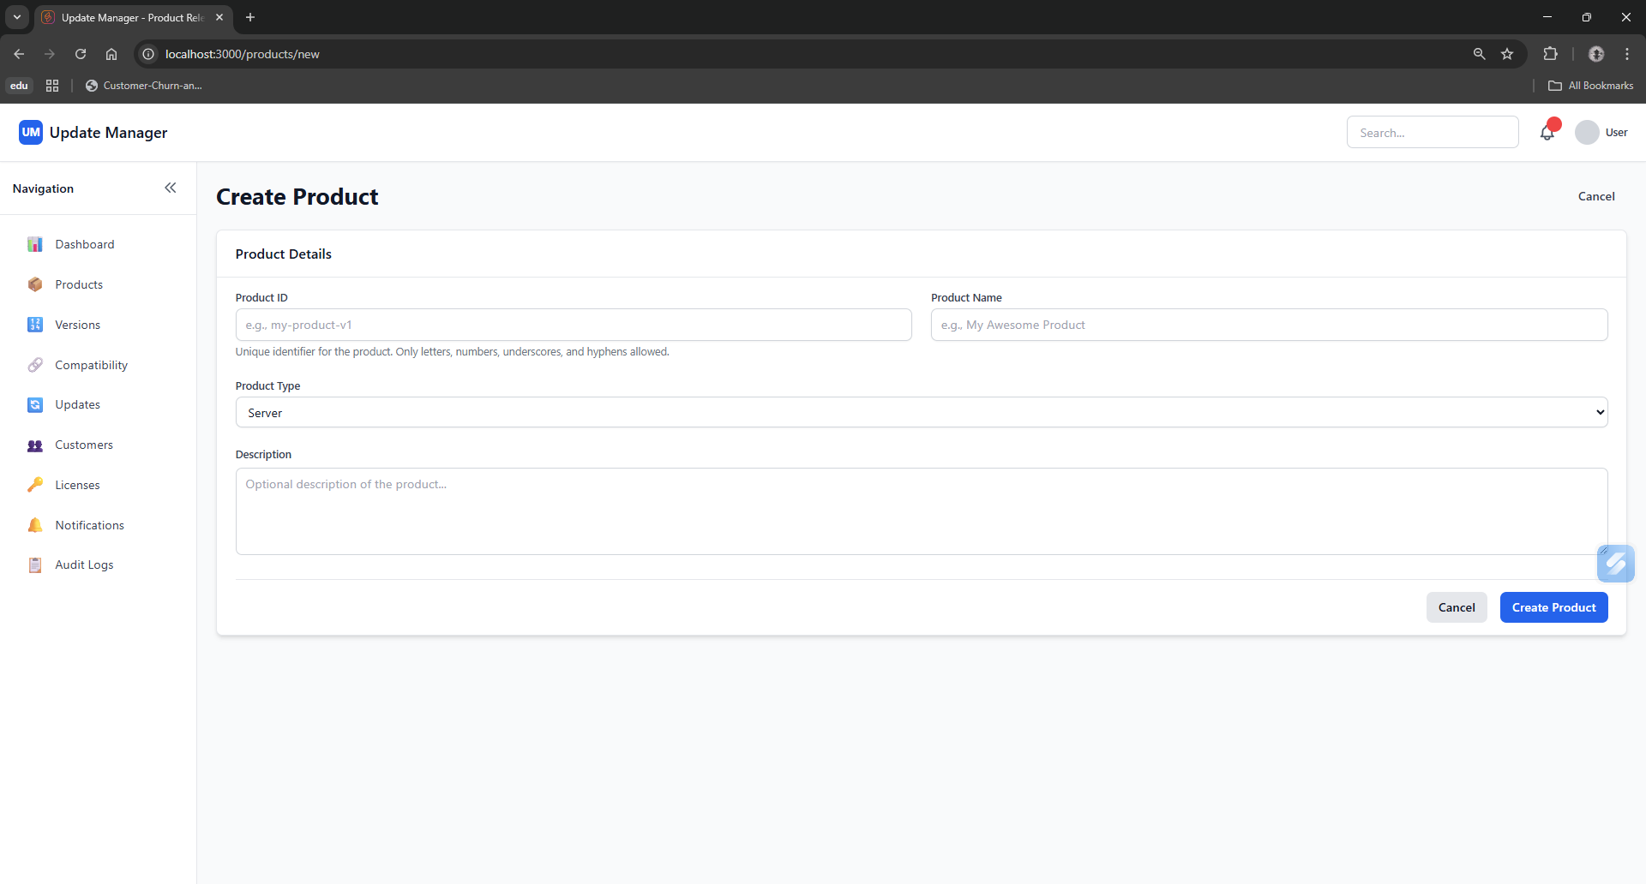
Products→Create Product

Slide 25
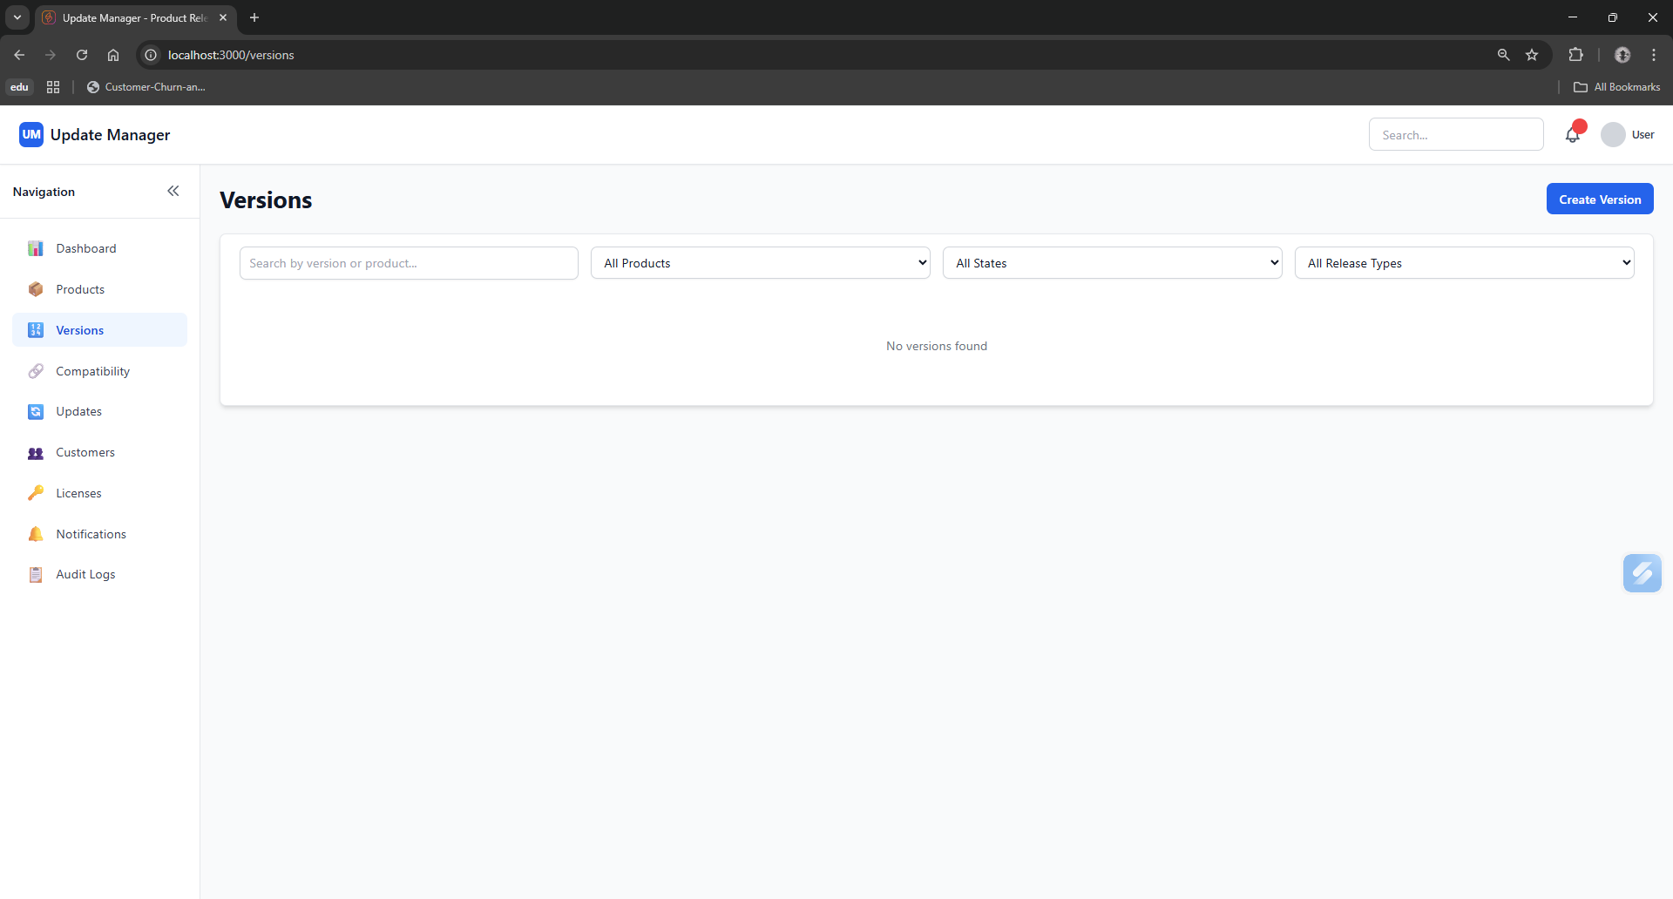
Versions

Slide 26
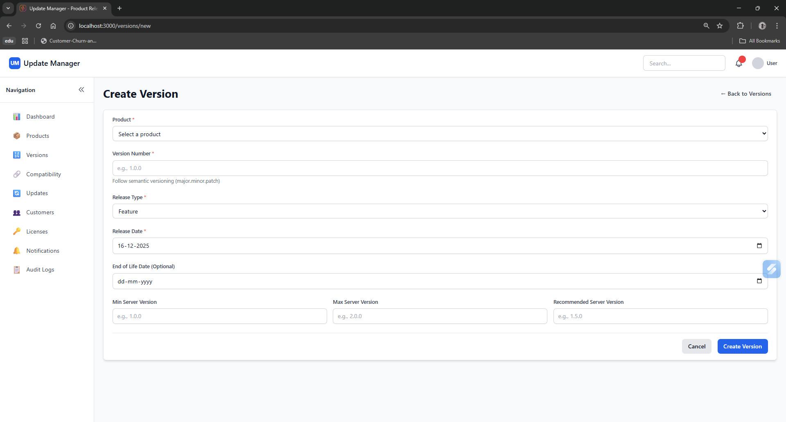
Versions→Create Version

Slide 27
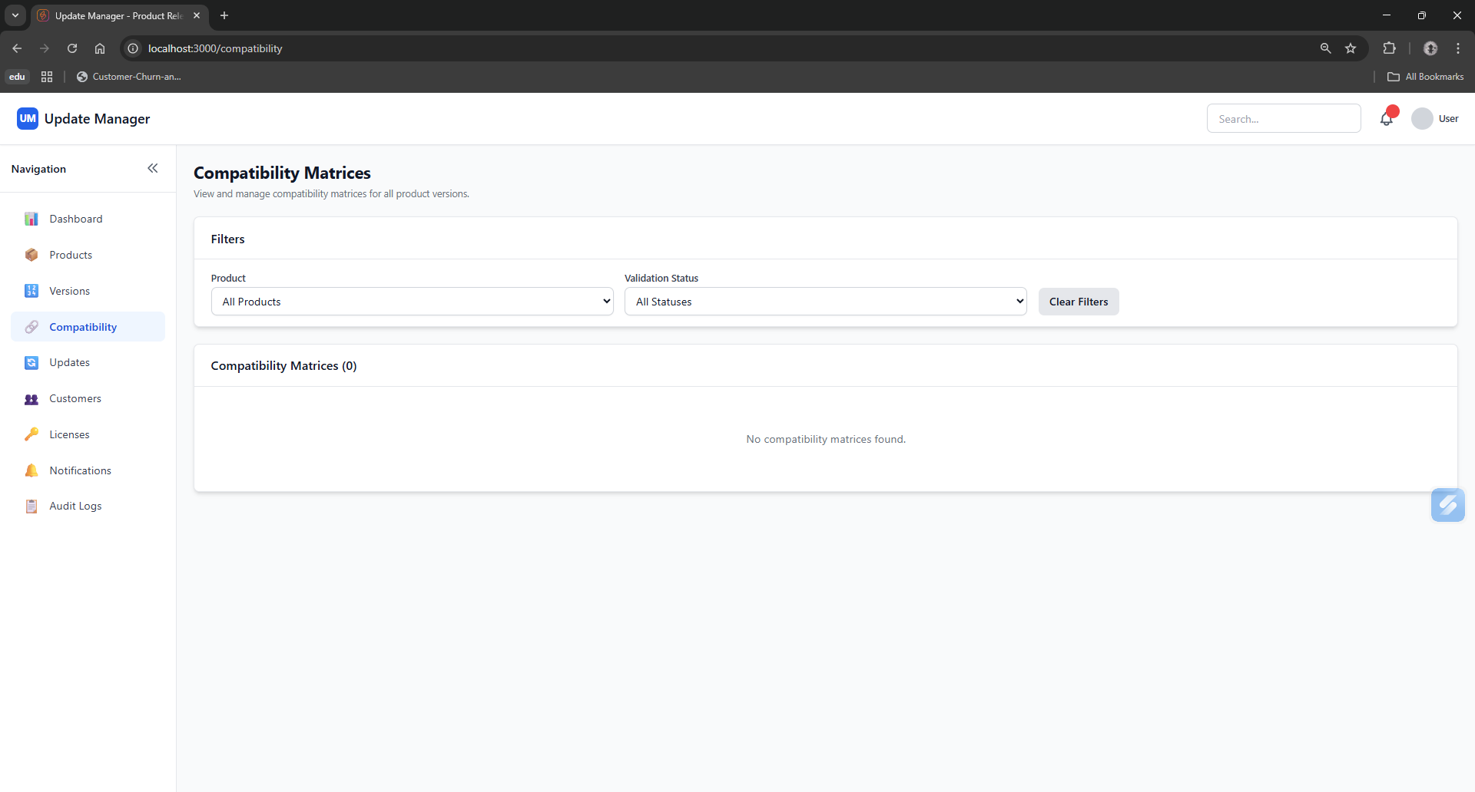
Compatibility

Slide 28
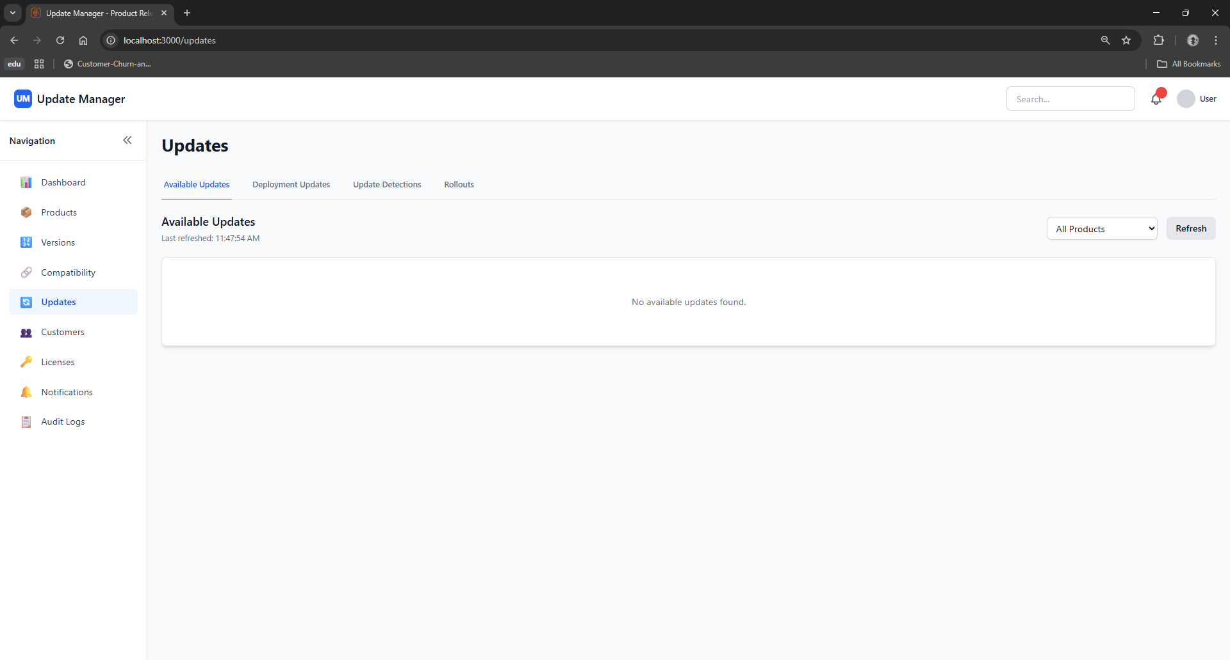
Updates→Available Updates

Slide 29
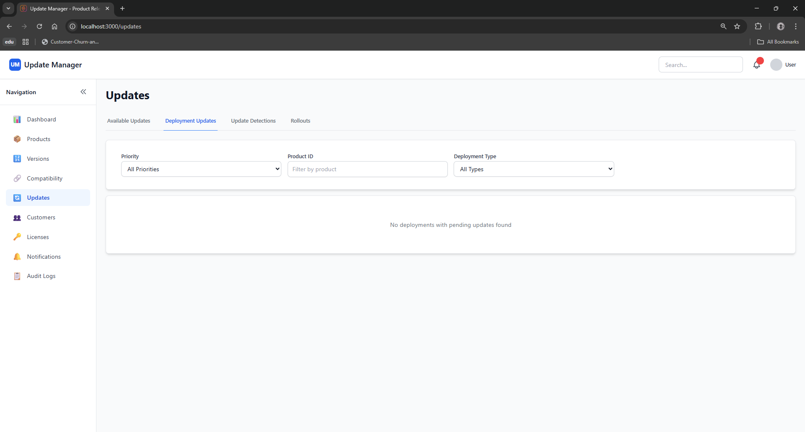
Updates→Deployment Update

Slide 30
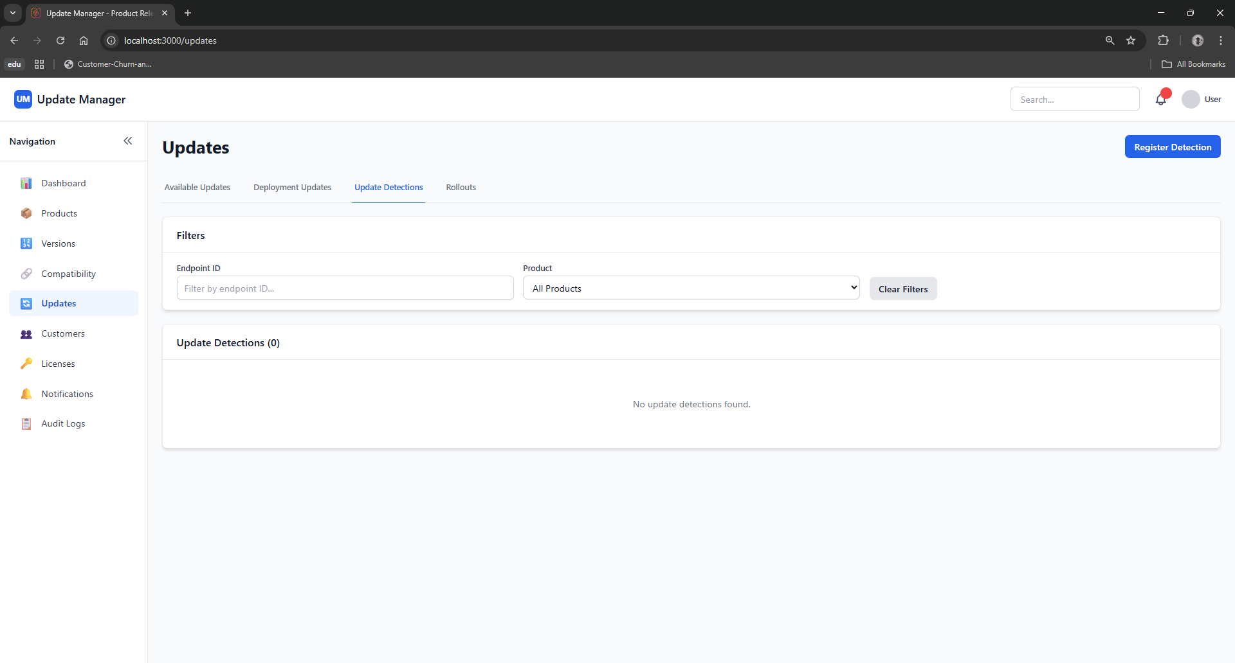
Updates→Update Detections

Slide 31
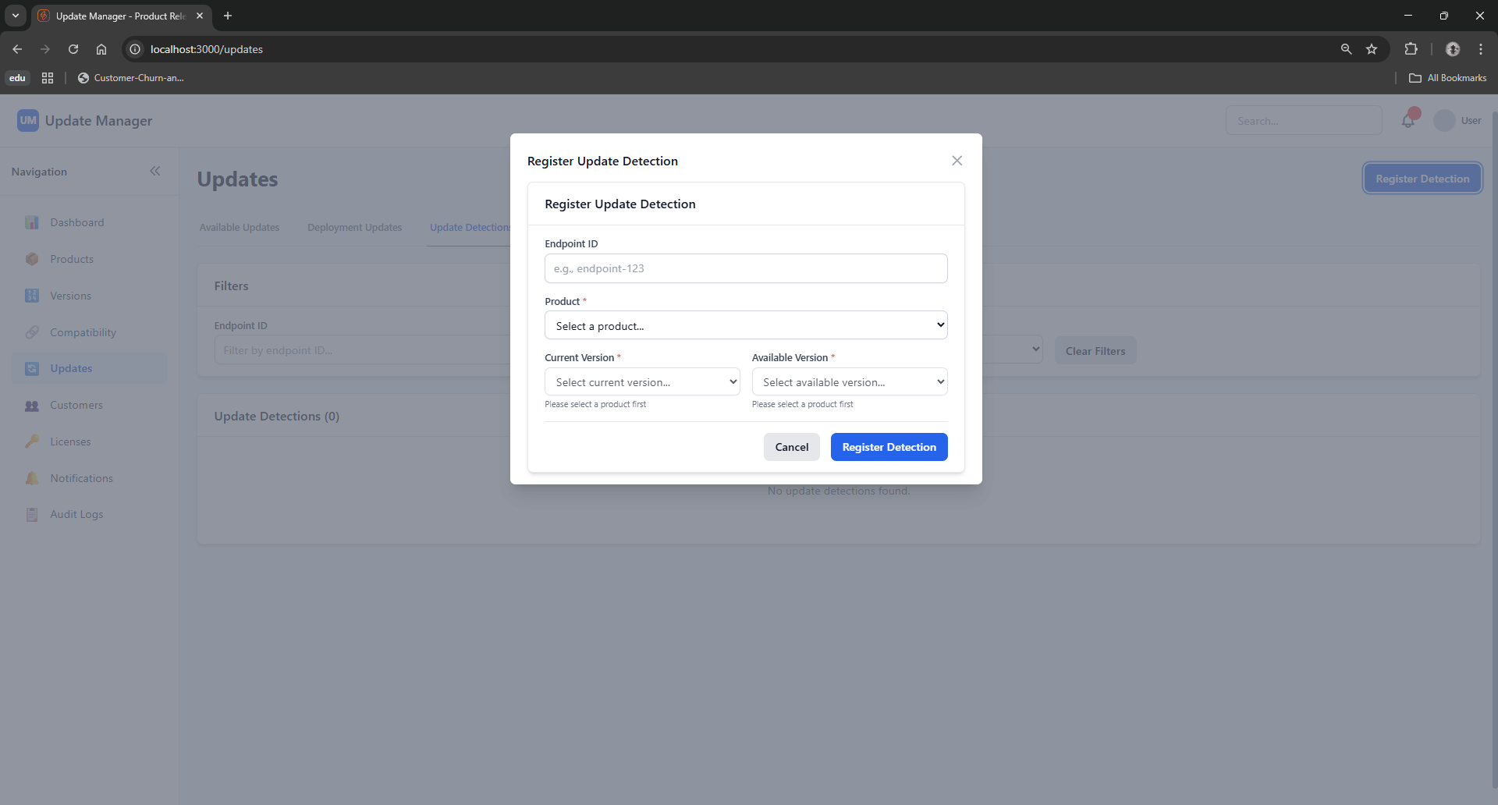
Updates→Update Detections→Register Detection

Slide 32
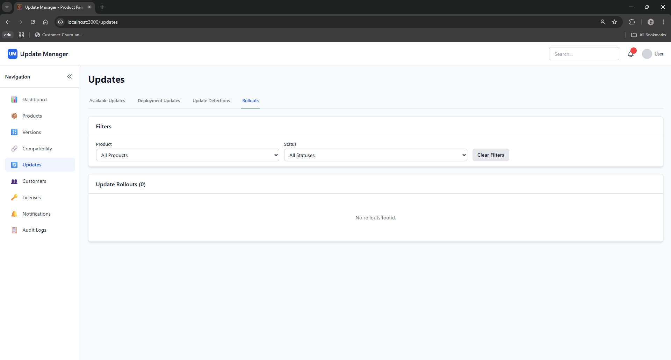
Updates→Rollouts

Slide 33
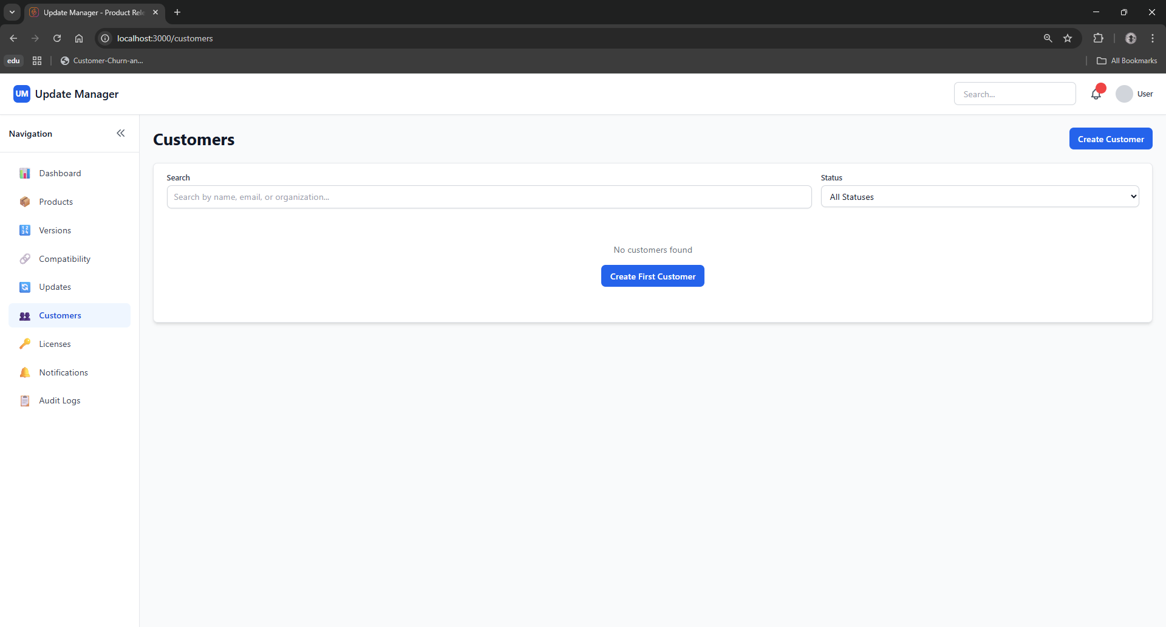
Customers

Slide 34
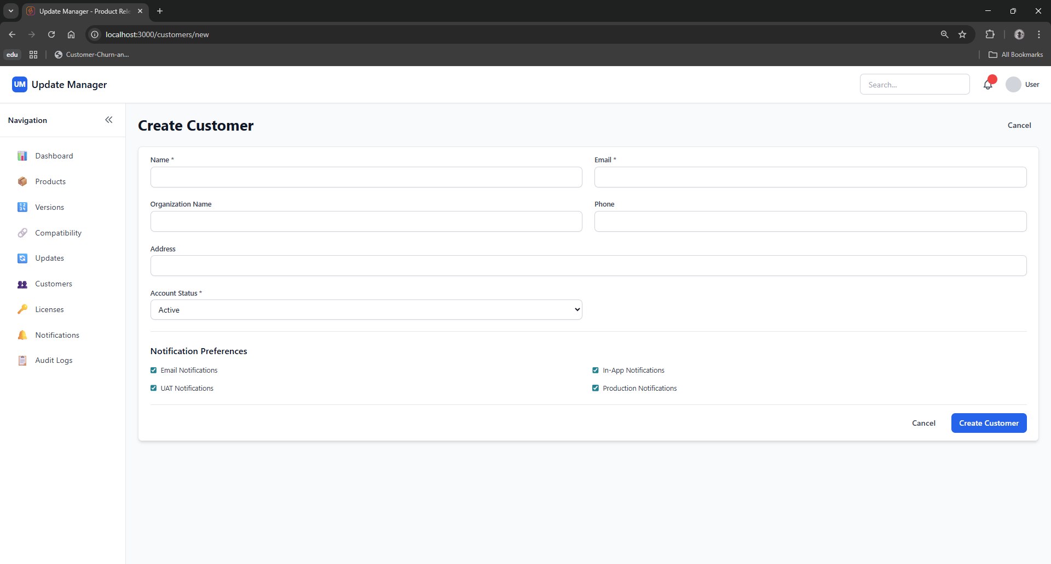
Customers→Create Customer

Slide 35
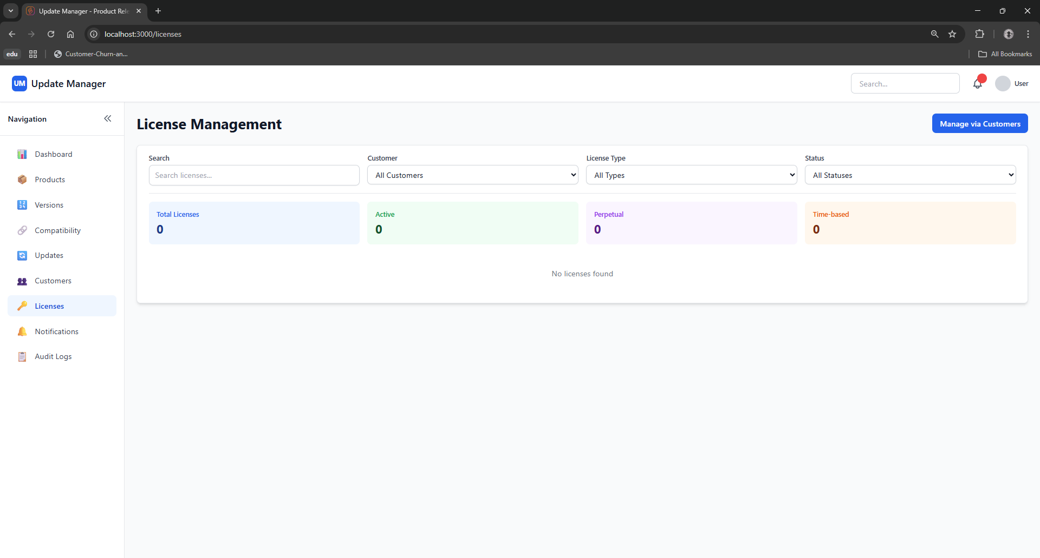
Licenses

Slide 36
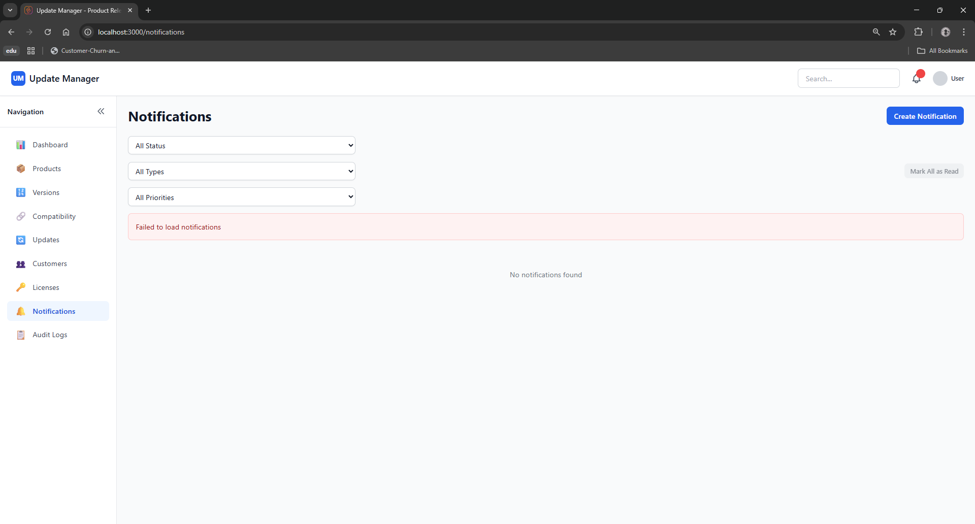
Notifications

Slide 37
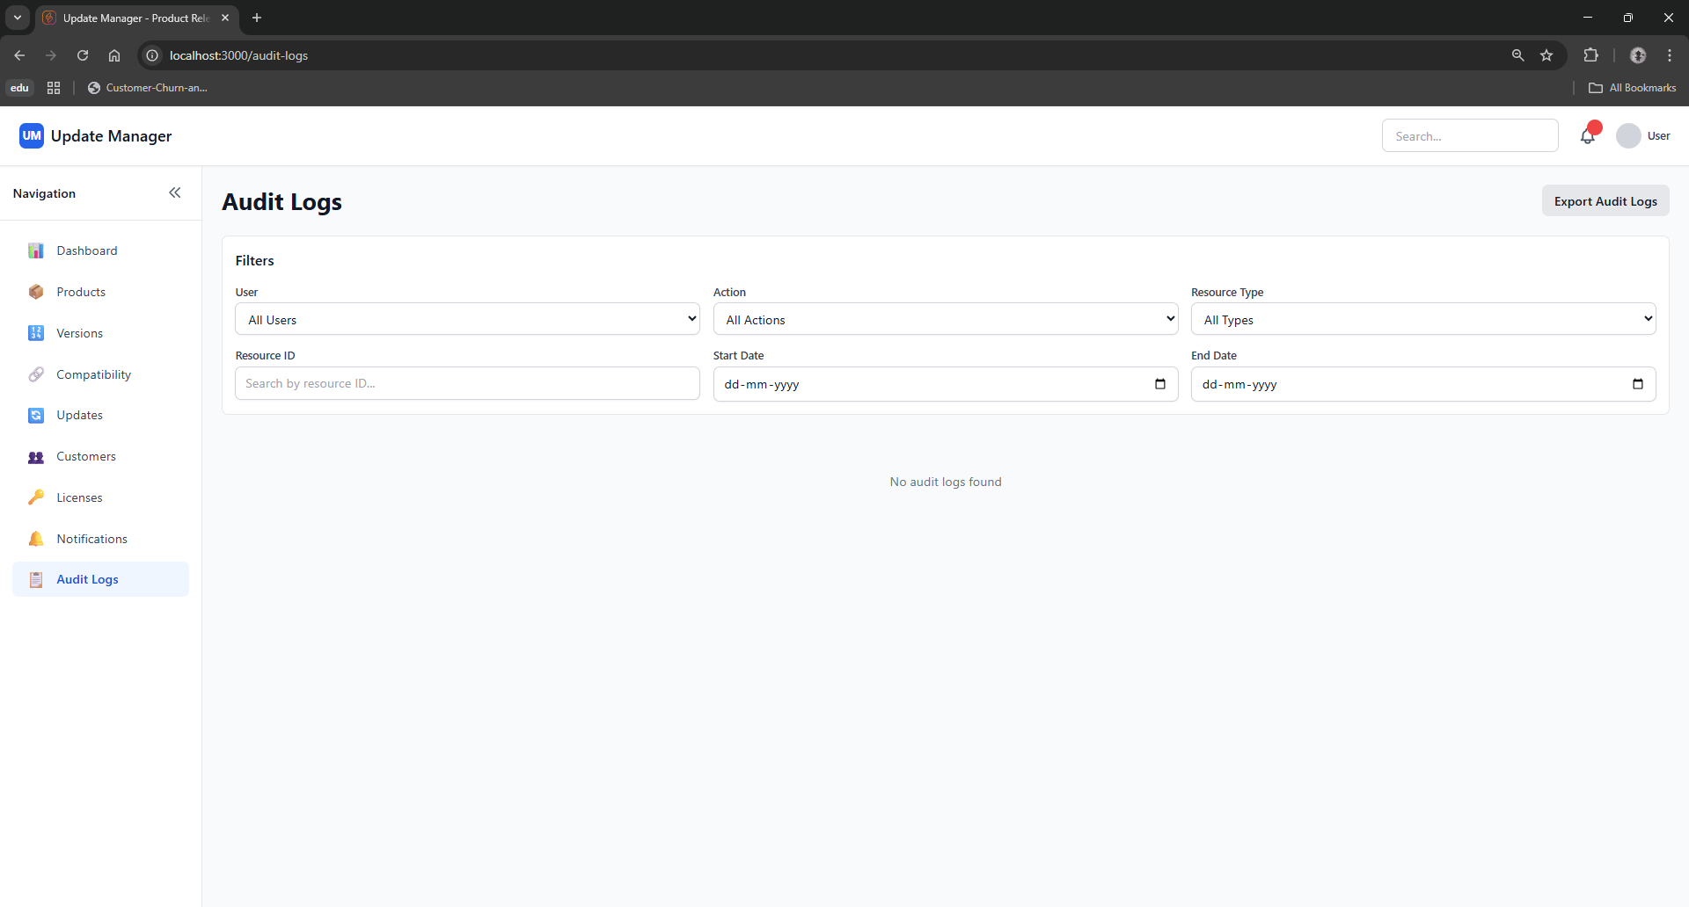
Audit Logs

