Slide 1
PROJECT OVERVIEW
E-Commerce Customer
Intelligence Platform
DB
SQL
A data-driven project that combines customer, product, browsing, purchase and review data to understand how people shop and support better business decisions.
ML
Data Foundation
Analytics
Machine Learning
BI
CX
Six connected MySQL tables organise users, products, sessions, interactions, purchases and reviews.
SQL analysis explores revenue, product performance and customer purchasing behaviour.
K-Means clustering groups customers by purchase recency, frequency and spending.
Why it matters: turn raw e-commerce records into clearer customer insights and more targeted actions.
DATABASE • SQL • ML • BUSINESS INSIGHTS
TEAM MEMBER – AKASH UNIYAL, ANURAG KUMAR , BISWAJIT GIRI, PRITHWISH MANNA
1 / 2

Slide 2
Project Objectives
The project aims to build a reliable analytical foundation and turn data into actionable customer and business insights.
01
1. Create a structured database
02
2. Prepare reliable data
Store and connect the six datasets in MySQL using primary keys, foreign keys and data-quality constraints.
Clean and validate records, check missing values and duplicates, and maintain consistent data types.
3. Analyse customer and business patterns
4. Segment customers with ML
Use SQL to study purchasing behaviour, product performance, revenue trends and customer activity.
Use customer-level features and K-Means clustering to identify groups with different purchase patterns.
Expected outcome: a connected data system, meaningful analysis and customer segments that can inform targeted engagement and retention strategies.
2 / 2

Slide 3
Database Architecture & ETL Pipeline

Slide 4
1. Overall System Architecture
MySQL database
E_Commerce_Customer_Intelligence
6 relational tables
PKs, FKs, CHECKs
Source data
Cleaned CSV files
6 data domains
Python ETL
csv / Pandas*
mysql.connector
Load records
Analysis layer
SQL queries
Python / Pandas
Business insights
Extract
Load
Query
Connection configuration
Data integrity
Analysis outputs
Python connects to MySQL at 127.0.0.1 using the root account and the target database.
Primary keys, foreign keys, CHECK constraints and triggers help enforce valid records.
The stored data can support sales, customer, product and engagement analysis.

Slide 5
2. Database Architecture (Relational Model)
USERS
PK user_id
Customer profile
SESSIONS
PK session_id
FK user_id
INTERACTIONS
PK interaction_id
FK user_id, product_id, session_id
PRODUCTS
PK product_id
Price, stock, category
PURCHASES
PK purchase_id
FK user_id, product_id
Optional session / interaction
REVIEWS
PK review_id
FK user_id, product_id
Optional purchase_id

Slide 6
3. ETL Workflow
EXTRACT
Read the source CSV files
Identify the six datasets:
users • products • sessions
interactions • purchases • reviews
TRANSFORM / PREPARE
Check column-to-table mapping
Handle missing values for SQL
Convert Pandas nulls to SQL NULL
Preserve expected data types
LOAD
Python MySQL Connector
Connect to local MySQL
Insert rows into matching tables
Commit changes
Prepare
Insert
OUTPUT: MySQL relational database
Six populated tables → SQL queries → analysis

Slide 7
4. Data Integrity & Automation
Primary & foreign keys
CHECK constraints
Uniquely identify records and maintain valid links between users, products, sessions, interactions, purchases and reviews.
Examples: price ≥ 0, stock ≥ 0, quantity > 0, review rating between 1 and 5.
Purchase triggers
Product trigger
Review trigger
BEFORE INSERT and BEFORE UPDATE calculate total_amount = quantity × unit_price.
Rejects a negative product price. This duplicates the existing CHECK constraint, providing a trigger example.
Rejects ratings outside 1–5. This also duplicates the review CHECK constraint.

Slide 8
DATA ANALYSIS

Slide 9
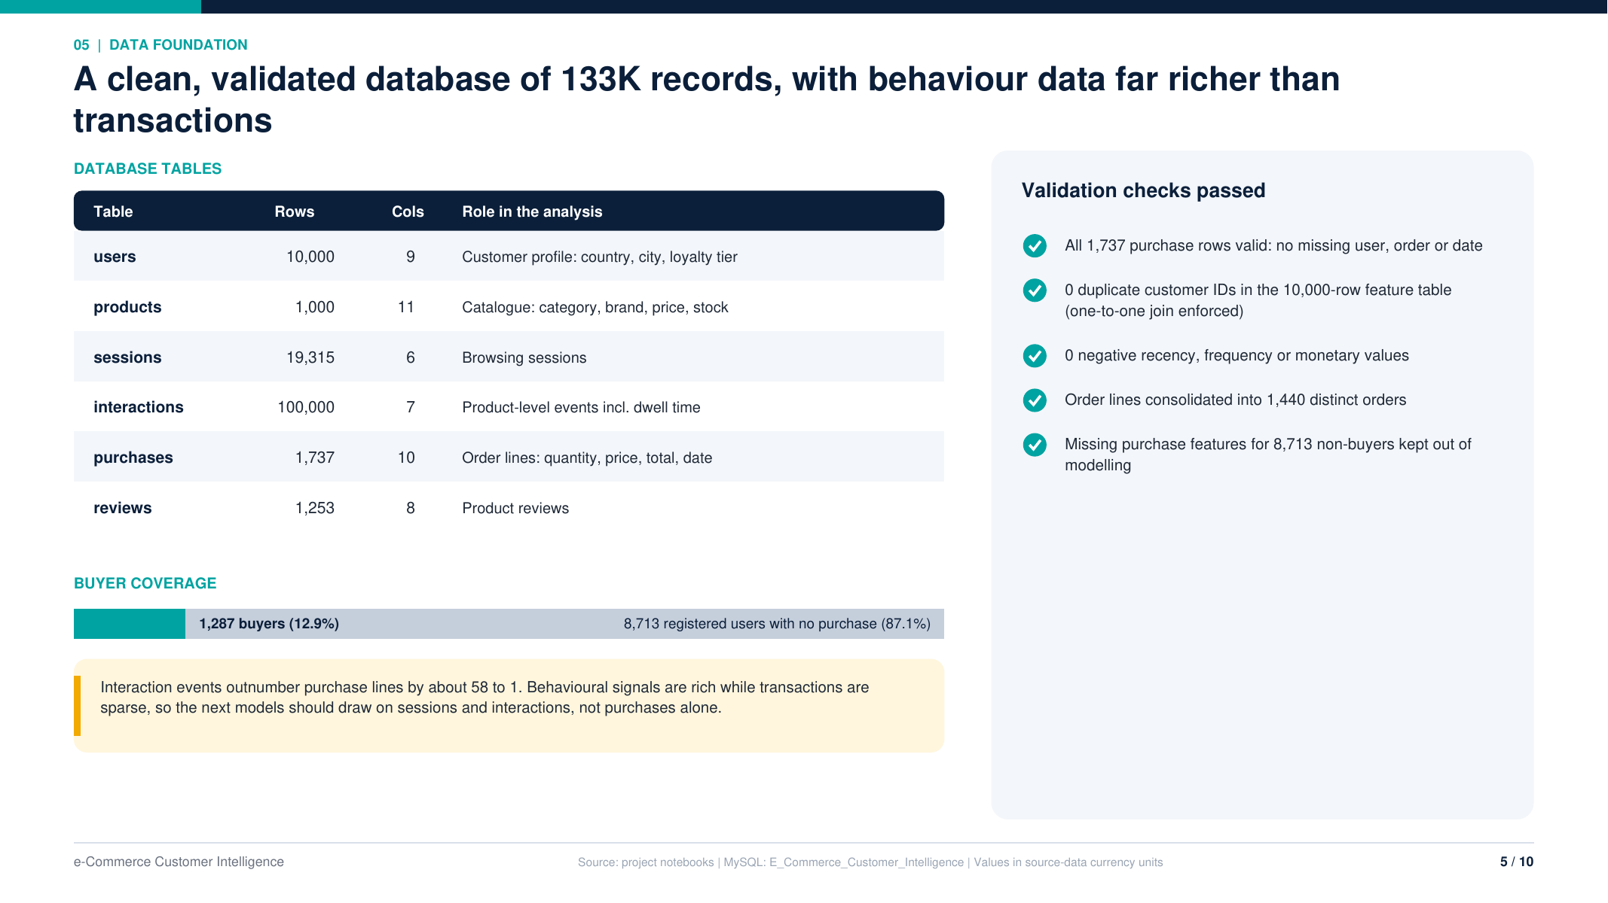

Slide 10
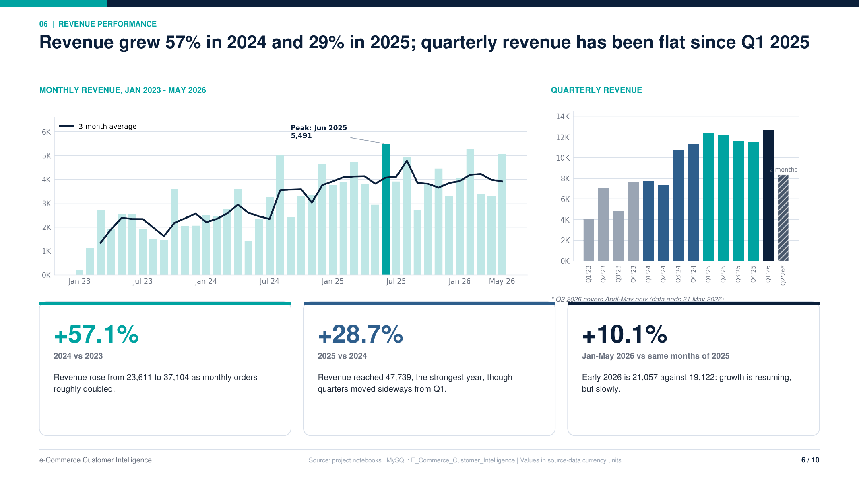

Slide 11
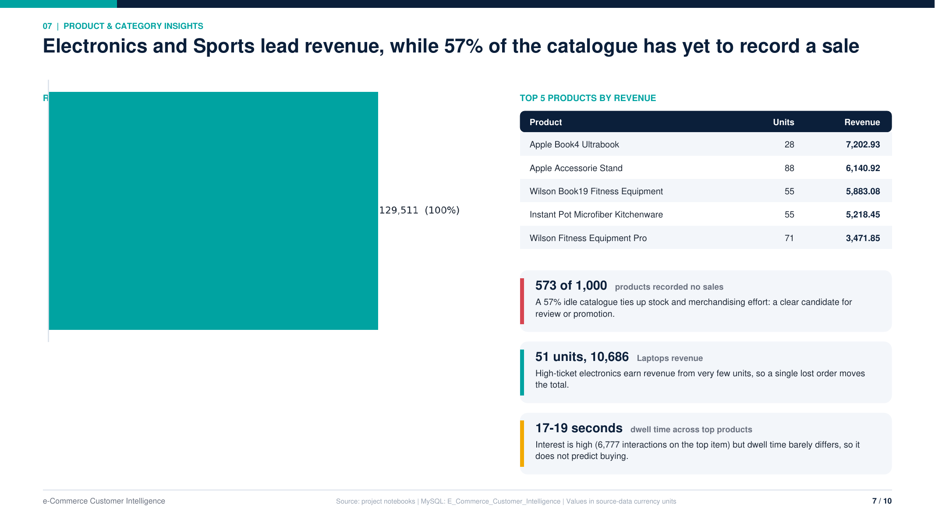

Slide 12
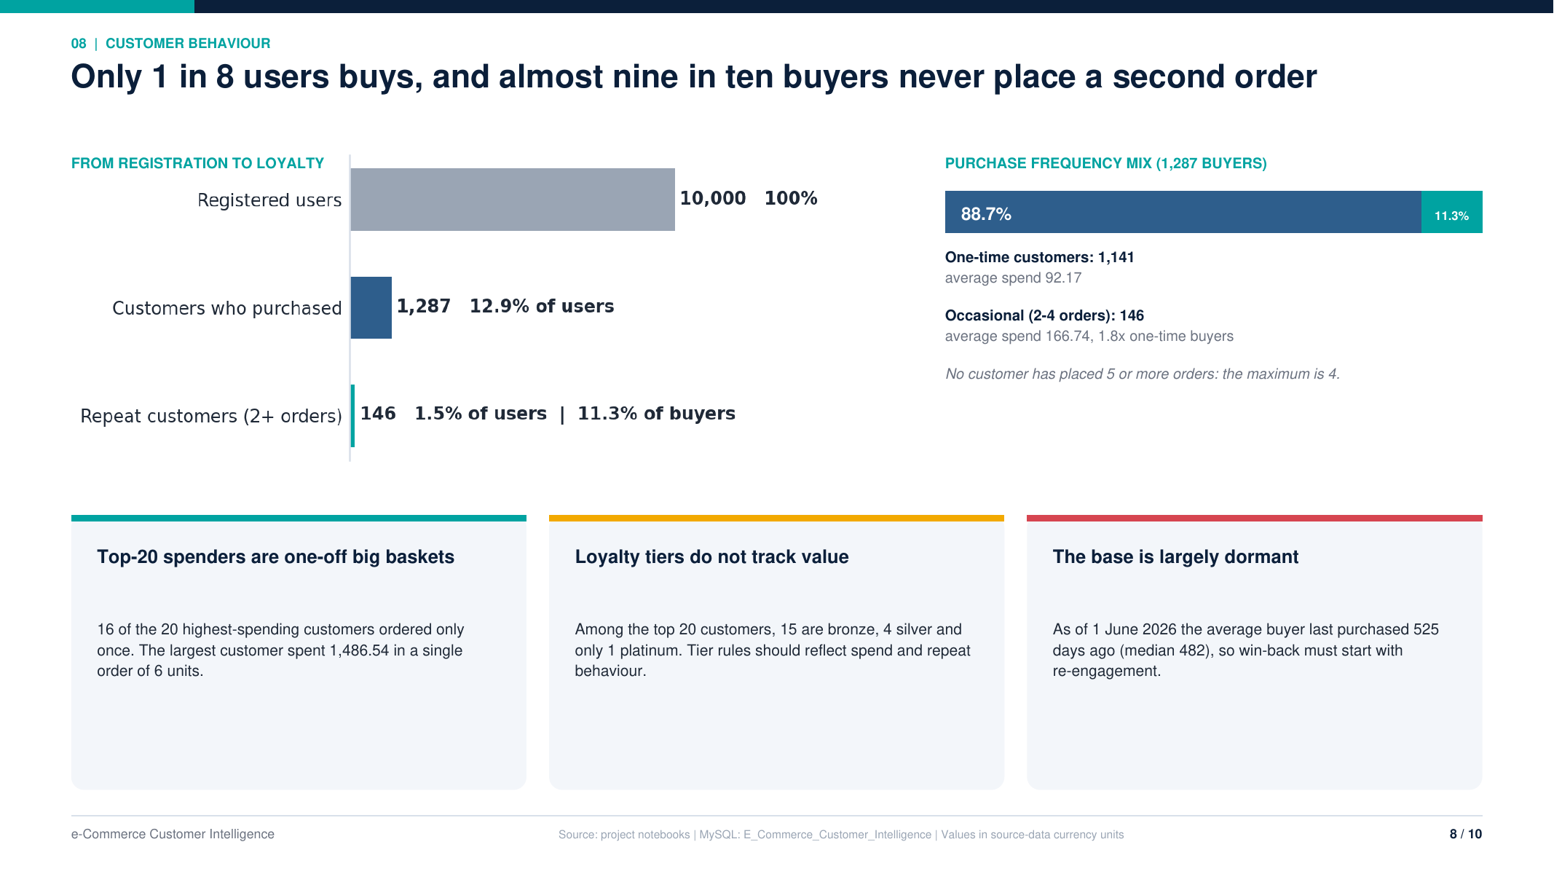

Slide 13
CUSTOMER SEGMENTATION

Slide 14
Use unsupervised machine learning to group customers with similar purchasing behaviour. The goal is to turn transaction history into interpretable customer segments that can support targeted marketing, retention campaigns and customer-value analysis.
Project objective
Workflow at a glance
1. Data source | 2. Feature engineering | 3. Model | 4. Business output
Purchase records retrieved from the MySQL e-commerce database. | Customer-level RFM-style purchase features calculated from orders. | Standard Scaler + K-Means clustering; compare candidate cluster counts. | Three named customer segments and a reusable prediction function.
Data preparation and customer features
Features used in the final model
• Converted order dates to datetime and purchase quantities, unit prices and total amounts to numeric values.
• Removed purchase rows missing essential identifiers or order dates, then aggregated line items to the customer-order level.
• Built one customer-level record for each customer with purchase history; customers without purchase records were excluded from clustering.
Feature | Meaning
Recency | Days since the customer's most recent purchase at the analysis reference date.
Frequency | Number of distinct orders made by the customer.
Monetary value | Total spending across the customer's recorded orders.
Average order value | Average monetary value per order.
E-commerce Customer Intelligence | ML: Customer Segmentation
Page 1

Slide 15
MODEL DEVELOPMENT
1. Feature scaling
Applied Standard Scaler to the numeric features before clustering. Scaling places features on comparable scales so that a high-magnitude variable such as total spending does not dominate the distance calculations simply because of its units.
2. K-Means and model selection
3. Refining the feature set
▪ Tested candidate cluster counts from k = 2 to k = 8. For each candidate, the notebook recorded inertia and the silhouette score.
▪ Inertia measures within-cluster squared distances; the silhouette score gives a measure of how well-separated and cohesive the clusters are.
An initial experiment used recency, frequency, monetary value, purchase frequency and average order value. The workflow then removed purchase frequency and repeated the comparison using four features: recency, frequency, monetary value and average order value. The final model was set to K-Means with k = 3.
Final segmentation model
Component | Implementation
Algorithm | K-Means clustering (unsupervised learning)
Final number of clusters | 3
Input features | Recency, frequency, monetary value, average order value
Scaling | Standard Scaler fit on the final four-feature matrix
Reproducibility | Random state = 42; n init = 10
Important interpretation note
What the model produces
Cluster IDs are numeric labels, not rankings. Their business meaning was assigned after inspecting each cluster's average purchase behaviour. The notebook records the final choice of three clusters, but the presentation does not claim a specific best silhouette score because no selected score value is documented in the notebook's explanatory notes.
For each customer in the segmentation dataset, the trained model assigns a cluster ID. The notebook maps those IDs to readable segment names and prepares the predictions for storage in MySQL.
E-commerce Customer Intelligence | ML: Customer Segmentation
Page 2

Slide 16
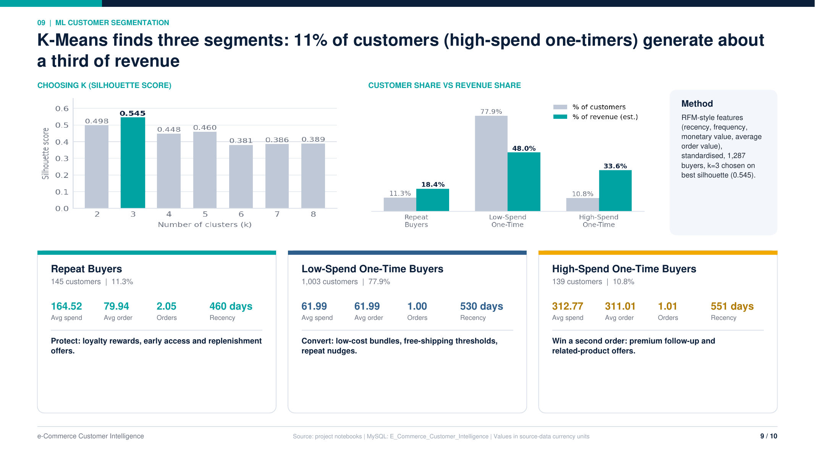

Slide 17
RESULTS & PRACTICAL USE
The three customer segments
Making the model reusable
The notebook's final cluster profiles were interpreted using average purchase frequency, spending and recency. The figures below are the values documented in the notebook's interpretation section.
• Created a prediction function that accepts recency, frequency, monetary value and average order value for a customer, applies the fitted scaler and predicts a cluster using the trained K-Means model.
• Mapped cluster IDs to business-friendly labels: Repeat Buyers, Low-Spending One-Time Buyers and High-Spending One-Time Buyers.
• Prepared a customer segmentation predictions table in MySQL to store user ID, features, predicted cluster and segment name.
• Saved the trained model and scaler as separate Joblib files: customer segmentation model.joblib and customer segmentation scaler. joblib.
Segment | Avg. orders | Avg. total spending | Interpretation
Repeat Buyers | ≈ 2 | 164.52 | Customers with more repeat purchases and the lowest average recency among the final segments.
Low-Spending One-Time Buyers | ≈ 1 | 61.99 | Customers who typically made one purchase and have the lowest average total spending.
High-Spending One-Time Buyers | ≈ 1 | 312.77 | Customers who typically made one purchase but have the highest average total spending; average order value ≈ 311.01.
Business value
These segments help a business distinguish repeat customers from lower-spending and high-spending one-time buyers.
They can guide tailored offers, repeat-purchase campaigns and differentiated customer engagement rather than treating every customer identically.
E-commerce Customer Intelligence | ML: Customer Segmentation
Page 3

Slide 18



