Slide 1

OpenWRT
Presented By V. Akash

Slide 2
What is OpenWRT?
OpenWRT Is An Open-Source Project For Embedded OS
Based On Linux
Used On Embedded Devices To Route Network Traffic.
Available On Over 50 Different Platforms, And In 7 different languages (+ 25 partially translated languages)

Slide 3
What ISAs does OpenWRT run on?
ARCompact - RISC-type
ARM - The architecture RISC-V (And Shakti Processors) aims to rival
MIPS - another RISC-type
x86 – Developed By Intel, CISC-Type
x86-64 -64-bit version of x86

Slide 4
Some Important Terms
An OpenWrt device is a network interface in the host Linux operating system (what you see with ip link list). These include network ports, as well as virtual devices like the br-lan bridge.
An OpenWrt radio ("wireless") is a device with wireless capability. Every radio provides a device for you to put network config on, but it also provides a radio object to adjust the many wireless-specific things that wired networks don't have. The UI forces interface configuration into the "Wireless" page.
An OpenWrt interface is an IP address configured on a device or radio, and maybe additional IP-and-higher-layer protocols bound to it.

Slide 5
Some General Features of OpenWRT
Provides a fully writable file system with package management¹
Framework to build an application without having to build a complete firmware around it
Ability for full customization, to use the device in ways never envisioned

Slide 6
Current stable series: OpenWrt 22.03
(17. October 2022)

Slide 7
Why use OpenWRT?
It works better than the stock firmware from their vendor
Extensibility: Over 3000 standardized packages, so easily replicable
Security: standard installation secure by default, software components are kept up-to-date
Performance and Stability: made of standardized modules used in all supported devices, thus each module more testing and bug fixing than stock firmware.
Community Support: OpenWrt users are always available to help solve an issue

Slide 8
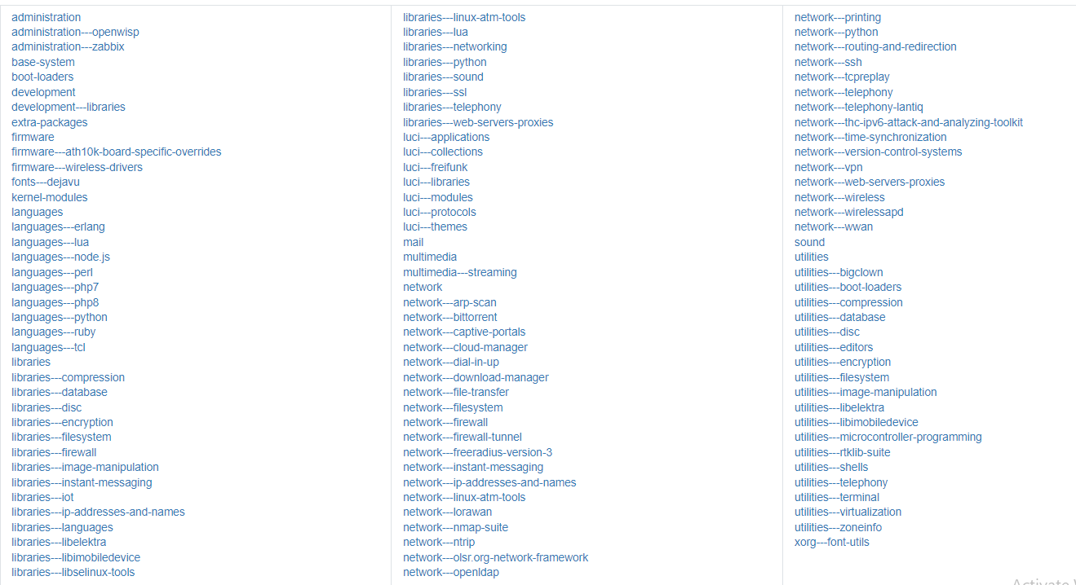
Packages

Slide 9
Development Overview – Packages (1)
A package is a compressed archive containing a program, a library or some scripts, its accompanying configuration files and information used to integrate it in the operating system.
These packages are handled by a package manager (opkg in OpenWrt); a program that downloads/opens/installs/uninstalls the packages.
Thus, an OpenWrt firmware is made by assembling packages around a Linux kernel.
Each package is compiled separately, when all are done the needed packages are “installed” in a temporary directory that will then be the compressed-read-only SquashFS partition in the device firmware.

Slide 10
Development Overview – Packages (2)
While the kernel is handled as a package, it is added to firmware images in the special way each device's bootloader expects.
Thus, we can replace the stock firmware without touching the bootloader.

Slide 11
Development Overview – Packages (3)
How is a package compiled?
Get official download link for the sources to be compiled
A SHA256 hash to check the integrity of such download
A version number of the upstream project as package base
A release number to indicate OpenWrt changes
All packages are compiled by OpenWrt's own toolchain, which is again handled like packages
When you run make the OpenWrt build system will use your system's existing building infrastructure to compile the OpenWrt's toolchain first, and then use that to compile the packages

