Slide 1
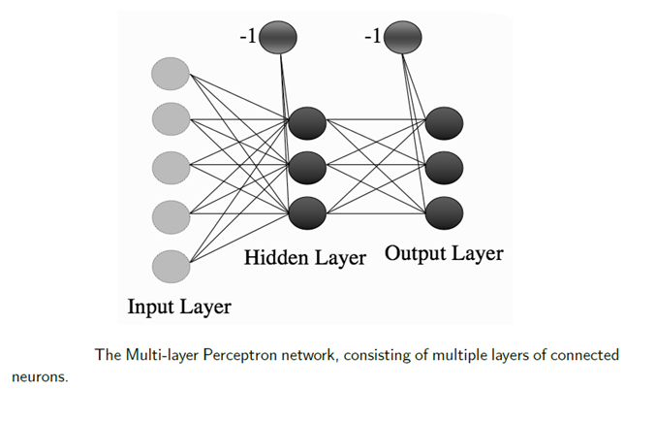
MULTILAYER NETWORKS AND THE BACKPROPAGATION ALGORITHM

Slide 2
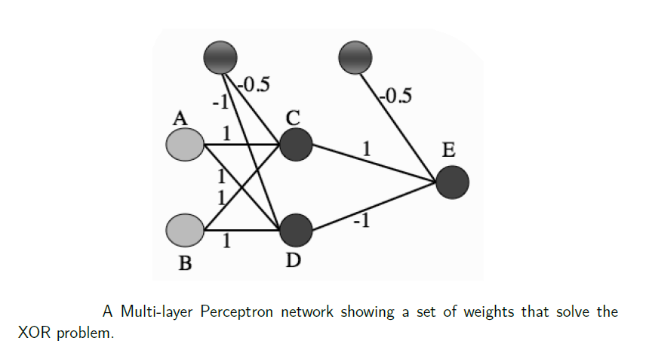

Slide 3
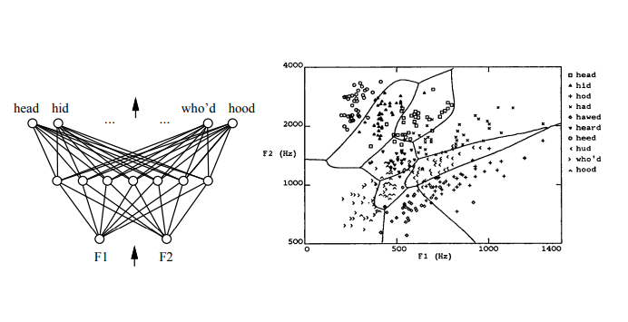
Multilayer Networks of Sigmoid Units

Slide 4
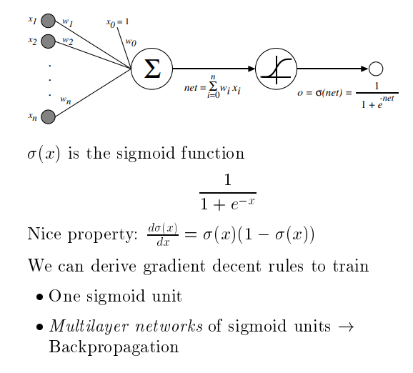
Sigmoid Unit
Logistic function
Squashing function of
the unit

Slide 5
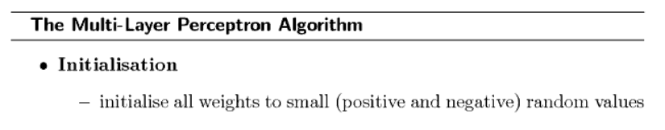

Slide 6
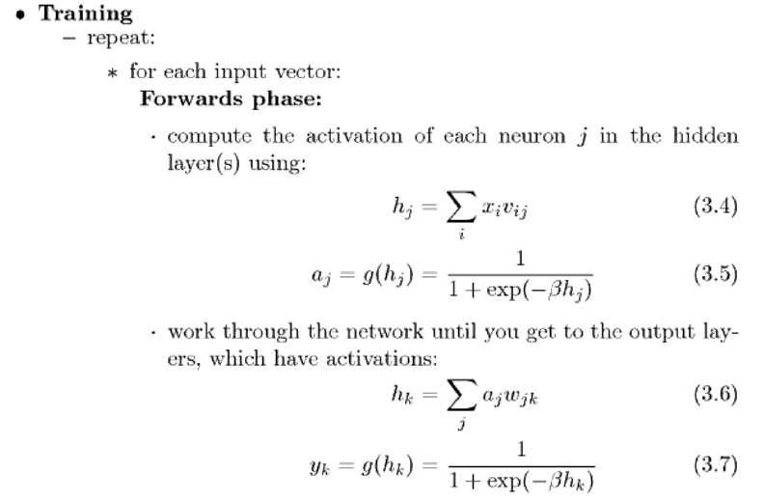

Slide 7
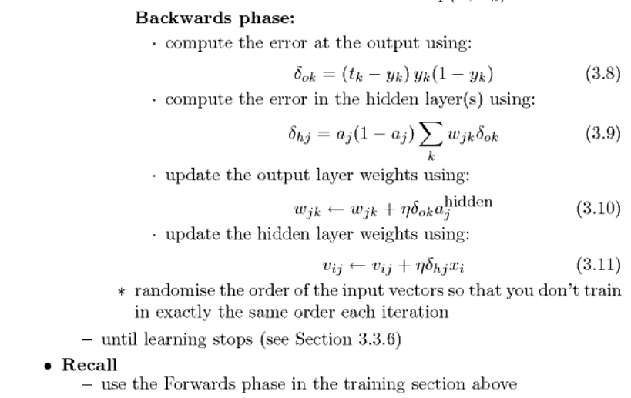

Slide 8
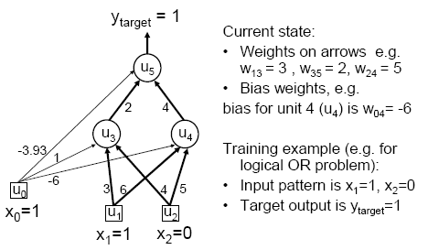
MLP/BP: A worked example

Slide 9
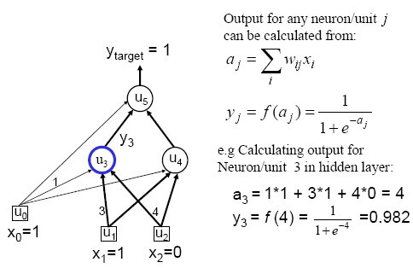
Worked example: Forward Pass

Slide 10
Worked example: Forward Pass

Slide 11
Worked example: Backward Pass

Slide 12
Worked example: Update Weights Using Generalized Delta Rule (BP)

Slide 13
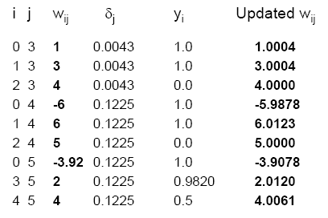
Similarly for the all weights wij:

Slide 14
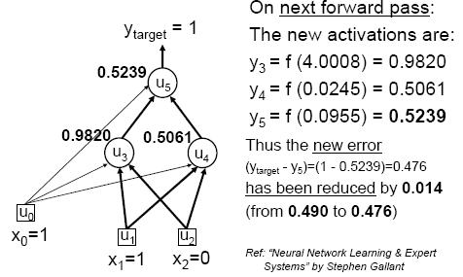
Verification that it works

Slide 15
Backpropagation Algorithm
The case of multilayer networks is that the error surface can have multiple local minima
This means that gradient descent is guaranteed only to converge toward some local minimum, and not necessarily the global minimum error.
Despite this obstacle, in practice BACKPROPAGATION been found to produce excellent results in many real-world applications.

Slide 16
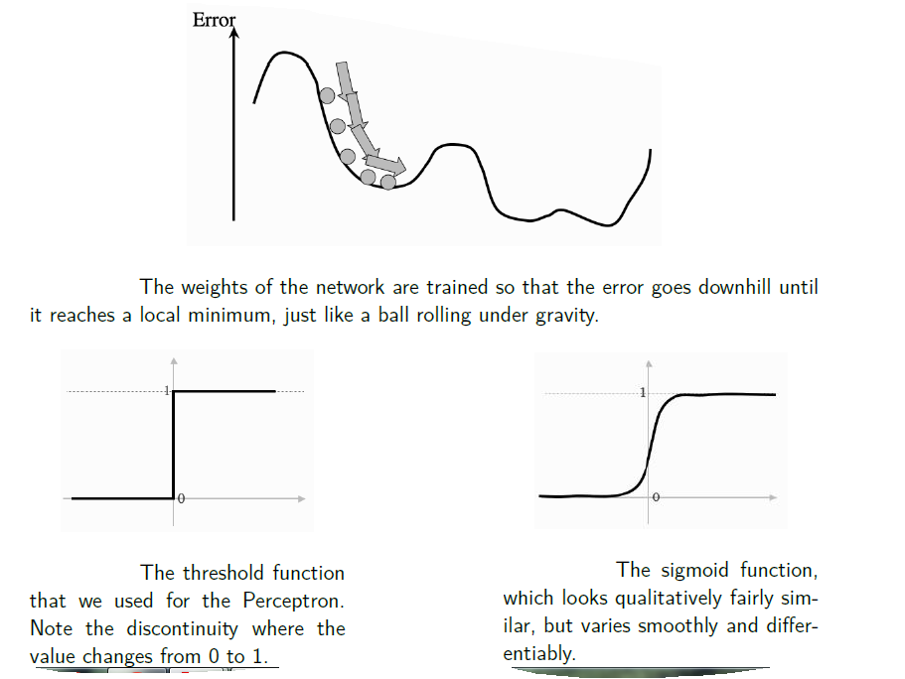

Slide 17
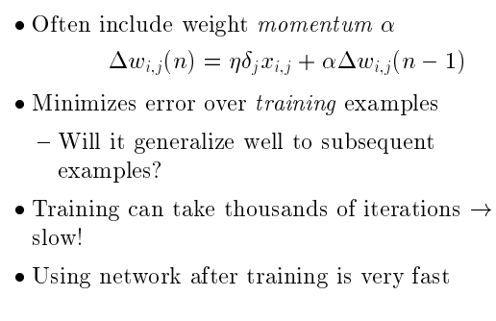

Slide 18
Expressive Capabilities of ANNs
Boolean functions:
Every boolean function can be represented by network with single hidden layer
but might require exponential (in number of inputs) hidden units
Continuous functions:
Every bounded continuous function can be approximated with arbitrarily small error, by network with one hidden layer [Cybenko 1989; Hornik et al. 1989]
Arbitrary functions
Any function can be approximated to arbitrary accuracy by a network with two hidden layers [Cybenko 1988].

Slide 19
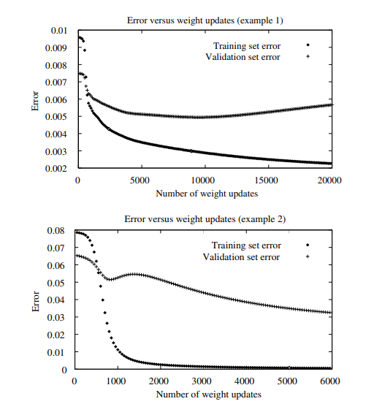
Overfitting in ANNs

Slide 20
Hypothesis space
Generalization
Overfitting
Stopping criterion

Slide 21
References
“Machine Learning” by Tom M. Mitchell
“Machine Learning An Algorithmic Perspective” by Stephen Marsland

