Slide 1
ARTIFICIAL NEURAL NETWORKS
Artificial neural networks (ANNs) provide a general, practical method for learning
real-valued,
discrete-valued, and
vector-valued functions
from examples

Slide 2
Biological Motivation
Biological learning systems are built of very complex webs of interconnected neurons
ANNs are
built out of a densely Interconnected set of simple units, where
each unit takes a number of real-valued inputs and
produces a single real-valued output

Slide 3
Hebb’s Rule
Hebb’s rule says that the changes in the strength of synaptic connections are proportional to the correlation in the firing of the two connecting neurons.
So if two neurons consistently fire simultaneously, then any connection between them will change in strength, becoming stronger.
However, if the two neurons never fire simultaneously, the connection between them will die away.
The idea is that if two neurons both respond to something, then they should be connected.

Slide 4
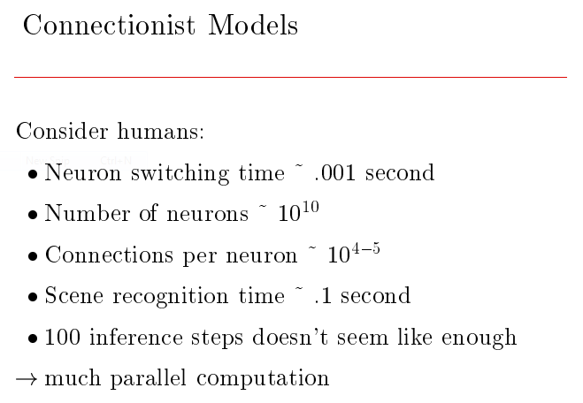

Slide 5


Slide 6
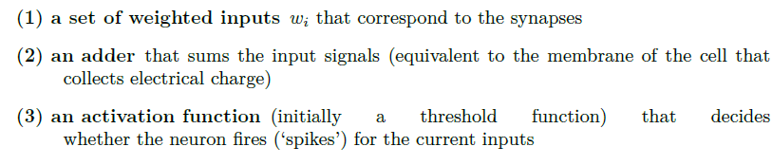
McCulloch and Pitts Neurons
The purpose of a mathematical model is that
it extracts only the bare essentials required to accurately represent the entity being studied,
removing all of the extraneous details.
McCulloch and Pitts produced a perfect example of this when they modelled a neuron as:

Slide 7
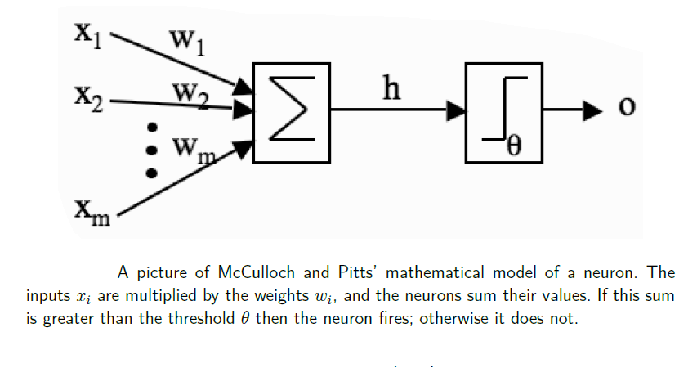

Slide 8
Limitations of the McCulloch and Pitts Neuronal Model
The inputs to a real neuron are not necessarily summed linearly
real neurons do not output a single output response, but a spike train
the neurons are not updated sequentially according to a computer clock, but update themselves randomly
synaptic connections are either excitatory or inhibitory, and never change from one to the other
real neurons can have synapses that link back to themselves in a feedback loop

Slide 9
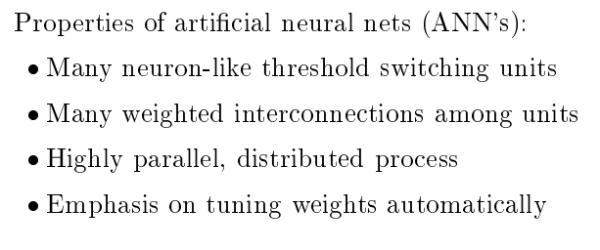

Slide 10
NEURAL NETWORK REPRESENTATIONS
A prototypical example of ANN learning is which uses a learned ANN to steer an autonomous vehicle driving at normal speeds on public highways.
The input to the neural network is a 30 x 32 grid of pixel intensities obtained from a forward-pointed camera mounted on the vehicle.
The network output is the direction in which the vehicle is steered.

Slide 11
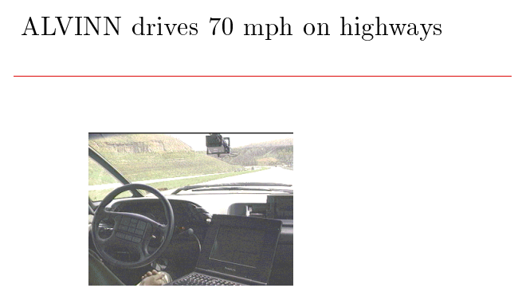
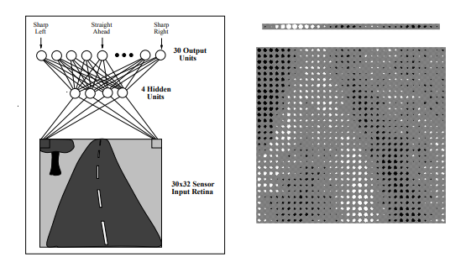

Slide 12
APPROPRIATE PROBLEMS FOR NEURAL NETWORK LEARNING
Instances are represented by many attribute-value pairs.
The target function output may be discrete-valued, real-valued, or a vector of several real- or discrete-valued attributes.
The training examples may contain errors.
Long training times are acceptable.
Fast evaluation of the learned target function may be required.
The ability of humans to understand the learned target function is not important

Slide 13
PERCEPTRONS

Slide 14
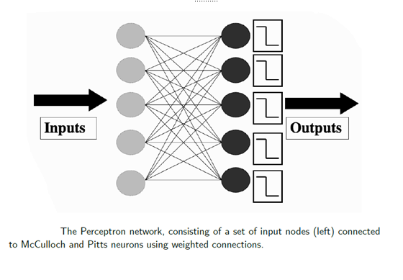
PERCEPTRONS

Slide 15
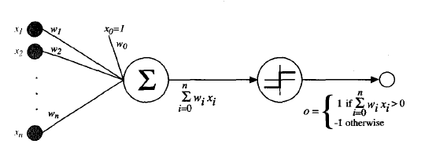
PERCEPTRONS

Slide 16
PERCEPTRONS
We can view the perceptron as representing a hyperplane decision surface in the n-dimensional space of instances (i.e., points).
The perceptron outputs a 1 for instances lying on one side of the hyperplane and outputs a -1 for instances lying on the other side.
The equation for this decision hyperplane is
Of course, some sets of positive and negative examples cannot be separated by any hyperplane.
Those that can be separated are called linearly separable sets of examples.

Slide 17

The Perceptron Training Rule
The Learning Rate
The Bias Input

Slide 18
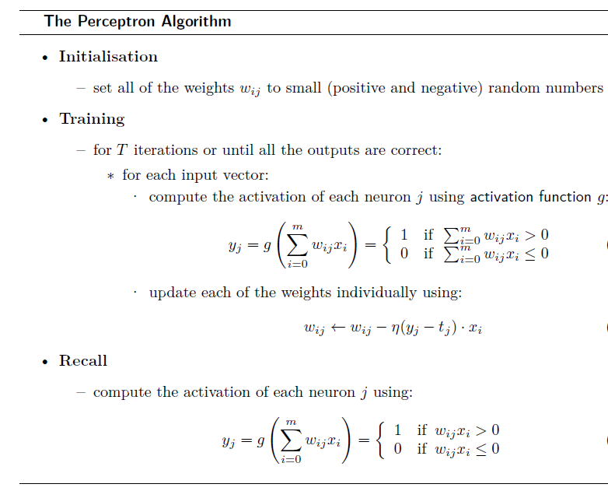

Slide 19
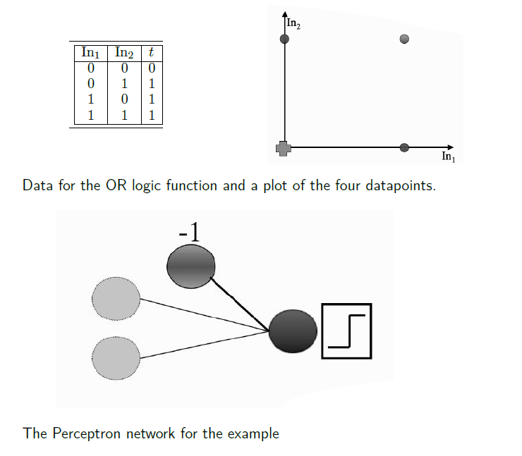

Slide 20
Perceptron for OR logic function
w0 = −0.05,w1 = −0.02,w2 = 0.02.
the input to the bias weight is always −1,
so the value that reaches the neuron is
−0.05 × −1 +−0.02 × 0 + 0.02 × 0 = 0.05.
This value is above 0, so the neuron fires and the output is 1, which is incorrect according to the target
η = 0.25

Slide 21
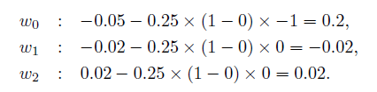
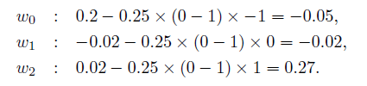
Perceptron for OR logic function
feed in the next input (0, 1) and compute the output (check that you agree that the neuron does not fire, but that it should)
For the (1, 0) input the answer is already correct, so we don’t have to update the weights at all, and
the same is true for the (1, 1) input.
We now need to start going through the inputs again, until the weights settle down and stop changing, which is what tells us that the algorithm has finished

Slide 22
The decision boundary computed by a Perceptron for the OR function

Slide 23
LINEAR SEPARABILITY

Slide 24
LINEAR SEPARABILITY
What does the Perceptron actually compute?
It tries to separate out the cases where the neuron should fire from those where it shouldn’t
It tries to find a straight line (in 2D, a plane in 3D, and a hyperplane in higher dimensions) where the neuron fires on one side of the line, and doesn’t on the other.
This line is called the decision boundary or discriminant function.

Slide 25
A decision boundary separating two classes of data.
The neuron fires if x·w^{T} ≥ 0
The boundary case is where we find an input vector x1 that has x₁ · w^{T} = 0.
Now suppose that we find another input vector x2 that satisfies x₂ · w^{T} = 0.
x₁ · w^{T} = x₂ · w^{T}
(x₁ − x₂) · w^{T} = 0
cos θ = 0
= π/2
(x₁ − x₂) and w^{T} are orthogonal
The cases where there is a straight line are called linearly separable cases.

Slide 26
What happens when we have more than one output neuron.
The weights for each neuron separately describe a straight line,
so by putting together several neurons we get several straight lines that each try to separate different parts of the space.

Slide 27
Different decision boundaries computed by a Perceptron with four neurons.

Slide 28
The Perceptron Convergence Theorem (Rosenblatt’s 1962 proof)
Given a linearly separable dataset, the Perceptron will converge to a solution that separates the classes, and that it will do it after a finite number of iterations.
In fact, the number of iterations is bounded by 1/γ², where γ is the distance between the separating hyperplane and the closest datapoint to it.

Slide 29
if the weights are linearly separable then the algorithm will converge, and
the time that this takes is a function of
the distance between the separating hyperplane and the nearest datapoint. This is called the margin
Perceptron stops learning as soon as it gets all of the training data correct, and so there is no guarantee that it will find the largest margin, just that if there is a linear separator, it will find it.

Slide 30
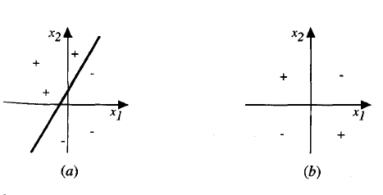

Slide 31
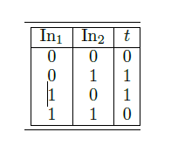
The Exclusive OR (XOR) Function
Data for the XOR logic function and a plot of the four datapoints

Slide 32
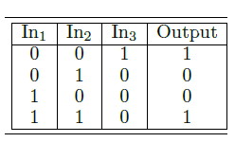
It is always possible to separate out two classes with a linear function, provided that you project the data into the correct set of dimensions.
There is a whole class of methods for doing this reasonably efficiently, called kernel classifiers, which are the basis of Support Vector Machines
A decision boundary (the shaded plane) solving the XOR problem in 3D with the crosses below the surface and the circles above it

Slide 33
Left: Non-separable 2D dataset. Right: The same dataset with third coordinate x1 × x2, which makes it separable.

