Slide 1
TURNING DATA INTO PROBABILITIES
FIGURE 2.10 A histogram of feature values (x) against their probability for two classes.

Slide 2
Prior probability
Class conditional probability
Posterior probability
Baye’s rule

Slide 3
We can use the posterior probability to assign each new observation to one of the classes by picking the class Ci where:
where x is a vector of feature values instead of just one feature. This is known as the
maximum a posteriori or MAP hypothesis, and it gives us a way to choose which class to choose as the output one.

Slide 4
Minimizing risk
The MAP question is what is the most likely class given the training data?
Suppose that there are three possible output classes, and for a particular input the posterior probabilities of the classes are P(C1|x) = 0.35, P(C2|x) = 0.45, P(C3|x) = 0.2.
The MAP hypothesis therefore tells us that this input is in class C2, because that is the class with the highest posterior probability. Now suppose that, based on the class that the data is in, we want to do something.
If the class is C1 or C3 then we do action 1, and if the class is C2 then we do action 2. As an example, suppose that the inputs are the results of a blood test, the three classes are different possible diseases, and the output is whether or not to treat with a particular antibiotic.
The MAP method has told us that the output is C2, and so we will not treat the disease.
But what is the probability that it does not belong to class C2, and so should have been treated with the antibiotic? It is 1 − P(C2) = 0.55.
So the MAP prediction seems to be wrong: we should treat with antibiotic, because overall it is more likely.
This method where we take into account the final outcomes of all of the classes is called the Bayes’ Optimal Classification.
It minimises the probability of misclassification, rather than maximising the posterior probability.

Slide 5
Example
A doctor is called to see a sick child. The doctor has prior information that 90% of sick children in that neighborhood have the flu, while the other 10% are sick with measles. Assume for simplicity that there no other maladies in that neighborhood. A well-known symptom of measles is a rash with a probability of 0.95.However, occasionally children with flu also develop rash with a probability 0.08. Upon examining the child, the doctor finds a rash. What is the probability that the child has measles?
Solution:
A doctor is called to see a sick child. The doctor has prior information that 90% of sick children in that neighborhood have the flu, while the other 10% are sick with measles. Assume for simplicity that there no other maladies in that neighborhood.
P(class = flu) = 0.9
P(class = measles) = 0.1

Slide 6
A well-known symptom of measles is a rash with a probability of 0.95.However, occasionally children with flu also develop rash with a probability 0.08.
P(rash = true/class = measles) = 0.95
P(rash = true/class = flu) = 0.08
Upon examining the child, the doctor finds a rash. What is the probability that the child has measles?
P(class = measles/rash=true) = ?
Let F represent an event of a child being sick with flu, M represent an event of a child being sick with measles and R represent the event of having rash

Slide 7
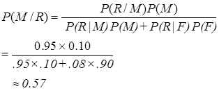
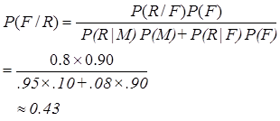
Prior
P(F) = 0.9 (90%)
P(M) = 0.1 (10%)
Likelihood
P(R|M) = .95
P(R|F) = 0.08

Slide 8
To decide whether the child is affected by measles or flu:
P(M/R) = 0.57
P(F/R) = 0.43
Since, P(M/R) > P(F/R), it is more probable that the rash is due to measles
i.e., it is more probable that the child has measles

Slide 9


Slide 10
NAIVE BAYESIAN CLASSIFIER
The assumption that the pieces of evidence are conditionally independent is called the naive Bayes assumption.
Thus, attributes are conditionally independent

Slide 11
P(p) = 9/14 P(n) = 5/14
outlook
P(sunny|p) = 2/9 P(sunny|n) = 3/5
P(overcast|p) = 4/9 P(overcast|n) = 0
P(rain|p) = 3/9 P(rain|n) = 2/5
temperature
P(hot|p) = 2/9 P(hot|n) = 2/5
P(mild|p) = 4/9 P(mild|n) = 2/5
P(cool|p) = 3/9 P(cool|n) = 1/5
humidity
P(high|p) = 3/9 P(high|n) = 4/5
P(normal|p) = 6/9 P(normal|n) = 2/5
windy
P(true|p) = 3/9 P(true|n) = 3/5
P(false|p) = 6/9 P(false|n) = 2/5
Outlook | Temp | Humidity | Windy | Class
sunny | Hot | high | false | N
sunny | Hot | high | true | N
Overcast | Hot | high | false | P
rain | Mild | high | false | P
rain | cool | normal | false | P
rain | cool | normal | true | N
Overcast | cool | normal | true | P
sunny | Mild | high | false | N
sunny | cool | normal | false | P
rain | Mild | normal | false | P
sunny | Mild | normal | true | P
Overcast | Mild | high | true | P
Overcast | Hot | normal | false | P
rain | Mild | high | true | N

Slide 13
SOME BASIC STATISTICS
Averages – mean, median, mode
Mean - is the value that is found by adding up all the points in the dataset and dividing by the number of points
Median - the middle value - sort the dataset according to size and then find the point that is in the middle (of course,if there is an even number of datapoints then take the value halfway between the two points that are closest to the middle)
Mode - most common value - counting how many times each element appears and picking the most frequent one
Expectation – mean
Variance and Covariance

Slide 14
The variance of the set of numbers is a measure of how spread out the values are.
It is computed as the sum of the squared distances between each element in the set and the expected value of the set (the mean, μ):
The square root of the variance is known as the standard deviation.
The variance looks at the variation in one variable compared to its mean.
It can be generalised to look at how two variables vary together, which is known as the covariance.
It is a measure of how dependent the two variables are (in the statistical sense). It is computed by:

Slide 15
It can be generalised to look at how two variables vary together, which is known as the covariance.
It is a measure of how dependent the two variables are (in the statistical sense). It is computed by:

Slide 16
The covariance can be used to look at the correlation between all pairs of variables within a set of data.
We need to compute the covariance of each pair, and these are then put together into what is imaginatively known as the covariance matrix.
It can be written as:
where xi is a column vector describing the elements of the ith variable, and μi is their mean.
the matrix is square,
the elements on the leading diagonal of the matrix are equal to the variances, and
it is symmetric since cov(xi, xj) = cov(xj , xi).

Slide 17
Mahalanobis distance
where x is the data arranged as a column vector, μ is column vector representing the mean,
and Σ⁻¹ is the inverse of the covariance matrix.
If we set the covariance matrix to the identity matrix, then the Mahalanobis distance reduces to the Euclidean distance.

Slide 18
THE BIAS-VARIANCE TRADEOFF
Whenever we train any type of machine learning algorithm we are making some choices about a model to use, and fitting the parameters of that model.
The more degrees of freedom the algorithm has, the more complicated the model that can be fitted.
more complex models do not necessarily result in better results
A model can be bad for two different reasons.
Either it is not accurate and doesn’t match the data well (bias), or
it is not very precise and there is a lot of variation in the results (statistical variance)
More complex classifiers will tend to improve the bias, but the cost of this is higher variance, while making the model more specific by reducing the variance will increase the bias.
straight line fit vs spline

Slide 19
When looking at sum-of-squares error function we can split it up into separate pieces that represent the bias and the variance.
Suppose that the function that we are trying to approximate is
where epsilon is the noise, which is assumed to be Gaussian with 0 mean and variance sigma²

Slide 20
Let Z be just some random variable

Slide 21
The first term is the irreducible error and is the variance of the test data.
The second term is variance,
The variance tells us how much x changes depending on the particular training set that was used
The third term is the square of the bias
the bias tells us about the average error of h(x).
you can have a model with low bias (meaning that on average the outputs are current), but high variance (meaning that the answers wibble around all over the place) or vice versa, but you can’t make them both zero
for each model there is a tradeoff between them.
However, for any particular model and dataset there is some reasonable set of parameters that will give the best results for the bias and variance together
part of the challenge of model fitting is to find this point.

Slide 22
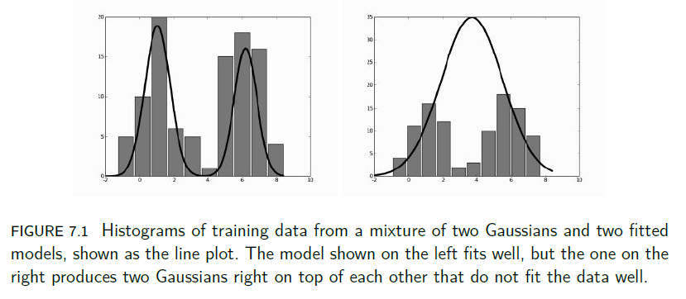


Gaussian Mixture Models

Slide 23
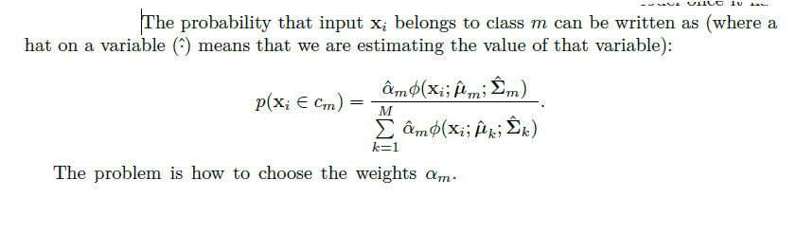
The common approach is to aim for the maximum likelihood solution (the likelihood is the conditional probability of the data given the model, and the maximum likelihood solution varies the model to maximise this conditional probability).
In fact, it is common to compute the log likelihood and then to maximise that; it is guaranteed to be negative, since probabilities are all less than 1, and the logarithm spreads out the values, making the optimisation more effective.

Slide 24
The Expectation-Maximisation (EM) Algorithm
The basic idea of the EM algorithm is that sometimes it is easier to add extra variables that are not actually known (called hidden or latent variables) and then to maximise the function over those variables.

Slide 25
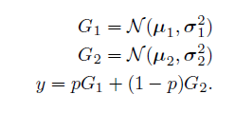

Consider the simplest interesting case of the Gaussian mixture model: a combination of just two Gaussian mixtures.
The assumption now is that data were created by randomly choosing one of two possible Gaussians, and then creating a sample from that Gaussian.
If the probability of picking Gaussian one is p, then the entire model looks like this
If the probability distribution of p is written as π , then the probability density is:

Slide 26

If f = 0 then the data came from Gaussian one, if f = 1 then it came from Gaussian two.
This is the typical initial step of an EM algorithm: adding latent variables.
Now we just need to work out how to optimise over them.
We don’t know much about variable f, but we can compute its expectation (which is the mean average) from the data:
where D denotes the data. Note that since we have set f = 1 this means that we are choosing Gaussian two.

Slide 27
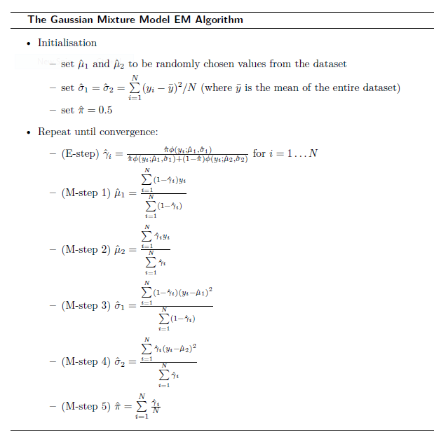

Slide 28
