Slide 1
Ch. 4: Radial Basis Functions
Stephen Marsland, Machine Learning: An Algorithmic Perspective.

Slide 2
Perceptron

Slide 3
In the MLP, the activations of the hidden nodes were decided by whether the inputs times the weights were above a threshold that made the neuron fire.
In RBFN a different approach is used, which is to use local neurons, where each neuron only responds to inputs in one particular part of the input space.
  The argument is that if inputs are similar, then the responses to those inputs should also be similar, and so the same neuron should respond.

Slide 4
In RBFN
The most important difference between them is the fact that the MLP uses the hidden nodes to separate the space using hyperplanes, which are global, while the
RBF uses them to match functions locally.

Slide 5

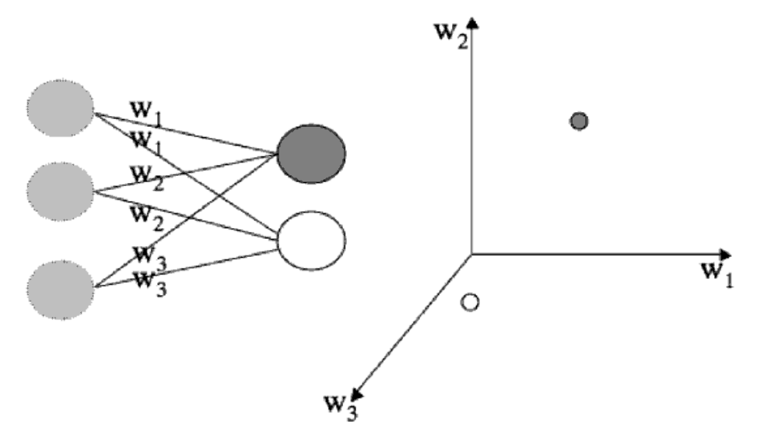
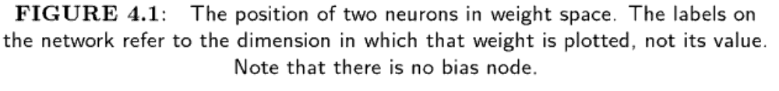

Slide 6
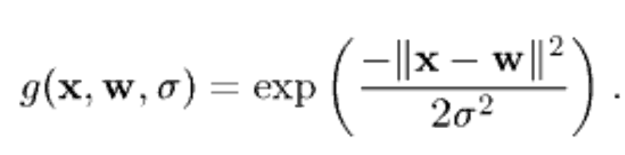
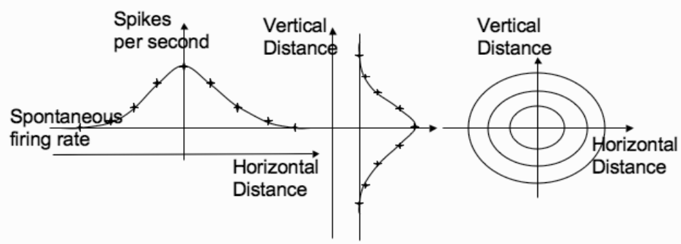
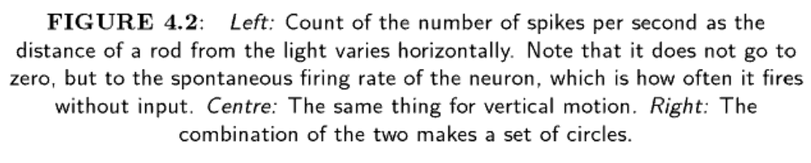
RECEPTIVE FIELDS

Slide 7
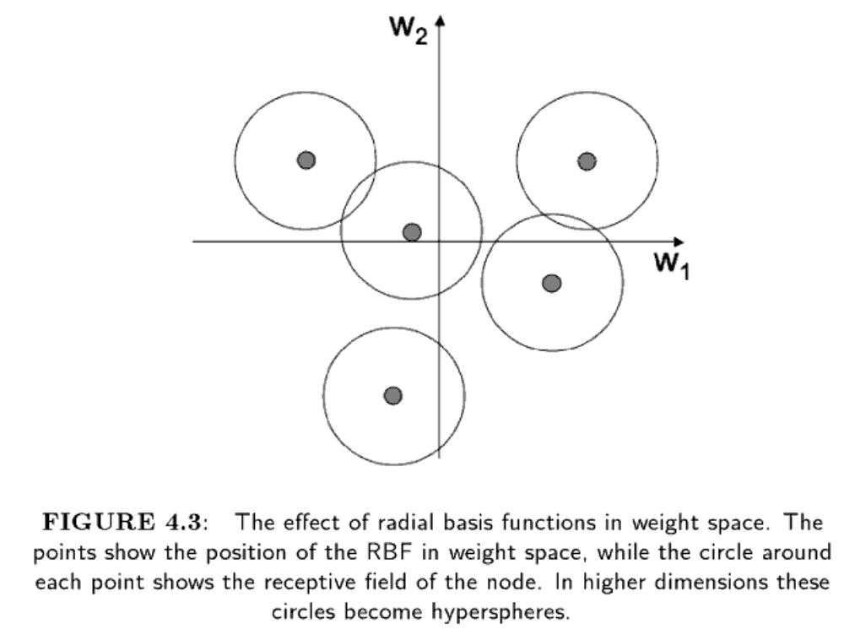

Slide 8
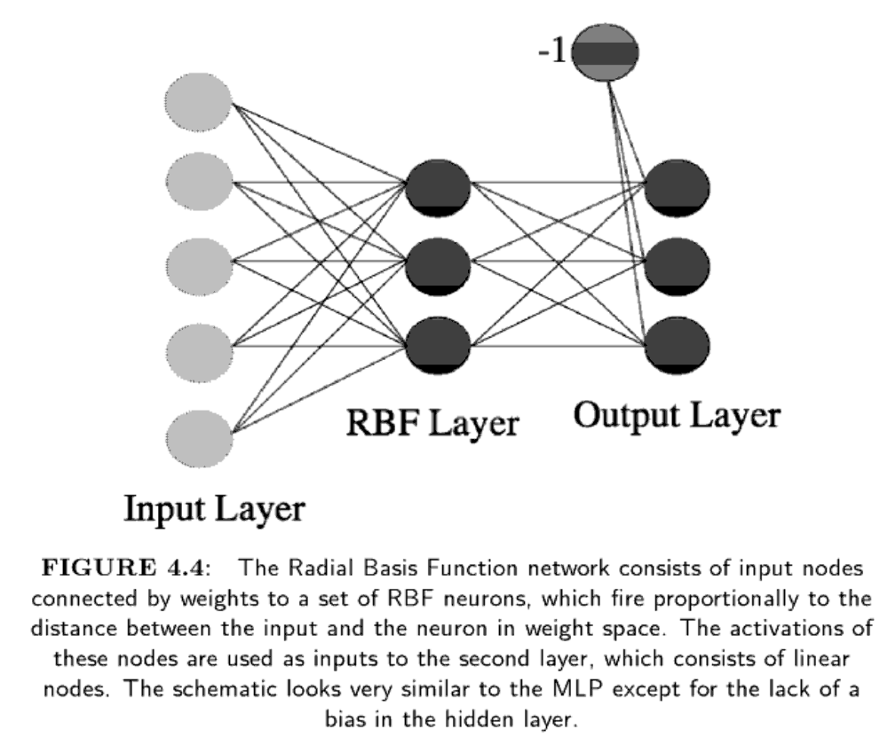

Slide 9
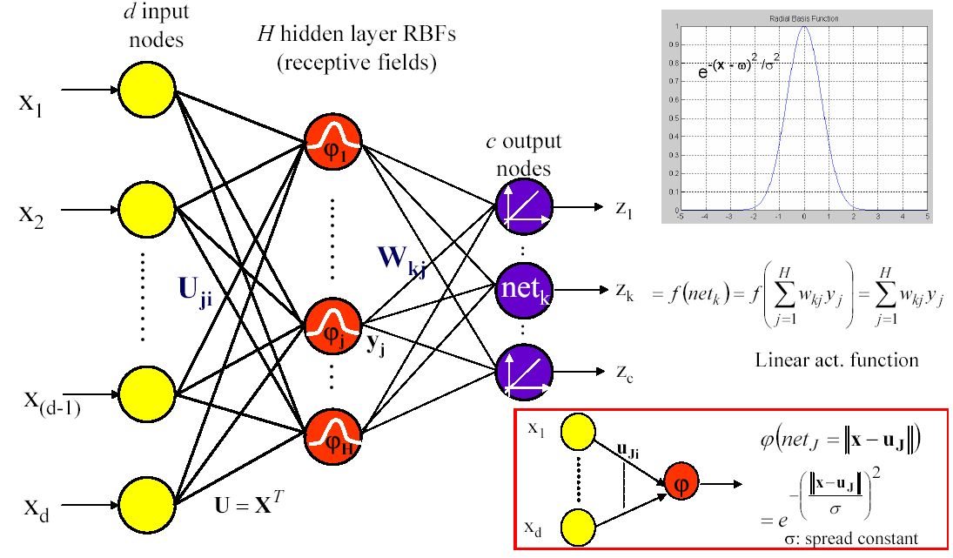
RBF Networks

Slide 10
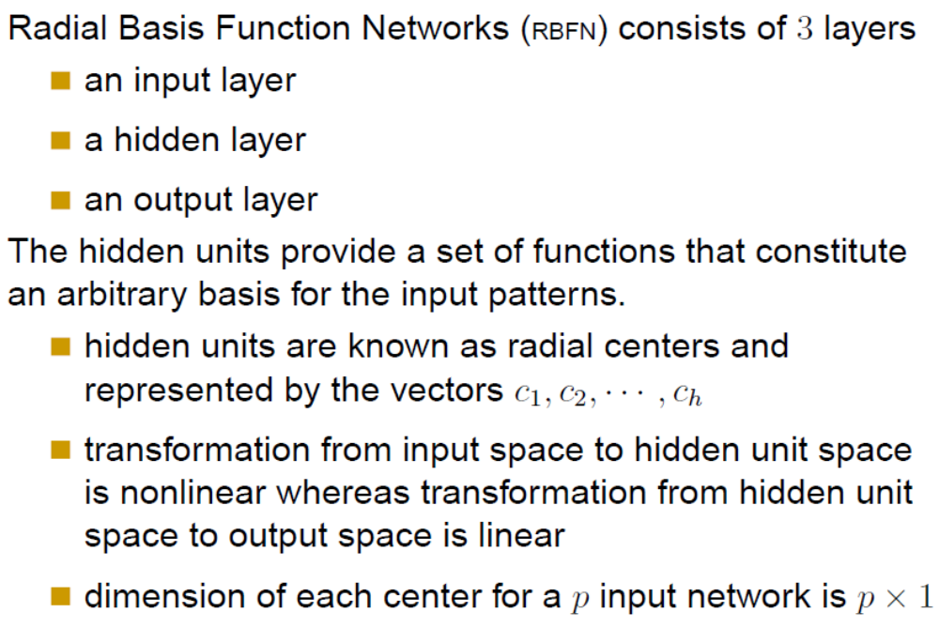

Slide 11
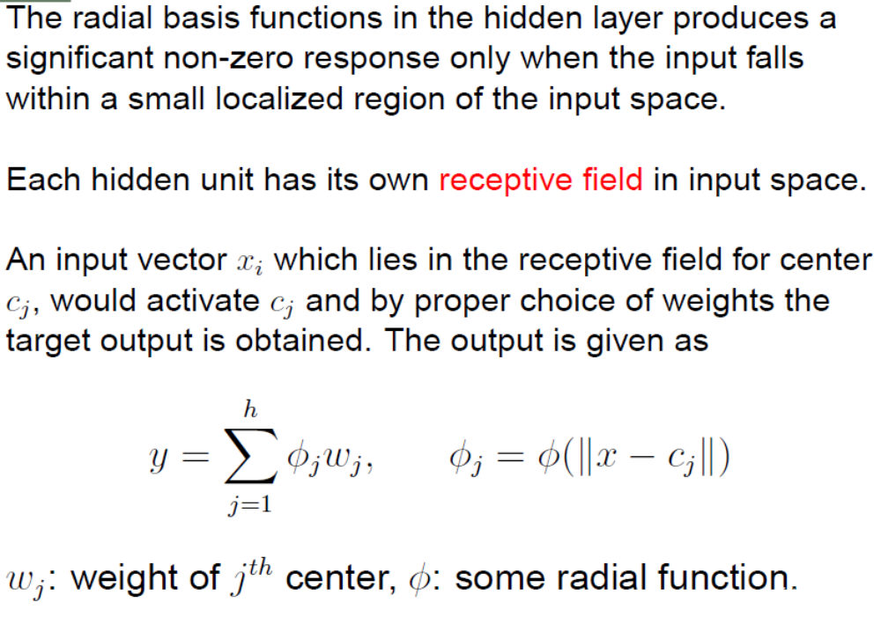

Slide 12
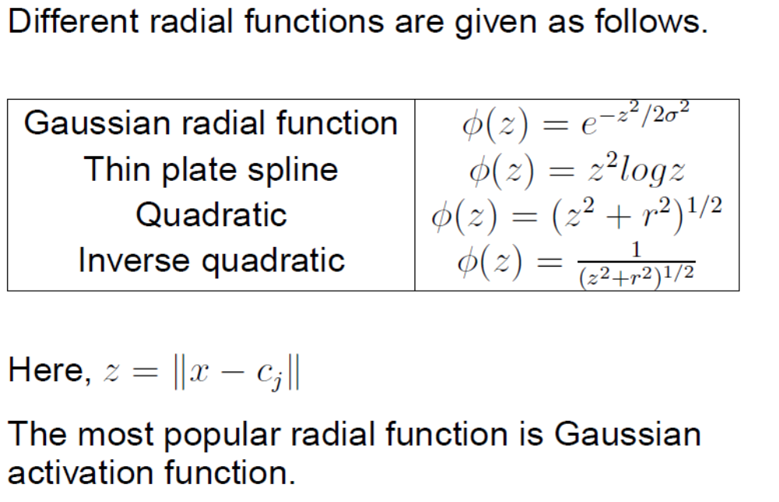

Slide 13
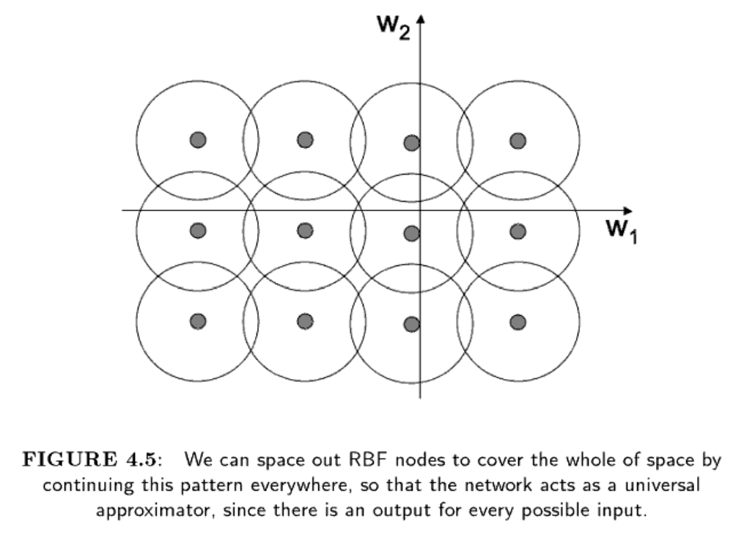

Slide 14
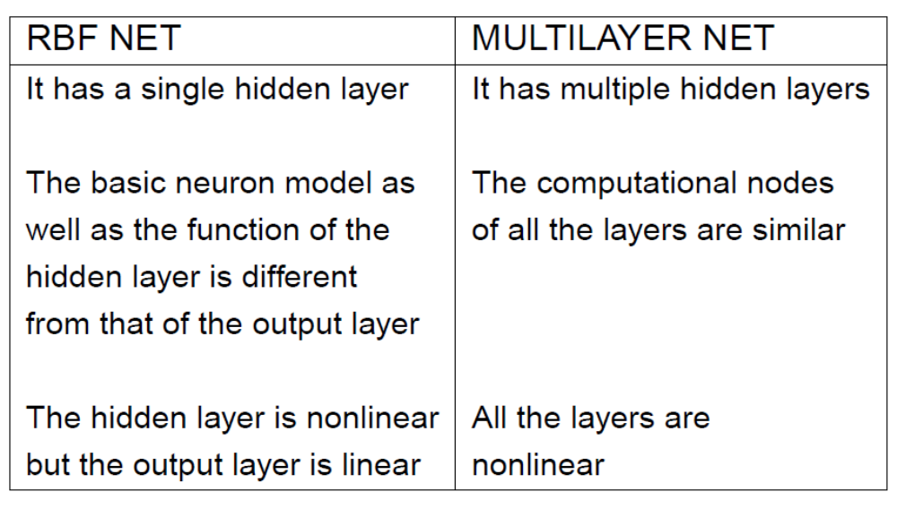

Slide 15
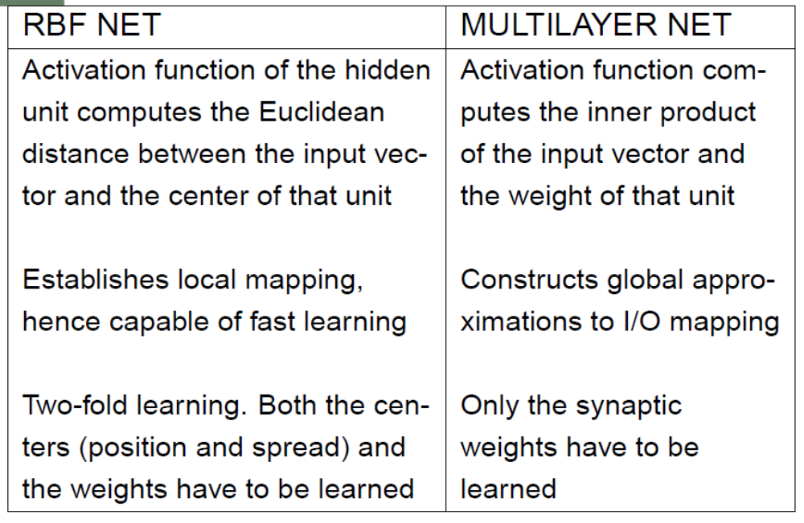

Slide 16
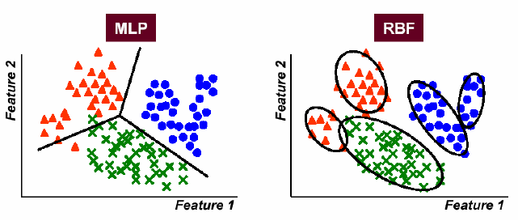
RBFs for Classification

Slide 17
Purpose of hidden nodes
  Find a non-linear representation of the inputs
Purpose of output layer
  Find a linear combination of those hidden nodes that does the classification

Slide 18
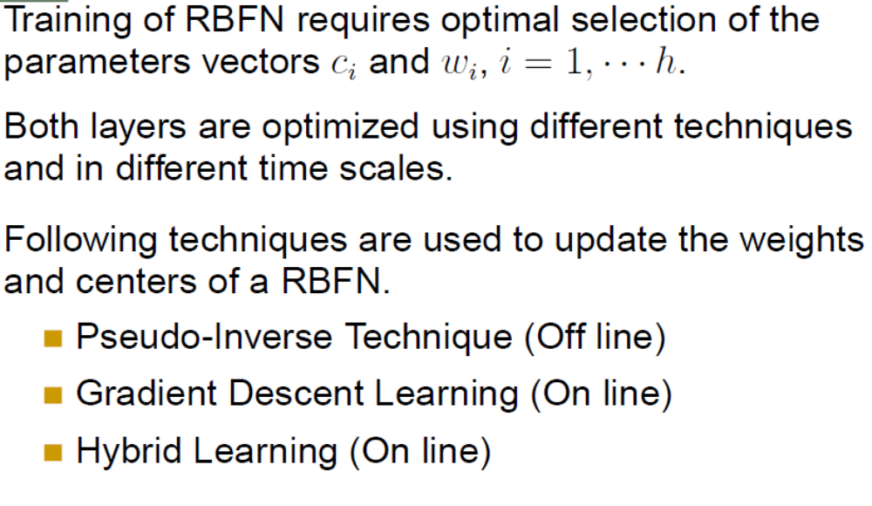

Slide 19
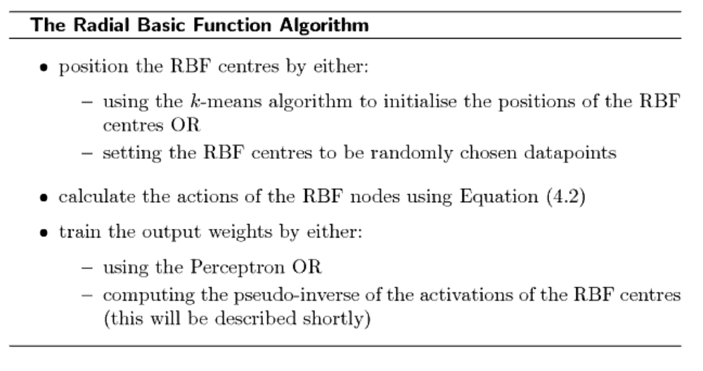


Slide 20
Network Parameters
What do these parameters represent?
φ: The radial basis function for the hidden layer. This is a simple nonlinear mapping function (typically Gaussian) that transforms the d- dimensional input patterns to a (typically higher) H-dimensional space. The complex decision boundary will be constructed from linear combinations (weighted sums) of these simple building blocks.
u_{Ji}: The weights joining the first to hidden layer. These weights constitute the center points of the radial basis functions. Also called prototypes of data.
σ: The spread constant(s). These values determine the spread (extend) of each radial basis function.
W_{jk}: The weights joining hidden and output layers. These are the weights which are used in obtaining the linear combination of the radial basis functions. They determine the relative amplitudes of the RBFs when they are combined to form the complex function.
||x-u_{J}||: the Euclidean distance between the input x and the prototype vector u_{J}. Activation of the hidden unit is determined according to this distance through φ.

Slide 21
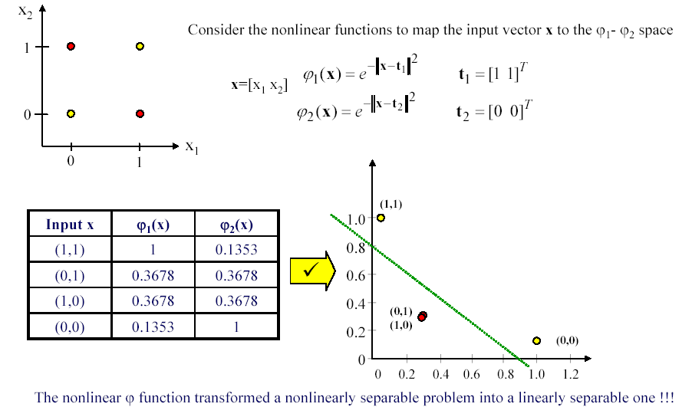
Illustrative Example - XOR Problem
Using nonlinear functions, we can convert a nonlinearly separable problem into a linearly separable one.
φ1
φ2

Slide 22
RBF Networks

Slide 23
Training RBF Networks
Approach 1: Exact RBF
Approach 2: Fixed centers selected at random
Approach 3: Centers are obtained from clustering
Approach 4: Fully supervised training

Slide 24
Training RBF Networks
Approach 1: Exact RBF
    Guarantees correct classification of all training data instances.
    Requires N hidden layer nodes, one for each training instance.
    No iterative training is involved: w are obtained by solving a set of linear equations
    Non-smooth, bad generalization

Slide 25
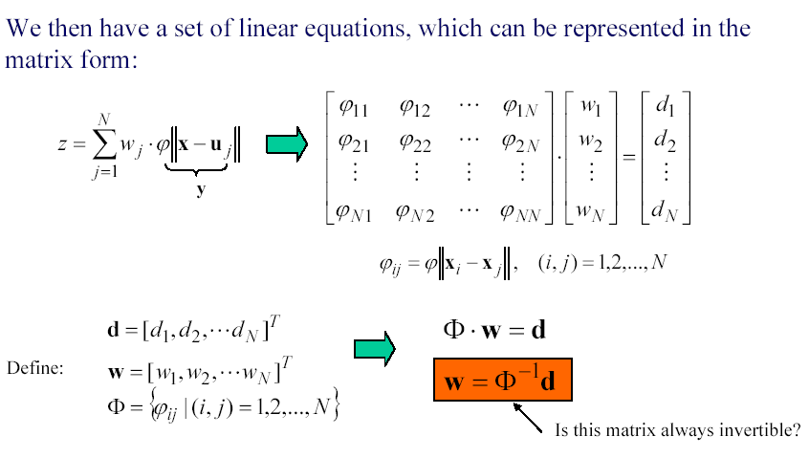
Exact Interpolation

Slide 26
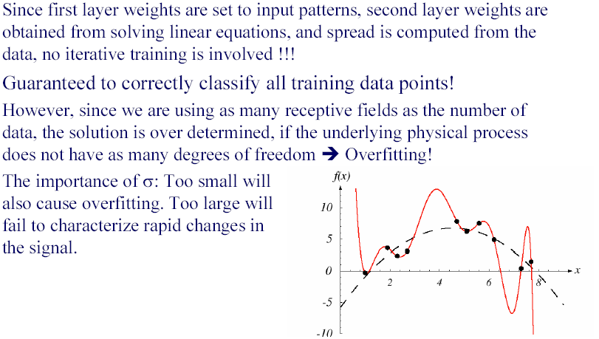
Exact Interpolation

Slide 27
Too Many Receptive Fields?
In order to reduce the artificial complexity of the RBF, we need to use fewer number of receptive fields.
Approach 2: Fixed centers selected at random.
    Use M < N data points as the receptive field centers.
    Fast but may require excessive centers
Approach 3: Centers are obtained from unsupervised learning (clustering).
    Centers no longer has to coincide with data points
    This is the most commonly used procedure, providing good results.

Slide 28
For each input vector, we compute the activation of all the hidden nodes, and assemble them into a matrix G.
So each element of G, say G_{ij} , consists of the activation of hidden node j for input i.
The outputs of the network y = GW for set of weights W.
We want to choose W using the target outputs t.

Slide 29
If we were able to get all of the outputs correct, then we could write t = GW
W= G⁻¹t
The matrix inverse is only defined if a matrix is square, and this one probably isn’t
  the number of hidden nodes need not be the same as the number of training inputs

Slide 30
there is a well-defined pseudo-inverse G+ of a matrix, which is G⁺ = (G^{T}G)⁻¹G^{T}
the pseudo-inverse is the matrix that satisfies G⁺G=I
If G is a square, non-singular (i.e., with non-zero determinant) matrix then G⁺ = G⁻¹ = I

Slide 31
Choice of the size of the receptive fields for the nodes
  giving all of the nodes the same size, and testing lots of different sizes using a validation set to select one that works
  set according to the maximum distance between the locations of the hidden nodes (d) and the number of hidden nodes
    d/sqrt(2M), where M is the number of RBFs

Slide 32
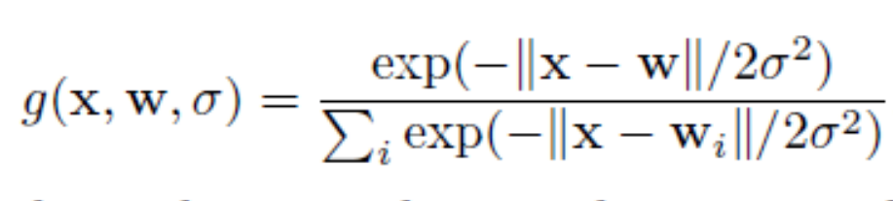
There is another way to deal with the fact that there may be inputs that are outside the receptive fields of all nodes,
use normalised Gaussians, so that there is always at least one input firing: the node that is closest to the current input, even if that is a long way off

Slide 33
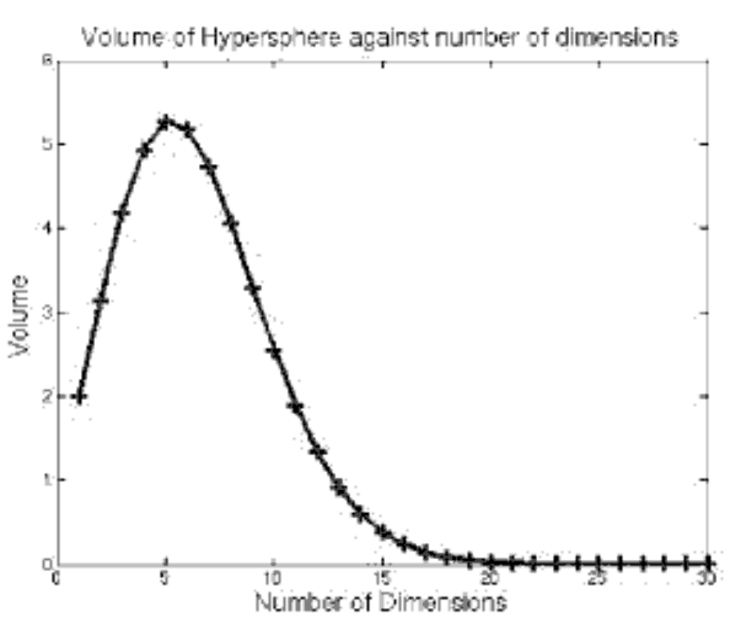
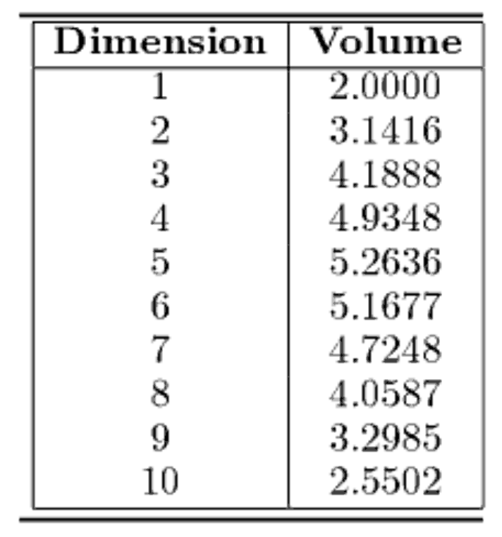
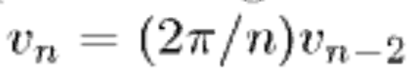

Slide 34
INTERPOLATION AND BASIS FUNCTIONS
function approximation:
  given some data, find a function that goes through the data without overfitting to the noise, so that values between the known datapoints can be inferred or interpolated.
The RBF network solves this problem
  by each of the basis functions making a contribution to the output whenever the input is within its receptive field.
So several RBF nodes will probably respond for each input.

Slide 35
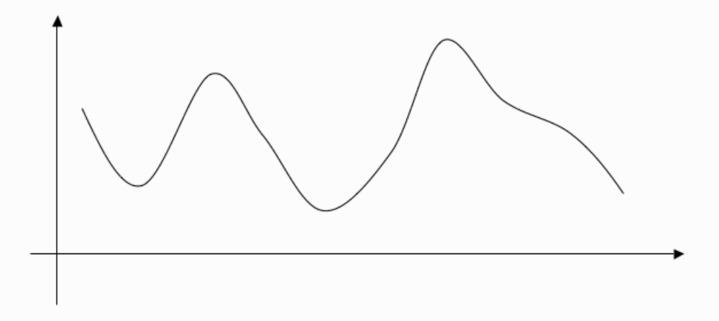
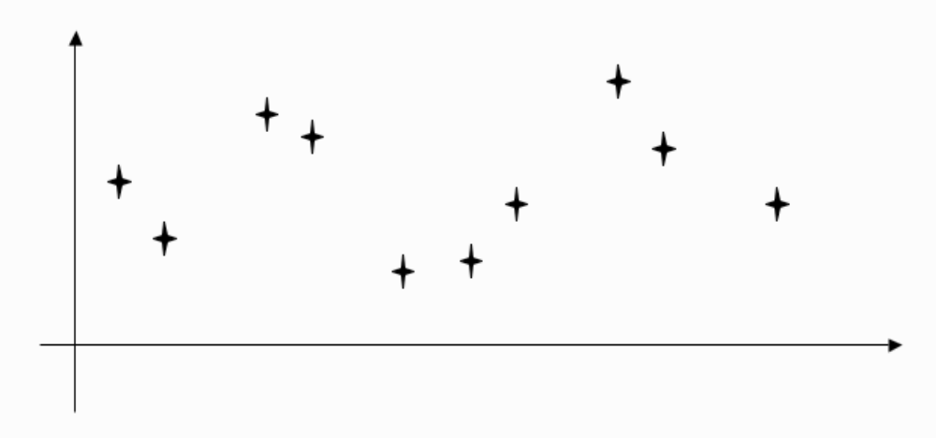
Curve showing a function
A set of datapoints from the curve

Slide 36
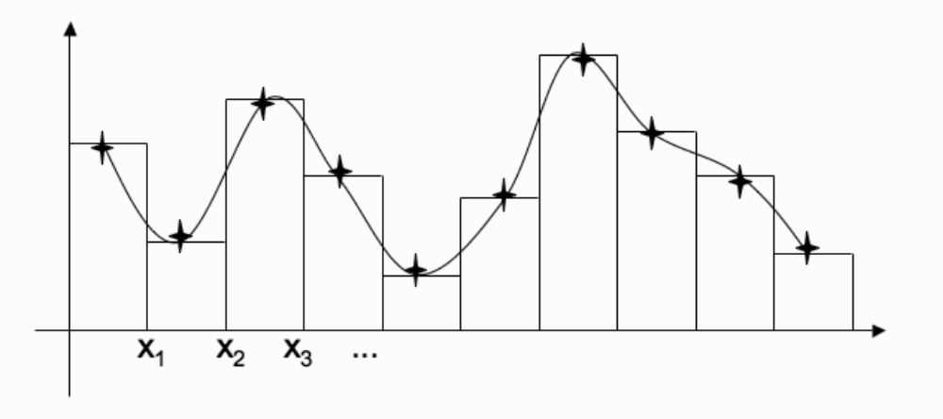
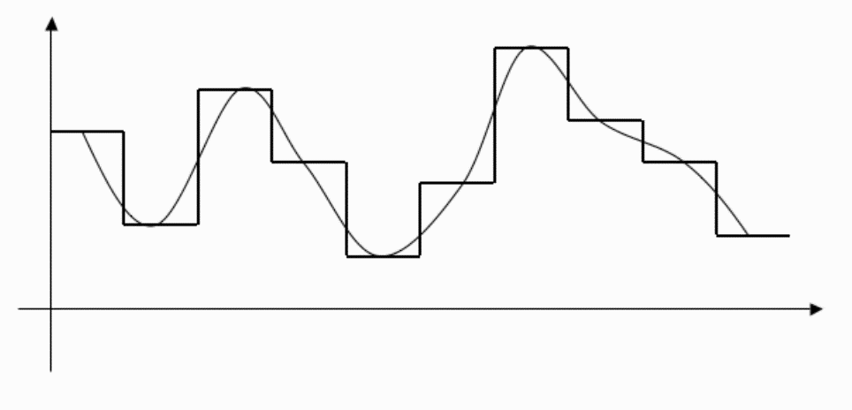
Putting a straight horizontal line through each point creates a histogram that describes an approximation to the curve
That approximation

Slide 37
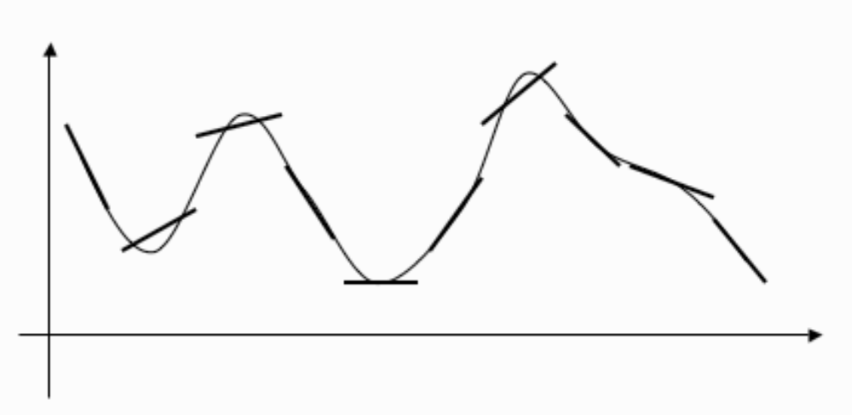
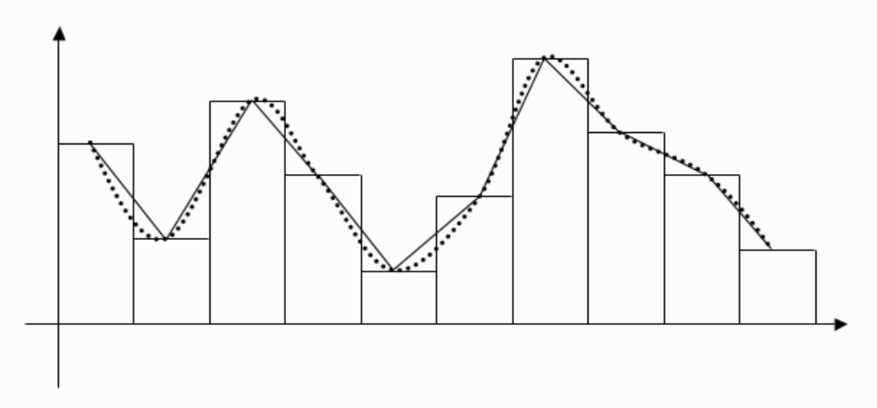
Representing the points by straight lines that aren’t necessarily horizontal (so
that their first derivative matches at the point) gives a better approximation.
Making the straight lines meet so that the function is continuous gives a
better approximation

Slide 38
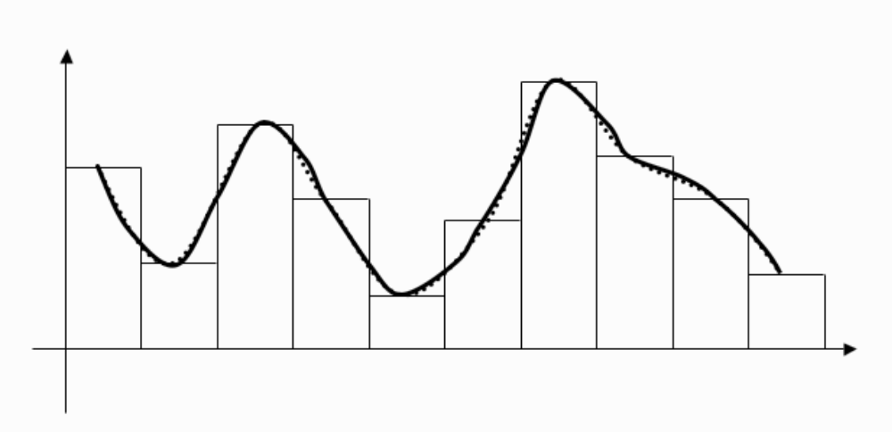
Using cubic functions to connect the points gives an even better approximation, and the curve is also continuous at the points where the sections join up (known as knotpoints).

