Slide 1
Use Cases
CS/SWE 421
Introduction to Software Engineering
Dan Fleck
(Slides adapted from Dr. Stephen Clyde with permission)
Coming up: Introduction
Notes:
Additional information:
http://www.rational.com/uml/resources.html

Slide 2
Introduction
Use Case: “... a typical interaction between a user and a computer system”, Booch
  Here, “user” is anything that needs or invokes the functionality of the system
  “Computer system” is the system being modeled
Use cases capture and document the user-visible functionality of a system (functional requirements)
Use cases capture how the system will benefit the user
Each use case represents a discrete goal for the user
Coming up: Example Use Case Diagram
Notes:
Examples of modeling languages:
Data Flow Diagrams
Entity Relationship Diagrams
Flow Charts
Context Diagrams
State Charts
Object-oriented Systems Modeling (OSM)
The term model is actual a more appropriate term for what Booch, et al.m informal refer to as a modeling language.

Slide 3
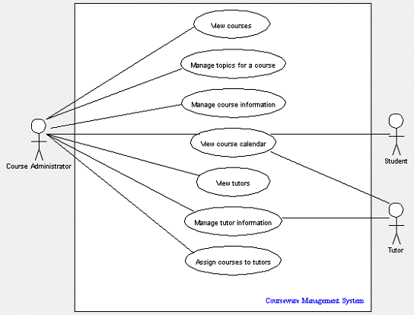
Example Use Case Diagram
Coming up: Use Case Diagrams

Slide 4


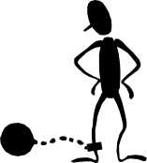
Use Case Diagrams
Use Case Diagrams provide a visual way to document user goals and explore possible functionality
Three primary modeling components:
  Actors
  Use Cases
  Relationships between use cases
Record class grades
Review Transcripts
Teacher
Authorized
Staff Worker
Student
Coming up: Actors

Slide 5
Actors
Actors are people or external systems that need to interact with our system
Finding Actors
Who or what will use the main functionality of the system?
Who or what will provide input to this system?
Who or what will use output from this system?
Who will need support from the system to do their work?
Are there any other software systems with which this one needs to interact
Are there any hardware devices used or controlled by this system?
Answer these questions to find actors for an iPod
Coming up: Relationships Between Actors

Slide 6
Relationships Between Actors
Actors can be related by generalization/specialization
Actors are classifiers (not individual users)
Student
Do this when very obvious.. otherwise skip it
Graduate Student
Coming up: Use Case Relationships

Slide 7
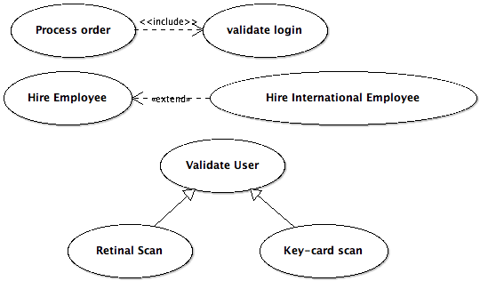
Use Case Relationships
Includes
Extends
Generalization
After a while you realize extends and generalization are not too different. Just know generalization and includes… forget about extends (the difference is only in intent)
Coming up: Use-Case Relationships
Notes:
Validate User (General) --- Specialization: retinal scan, key-card scan
Extends - Hire Employee --- Hire international employee
Includes - process data --- login to system
Extends adds functionality usually for abnormal case, generalization/specialization replaces functionality

Slide 8
Use-Case Relationships
Includes Dependency: Defines how one use case can invoke behavior defined by another use case
Alter Student Grade
<<includes>>
Record Grades for a Section
Teacher
Coming up: Use-Case Relationships

Slide 9
Use-Case Relationships
Extends dependency: defines a use-case that is a variation of another, usually for handling an abnormal situation
Alter Student Grade
<<extends>>
Alter student grade for a class taken more than a year ago
Authorized
Staff Worker
Coming up: Use-Case Relations

Slide 10
Use-Case Relations
Generalization: Defines one use case as a generalization of another. Replaces generic functionality with alternate implementation
Alter Student Grade
Alter Student Grade for a Graduate Course
Teacher
Coming up: Documenting Use Cases

Slide 11
Documenting Use Cases
What is system response to external event? What is the user’s goal?
List Actors
List External Events
Determine expected behavior
Name behaviors as use cases
Add relations (includes, extends, generalization)
Document use case (basic flow, alternate, exception)
Be Patient… let them unfold
Coming up: Benefits of Use Cases

Slide 12
Benefits of Use Cases
Use cases diagrams capture user-visible functions
Identifying actors help capture who needs the system functionality
Relationships between use cases document opportunities for reuse
Use cases provide a basis planning and scheduling incremental development
Use cases can provide a basis for system testing
Coming up: In Class Exercise

Slide 13
In Class Exercise
Lets create a use case diagram for
  iPod
  Television set
  Elevator
  ATM
  Online Scrabble game
  Word Processor
Coming up: Use cases for CS421

Slide 14
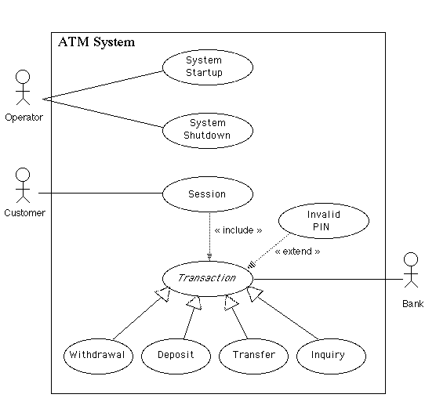
Use cases for CS421
Show system boundary
Show Actors outside boundary
Use extend, include, generalization/specialization where appropriate
Typically one diagram for your project is sufficient
Coming up: Use cases for CS421

Slide 15
Use cases for CS421
For each use-case (oval) in your diagram include the use-case description text described in the slide for Chapter 5, titled:
Use Case Description
  about slide #14
Coming up: Questions

Slide 16
Questions
Who might be interested in reviewing or using use case diagrams?
When in the development life cycle should we employ use cases?
What do use cases have to do with object-orientation?
What level of use-case granularity is best?
How many use cases are enough?
Can other modeling activities help in discovering use cases?
When in the development life cycle do we stop referring to or refining the use cases?
What should the text description of use case contain?
Coming up:
Notes:
2/4/2010 early class – got here (created paper version of use case desc for Web browser… still need review them)

Slide 17
Backup Slides
The following slides were removed over time.
Coming up: Extends vs. Includes vs. Generalization

Slide 18
Extends vs. Includes vs. Generalization
Extends, includes, and generalization may appear similar, but differ in intent
  Extend dependencies model variations from normal workflows
  Specializations are refinements of a general use cases
  “Include” uses case (or sub-use cases), unlike specializations, can represent different goals or processes
  Include dependencies are a form of aggregation
  The actors for a general use case are also actors for the use cases that specialize it
  Often there are no actors for sub-use cases
Coming up: User Goals

Slide 19
User Goals
User Goals are statements that represent what the users need to accomplish, independent of specific software features
Examples of user goals for a Student Records Management System
  Ensure that a student’s records reflects courses taken and grades received in those courses
  Allow only authorized faculty and staff to update student records
  Ensure that students can obtain copies of their own (and only their) records in a timely manner
Coming up: System Interactions

Slide 20
System Interactions
Represent expected interacts between users and the computer-based system
Suggest how the system fulfills a user goal
Examples:
  A teacher alters a course grade for a student by
    selecting a semester
    selecting a course
    selecting a student
    reviewing the previous grade
    entering a new grade
    confirming the change
  A process for an administrator to create a new user
  A process for granting a user access rights
Coming up: User Goals vs. System Interactions

Slide 21
User Goals vs. System Interactions
Example showing interactions:
User wants to spell check document.
Basic Flow
User clicks “Spell Check” button
System checks each word
New dialog box appears with results
In some cases, system interactions and user goals can be very similar
However, confusing system interactions with user goals or neglecting to identify user goals can
  obscure the reasons why a system should have certain features
  result in lost opportunities for creativity
Example showing goals:
User wants to spell check document.
Basic Flow
User starts spell check process
System checks each word
System presents results to the user
Coming up: User Goals vs. System Interactions

Slide 22
User Goals vs. System Interactions
User goals help answer “What” and “Why” questions
System interactions help answer “How” questions (from a user’s perspective)
We will model user goals with Uses Cases
Later, we will model system interactions with interaction diagrams or activity diagrams
Coming up: Actors

Slide 23
Actors
Actors are people or external systems that need to interact with our system
Actors carry out use cases
Actors are represented as stick figures
Although users are actors, not all actors are users
  Actors can be external software systems
  External hardware (sensors, actuators, etc.)
  Actors can be people that need the functionality of the system, but may not be the ones who actually invoke the software commands
Coming up: Hints for Finding Actors

Slide 24
Hints for Finding Actors
Who or what will use the main functionality of the system?
Who or what will provide input to this system?
Who or what will use output from this system?
Who will need support from the system to do their work?
Are there any other software systems with which this one needs to interact
Are there any hardware devices used or controlled by this system?
Using these what are some actors for an iPod?
Coming up: Hints for Modeling Actors

Slide 25
Hints for Modeling Actors
An actor can be a role that a user plays with respect to the system
A single person may play different roles
A single actor may perform many use cases
A use case may be performed by many actors
Show external systems as actors only when they are the ones who need a use case
End of presentation

