Slide 1
Chapter 1
Object-Oriented Analysis and Design

Slide 2
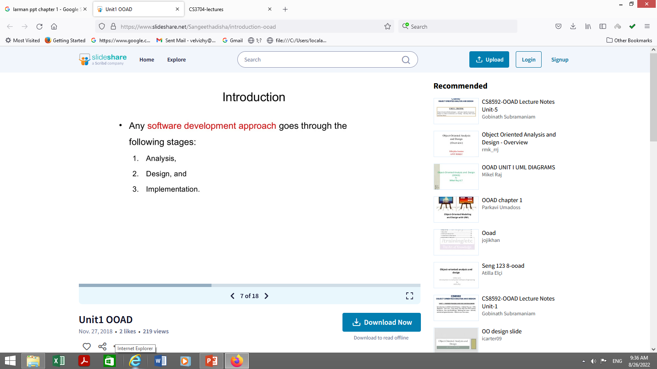

Slide 3
Thinking in Objects and UML - 1
The Unified Modeling Language (UML) is a standard diagramming notation; sometimes referred to as a blueprint.
It is NOT OOA/OOD or a method
Only a notation for capturing objects and the relationships among objects (dependency; inheritance; realizes; aggregates, . .)
UML is language-independent
Analysis and design provide software “blueprints” captured in UML.
Blueprints serve as a tool for thought and as a form of communication with others.
3 ways of Applying UML
  UML as a sketch
  UML as blueprint
  UML as a programming language

Slide 4
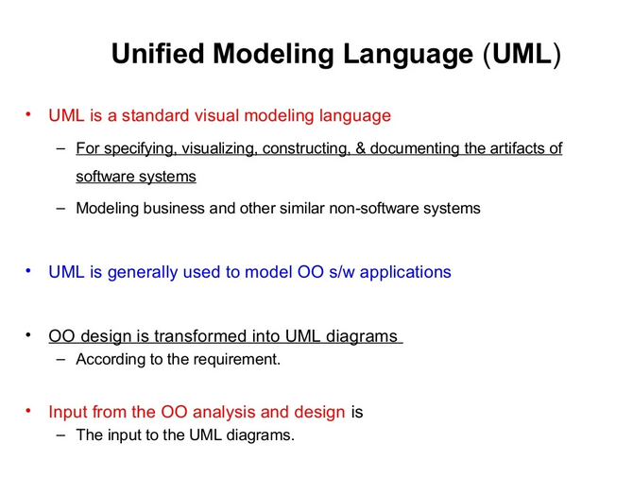

Slide 5
Thinking in Objects and UML – 2
But it is far more essential to ‘think’ in terms of objects as providing ‘services’ and accommodating ‘responsibilities.’
Discuss: What is meant by ‘services?’ How indicated?
  How might you think these ‘services’ impact the design of classes?
  How might a client access these services?
  What is encapsulation? How does it relate to reusability? Self-governance? Design?
Discuss: What is meant by ‘responsibilities?’
  Encapsulation of data and services?

Slide 6
Thinking in Terms of Objects and UML - 3
Object-Oriented Analysis (Overview)
  An investigation of the problem (rather than how a solution is defined)
  During OO analysis, there is an emphasis on finding and describing the objects (or concepts) in the problem domain.
  For example, concepts in a Library Information System include Book, and Library.
  High level views found in the application domain.
  Oftentimes called domain objects; entities.

Slide 7
Thinking in Terms of Objects and UML - 4
Object-Oriented Design
  Emphasizes a conceptual solution that fulfills the requirements.
  Need to define software objects and how they collaborate to meet the requirements.
  For example, in the Library Information System, a Book software object may have a title attribute and a getChapter method.
    What are the methods needed to process the attributes?
Designs are implemented in a programming language.
  In the example, we will have a Book class in Java.

Slide 8
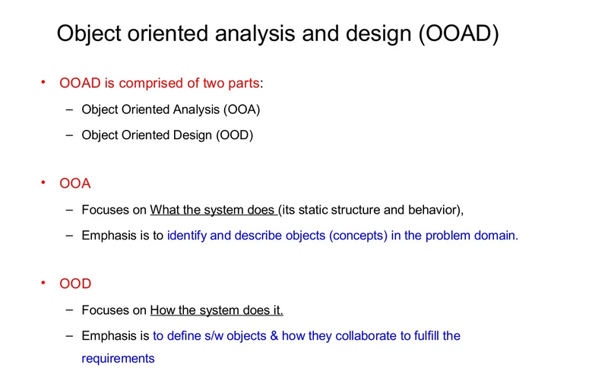

Slide 9
Thinking in Terms of Objects and UML – 5
From Design to Implementation
Analysis
investigation
of the problem
Design
logical solution
Construction
code
Book
public class Book {
  public void print();
  private String title;
}
Book
(concept)
title
print()
Domain concept
Representation in
analysis of concepts
Representation in an
object-oriented
programming language.
Can you see the services / responsibilities in the Book class?

Slide 10
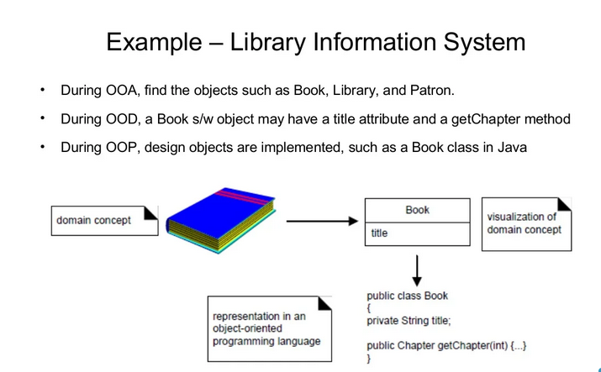

Slide 11
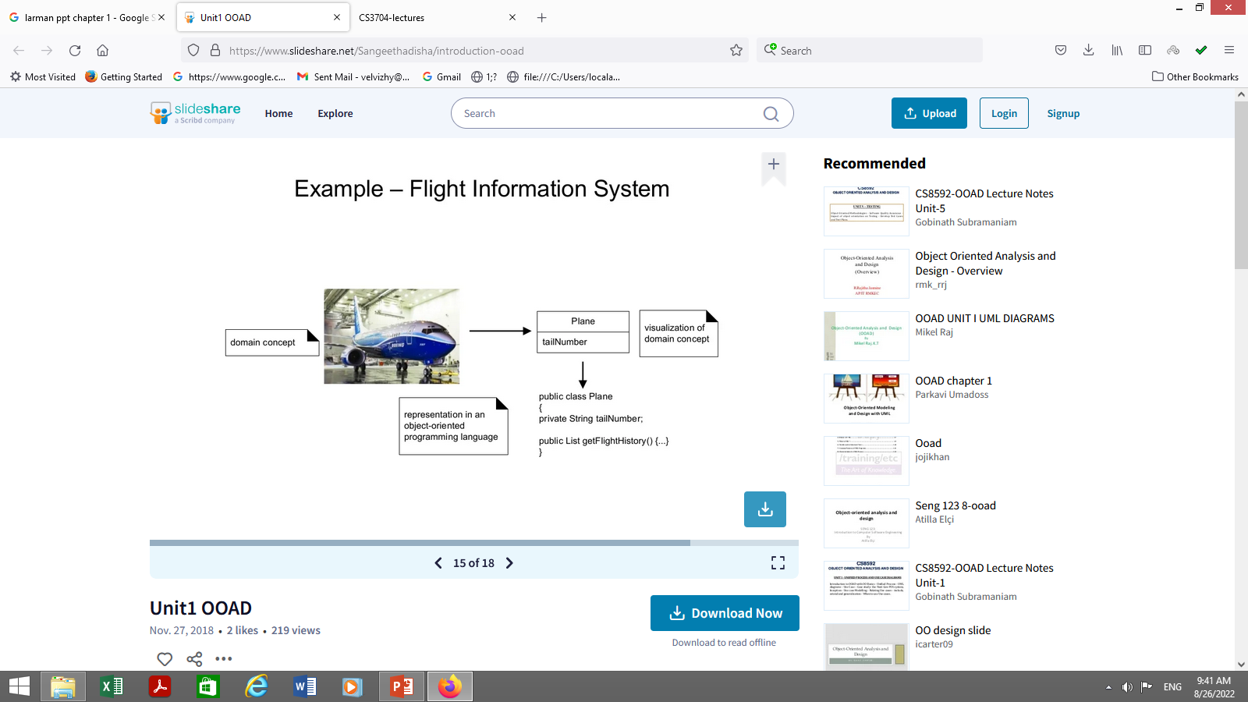

Slide 12
Thinking in Objects and UML-6
Then too, there are sets of proven design solutions to problems that are considered ‘best practices.’
  Certain ‘groupings’ of classes with specific responsibilities / interfaces.
  These provide specific solutions to specific problems.
  Called Design Patterns
We will discuss (much later) these standard patterns and how to apply them to develop solutions to common design problems.

Slide 13
Thinking in Objects and UML-7
Of course, design (solution to requirements) ‘assume’ a robust requirements analysis has taken place.
Use Cases are often used to capture stories of requirements and are often views as ‘constituting’ the functional requirements, but NOT the software quality factors (non-functional requirements).
Use Cases are not specifically designed to be object-oriented, but rather are meant to capture how an application will be used.
Many methods for capturing requirements.
We will concentrate on Use Cases (ahead).

Slide 14
Basic Terms: Iterative, Evolutionary, and Agile
1. Introduction
Iterative - the entire project will be composed of mini-projects and will iterate the same activities again and again (but on different part of the project AND with different emphases) until completion.
Evolutionary (or incremental) - the software grows by increments (to be opposed to the traditional, and somewhat old-fashioned, Waterfall model of software development).
Agile - we will use a light approach to software development rather than a very rigid one (which may be needed for a safety-critical system for example)
This kind of approach seems better at treating software development as a problem solving activity; also the use of objects makes it amenable.
Notes:
Explain Iterative, Evolutionary, Agile

Slide 15
Our Approach:
We need a Requirements Analysis approach with OOA/OOD need to be practiced in a framework of a development process.
We will adopt an agile approach (light weight, flexible) in the context of the Unified Process, which can be used as a sample iterative development process.
  Within this process, the principles can be discussed.
Please note that there are several other contexts that may be used, such as Scrum, XP, Feature-Driven Development, Lean Development, Crystal Methods and others…and we will look at a few of these.
Notes:
why do you think it works better this way for software?

Slide 16
Why the Unified Process:
The Unified Process is a popular iterative software development process.
Iterative and evolutionary development involves relatively early programming and testing of a partial system, in repeated cycles.
It typically also means that development starts before the exact software requirements have been specified in detail;
Feedback (based on measurement) is used to clarify, correct and improve the evolving specification:
This is in complete contrast to what we usually mean by engineering!
Notes:
why do you think it works better this way for software?

Slide 17
2. What is the Unified Process?
The UP is very flexible and open and can include other practices from other methods such as Extreme Programming (XP) or Scrum for example.
  e.g. XP’s test-driven development, refactoring can fit within a UP project; So can Scrum’s daily meeting.
  Being pragmatic in adapting a particular process to your needs is an important skill : all projects are different.

Slide 18
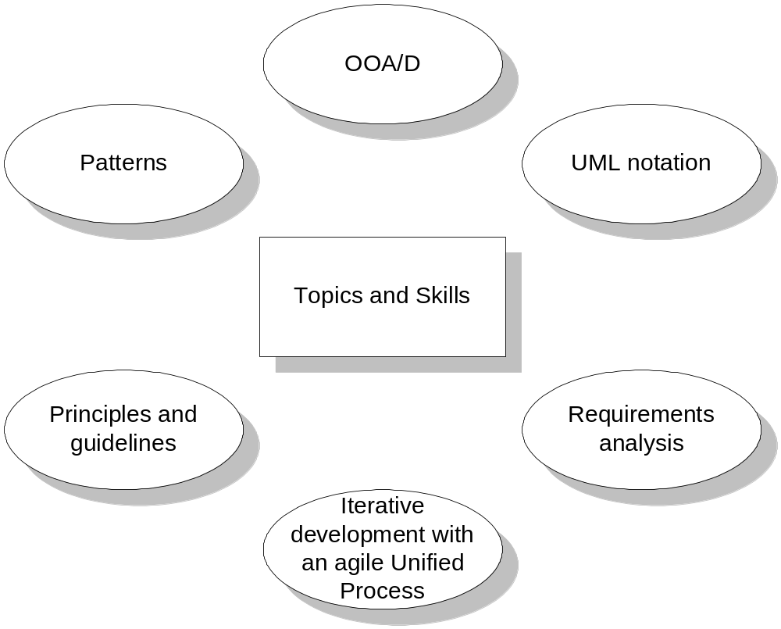
We will be studying all of the topics found in Fig. 1.1

Slide 19
The Rush to Code
Critical ability to develop is to think in terms of objects and to artfully assign responsibilities to software objects.
Talk at great length about encapsulation and assigning methods to objects where the data is defined…
One cannot design a solution if the requirements are not understood.
One cannot implement the design if the design is faulty.
If I could only stop my students….☺

Slide 20
The Rush to Code
Analysis: - investigate the problem and the requirements.
  What is needed? Required functions? Investigate domain objects.
  Problem Domain
  The Whats of a system.
  Do the right thing (analysis)
Design:
  Conceptual solution that meets requirements.
  Not an implementation
  E.g. Describe a database schema and software objects.
  Avoid the CRUD activities and commonly understood functionality.
  The Solution Domain
  The ‘Hows’ of the system
  Do the thing right (design)

Slide 21
What is Object-Oriented Analysis and Design
OOA: we find and describe business objects or concepts in the problem domain
OOD: we define how these software objects collaborate to meet the requirements.
  Attributes and methods.
OOP: Implementation: we implement the design objects in, say, Java, C++, C#, etc.

Slide 22
Using the model below, develop a two-three page discussion
outlining the four activities listed and present the major features of each.
A short definition and example of a domain model, interaction diagram, and class diagram is sufficient, but be prepared to discuss each of these.
Also, have a general idea about use cases – what they are designed to do and what they are not designed to do.
Define Use Cases
Define Domain Model
Define Interaction
Diagrams
Define Design Class
Diagrams

