Slide 1


Name: Akash Verma Roll Number: 1/17/FET/BCB/007
github.com/akashvermaprojects
akashpool103@gmail.com

Slide 2

Summer Training at ItOctane(Startup)
DURATION: 3 MONTHS(5/5/2020 TO 5/8/2020)
And courses done:
MACHINE LEARNING(CODING BLOCKS)
DATA STRUCTURES AND ALGORITHM(CODING BLOCKS)
PYTHON(APTECH)

Slide 3
Responsibility and learnings in Intern Phase
I worked with ItOctane (startup) for three months. The basic of intern were based on machine learning skills where I was given responsibility of an analyst.
I worked on large dataset, my prior work was on data cleaning and transformation so as to make it ready as per the models requirement.
I worked on few ML libraries : neural networks(CNN and RNN specially), Numpy, scikit learn, open-cv and few more.
As I worked for the startup , even though I worked for the it, I still tried to work on few interesting projects based on knowledge attained from there.

Slide 4
Covid 19 Detector and journal published
In this project I have made use of Convolutional Neural networks to make a NN model ready to predict the result of covid positive or covid negative on going through chest pv-xray.
Libraries used: sequential models(CNN), numpy, matplotlib, os ,etc.
the training took place on large dataset and the results and few snapshots of code are attached in next slide.
Research paper
Link:
https://github.com/akashvermaprojects/ResearchPaper- Covid/blob/main/167-ACJ-AUGUST-2658.pdf
Acceptance Letter:
https://github.com/akashvermaprojects/AcceptanceLetter-of-Covidproject/blob/main/2658.pdf

Slide 5
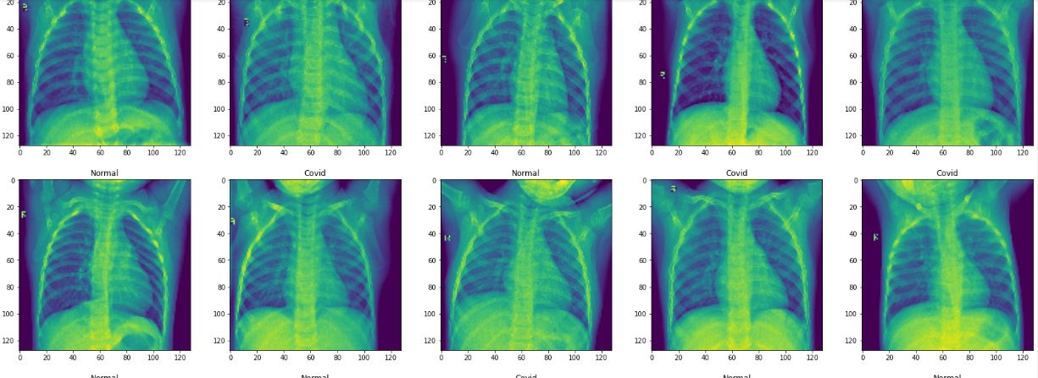
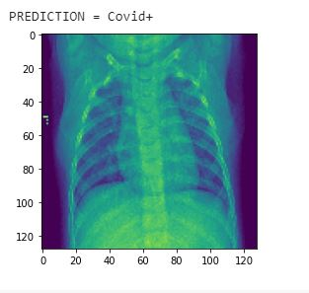

Slide 6
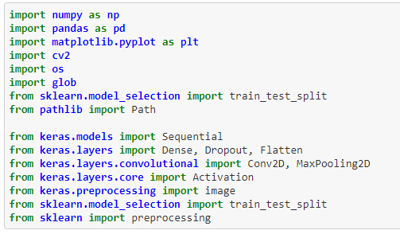

Slide 7
Virtual Painting(using concept of HSV)
This was the second gesture of learning provided by ItOctane.
Objective: In this project we can draw virtually on screen simply by waving the coloured marker or pen infront of webcam and the colour of marker you wave is the colour of drawing it makes on screen.
Language used: Python
Libraries Used: cv2,os ,Numpy and the used of HSV range is the key factor used.
The code and result snapshots are included in next slide.

Slide 8
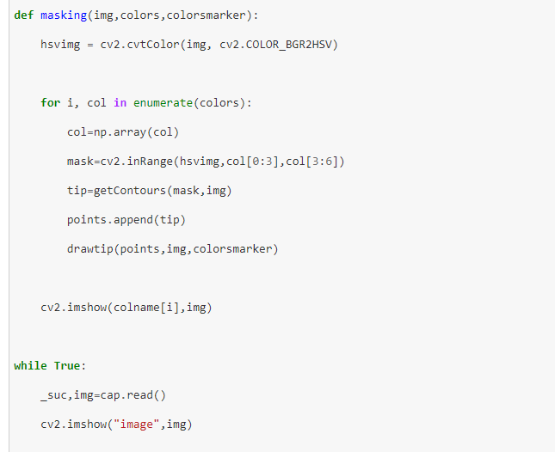
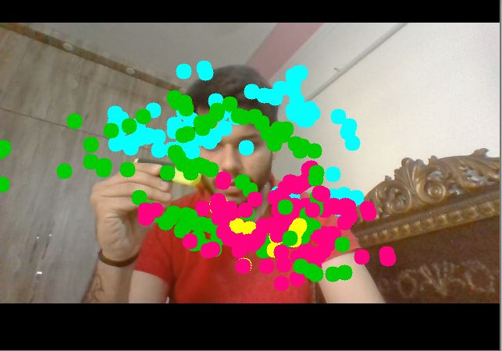

Slide 9
Internship Certification:
https://github.com/akashvermaprojects/InternshipCertification-ItOctane/blob/main/Certificate_Akash%20Verma%20(2).pdf
Machine Learning Certification:
https://github.com/akashvermaprojects/machine-learning-certificate/blob/master/ML%20_%20DS.pdf
Data Structures and Algorithm Certification:
https://github.com/akashvermaprojects/data-structures-and-algorithm-certificate/blob/master/LP.pdf

Slide 10
Credits: Mr vishal(Mentor at ItOctane) Machine learning team: Coding Blocks and thank you all for your kind attention

