Slide 1
Analyzing Deodorant Data
Marketing Predictive Analytics using SAS Prof B P S Murthi
Group 7
Hetul Patel
Darshil Gohel
Akash Joshi
Poonam Malik
Rushabh Shah

Slide 2
Data Description
Deodorant sales data for 52 weeks - Jan 1, 2001 till Dec 31, 2001
Demographic/Customer information such as family size, education, annual income, age, Occupation, children etc.
Scanner data which includes Deodorant category, Deodorant Levels, UPC code, package, strength etc.
Customer level deodorant sales panel data consisting information such as customer id, selling week, total units sold, total price, from which store it has been bought, UPC code of deodorant
Store level deodorant sales data consisting information such as store id, selling week, total units sold, total dollar amount , UPC code of product, display information , discount information etc.

Slide 3
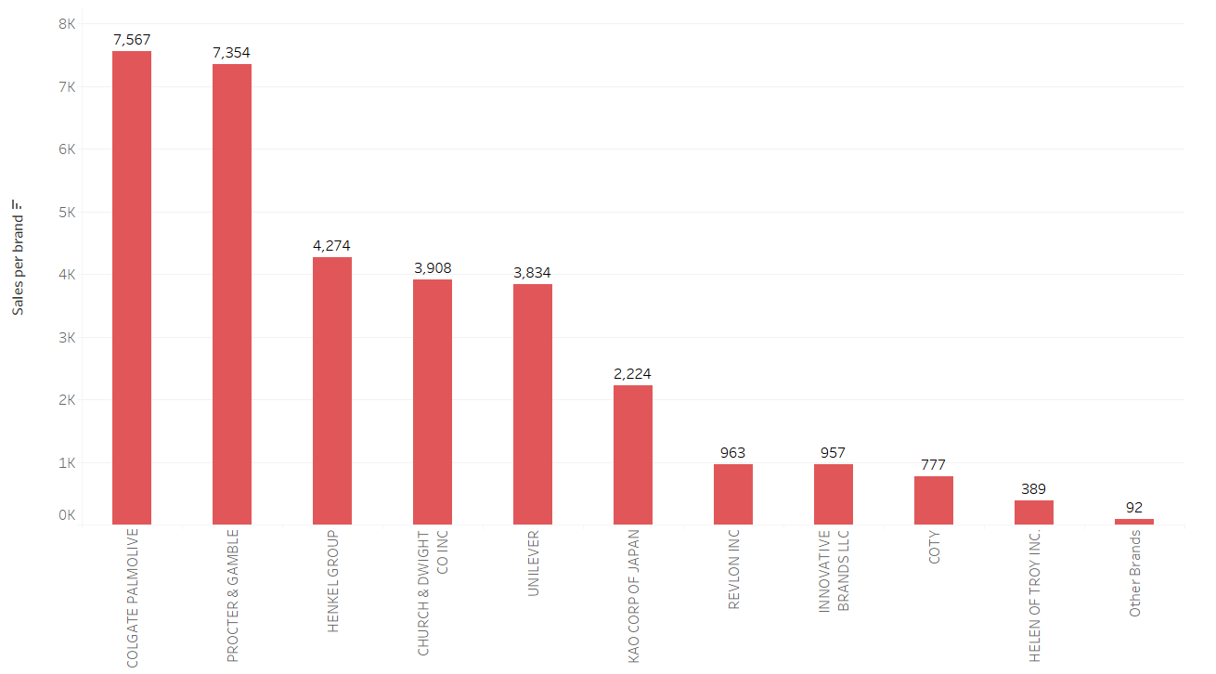
Market Share of Different Brands
Some of the top Deodorant selling Brands are Colgate Palmolive, P&G, Henkel Group, Church & Dwight Co Inc and Unilever.

Slide 4
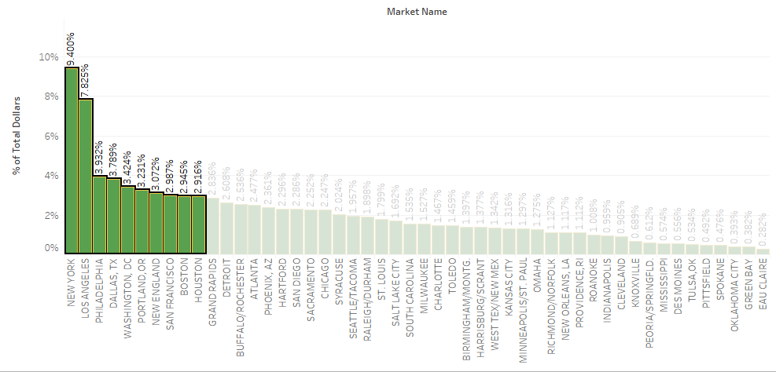
Total sale based on Geography

Slide 5
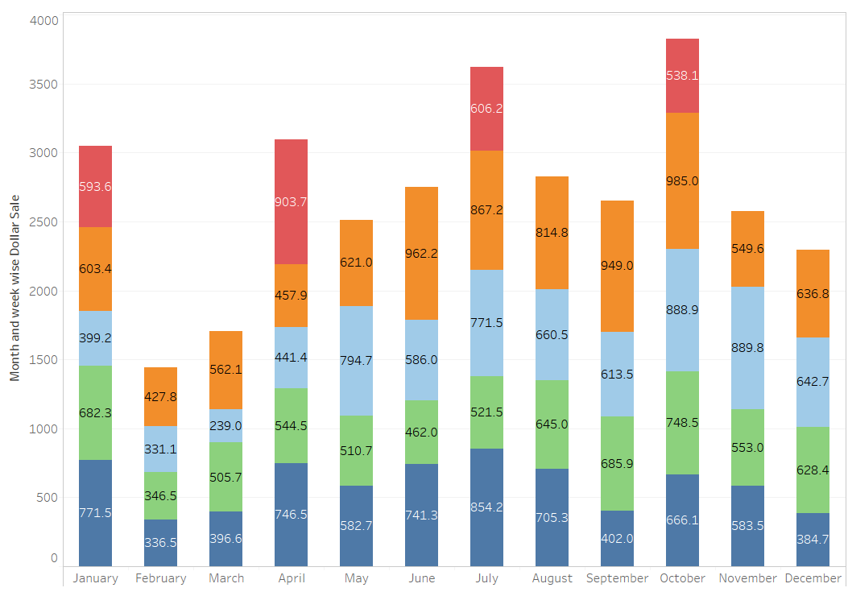
Monthly & Weekly Dollar sales:
January, April, July and October are the months when we have highest selling of Deodorants.
Second half of every month has higher sales of deodorants compared to the first half of the month.

Slide 6
RFM Analysis
R Score - Recency (most recent week of customer purchase)
F Score - Frequency (frequency of customer visits to the store)
M Score - Monetary amount (total purchase amount for each customer)
RFM Score – Combining all three

Slide 7
Observations based on RFM Analysis
Cluster 5 which has high RFM scores has the customers with
Recency 5 and frequency 4 / 5
High household incomes, High education level, Working full time, Smaller family sizes
Cluster 4 has,
Recency 5, frequency 1 / 2 and Monetary amount 2 / 3
Cluster 3 is the biggest clusters that covers 55% of all the customers.
Recency 4, frequency 3 / 4 and Monetary 1
Age of the male head of household is between 45 – 54, Machine Operators and laborer by occupation, Technical school level education
Cluster 2 is the second biggest clusters that covers 30% of all the customers.
Recency 3, frequency 2 / 3 and Monetary 1 / 2
Age of the male head of household is between 55 – 64, Craftsman and Some college level education

Slide 8
MNL Analysis Procedure
Multinomial Logit Model
Factor affecting the brand choice of deodorant
Panel data, Sales Data, Product Data and Demographic data are used
Category “Anti-Perspirant”
PROC MDC on panel data
Top four deodorant bands →
COLGATE PALMOLIVE
PROCTER & GAMBLE
CHURCH & DWIGHT CO INC
UNILEVER

Slide 9
MNL Analysis Conclusion
Highest preference → Brand 4
Lowest Preference→ Brand 3
Display and Feature have positive impact on brand preference
Price doesn’t have any significant impact on sales of deodorant
Lower income household are going for Brand 4
Number of family members does not have any impact on brand choice
Old Male buyer prefer Brand 3 among all the brands
Old Female buyer prefer Brand 3 while Young female buyer prefer brand 4

Slide 10
Thank you

