Slide 1
Eye-NAB A Navigation Aid For Blind
Performed By:-
AkshaySingh C Pardeshi (I-19)
Nikhil D Pote (I-28)
Akash C Warade (I-60)
Sumeet H Wathore (I-61)
Guided By:-
Prof. M .V . Kulkarni

Slide 2
Introduction
Vision is the primary sense used in daily life.
How do people with optical eye defects perceive the world?
Why can’t they become independent ?

Slide 3
Solutions
Why not to make a device which will act as a Virtual eye?
Consisting of
Camera - Optical Lens System
Film - Retina
Image processing Unit – Retina and Visual Cortex

Slide 4
Solution (continued)
Hardware consists of 3 main parts:
Camera
Take a Input Image from Camera.
Processing
Microcontroller or portable computer to carry out the processing unit.
Headphone
Output part uses speaker(headphones) to Notify the person.

Slide 5
Modules:-
Currency Recognition.
Color Detection.
Face Recognition.
Object Detection

Slide 6
Currency Recognition:-
Template Images Of Currencies’s are taken.
20 Images are captured of the Currency to be detected.
Extract the Currency from the background.
Template Match Algorithm.
Face Detection Algorithm.
Extraction Of Image based on above parameters.

Slide 7
Currency Recognition(Cont…)
Actual Currency Recognition.
Template Match.
Number Extraction.
Number Match.

Slide 8
Color Detection:-
Capture the image of the object of which color is to be
Detected.
Convert RGB image into HSV image.
Set the range and Saturation value’s using cvScalar().
cvDilate():-Dilate the source image.
cvInRangeS():-Trace the image in the range of colors.
Store the occurrence of each pixel of color in maxarray[].
Repeat the procedure for each frame.

Slide 9
Color Detection(Contd…..):-
Calculate the percentage of occurrence of each color.
Threshold=20%.
If percentage>threshold
Result is the highest occurrence.
Else
Discard the occurrence.

Slide 10
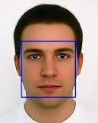
Face Recognition:-
Detect the face in front of camera.
Fetch the face in Database:
If present→Recognise the face.
Else→Train this face and save it in Database
with it’s information.

Slide 11
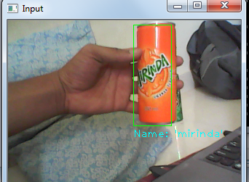
Object Detection:-
Detect the Object in front of camera.
Fetch the Object Images in
Database:
If present→Recognise the Object.
Else→Train and save
the Object_Image in Database with it’s information.

Slide 12
Problems:-
Accuracy?
Color Image Normalization.
Time Efficiency.
Camera Resolution.
Processing of n-dimensional object as 2-dimensional image.

Slide 13
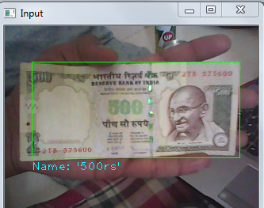
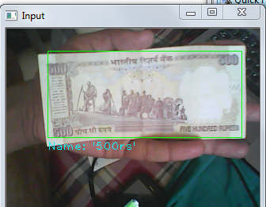
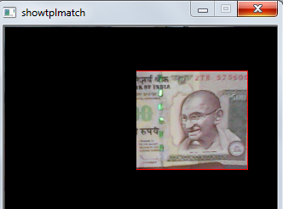
Testing:-

Slide 14
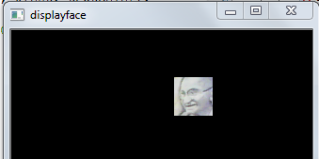
Testing(Cont.d….):-

Slide 15
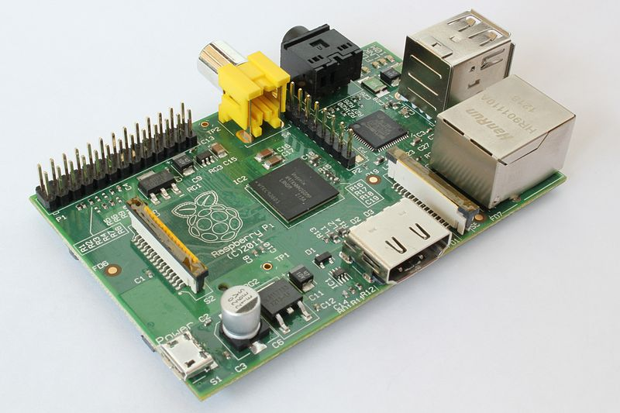
Future Scope:-
Raspberry PI:-

Slide 16
Conclusion:-
With these module a visually challenged person will be able to detect
Face
Color
Currency
Object

Slide 17
References
An Image Based Detection of Pedestrian Crossing- http://ieeexplore.ieee.org/Xplore/
Banknote and coin speaker device for blind people -http://ieeexplore.ieee.org/Xplore/
Improving mobility for blind persons using video sunglasses
http://ieeexplore.ieee.org/Xplore/
Digital Image Processing by Gonzalez & Woods and for Digital Image Processing Using MATLAB by Gonzalez, Woods, & Eddins.

