Slide 1
Automated Pneumonia Detection from Chest X-Ray Images Using Machine Learning
Akash Kumar Yadav
MS in Computer Science
Fordham University

Slide 2
Problem Statement
The Global Health Challenge
🏥 Problem: Pneumonia causes ~2.5 million deaths annually.
👶 Impact: Responsible for 15% of child mortality under age 5 (WHO).
⏱️ Challenge: Manual X-ray interpretation is time-consuming and error-prone.
🌍 Gap: Expert radiologists are often unavailable in resource-limited settings.
Project Goal:
Develop an automated screening system achieving >95% sensitivity.

Slide 3
Related Work & Contributions
Prior Work
CheXNet (DenseNet): Achieved radiologist-level accuracy.
Transfer Learning: Proven effective for medical imaging tasks.
Limitation: Limited work exists on interpretability & robustness validation.
Our Contributions
  ✅ Comparison: Evaluated 3 architectures (Custom CNN, VGG16, ResNet50).
  ✅ Performance: Achieved 99.74% recall (missing only 1 case per 390).
  ✅ Interpretability: Validated decision-making using Grad-CAM.
  ✅ Robustness: Independent validation confirming stability.

Slide 4
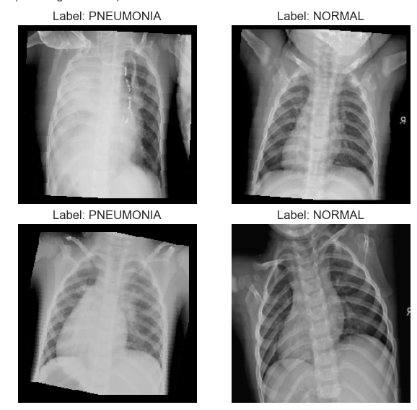
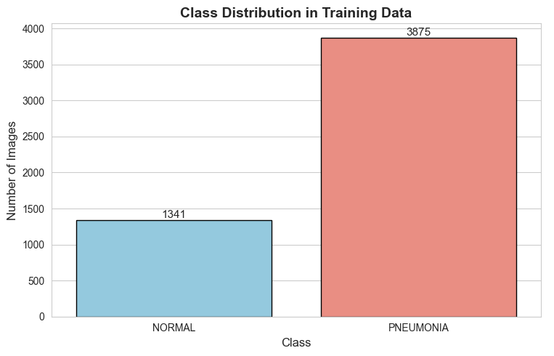
Dataset Overview
Chest X-Ray Dataset Breakdown
Total Images: 5,840 (Pediatric patients, 1-5 years)
├─ Training: 5,216 (89%)
│ ├─ Normal: 1,341 (25.7%)
│ └─ Pneumonia: 3,875 (74.3%)
└─ Testing: 624 (11%)
├─ Normal: 234 (38%)
└─ Pneumonia: 390 (62%)
⚠️ Class Imbalance: 3:1 ratio (Pneumonia : Normal)

Slide 5
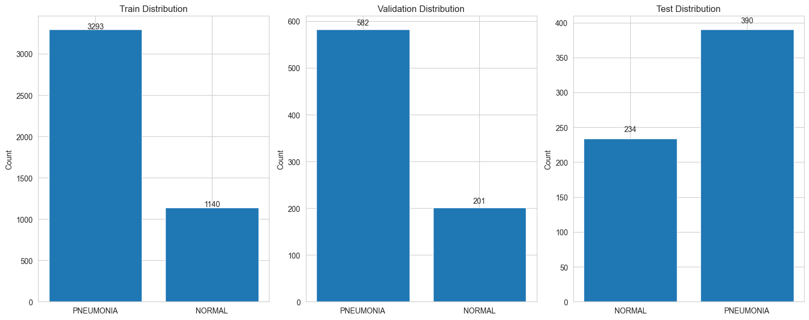
Methodology & Data Augmentation
Training Strategy
Splits: 85% Train / 15% Validation (main); 80/20 (independent).
Loss Function: Weighted Cross-Entropy (Weights: Normal ~1.94, Pneumonia ~0.67).
Optimizer: Adam with ReduceLROnPlateau scheduler.
Data Augmentation Techniques
Technique | Parameters | Purpose
Rotation | ±15° | Fix orientation issues
Horizontal Flip | p=0.5 | Mirror views
Color Jitter | ±0.1 bright/contrast | Lighting variation
Normalization | ImageNet mean/std | Standardization
Random Scaling | 0.9x - 1.1x | Size invariance

Slide 6
Model Architectures
1. Custom CNN (Baseline)
5-layer convolutional network.
3 conv blocks + batch norm + max pooling.
Trained from scratch.
2. VGG16
(Transfer Learning)
Pre-trained on ImageNet; frozen conv layers.
Custom classifier: 4096 → 1024 → 2 classes.
Learning rate: 1e-5 (careful fine-tuning).
3. ResNet50
(Transfer Learning)
Pre-trained on ImageNet; last 20 layers trainable.
Residual connections for deeper architecture.
Scheduler: Decays LR when validation loss plateaus (Patience=3).

Slide 7
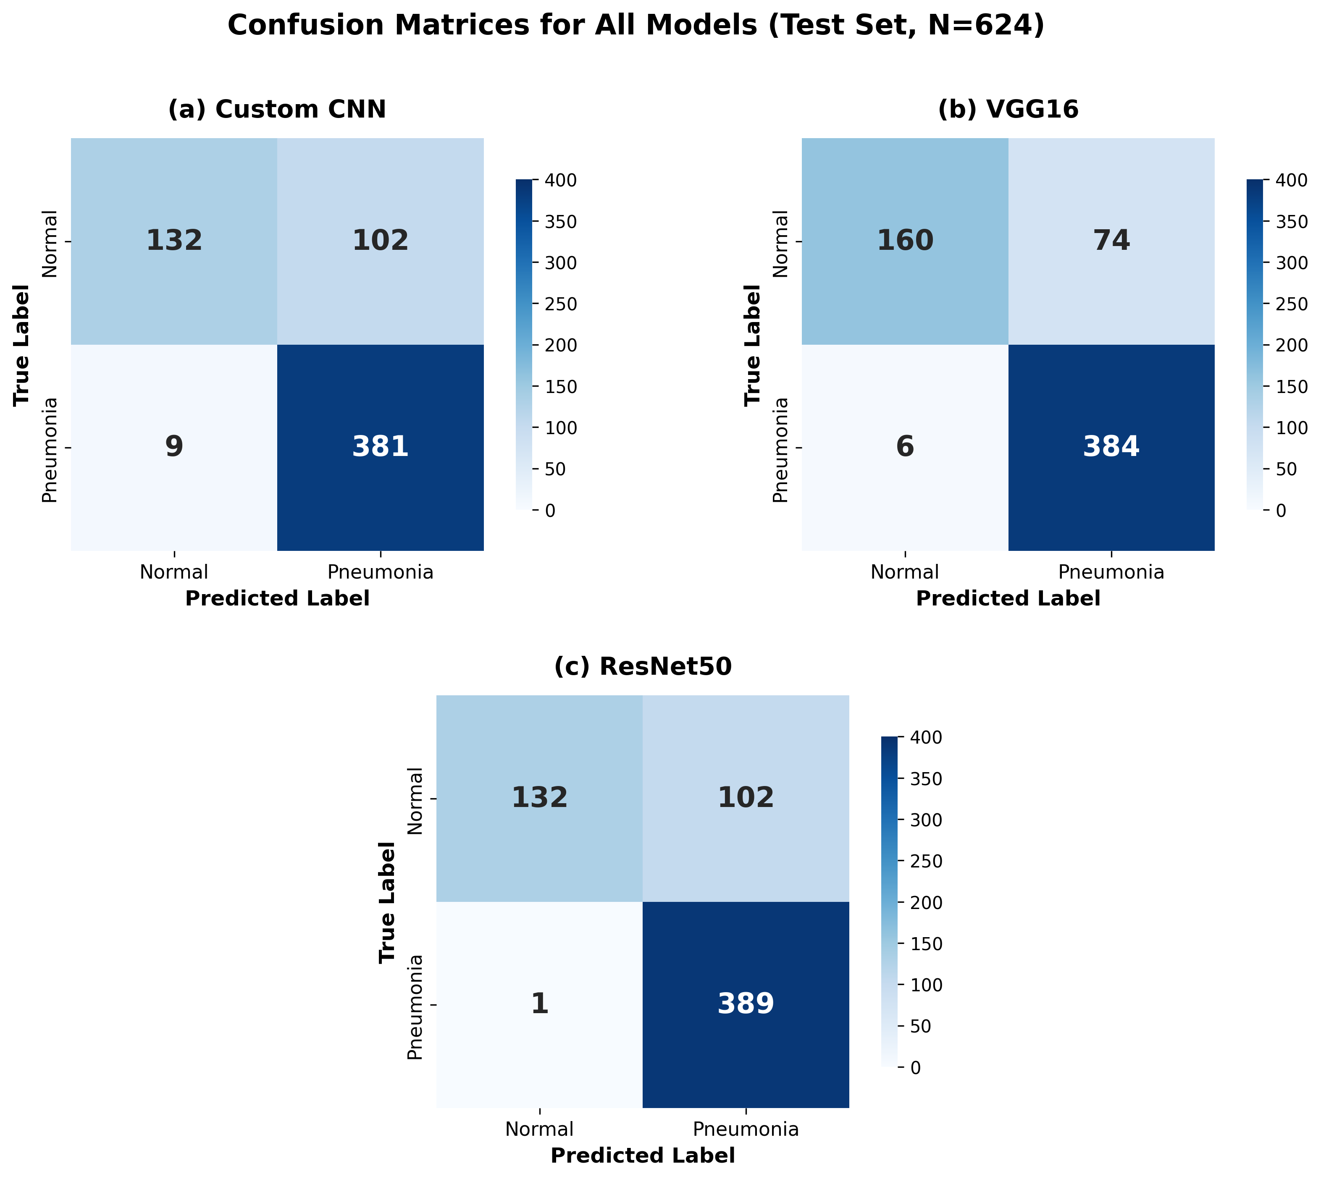
Results - Confusion Matrix
Key Finding:
ResNet50 missed only 1 pneumonia case out of 390!

Slide 8
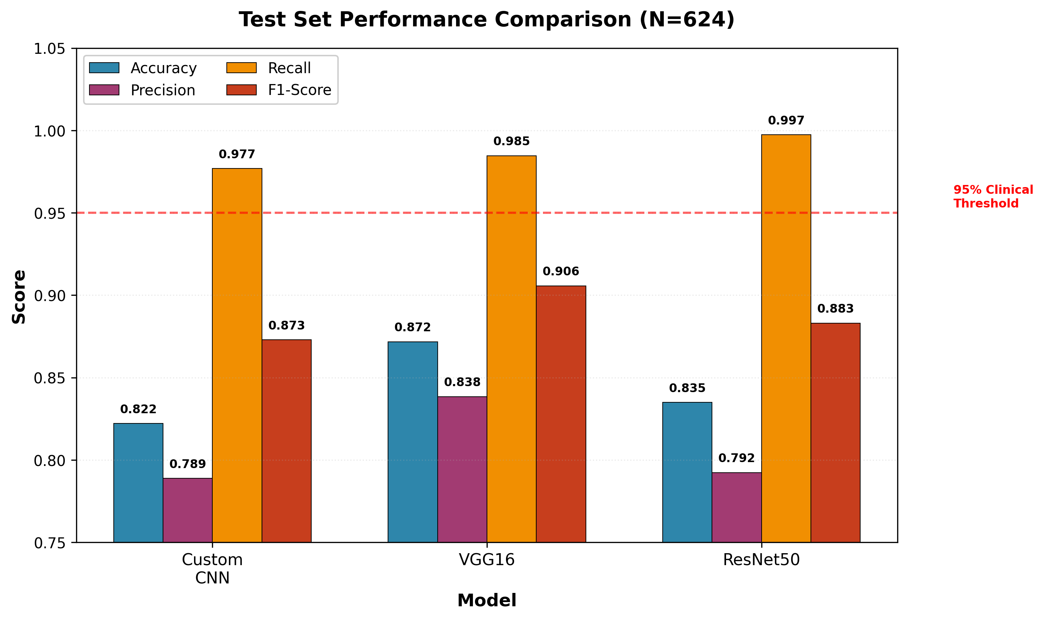
Results - Performance Metrics
Key Finding
✅ All models exceed 95% clinical threshold.
ResNet50: Highest recall (99.74%).
VGG16: Best balanced F1-score (90.57%).

Slide 9
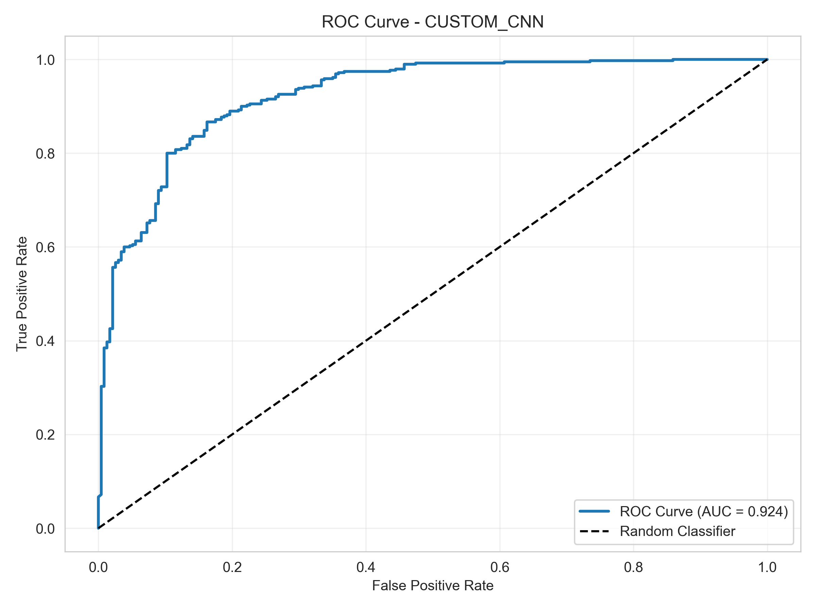
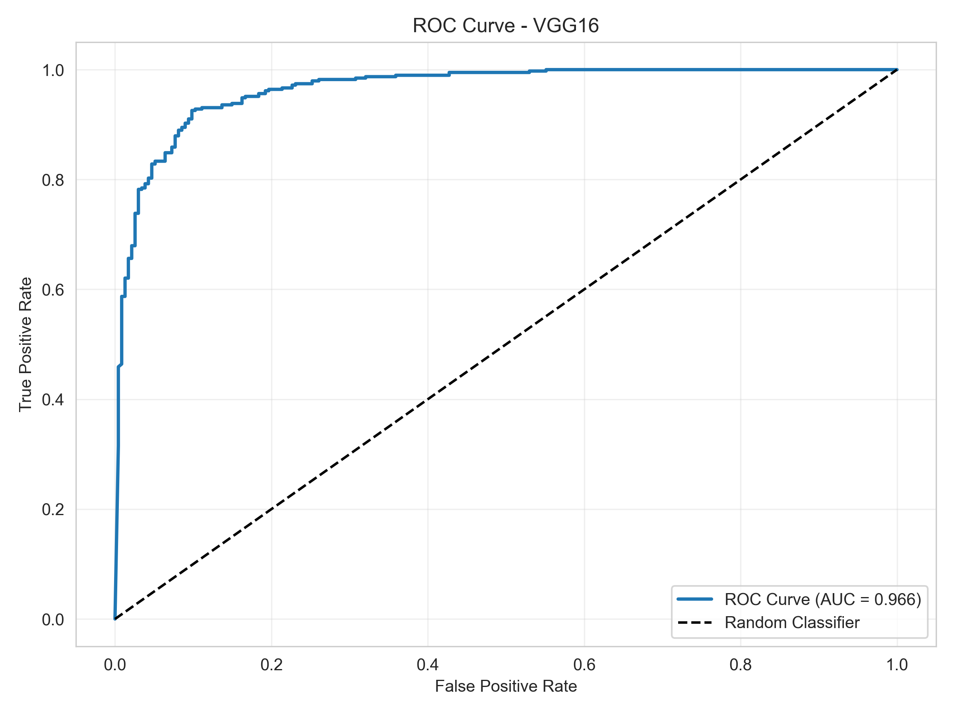
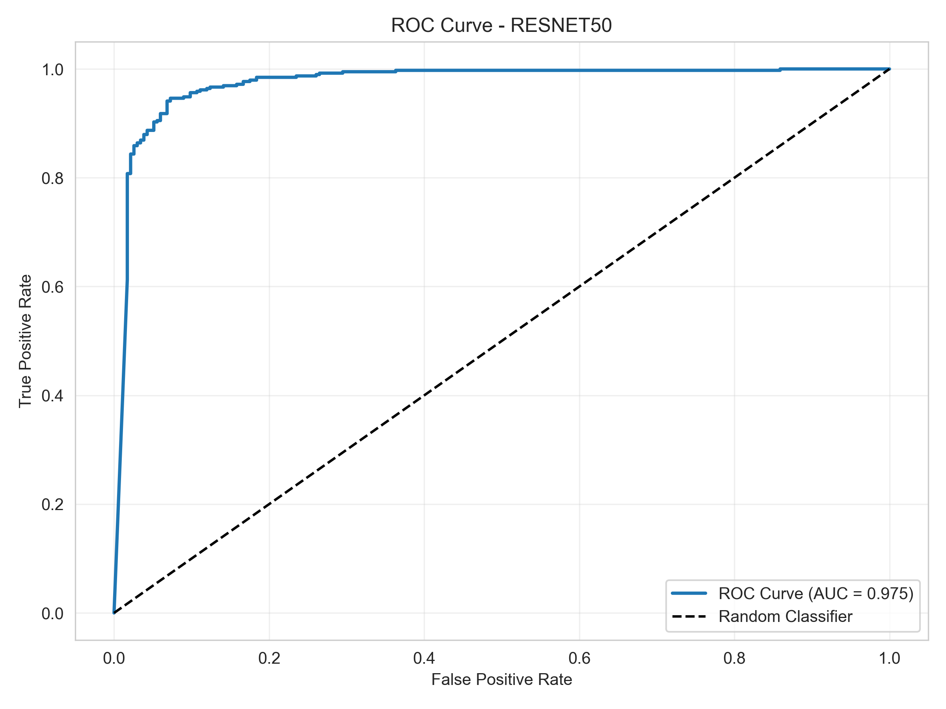
ROC Curves & AUC Analysis
ROC-AUC Scores (Higher is Better)
Custom CNN: 92.4%
VGG16: 96.60%
ResNet50: 97.45% ⭐
📊 Key Insight: ResNet50 shows excellent discrimination across all decision thresholds (AUC 97.45%).

Slide 10
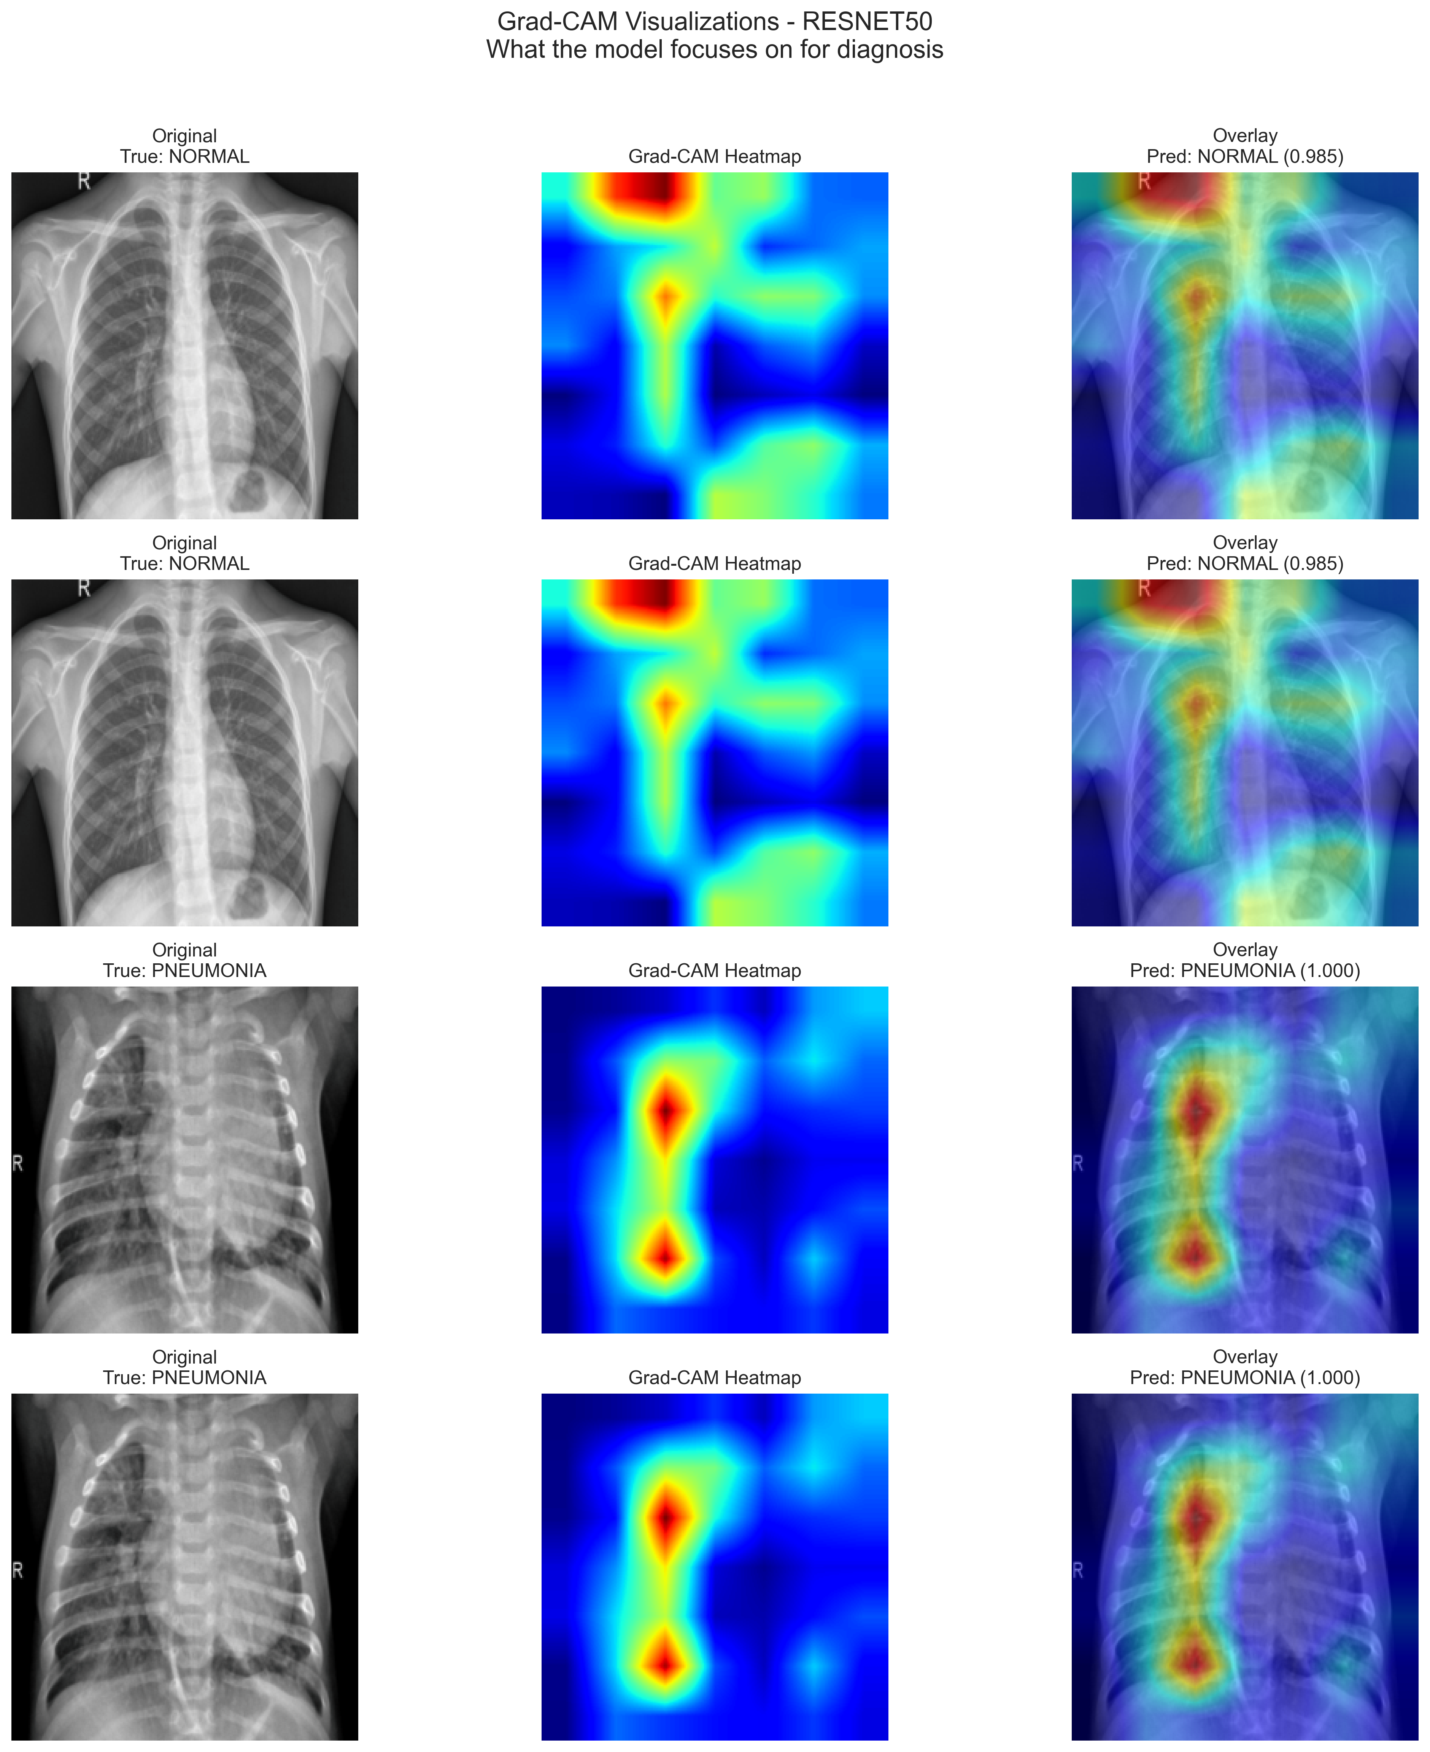
Interpretability –
Grad-CAM
Grad-CAM Findings
✅ Models focus on lung regions (clinically relevant).
✅ Strong activation on infiltrates in pneumonia cases.
✅ Minimal activation in normal cases.
✅ No learning of image artifacts or borders.’
Result: High clinical trust via explainable decisions.

Slide 11
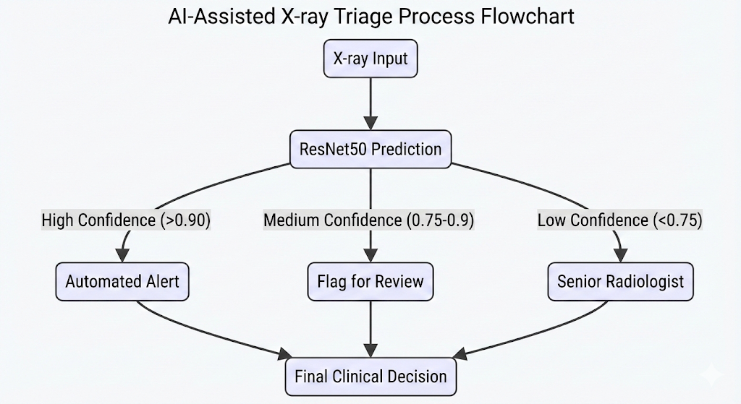
Clinical Significance & Deployment
Clinical Impact
🎯 0.26% miss rate (Only 1 case missed per 390 patients).
🏥 Exceeds clinical sensitivity requirements.
🔄 Higher False Positive rate (40%) is acceptable for screening safety.

Slide 12
Conclusion & Future Work
Key Achievements
✅ Best-in-class Performance: 99.74% recall with ResNet50.
✅ Validated Robustness: 98.70% (±0.28%) via K-fold cross-validation.
✅ Clinical Interpretability: Grad-CAM validates clinically relevant features.
Future Directions
🌍 External validation on diverse datasets.
🏥 Multi-class classification (Bacterial vs. Viral).
📱 Edge deployment for resource-limited settings.
Impact: Transfer learning with careful fine-tuning can achieve radiologist-level performance, offering scalable diagnostic assistance worldwide.

Slide 13

Thank You

