Slide 1



A CENTER FOR INTER-DISCIPLINARY RESEARCH
2021-22
“Stocks Prediction Using Machine Learning”
SUPERVISED BY
JATIN MENGHWANI
GOKARAJU RANGARAJU
INSTITUTE OF ENGINEERING AND TECHNOLOGY AUTONOMOUS

Slide 2

Advanced Academic Center
(A Center For Inter-Disciplinary Research)
This is to certify that the project titled
“Stocks Prediction Using Machine Learning”
is a bonafide work carried out by the following students in partial fulfilment of the requirements for Advanced Academic Center intern, submitted to the chair, AAC during the academic year 2021-22.
NAME | ROLL NO. | BRANCH
YERRA AKASH | 21241A0565 | CSE
KADALI VENKAT AMAR | 21241A0522 | CSE
RAMOJI TANYA | 21241A0543 | CSE
This work was not submitted or published earlier for any study
Mr. Jatin Menghwani
Dr. G. Ramesh
Project Supervisor
Dean, AAC

Slide 3


ACKNOWLEDGEMENTS
We express our deep sense of gratitude to our respected Director, Gokaraju Rangaraju Institute of Engineering and Technology, for the valuable guidance and for permitting us to carry out this project.
With immense pleasure, we extend our appreciation to our respected Principal, for permitting us to carry out this project.
We are thankful to the Associate Dean, Advanced Academic Centre, for providing us an appropriate environment required for the project completion.
We are grateful to our project supervisor who spared valuable time to influence us with their novel insights.
We are indebted to all the above-mentioned people without whom we would not have concluded the project.

Slide 4

Stocks Prediction Using Machine Learning
Abstract-In Stock Market Prediction, the aim is to predict the future value of the financial stocks of a company. The recent trend in stock market prediction technologies is the use of machine learning which makes predictions based on the values of current stock market indices by training on their previous values. Machine learning itself employs different models to make prediction easier and authentic. The paper focuses on the use of Regression and LSTM based Machine learning to predict stock values.
Factors considered are open, close, low, high and volume.
Index Terms- Close, high, low, LSTM model, open, regression, and volume.
I. INTRODUCTION
A correct prediction of stocks can lead to huge profits for the seller and the broker. Frequently, it is brought out that prediction is chaotic rather than random, which means it can be predicted by carefully analysing the history of respective stock market.
Machine learning is an efficient way to represent such processes.
It predicts a market value close to the tangible value, thereby increasing the accuracy. Introduction of machine learning to the area of stock prediction has appealed to many researches because of its efficient and accurate measurements.
The vital part of machine learning is the dataset used. The dataset should be as concrete as possible because a little change in the data can perpetuate massive changes in the outcome. In this project, supervised machine learning is employed on a dataset obtained from stooq.com to obtain dataset for the stock data. This dataset comprises of following five variables: open, close, low, high and volume. Open, close, low and high are different bid prices for the stock at separate times with nearly direct names. The volume is the number of shares that passed from one owner to another during the time period. The model is then tested on the test data.

Slide 5
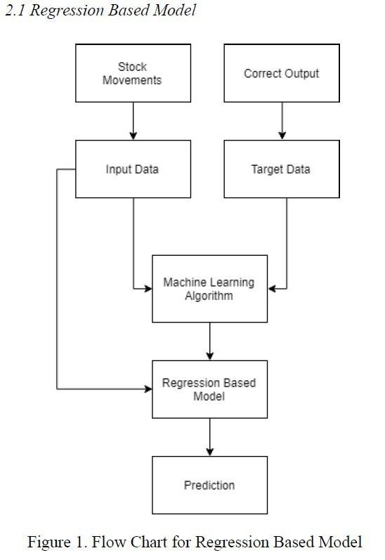
Regression and LSTM models are engaged for this conjecture separately. Regression involves minimizing error and LSTM contributes to remembering the data and results for the long run. Finally, the graphs for the fluctuation of prices with the dates (in case of Regression based model) and between actual and predicted price (for the LSTM based model) are plotted.
The rest of the paper consists of following: Part 2 puts forward the two models used and the methods used in them in detail. Part 3 discusses the results produced with different plots for both the models in detail. Part 4 consists of the code and Part 5 consists of the conclusion and the last section involves the references.
II. METHODOLOGY
Stock market prediction seems a complex problem because there are many factors that have yet to be addressed and it doesn’t seem statistical at first. But by proper use of machine learning techniques, one can relate previous data to the current data and train the machine to learn from it and make appropriate assumptions. Machine learning as such has many models but this paper focuses on two most important of them and made the predictions using them.

Slide 6
Regression is used for predicting continuous values through some given independent values. The project is based upon the use of linear regression algorithm for predicting correct values by minimizing the error function as given in Figure1. This operation is called gradient descent.
Regression uses a given linear function for predicting continuous values:
V = a + bk + error
Where, Vis a continuous value; K represents known independent values; and, a, b are coefficients.
Work was carried out on csv format of data through panda library and calculated the parameter which is to be predicted, the price of the stocks
with respect to time. The data is divided into different train sets for cross validation to avoid over fitting. The test set is generally kept 20% of the whole dataset. Linear regression as given by the above equation is performed on the data and then predictions are made, which are plotted to
show the results of the stock market prices vs time .

Slide 7
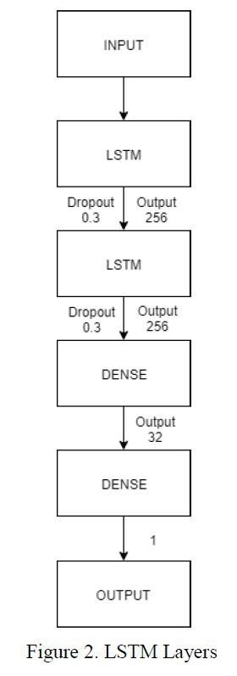
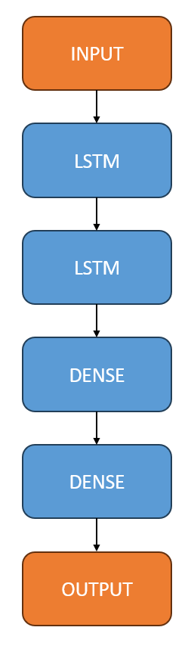
2.2 Long Short-Term Memory (LSTM) Network Based Model
LSTM is the advanced version of Recurrent- Neural-Networks (RNN) where the information belonging to previous state persists. These are different from RNNs as they involve long term dependencies and RNNs works on finding the relationship between the recent and the current information. This indicates that the interval of information is relatively smaller than that to LSTM. The main purpose behind using this model in stock market prediction is that the predictions depend on large amounts of data and are generally dependent on the long-term history of the market. So, LSTM regulates error by giving an aid to the RNNs through retaining information for older stages making the prediction more accurate.
Since stock market involves processing of huge data, the gradients with respect to the weight matrix may become very small and may degrade the learning rate of the system. This corresponds to the problem of Vanishing Gradient. LSTM prevents this from happening. The LSTM consists of a remembering cell, input gate, output gate and a forget gate. The cell remembers the value for long term propagation and the gates regulate them .
In this paper, a sequential model has been made which involves stacking two LSTM layers
on top of each other with the output value of 256. The input to the layer is
in the form of two layer [0] and layer [1]. A dropout value of 0.2 has been fixed which means that 0.2 out of total nodes will be frozen during the training process to avoid over-fitting of data and increase the speed of the training process. At last, the core dense layer where each neuron is connected to every other in the next layer is added providing input of 32 parameters to the next core layer which gives output as 1. The model is compiled with a mean square cost function to maintain the error throughout the process and accuracy is chosen as a metric for the prediction .

Slide 8
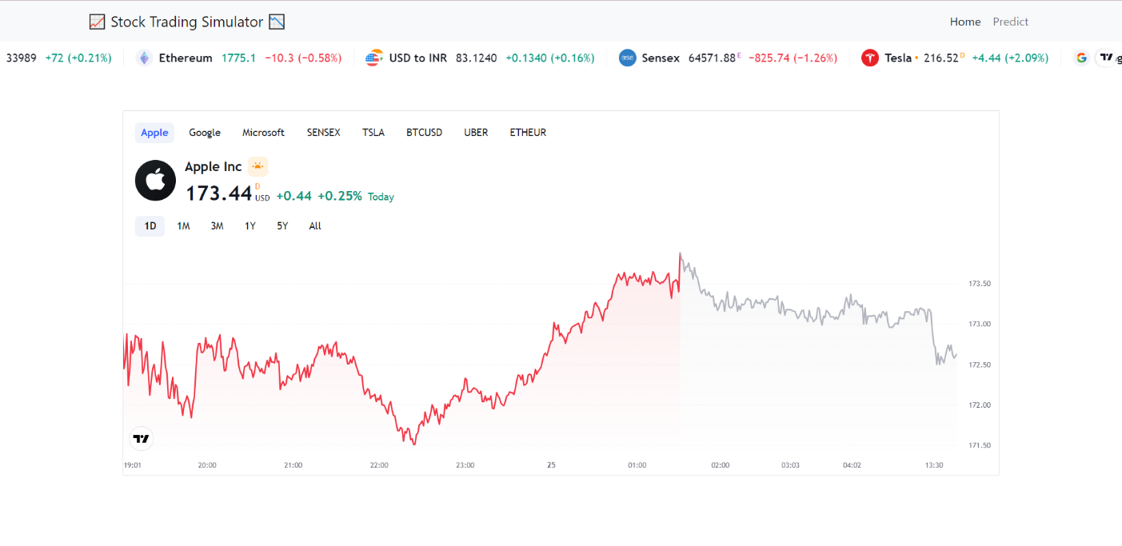
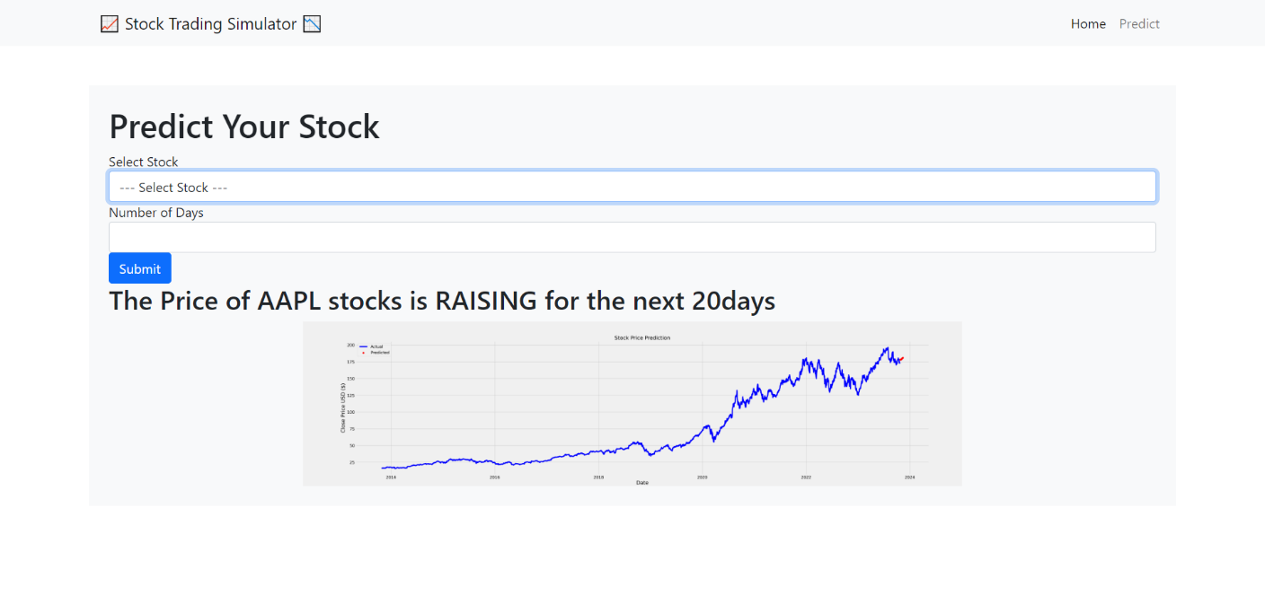
USER INTERFACE

Slide 9
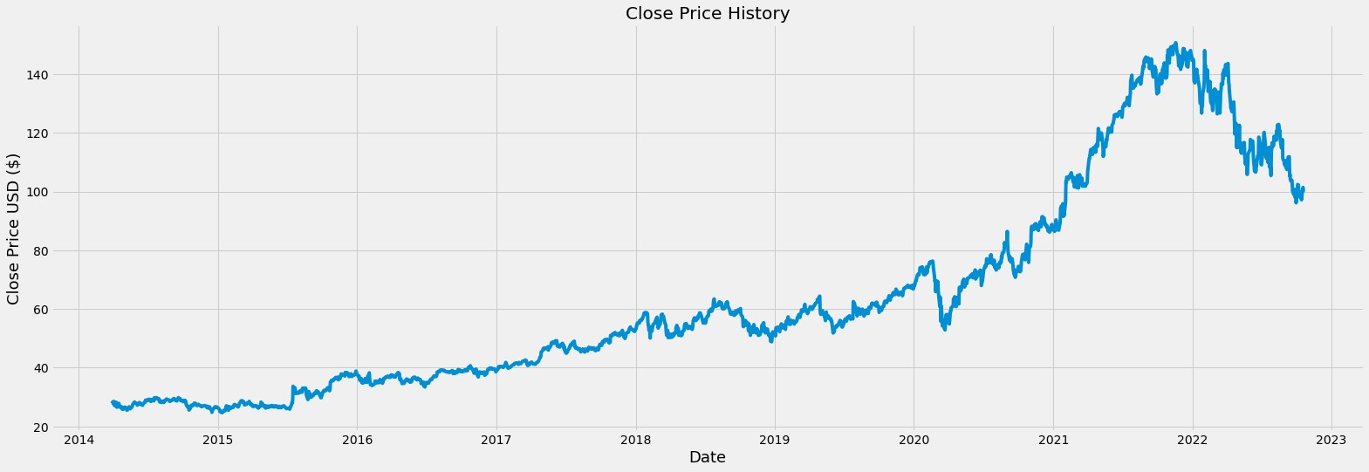
III. EXPERIMENTAL RESULTS
The proposed system is trained and tested over the dataset taken from stooq.com website. It is split into training and testing sets respectively and yields the following results upon passing through the different models:
3.1 Regression Based Model Results
The plot in figure3 is the result of application of linear regression algorithm on the dataset to predict varying prices with respect to the time.
Figure 3. Plot between Price and Date Using Regression

Slide 10
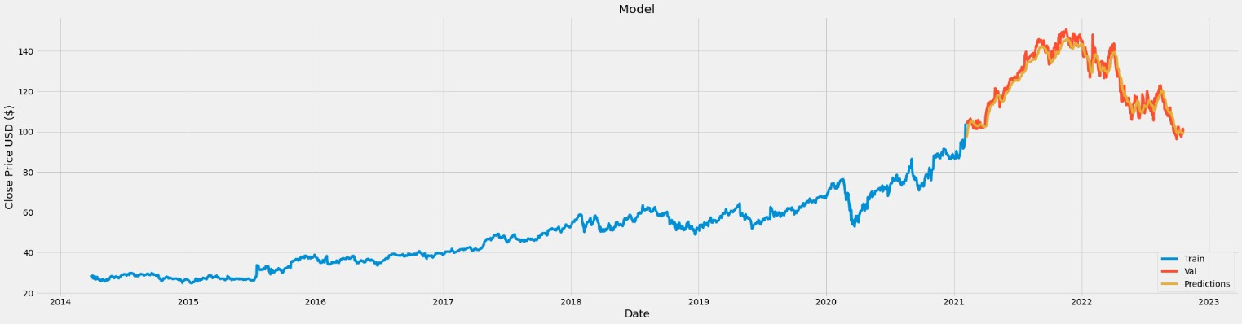
3.2. LSTM Based Model Results
The above graph figure 3 is plot over the data having batch size 1 and 1 epochs. The prediction is shown by yellow line and the actual trend is shown by blue and orange. The proximity of these two lines tells, how efficient the LSTM based model is. The prediction approximates real trend when a considerable amount of time has passed. The more the system is trained the greater the accuracy which will be attained.0
Figure 4. Plot between Actual and Predicted Trend of LSTM

Slide 11
IV. CODE
import os
from flask_pymongo import PyMongo
from flask import Flask, flash, redirect, render_template, request, session
from flask_session import Session
from werkzeug.security import check_password_hash, generate_password_hash
from helpers import apology, login_required, lookup, usd
# Configure application
app = Flask(__name__)
app.config["TEMPLATES_AUTO_RELOAD"] = True
# Initialize PyMongo with your MongoDB URI
app.config['MONGO_URI'] = 'mongodb://localhost:27017/your_database_name'
db = PyMongo(app)
# Custom filter
@app.template_filter('usd')
def usd(value):
return f"${value:,.2f}"
@app.after_request
def after_request(response):
"""Ensure responses aren't cached"""
response.headers["Cache-Control"] = "no-cache, no-store, must-revalidate"
response.headers["Expires"] = 0
response.headers["Pragma"] = "no-cache"
return response
@app.route("/")
@login_required
def index():
"""Show portfolio of stocks"""
return render_template("index.html")

Slide 12
@app.route("/buy", methods=["GET", "POST"])
@login_required
def buy():
"""Buy shares of stock"""
# define BUY action
action = "BUY"
if request.method == "POST":
symbol = request.form.get("symbol")
shares = int(request.form.get("shares"))
# if symbol or shares are empty
if not symbol or not shares:
flash("Stock symbol and number of shares must not be empty.", "error")
# if user manually changed shares to 0 or negative int
elif shares <= 0:
flash("Number of shares must be a positive integer.", "error")
else:
quote = lookup(symbol)
# if quote is null
if not quote:
flash("Stock symbol does not exist.", "error")
else:
user_id = session["user_id"]
price = quote["price"]
name = quote["name"]
# check cash balance
user = db.users.find_one({"_id": user_id})
cash = user["cash"]
# check stock purchase total cost
cost = price * shares
# balance has to be >= 0
balance = cash - cost
# if total cost exceeds cash balance, return error message
if balance < 0:
flash(f"You do not have enough cash balance. Current balance: {usd(cash)}. Total cost to buy stock: {usd(cost)}", "error")
else:
# insert buy transaction
db.transactions.insert_one({
"user_id": user_id,
"action": action,
"symbol": symbol,
"name": name,
"price": price,
"shares": shares
})

Slide 13
# update user document with new cash balance
db.users.update_one({"_id": user_id}, {"$set": {"cash": balance}})
flash("Stock bought!", "information")
return redirect("/")
return render_template("buy.html", action=action)
@app.route("/history")
@login_required
def history():
"""Show history of transactions"""
user_id = session["user_id"]
# Get this user's transactions
trades = db.transactions.find({"user_id": user_id}).sort([("symbol", 1), ("datetime", 1)])
return render_template("history.html", trades=trades)
@app.route("/login", methods=["GET", "POST"])
def login():
"""Log user in"""
# Forget any user_id
session.clear()
# User reached route via POST (as by submitting a form via POST)
if request.method == "POST":
# Ensure username was submitted
if not request.form.get("username"):
flash("Must provide username", "error")
return redirect("/login")
# Ensure password was submitted
elif not request.form.get("password"):
flash("Must provide password", "error")
return redirect("/login")
# Query database for username
user = db.users.find_one({"username": request.form.get("username")})
# Ensure username exists and password is correct
if user is None or not check_password_hash(user["hash"], request.form.get("password")):
flash("Invalid username and/or password", "error")
return redirect("/login")
# Remember which user has logged in
session["user_id"] = user["_id"]

Slide 14
# Display message
flash("Logged in!", "information")
# Redirect user to home page
return redirect("/")
# User reached route via GET (as by clicking a link or via redirect)
else:
return render_template("login.html")
@app.route("/logout")
def logout():
"""Log user out"""
# Forget any user_id
session.clear()
# Redirect user to login form
return redirect("/login")
@app.route("/register", methods=["GET", "POST"])
def register():
"""Register user"""
session.clear()
if request.method == "POST":
# Get user inputs
username = request.form.get("username")
password = request.form.get("password")
confirmation = request.form.get("confirmation")
if not username:
return apology("Username must not be empty.")
# Check if username already exists
user = db.users.find_one({"username": username})
if user:
return apology("Username already exists.")
if not password or not confirmation:
return apology("Password and confirmation must not be empty.")
if password != confirmation:
return apology("Passwords do not match")
# Hash the password
hash_pw = generate_password_hash(password)
# Register the new user
db.users.insert_one({
"username": username,
"hash": hash_pw
})

Slide 15
# Display a message that the user is registered
flash("User registered!", "information")
return redirect("/login")
# If the request method is GET
return render_template("register.html")
@app.route("/sell", methods=["GET", "POST"])
@login_required
def sell():
"""Sell shares of stock"""
# Define SELL action
action = "SELL"
user_id = session["user_id"]
# Get user stocks information
stocks = list(db.transactions.aggregate([
{"$match": {
"user_id": user_id,
"symbol": {"$ne": ""},
"action": "BUY"
}},
{"$group": {
"_id": "$symbol",
"name": {"$first": "$name"},
"shares": {"$sum": "$shares"}
}}
]))
# GET
if request.method != "POST":
return render_template("sell.html", stocks=stocks)
# POST
symbol = request.form.get("symbol")
shares = request.form.get("shares", type=int)
# If symbol or shares are empty
if not symbol or not shares:
return apology("Stock symbol and number of shares must not be empty.")
# If the number of shares is not a positive integer
if shares <= 0:
return apology("Number of shares must be a positive integer")
shares_owned = 0
for stock in stocks:
if stock["_id"] == symbol:
shares_owned = stock["shares"]
if shares > shares_owned:
return apology("You do not own that many shares of this stock")

Slide 16
quote = lookup(symbol)
price = quote["price"]
name = quote["name"]
# Insert sell transaction
db.transactions.insert_one({
"user_id": user_id,
"action": action,
"symbol": symbol,
"name": name,
"price": price,
"shares": shares
})
# Update user cash balance
user = db.users.find_one({"_id": user_id})
cash = user["cash"]
balance = cash + price * shares
db.users.update_one({"_id": user_id}, {"$set": {"cash": balance}})
# Display message that stock sold
flash("Stock sold!", "information")
return redirect("/")
if __name__ == '__main__':
app.run(debug=True)
Valid

Slide 17
CONCLUSION
Two techniques have been utilized in this paper: LSTM and Regression, on the Yahoo finance dataset. Both the techniques have shown an improvement in the accuracy of predictions, thereby yielding positive results. Use of recently introduced machine learning techniques in the prediction of stocks have yielded promising results and thereby marked the use of them in profitable exchange schemes. It has led to the conclusion that it is possible to predict stock market with more accuracy and efficiency using machine learning techniques.
In the future, the stock market prediction system can be further improved by utilizing a much bigger dataset than the one being utilized currently. This would help to increase the accuracy of our prediction models. Furthermore, other models of Machine Learning could also be studied to check for the accuracy rate resulted by them.
REFERENCES:
Stooq.com for obtaining the dataset of the previous google stocks data.
Visual Studio Code is used as a coding platform.
Youtube.com for learning LSTM and machine learning along with python.

