Slide 1
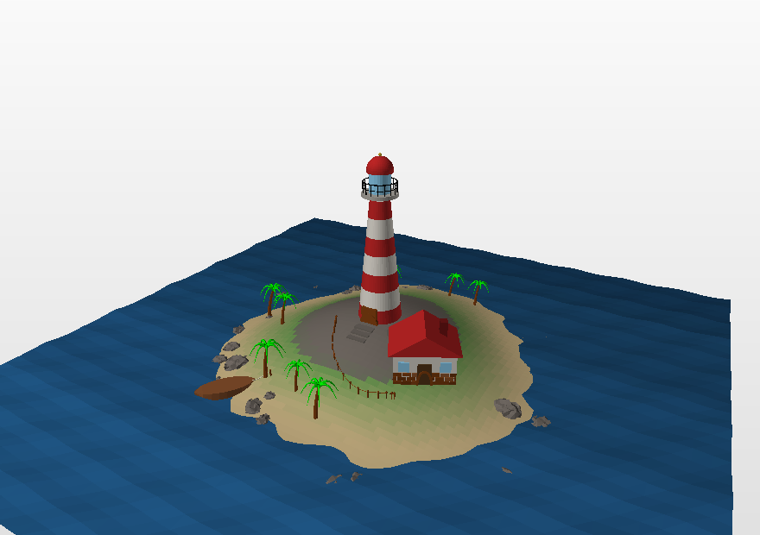
add.py 2.0
Build 3D models with nothing but code -- in Python or in C++
Algorithms and Data Structures · Algorithm Design and Analysis · creative assignment
Notes:
The add.py part of the first lecture, updated for version 2.0 -- for students and for anyone who wants to build 3D models from code. The module is refreshed every year; 2.0 is the largest change since 1.2.

Slide 2
ADD.PY
What is new in 2.0
Boolean operations
Regular polyhedra and a geodesic sphere
union, intersect, difference -- written from scratch, no libraries.
tetrahedron ... icosahedron, centred; sphere() is now a dome of triangles.
Smooth surfaces
Vertex tools
catmull_clark, and smooth(): the generalised Catmull-Clark algorithm, any number of cells per edge.
set_vertex, neighbors, valence, dual, truncate -- a football from the vertices of an icosahedron.
Named surfaces, colour functions, parts
Sketchfab-ready export
25 surfaces by name; color=lambda u, v: ...; beam, wheel, gear, roof, tree, text ...
check() watches the 50 MB / 50 colour limits; glass (transparent) and image textures go into the .mtl.
Everything written for 1.2 keeps working without a single change -- and all of it now comes for C++ too: add.hpp, one header, the same functions, the same models.
1
Notes:
The key message: nothing has to be rewritten. For students and for anyone interested.

Slide 3
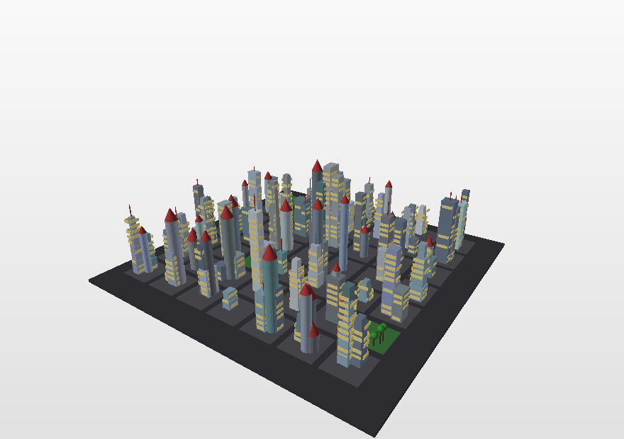
REMINDER
The creative assignment
Make a 3D model using nothing but program source code.
File format: OFF or OBJ.
At least 10 000 polygons.
At least 3 different colours.
The algorithm must contain a for or while loop.
At least one parameter that changes the shape.
No 3D modelling programs.
Individually or in pairs.
One number (SEED) decides the whole city
add.check()
tells you which requirements are already met.
2

Slide 4
ENVIRONMENT
Recommended tools
Python 3
add.py
Nothing else to install: add.py uses only math and random.
One file next to your script. Downloaded from GitHub (project add3d).
tools/preview.py
GeoGebra
Look at a model without any other program: writes a PNG.
Handy for checking curve and surface formulas before coding them.
MeshLab
Sketchfab.com
Viewing and converting OFF. No longer required: add.py writes OBJ itself.
.obj + .mtl in one archive -- and anyone can turn the model in a browser.
3
Notes:
MeshLab used to be required for OBJ. Not any more.

Slide 5
BASICS
A model is two lists
OFF
8 6 0
-1 -1 -1
-1 -1 1
...
4 0 4 5 1 255 0 0
4 0 1 3 2 255 0 0
...
OFF -- the format's name
8 6 0 -- number of vertices, faces and edges
then the vertex coordinates
4 0 4 5 1 -- a quadrilateral joining vertices 0, 4, 5 and 1
255 0 0 -- the face's colour
Every drawing function in the library does the same thing: it works out some points and adds some faces.
import add
add.box([0, 0, 0], 2, "red")
add.save("cube.off")
The same cube -- four lines.
4

Slide 6
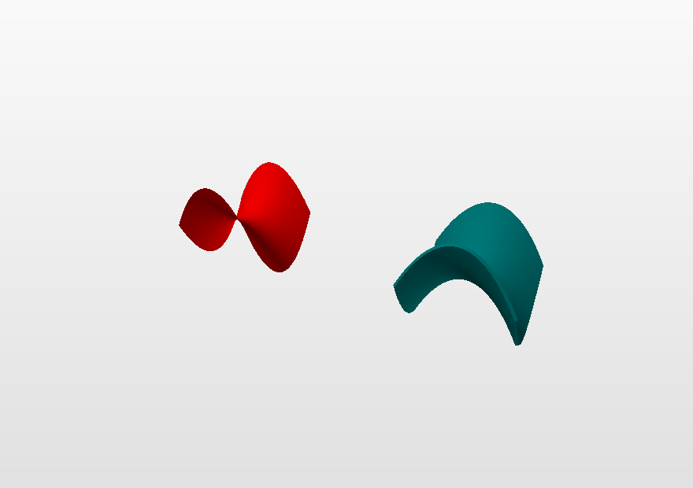
BASICS
Inside and outside
Seen from outside the model, the corners of a face run counter-clockwise.
Seen from inside -- clockwise.
A face the wrong way round is drawn black or not at all.
The library orients its own shapes; you only think about it when writing add.polygon(...) by hand.
add.fix_normals(M) fixes a whole model; add.check() says whether the surface is closed.
The same saddle: sheet, two-sided, solid
5

Slide 7
THE MAIN IDEA
The scene, layers and meshes
add.box([0, 0, 0], 1, "red")
brick = add.layer() # the scene is empty again
for i in range(10):
add.mesh(add.move(brick, [i * 1.2, 0, 0]))
add.save("wall.off")
Build once -- place many times.
Transformations never change the mesh you give them -- they return a new one.
layer()
mesh(M)
Takes the scene out as a mesh and leaves the scene empty.
Puts a mesh back into the scene.
merge([...])
push() / pop()
Joins several meshes into one.
Inside a function that builds a part: put the scene aside, then bring it back.
6

Slide 8
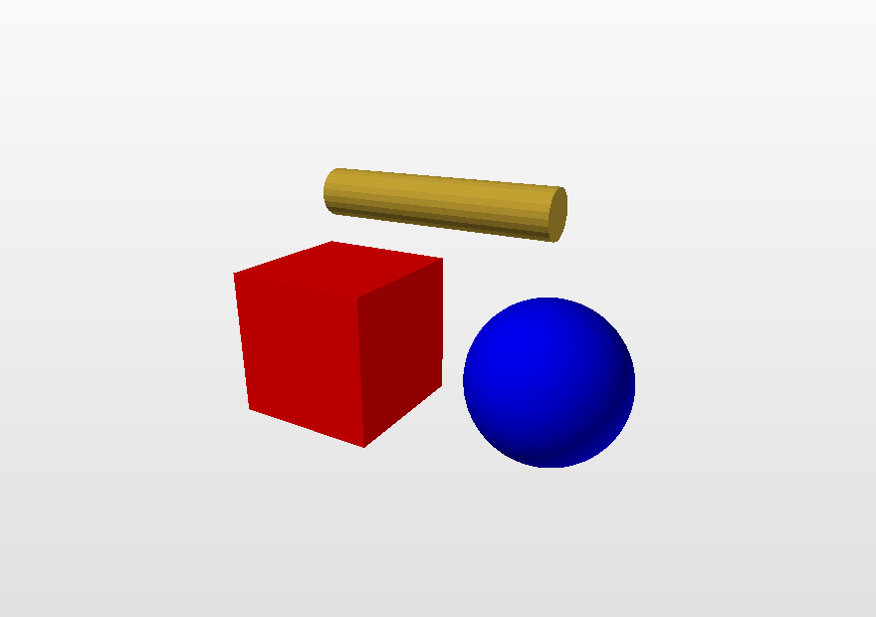
START
The first model
import add
add.box([0, 0, 0], 2, "red")
add.sphere([3, 0, 0], 1, 20, "blue")
add.cylinder([0, 2, 0], [3, 2, 0],
0.3, 24, "gold")
add.check()
add.save("first.off")
vertices 2460
!! polygons 2478 (need 10000)
OK colours 3 (need 3)
OK closed surface yes
The check() report: still short of polygons.
7

Slide 9
NEW
Only import add
import add
for i in range(12):
a = 2 * add.pi * i / 12
p = [3 * add.cos(a), 0, 3 * add.sin(a)]
add.sphere(p, 0.4, 8, add.hsv(i / 12))
add.seed(7)
add.box([add.uniform(-3, 3), 0, 0], 1, "red")
add.sin, add.pi, add.sqrt ...
Everything from math, straight from add.
add.randint, add.seed, add.Random
Everything from random, too.
A model file has exactly one import. (Plain import math still works.)
The examples in examples/ are written this way: import add and nothing else.
8

Slide 10
C++
The same model in C++
Python
C++
import add
add.box([0, 0, 0], 2, "red")
add.sphere([3, 0, 0], 1, 20, "blue")
add.cylinder([0, 2, 0], [3, 2, 0],
0.3, 24, "gold")
add.save("first.off")
#include "add.hpp"
int main() {
add::box({0, 0, 0}, 2, "red");
add::sphere({3, 0, 0}, 1, 20, "blue");
add::cylinder({0, 2, 0}, {3, 2, 0},
0.3, 24, "gold");
add::save("first.off");
}
Byte for byte the same file. add.hpp is the whole library as one header, using only the C++17 standard library: every function of add.py, with the same name, parameters and defaults.
g++ -std=c++17 -O2 first.cpp -o first && ./first
9
Notes:
For students who write C++: the same library, the same functions, the same numbers -- and the same file as the Python program writes. All 43 example programs have a .cpp twin (the castle's: its Python, translated).

Slide 11
C++
From Python to C++
Python | C++
import add | #include "add.hpp"
[1, 2, 3] | {1, 2, 3}
add.bend(M, 0.4, around=2) | add::bend(M, 0.4, 1, 2)
add.bbox() | add::bbox()
lambda t: [t, 0, 0] | [](double t) { return add::Point{t, 0, 0}; }
add.make(add.box, [0, 0, 0], 2) | add::make([] { add::box({0, 0, 0}, 2); })
M.V, M.F, M.C | M.V, M.F, M.C
add.union(a, b) | add::union_(a, b)
print(add.center(M)) | std::cout << add::center(M);
No keyword arguments: give them in order (bend: angle, axis, around). A mesh left out means the scene, as in Python. union is a C++ keyword, so it is union_. Points and colours print as Python prints them.
Tested for every function, all 235 documentation examples and 43 example programs, with GCC and Clang. On ARM (a Mac with Apple Silicon) compile with -ffp-contract=off too.
10

Slide 12
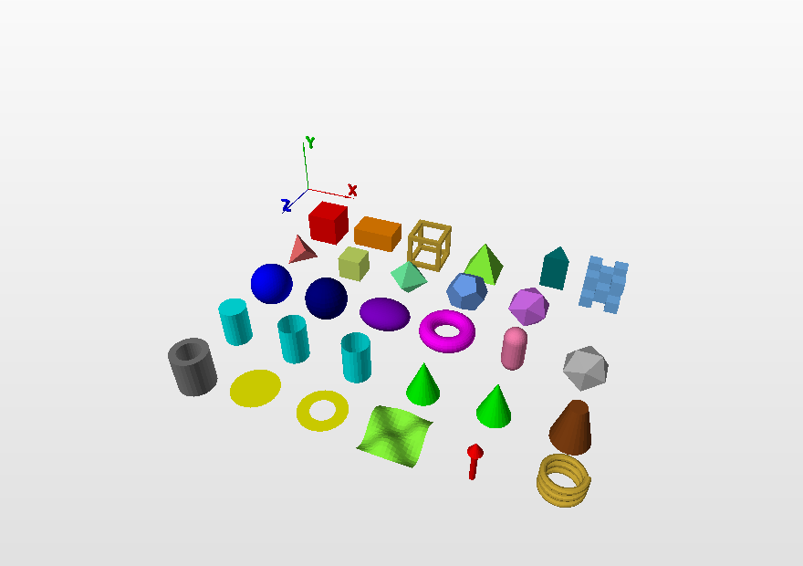
FUNCTIONS
Ready-made shapes
Solids
box, cuboid, rounded_box, frame, pyramid, prism, polyhedron, voxels
Round
sphere, hemisphere, uvsphere, ellipsoid, torus, capsule, cylinder, tube, cup, cone, cone_open, frustum, pipe
Flat
polygon, triangle, quad, disc, ring, grid
Parts
beam, arch, stairs, gear, wheel, roof, column, bricks, tree, pixels, heightmap, text
examples/02_primitives.py -- every shape in one program.
11

Slide 13
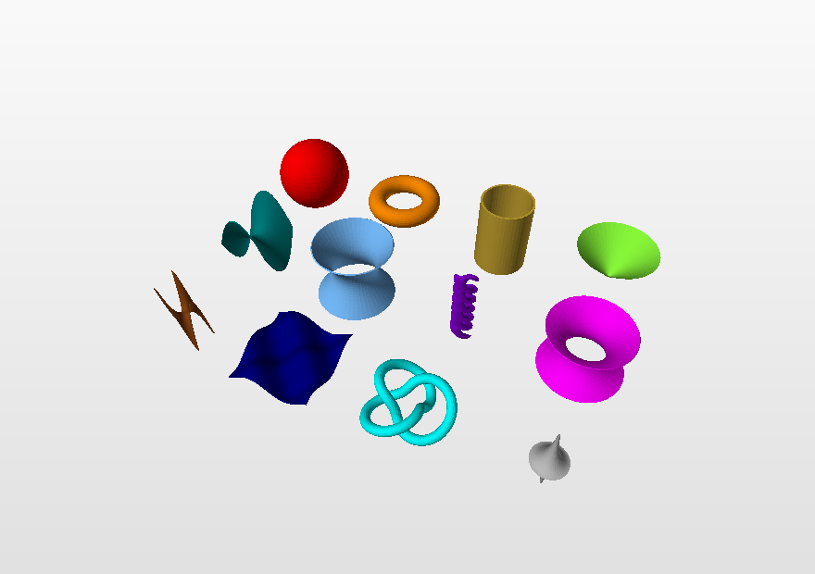
SURFACES
parametric() -- the central function
def torus(u, v):
return [(5 + add.cos(u)) * add.cos(v),
add.sin(u),
(5 + add.cos(u)) * add.sin(v)]
add.parametric(torus, 0, 2*add.pi, 40,
0, 2*add.pi, 80,
"gold", wrap_u=True, wrap_v=True)
wrap_u, wrap_v
thickness=
color=lambda u, v: ...
Close the surface without a seam or repeated vertices.
Give the sheet a real thickness -- a closed solid.
Paint every cell by its own parameters.
12

Slide 14
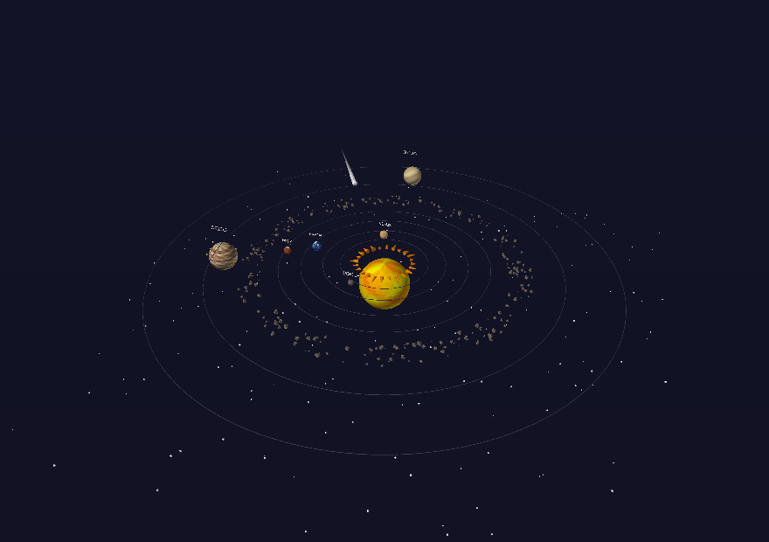
NEW
Colour functions
add.parametric(f, 0, 1, 40, 0, 1, 40,
color=lambda u, v: add.hsv(u))
add.revolve(vase, A, B, 0, 4, 60, 40,
color=lambda t, a: "red" if int(t) % 2 else "white")
add.curve(spiral, 0, 20, 300, 12, 0.2,
color=lambda t, a: add.hsv(t / 20))
Planets: lathes painted by (latitude, longitude)
The function is called once per cell with the surface's own two parameters: (u, v) for parametric, (t, angle) for revolve and curve, (x, z) for grid. Stripes, chequerboards, maps and gradients cost one lambda.
For a mesh you already have: color_by(M, lambda p: ...) paints by position.
13

Slide 15
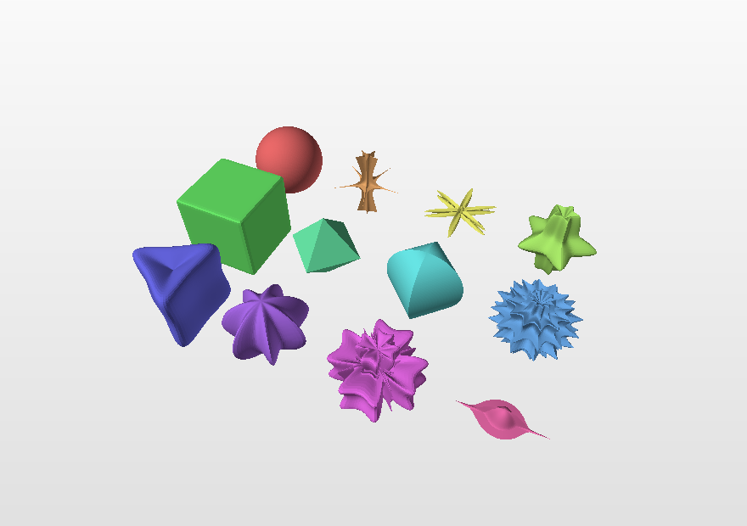
PARAMETRIC SURFACES
One equation, twelve shapes
Gielis's superformula (2003)
r(t) = ( |cos(m·t/4)/a|^n₂ + |sin(m·t/4)/b|^n₃ ) ^ (−1/n₁)
Six numbers -- and you get a starfish, a flower, a crystal or a plain ball.
Exactly what the assignment asks for: one parameter that changes the shape.
examples/08_surfaces_superformula.py
14

Slide 16
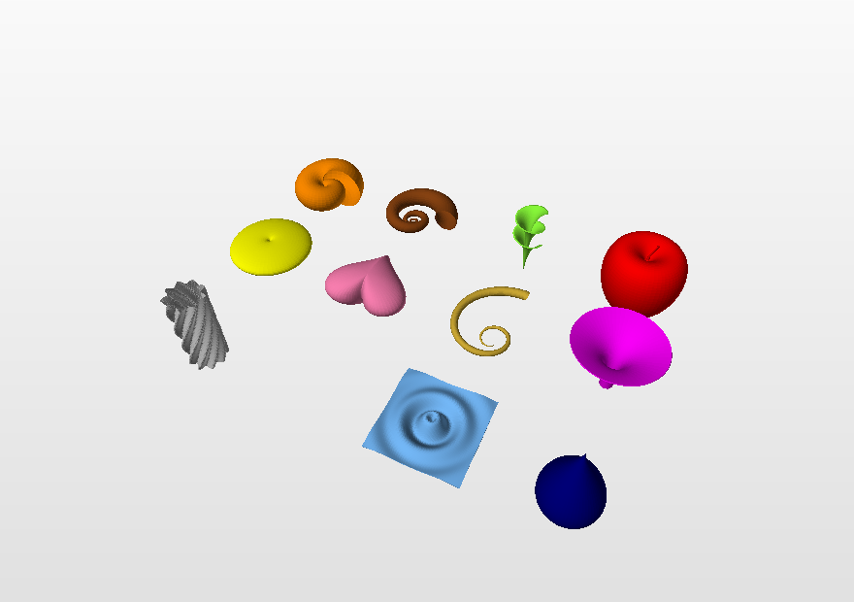
EXAMPLES
Surfaces that look like things
Shell, snail, Dini's surface, apple, lemon, heart, horn, trumpet, wavy column, breather, ripples, drop. examples/09_surfaces_nature.py
15

Slide 17
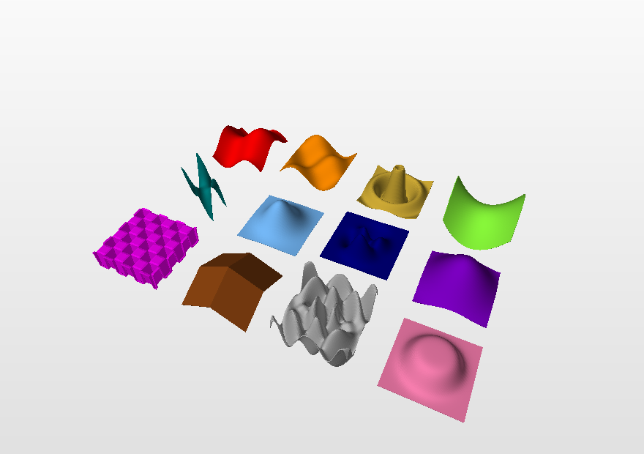
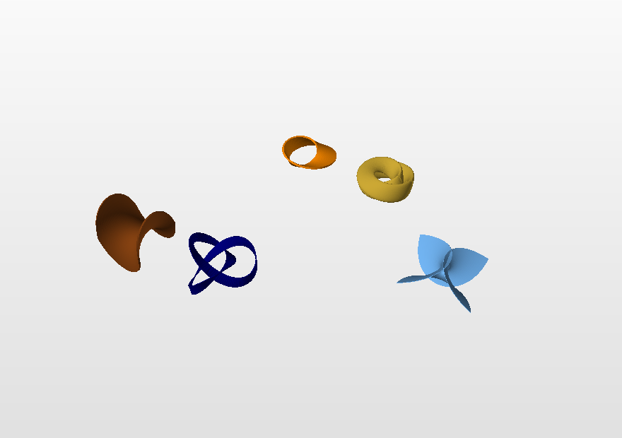
EXAMPLES
Graphs and exotic surfaces
y = f(x, z) · 10_height_fields.py
Möbius, Klein, Boy, Roman surface · 07_surfaces_exotic.py
One-sided surfaces have no "outside". Give them a thickness and they become ordinary two-sided solids.
16

Slide 18
SURFACES
When a surface is black from one side
A plain sheet
double_sided=True
thickness=0.1
One good side, one "dead" side.
Every face and its reversed copy. Cheap; still no thickness.
A real solid with a wall: closed, printable, right from every angle.
17

Slide 19
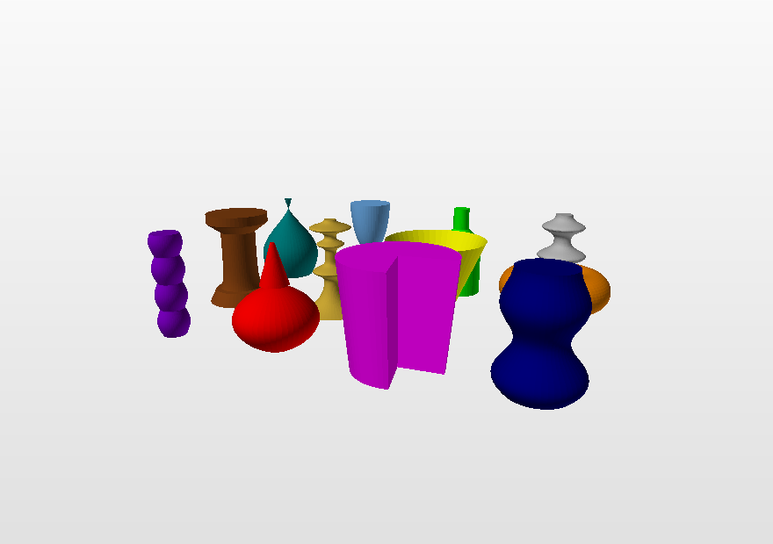
SURFACES
revolve() -- the lathe
def vase(t):
return [1 + 0.4*add.sin(3*t), t]
add.revolve(vase, [0, 0, 0], [0, 1, 0],
0, 4, 60, 40, "teal")
profile(t) returns [radius, height]
caps=True closes the ends -- a solid ready for booleans
angle= less than a full turn cuts out a wedge
The old spin3D(A, B, S, ...) still works -- the same lathe without lids. examples/14_lathe_gallery.py
18

Slide 20
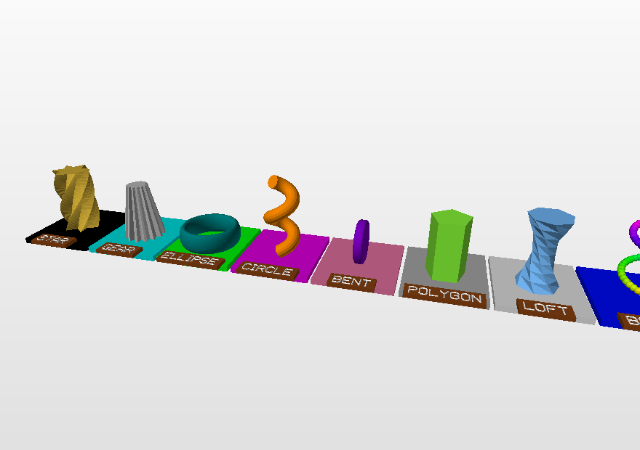
SURFACES
A cross-section copied, turned and stretched
add.extrude(star, [0, 3.4, 0], "gold",
steps=90, twist=1.6*add.pi,
scale=lambda t: 1 - 0.45*t)
twist and scale may be functions of the position along the path -- the shape changes as it goes. profile_star, profile_gear, profile_rect ... give the outlines. examples/13_sweep_and_twist.py, 33_cross_sections.py
extrude
sweep
A 2D shape pulled into 3D; turned and narrowed on the way.
A cross-section pushed along any 3D path.
loft
polyline, trace
A surface skinned over a sequence of cross-sections.
A tube through a list of points; the path of a vector field.
19

Slide 21
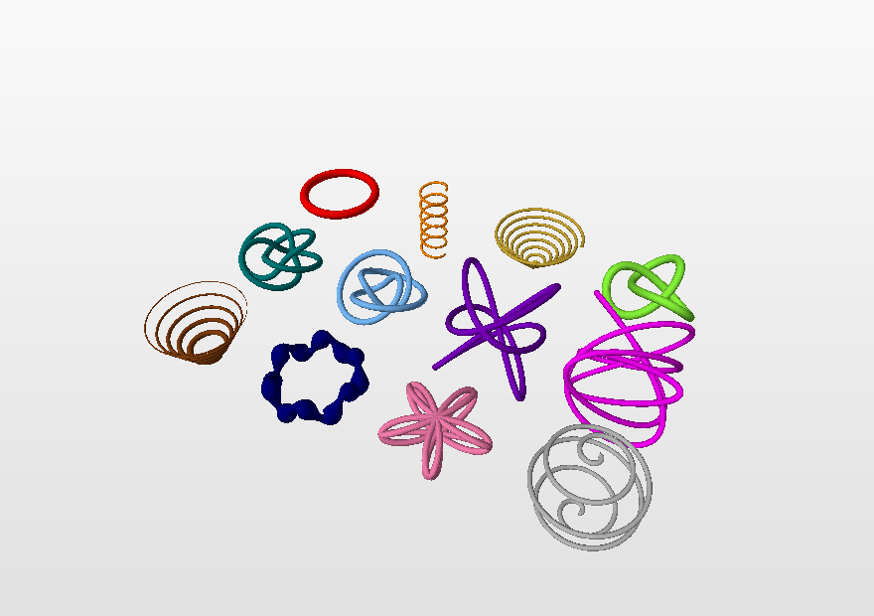
SURFACES
curve() -- curves as tubes
def knot(t):
return [add.sin(t) + 2*add.sin(2*t),
-add.sin(3*t),
add.cos(t) - 2*add.cos(2*t)]
add.curve(knot, 0, 2*add.pi,
300, 18, 0.28, "lime", True)
The radius may be a function r(t) -- the tube swells and narrows. The tube does not twist on its own: a rotation-minimising frame is carried along the curve.
20

Slide 22
LAYERS
Transformations
move, place, align, ground
rotateX/Y/Z, rotate, aim
Shift; put the centre, a corner or the bottom at a point.
Turn about an axis -- any axis -- or aim a part along a direction.
zoom, stretch, fit
mirror
Scale: uniform, per axis, or to a size.
Reflection in a plane; the face winding is reversed too.
twist, bend, taper
deform
Twist, bend, narrow.
Any function of yours: f(p) -> new point.
All of them return a new mesh -- the original is untouched, so they chain:
M = add.move(add.rotateY(add.zoom(M, 0.5), 0.4), [0, 3, 0])
21

Slide 23
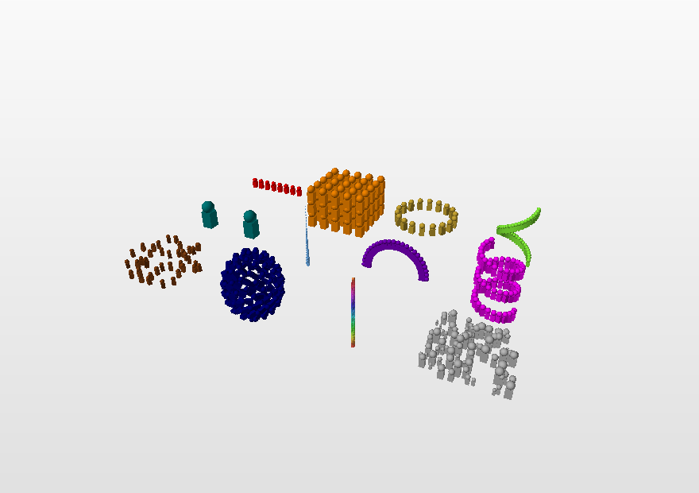
LAYERS
One part, many copies
array_linear(M, step, n)
array_grid(M, steps, counts)
array_radial(M, n, axis, P)
array_mirror(M, point, normal)
scatter(M, points, seed)
along(M, path, n)
repeat(M, n, step)
The most general: you say where copy number i ends up.
spiral = add.repeat(brick, 40,
lambda M, i: add.move(
add.rotateY(M, i * 0.3),
[0, i * 0.2, 0]))
22

Slide 24
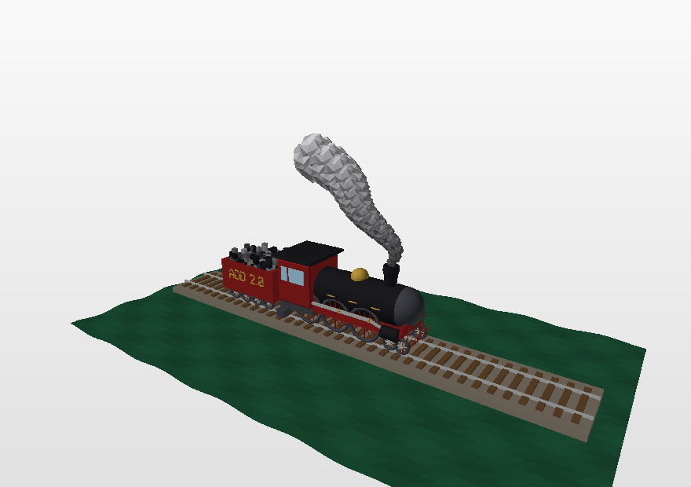
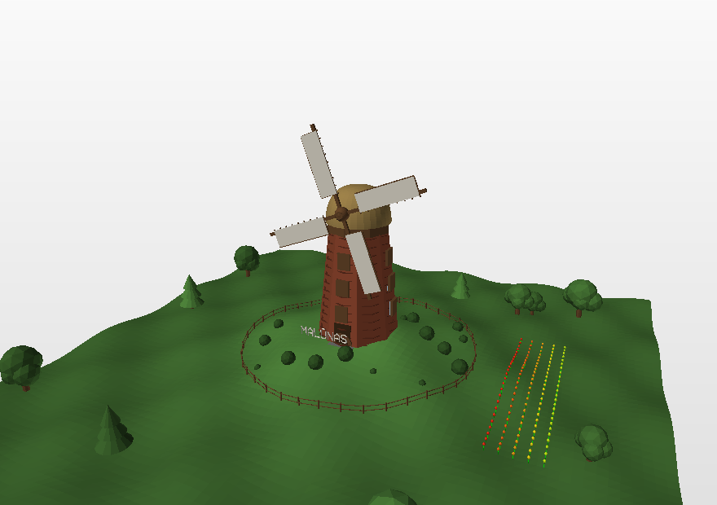
NEW
Parts that models keep needing
23_locomotive.py -- wheel, beam, rotate_point, array_mirror
24_windmill.py -- extrude, arch, stairs, tree, scatter, along
beam(A, B, w, h)
wheel, gear, arch, stairs
A bar between two points -- it works out the orientation itself.
Wheels with spokes, cogs that mesh, arches, flights of steps.
roof, column, bricks, tree
pixels, heightmap, text
Houses, temples, walls, forests.
Pixel art, block terrain, labels in a built-in font (ĄČĘĖĮŠŲŪŽ too).
23

Slide 25
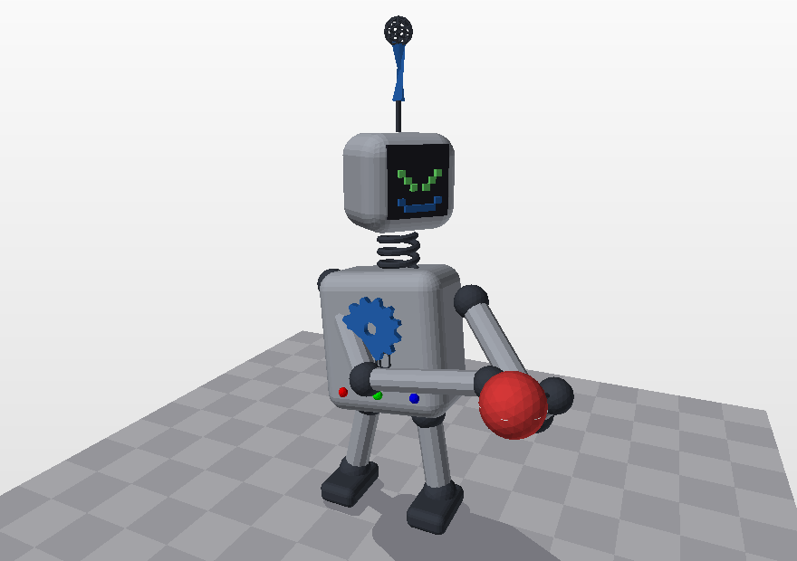
NEW
Placing: aim, scatter, along
# a part built around the origin, pointing up
add.push()
add.capsule([0, 0, 0], [0, 2, 0], 0.2, 12, "silver")
arm = add.pop()
# aim it from shoulder to hand, then move it
arm = add.aim(arm, add.direction(shoulder, hand))
add.mesh(add.move(arm, shoulder))
# forty trees on the hills
spots = add.random_points(40, lo, hi, seed=1,
height=hills)
add.mesh(add.scatter(tree, spots, seed=1,
scale=(0.7, 1.4)))
27_robot.py -- every limb aimed at a point
Build every part around the origin between push() and pop(); then aim it, turn it, and move it into place.
24

Slide 26
LAYERS
Colours
add.box(c, 1, "red") # by name
add.box(c, 1, "#ff8800") # hex
add.box(c, 1, [255, 136, 0]) # RGB
add.hsv(0.3, 0.7, 1.0) # hue
add.gradient(t, "navy", "gold") # blend
add.shade("red", 0.6) # darker
M = add.color_by(M,
lambda p: add.hsv(p[1] / 10.0))
The assignment wants at least three colours -- it looks better when they mean something.
color(M, colour)
color_by(M, fn)
Repaints the whole mesh.
Colour by the position of each face -- rainbows, height maps.
color_gradient
color_random
A blend from one colour to another along an axis.
Every face its own random colour.
25

Slide 27
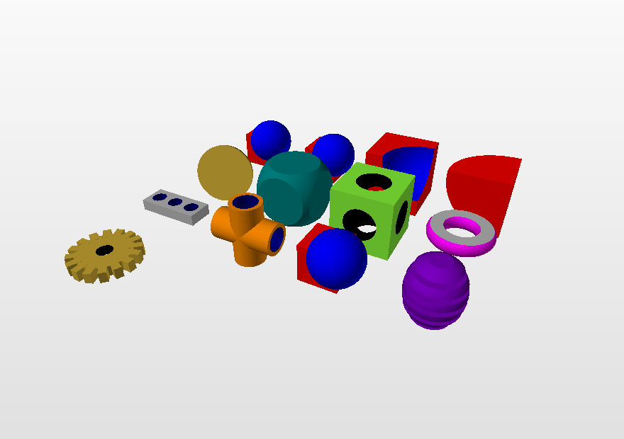
SOLIDS
Boolean operations on solids
union(A, B)
Union: everything in either solid. Hidden inner walls disappear.
intersect(A, B)
Intersection: only what is common.
difference(A, B)
Difference: A with B cut out. This is how holes and notches are made.
cut(M, point, normal)
A cut with a plane -- cheaper.
add.cuboid([0,0,0], [4,1,4], "brown")
plate = add.layer()
add.cylinder([0,-1,0], [0,1,0], 0.6, 32, "black")
drill = add.layer()
add.mesh(add.difference(plate, drill))
26

Slide 28
SOLIDS
How the booleans work
1. Split
2. Ask
3. Keep
Every face is cut where the other solid's triangles could cross it. Neighbours come from a spatial grid, so a distant face is never cut.
Each piece is asked: inside, outside, or lying on the other surface? A ray counting crossings answers.
Union keeps what is outside; intersection what is inside; difference A's outside and B's inside, reversed.
About 600 lines of plain Python. No libraries.
A 6000-face sphere minus a box: about 0.5 s. 25 000 faces: about 2 s.
The result is welded, its T-junctions healed, the surface closed.
Booleans need closed solids. If the result looks odd, check both inputs with add.check() first.
27

Slide 29
TOOLS
Repairing and checking a model
clean(M)
heal(M)
Welds coincident vertices, drops zero-area and repeated faces, removes the inner walls where two solids touch.
Closes the hairline gaps where an edge passes a foreign vertex.
fix_normals(M)
triangulate(M), inside(M, p)
Points every face the same way -- outwards, for a closed model.
Every face a triangle; is a point inside the solid?
model = add.clean(add.layer())
add.mesh(model)
add.check()
vertices 136768
OK polygons 163132
OK colours 6
OK closed surface yes
volume 60.286
Two touching cubes each keep a wall where nobody can see it. clean() finds and removes them. examples/31_workbench.py shows every repair tool at work.
28

Slide 30
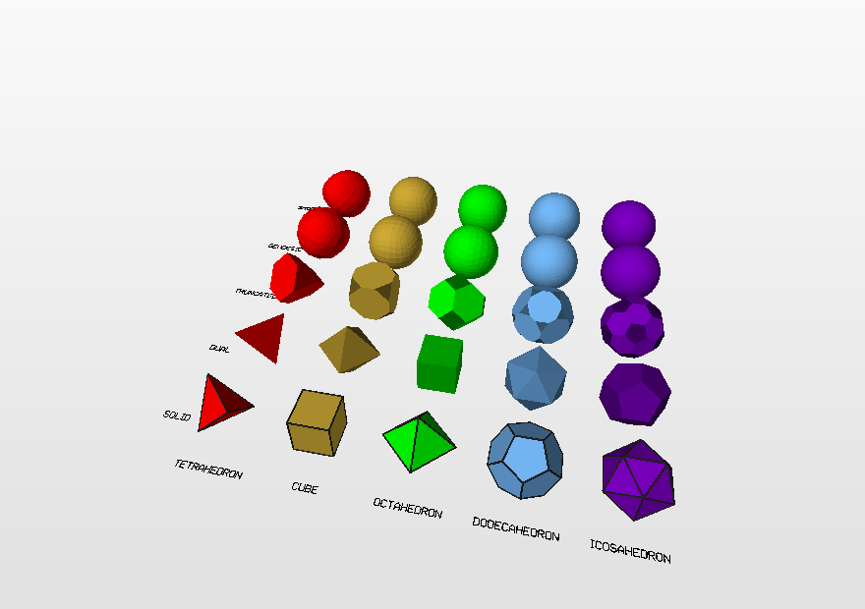
SHAPES
The five regular polyhedra, and a sphere of triangles
add.icosahedron([0, 0, 0], 2, "purple")
add.dodecahedron([5, 0, 0], 2, "gold")
P = add.polyhedron_points("icosahedron")
add.sphere([0, 5, 0], 2, 20, "sky") # 5120 tri
add.icosphere([5, 5, 0], 2, 3, "red") # 1280
add.quadsphere([9, 5, 0], 2, 12, "gold")
38_polyhedra.py -- solids, duals, truncations, domes, smooth
Centred
The dome principle
k as before
The average of the vertices is exactly the centre; every vertex at distance r.
Split every triangle in four, push the midpoints out to the sphere, repeat: 20, 80, 320, 1280 ...
sphere(c, r, k) picks the level from k: k=10 -> 1280, k=20 -> 5120 faces.
29
Notes:
Example 36 shows the same sphere three ways: the Maple cube-sphere, a ball of blocks, the geodesic one.

Slide 31
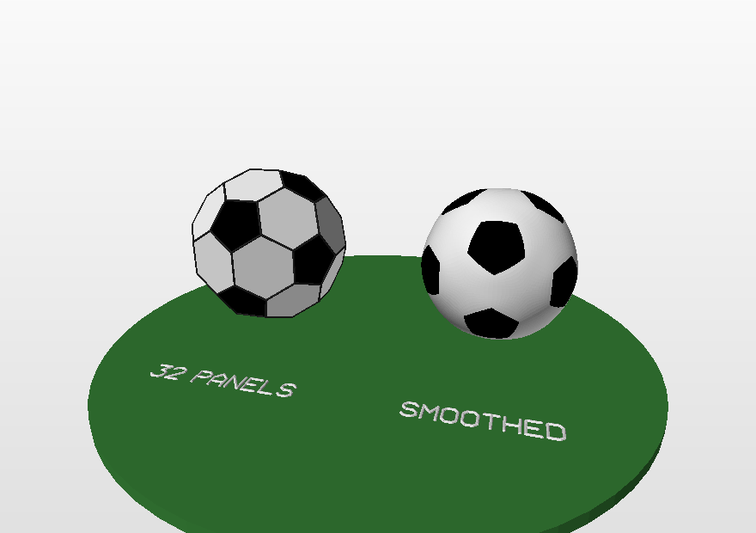
VERTEX TOOLS
A football from the vertices of an icosahedron
ico = add.make(add.icosahedron, [0, 0, 0], 3)
print(add.neighbors(ico, 0)) # 5, in order
print(add.valence(ico, 0))
ball = add.truncate(ico, 1 / 3.0) # corners off
ball = add.color_by_sides(ball,
{5: "black", 6: "white"})
add.mesh(add.smooth(ball, 16)) # rounded
37_football.py
Ask the mesh
Change one corner
Rebuild
neighbors, valence, mean_neighbor_distance, edges, vertex_normal, face_center, boundary_loops.
set_vertex(M, i, [x, None, z]) moves vertex i and keeps the faces -- then smooth() it.
dual, truncate, refine + spherify, inflate -- new solids from old ones.
30

Slide 32
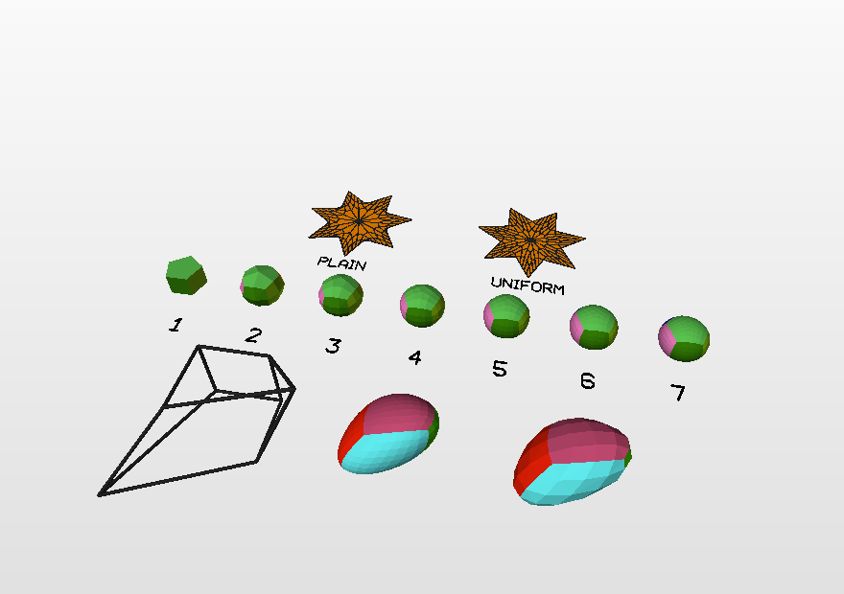
SMOOTH()
Smooth surfaces: generalised Catmull-Clark
add.box([0, 0, 0], 2, "gold")
block = add.layer()
i = add.nearest_vertex(block, [1, 1, 1])
block = add.set_vertex(block, i, [2.5, 2.5, None])
add.mesh(add.smooth(block, 8)) # 8 per edge
add.mesh(add.catmull_clark(block, 3))
39_smooth_shapes.py -- n = 1 ... 7 on one prism
Any n
Exactly on the limit surface
The paper
n cells on every control edge for n = 1, 2, 3, 4, 5 ... -- classical subdivision only gives 2, 4, 8.
Every new vertex is evaluated on the limit surface; near odd corners the grid is reparameterised to stay even.
Sabaliauskas, Uniform n-grids on Catmull-Clark limit surfaces of arbitrary polygon meshes (2026); a line-by-line port to pure Python.
31

Slide 33
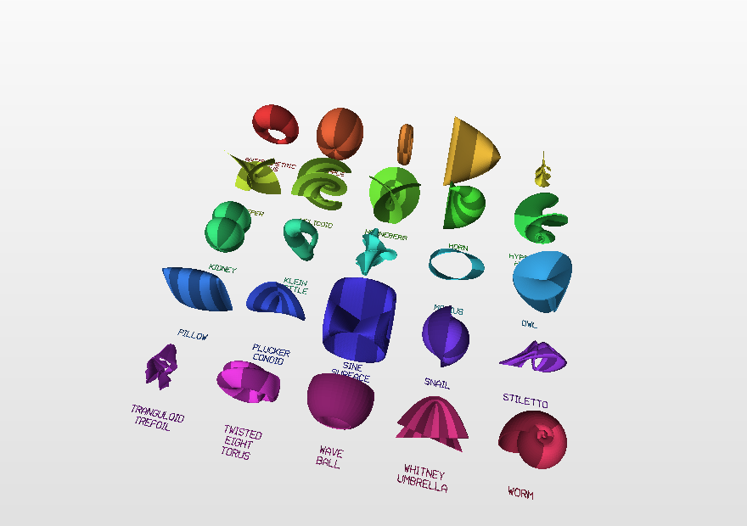
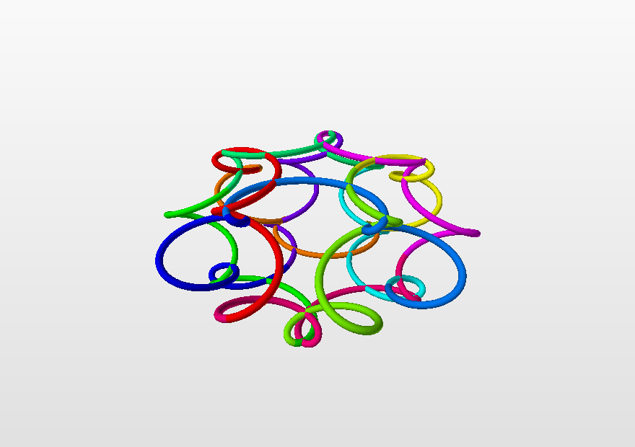
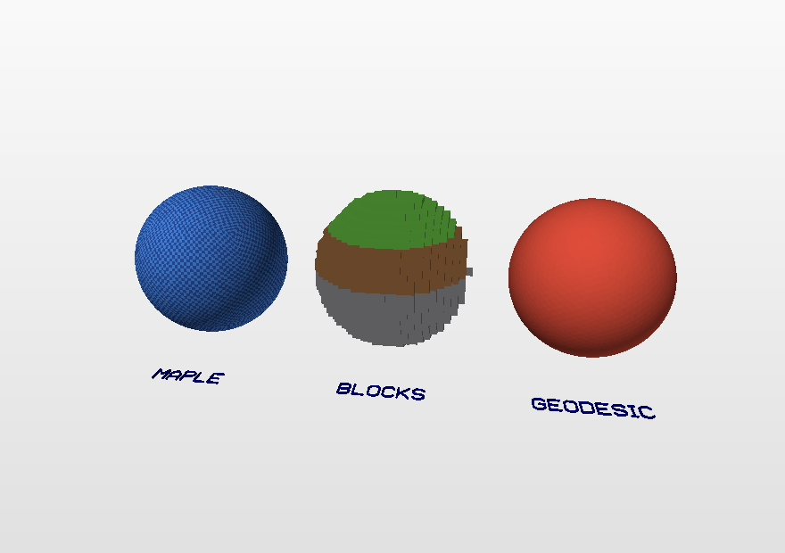
SURFACE()
Twenty-five surfaces by name
print(add.surface_names())
add.surface("klein_bottle", [0, 0, 0], 4, 120)
add.surface("dini", [6, 0, 0], 4,
color=lambda u, v: add.hsv(u / 12))
add.surface("pillow", [-6, 0, 0], 3, a=0.9)
owl = add.surface_function("owl") # bare f(u, v)
34_surface_zoo.py
35_knot_curve.py -- a knot from rotating circles, one curve() call
36_minecraft_sphere.py -- Maple, blocks, geodesic
32

Slide 34
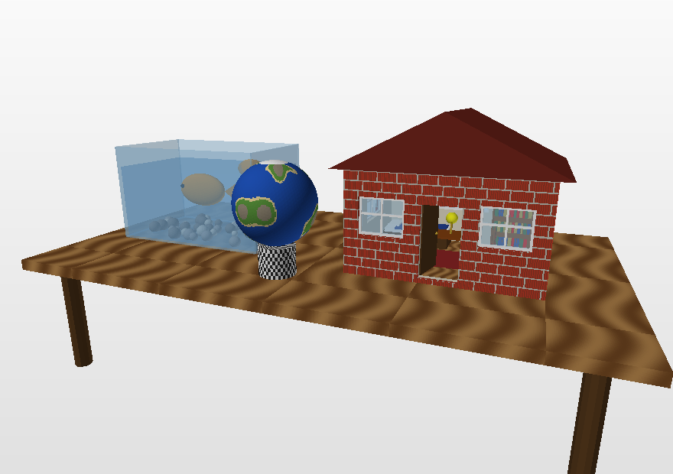
.OBJ + .MTL
Glass, pictures and the Sketchfab limits
glass = add.transparent("sky", 0.35) # 0..1
wall = add.make(add.cuboid, [0, 1.5, 0], [6, 3, 0.3])
hole = add.make(add.cuboid, [0, 1.6, 0], [2, 1.2, 1])
wall = add.difference(wall, hole) # cut first,
add.mesh(add.texture(wall, "bricks.png")) # then
# the pane, in the opening
add.cuboid([0, 1.6, 0], [2, 1.2, 0.03], glass)
add.check() # <= 50 MB, <= 50 colours
add.save("house.obj", colors=50) # .mtl
45_glass_and_textures.py -- a room behind the glass
Optional
Limits
Pictures from code
Without transparent/texture everything is exactly as before; .off files keep plain colours.
Sketchfab: 100 MB free plan, 100 materials merged beyond that. The course: 50 MB, 50 colours. limit_colors() and obj_size() help.
write_png("bricks.png", rows) writes a picture you computed -- no image files needed.
33

Slide 35
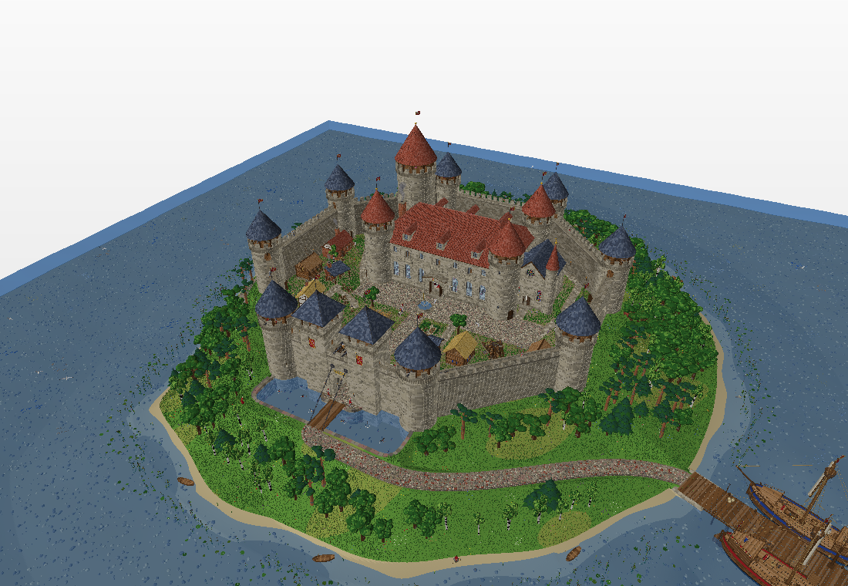
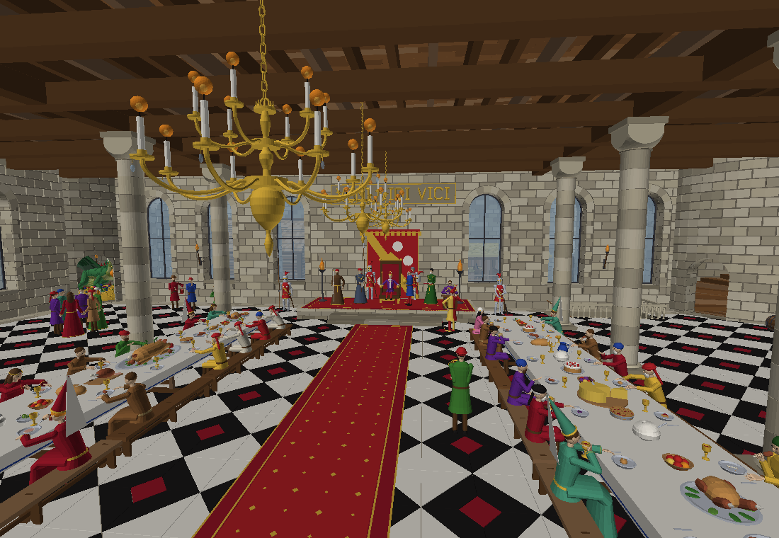
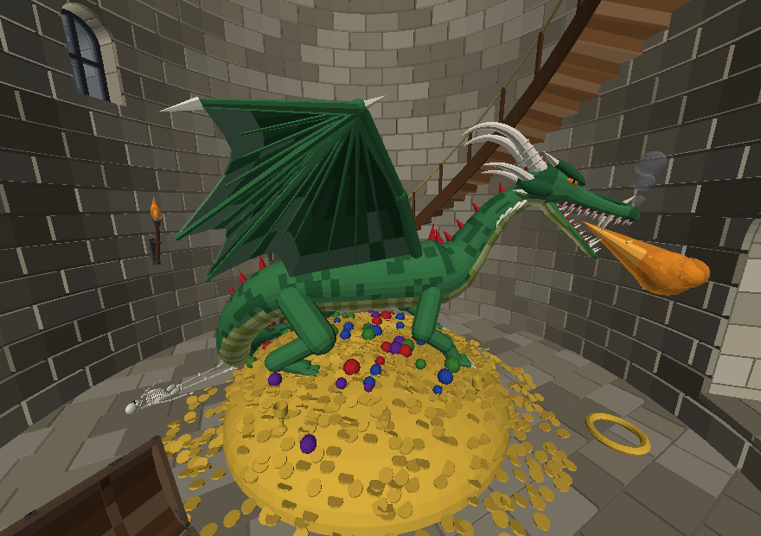
46_CASTLE.PY, STREAM()
The castle: a model bigger than memory
the throne hall and the feast
no textures, every stone a polygon: an .off of about 1 GB and an .obj that 7-Zip brings under 100 MB for Sketchfab
the dragon on the treasure
out = add.stream("castle.off", precision=4) # parts go to disk at once,
wall_of_bricks(); out.add() # tidied (no overlaps), written, cleared
out.close() # fills in the OFF header (.mtl for .obj)
The castle on Sketchfab, to turn round in 3D: skfb.ly/pOnRS
34

Slide 36
FILES
Saving and sharing a model
add.save("model.off") # the course format
add.save("model.obj") # + .mtl for colours
add.save("model.ply")
add.save("model.stl") # for 3D printing
The MeshLab conversion step is gone -- add.py writes OBJ and MTL itself.
Sketchfab
3D printing
Put .obj and .mtl in one archive and upload -- anyone can turn the model in a browser, like the castle: skfb.ly/pOnRS
clean(..., normals=True), then save("m.stl"). The surface must be closed.
Preview without MeshLab
Loading back
python3 tools/preview.py model.off writes a PNG. No libraries either.
load("letter.off") returns a mesh you can move and paint.
35

Slide 37
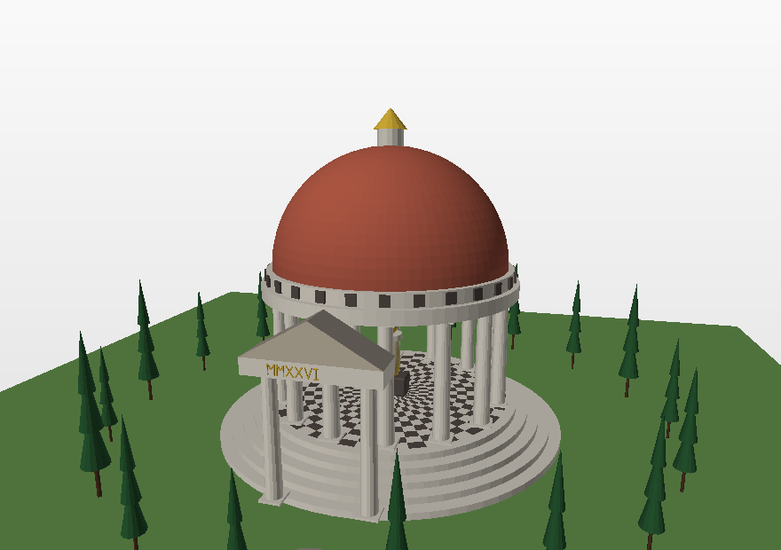
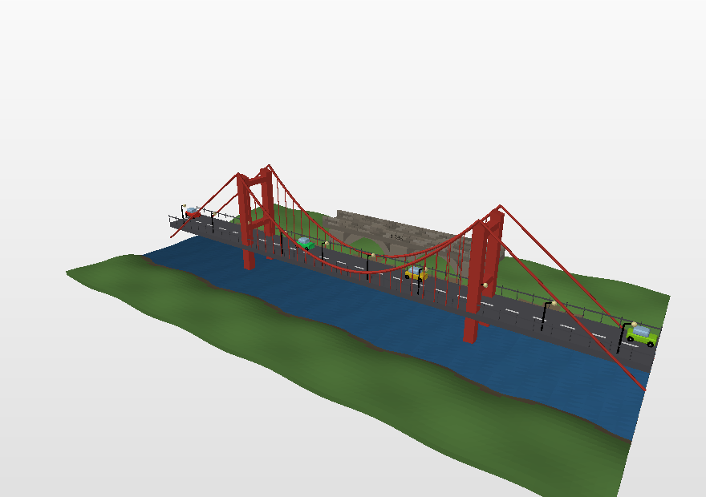
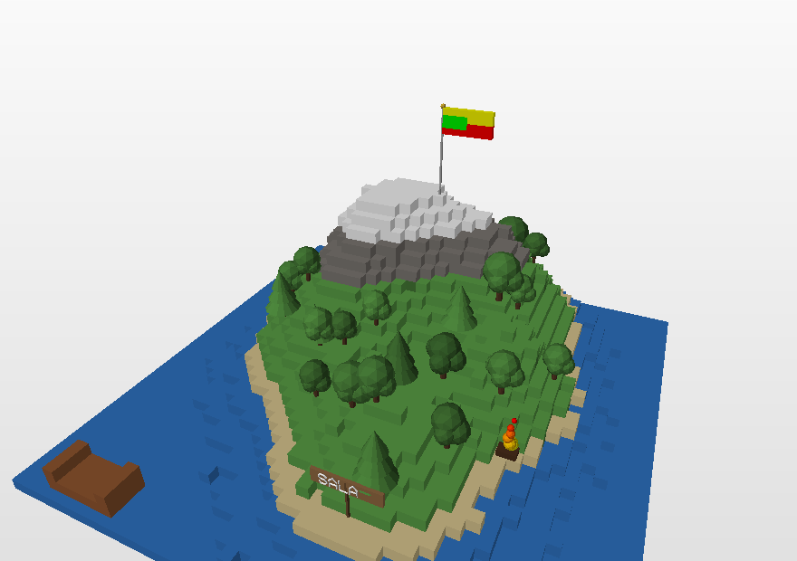
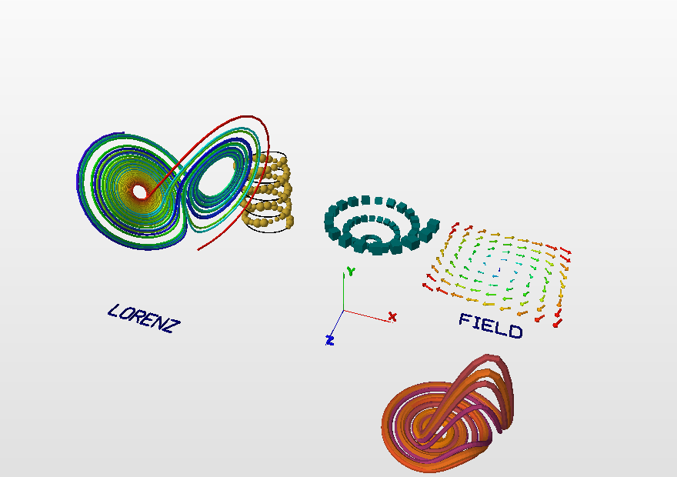
GALLERY
Complete models
25_temple.py -- columns on a circle, a chequered floor
29_bridge.py -- beams, cables, hangers, cars along the road
36

Slide 38
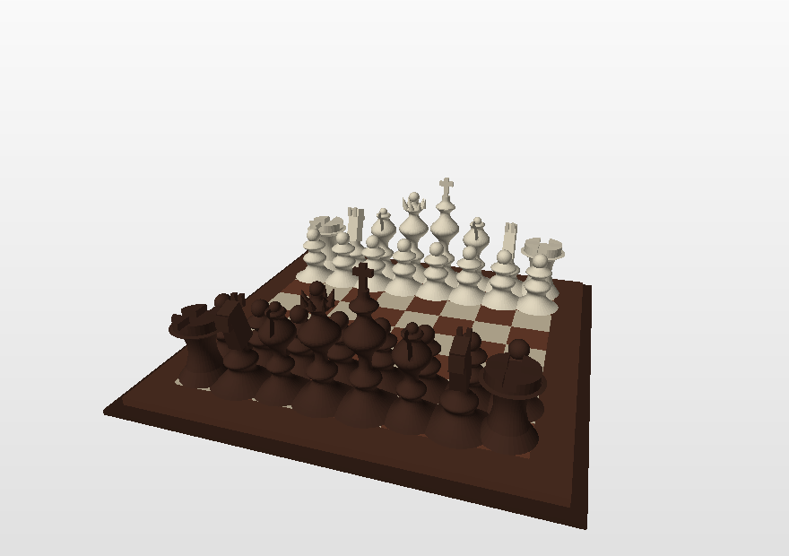
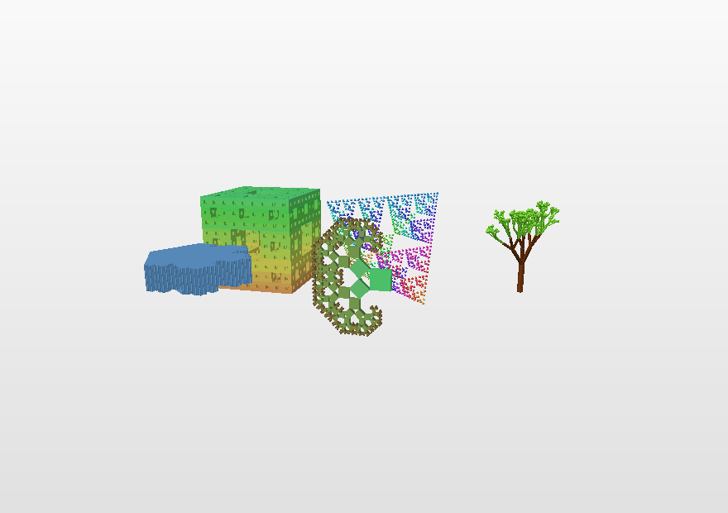
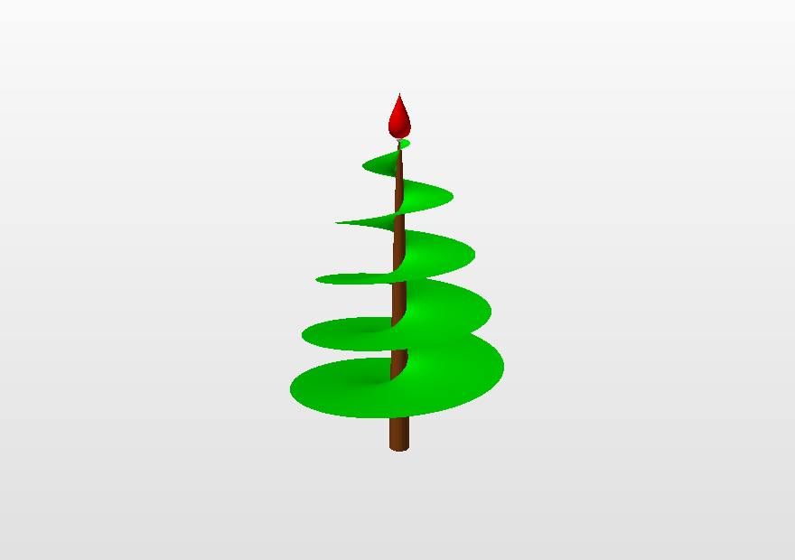
GALLERY
Larger studies
18_chess_set.py -- lathe, layers, booleans
17_fractals.py -- Menger sponge, Sierpinski, a tree
37
Notes:
43 example programs, 42 of them also in C++; every public function is used by at least one of them (python3 tools/coverage.py), and every model fits the Sketchfab limits.

Slide 39
COMPATIBILITY
From 1.2 to 2.0
add.py 1.2 | add.py 2.0 | what it is
cube2(c, e, b, RGB) | frame | a hollow cube of bars
cylinder2(A, B, r, k, RGB) | tube | a cylinder with no lids
cylinder3(A, B, r, k, RGB) | cup | closed at one end
cone2(A, B, r, k, RGB) | cone_open | the slanted wall only
rectangle3D(c, e, RGB) | cuboid | a rectangular block
newface(A, RGB) | polygon | one flat face
spin3D(A, B, S, ...) | revolve | a lathe
off(file) | save(file) | .off, .obj, .ply or .stl
All the old names still work. Twelve models written for 1.2 live in tests/legacy/, and the tests check that they produce exactly as many faces as before (only sphere changed: it is geodesic now; quadsphere is the old one). examples/32_old_names.py is a whole model in the 1.2 vocabulary.
38

Slide 40
Where to find everything
add.py and add.hpp, the examples, the tests and the documentation
github.com/…/add3d
Documentation in English and Lithuanian
…github.io/add3d
Questions
akatasis@gmail.com · martynas.sabaliauskas@mif.vu.lt
Thank you.
Notes:
For students: start with examples/01_first_model.py, then 02_primitives.py. For the assignment, examples 06-16 and the complete models 22-33 are the most useful.

