Slide 1
Common EBB Operation

Slide 2
Claim a batch
Claimed By: <Your ESIGNUM>
Classification: From the log, determine if the failure is env or product fault
Reason: Error from the log. If the batch has PMD crash, claim with PMD signature
Ticket Link: If there’s a ticket to track the issue
Test Suite: <Failed Test Suite>
Test Case: <Failed Test Case>
Affected STP: Which STP the test failed

Slide 3
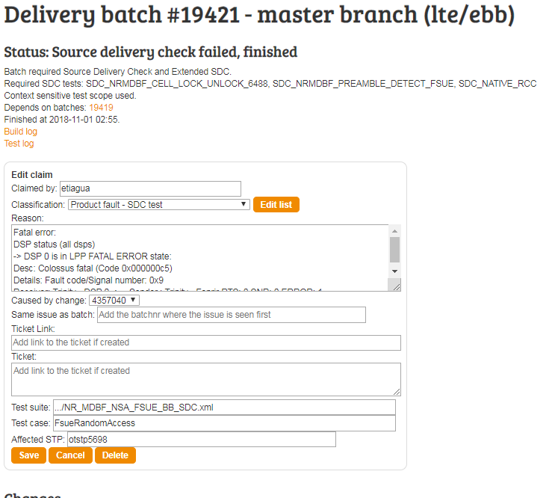
Test case Failure

Slide 4
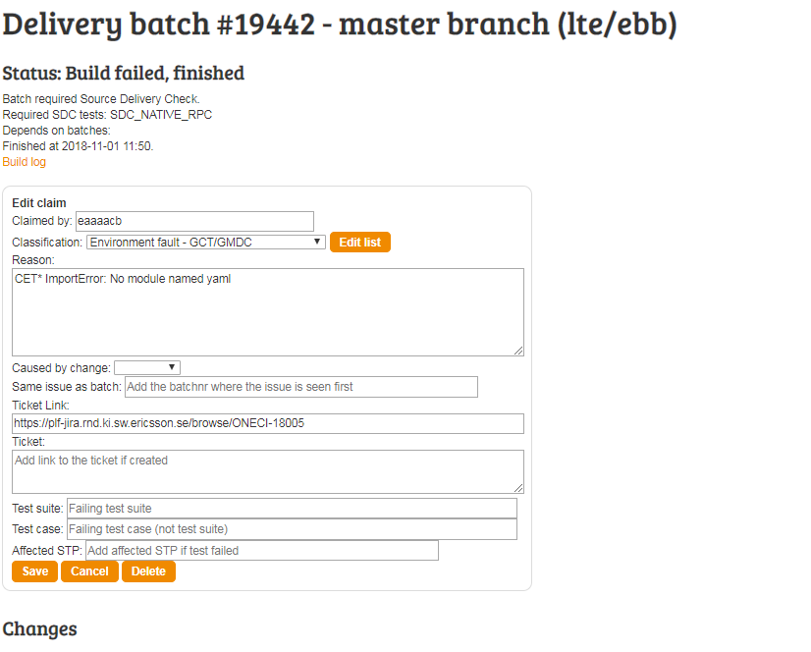
Build Failure

Slide 5
Sample JCAT LOG
Sample BUILD LOG

Slide 6
KIBANA
Please read on KIBANA online
Useful links:
https://www.elastic.co/products/kibana
https://www.elastic.co/guide/en/kibana/current/introduction.html

Slide 7
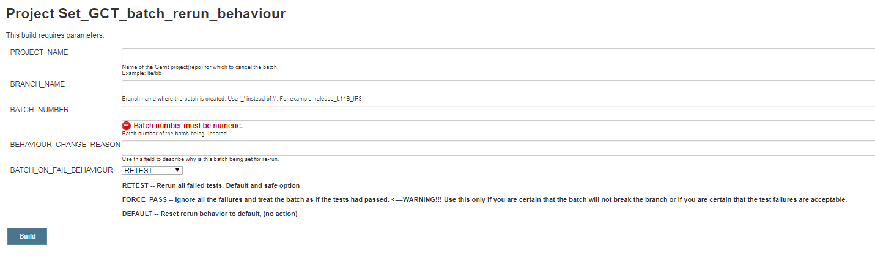
Reset a Batch
https://lte-wiki.rnd.ki.sw.ericsson.se/wiki/LRAT_CI/Supervision/Batch#Set_a_batch_as_restartable

Slide 8
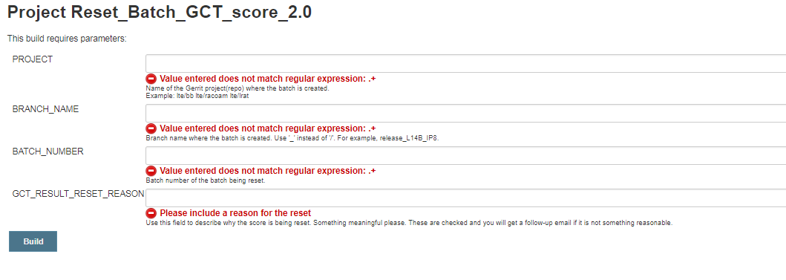
Re-set GCT score
https://lte-wiki.rnd.ki.sw.ericsson.se/wiki/LRAT_CI/Supervision/Batch#Reset_the_batch_GCT_score

Slide 9
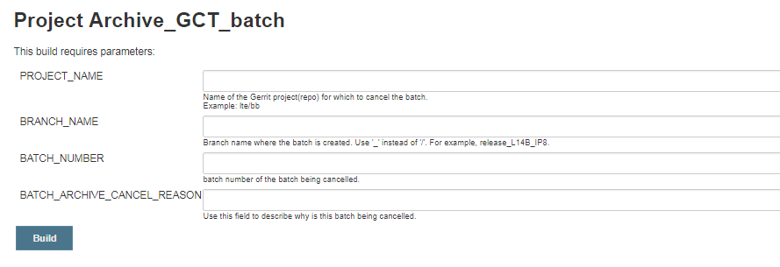
Cancel a batch
https://fem012-eiffel003.rnd.ki.sw.ericsson.se:8443/jenkins/job/Archive_GCT_batch

Slide 10
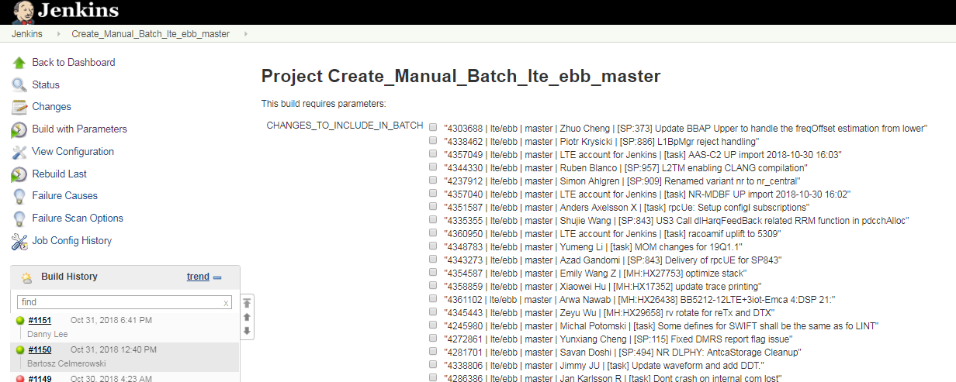
Create manual batch in EBB
https://lte-wiki.rnd.ki.sw.ericsson.se/wiki/LRAT_CI/Supervision/Batch#Create_a_manual_batch_in_master

Slide 11
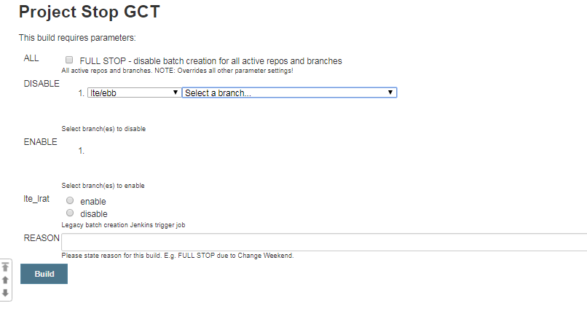
Stop batch creation
https://lte-wiki.rnd.ki.sw.ericsson.se/wiki/LRAT_CI/Supervision/Flow#Stop_GCT

Slide 12
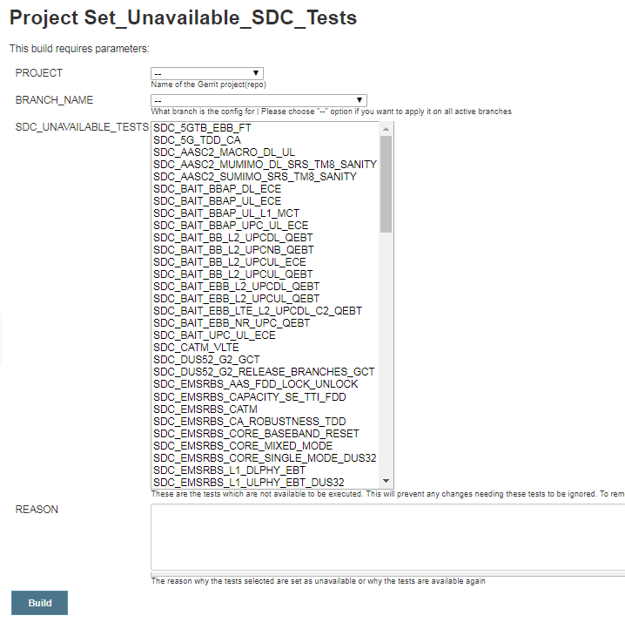
Set SDC test unavailable
https://lte-wiki.rnd.ki.sw.
ericsson.se/wiki/LRAT_CI/Supervision/
Flow#Set_Unavailable_SDC_Tests

Slide 13
Remove or Add test from gating
https://lte-wiki.rnd.ki.sw.ericsson.se/wiki/LRAT_CI/Supervision/Flow#Add.2Fremove_gating_and_non-gating_tests
Very rare operation

Slide 14
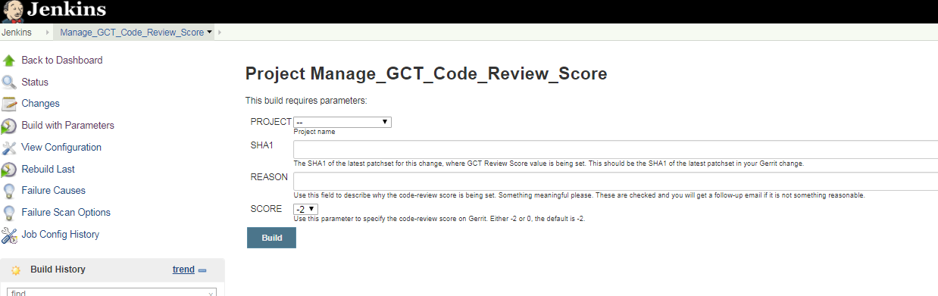
Set -2 on to stop a delivery that constantly fails – STEP 1
https://lte-wiki.rnd.ki.sw.ericsson.se/wiki/LRAT_CI/Supervision/Commit#Manage_the_GCT_code-review_score

Slide 15
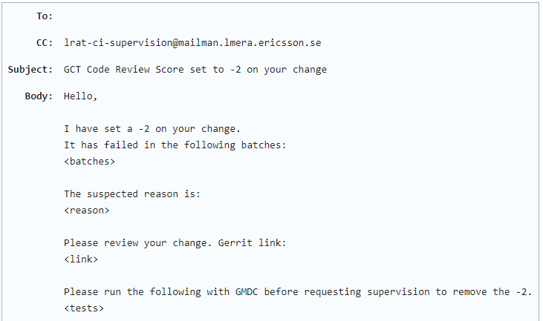
Set -2 on to stop a delivery that constantly fails – STEP 2
Send email in this format to designer (commit owner), explaining why you set -2 on their commit

Slide 16
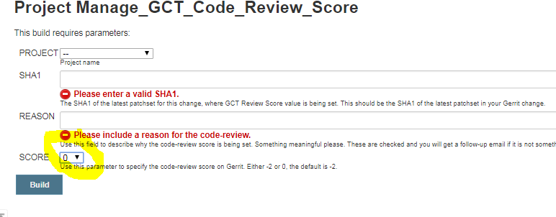
Remove -2: Set score to ‘0’
https://fem012-eiffel003.rnd.ki.sw.ericsson.se:8443/jenkins/job/Manage_GCT_Code_Review_Score/

Slide 17
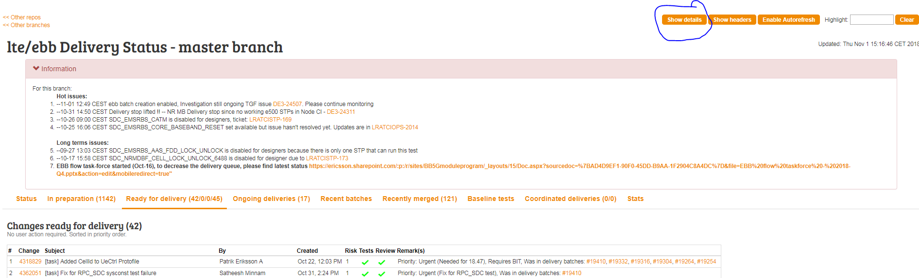
How to check commits for specific test

Slide 18
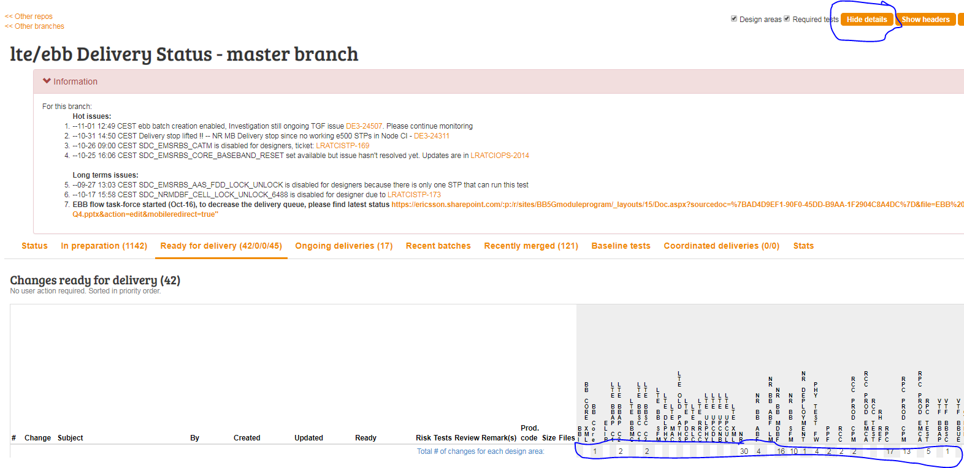
How to check commits for specific test

Slide 19
How to swap STPs
Ideally master STP is locked pool=gct_reserved and release branches STP is locked to pool=dc. But both branch triggers TGF job under ‘ltegct’ owner
If we have a broken node then we lock the broken to ourselves and lock the working node to owner=ltegct so that it’s available for master and release branches.
For example:
Tglock force lock otstp5118 = will lock to user owner=eshrdee (Broken node)
Tglock force lock kistp0149 owner=ltegct (locked for both the branches)
For more TGF commands, please refer to TGF wiki
https://wiki.lmera.ericsson.se/wiki/TGF/Using

