Slide 1

Dandelion: Next-gen Distributed Datastore Small Clusters, Bigger Speeds – Distributed txns redefined VLDB 25 | Eurosys 25 best poster nominee Research Track – Distributed Transactions I
Vasilis Gavrielatos*, Antonios Katsarakis*, Chris Jensen, Nikos Ntarmos
Huawei Research – DB Lab Edinburgh

Slide 2
Apps (Knowledge Graphs, ML)
Distributed Datastores 101
Relational DBMS
Graph DBMS
Language (SQL)
Language (GQL)
Plan & optimize
Plan & optimize
Key backbone of numerous applications, systems, and services (core backbone of DBMS)
Performance-critical intra-datacenter storage layer to access and manipulate data with
Efficiency: high throughput, low latency, cost-effectiveness, …
Programmability: interactive transactions, strong consistency, …
Reliability: high availability, durability, …
Datastore
Hashtables
...
B+-trees
Graph Topology
Reads & Writes
ACID Tx
Distributed shared memory
Evolution of Datastores (note: 10x leaps that need redesign)
Traditional Era
New Era (industry & academia)
Traditional Datastores:
Disk-based, slow network
Efficiency: non-scalable, low performance
Modern Datastores: e.g., Microsoft’s FaRM
Scalable, good performance, transactions, consistency, availability
In-memory
Fast (RDMA) network
FaRM ➔ 140M TATP txs/sec (90 machines – 5TB)
#2:
Exploit new HW for programmability + efficiency
#1
#3
NoSQL Datastores:
Sacrifice programmability for performance
Ok for best-effort web-services but not critical apps!
Programmability: sacrifice transactions, consistency
Next-gen Datastores: academia + our goal
Modern datastores + higher performance, less cost, larger capacity
HW acceleration: FPGA, ASICs, smart NICs/switches
CXL expansion, Disaggregated memory, PMEM
More memory with less compute ➔ 5-40TB in 5-10 machines
Opportunity / Challenge: Better performance with 10x fewer machines (compute) !?
Notes:
Relational vs graph

Slide 3
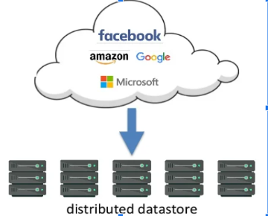
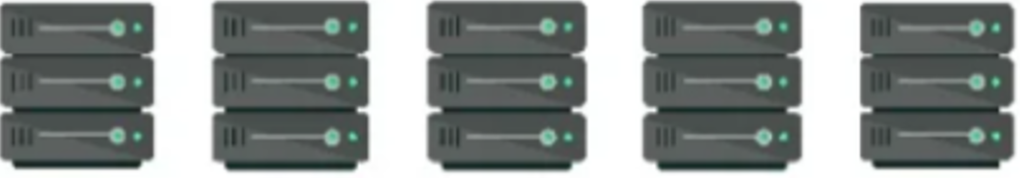
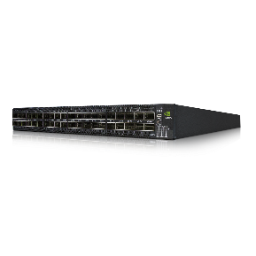
Dandelion: Scope and Goals
tx.Init();
auto val = tx.Get(A)
if (val == 0) {
tx.Put(B, 0);
}
tx.Insert(C, 1);
tx.Delete (D)
tx.Commit();
Context
In-memory dataset: small/moderate sized key-value pairs
Distributed across multiple machines for capacity
Replicated for availability in the face of faults
Interactive Transactions
So far: DRAM, RDMA cluster, SW CPU
Next: CXL/UBus, NVM, smart HW accel, broader context
Aim
1. Reliable: availability, strong consistency … 2. Programmable: expressive, transactional ... 3. Top performance / cost and energy: e.g., better perf with 10x fewer machines
A, B
C, A
B, E
D, C
D, E
Demands
State-of-the-art implementation
SW - HW co-design
Across-stack innovation (indexes, network, protocols, CC...)
RDMA-capable network

Slide 4

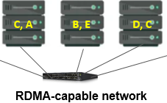
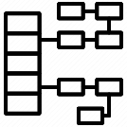
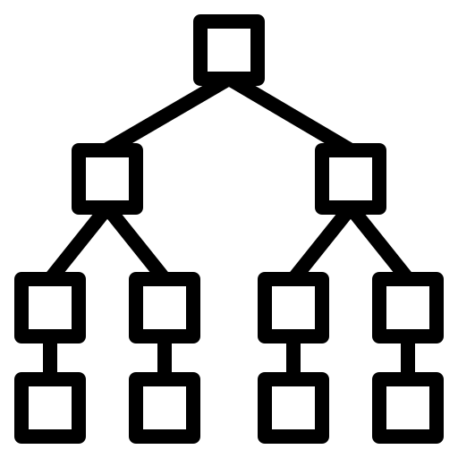
Dandelion: Four Key Building Blocks
Protocols
Transactional Protocol
Skeleton (3 novel protocols)
Distributed and single-node
Strong consistency
Recovery Protocol
Recover txs after fault
Correctness verified
Network
RPCs-over-RDMA
Datastore optimized
Data structures (single server)
Hashtable
B+tree
Data structures (single server)
Hashtable
B+tree
Let’s begin with Hashtables … what’s wrong with state-of-the-art?

Slide 5
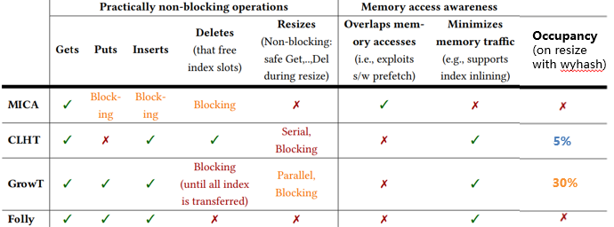
Existing single-node in-memory concurrent hashtables
Lack features / blocking ops …
Not memory-aware
Sacrifice key features and cannot match memory speeds!
Notes:
修改说明：
1、增加“撰写指引（完成idea胶片后请删除）：”
2、把有益效果修改为“技术效果”
3、把“与现有技术区别最大的地方，发明人最得意之处”修改为“与现有技术不同的技术特征”

Slide 6
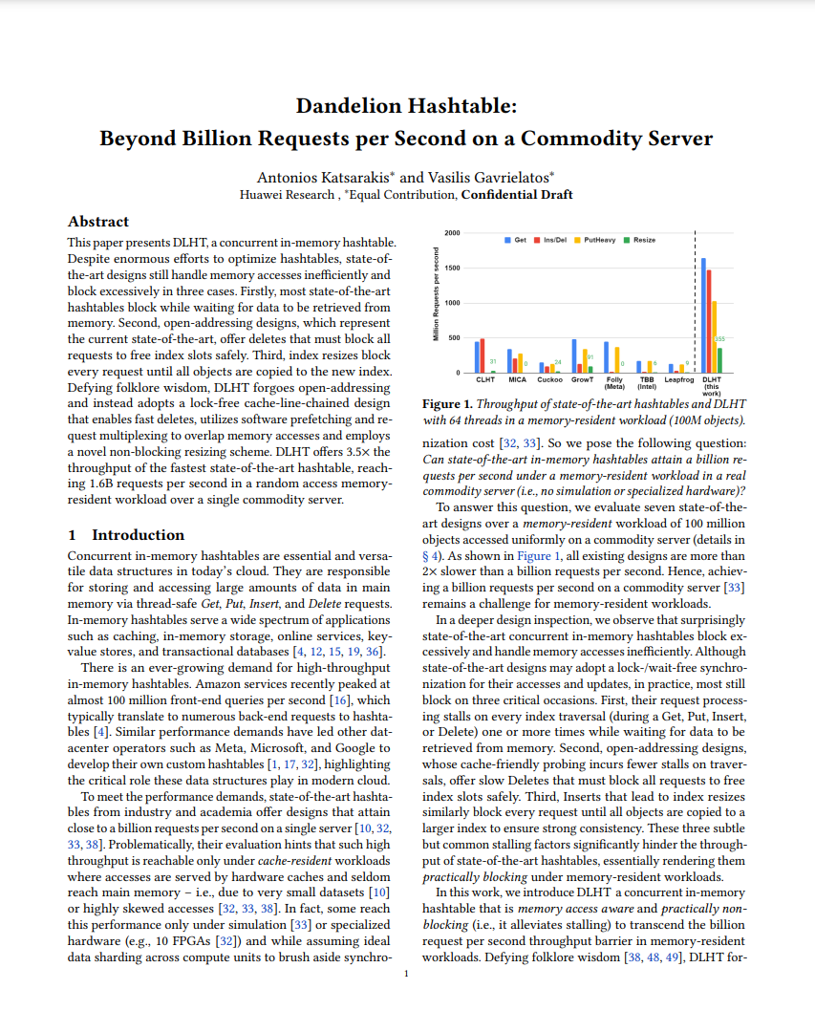
Dandelion Hashtable (DLHT)
Highly concurrent + cache-friendly
Non-blocking index operations, cache alignment, min. coherence traffic
Memory access aware
min memory accesses & masked latency → s/w prefetching + ~1 cache-line / request
Non-blocking parallel resize
concurrent operations complete with strongest consistency while other threads resize
Fully-featured
CRUD + Resize (no caveats), iterator, namespaces, variable size KVs in same index, etc.
→ scalable to many threads
[HPDC’24]
HPDC’24
In short …

Slide 7
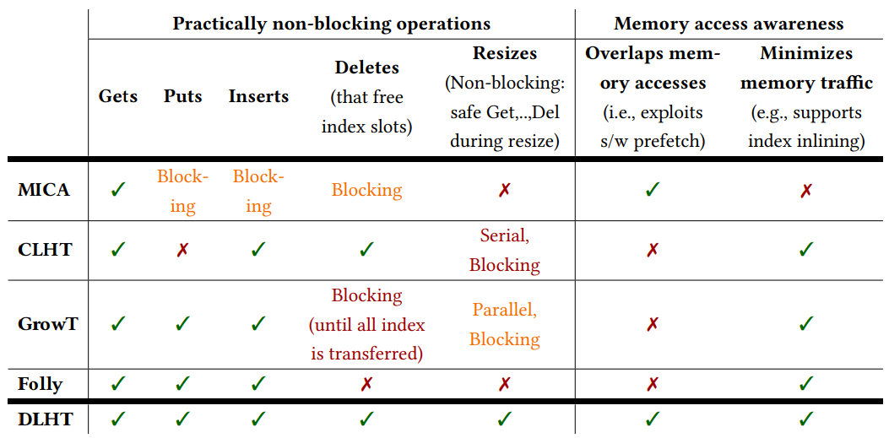
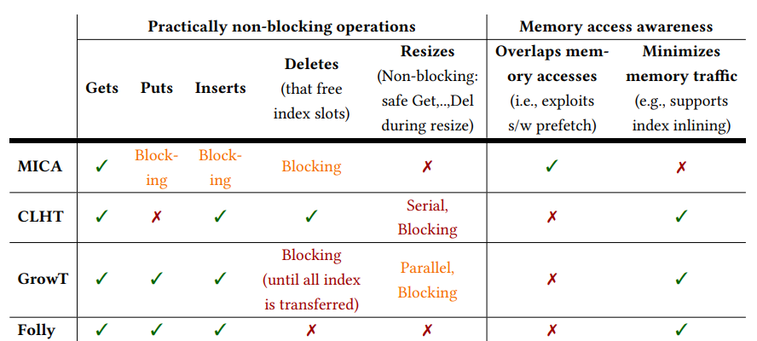



DLHT ticks all boxes
Occupancy (on resize with wyhash)
5%
30%
~70%
Reality check: Do all these translate into performance?
Notes:
修改说明：
1、增加“撰写指引（完成idea胶片后请删除）：”
2、把有益效果修改为“技术效果”
3、把“与现有技术区别最大的地方，发明人最得意之处”修改为“与现有技术不同的技术特征”

Slide 8
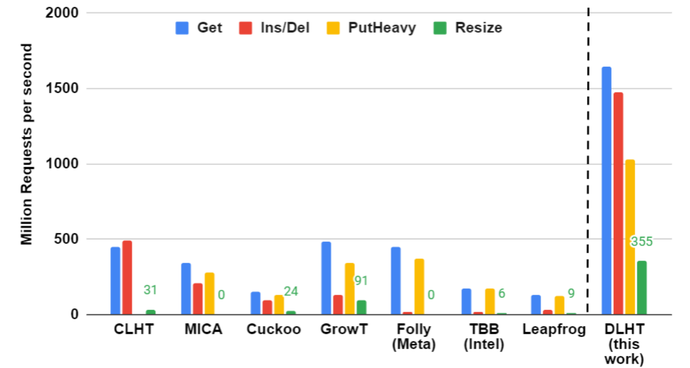
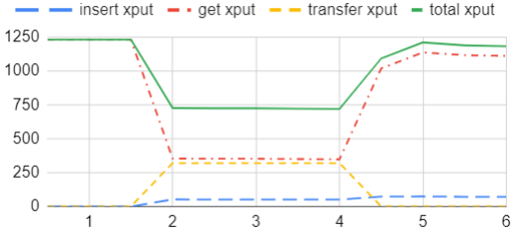
DLHT Performance
Memory-resident workload: 100M (16B KV) pairs uniformly Get/Ins/Del | 64 threads
Resize with consistent Gets/Inserts (60/4 threads)
non-blocking resize
200M -> 800M index
MIOPS
3.5x
12x
4x
Time (secs)
close addressing
open addressing with dels
& fastest growing
Dandelion Single-node Serializable Txs using DLHT as in-memory storage TATP: >250M txs/sec (read-intensive)
Smallbank: >170M txs/sec (write-intensive)
Up to 1.7B ops/sec, Non-blocking resize, >250 M. serializable txs/s

Slide 9
Dandelion: Four Key Building Blocks
Transactional Protocol
Skeleton (3 novel protocols)
Distributed and single-node
Recovery Protocol
Recover txs after fault
Correctness verified
Network
RPCs-over-RDMA
Network:
RPCs-over-RDMA
Data structures
Hashtable
B+tree

Slide 10

Network
eRPC [NSDI’19 – best paper 🏆]
Efficient general-purpose RPCs
DPDK, UDP, RoCE/IB (two-sided) RDMA
Retransmissions
Support packets > MTU
- General purpose, Reliable, callback API
- Great for large/medium messages … BUT
Datastores are dominated by Small data messages → access/update small key-value pairs (e.g. 8-32B)
Tiny protocol logic messages → lock/unlock, commit/abort, truncate, etc.
Dandelion Networking
faster eRPC kernel + datastore-optimized
DPDK, UDP, RoCE/IB RDMA
Retransmissions …
Multicast
- General purpose, Reliable, callback API
- Optimized eRPC kernel, small transfers, batching
Is batching that important ?!

Slide 11
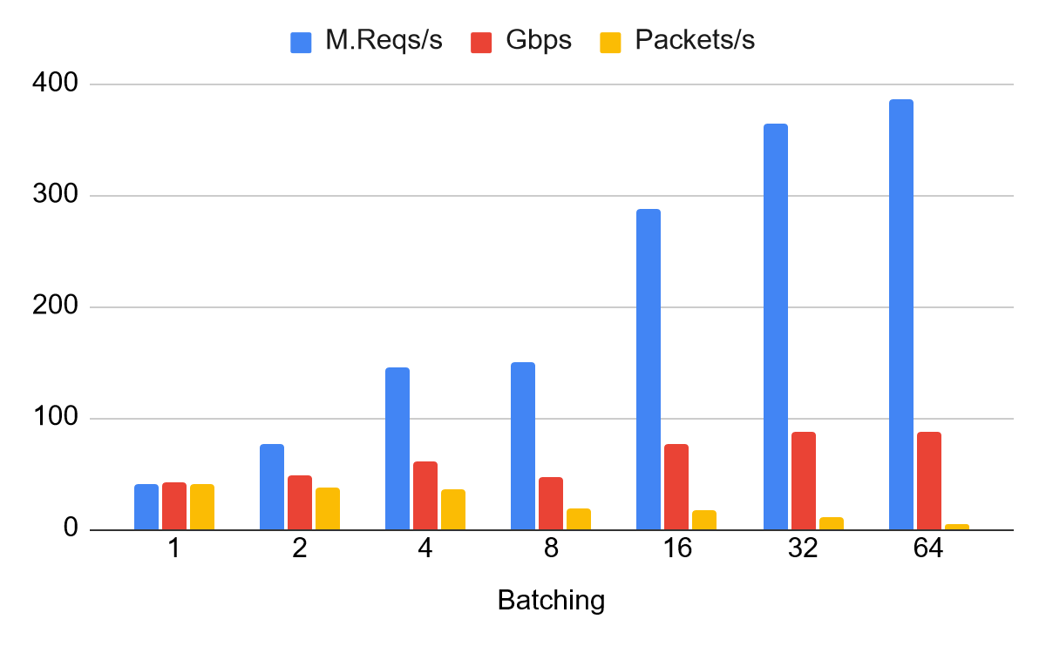
Importance of network batching
Issues with small (32B) app requests
1) RoCE packets have 66B Header
= 10-30% b/w utilization
2) Too many packets, NIC/switch
cannot keep up with packet rate
100Gbps
100Gbps

Slide 12
Importance of network batching
Issues with small (32B) app requests
1) RoCE packets have 66B Header
= 10-30% b/w utilization
2) Too many packets, NIC/switch
cannot keep up with packet rate
→ Application-level batching (app requests in same packet) necessary to fully utilize network
100Gbps

Slide 13
Importance of network batching
Issues with small (32B) app requests
1) RoCE packets have 66B Header
= 10-30% b/w utilization
2) Too many packets, NIC/switch
cannot keep up with packet rate
→ Application-level batching (app requests in same packet) necessary to fully utilize network
100Gbps
Payload > PCIe max inlining
→ NIC needs 2nd DMA for fetching

Slide 14
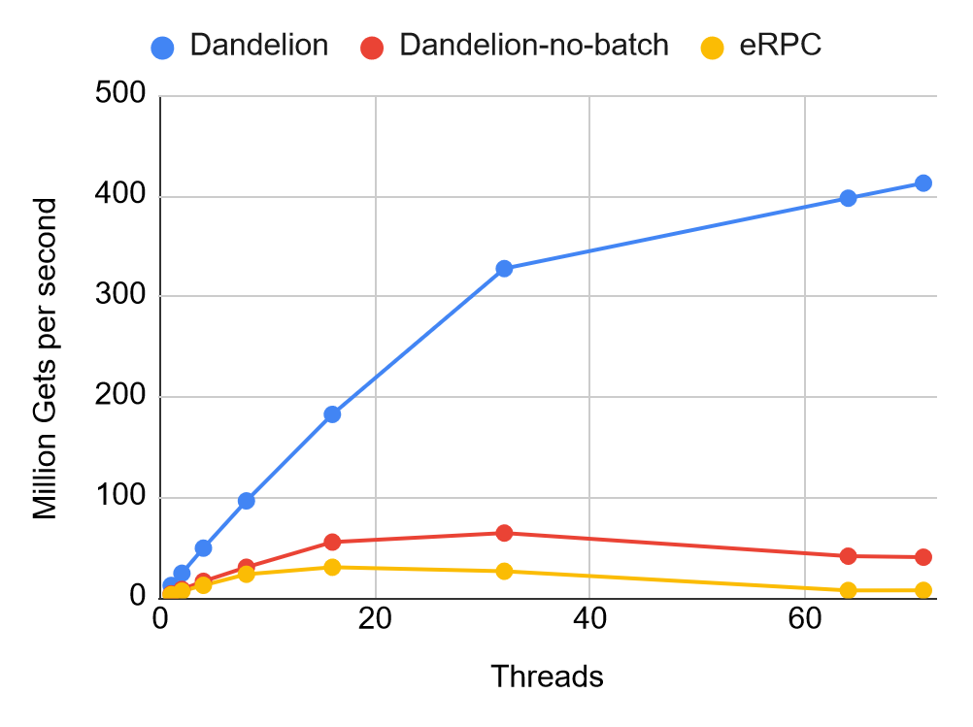
Dandelion networking vs. eRPC
2 client machines send Get requests to a KVS machine (over 100Gbps mlx5 RoCE).
Request = 8B Key Response = 24B Value
Dandelion can batch 10s requests in same packet
>10x
Batching
2-4x
Low level network
Optimizations
Dandelion networking 10 - 40x KVS requests / sec vs. eRPC

Slide 15
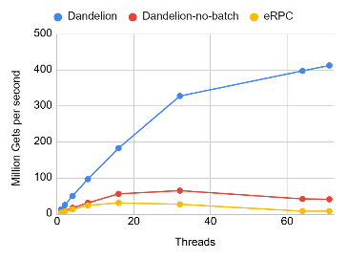
Dandelion: Four Key Building Blocks
Transactional Protocol
Skeleton (3 novel protocols)
Distributed and single-node
Recovery Protocol
Recover txs after fault
Correctness verified
Transactional Protocol
Skeleton (3 novel protocols)
Distributed and single-node
Recovery Protocol
Recover txs after fault
Correctness verified
Network
RPCs-over-RDMA
Datastore-optimized
Data structures
Hashtable
B+tree (in progress)

Slide 16
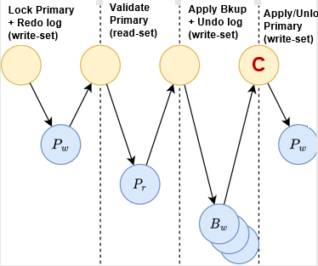
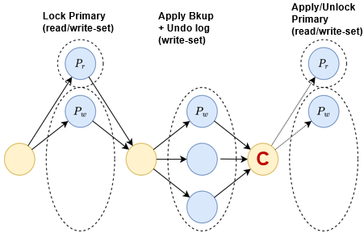
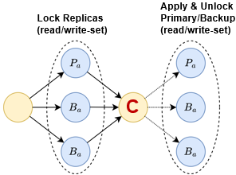
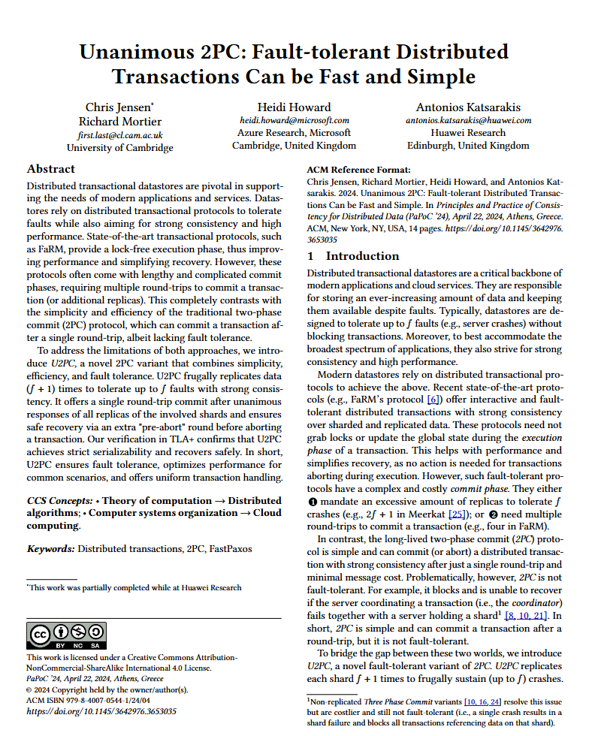
Distributed Reliable Transactions
3 RTTs (to commit)
Easy to implement multiple protocols efficiently in Dandelion
3 Novel Fast Reliable Protocols: latency, throughput, lock-window ...
High availability
Efficient logging: mix of redo/undo, no need for truncation
Decentralized recovery: simple & same across protocols
Strongest consistency: Correctness verified in TLA+
High performance
Lock-free execution phase (+ caching) neither reads nor writes grab locks → programmability, performance, simple recovery
Fast reliable commit (+ replicate) phase
read-only / write-only txs: 1RTT
read/write txs: 1RTT – 3RTTs (based on protocol)
2 RTTs
1 RTT
[PAPOC`24]
Is that all …?
First protocol (u2PC):
distributed lock-free execution +
1 RTT strictly-serializable fault-tolerant commit

Slide 17
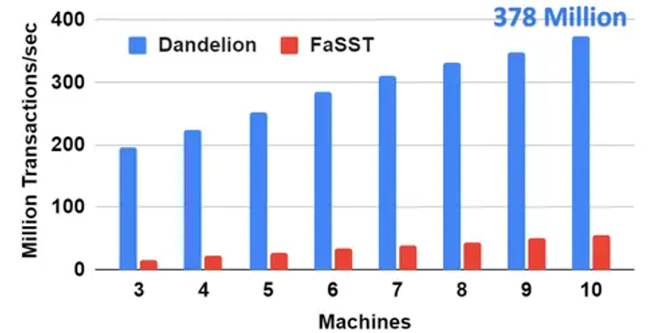
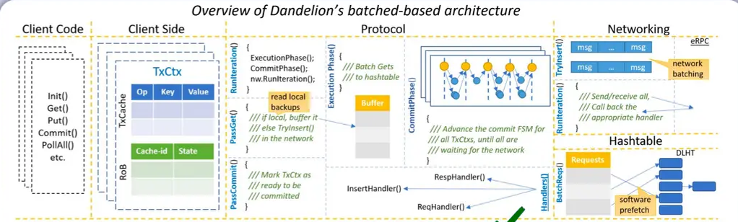
Dandelion: Four + 1 Key Building Blocks
Execution Engine
end-to-end asynchronous & batched based → avoids wasting CPU cycles
Performance (3-way replicated, 5 shards, 5 nodes) TATP: >50M txs/sec per node → >20x over Microsoft’s FaRM
Smallbank: 20M txs/sec per node
Transactional Protocol
Skeleton (3 novel protocols)
Distributed and single-node
Recovery Protocol
Recover txs after fault
Correctness verified
Network
RPCs-over-RDMA
Datastore-optimized
Data structures
Hashtable
B+tree (in progress)
Key ideas: across-stack innovation + SW-HW co-design + async batched OLTP (more like OLAP)
→ max HW utilization and performance! … Let’s summarize.

Slide 18
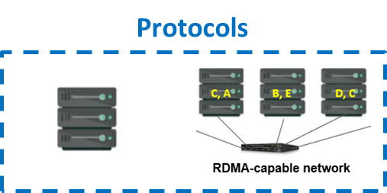
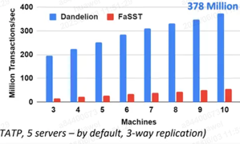
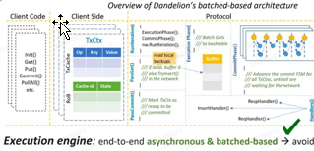
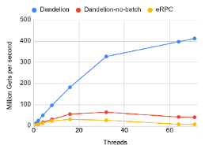
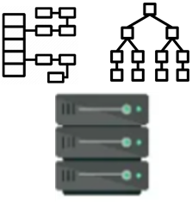
Dandelion Summary
Modern Datastores: e.g. Microsoft FaRM [SOSP’15, SIGMOD '19]
Scalable, good perf., transactions, consistency, availability
- In-memory storage
- Fast (RDMA) network
- FaRM ➔ 140M TATP txs/sec (90 machines – 5TB)
Next-gen Datastores: academia + Dandelion’s goal
Better performance, less cost, higher capacity
- HW acceleration: FPGA, ASICs, smart NICs/switches
- UB, CXL expansion, Disaggregated memory, PMEM
- More memory with less compute ➔ 5-40TB in 5-10 machines
10x leap,
calls redesign
Challenge: Can we achieve better performance with 10x fewer machines (compute) ?
Execution Engine
end-to-end asynchronous & batched based → avoids wasting CPU cycles
- >250M single-server serializable multi-key txs/sec
- >50M distributed high avail. txs/sec per server (>20x Microsoft FaRM)
- u2PC: First protocol → lock-free execution + 1RTT commit
Transactional Protocols
3 protocols → lock-free execution phase + fast commit (1-3RTTs)
Recovery
SC + FT
Decentralized
TLA+ verified
Network
RPCs-over-RDMA
Datastore-optimized
Data structures
Hashtable (DLHT)
B+tree (DLTree)
- Programmability of eRPC [NSDI’19 – best paper]
- >10x throughput vs. eRPC
- Fastest lock-free Hahstable →
easy persistency, HW acceleration > 2B in-memory reqs/sec random accesses over GBs of data
Great output … One more thing: Dandelion’s building blocks also benefit numerous use-cases!

Slide 19
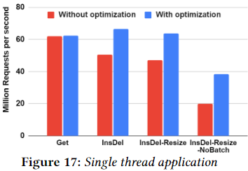
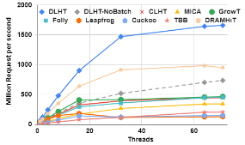
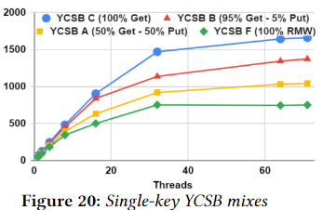
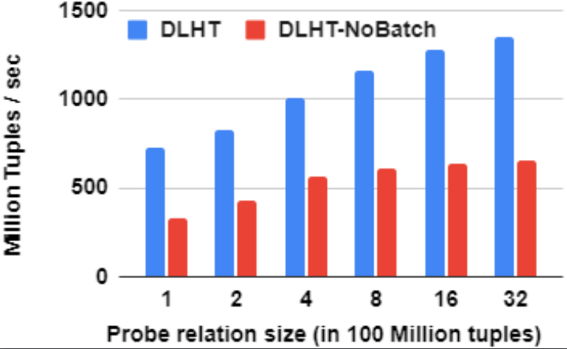
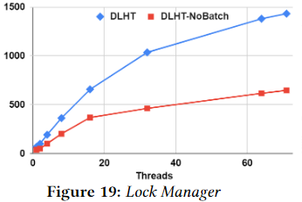
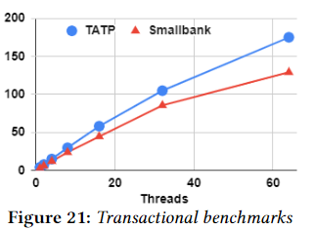
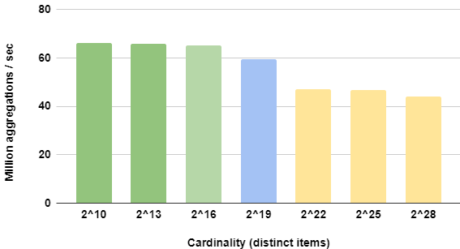

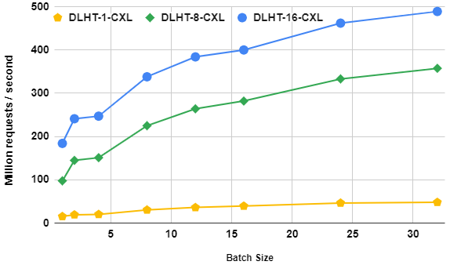
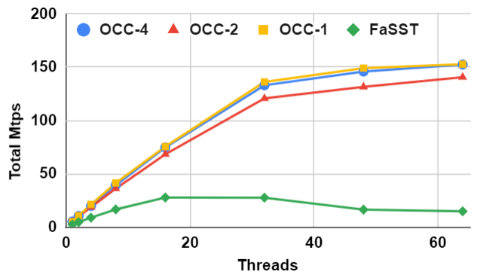
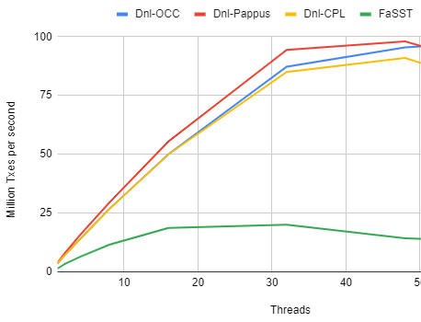
Dandelion’s lighting fast use-cases (single-node & distributed)
Fast map for Single-threaded app
In-memory caching
Single node in-memory storage
OLAP (Joins, Aggregation, etc.)
DB Lock manager
Single-node OLTP Transactions
Large slower memory: UB/CXL/NVM/Far memory
Remote KVS
Replicated in-memory storage
Distributed reliable Transactions
Dandelion building blocks: internally in OLAP, OLTP, HTAGAP & embedded → server → clusters

Slide 20
Dandelion Summary
Modern Datastores: e.g. Microsoft FaRM [SOSP’15, SIGMOD '19]
Scalable, good perf., transactions, consistency, availability
- In-memory storage
- Fast (RDMA) network
- FaRM ➔ 140M TATP txs/sec (90 machines – 5TB)
Next-gen Datastores: academia + Dandelion’s goal
Better performance, less cost, higher capacity
- HW acceleration: FPGA, ASICs, smart NICs/switches
- UB, CXL expansion, Disaggregated memory, PMEM
- More memory with less compute ➔ 5-40TB in 5-10 machines
10x leap,
calls redesign
Challenge: Can we achieve better performance with 10x fewer machines (compute) ?
Execution Engine
end-to-end asynchronous & batched based → avoids wasting CPU cycles
- >250M single-server serializable multi-key txs/sec
- >50M distributed high avail. txs/sec per server (>20x Microsoft FaRM)
- u2PC: First protocol → lock-free execution + 1RTT commit
Transactional Protocols
3 protocols → lock-free execution phase + fast commit (1-3RTTs)
Recovery
SC + FT
Decentralized
TLA+ verified
Network
RPCs-over-RDMA
Datastore-optimized
Data structures
Hashtable (DLHT)
B+tree (DLTree)
- Programmability of eRPC [NSDI’19 – best paper]
- >10x throughput vs. eRPC
- Fastest lock-free Hahstable →
easy persistency, HW acceleration > 2B in-memory reqs/sec random accesses over GBs of data
More dandelion-datastore.com
Thanks! Questions?

Slide 21



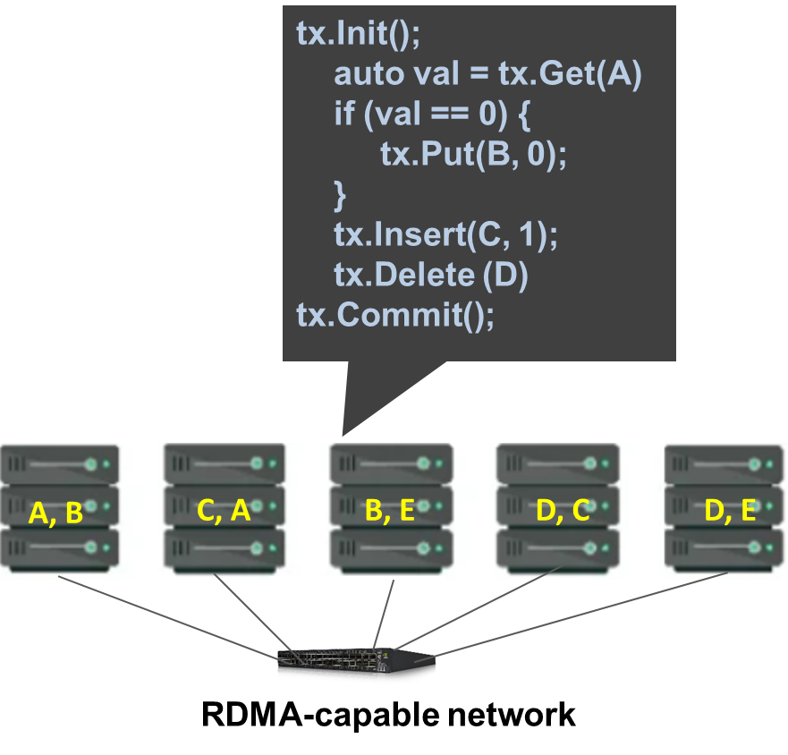
Some of DLHT’s use-cases
Next-gen Graph DB (HTAGAP)
target: routers & switches (weak CPU, small memory)
usage: in-memory storage, caching, lock-manager
Next-gen OLAP (GaussDB)
- target: single- & multi-node relational analytics
- usage: hash joins, hash aggregations
Next-gen OLTP (Dandelion)
- target: distributed fault-tolerant txns on emerging HW
- usage: in-memory transactional storage

Slide 22

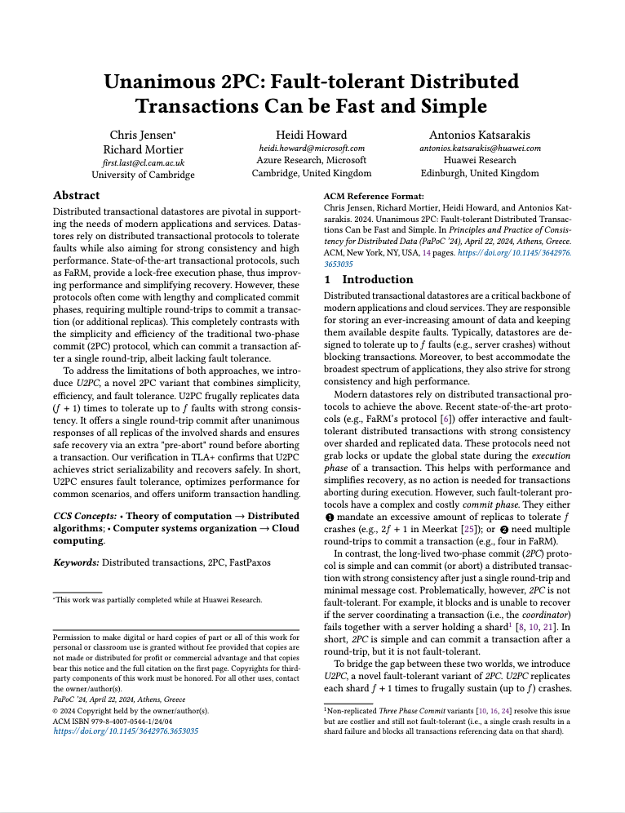
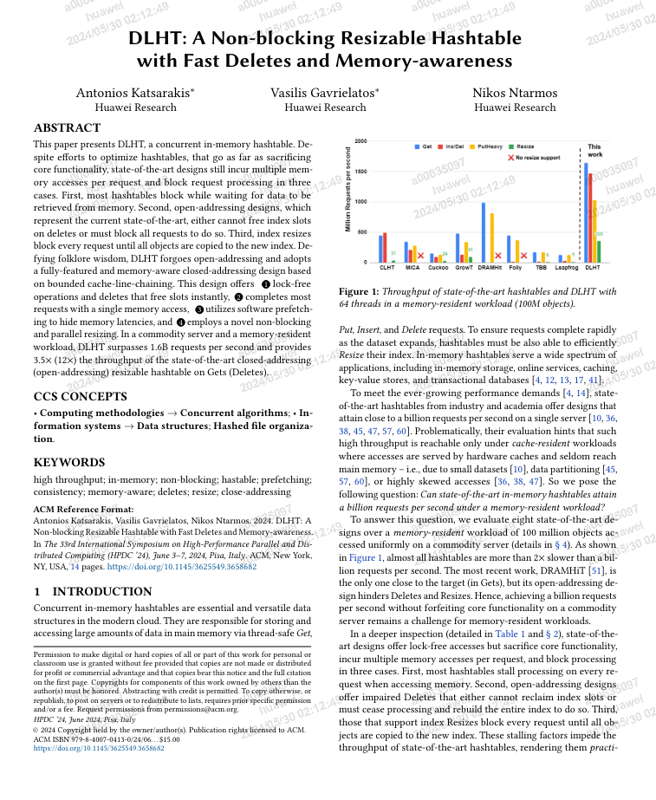
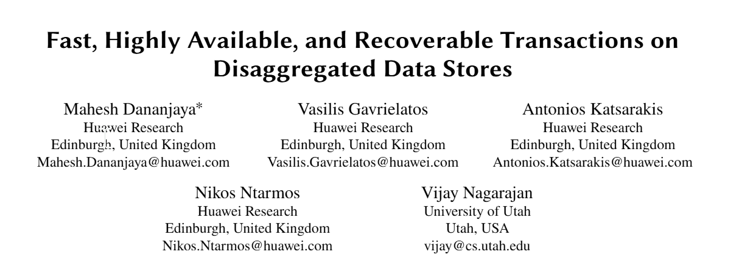
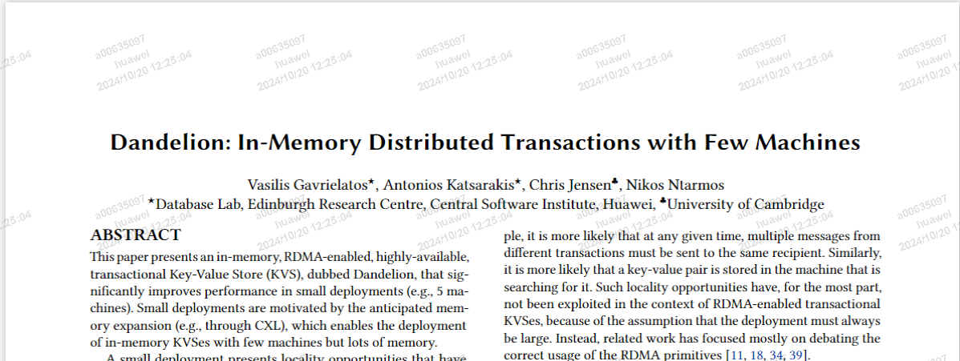
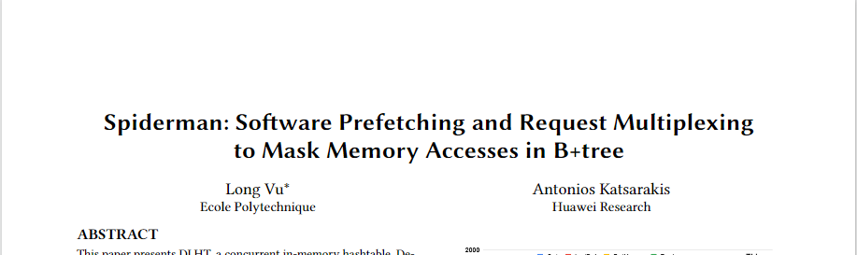
Summary of Dandelion
Modern Datastores: e.g. Microsoft FaRM [SOSP’15, SIGMOD '19]
Scalable, good perf., transactions, consistency, availability
- In-memory storage
- Fast (RDMA) network
- FaRM ➔ 140M TATP txs/sec (90 machines – 5TB)
Next-gen Datastores: academia + Dandelion’s goal
Better performance, less cost, higher capacity
- HW acceleration: FPGA, ASICs, smart NICs/switches
- UB, CXL expansion, Disaggregated memory, PMEM
- More memory with less compute ➔ 5-40TB in 5-10 machines
10x leap,
calls redesign
Challenge: Can we achieve better performance with 10x fewer machines (compute) ?
Execution Engine
end-to-end asynchronous & batched based → avoids wasting CPU cycles
- >250M single-server serializable multi-key txs/sec
- >50M distributed high avail. txs/sec per server (>20x Microsoft FaRM)
- u2PC: First protocol → lock-free execution + 1RTT commit
Transactional Protocols
3 protocols → lock-free execution phase + fast commit (1-3RTTs)
Recovery
SC + FT
Decentralized
TLA+ verified
[HPDC’24]
[Global UG Award]
[PaPoC’24]
[EDBT’25]
[VLDB’25]
Network
RPCs-over-RDMA
Datastore-optimized
Data structures
Hashtable (DLHT)
B+tree (DLTree)
[Eurosys’25 – best poster nominee]
- Programmability of eRPC [NSDI’19 – best paper]
- >10x throughput vs. eRPC
- Fastest lock-free Hahstable →
easy persistency, HW acceleration > 2B in-memory reqs/sec random accesses over GBs of data
Great output … One more thing: Dandelion’s building blocks also benefit numerous use-cases!

Slide 23
Distributed Reliable Transactions
3 RTTs (to commit)
Easy to implement multiple protocols efficiently in Dandelion
3 Novel Fast Reliable Protocols: latency, xPut, lock-window ...
Efficient logging: mix of redo/undo, no need for truncation
Decentralized recovery: simple and common across protocols
Strongest consistency, Correctness: verified in TLA+
High performance Lock-free execution phase (+ caching) neither reads nor writes grab locks → programmability, performance, simple recovery Fast reliable commit phase - read-only / write-only txs: 1RTT - read/write txs: 1RTT – 3RTTs (based on protocol)
2 RTTs
Performance (3-way replicated, 5 shards, 5 nodes) TATP: >50M txs/sec per node → >20x over Microsoft’s FaRM
Smallbank: 20M txs/sec per node
1 RTT
[PAPOC`24]
Is that all …?
First protocol (u2PC):
distributed lock-free exec
+ 1 RTT SC FT commit

Slide 24
Dandelion: Four + 1 Key Building Blocks
Execution Engine
end-to-end asynchronous & batched based → avoids wasting CPU cycles
Transactional Protocol
Skeleton (3 novel protocols)
Distributed and single-node
Recovery Protocol
Recover txs after fault
Correctness verified
Network
RPCs-over-RDMA
Datastore-optimized
Data structures
Hashtable
B+tree (in progress)
Key idea: OLTP more like OLAP → max HW utilization! … Let’s summarize.

Slide 25
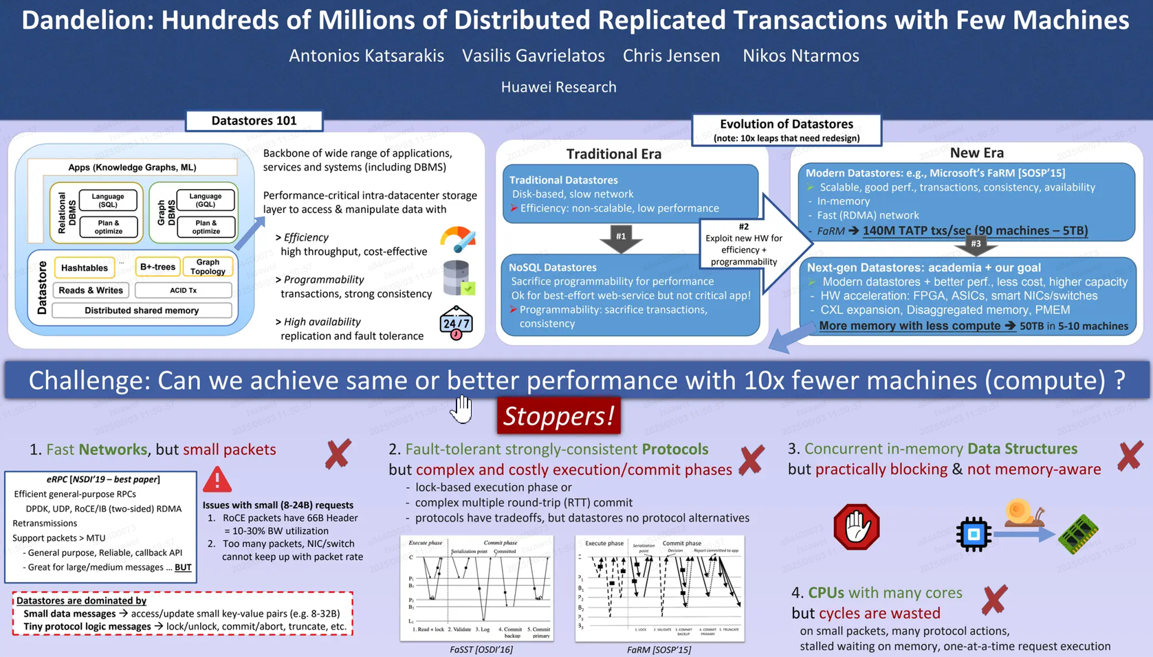

Slide 26
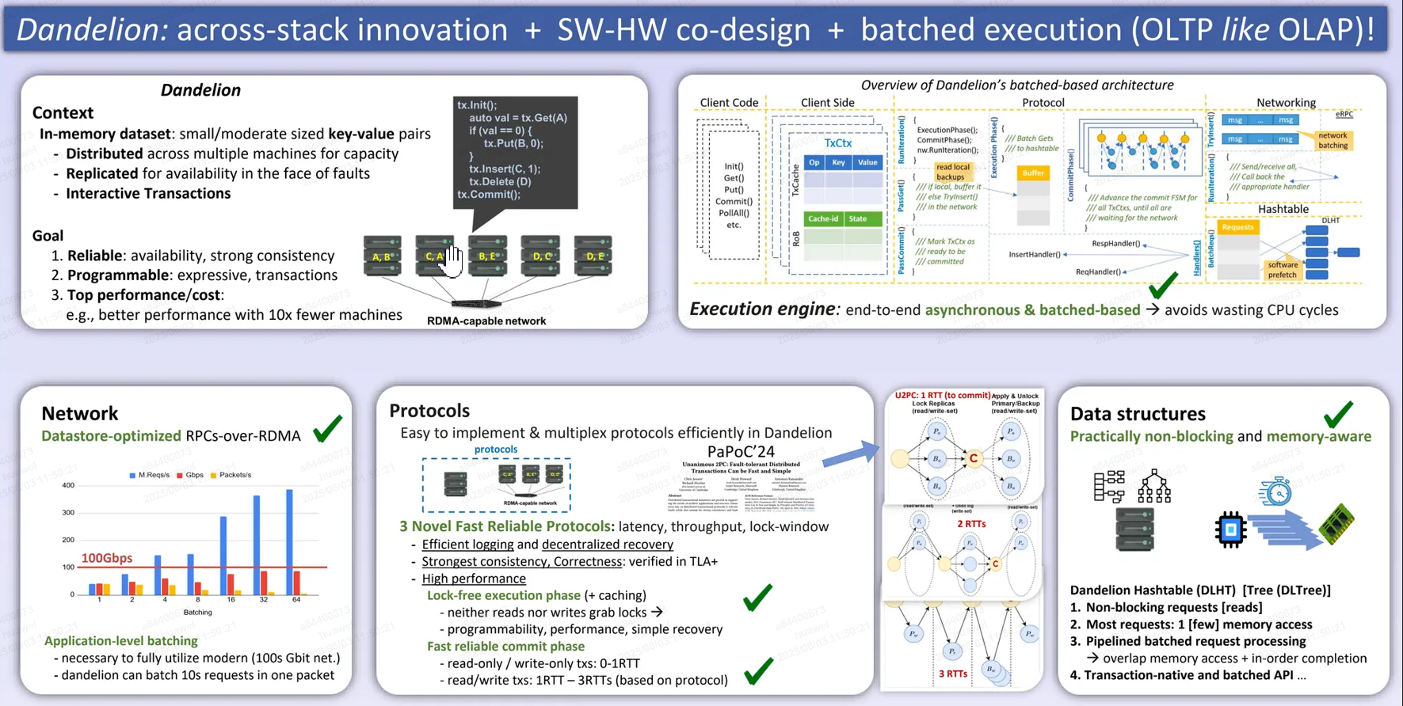

Slide 27
