Slide 1
Dandelion Hashtable A non-blocking resizable hashtable with fast deletes & memory-awareness
Beyond billion requests per second
on a commodity server
Antonios Katsarakis, Vasilis Gavrielatos, Nikos Ntarmos
Huawei Research, Edinburgh UK
High performance Distributed Computed (HPDC’24)

Slide 2


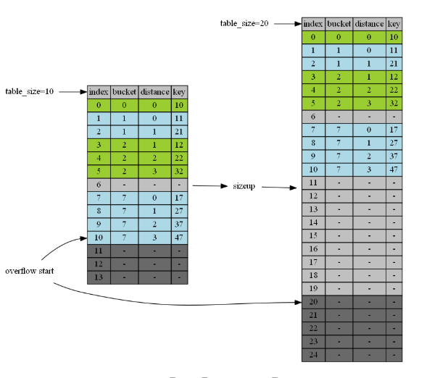
Concurrent growing hashtables
Ubiquitous in todays cloud and HPC
caching, in-memory storage, key-value stores,
transactional and analytical DBs, bioinformatics, …
Store large amounts of data
as <Key, Value> (KV) pairs
Offer thread-safe Gets, Puts, Inserts, Deletes
+ index Resizes to grow capacity vertically
Notes:
Let me start by saying that recent
Distributed Datastores keep data in-memory while offering a read/write API.
Such datastores consist the backbone of modern online services,
which are latency-sensitive and must serve numerous concurrent requests.
As a result, distributed datastores must offer high-performance.
Furthermore, because datastores are deployed over commodity
failure prone h/w they must also be able to tolerate faults.
This mandates data replication

Slide 3
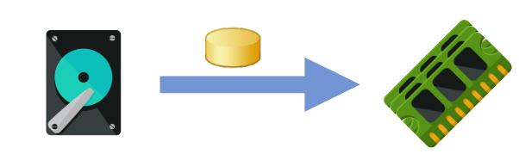
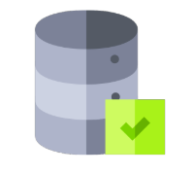

Modern hashtables
Keep data in-memory
Ensure strong consistency
Exploit concurrency to deliver
high throughput needs of modern services
How fast is the state-of-the-art?
Notes:
Let me start by saying that recent
Distributed Datastores keep data in-memory while offering a read/write API.
Such datastores consist the backbone of modern online services,
which are latency-sensitive and must serve numerous concurrent requests.
As a result, distributed datastores must offer high-performance.
Furthermore, because datastores are deployed over commodity
failure prone h/w they must also be able to tolerate faults.
This mandates data replication

Slide 4

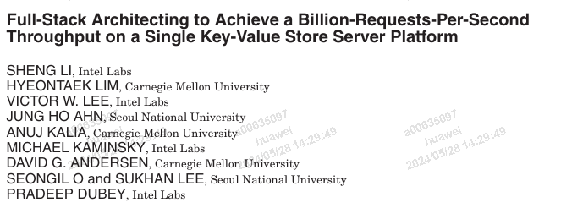
State-of-the-art performance
Throughput almost a billion requests per second !!
Problem: Such high throughput only on cache-resident workloads
where accesses served by h/w caches, seldom reach main memory
– e.g., evaluating high access skew or small datasets
What about larger (i.e. memory-resident) workloads?
Notes:
Let me start by saying that recent
Distributed Datastores keep data in-memory while offering a read/write API.
Such datastores consist the backbone of modern online services,
which are latency-sensitive and must serve numerous concurrent requests.
As a result, distributed datastores must offer high-performance.
Furthermore, because datastores are deployed over commodity
failure prone h/w they must also be able to tolerate faults.
This mandates data replication

Slide 5


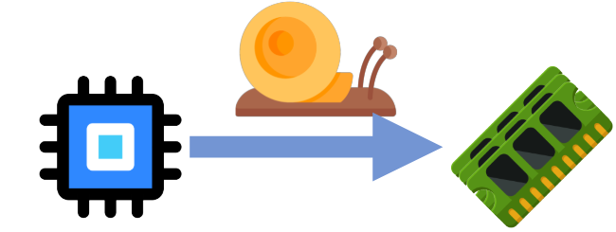
Deficiencies of state-of-the-art
Despite sacrificing functionality for performance, cannot maximize throughput in memory-resident workloads
Two issues
Concurrent but practically blocking → Lock-free Gets but blocks on several other occasions
In-memory but not memory-aware → Inefficient handling of memory accesses/utilization
Can you elaborate?
Notes:
Let me start by saying that recent
Distributed Datastores keep data in-memory while offering a read/write API.
Such datastores consist the backbone of modern online services,
which are latency-sensitive and must serve numerous concurrent requests.
As a result, distributed datastores must offer high-performance.
Furthermore, because datastores are deployed over commodity
failure prone h/w they must also be able to tolerate faults.
This mandates data replication

Slide 6
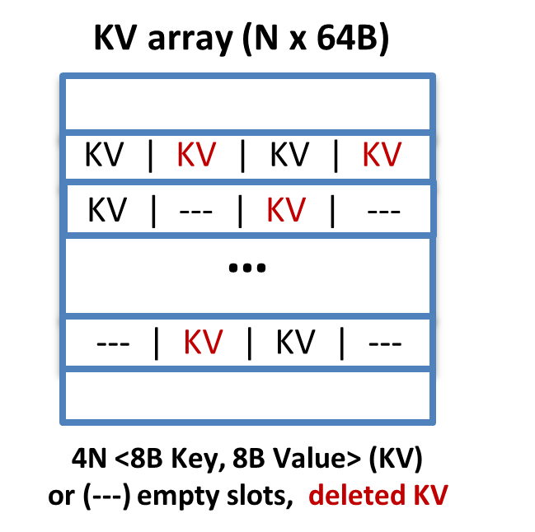
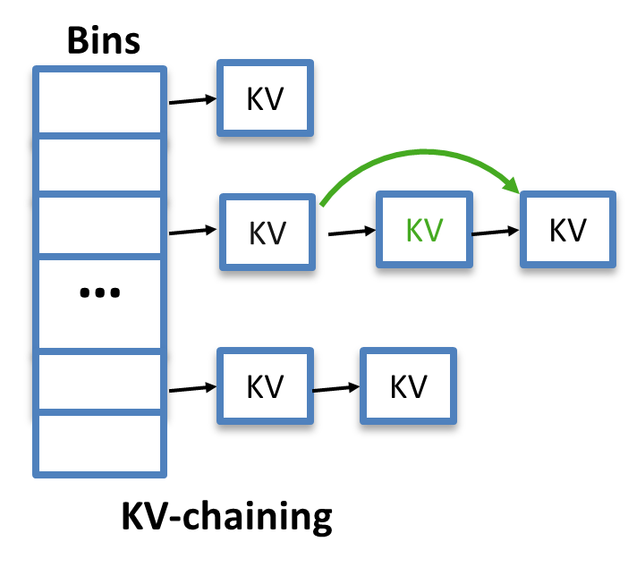
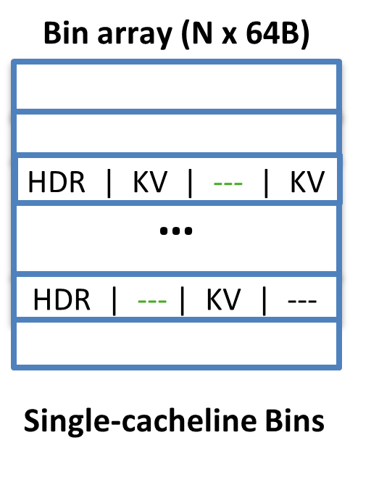
Closer look on state-of-the-art designs
Open addressing
1. Hash(key) to a slot
2. probe following slots until
find key or empty slot
Closed addressing
1. Hash(key) to a bin
2. search Bin for the key
→ One-to-one relation for a key and a Bin
Good occupancy
Low memory traffic: no pointer chasing
Deletes = tombstones → cannot free slots unless block all ops & copy KVs to new index
Easy deletes: rm from linked-list
Good occupancy
A lot of memory traffic too much pointer chasing!
Easy deletes: used slots in HDR Low memory traffic: no pointer chasing
Bad occupancy: must resize early after
4 collisions on any Bin!
For simplicity <8B keys, 8B values> KV pairs and efficient concurrent designs that can inline those in their index
Challenging tradeoff … is that all impacting performance?
Notes:
Let me start by saying that recent
Distributed Datastores keep data in-memory while offering a read/write API.
Such datastores consist the backbone of modern online services,
which are latency-sensitive and must serve numerous concurrent requests.
As a result, distributed datastores must offer high-performance.
Furthermore, because datastores are deployed over commodity
failure prone h/w they must also be able to tolerate faults.
This mandates data replication

Slide 7
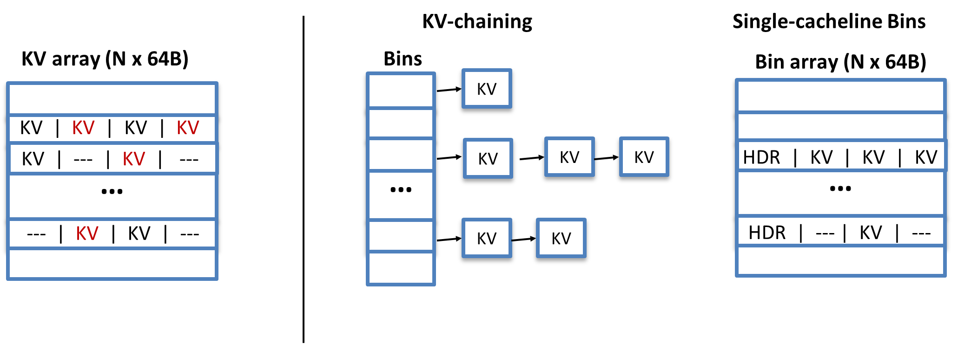
Issue: CPU stalls on each request
Insert(X, 3)
Get(C)
Delete(D)
Insert(X, 3)
Get(C)
Delete(D)
Regardless of scheme most hashtables stall the CPU on every request
(Get, Put, Insert, Delete) waiting one or more memory accesses
Cannot overlap memory accesses
→ each request blocks CPU waiting for memory!
Notes:
Let me start by saying that recent
Distributed Datastores keep data in-memory while offering a read/write API.
Such datastores consist the backbone of modern online services,
which are latency-sensitive and must serve numerous concurrent requests.
As a result, distributed datastores must offer high-performance.
Furthermore, because datastores are deployed over commodity
failure prone h/w they must also be able to tolerate faults.
This mandates data replication

Slide 8
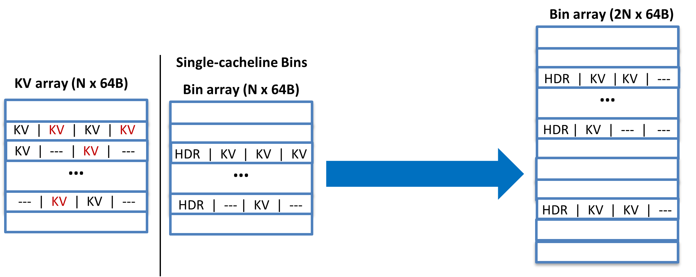
Another issue: resize is also blocking
Memory-resident hashtables = GBs of data → blocking for seconds!
Insert(X, 3)
Get(C)
Delete(D)
Hashtables optimizing for memory accesses and common case (i.e. when not resizing)
stall all requests until all KV pairs are copied to the new index when resizing.
To recap …
Notes:
Let me start by saying that recent
Distributed Datastores keep data in-memory while offering a read/write API.
Such datastores consist the backbone of modern online services,
which are latency-sensitive and must serve numerous concurrent requests.
As a result, distributed datastores must offer high-performance.
Furthermore, because datastores are deployed over commodity
failure prone h/w they must also be able to tolerate faults.
This mandates data replication

Slide 9
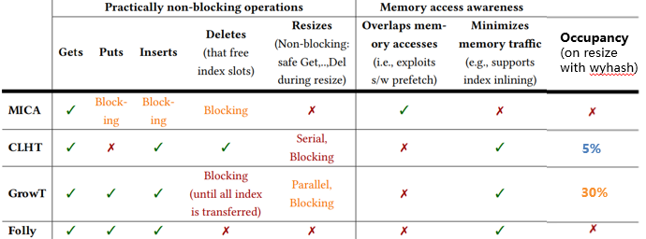
Fastest concurrent in-memory hashtables
Sacrifice functionality or blocking ops
Not memory-aware
To resolve these issues we designed the Dandelion Hashtable …
Notes:
TODO add DRAMHiT

Slide 10
Dandelion Hashtable (DLHT)
Highly concurrent + cache-friendly → scalable to many threads
Non-blocking index operations: Gets, Puts, Inserts, Deletes – that immediately free slots
Non-blocking parallel resizes
concurrent ops complete with strongest consistency while other threads resize
Memory-aware
good occupancy min memory accesses: ~1x access per request
masked memory latency: to avoid CPU stalling
Beyond fully-featured
transactions, iterator, namespaces, variable-sized KVs, GC, snapshots, etc.
What’s the secret sauce?
Notes:
Let me start by saying that recent
Distributed Datastores keep data in-memory while offering a read/write API.
Such datastores consist the backbone of modern online services,
which are latency-sensitive and must serve numerous concurrent requests.
As a result, distributed datastores must offer high-performance.
Furthermore, because datastores are deployed over commodity
failure prone h/w they must also be able to tolerate faults.
This mandates data replication

Slide 11
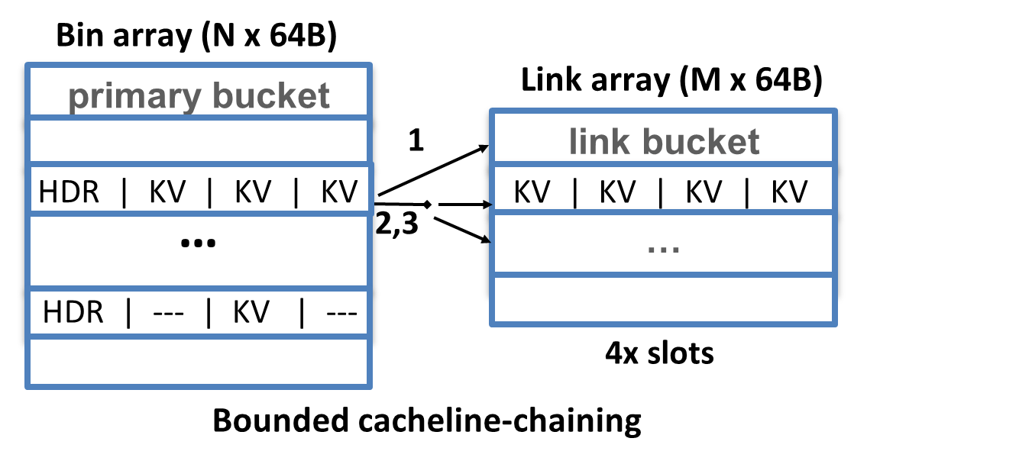
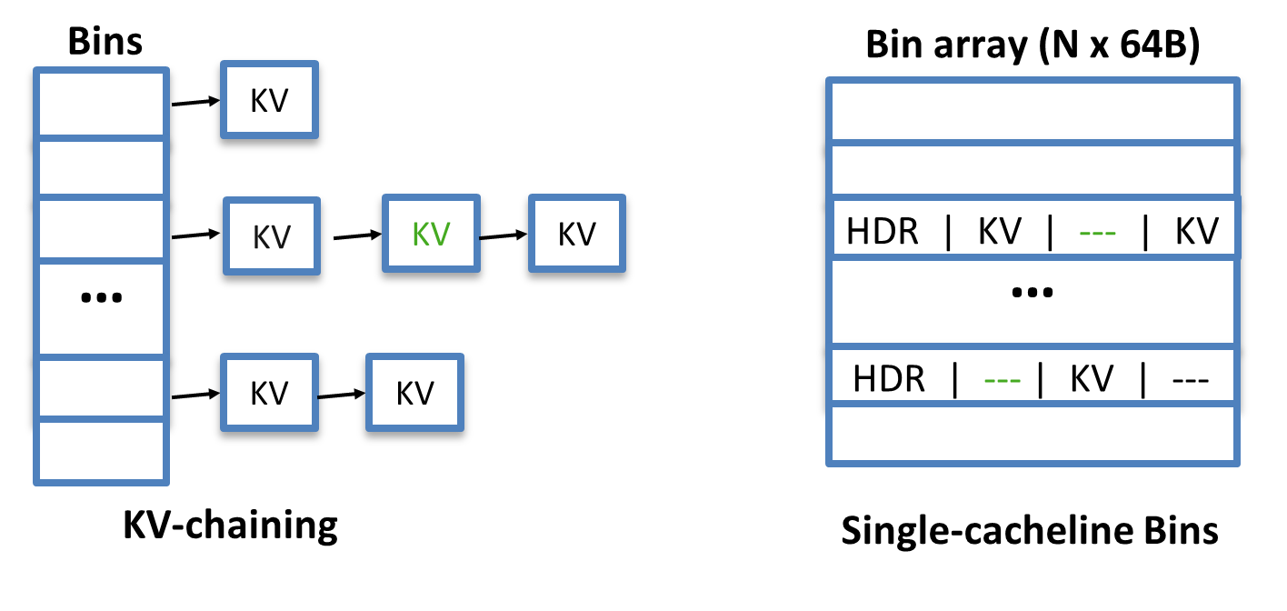
DLHT’s bounded cacheline chaining
Open addressing
Close addressing
Good occupancy
Too much memory traffic
Low memory traffic
Bad occupancy
1. No open addressing to avoid severe blocking on deletes
2. Rethinks closed addressing →
Bounded cacheline-chaining = best of KV-chaining + Single-cacheline Bins
- Cacheline Bins + can link up to 3 extra buckets from Link Array → delays resize for high occupancy
- Link array << Bin array (e.g. 4x or 8x smaller)
Most bins consist of one bucket → most requests = 1 memory access
- If all Link array buckets are linked → non-blocking resize (details next)
Notes:
Let me start by saying that recent
Distributed Datastores keep data in-memory while offering a read/write API.
Such datastores consist the backbone of modern online services,
which are latency-sensitive and must serve numerous concurrent requests.
As a result, distributed datastores must offer high-performance.
Furthermore, because datastores are deployed over commodity
failure prone h/w they must also be able to tolerate faults.
This mandates data replication

Slide 12
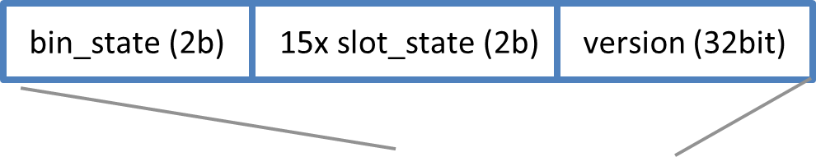
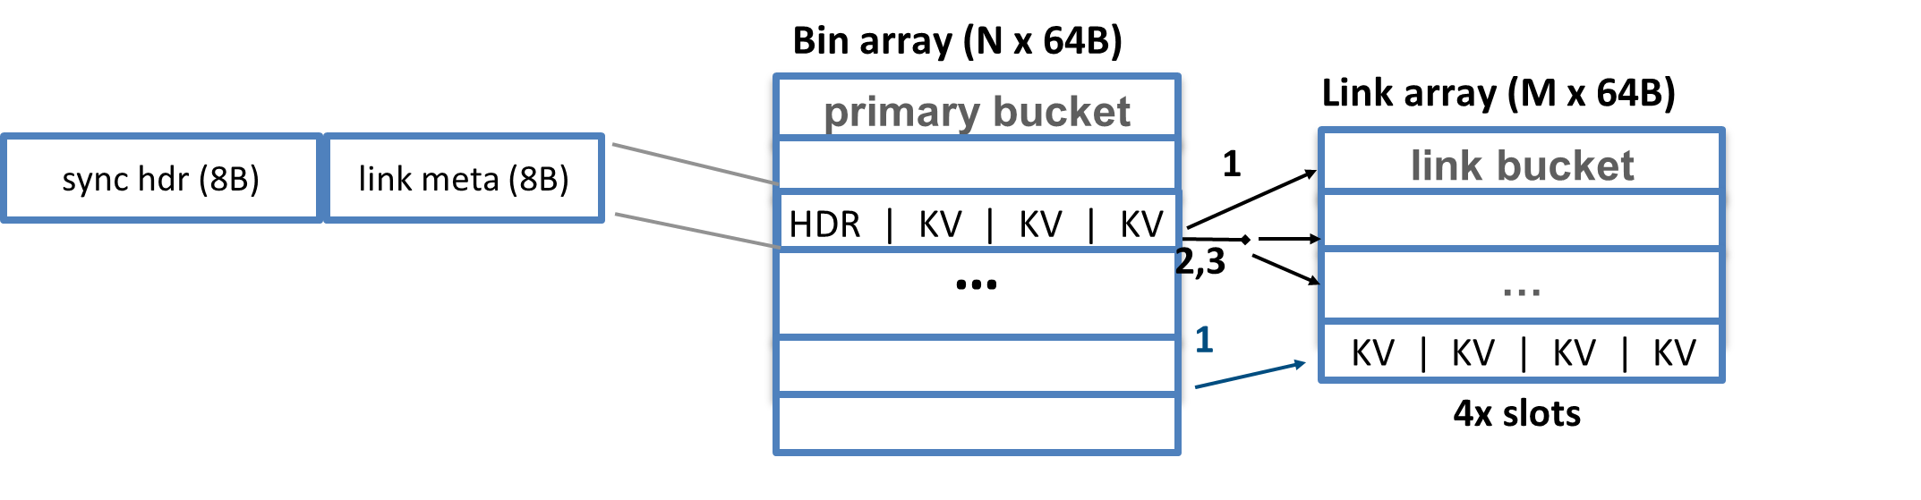
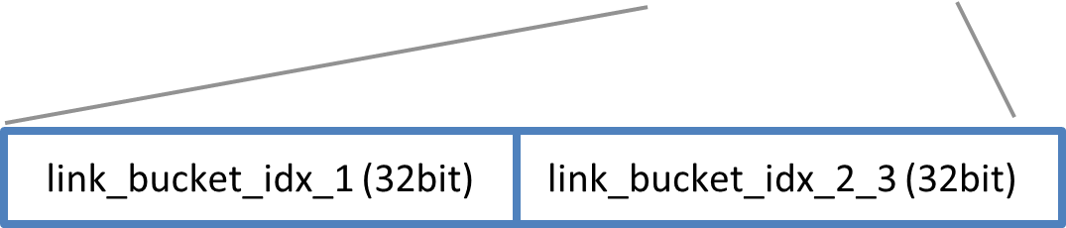
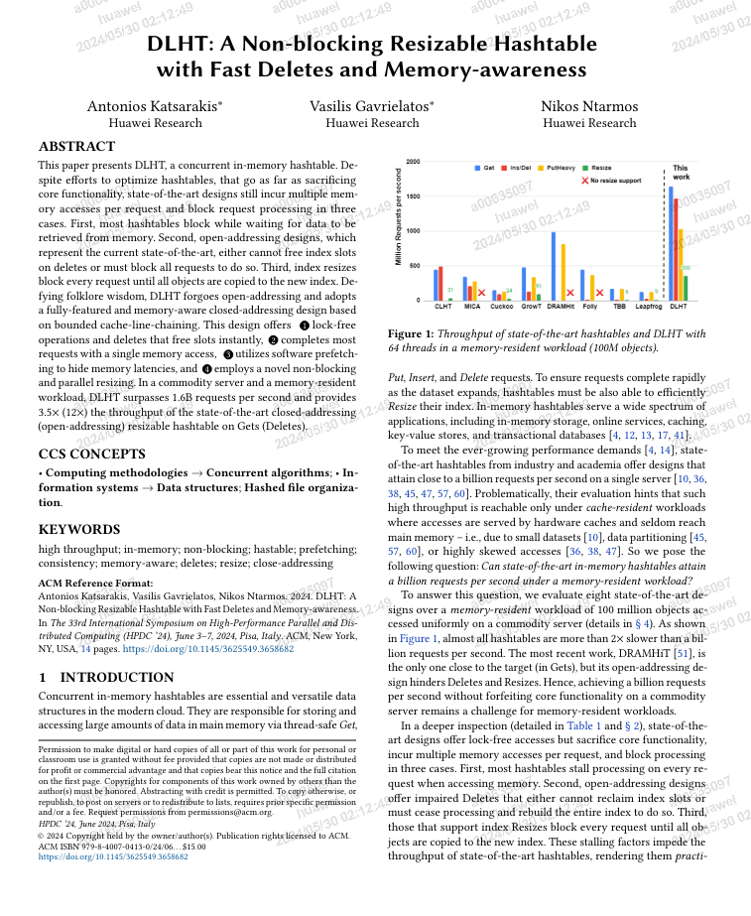
Compact bin header
3. Compact Bin Header (HDR): consists of <8B sync hdr, 8B link meta>
Link meta: 2x 32bit offsets to Link array idx_1: 1st linked bucket idx_2_and_3: 2nd and 3rd consecutive in link array buckets
Fitting all synchronization state in 8B <bin state, 15 slot states, version> enables lock-free index operations (Get, Put, Insert, Delete)
and practically non-blocking Resizes
See paper for lock-free index ops … Let’s look on resizing together!
Notes:
Let me start by saying that recent
Distributed Datastores keep data in-memory while offering a read/write API.
Such datastores consist the backbone of modern online services,
which are latency-sensitive and must serve numerous concurrent requests.
As a result, distributed datastores must offer high-performance.
Furthermore, because datastores are deployed over commodity
failure prone h/w they must also be able to tolerate faults.
This mandates data replication

Slide 13
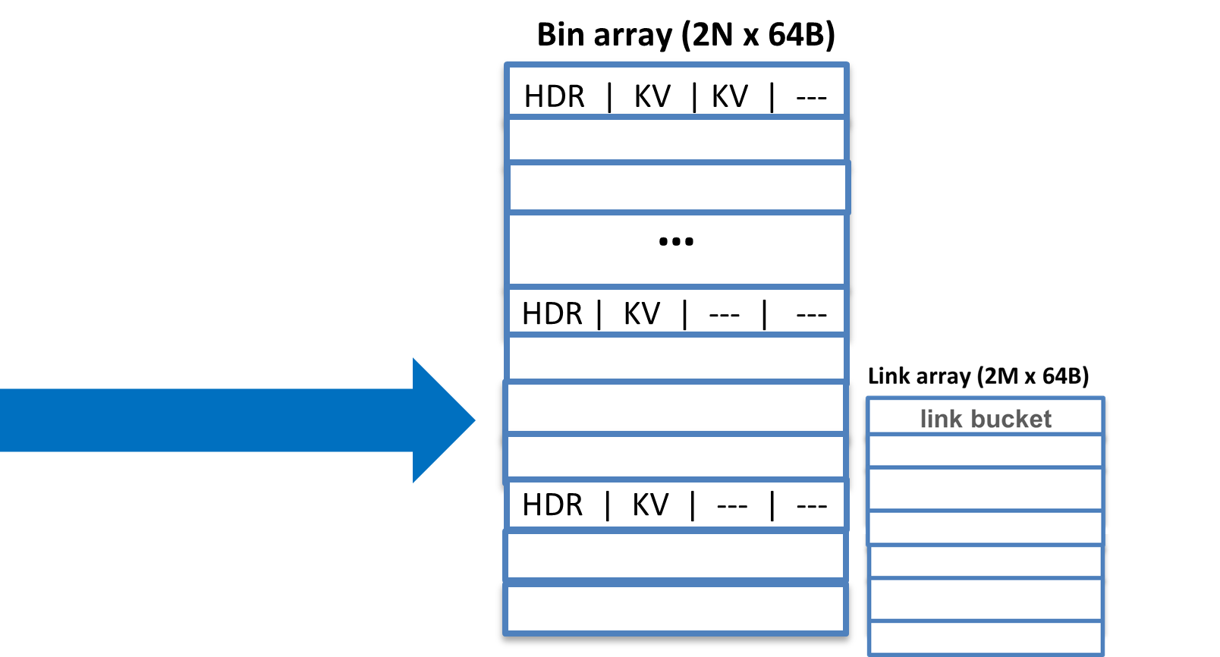
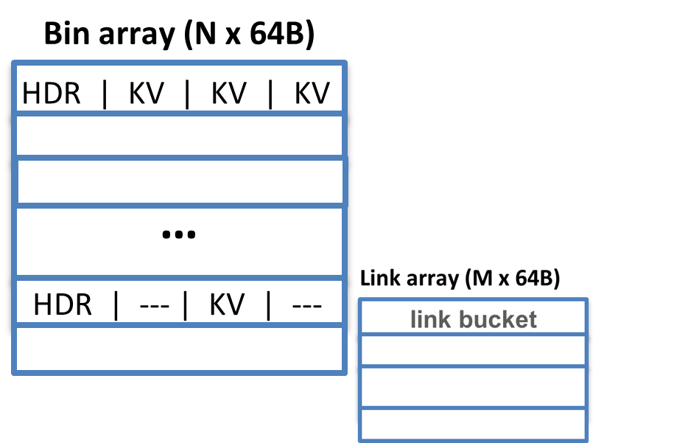
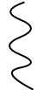

Practically non-blocking resize
Get(X)
Insert(X, 3)
Bin_state: TransferDone
Get(X)
Insert(X, 3)
Get(Y)
Bin_state: NoTransfer
No free link buckets
Index resize: triggered by Inserts if 1) all 15 slots of a bin are filled or 2) no free buckets to link.
Parallel resize: index broken in chunks (e.g. 16K bins)→Resize threads collaborate with min synchronization. Each resizing thread picks a not-yet-transferred chunk to transfer.
Non-blocking ops: Blocking all ops for whole resize (GBs of data) Ops wait at most related (one) bin transfer. If another Insert needs resize, it joins effort of resizing.
Recall each bin has a bin state in sync meta → NoTransfer, InTransfer, and TransferDone.
To transfer a chunk a thread transfers all its Bins one-by-one:
1) bin_state = InTransfer 2) transfer all bin’s slots to new index 3) bin_state = TransferDone
Ops always check the bin state. if NoTransfer proceed in current/old index.
If InTransfer they wait until TransferDone to perform their op in new index.
Cool! What about the issue of CPU stalling on memory accesses?
Notes:
Let me start by saying that recent
Distributed Datastores keep data in-memory while offering a read/write API.
Such datastores consist the backbone of modern online services,
which are latency-sensitive and must serve numerous concurrent requests.
As a result, distributed datastores must offer high-performance.
Furthermore, because datastores are deployed over commodity
failure prone h/w they must also be able to tolerate faults.
This mandates data replication

Slide 14

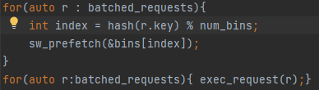


Overlapping memory accesses
In-order
batch
Insert(X, 3)
Insert(X, 3)
Get(C)
Get(C)
Delete(D)
Delete(D)
4. Pipelined batched processing
In DLHT that minimizes memory accesses via a batched API, we can easily pipeline requests + exploit software prefetching
→ overlap memory accesses to bins
– while ensuring in-order request completion
Insert(X, 3)
Get(C)
Delete(D)
Stalls CPU on every request waiting
one or more memory accesses
Reality check: Do all these translate into performance?
Notes:
Let me start by saying that recent
Distributed Datastores keep data in-memory while offering a read/write API.
Such datastores consist the backbone of modern online services,
which are latency-sensitive and must serve numerous concurrent requests.
As a result, distributed datastores must offer high-performance.
Furthermore, because datastores are deployed over commodity
failure prone h/w they must also be able to tolerate faults.
This mandates data replication

Slide 15
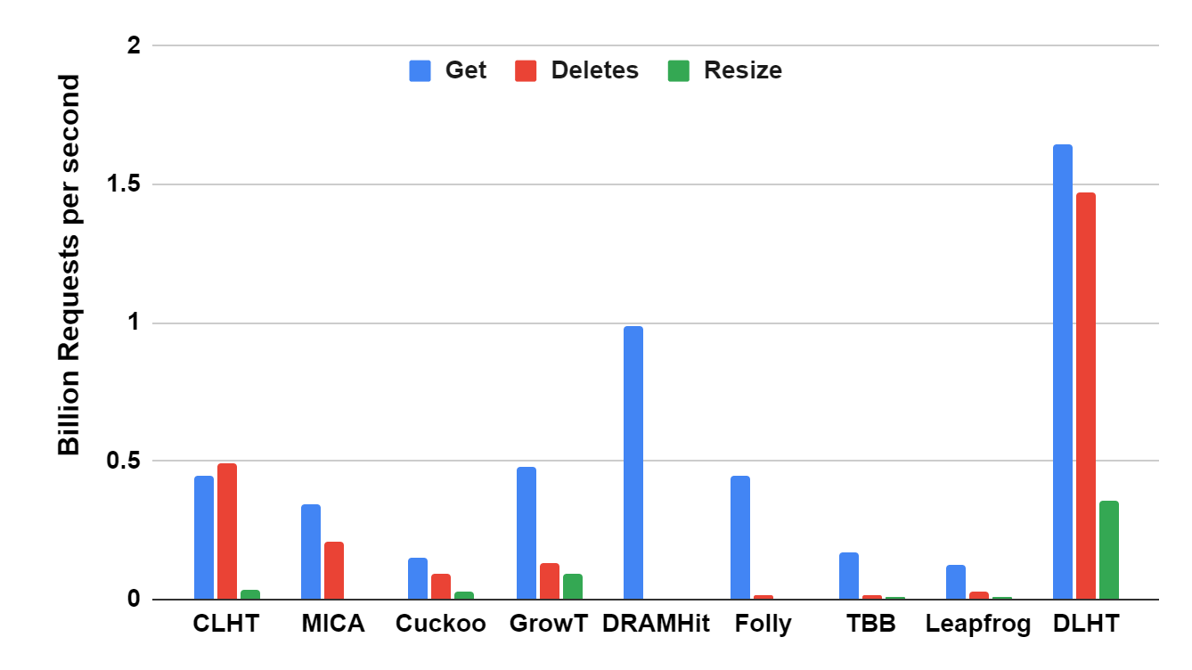


Performance across the board
Ins/Del
Not supported
1.7x
3.5x
12x
3.9x
close addressing
open addressing
open addressing with dels
& fastest growing
See paper for many more results!
Commodity server: 18-core Intel Xeon Gold 6254 (2 sockets), 8x 32GB DDR4-2933
Workload: 4GB memory-resident, random access

Slide 16


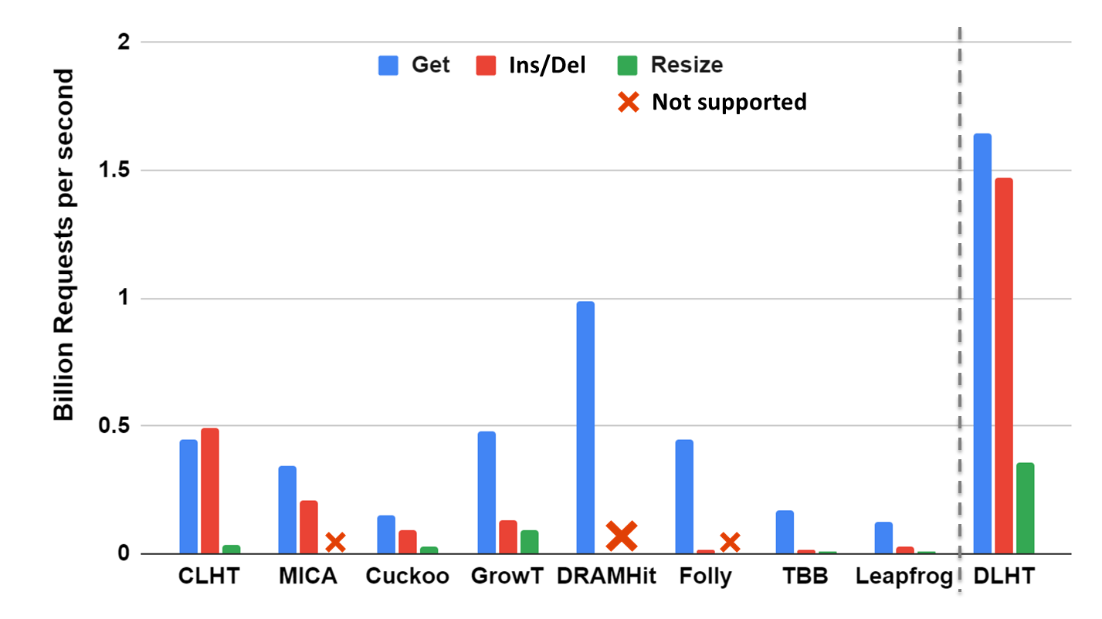
To conclude
State-of-the-art concurrent in-memory hashtables Sacrifice core functionality for performance
→ still practically blocking + not memory-aware
DLHT
No open addressing → no severe blocking on deletes
Closed addressing via bounded cacheline chaining
→ High occupancy + Most requests: 1 memory access
Memory compact bin header
→ Lock-free operations + parallel non-blocking resizes
Pipelined batched request processing
→ overlap memory access + in-order completion
Beyond fully-featured (see paper): hashset, transactions, namespaces, GC, variable sizes, iterators, snapshots, etc..
Memory-resident workload performance
Surpassing 1.6 Billion in-memory rps
3.5x Gets (12x Dels) vs. fastest closed (open) addressing
3.9x faster resizes vs. fastest growing hashtable
Open addressing
Thank you!! Questions?

Slide 17
Backup Slides

Slide 18
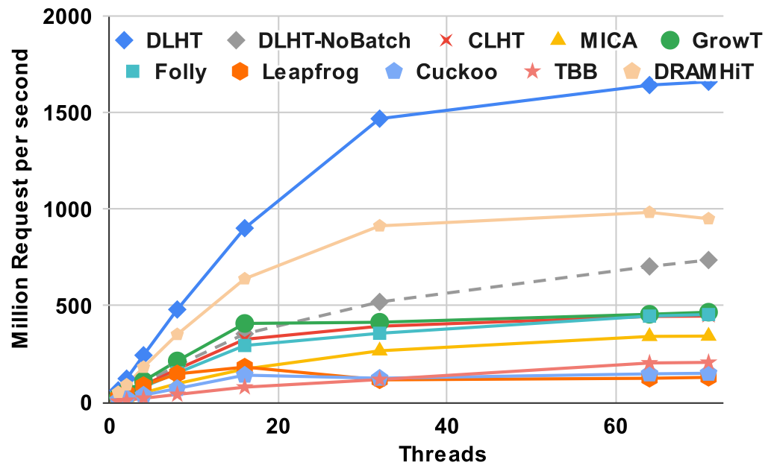
Get performance
Memory b/w bound → more dimms = higher throughput
1.7x
3.5x
Commodity server: 18-core Intel Xeon Gold 6254 (2 sockets), 8x 32GB DDR4-2933
Workload: >4GB random memory-resident

Slide 19
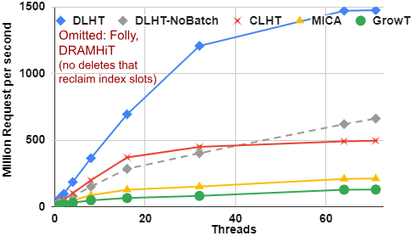
Insert-delete performance
12x
2.9x

Slide 20
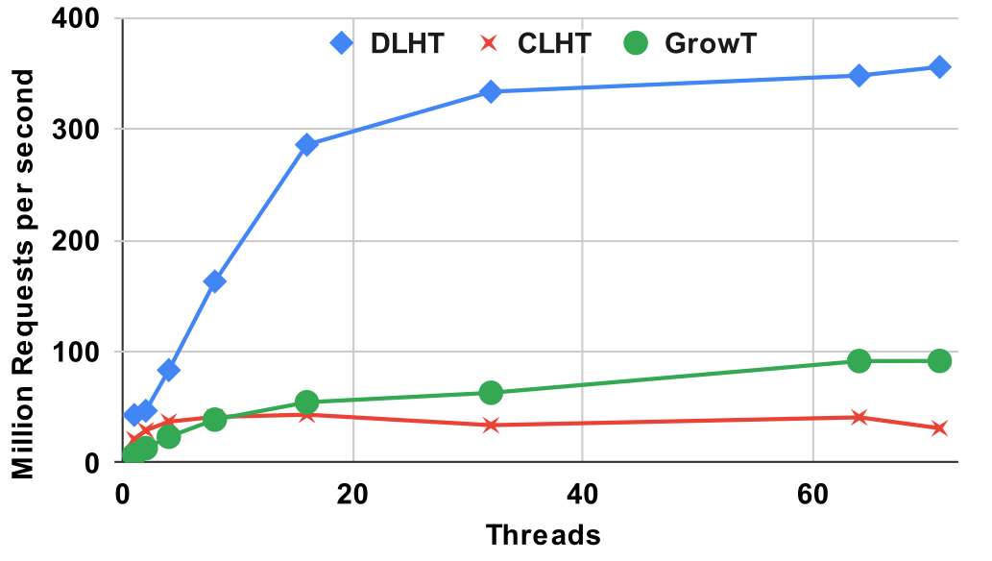
Inserting 800M keys (growing index)
3.9x

Slide 21

DLHT recap
Open addressing
Eschews open addressing → no severe blocking on deletes
Improved closed addressing via bounded cacheline chaining
→ Most bins: 1 bucket = Most requests: 1 memory access
→ Can link up to 3 extra buckets (15 slots) for high occupancy
Memory compact bin header
→ Lock-free operations: 8B sync header fits all needed state
→ Sync header incl. bin state to enable parallel non-blocking resizes
Pipelined batched request processing
→ Exploits software prefetching to overlap memory accesses
→ Guarantee in-order request completion
Many extra features (see paper): hashset, transactions, namespaces, GC,
variable-sized keys, single-threaded optimizations, iterators, snapshots, etc..
Reality check: Do all these translate into performance?
Notes:
Let me start by saying that recent
Distributed Datastores keep data in-memory while offering a read/write API.
Such datastores consist the backbone of modern online services,
which are latency-sensitive and must serve numerous concurrent requests.
As a result, distributed datastores must offer high-performance.
Furthermore, because datastores are deployed over commodity
failure prone h/w they must also be able to tolerate faults.
This mandates data replication

Slide 22
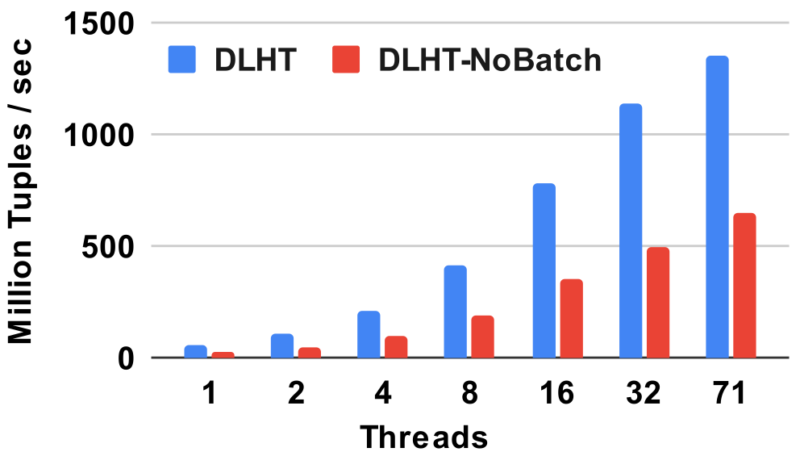
Hash Joins
Million requests / sec
See paper for more results!

Slide 23
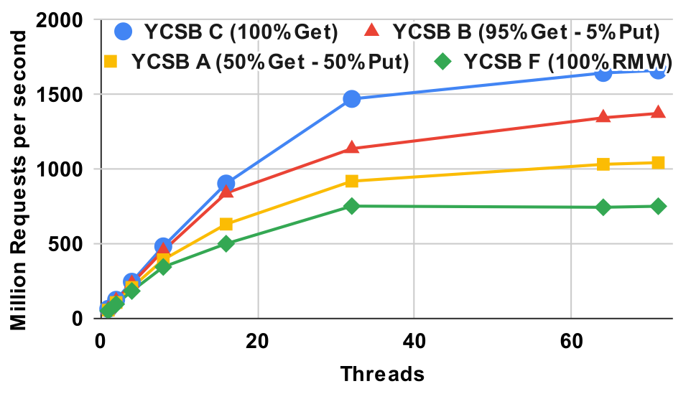
YCSB – Workload Mix

Slide 24
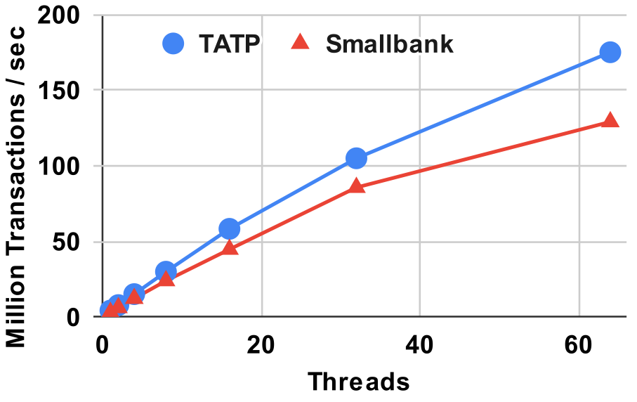
Multi-key Transactions

Slide 25
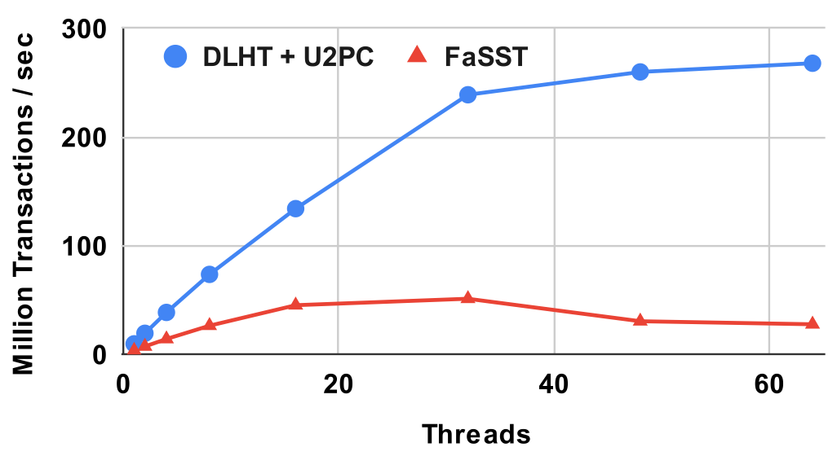
Fault-tolerant Dist. Transactions
(TATP, 5 servers, 3-way replication)

Slide 26
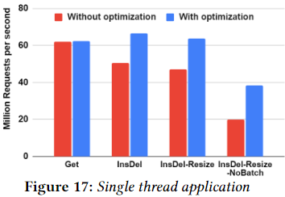
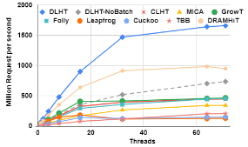
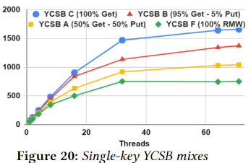
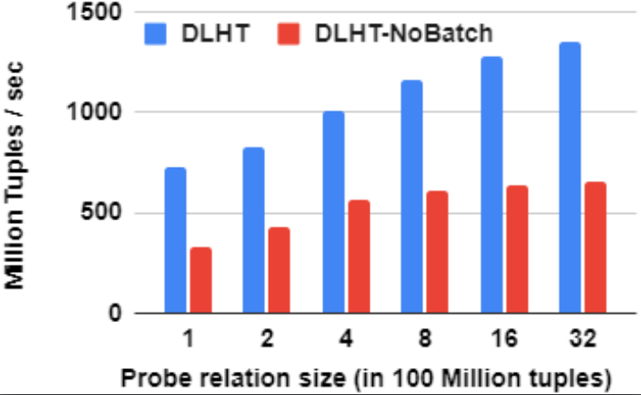
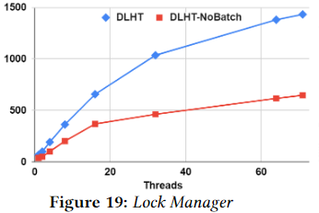
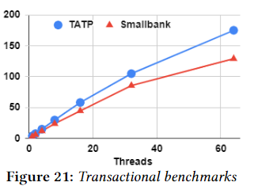
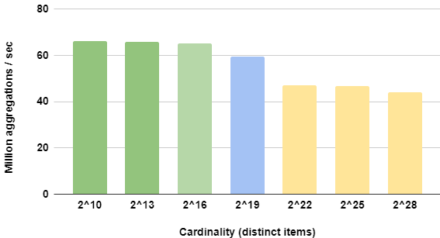
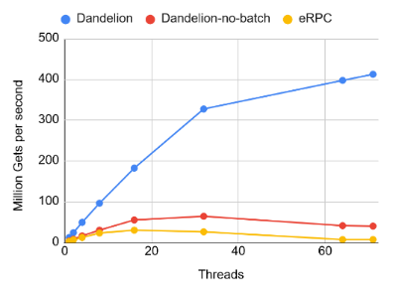
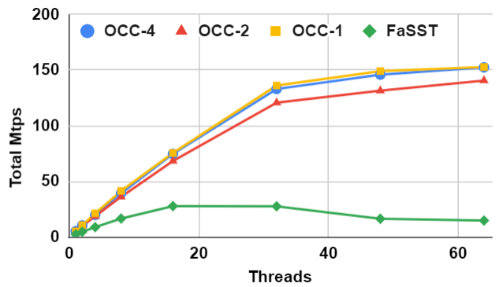
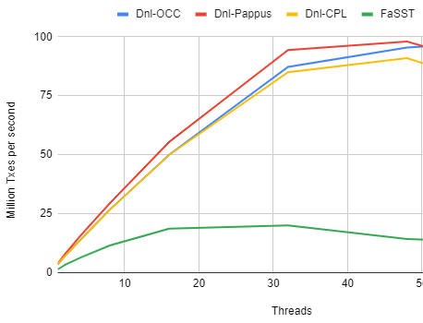
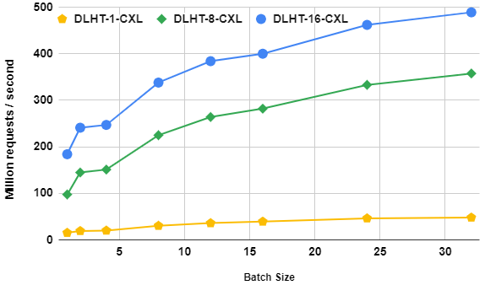
Lighting fast use-cases (single-node and distributed)
Fast map for Single-threaded app
In-memory caching
Single node in-memory storage
OLAP (Joins, Aggregation, etc.)
DB Lock manager
Single-node OLTP Transactions
Large slower memory: CXL/NVM/Far memory
Remote KVS
Replicated in-memory storage
Distributed reliable Transactions

Slide 27
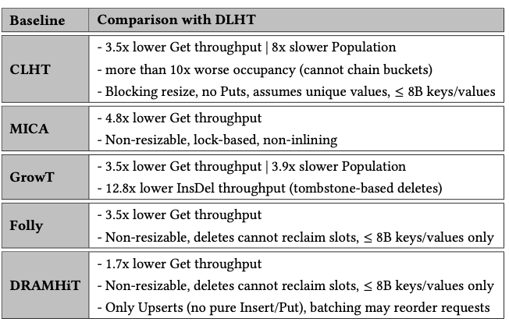
Performance
Million requests / sec
Takeaway: writes can block reads → good write performance of is crucial even at low-write ratio !
See paper for more results!

