Slide 1

Week#2
Formation POE Java
Journée #2: Packages
Athanasia Katsouraki
16.10.2017

Slide 2
Packages en Java – Pourquoi?
Un package est un espace de noms qui organise un ensemble de classes et d'interfaces associées.
Vous pouvez considérer les paquets comme des dossiers similaires sur votre ordinateur.
Ex. Vous pouvez conserver des pages HTML dans un dossier, des images dans un autre, et des scripts ou des applications dans un autre.

Slide 3
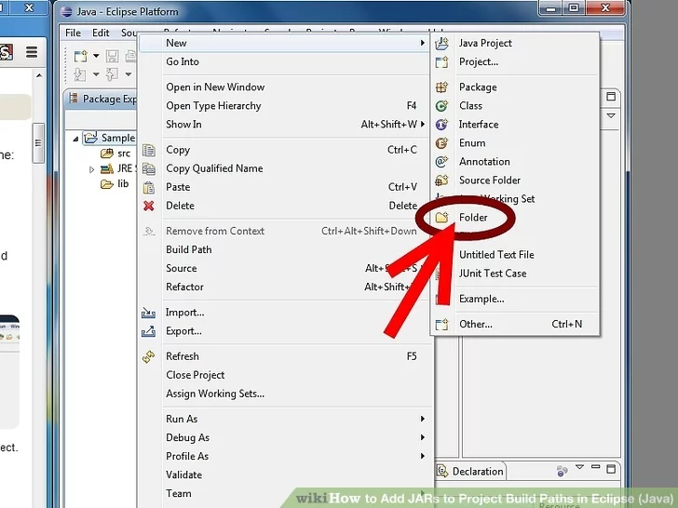
Copy the JARs you'll be using to
your project.
Create a new folder named lib in your project folder. This stands for "libraries" and will contain all the JARs you'll be using for that project.

Slide 4
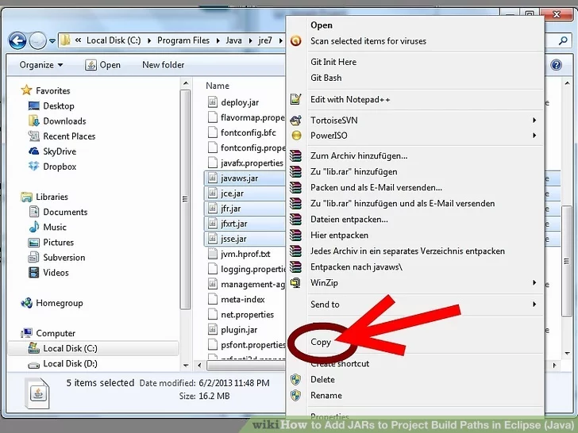
Copy the JARs you need to lib.

Slide 5
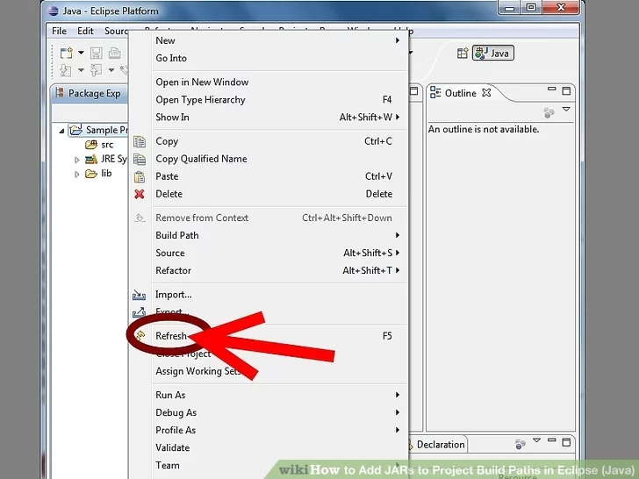
Refresh your project by right clicking the project name and selecting Refresh. The lib folder will now be visible in Eclipse with the JARs inside.

Slide 6
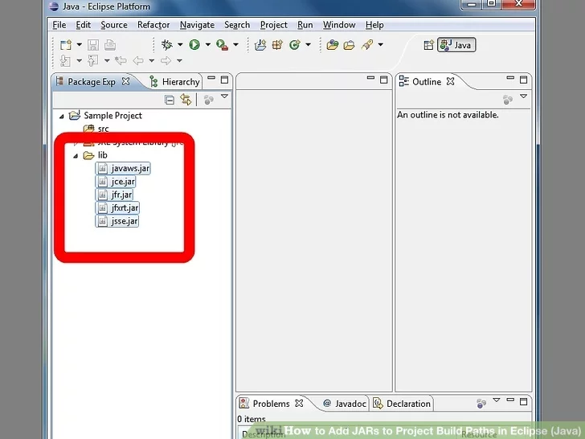
…to finish configuring your build path

Slide 7
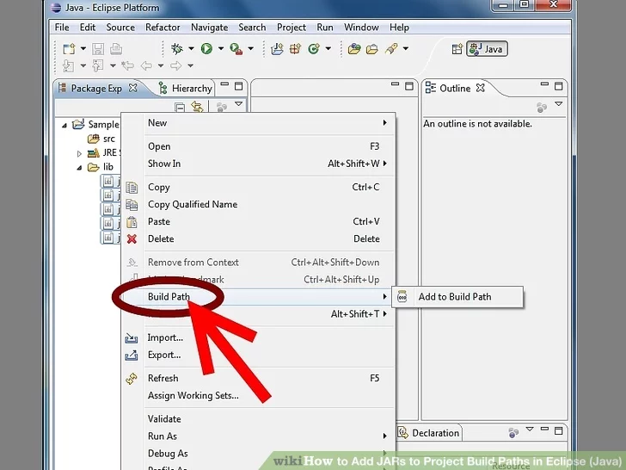

Slide 8
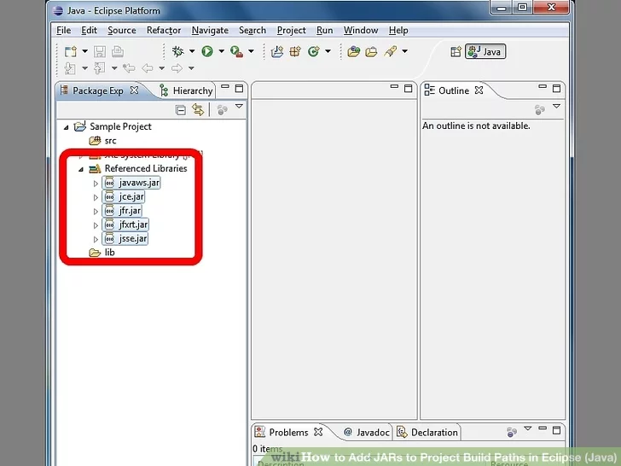

Slide 9
How to add a variable
Make sure you have javabook.jar. You can download it here.
Open the Java Build Path property pane for your project (Project > Properties).
Choose the Libraries tab of the build path pane.
Click the Add Variable... button.
You will be presented with a list of already declared variables. If the javabook variable is already there, and if it's value is correct, then select it and click OK. If not, continue to the next step.
Click Configure Variables....
A new window will appear. Click New to create a new variable.
Define it: Name: javabook library
Path: the path to your copy of javabook.jar
Note: in order to make it easy for me to use your project, please be sure you use the exact variable name above (same spelling and spacing).
Click OK to finish configuring variables. Click OK again to choose to add the javabook library variable to your project.

Slide 10
The old way -- adding an external JAR file
In the first lab, we showed you how to add an external JAR file to a project's build path. That works fine, until you want to share your project (e.g. when you want to share it with me so I can grade it). When you add an external JAR file, you tell Eclipse where to find the JAR file on your computer. However, if you want to share the project, the person you share it with would need to have the JAR file stored in exactly the same place.
The better way -- adding a build path variable
Because Eclipse is designed for real programming, by real programming teams, it supports sharing projects. One way it does this is by making it possible to avoid hard-coding the full paths for the JAR files you are using. Instead, you can create a variable and add it to your project's build path. Since the specific value of the variable (the path to the actual JAR file) is not part of the project, but part of your Eclipse workspace, you can more easily share the project. The person you share with (me) will then simply give the variable a value in their workspace to tell Eclipse where to find their copy of the JAR file.
For example, you can say to use the javabook.jar library located at /Volumes/UnixFiles/csc150/workspace by creating a variable called "javabook library" whose value is "/Volumes/UnixFiles/csc150/workspace". You can then add this variable to your project's build path. The person you share with can then give a different value to specify where they have stored the JAR file.

