Slide 1

Week#2
Formation POE Java
Journée #1: Part 1
Athanasia Katsouraki
16.10.2017

Slide 2
On a déjà vu…

Slide 3
To begin with…
Your first Java application.
class HelloWorld {
public static void main (String args[]){
System.out.println(“Hello World!”);
}
}
Class
Dans la classe :
Attributes
Methodes
Main()

Slide 4
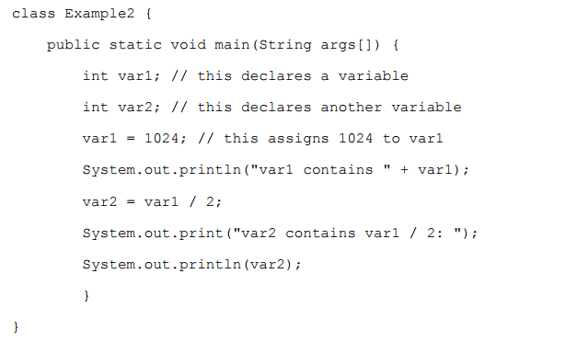
Variables
5’ pour trouver les resultats
Notes:
var2 contains var1 / 2: 512

Slide 5
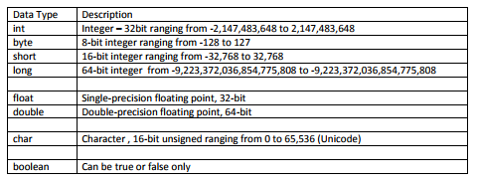
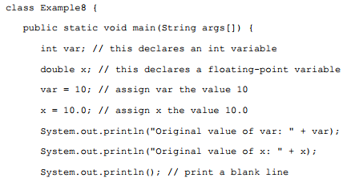
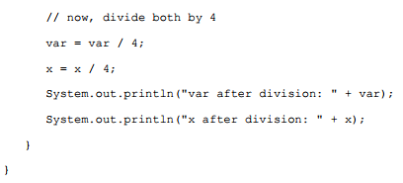
5’ pour trouver les resultats
Notes:
Original value of var: 10
Original value of x: 10.0
var after division: 2
x after division: 2.5

Slide 6
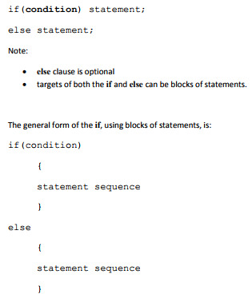
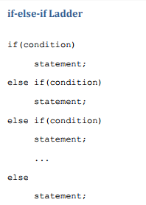
If…else

Slide 7
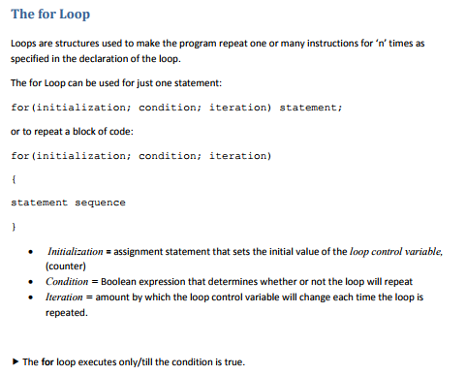
for...

Slide 8
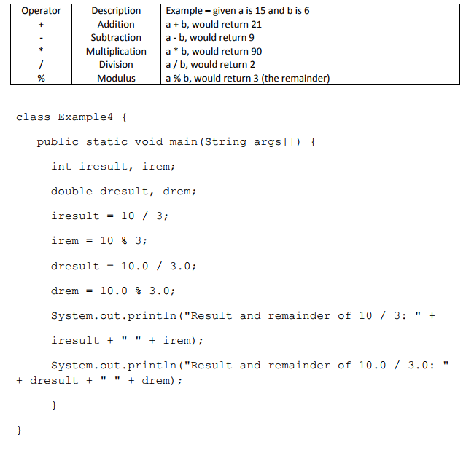
Math. Operators
5’ pour trouver les resultats
Notes:
Result and Remainder of 10/3: 3
Result and Remainder of 10.0/3.0: 3.3333333333333335

Slide 9
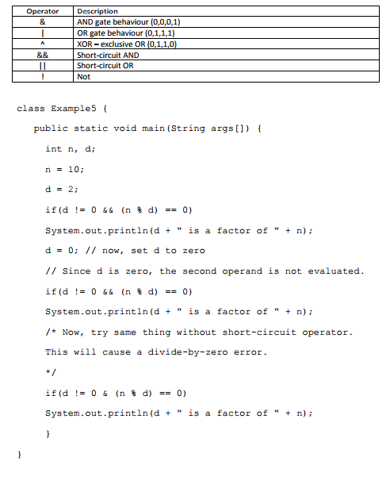
Logical Operators
10’ pour trouver les resultats
Notes:
2 is a factor of 10

Slide 10
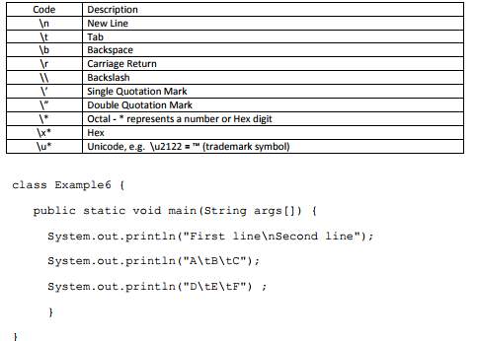
Character Escape Codes
5’ pour trouver les resultats
Notes:
First Line
Second Line
A B C
D E F

Slide 11
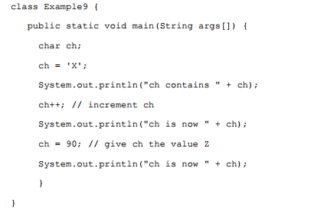
Output?
10’ pour trouver les resultats
**Si vous voulez vous pouvez chercher
“ASCII code”
Notes:
ch is now X
ch is now Y
ch is now Z

Slide 12
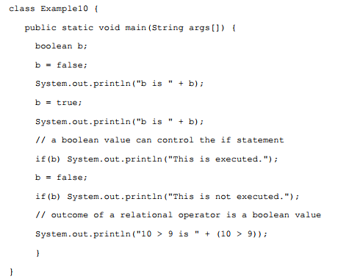
Output?
5’ pour trouver les resultats
Notes:
b is false
b is true
This is executed 10 > 9 is true

Slide 13
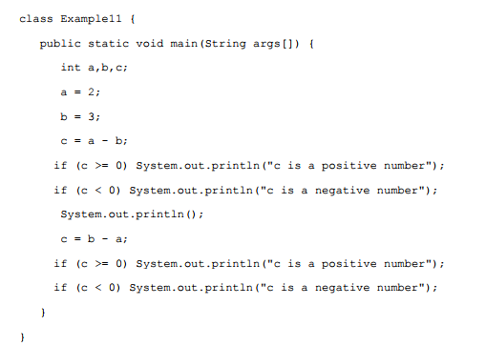
Output?
10’ pour trouver les resultats
Notes:
c is a negative number
c is a positive number

Slide 14
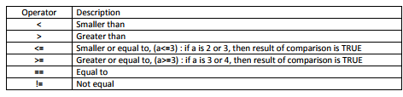
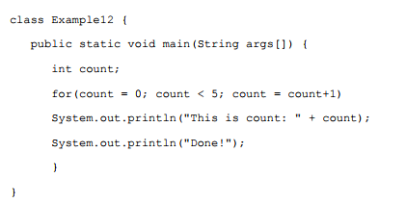
Conditions
10’ pour trouver les resultats
Notes:
This is count: 0
This is count: 1
This is count: 2
This is count: 3
This is count: 4
Done!

Slide 15
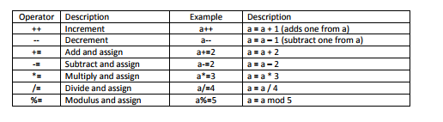

Slide 16
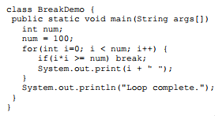
Output?
10’ pour trouver les resultats
Notes:
0 1 2 3 4 5 6 7 8 9 Loop complete

Slide 17
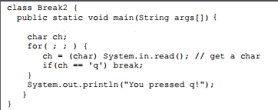
Output?
10’ pour trouver les resultats
???
Notes:
In the above program there is an infinite loop, for( ; ; ) .
This means that the program will never terminate unless
the user presses a particular letter on the keyboard, in this case ‘q’.

Slide 18
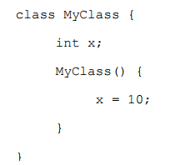
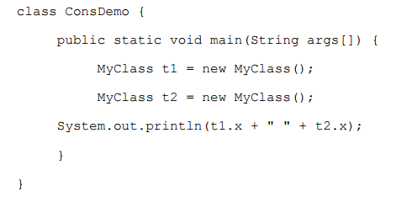
Output?
10’ pour trouver les resultats
Notes:
10 10

Slide 19
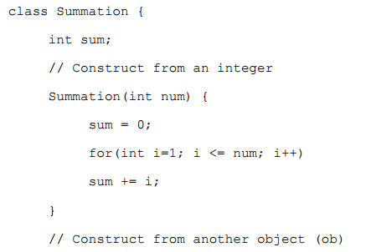
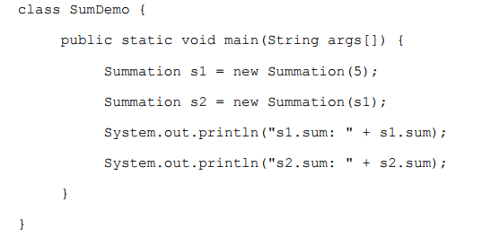
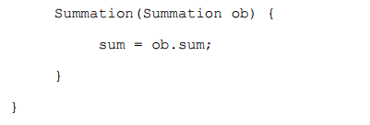
Output?
15’ pour trouver les resultats
Notes:
s1.sum: 15
s2.sum: 15

Slide 20
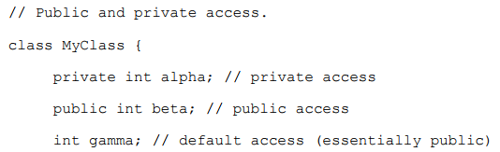
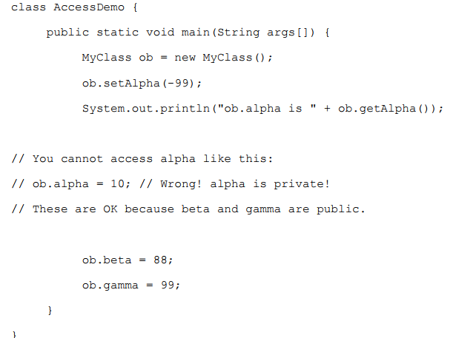
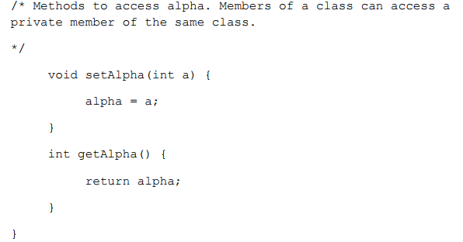
Output?
15’ pour trouver les resultats
Notes:
ob.alpha is -99

Slide 21

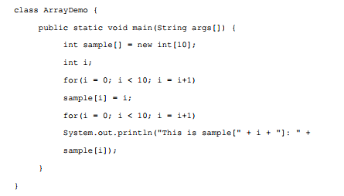
Arrays
10’ pour trouver les resultats
Notes:
This is sample[0]: 0
This is sample[1]: 1
This is sample[2]: 2
This is sample[3]: 3
This is sample[4]: 4
This is sample[5]: 5
This is sample[6]: 6
This is sample[7]: 7
This is sample[8]: 8
This is sample[9]: 9

Slide 22
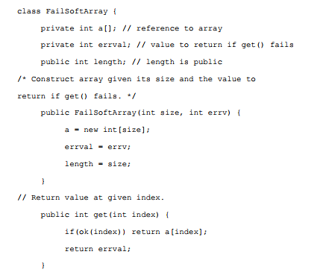
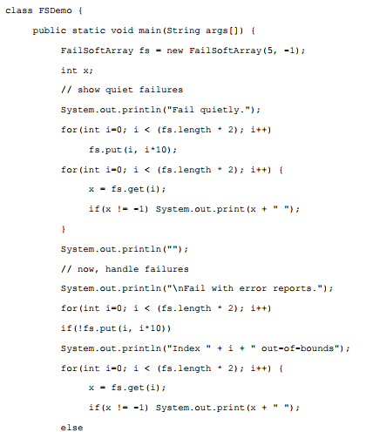
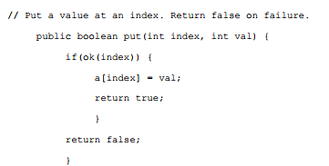
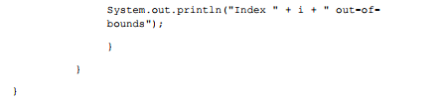
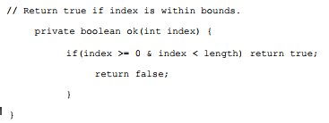
O u t p u t ?
25’ pour trouver les resultats
Notes:
Fail with error reports.
Index 5 out-of-bounds
Index 6 out-of-bounds
Index 7 out-of-bounds
Index 8 out-of-bounds
Index 9 out-of-bounds
0 10 20 30 40 Index 5 out-of-bounds
Index 6 out-of-bounds
Index 7 out-of-bounds
Index 8 out-of-bounds
Index 9 out-of-bounds

