Slide 1
New York cabs data: case study
19.06.2018
Katerina Dimitrova
Jose Romero
Sergi Munoz

Slide 2

Contents
Data green taxi records from NYC
Preprocessing
Principal component analysis (PCA) and Clustering
CA, MCA, Clustering
Modeling Total Amount and AnyTip
Conclusions

Slide 3
Data green taxi records from NYC
Variables
pick-up and drop-off dates/times
pick-up and drop-off locations
trip distances
rate and payment types
etc.
Targets
Total Amount
Any Tip
Aim
20
5000
Data
Notes:
pick-up and drop-off dates/times, pick-up and drop-off locations, trip distances, itemized fares, rate types, payment types, and driver-reported passenger counts

Slide 4
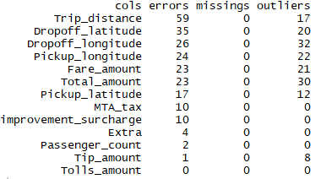


Preprocessing
Cleaning process - errors, missing values, outliers
Per variable
Per Individual
No missing values
Outliers
Errors

Slide 5
Preprocessing
Imputation
All errors and outliers
Using PCA imputation
Synthetic variables
Trip length
Travel time
Pickup period
Effective speed
Factors for all continuous variables

Slide 6
Preprocessing
Profiling
TODO!

Slide 7
Principal component analysis (PCA)
Methodic
Multidimensional outliers

Slide 8
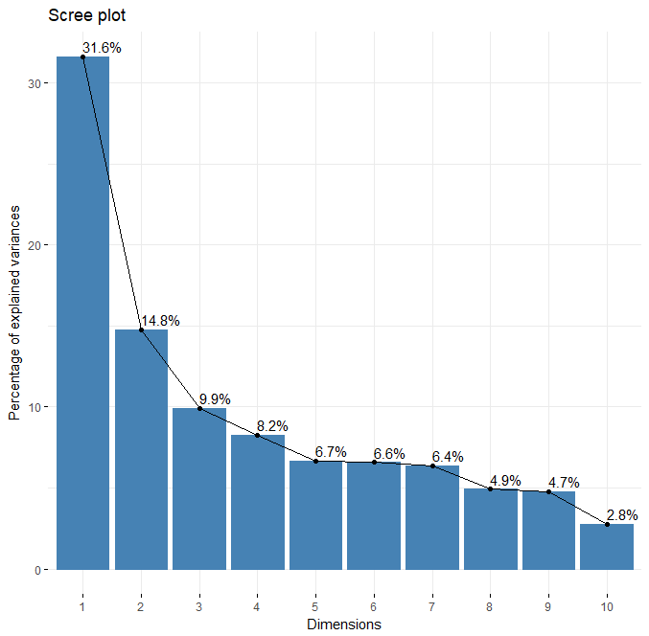
Principal component analysis (PCA)

Slide 9
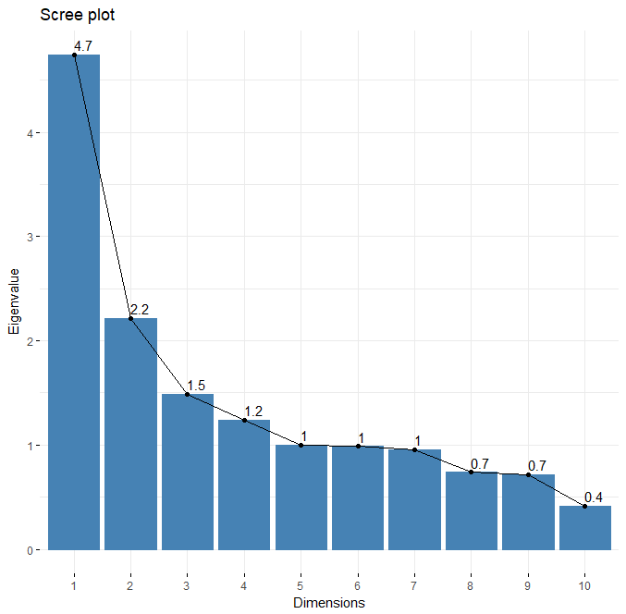
Principal component analysis (PCA)

Slide 10
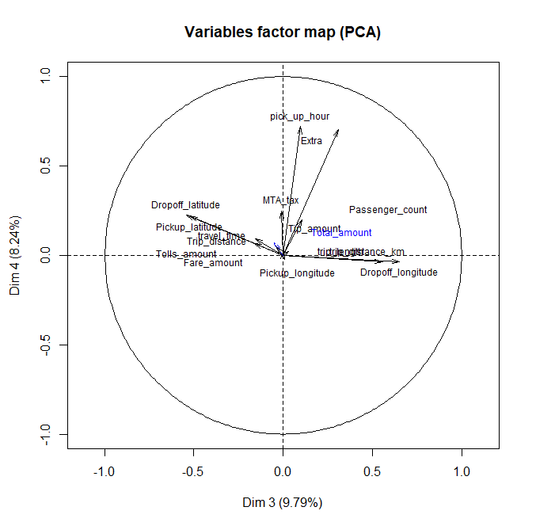
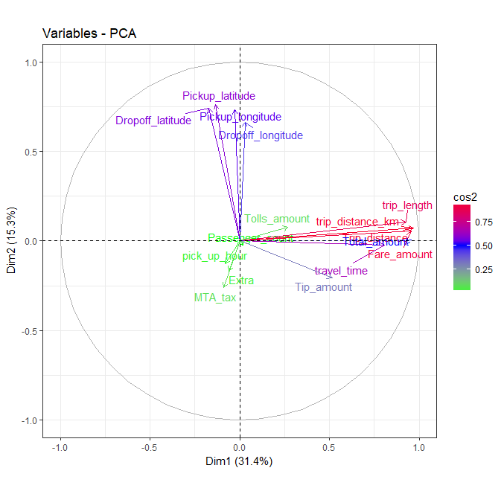
Principal component analysis (PCA)

Slide 11

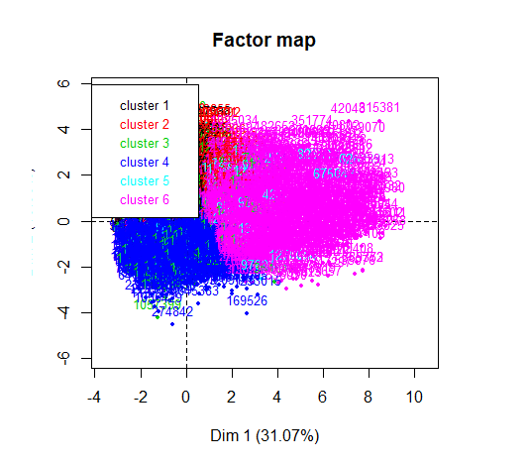
Clustering (PCA) -HCPC
Cluster 1
dropoff_latitude, dropoff_longitude
Cluster 2
f.pickup_latitude, f.dropoff_longitude
Cluster 3
Also passenger > 1
Cluster 4
f.pickup_latitude, f.dropoff_longitude
Cluster 5
Improvement surcharge and MTA tax
Cluster 6
Expensive trip, pickup time - morning

Slide 12
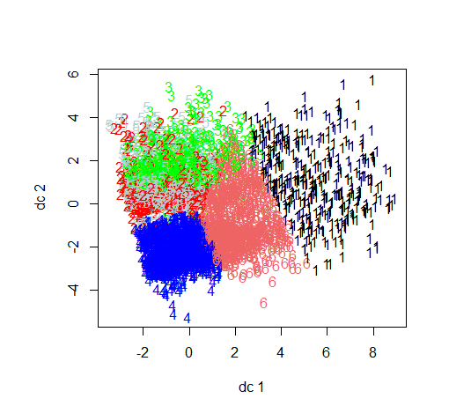

Clustering (PCA) –K-Means
Comparison
0,723 % Similarity

Slide 13
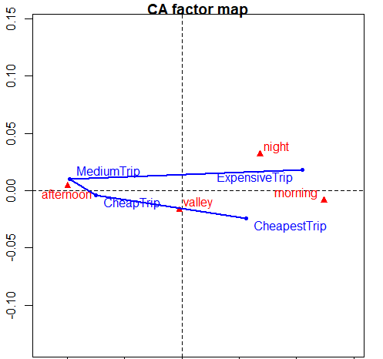
Correspondence Analysis (CA)
Total Amount and Pickup period
At night and morning - expensive
In the afternoon - middle prices
Cheap trips stay at valley
Dim 1 – 95,7%
Dim 2 – 3,4%

Slide 14
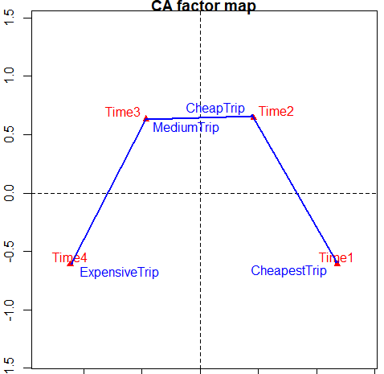
Correspondence Analysis (CA)
Total Amount and Travel Time
Longer trips -> Higher cost
Dim 1 – 59,8%
Dim 2 – 30,3%

Slide 15
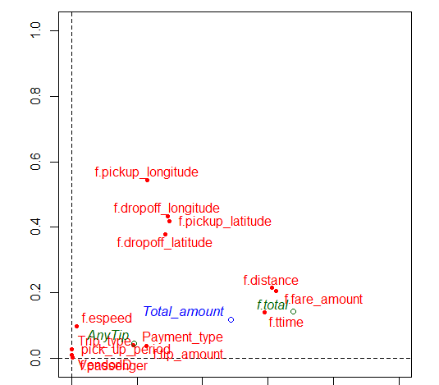
Multiple Correspondence Analysis (MCA)
80% the variance – first 17 Dimensions
Individual should have ~ 0.02 contribution
Correlated variables
Dim1- distance, time and fare amount
Dim2 – longitude and latitude

Slide 16
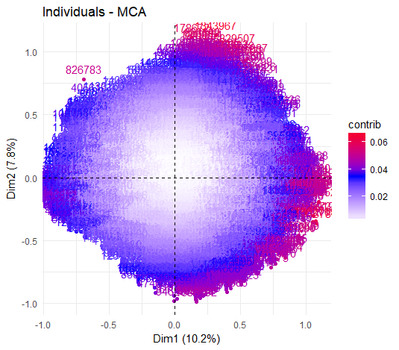
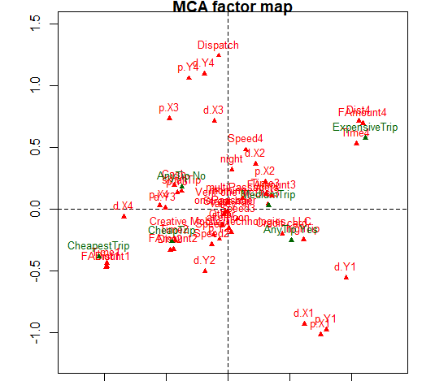
Multiple Correspondence Analysis (MCA)
Expected average contribution of individuals~ 0.02 contribution
Notes:
Too contributive groups would be:
- Individuals with longest travel time, high total price, high fare amount and longest distance
- Individulas with shortest travel time, lowest Fare Amount and lowest total amount
- Individuals with a dispach trip type and the biggest pickup and dropoff longtitude
- Individuals with smallest pickup and droppoff longitude and latitude.

Slide 17
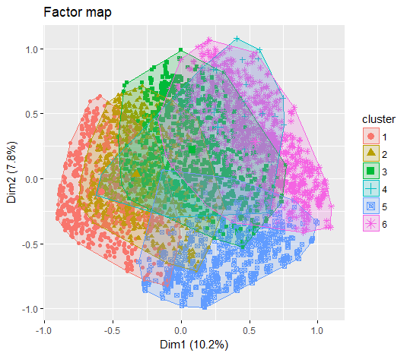

Clustering (MCA) -HCPC
50% of matching in the cluster structure
Cluster 1, Cluster 2
cheapest and shortest trips with a small tips
f.distance, f.fare_amount and f.ttime
Cluster 3
Middle cost and length of trips
Cluster 4
All trips of type "Dispatch"
Cluster 5
longitudes and latitudes
Cluster 6
Expensive and long trips

Slide 18
Re

Slide 19
Re

Slide 20
Re

Slide 21
Re

Slide 22
Re

