Slide 1

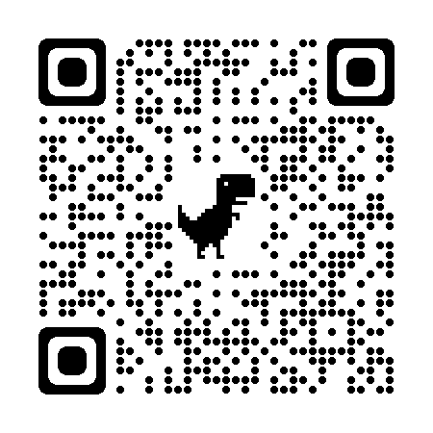
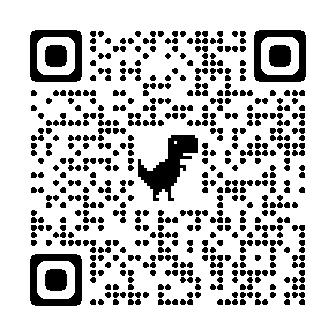


Wenpu Li
Recent Graduated, Seeking PhD or RA opportunities
Research Assistant at Westlake University supervised by Peidong Liu
Research topic: 3D/4D reconstruction and generation
Email: liwenpu@weslake.edu.cn
Homepage: https://akawincent.github.io/
Twitter: @pu_wen99907

Slide 2
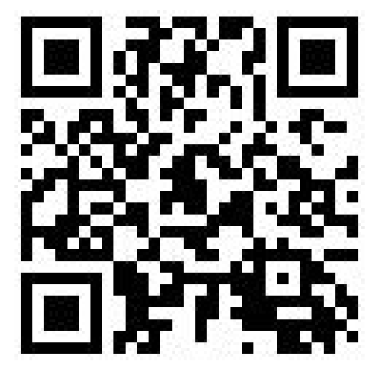
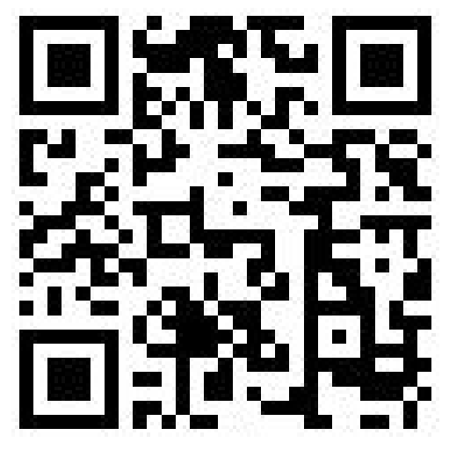


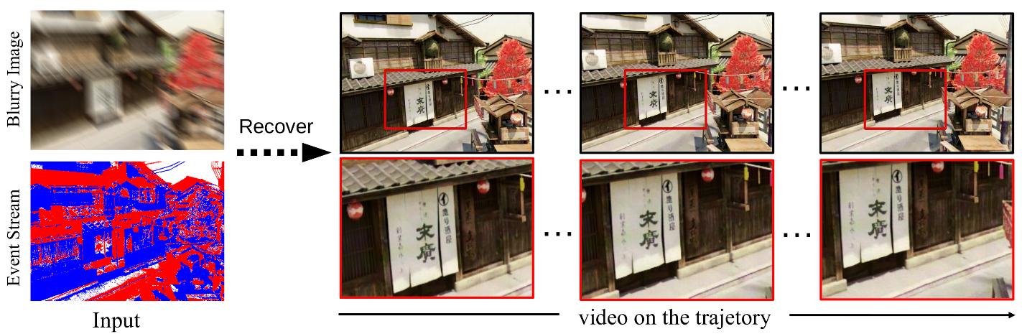
BeNeRF: Neural Radiance Fields from a Single Blurry Image and Event Stream
Code
Project page
Paper

