Slide 1


K.RAMAKRISHNAN COLLEGE OF ENGINEERING
(AUTONOMOUS)
SMS Based Remote Server Monitoring System
Presented by,
Name : AKASH N
Register No. : 8115U24AM003
Roll No. : AM2403
Year : II /CSE(AIML)
Date of Review : 06/05/2026

Slide 2
PRESENTATION OVERVIEW
Objective
Introduction
Abstract
Architecture Diagram
Module Description
Implementation
Conclusion

Slide 3
OBJECTIVE
To develop an SMS-based remote server monitoring system that enables administrators to track server performance and receive alerts without internet dependency.
To design and maintain a structured SQL database for storing server metrics such as CPU usage, memory usage, disk space, and system status efficiently.

Slide 4
INTRODUCTION
In today’s technology-driven world, servers play a crucial role in managing data, applications, and network services. Organizations depend heavily on servers for continuous operations, making it essential to monitor their performance and availability at all times. Any server downtime or failure can result in data loss, reduced productivity, and financial impact.

Slide 5
ABSTRACT
The SMS Based Remote Server Monitoring System is designed to monitor the status and performance of servers remotely using Short Message Service (SMS). In today’s digital environment, continuous server availability is critical, and any downtime can lead to major losses. This system helps administrators receive instant alerts about server conditions such as CPU usage, memory status, network issues, and server failures.

Slide 6
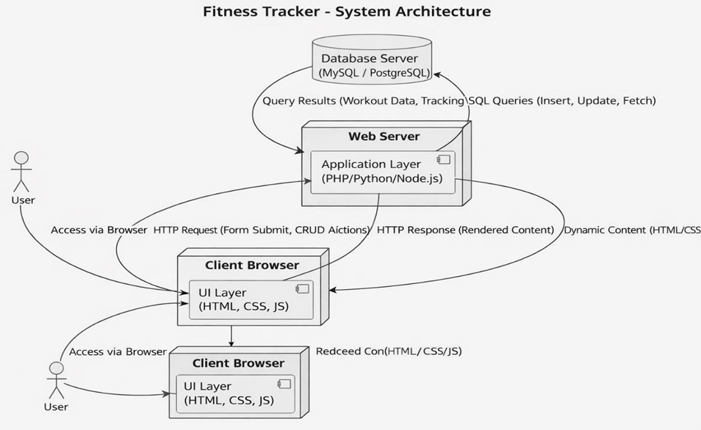
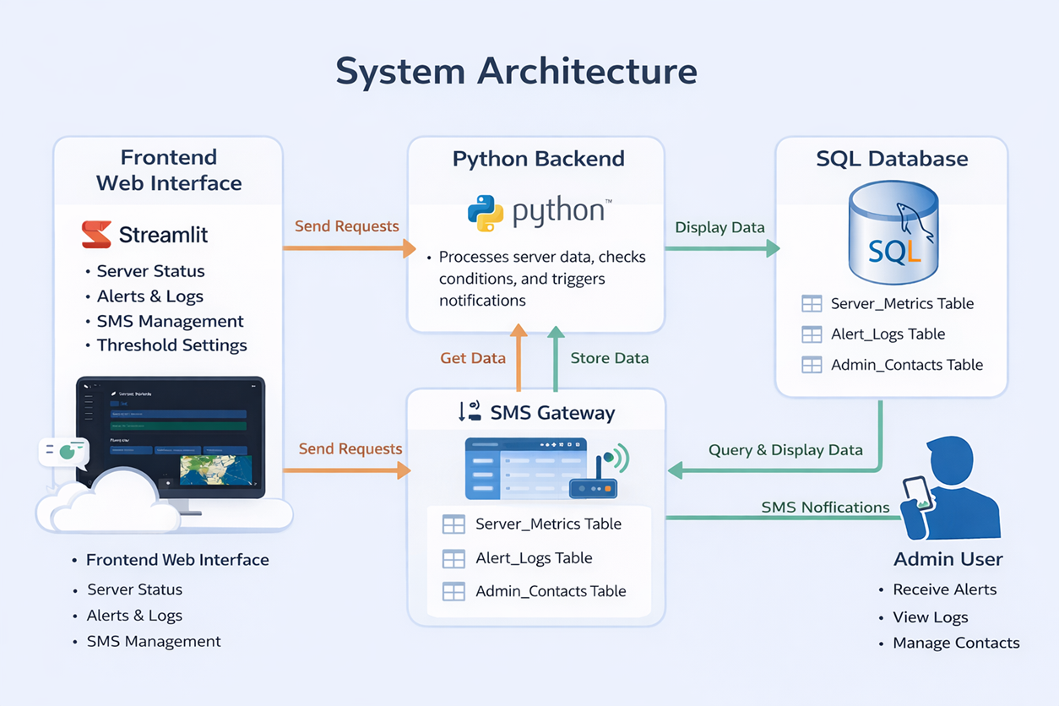
ARCHITECTURE DIAGRAM
.

Slide 7
MODULE DESCRIPTION
Data Collection Module: Collects server performance data such as CPU usage, memory utilization, disk space, and system status at regular intervals using monitoring tools or scripts.
Database Module: Stores and manages the collected data in a structured SQL database, ensuring efficient data organization, retrieval, and maintenance.
.

Slide 8
MODULE DESCRIPTION
Monitoring Module: Analyzes the stored data using SQL queries and identifies abnormal conditions when server parameters exceed predefined limits.
Alert Module: Generates and sends SMS notifications to administrators through an SMS gateway when critical issues or threshold violations occur.
.

Slide 9
MODULE DESCRIPTION
5 User Interface Module: Provides an interface for administrators to view server status, access logs, and monitor alerts for effective system management.
.

Slide 10
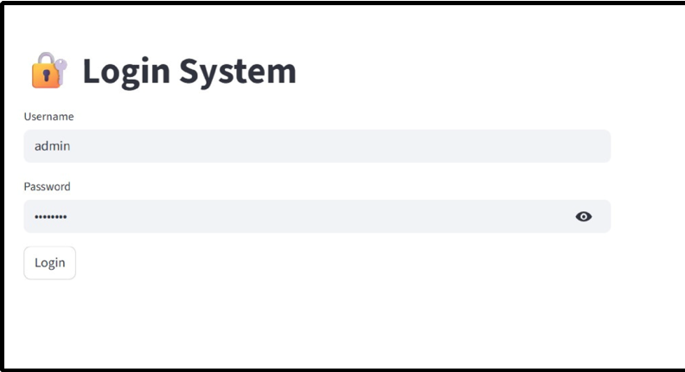
IMPLEMENTATION

Slide 11
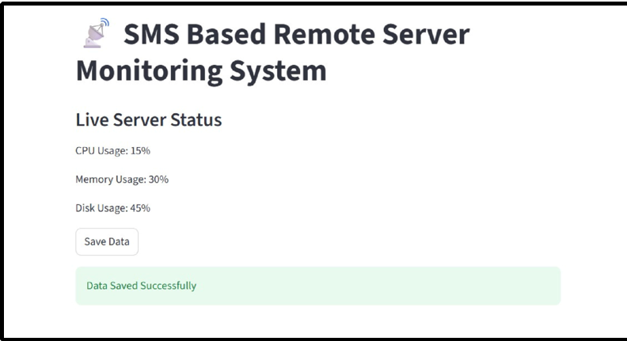
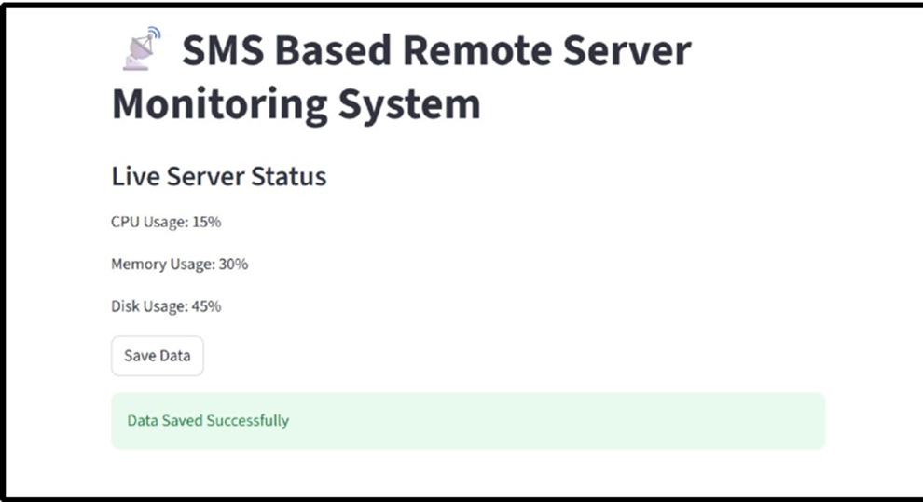
IMPLEMENTATION

Slide 12
CONCLUSION
To conclude that the system effectively monitors servers and provides timely alerts.
To highlight that SMS-based alerts improve reliability in low network conditions.
To demonstrate that database integration ensures efficient data handling and analysis.
To show that the system helps reduce downtime and improves system performance.

Slide 13


