Slide 1
Grades and Catalogs as Data
David Eubanks, Amanda Whalen, & Sara Vanovac
Furman University

Slide 2
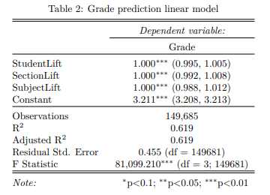
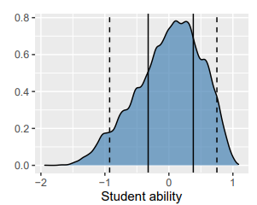
Grade = Student + Section + Subject + residual

Slide 3
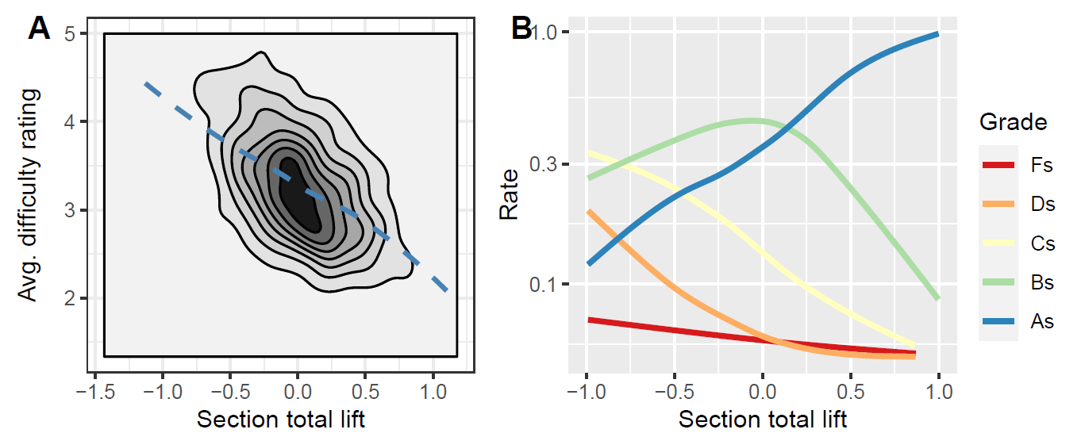
Measuring Course Difficulty
Notes:
Left: student difficulty ratings on end-of-course surveys graphed against the course parameters (negative values are more difficult courses).
Right: grade distributions by difficulty, log scale.

Slide 4
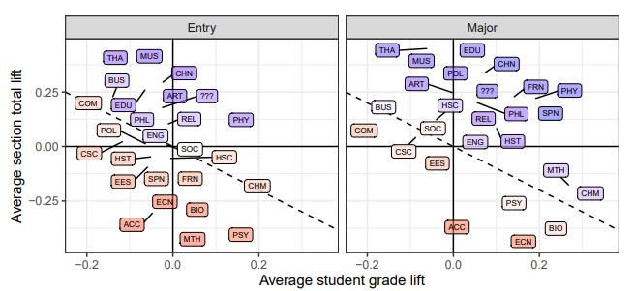
Match between Students and Subjects

Slide 5
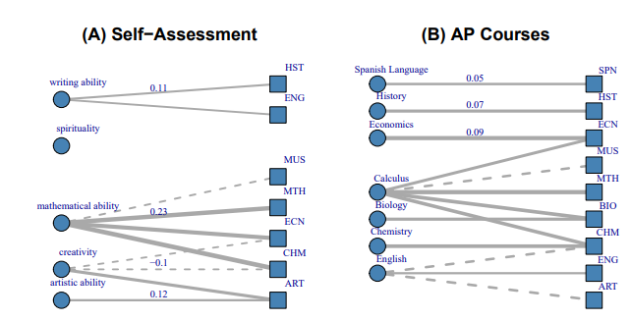
Student Lift = General Learning Ability

Slide 6
Catalog Course Descriptions
ART 234 Early Christian and Byzantine Art
Study of Christian art and architecture c. 100 - c. 500 A.D. in the lands of the western Roman Empire and of the art and architecture of the Byzantine Empire until its fall in 1453. Style, iconography and cultural context will be considered.
Notes:
My contribution to this project was to use different text-mining techniques to try to cluster course subjects into content groups based on the text in the course descriptions.

Slide 7
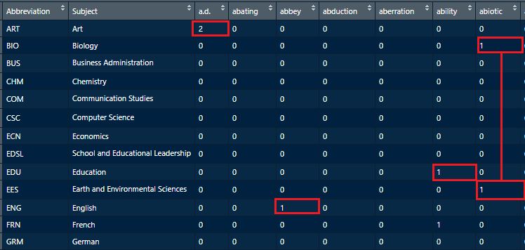
Vectorization of Subject Texts
Notes:
After cleaning up the text, each subject has a bag of words, which we enumerate to create a sparse matrix of word frequencies. These vectors are used to cluster the subjects.

Slide 8
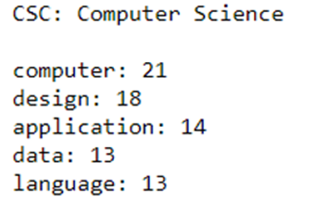
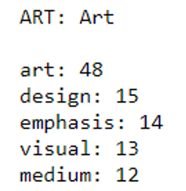
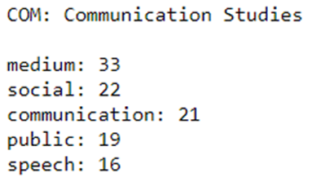
Most Frequent Words
Notes:
These patterns can be seen at the subject level through the most frequent words in all the course descriptions in that subject. Here we can see that Art is related to computer science and communication studies.

Slide 9
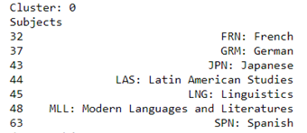
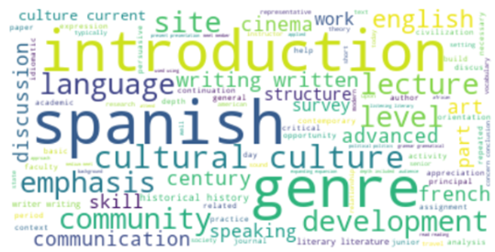
K-Means Clusters
Tableau link: https://public.tableau.com/app/profile/amanda.whalen/viz/K-meansresults/K-meansresults
Notes:
One method of clustering is to use k-means, to identify cluster centers and neighborhoods using individual course descriptions. This is one cluster, showing that different subjects related to foreign languages naturally cluster together.

Slide 10
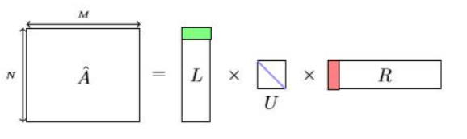

Probabilistic Latent Semantic Analysis (PLSA)
PLSA is an NLP technique used for topic modeling. It can be seen as breaking down the document-word matrix A into 3 smaller matrices:
  L: a matrix of the document probabilities for the topics P(d|z)
  U: a diagonal matrix of P(z), the probabilities of the topics
  R: a matrix of the word probabilities for the topics P(w|z)
When you multiply these three matrices, that’s the same thing as taking the probability below:
Notes:
Singular value decomposition.

Slide 11
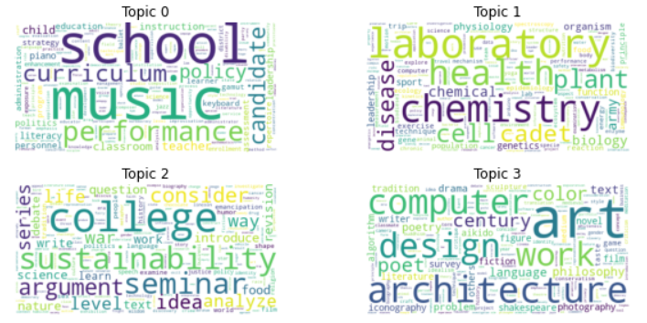
Probabilistic Latent Semantic Analysis (PLSA)
Tableau link: https://public.tableau.com/app/profile/amanda.whalen/viz/PLSAresultsnum_topics10/PLSAresults

Slide 12
Latent Dirichlet Allocation (LDA)
LDA is another popular topic modeling method used in NLP.
It is a Bayesian version of PLSA and uses dirichlet distributions (a type of continuous multivariate probability distribution), hence the name.
It can be seen as an improvement on PLSA because it creates models that can be used to classify new documents, while PLSA is not well defined for this.

Slide 13
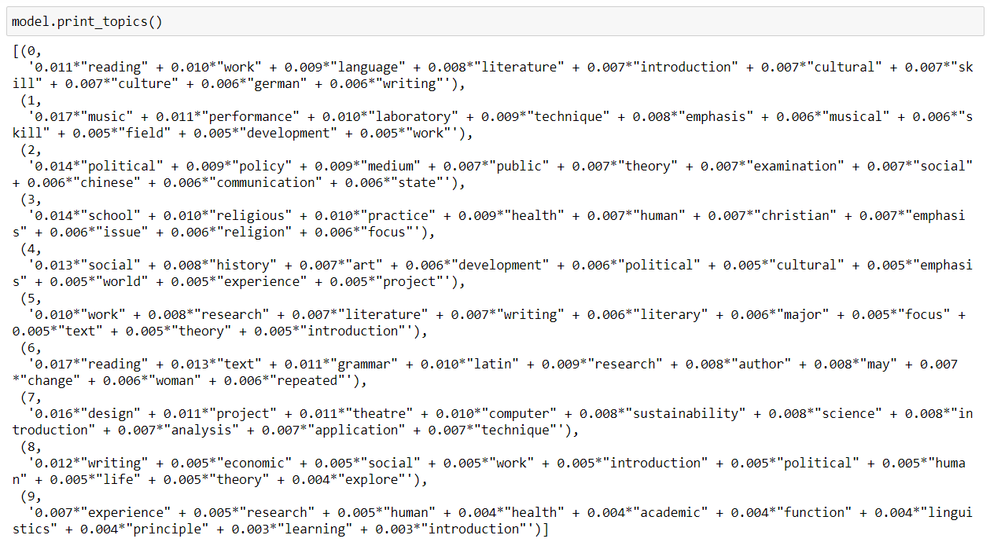
Latent Dirichlet Allocation (LDA)

Slide 14
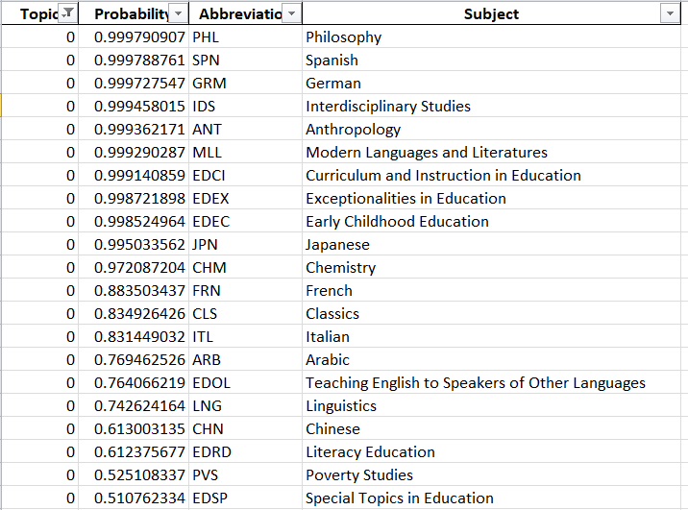
Latent Dirichlet Allocation (LDA)
Tableau link: https://public.tableau.com/app/profile/amanda.whalen/viz/LDAresults/LDAresults

Slide 15
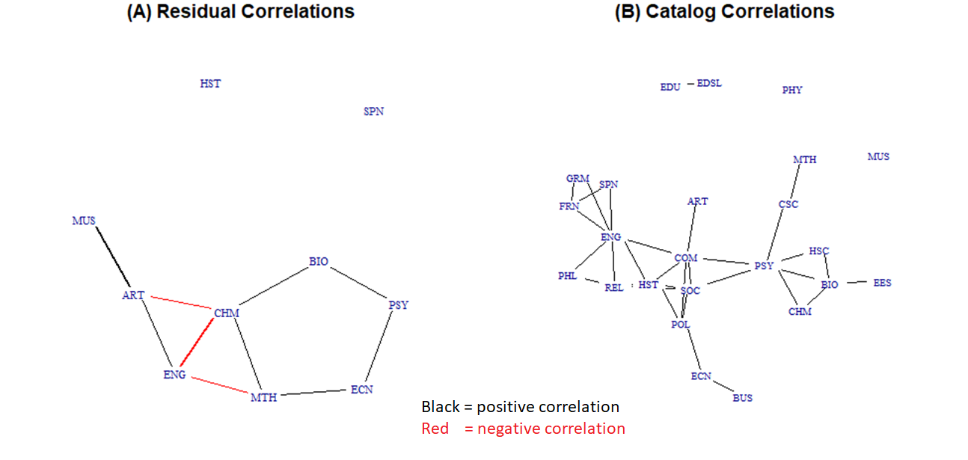
Notes:
The left graph is from the grades analysis, where the red lines are negative correlations. It suggests that there is a difference between arts & humanities learning and STEM learning. The right graph shows correlations among the vectorized catalog descriptions by subject. The subjects are organized like we would expect, with foreign languages clustering together, and English in a central position for the humanities. STEM subjects are linked linguistically via psychology (EES = earth and environment).
Thresholds: (A) correlation >= .10, (B) correlation >= .30

Slide 16
Questions?
david.eubanks@furman.edu
amanda.whalen92@gmail.com
sara.vanovac2@furman.edu

