Slide 1
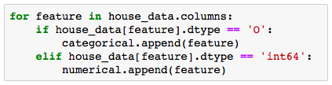


Pre-Processing Missing Data and string values “fixing”
1. Missing Data Training and Test Set
3. Features Classification
IMPORTANCE : Making sure models won’t ignore NAs meaning
Features with character values $→$ “CATEGORICAL”
Features with number values $→$ “NUMERICAL”
Decision:
ALL CATEGORICAL VALUES
+
ALL MNAR
=
CHARACTER IMPUTES
IMPORTANCE : Using appropriate models to each value type
4. Dummifying Character Values (Python)
Spreading features string levels to columns $→$ binary
Dropping dominant level $→$ default
Other Missing Values (Test Set) : Impute kNN values (k = 1)
IMPORTANCE : Allowing the use of all features in all models

Slide 2




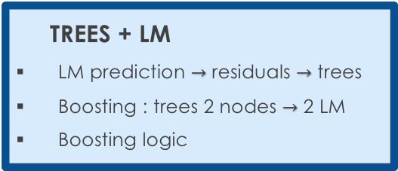


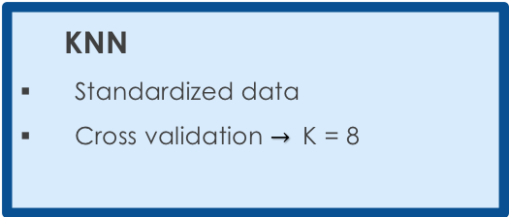
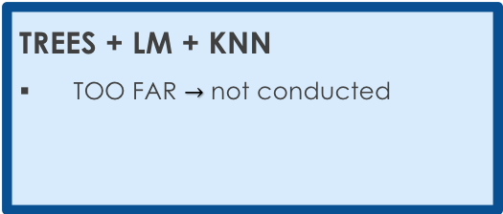
Selecting a Model Our approach to minimize the RMSE
Update RMSE
DECISION TREES
Cost Complexity Tree Pruning
Random Forest and Boosting
LINEAR MODEL
Lasso, Ridge and Elastic Net
Stepwise AIC and cross validation
KNN
Standardized data
Cross validation $→$ K = 8
1
RMSE : 0.11
2
RMSE : 0.11
3
RMSE : 0.11
+ NAÏVE BAYES $→$ RMSE : 0.11
+ NAÏVE BAYES $→$ RMSE : 0.11
+ NAÏVE BAYES $→$ RMSE : 0.11
TREES + LM
LM prediction $→$ residuals $→$ trees
Boosting : trees 2 nodes $→$ 2 LM
Boosting logic
LM + KNN
p linear models
Knn (k = 1) for beta selection
4
RMSE : 0.11
5
RMSE : 0.11
+ NAÏVE BAYES $→$ RMSE : 0.11
+ NAÏVE BAYES $→$ RMSE : 0.11
TREES + LM + KNN
TOO FAR $→$ not conducted
+
RMSE : ?
NAÏVE BAYES
Combining categorical variables
+ NAÏVE BAYES $→$ RMSE : ?

Slide 3
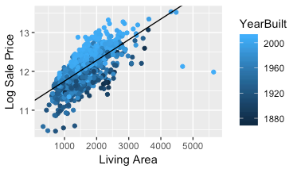
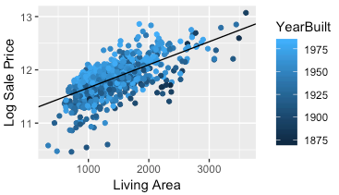
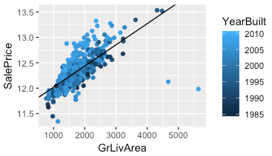


Selecting a Model Boosting trees combined with linear models
TREES + LM
RMSE : 0.11
Logics $→$ split groups to reduce linear model RSS
Results
Sale Prices x Living Area $→$ Year Built cut
Example
Iteration : tree $→$each node has its own linear models
Stepwise operation required each time to select the best features
Too much computational power required!
Derail cross validations to select best features
Year Built < 1984
Year Built > 1984
RSS = 118
NO GO!
We need to keep it simple.
RSS = 52
RSS = 28

