Slide 1
Exploratory Data Analysis XXXX
Goal: key learnings from the dataset that influenced the analysis.
Univariate vs. Multivariate
Numerical Data (scatter/bubble) vs Nominal Data
Nominal Data (boxplot).
RAUL

Slide 2
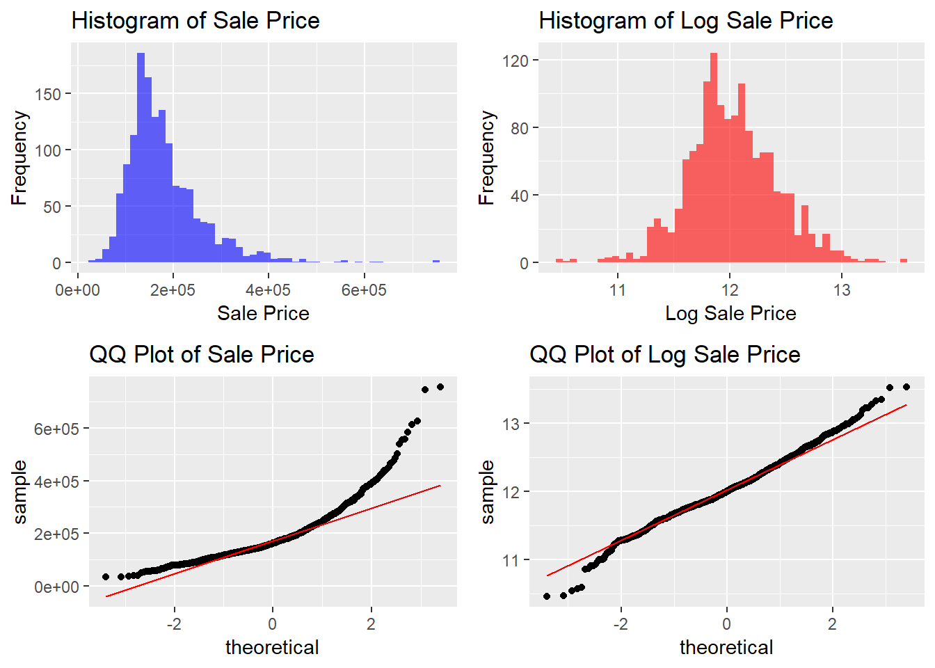
Exploratory Data Analysis First look at the response variable
Histogram: significant right skew
QQ plot: Log transformation is not enough to correct heavy tails
Observations in the tails will be THE HARDEST TO PREDICT

Slide 3
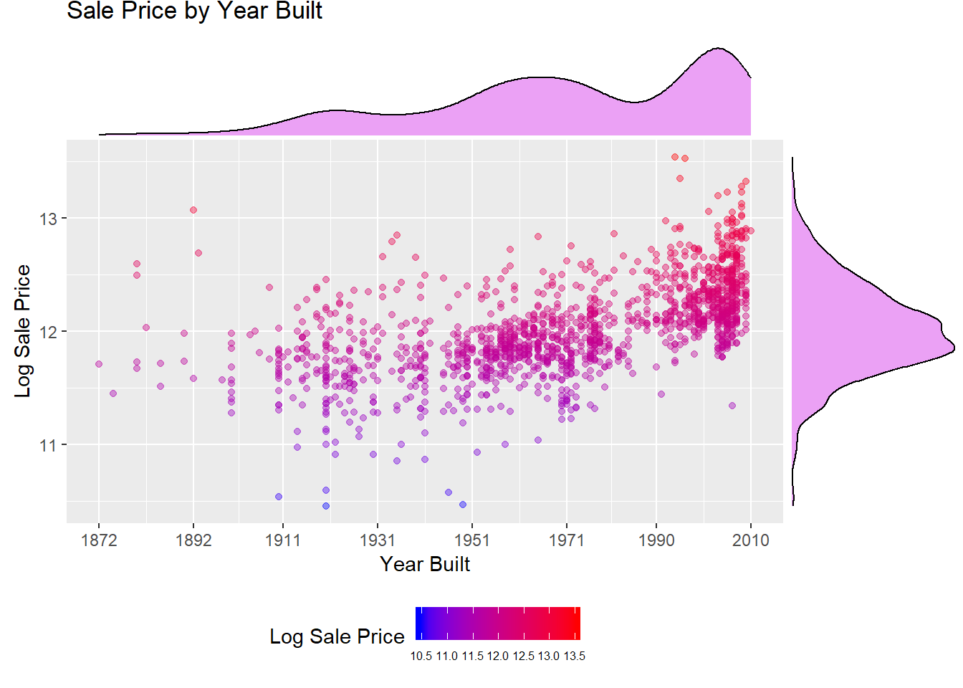
Exploratory Data Analysis Do new houses sell for higher prices?
Positive correlation between the variables
Year Built density suggests there are 3 modes / building sprees

Slide 4
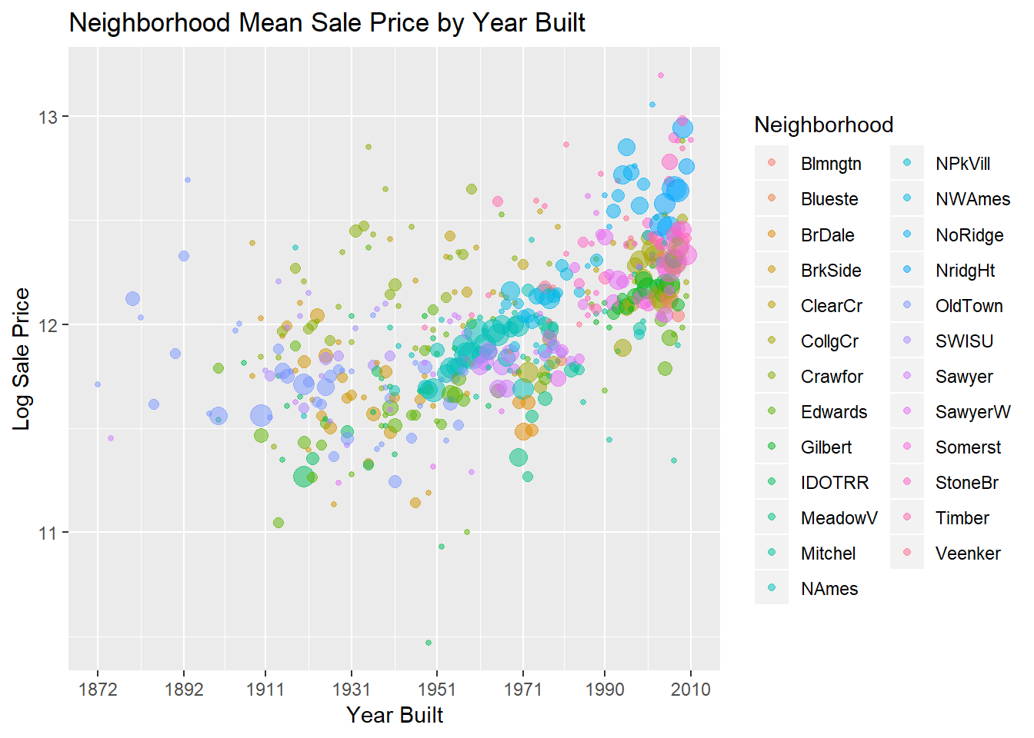
Exploratory Data Analysis Difference in neighborhoods explained
Price differences between neighborhoods can be explained
New neighborhoods pop up over time
Exponentially drives up average price
“Up and coming” effect
Gentrification?

Slide 5
Fitting Model Feature Selection
RAUL /ALE

Slide 6
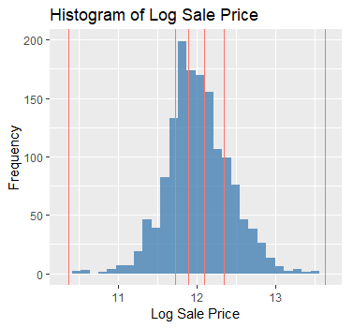
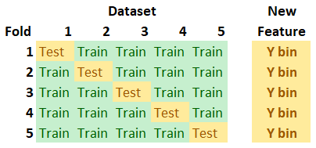
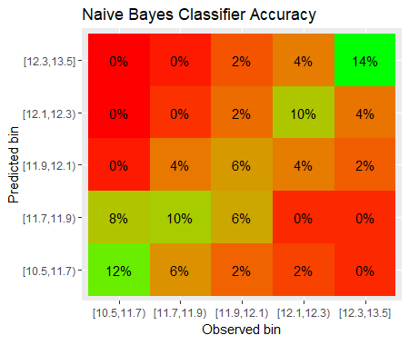
Fitting Model Naïve Bayes
Given a set of features, what is the probability of the house being in a certain price range?
Treat each house as a ‘basket’ of ‘items’ or features
Motivation: stacking up individual categorical features may ladder up into helpful information
Takeaway: We can assign probabilities to which price range the house is in

Slide 7
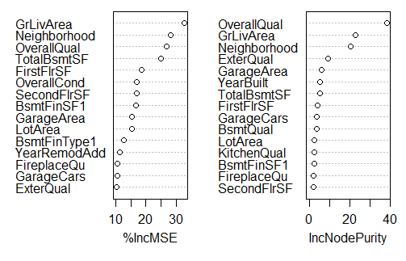
Fitting Model Feature Selection
Variable importance plot
Random forest variable importance tracking

