Slide 1
[Project Name] XXXXXXX

Slide 2
Agenda MY ROAD TO DISASTER
Project Objective
Workflow
Exploratory Data Analysis
Data Preparation: Feature Engineering, Transformation, Selection.
Selecting a Model
Feature Selection
Optimizing Model
Take Aways
Insights
Project Mgt: coordinating efforts;
GitHub
Exploring new models while executing the current

Slide 3
Project Objective XXXX
Goal: Anchor everyone in one objective.
Anything beyond just predicting house prices: winning, learning?
Simple statement + optional visual is fine (could be a team picture).

Slide 4
Workflow XXXX
Goal: Help ground everyone on how we got to the end (consistent with our objective).
Simple workflow. Example: Everyone tried everything > debated ideas > locked in best model. ALE
Language Chosen
Data Cleaning
Data/Feature Transformation
Feature Engineering
Feature Selection
Model Exploration

Slide 5
Exploratory Data Analysis XXXX
Goal: key learnings from the dataset that influenced the analysis.
Univariate vs. Multivariate
Numerical Data (scatter/bubble) vs Nominal Data
Nominal Data (boxplot).
RAUL

Slide 6
Data Preparation Feature Engineering
Goal: show data adjustments necessary to run analysis
Data Transformation: Target Variable: plot w & w/o log
Data Transformation: Predictors (Skewed)
Categorical: Dummy Variables
Missing Data: Plot % Missing Data, Imputing
New Variables (?)
Dealing with Outliers HELO

Slide 7
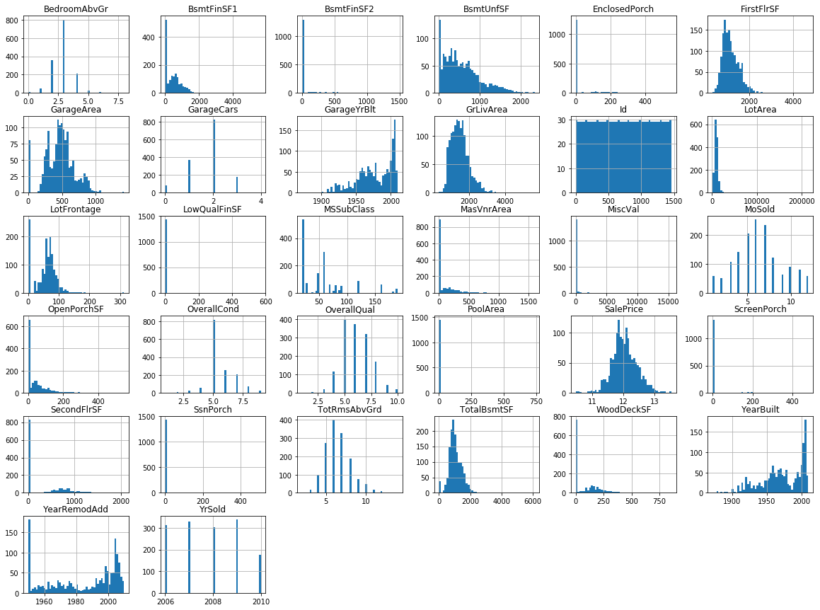
Data Preparation Feature Transformation
Features: Histograms
Candidates for Transformation
All Features show right skewness.
Analyzed if fit for some type of transformations..
Identified and analyzed 4 predictors
for transformation.

Slide 8
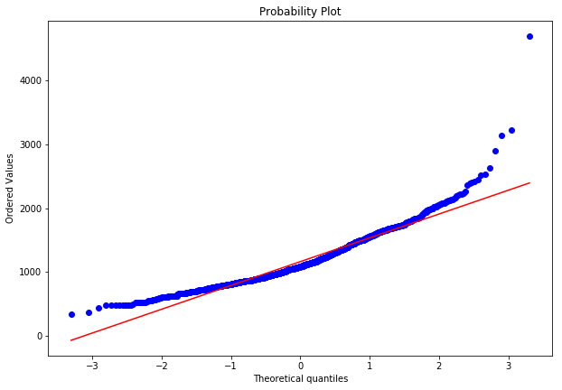
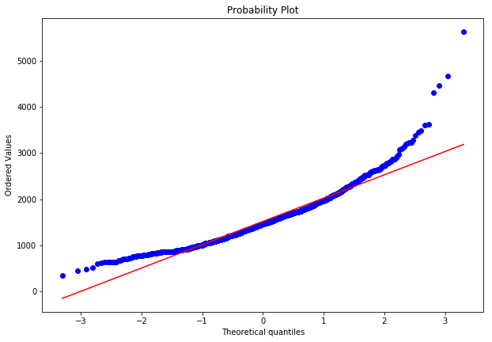
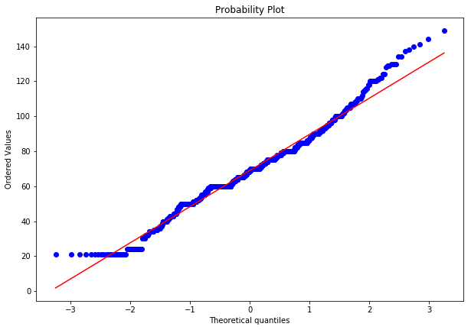
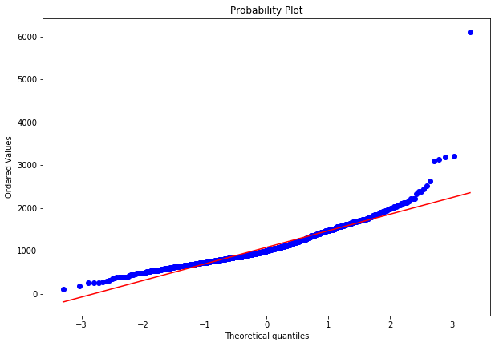
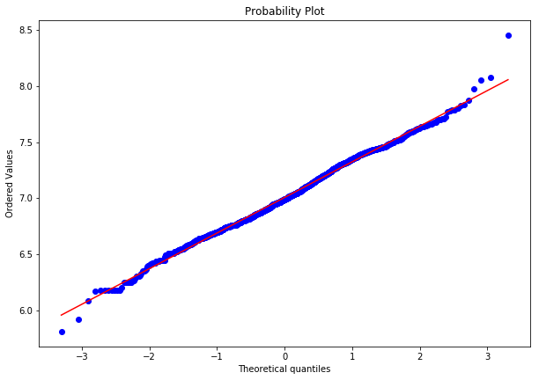
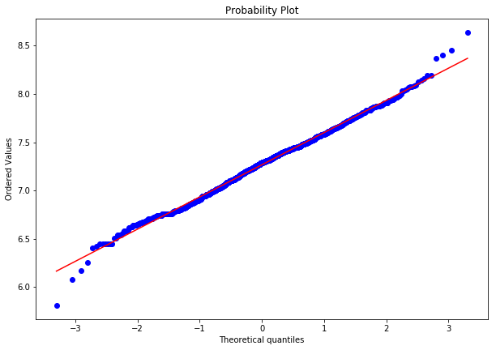
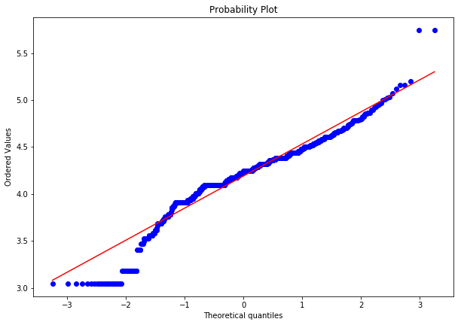
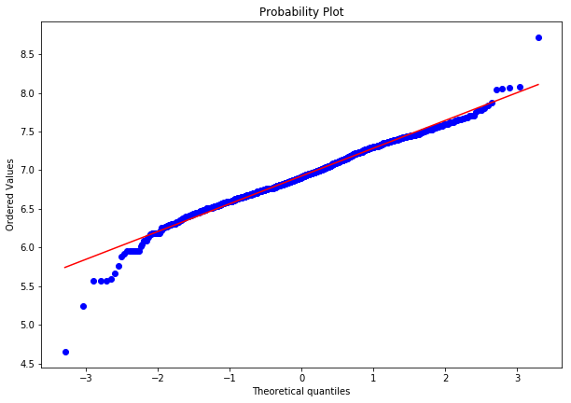
Data Preparation Feature Transformation
First Floor
FirstFlrSF
Living Area
GrLivArea
Lot Frontage
LotFrontage
Basement Area
TotalBsmtFF
QQ-Plot: Original Set
LOG
LOG
LOG
LOG
Kept Log Transformation
Kept Log Transformation
No Log,
Removed Outliers
No Log,
Removed Outliers
QQ-Plot: Log

Slide 9
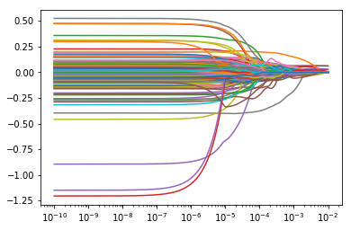
Selecting a Model Lasso Regression
Parameters
Coefficient vs Lambda
Y: log(SalePrice)
X: All Predictors (301*)
*Categorical: Dummyfied
Coefficients
Results
Coefficients Kept
11 of 301
R² Adj: 0.792
MSE: 0.0315 (low)
Alpha
We will try to find a smarter way to use the predictors.

Slide 10
Fitting Model Intro
HELO / AKAY

Slide 11
Fitting Model Feature Selection
RAUL /ALE

