Slide 1
Home Alone Adrian Kay Alejandro Esteve Heloisa Dutcocky Raul Vallejo

Slide 2
Agenda Our first Machine Learning Project!
Project Workflow
Exploratory Data Analysis
Data Preparation
Selecting a Model
Final Model
Final Considerations

Slide 3
Workflow All for one and one for all.
Team & Personal Objectives
Predict, Learn & Explore
Exploratory Data Analysis
Everyone gave it a run!
Data Processing
Everyone tried, but the best was used by all.
Selecting Model
Each picked (assigned) one. Some of us tried all :)
Final Model
Battle to the death. Only one model can stand.

Slide 4
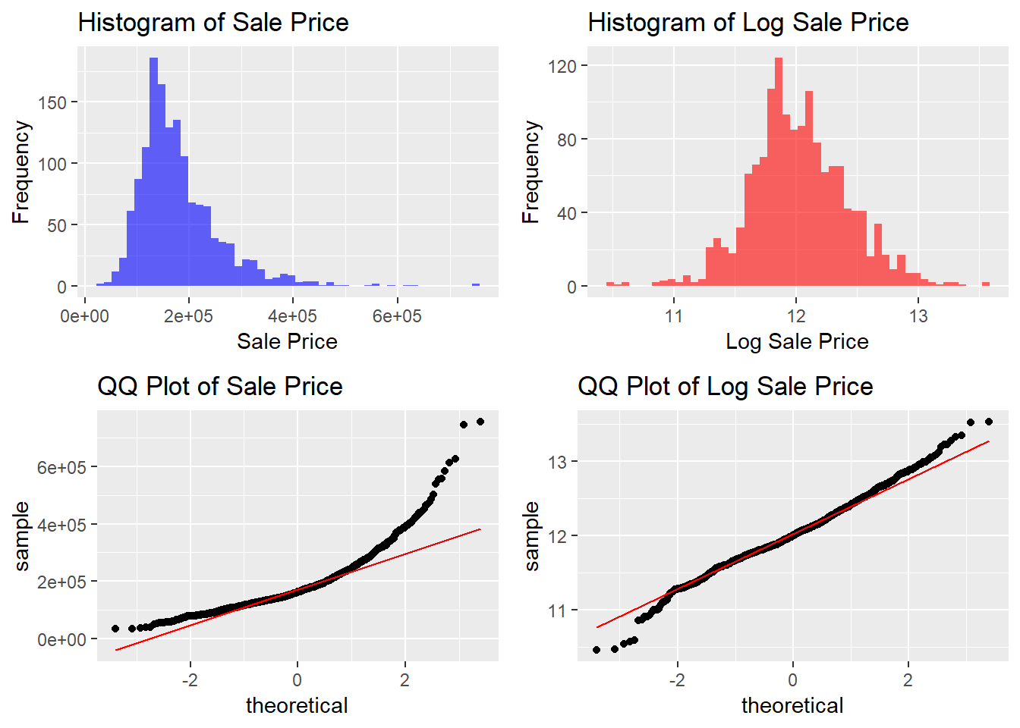
Exploratory Data Analysis Response Variable: First Look
Response Variable: Histogram & QQ-PLot
1. Takeaway
Histogram: Significant Right Skew
QQ plot: Log Transformation is not enough to correct heavy tails
Observations in the tails will be THE HARDEST TO PREDICT

Slide 5
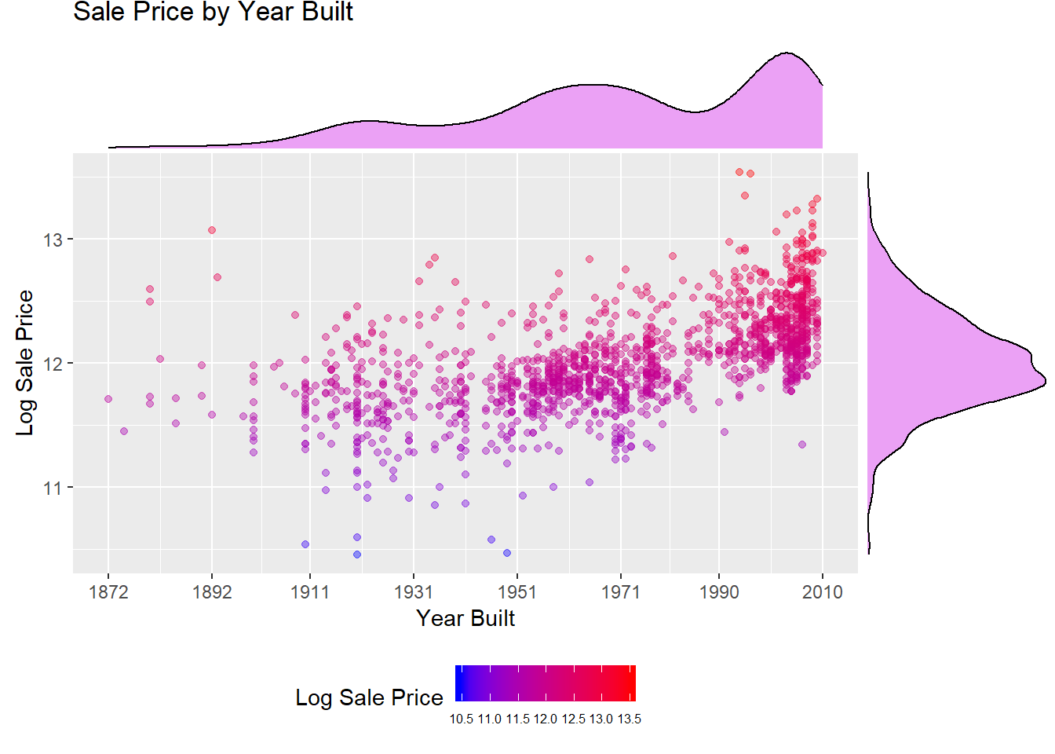
Exploratory Data Analysis Year Built: do new houses sell for higher prices?
Sales Price x Year Build
2. Takeaway
Positive correlation between the variables
Year Built density suggests there are 3 modes / building sprees

Slide 6
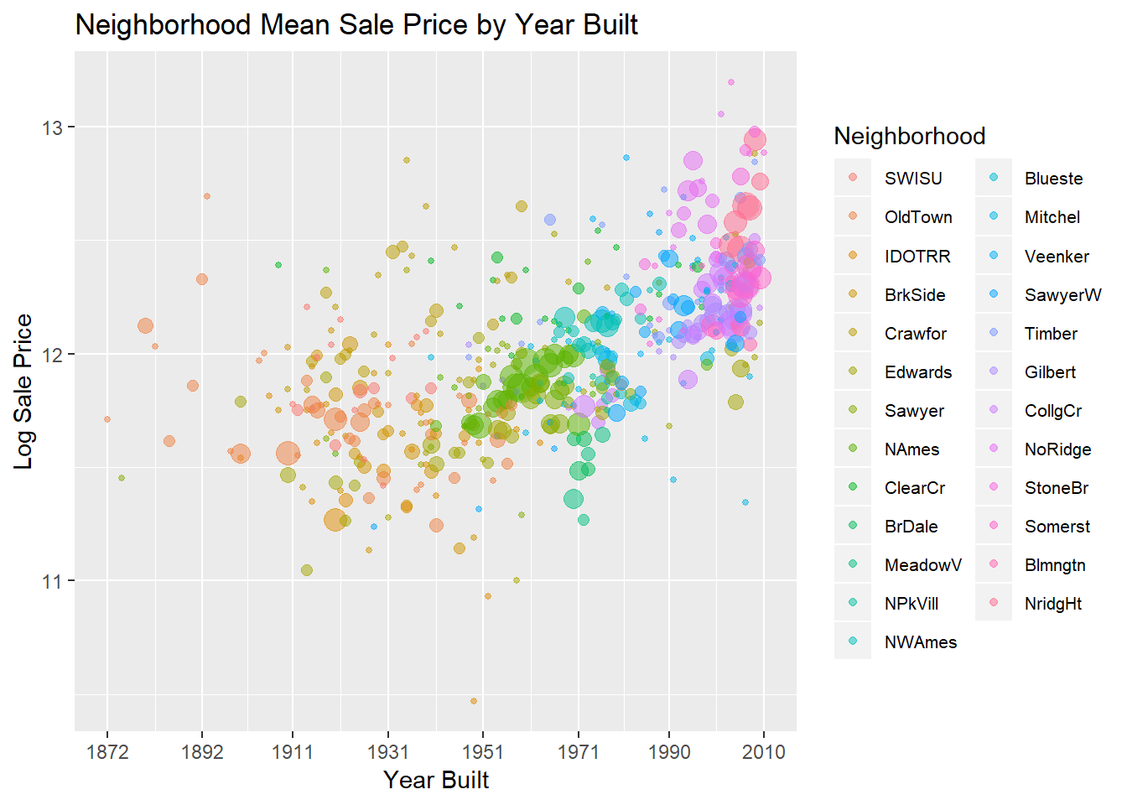
Exploratory Data Analysis Neighborhoods: differences explained
Sales Price x Year Build
3. Takeaway
Price differences between neighborhoods can be explained
New neighborhoods pop up over time
Exponentially drives up average price
“Up and coming” effect
Gentrification?

Slide 7
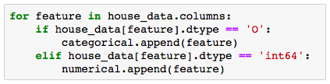


Data Preparation Pre-Processing: Missing Data and String Values “Fixing”
1. Missing Data Training Set
2. Features Classification
Imputing values
IMPORTANCE : Making sure models won’t ignore NAs meaning
Features with character values $→$ “CATEGORICAL”
Features with number values $→$ “NUMERICAL”
Decision:
ALL CATEGORICAL VALUES
+
ALL MNAR
=
CHARACTER IMPUTES
IMPORTANCE : Using appropriate models to each value type
3. Dummifying Character Values (Python)
Spreading features string levels to columns $→$ binary
Dropping dominant level $→$ default
Other Missing Values (Test Set) : Impute kNN values
IMPORTANCE : Allowing the use of all features in all models

Slide 8
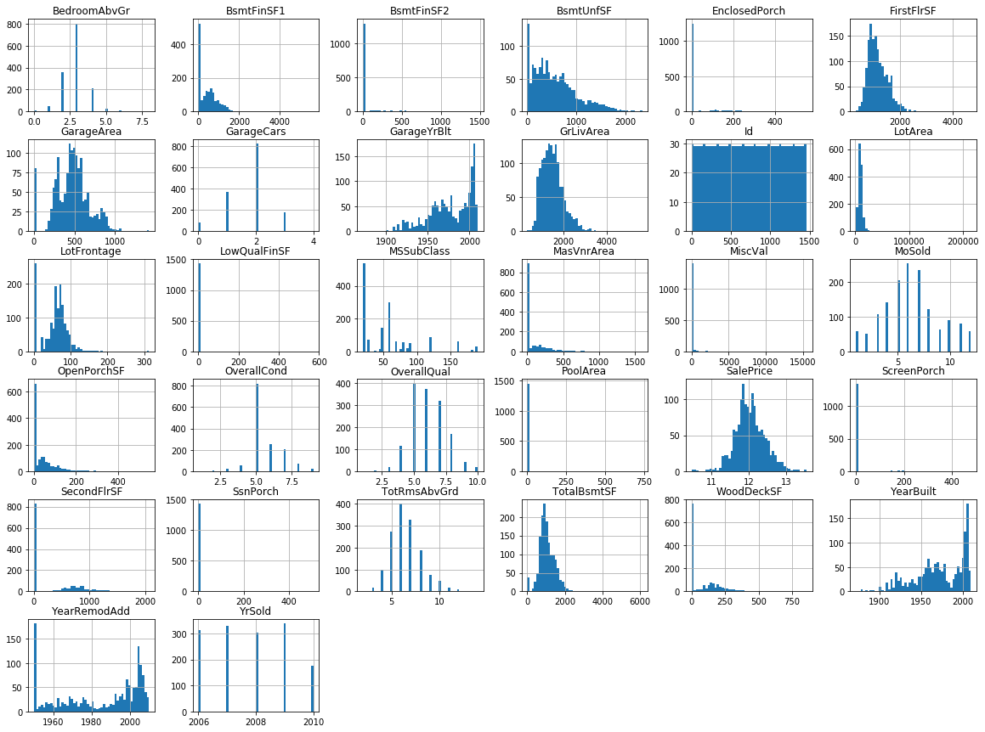
Data Preparation Feature Transformation: Identify Predictors
Features: Histograms
Candidates for Transformation
First Floor Sq Feet
Living Area
Lot Frontage
Total Basement Sq Feet
All Features show skewness.
Further analyzed if of transformations improved normality.
Identified and analyzed 4 predictors
for transformation.

Slide 9
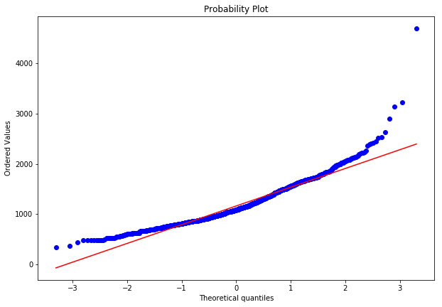
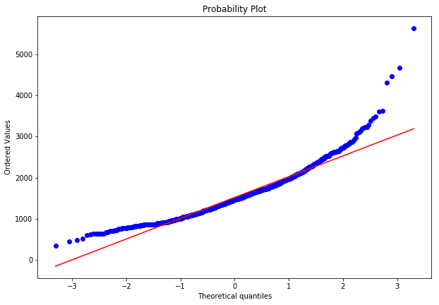
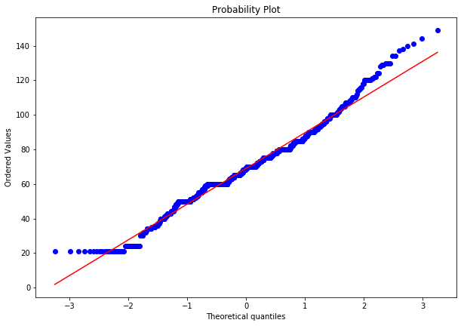
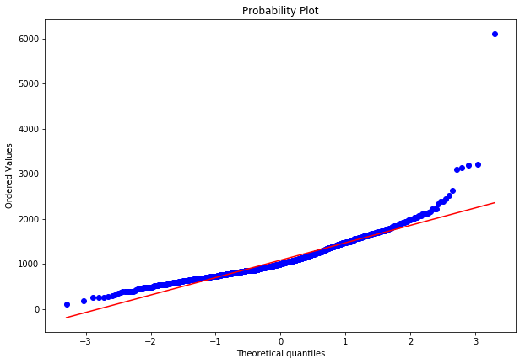
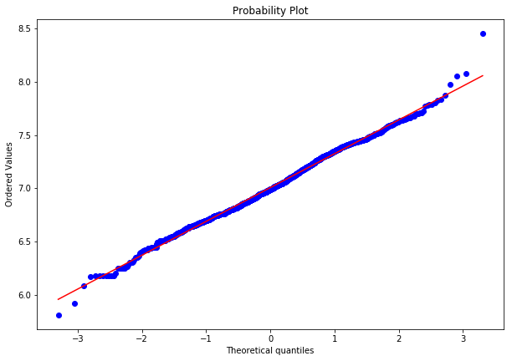
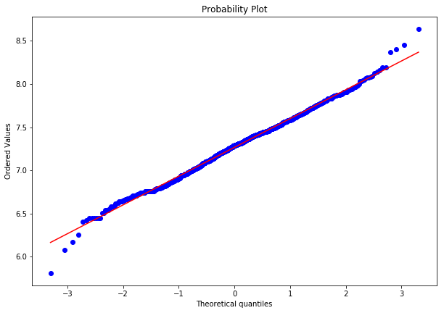
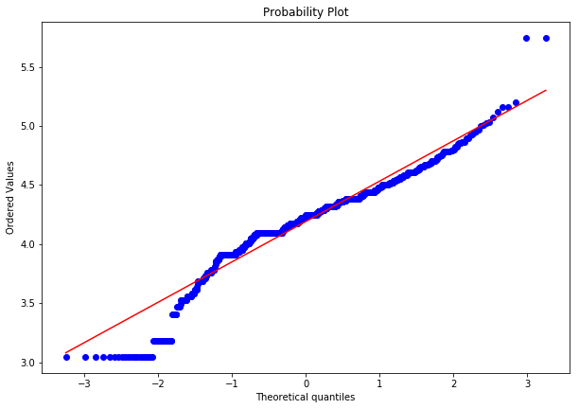
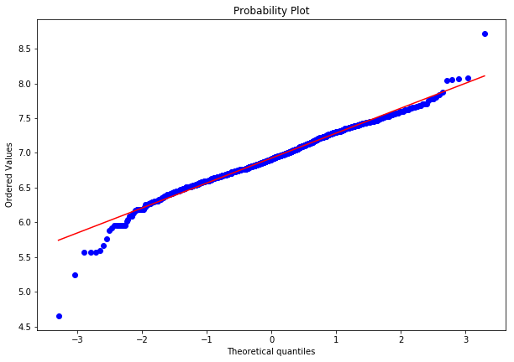
Data Preparation Feature Transformation: Log
First Floor
FirstFlrSF
Living Area
GrLivArea
Lot Frontage
LotFrontage
Basement Area
TotalBsmtFF
QQ-Plot: Original Set
LOG
LOG
LOG
LOG
Kept Log Transformation
Kept Log Transformation
No Log,
Removed Outliers
No Log,
Removed Outliers
QQ-Plot: Log

Slide 10




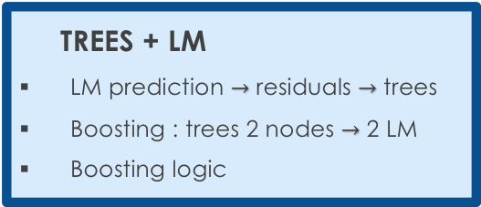

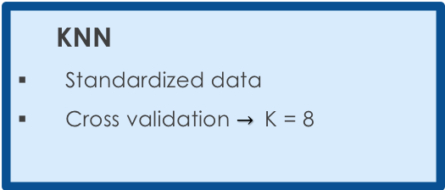
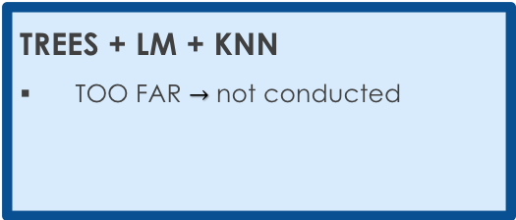
Selecting a Model Our approach to minimize the RMSE
BEST MODEL
DECISION TREES
Cost Complexity Tree Pruning
Random Forest and Boosting
LINEAR MODEL
Lasso, Ridge and Elastic Net
Stepwise AIC and cross validation
KNN
Standardized data
Cross validation $→$ K = 8
1
RMSE : 0.21
2
RMSE : 0.15
3
RMSE : 9.4
+ NAÏVE BAYES $→$ RMSE : 0.14
+ NAÏVE BAYES $→$ RMSE : 0.13
RMSE : 0.14
TREES + LM
LM prediction $→$ residuals $→$ trees
Boosting : trees 2 nodes $→$ 2 LM
Boosting logic
LM + KNN
p linear models
Knn (k = 1) for beta selection
4
RMSE : 0.3
5
n/a
+ NAÏVE BAYES $→$ RMSE : ?
+ NAÏVE BAYES $→$ RMSE : 0.11
n/a
RMSE : 9.7
TREES + LM + KNN
TOO FAR $→$ not conducted
+
RMSE : ?
NAÏVE BAYES
Combining categorical variables
+ NAÏVE BAYES $→$ RMSE : ?

Slide 11
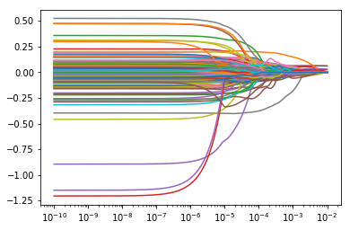
Selecting a Model Lasso Regression: decent R² Adj.; poor use of Features
Parameters
Coefficient vs Lambda
Y: log(SalePrice)
X: All Predictors (301*)
*Categorical: Dummyfied
Coefficients
Coefficients Kept
11 of 301
Results
R² Adj: 0.792
MSE: 0.0315 (low)
Alpha
NO GO!
We will try to find a smarter way to use the predictors.

Slide 12
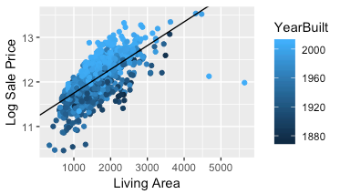
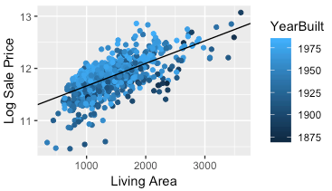
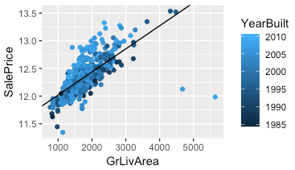


Selecting a Model Boosting trees combined with linear models
Logics $→$ split groups to reduce linear model RSS
Results
Sale Prices x Living Area $→$ Year Built cut
Example
Iteration : tree $→$each node has its own linear models
Stepwise operation required each time to select the best features
Too much computational power required!
Derail cross validations to select best features
Year Built < 1984
Year Built > 1984
RSS = 118
NO GO!
We need to keep it more simple.
RSS = 52
RSS = 28

Slide 13
Final Model Initial Explanation
LOOK AT THE WHITE BOARD

Slide 14
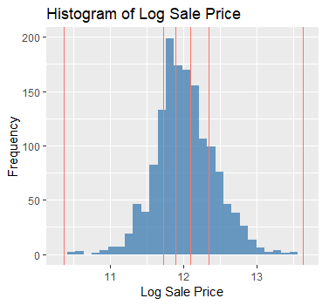
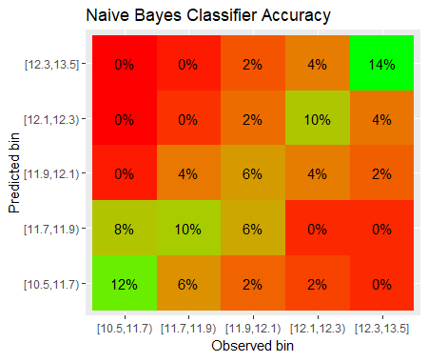
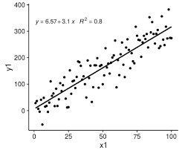
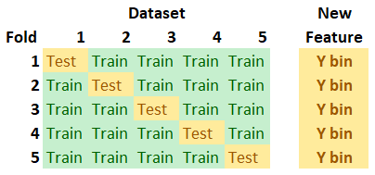
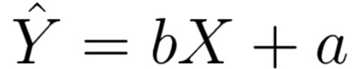
Final Model Step 1: Naïve Bayes
Given a set of features, what is the probability of the house being in a certain price range?
Treat each house as a ‘basket’ of ‘items’ or features
Motivation: stacking up individual categorical features may ladder up into helpful information
Takeaway: We can assign probabilities to which price range the house is in
1. Create Bins
2. Assign Probabilities
3. Bucket House
4. Run Linear Reg.

Slide 15
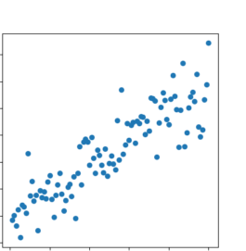
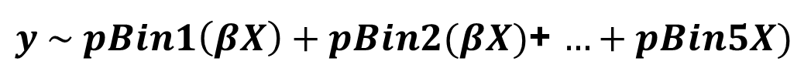
Final Model Step 2: Linear Regression Model
5. Stepwise Operation
7. Final Model & Prediction
Reduced 31 numeric variables to 17 significate variable through stepwise forward AIC
$pBin1\left(βX\right) pBin2(βX)$ $pBin3\left(βX\right) pBin4βX) pBin5βX)$
RMSE: 0.13
6. Multiple Linear Regression with Buckets
With probabilities from Naïve Bayes, we segmented the data to fit 5 models.
$y \sim pBin1\left(βX\right)+pBin2(βX)$+ $…+pBin5X)$

Slide 16
Final Considerations Great experience
PROJECT MANAGEMENT
First alignments – objectives & workflow – is key!
Designating roles is tough, since steps are interdependent.
Discipline is key, but tough, due to complexity.
Possible, but tough to work with different programming languages (R & Python)
Communication & Files: Slack & GitHub are good, but not enough.
MODELING
Interesting to see pros/cons of each model in dealing with different types of variables.
Hard to identify overfitting – especially when joining models
Tough to assess computational power required.

Slide 17
Questions? …and Thank You!

