Slide 1
[Project Name] XXXXXXX

Slide 2
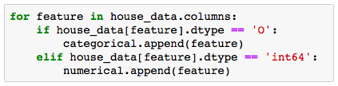


Pre-Processing Missing Data and string values “fixing”
Missing data Training set
Features classification
Imputing values
IMPORTANCE : Making sure models won’t ignore NAs meaning
Features with character values $→$ “CATEGORICAL”
Features with number values $→$ “NUMERICAL”
Decision:
ALL CATEGORICAL VALUES
+
ALL MNAR
=
CHARACTER IMPUTES
IMPORTANCE : Using appropriate models to each value type
Feature | Features meaning | NA meaning | Impute
Alley | Type of alley access | No alley access | "NoAlley"
BsmtQual | Height of the basement | No basement | "NoBsmt"
BsmtCond | Basement condition | No basement | "NoBsmt"
BsmtExposure | Walkout or garden level walls | No basement | "NoBsmt"
BsmtFinType | Rating of basement area | No basement | "NoBsmt"
FireplaceQu | Fireplace quality | No fireplace | "NoFire"
GarageType | Garage location | No garage | "NoGarage"
GarageFinish | Interior finish of the garage | No garage | "NoGarage"
GarageQual | Garage quality | No garage | "NoGarage"
GarageCond | Garage condition | No garage | "NoGarage"
PoolQC | Pool quality | No pool | "NoPool"
Fence | Fence quality | No fence | "NoFence"
MiscFeature | Extra features (not covered) | No other features | "None"
NOT NECESSARY: I just added because I see it as a easy way to see the logic, but it sure can be removed
Dummifying character values - Python
Spreading features string levels to columns $→$ binary
Dropping dominant level $→$ default
IMPORTANCE : Allowing the use of all features in all models

Slide 3


Pre-Processing Dealing with missing data and features with string values
1. Missing Data Training Set
2. Features Classification
IMPORTANCE : Making sure models won’t ignore NAs meaning
Features with character values $→$ “CATEGORICAL”
Features with number values $→$ “NUMERICAL”
Decision:
ALL CATEGORICAL VALUES
+
ALL MNAR
=
CHARACTER IMPUTES
IMPORTANCE : Using appropriate models to each value type
Feature | Features meaning | NA meaning | Impute
Alley | Type of alley access | No alley access | "NoAlley"
BsmtCond | Basement condition | No basement | "NoBsmt"
BsmtExposure | Walkout or garden level walls | No basement | "NoBsmt"
FireplaceQu | Fireplace quality | No fireplace | "NoFire"
GarageType | Garage location | No garage | "NoGarage"
GarageQual | Garage quality | No garage | "NoGarage"
PoolQC | Pool quality | No pool | "NoPool"
Fence | Fence quality | No fence | "NoFence"
MiscFeature | Extra features (not covered) | No other features | "None"
3. Dummifying Character Values (Python)
Spreading features string levels to columns $→$ binary
Dropping dominant level $→$ default
IMPORTANCE : Allowing the use of all features in all models

Slide 4


Pre-Processing Missing Data and string values “fixing”
1. Missing Data Training Set
3. Features Classification
IMPORTANCE : Making sure models won’t ignore NAs meaning
Features with character values $→$ “CATEGORICAL”
Features with number values $→$ “NUMERICAL”
Decision:
ALL CATEGORICAL VALUES
+
ALL MNAR
=
CHARACTER IMPUTES
IMPORTANCE : Using appropriate models to each value type
4. Dummifying Character Values (Python)
2. Missing Data Test Set
Spreading features string levels to columns $→$ binary
Dropping dominant level $→$ default
MCAR $→$Knn impute with k =
IMPORTANCE : Allowing the fitted model prediction
IMPORTANCE : Allowing the use of all features in all models

Slide 5




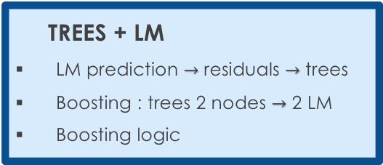


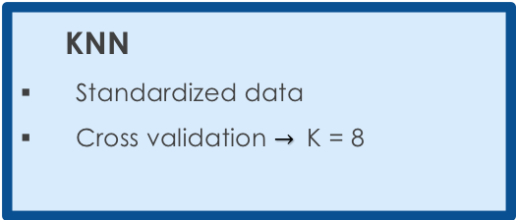
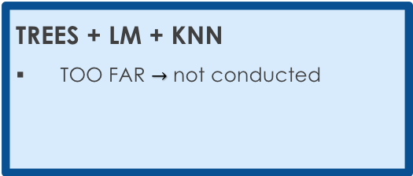
Selecting a Model Our approach to minimize the RMSE
Update RMSE
DECISION TREES
Cost Complexity Tree Pruning
Random Forest and Boosting
LINEAR MODEL
Lasso, Ridge and Elastic Net
Stepwise AIC and cross validation
KNN
Standardized data
Cross validation $→$ K = 8
1
RMSE : 0.11
2
RMSE : 0.11
3
RMSE : 0.11
+ NAÏVE BAYES $→$ RMSE : 0.11
+ NAÏVE BAYES $→$ RMSE : 0.11
+ NAÏVE BAYES $→$ RMSE : 0.11
TREES + LM
LM prediction $→$ residuals $→$ trees
Boosting : trees 2 nodes $→$ 2 LM
Boosting logic
LM + KNN
p linear models
Knn (k = 1) for beta selection
4
RMSE : 0.11
5
RMSE : 0.11
+ NAÏVE BAYES $→$ RMSE : 0.11
+ NAÏVE BAYES $→$ RMSE : 0.11
TREES + LM + KNN
TOO FAR $→$ not conducted
+
RMSE : ?
NAÏVE BAYES
Combining categorical variables
+ NAÏVE BAYES $→$ RMSE : ?

Slide 6
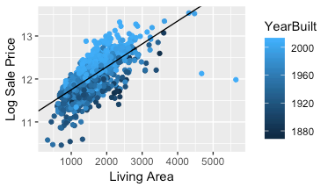
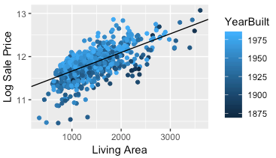
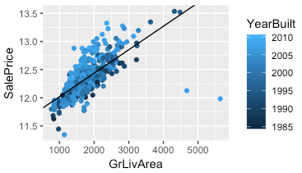


Selecting a Model Boosting trees combined with linear models
TREES + LM
RMSE : 0.11
Logics $→$ split groups to reduce linear model RSS
Results
Sale Prices x Living Area $→$ Year Built cut
Example
Iteration : tree $→$each node has its own linear models
Stepwise operation required each time to select the best features
Too much computational power required!
Derail cross validations to select best features
Year Built < 1984
Year Built > 1984
RSS = 118
NO GO!
We need to keep it simple.
RSS = 52
RSS = 28

Slide 7
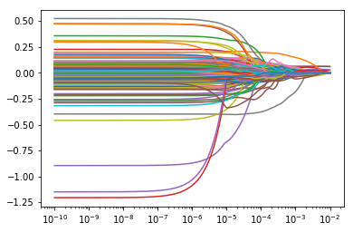
Selecting a Model Lasso Regression: decent R² Adj.; poor use of Features
Parameters
Coefficient vs Lambda
Y: log(SalePrice)
X: All Predictors (301*)
*Categorical: Dummyfied
Coefficients
Coefficients Kept
11 of 301
Results
R² Adj: 0.792
MSE: 0.0315 (low)
Alpha
NO GO!
We will try to find a smarter way to use the predictors.

