Slide 1
My First ML Project Adrian Kay Alejandro Esteve Heloisa Dutcocky Raul Vallejo

Slide 2
Agenda MY ROAD TO DISASTER
Workflow
Project Objective
Exploratory Data Analysis
Data Preparation
Selecting a Model
Final Model
Final Considerations

Slide 3
Workflow All for one and one for all.
Team & Personal Objectives
Predict, Learn & Explore
Exploratory Data Analysis
Everyone gave it a run!
Data Processing
Everyone tried, best was used by all.
Model Optimization
Each picked (assigned) one. Some of us tried all :)
Final Model
Battle to the death. Only one model can stand.

Slide 4
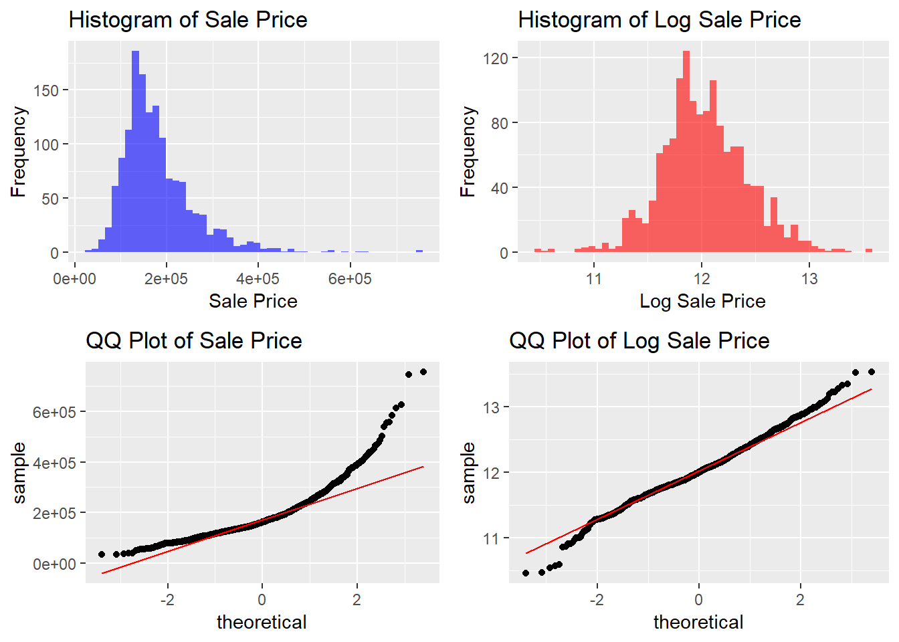
Exploratory Data Analysis Response Variable: Frist Look
Response Variable: Histogram & QQ-PLot
1. Takeaway
Histogram: Significant Right Skew
QQ plot: Log Transformation is not enough to correct heavy tails
Observations in the tails will be THE HARDEST TO PREDICT

Slide 5
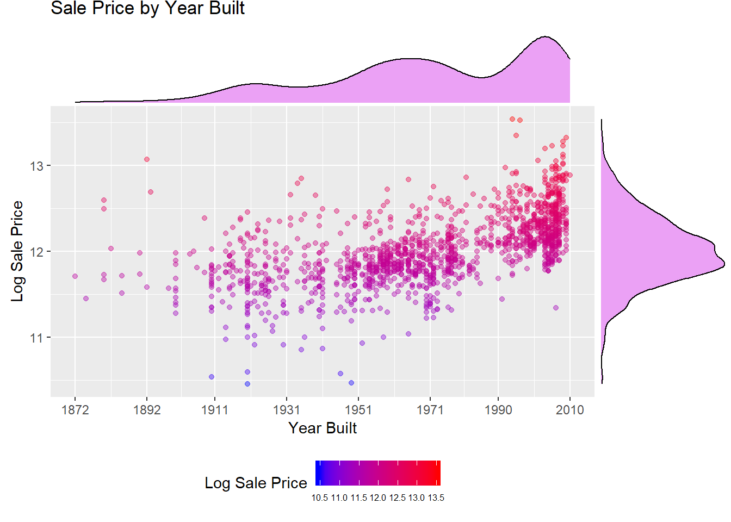
Exploratory Data Analysis Year Built: do new houses sell for higher prices?
Sales Price x Year Build
2. Takeaway
Positive correlation between the variables
Year Built density suggests there are 3 modes / building sprees

Slide 6
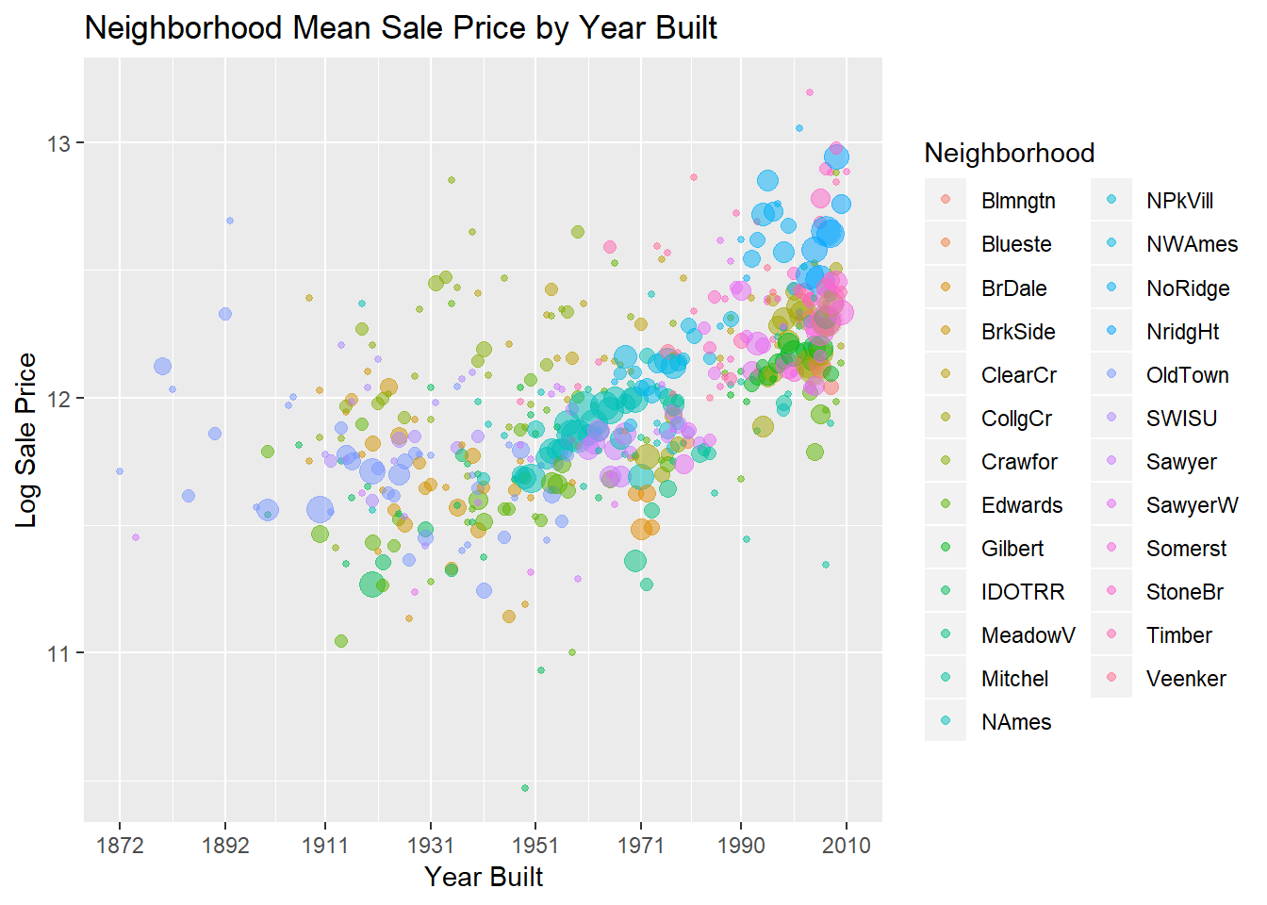
Exploratory Data Analysis Neighborhoods: differences explained
Sales Price x Year Build
3. Takeaway
Price differences between neighborhoods can be explained
New neighborhoods pop up over time
Exponentially drives up average price
“Up and coming” effect
Gentrification?

Slide 7
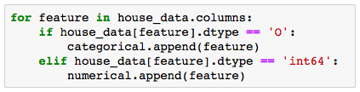


Pre-Processing Missing Data and string values “fixing”
1. Missing Data Training Set
2. Features Classification
Imputing values
IMPORTANCE : Making sure models won’t ignore NAs meaning
Features with character values $→$ “CATEGORICAL”
Features with number values $→$ “NUMERICAL”
Decision:
ALL CATEGORICAL VALUES
+
ALL MNAR
=
CHARACTER IMPUTES
IMPORTANCE : Using appropriate models to each value type
3. Dummifying Character Values (Python)
Spreading features string levels to columns $→$ binary
Dropping dominant level $→$ default
IMPORTANCE : Allowing the use of all features in all models

Slide 8
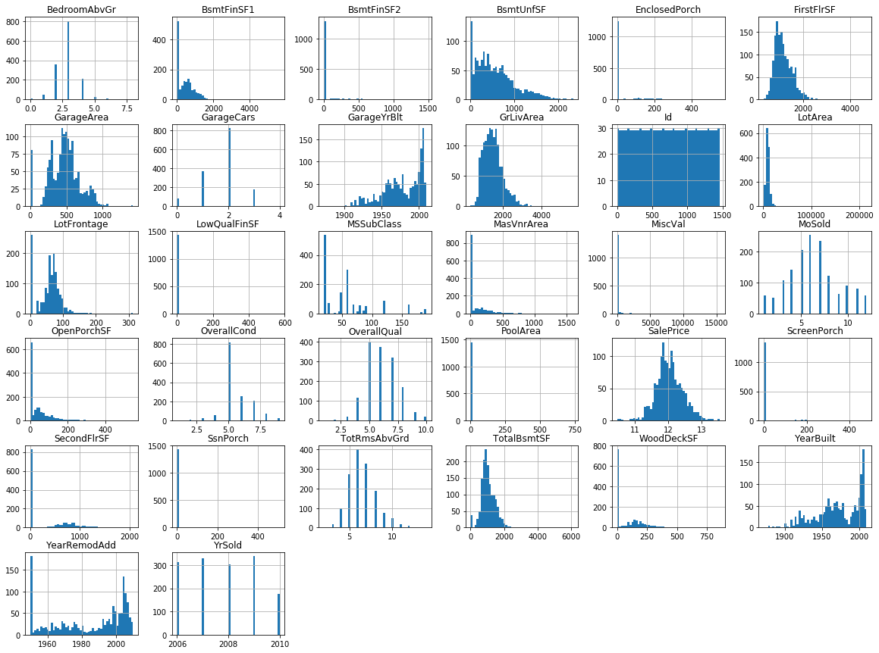
Data Preparation Feature Transformation: Identify Predictors
Features: Histograms
Candidates for Transformation
All Features show right skewness.
Analyzed if fit for some type of transformations..
Identified and analyzed 4 predictors
for transformation.

Slide 9
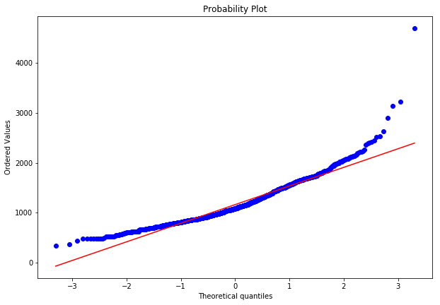
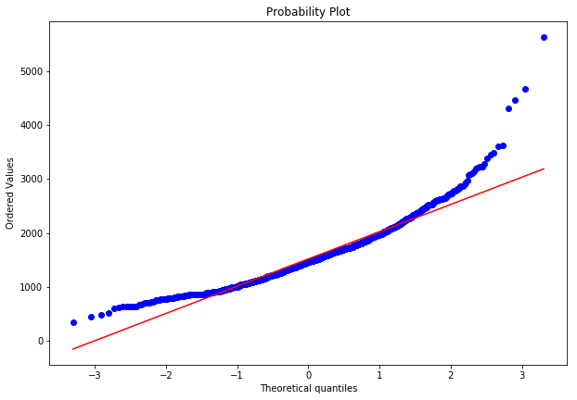
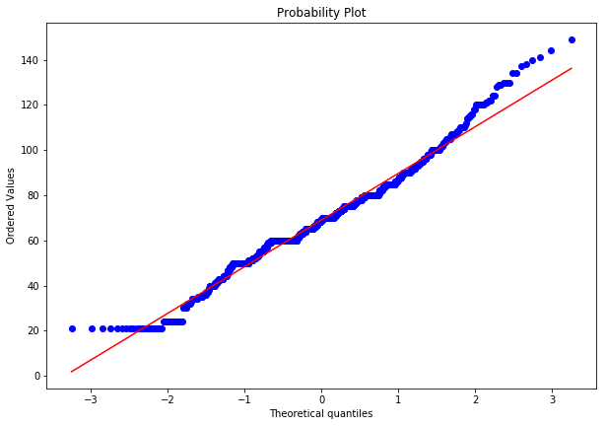
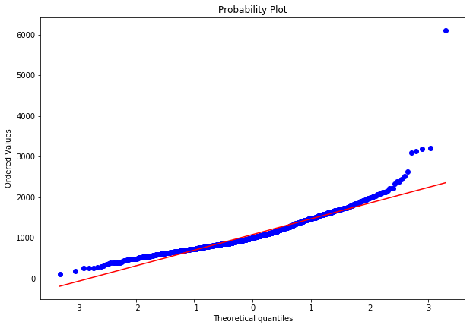
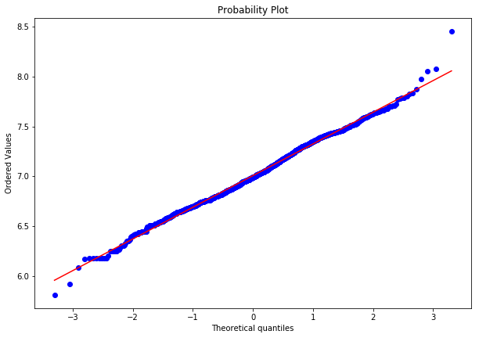
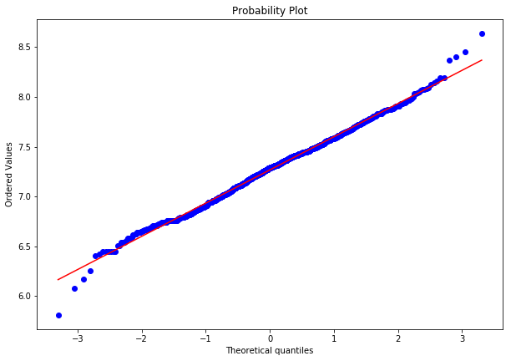
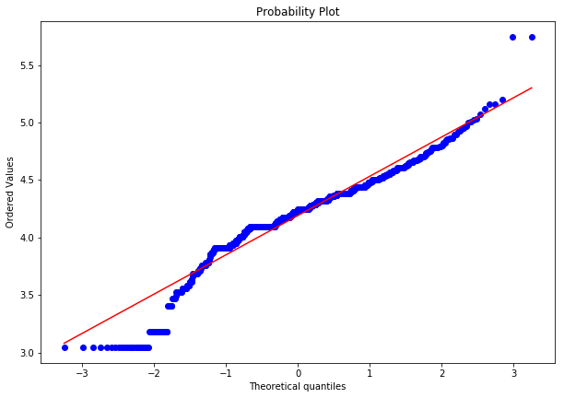
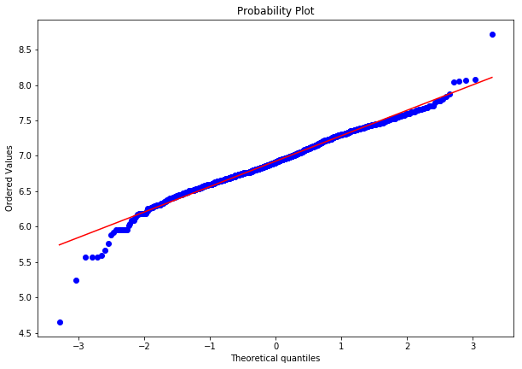
Data Preparation Feature Transformation: Log
First Floor
FirstFlrSF
Living Area
GrLivArea
Lot Frontage
LotFrontage
Basement Area
TotalBsmtFF
QQ-Plot: Original Set
LOG
LOG
LOG
LOG
Kept Log Transformation
Kept Log Transformation
No Log,
Removed Outliers
No Log,
Removed Outliers
QQ-Plot: Log

Slide 10
Selecting a Model Exploration: Try everything
Helo
Everyone send Kaggle Scores

Slide 11
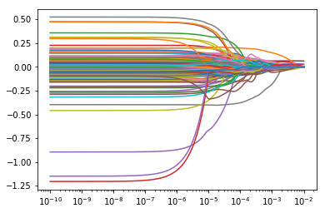
Selecting a Model Lasso Regression: decent R² Adj.; poor use of Features
Parameters
Coefficient vs Lambda
Y: log(SalePrice)
X: All Predictors (301*)
*Categorical: Dummyfied
Coefficients
Coefficients Kept
11 of 301
Results
R² Adj: 0.792
MSE: 0.0315 (low)
Alpha
NO GO!
We will try to find a smarter way to use the predictors.

Slide 12
Selecting a Model XXXXX
Helo (Optional)

Slide 13
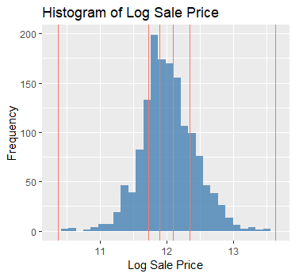
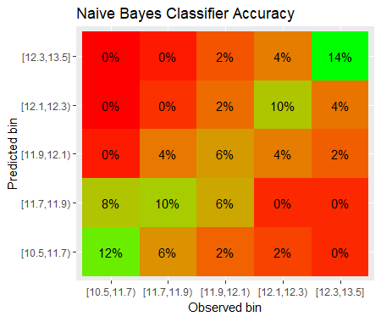
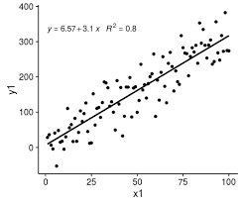
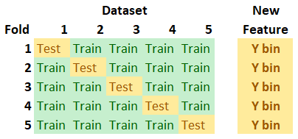
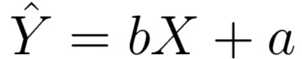
Final Model Step 1: Naïve Bayes
Given a set of features, what is the probability of the house being in a certain price range?
Treat each house as a ‘basket’ of ‘items’ or features
Motivation: stacking up individual categorical features may ladder up into helpful information
Takeaway: We can assign probabilities to which price range the house is in
1. Create Bins
2. Assign Probabilities
3. Bucket House
4. Run Linear Reg.

Slide 14
Final Model Step 2: Linear Regression Model
Akay

Slide 15
Final Considerations XXXX
Process
Project Management
Team Dynamics
Selecting a Model
.

