Slide 1
[Project Name] XXXXXXX

Slide 2
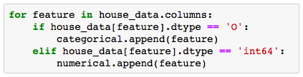

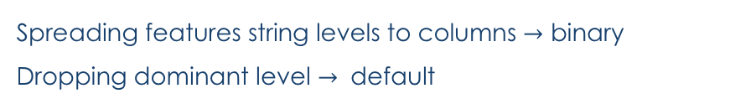
Pre-Processing Missing Data and string values “fixing”
Missing data Training set
Features classification
Imputing values
IMPORTANCE : Making sure models won’t ignore NAs meaning
Features with character values $→$ “CATEGORICAL”
Features with number values $→$ “NUMERICAL”
Decision:
ALL CATEGORICAL VALUES
+
ALL MNAR
=
CHARACTER IMPUTES
IMPORTANCE : Using appropriate models to each value type
Feature | Features meaning | NA meaning | Impute
Alley | Type of alley access | No alley access | "NoAlley"
BsmtQual | Height of the basement | No basement | "NoBsmt"
BsmtCond | Basement condition | No basement | "NoBsmt"
BsmtExposure | Walkout or garden level walls | No basement | "NoBsmt"
BsmtFinType | Rating of basement area | No basement | "NoBsmt"
FireplaceQu | Fireplace quality | No fireplace | "NoFire"
GarageType | Garage location | No garage | "NoGarage"
GarageFinish | Interior finish of the garage | No garage | "NoGarage"
GarageQual | Garage quality | No garage | "NoGarage"
GarageCond | Garage condition | No garage | "NoGarage"
PoolQC | Pool quality | No pool | "NoPool"
Fence | Fence quality | No fence | "NoFence"
MiscFeature | Extra features (not covered) | No other features | "None"
NOT NECESSARY: I just added because I see it as a easy way to see the logic, but it sure can be removed
Dummifying character values - Python
Spreading features string levels to columns $→$ binary
Dropping dominant level $→$ default
IMPORTANCE : Allowing the use of all features in all models

Slide 3





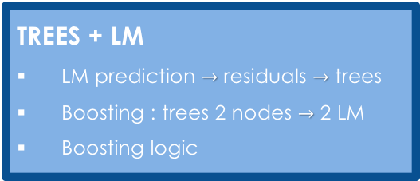

Selecting a Model Our approach to minimize the RMSE
RMSEs will be updated
DECISION TREES
Cost Complexity Tree Pruning
Random Forest and Boosting
LINEAR REGRESSION
Lasso, Ridge and Elastic Net
Stepwise AIC and cross validation
KNN
?
RMSE : 0.11
RMSE : 0.11
RMSE : 0.11
+ NAÏVE BAYES $→$ RMSE : 0.11
+ NAÏVE BAYES $→$ RMSE : 0.11
+ NAÏVE BAYES $→$ RMSE : 0.11
TREES + LM
LM prediction $→$ residuals $→$ trees
Boosting : trees 2 nodes $→$ 2 LM
Boosting logic
LM + KNN
p linear models
Knn (k = 1) for beta selection
RMSE : 0.11
RMSE : 0.11
+ NAÏVE BAYES $→$ RMSE : 0.11
+ NAÏVE BAYES $→$ RMSE : 0.11
TREES + LM + KNN
?
NAÏVE BAYES
Combining categorical variables
RMSE : 0.11
+ NAÏVE BAYES $→$ RMSE : 0.11
I’ll do this one just to keep the structure

