Slide 1
[Project Name] XXXXXXX

Slide 2
Agenda MY ROAD TO DISASTER
Workflow
Project Objective
Exploratory Data Analysis
Data Preparation
Selecting a Model
Final Model
Final Considerations

Slide 3
Workflow XXXX
Team & Personal Objectives
Team: Finding the best prediction
Learning & Exploring
R & Python: Each focused on language of choice
EDA
XXXX
Model Explorations
XXXX
Model Optimization
XXXX
Final Considerations
XXXX

Slide 4
Project Objective XXXX
Send ideas on Slack

Slide 5
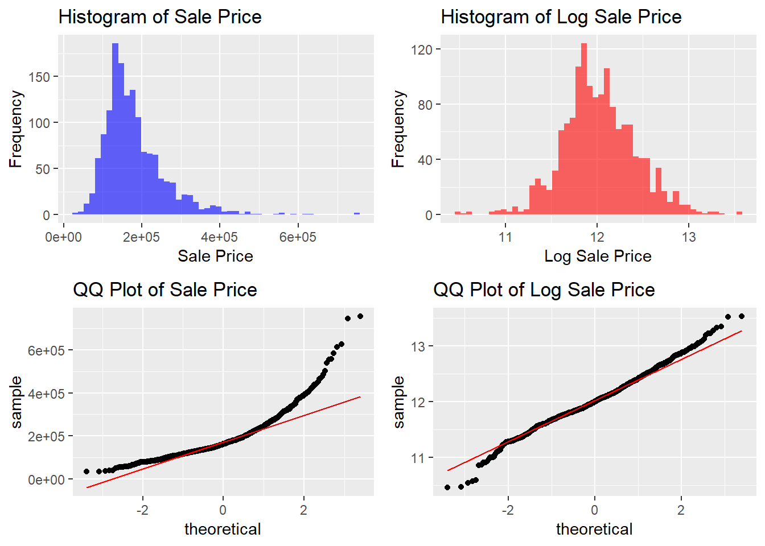
Exploratory Data Analysis Response Variable: Frist Look
Response Variable: Histogram & QQ-PLot
1. Takeaway
Histogram: Significant Right Skew
QQ plot: Log Transformation is not enough to correct heavy tails
Observations in the tails will be THE HARDEST TO PREDICT

Slide 6
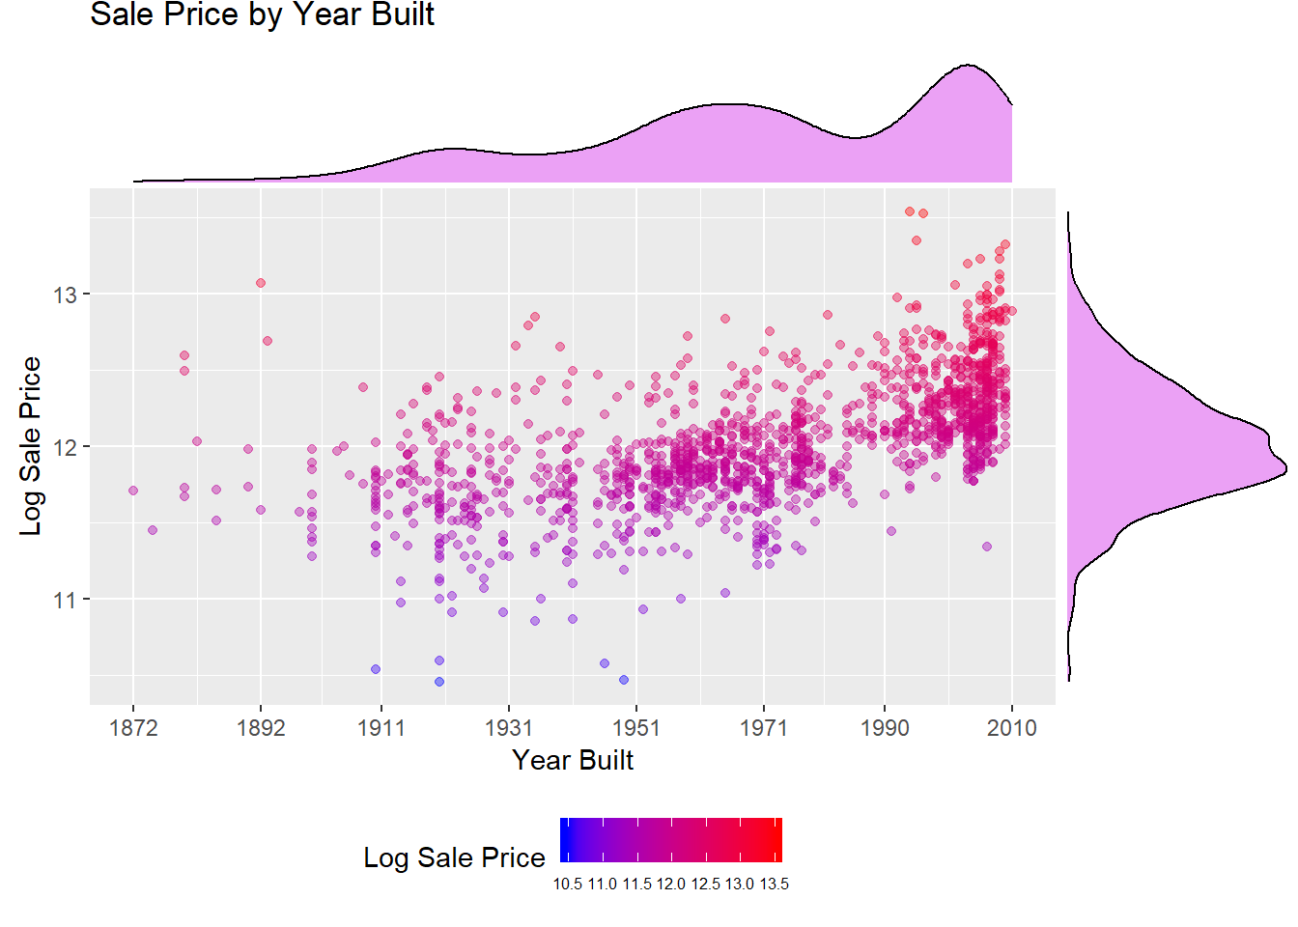
Exploratory Data Analysis Year Built: do new houses sell for higher prices?
Sales Price x Year Build
2. Takeaway
Positive correlation between the variables
Year Built density suggests there are 3 modes / building sprees

Slide 7
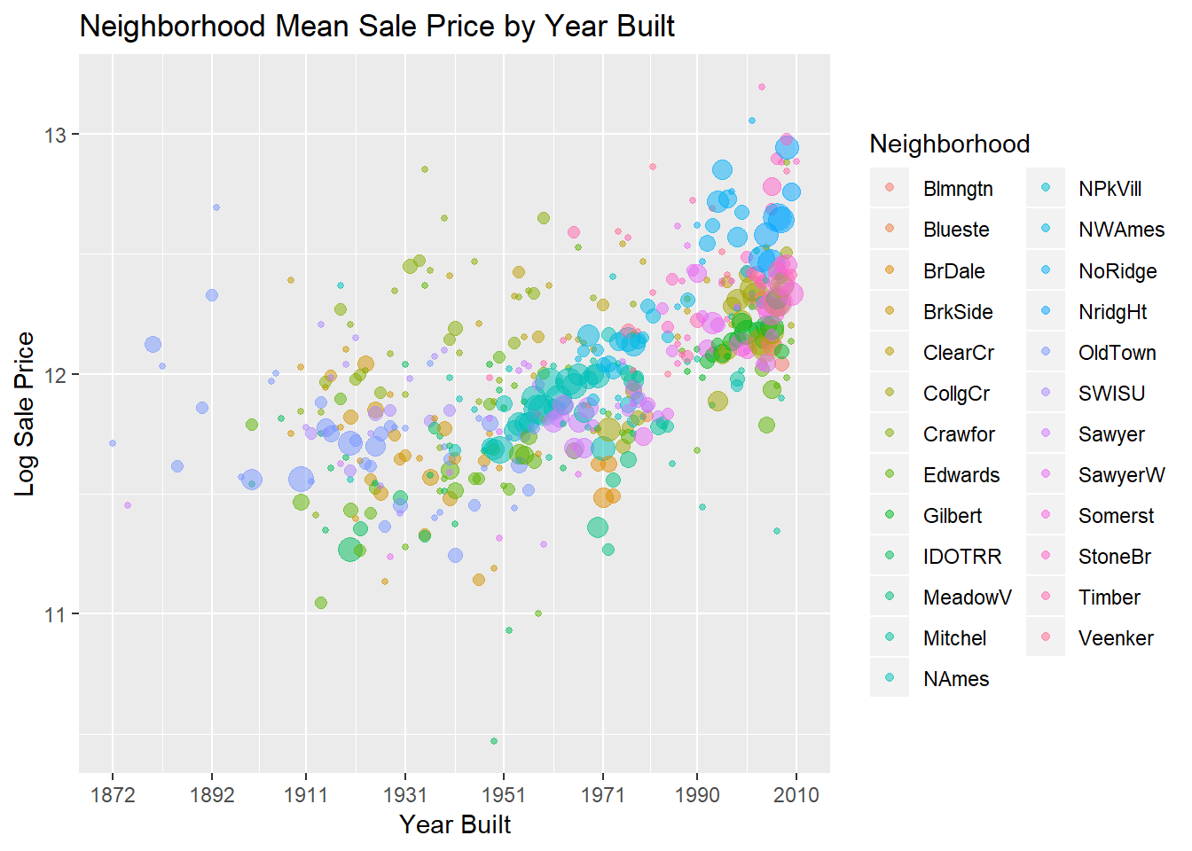
Exploratory Data Analysis Neighborhoods: differences explained
Sales Price x Year Build
3. Takeaway
Price differences between neighborhoods can be explained
New neighborhoods pop up over time
Exponentially drives up average price
“Up and coming” effect
Gentrification?

Slide 8
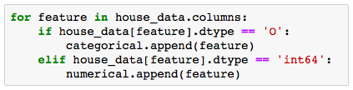



Pre-Processing Missing Data and string values “fixing”
1. Missing Data Training and Test Set
2. Features Classification
IMPORTANCE : Making sure models won’t ignore NAs meaning
Features with character values $→$ “CATEGORICAL”
Features with number values $→$ “NUMERICAL”
Decision:
ALL CATEGORICAL VALUES
+
ALL MNAR
=
CHARACTER IMPUTES
IMPORTANCE : Using appropriate models to each value type
3. Dummifying Character Values (Python)
Spreading features string levels to columns $→$ binary
Dropping dominant level $→$ default
Other Missing Values (Test Set) $→$ MCAR : Impute kNN values (k = 1)
IMPORTANCE : Allowing the use of all features in all models

Slide 9
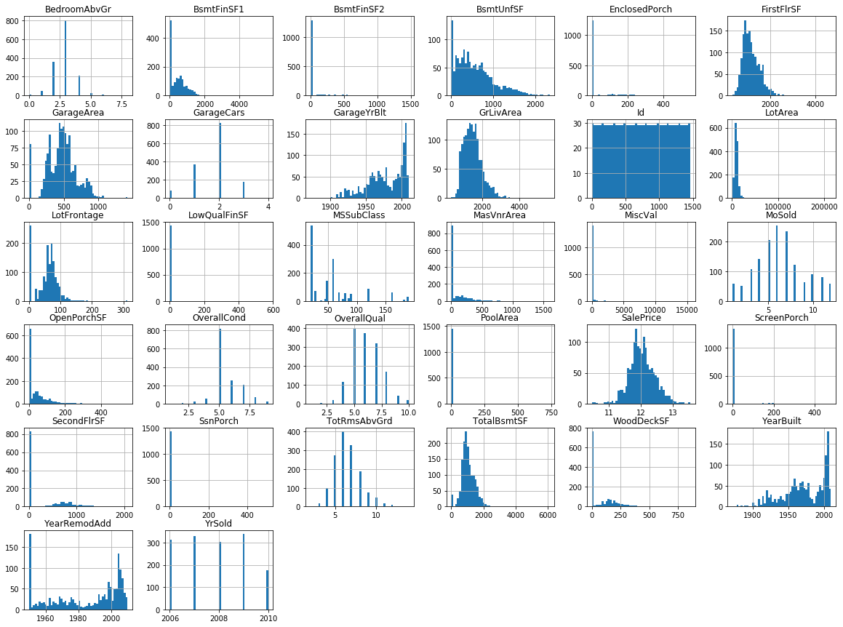
Data Preparation Feature Transformation: Identify Predictors
Features: Histograms
Candidates for Transformation
All Features show right skewness.
Analyzed if fit for some type of transformations..
Identified and analyzed 4 predictors
for transformation.

Slide 10
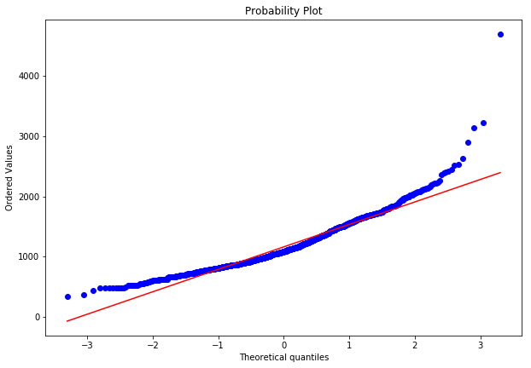
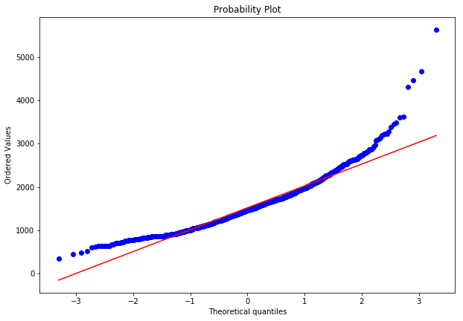
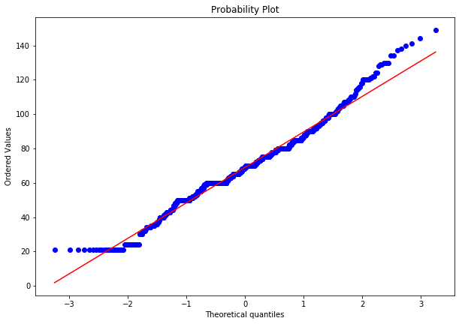
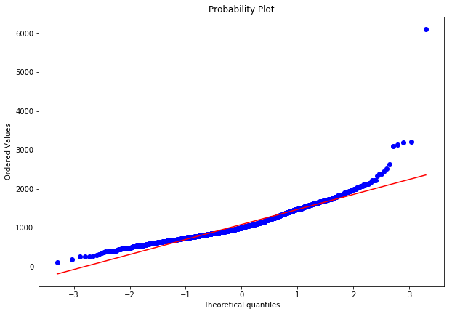
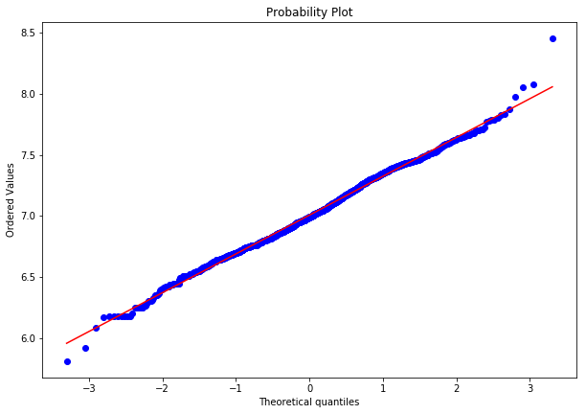
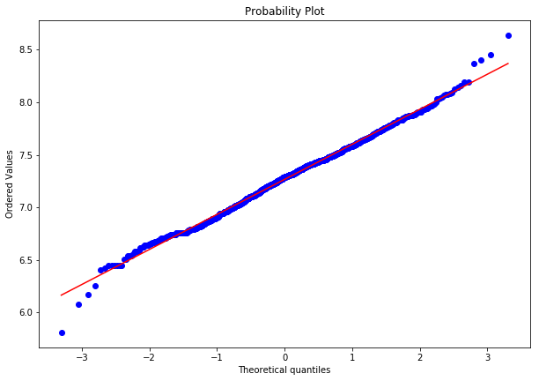
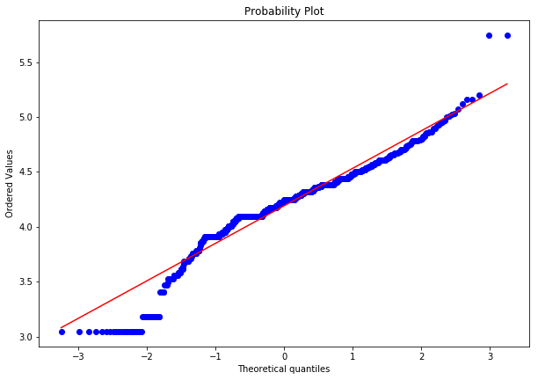
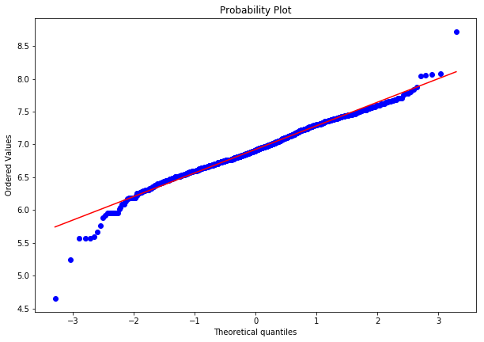
Data Preparation Feature Transformation: Log
First Floor
FirstFlrSF
Living Area
GrLivArea
Lot Frontage
LotFrontage
Basement Area
TotalBsmtFF
QQ-Plot: Original Set
LOG
LOG
LOG
LOG
Kept Log Transformation
Kept Log Transformation
No Log,
Removed Outliers
No Log,
Removed Outliers
QQ-Plot: Log

Slide 11




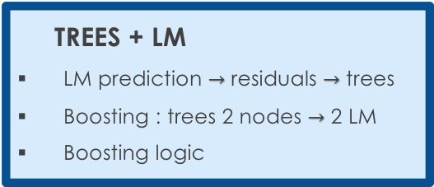


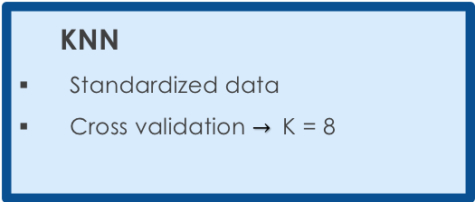
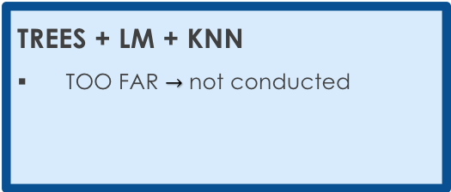
Selecting a Model Our approach to minimize the RMSE
KAGGLE SCORES TO BE UPDATED
DECISION TREES
Cost Complexity Tree Pruning
Random Forest and Boosting
LINEAR MODEL
Lasso, Ridge and Elastic Net
Stepwise AIC and cross validation
KNN
Standardized data
Cross validation $→$ K = 8
1
RMSE : 0.11
2
RMSE : 0.11
3
RMSE : 0.11
+ NAÏVE BAYES $→$ RMSE : 0.11
+ NAÏVE BAYES $→$ RMSE : 0.11
+ NAÏVE BAYES $→$ RMSE : 0.11
TREES + LM
LM prediction $→$ residuals $→$ trees
Boosting : trees 2 nodes $→$ 2 LM
Boosting logic
LM + KNN
p linear models
Knn (k = 1) for beta selection
4
RMSE : 0.11
5
RMSE : 0.11
+ NAÏVE BAYES $→$ RMSE : 0.11
+ NAÏVE BAYES $→$ RMSE : 0.11
TREES + LM + KNN
TOO FAR $→$ not conducted
+
RMSE : ?
NAÏVE BAYES
Combining categorical variables
+ NAÏVE BAYES $→$ RMSE : ?

Slide 12
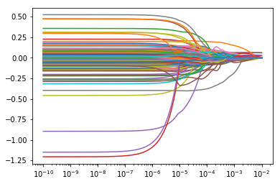
Selecting a Model Lasso Regression: decent R² Adj.; poor use of Features
Parameters
Coefficient vs Lambda
Y: log(SalePrice)
X: All Predictors (301*)
*Categorical: Dummyfied
Coefficients
Coefficients Kept
11 of 301
Results
R² Adj: 0.792
MSE: 0.0315 (low)
Alpha
NO GO!
We will try to find a smarter way to use the predictors.

Slide 13
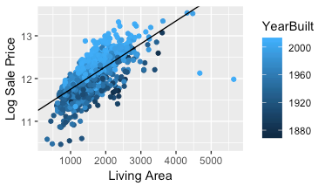
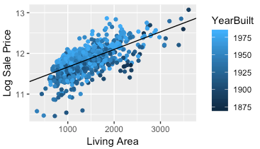
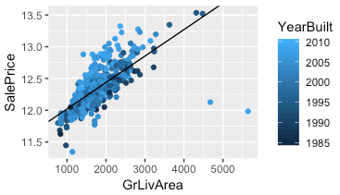


Selecting a Model Boosting trees combined with linear models
Logics $→$ split groups to reduce linear model RSS
Results
Sale Prices x Living Area $→$ Year Built cut
Example
Iteration : tree $→$each node has its own linear models
Stepwise operation required each time to select the best features
Too much computational power required!
Derail cross validations to select best features
Year Built < 1984
Year Built > 1984
RSS = 118
NO GO!
We need to keep it more simple.
RSS = 52
RSS = 28

Slide 14
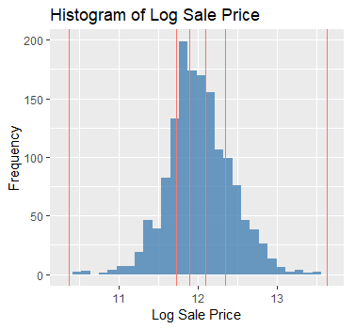
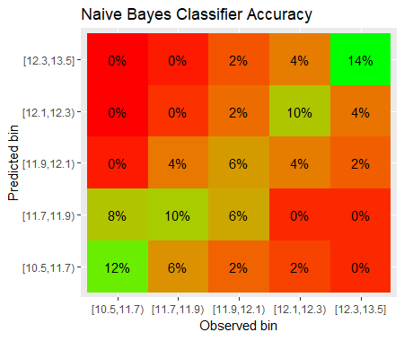
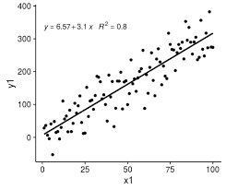
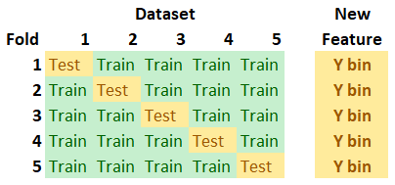
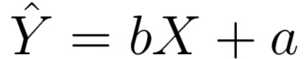
Final Model Step 1: Naïve Bayes
Given a set of features, what is the probability of the house being in a certain price range?
Treat each house as a ‘basket’ of ‘items’ or features
Motivation: stacking up individual categorical features may ladder up into helpful information
Takeaway: We can assign probabilities to which price range the house is in
1. Create Bins
2. Assign Probabilities
3. Bucket House
4. Run Linear Reg.

Slide 15

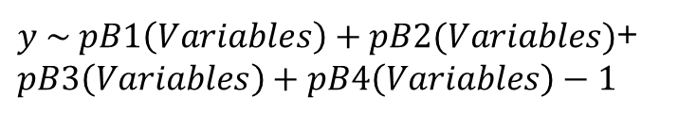
Final Model Step 2: Linear Regression Model
$y \sim pB1\left(Variables\right)+pB2(Variables)$+ $pB3\left(Variables\right)+pB4\left(Variables\right)−1$
Results
Iteration : tree $→$each node has its own linear models
Stepwise operation required each time to select the best features
Too much computational power required!
Derail cross validations to select best features
5. Stepwise operation
6. Prediction
NO GO!
We need to keep it more simple.

Slide 16
Final Considerations XXXX
Process
Project Management
Team Dynamics
Selecting a Model
.

